Slide 1
Deep Multiview Stereo
3D Vision
University of Illinois
Derek Hoiem
Many slides adapted from Lana Lazebnik, Steve Seitz, Yasu Furukawa, Noah Snavely

Slide 2
This class: Deep Multiview Stereo
Potential benefits of deep learning
Deep learning background
Deep network approaches to MVS
  MVSNet
  AttMVSNet

Slide 3
Benefits of deep learning
Learn image and feature representations that are well-tuned for problems of interest
Can optimize for many different kinds of losses or combinations of losses
Can learn representations on large datasets and finetune them on smaller datasets
Often, efficient inference on GPUs

Slide 4
Potential for deep networks in MVS
Learn better photometric scoring functions, e.g. more robust to smooth or reflective surfaces or boundaries, via better features or adaptive neighborhoods
Learn better prediction of visibility
Learn better combination of cues, such as photometric score, geometric consistency, and surrounding predictions
Integrate multiview depth estimations and recognition

Slide 5
Challenges for deep networks in MVS
Pixelwise view selection, propogation, and other staples of MVS are difficult to do efficiently and make differentiable within a MVS framework
Most deep methods so far, therefore, follow

Slide 6
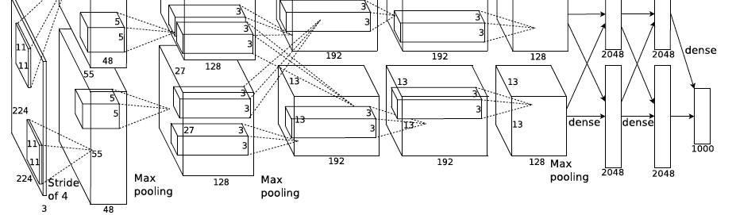
Deep networks: basic structures
Image classification network (AlexNet shown)
Input image
Label confidences
Convolutional layers: aggregate/organize local information
Pooling:
positional invariance
Fully connected (FC) layers :
Integrate/organize all information
Prediction layer :
Map final features to logistic scores
A. Krizhevsky, I. Sutskever, and G. Hinton, ImageNet Classification with Deep Convolutional Neural Networks, NIPS 2012

Slide 7
Deep networks: basic structures
Pixel labeling network (U-Net shown)
Input image
Segmentation map
Encoder:
convolve/pool to create feature image or vector that incorporates context
Decoder:
Upsample while combining with detail encoder layers to create features for local prediction
Prediction layer :
1x1 convolution to predict label at each position
O. Ronneberger, P. Fischer, and T. Brox, U-Net: Convolutional Networks for Biomedical Image Segmentation, 2015

Slide 8
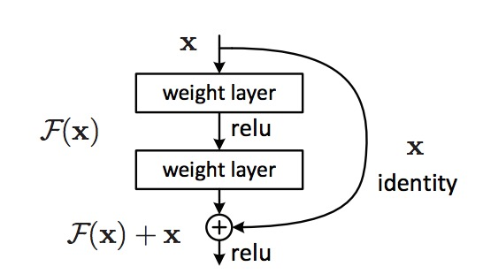
ResNet: the residual module
Introduce skip or shortcut connections (existing before in various forms in literature)
Make it easy for network layers to represent the identity mapping
Sparser, more direct updates in training
Important but non-intuitive idea: to combine information, no need to concatenate – just add
Kaiming He, Xiangyu Zhang, Shaoqing Ren, and Jian Sun, Deep Residual Learning for Image Recognition, CVPR 2016 (Best Paper)

Slide 9
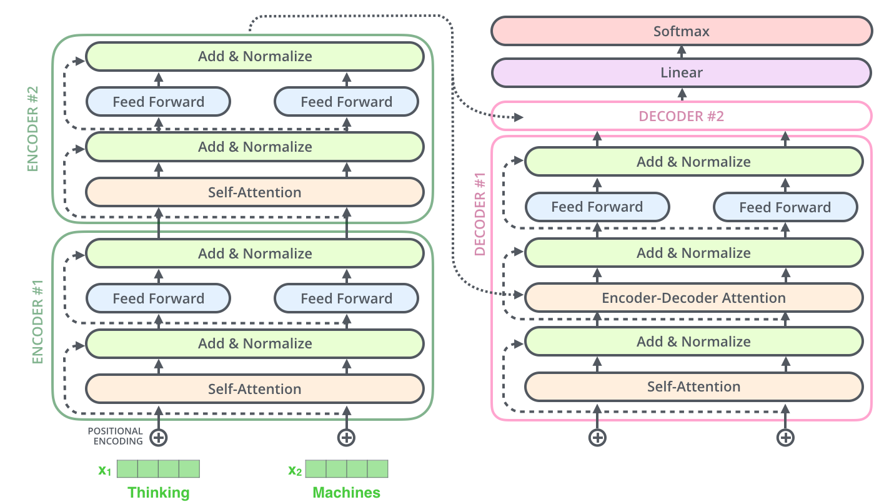
Transformers
Can process an unordered set of tokens/vectors
  Positional encoding adds spatial information
Self-Attention is like clustering and replacing vectors with centers, except
  Multiple, complex, learnable similarity functions
  No need to preset number of clusters
Vectors are iteratively aggregated and transformed
Vectors can start as purely local information (e.g. 16x16 patch)
Figure from Ming Li. See full deck for details/illustrations.
https://cs.uwaterloo.ca/~mli/Lecture2.pptx

Slide 10
MVSNet (Yao et al. ECCV 2018)

Slide 11
Plane Sweep Stereo
Plane Sweep Stereo
Slide credit: Jae Yong Lee

Slide 12
Plane Sweep Stereo
Plane Sweep Stereo
Slide credit: Jae Yong Lee

Slide 13
Plane Sweep Stereo
Plane Sweep Stereo
Slide credit: Jae Yong Lee

Slide 14
Plane Sweep Stereo
Slide credit: Jae Yong Lee

Slide 15

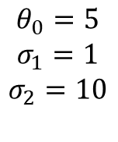
View Selection
Score is weighted count of common sparse points, favoring those with triangulation angle close to 5 degrees
.
$$θ_{0}=5$$
$$σ_{1}=1$$
$$σ_{2}=10$$
p
$$θ_{ij}$$
c_{i}
c_{j}

Slide 16
Photometric costs: features
ConvNet: W/4 x H/4 x F features
  Same # of values as W x H when F = 32
  Same model extracts feature for each image
BatchNorm and ReLU

Slide 17
Photometric cost volume computation
Homography maps from each reference depth plane to each view to obtain interpolated feature values (D = # depths = 256, N = # views = 5)
Stack features into N volumes of size W/4 x H/4 x D x F
Compute variance over volumes to get W/4 x H/4 x D x F photometric score volume
What do you think of feature variance vs. NCC with reference image?

Slide 18
Cost volume regularization and initial depth estimation
3D UNet: compress while accumulating spatial context and then uncompress with skip connections
Softmax in depth direction results in W/4 x H/4 x D probability volume P
  P(x, y, d) is probability that depth at coordinate (x,y) had depth d
Compute expectation of depth to get initial estimate

Slide 19
Depth refinement
Predict a residual depth from reference image and initial depth map
  Attempts to refine around boundaries
  Residual depth is added to initial

Slide 20
Filtering and Fusion
Keep points that have:
  probability of at least 0.8
  low reprojection error and low reprojection depth difference with at least two other images
Visibility-based fusion (Merrell et al. ICCV 2007)
  Efficient GPU implementation
(Note: depth ratio)

Slide 21
Training
Loss on initial and refined maps
N = 3, W=640, H=512 for training
Ground truth from DTU depth-rendered meshes

Slide 22
Recap

Slide 23
Results: example

Slide 27
Runtime: 4.7s per view
100x faster than COLMAP, 5x faster than Gipuma

Slide 28
2 min break (and think)
Compared to non-ML MVS algorithms, how is this one better?
How is it worse?

Slide 29
Pros and Cons of MVSNet
Pros
  Fast and relatively simple
  Learnable features
  Good completeness
Cons
  Loses benefits of pixelwise view selection and normal estimates
  Requires dense views (lack of pixelwise view selection) and small depth range (cost volume)
  (Maybe) depth expectation can lead to inaccurate estimates

Slide 30
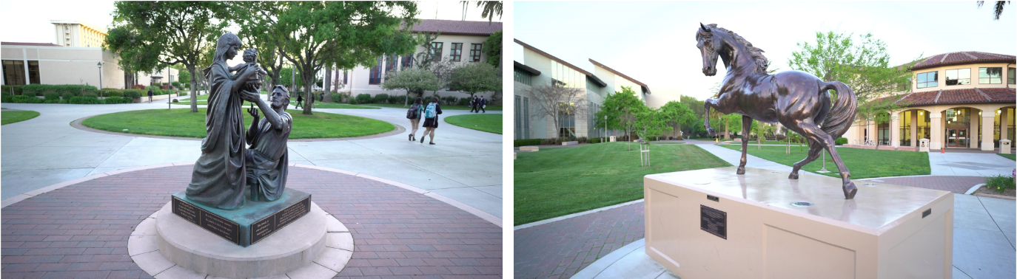
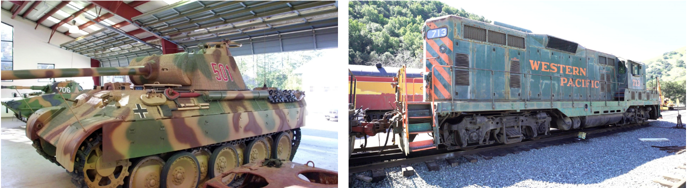
State-of-the-art works in MVS
Model | F1-Score
Vis-MVSNet (BMVC 2020) | 60.03
AttMVSNet (CVPR 2020) | 60.05
…
ACMP (AAAI 2020) | 58.41
ACMM (CVPR 2019) | 57.27
Tanks and Temples
Intermediate Benchmark
Dense views for object scenes
Slide credit: Jae Yong Lee

Slide 31
State-of-the-art works in MVS
Model | F1-Score
Vis-MVSNet (BMVC 2020) | 60.03
AttMVSNet (CVPR 2020) | 60.05
…
ACMP (AAAI 2020) | 58.41
ACMM (CVPR 2019) | 57.27
Learning (Cost-Volume) based
Non-Learning PatchMatch based
Tanks and Temples
Intermediate Benchmark
Slide credit: Jae Yong Lee

Slide 32


In more Challenging Benchmarks…
Model | F1-Score
MARMVS (CVPR2020) | 81.84
ACMP (AAAI 2020) | 81.51
ACMM (CVPR 2019) | 80.78
…
Vis-MVSNet (BMVC 2020) | 78.36
PVSNet | 72.08
With wide baselines with strict thresholds
ETH3D High-Res Benchmark
Slide credit: Jae Yong Lee

Slide 33
In more Challenging Benchmarks…
Model | F1-Score
MARMVS (CVPR2020) | 81.84
ACMP (AAAI 2020) | 81.51
ACMM (CVPR 2019) | 80.78
…
Vis-MVSNet (BMVC 2020) | 78.36
PVSNet | 72.08
Model | F1-Score
ACMP (AAAI 2020) | 37.44
ACMM (CVPR 2019) | 34.02
ACMH (CVPR 2019) | 33.73
…
AttMVSNet (CVPR 2020) | 31.93
CasMVSNet (CVPR 2020) | 31.12
ETH3D High-Res Benchmark
Tanks and Temples Advanced Benchmark
Slide credit: Jae Yong Lee

Slide 34
Attention-Aware MVS (Luo et al. CVPR 2020)

Slide 35
Attention-enhanced confidence volume
Features: like MVSNet but 10 layers, 16 channels, LeakyReLU, InstanceNorm
Predict “attention” weights based on variance of average feature channels across images
Feature confidence channels based on mean squared diff of sources with ref along each channel
Sum feature confidence channels weighted by attention weights
Allows scene-specific feature importance

Slide 36
Attention-guided hierarchical regularization
Create multiscale cost volume by stacking feature x depth channels and using stride=2 to downsample
Confidence volumes are processed with 3D convolution and linear layers at multiple scales

Slide 37
Depth regression
Compute expected depth like MVSNet
In training, optimize over relative depth and depth gradient (train on DTU w/ improved GT maps)
-
-
-

Slide 38
Ablation

Slide 41
Summary
Deep MVS applies learned features and cost volume regularization
Outperforms for dense views, moderate scene depth
Underperforms non-ML methods for sparse views, large scene depths
Deep patch-match based methods try to address this and are catching up to non-ML methods, but so far ACMMP

