Slide 1
CS 498 KA
Experimental HCI & Interactive Technologies
Text Chapter 8
Six principles for conducting experiments

Slide 2
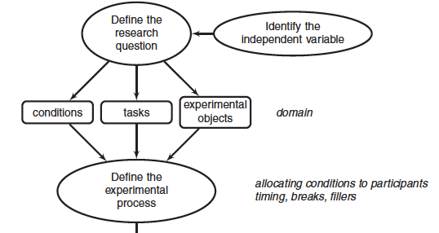
Text Chapter 8:
Six Principles for Conducting Experiments

Slide 3
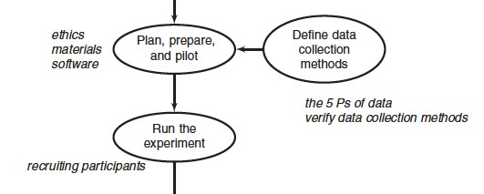
Text Chapter 8:
Six Principles for Conducting Experiments

Slide 4
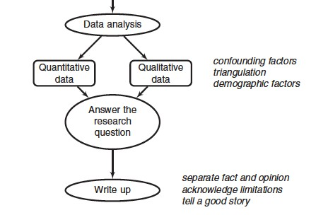
Text Chapter 8:
Six Principles for Conducting Experiments

Slide 5
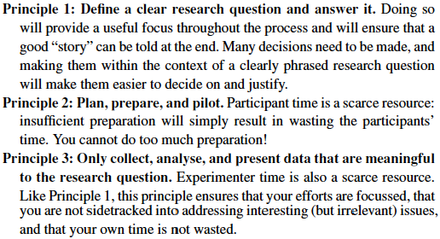
Text Chapter 8:
Six Principles for Conducting Experiments

Slide 6
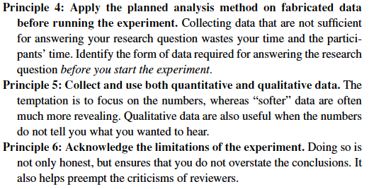
Text Chapter 8:
Six Principles for Conducting Experiments

Slide 7
Text Chapter 8:
Six Principles for Conducting Experiments
“Much of the specific and detailed advice given may seem to the first-time experimenter to be a set of hard-and-fast, inflexible, constraining and unnecessary rules: experience will help in identifying when these rules can reasonably be bent or broken while still conducting a reliable and valid experiment.
HCI experimentation of the form described here has been criticized for being too [cf. Hudson & Mankoff] narrow, with an inappropriate focus on small, discrete research questions rather than on a broader picture.
Because small questions can be addressed in a controlled manner and larger ones cannot, broader questions cannot be easily answered using this method.”

Slide 8
Text Chapter 8:
Six Principles for Conducting Experiments
”I take the view that every experimental result is a useful small step:
I have been chipping away at the marble block that is the useful design of graph layout algorithms for many years now, taking off small chips one at a time and getting closer to general conclusions with every use of the chisel.”
END

