Slide 1
CS 598 AK
Experimental HCI and Interactive Technologies in Engineering
https://courses.grainger.illinois.edu/CS598AK/FA2021/

Slide 6
CS 598 AK
Experimental HCI & Interactive Technologies
Text Chapter 1: Introduction

Slide 7
Text Chapter 1: Introduction
1.1 Assessing the worth of an HCI idea
“It is your idea, so of course you believe that it is wonderful; however, your subjective judgment (or even the views of your friends in the research laboratory) is not sufficient to prove its general worth. An objective evaluation
of the idea (using people not involved in the research) is required.”

Slide 8
Text Chapter 1: Introduction
1.1 Assessing the worth of an HCI idea
“It is your idea, so of course you believe that it is wonderful; however, your subjective judgment (or even the views of your friends in the research laboratory) is not sufficient to prove its general worth. An objective evaluation
of the idea (using people not involved in the research) is required.”
But what exactly is meant here by “(using people not involved in the research)”? Who, and to do what?

Slide 9
Text Chapter 1: Introduction
1.1 Assessing the worth of an HCI idea
\

Slide 10
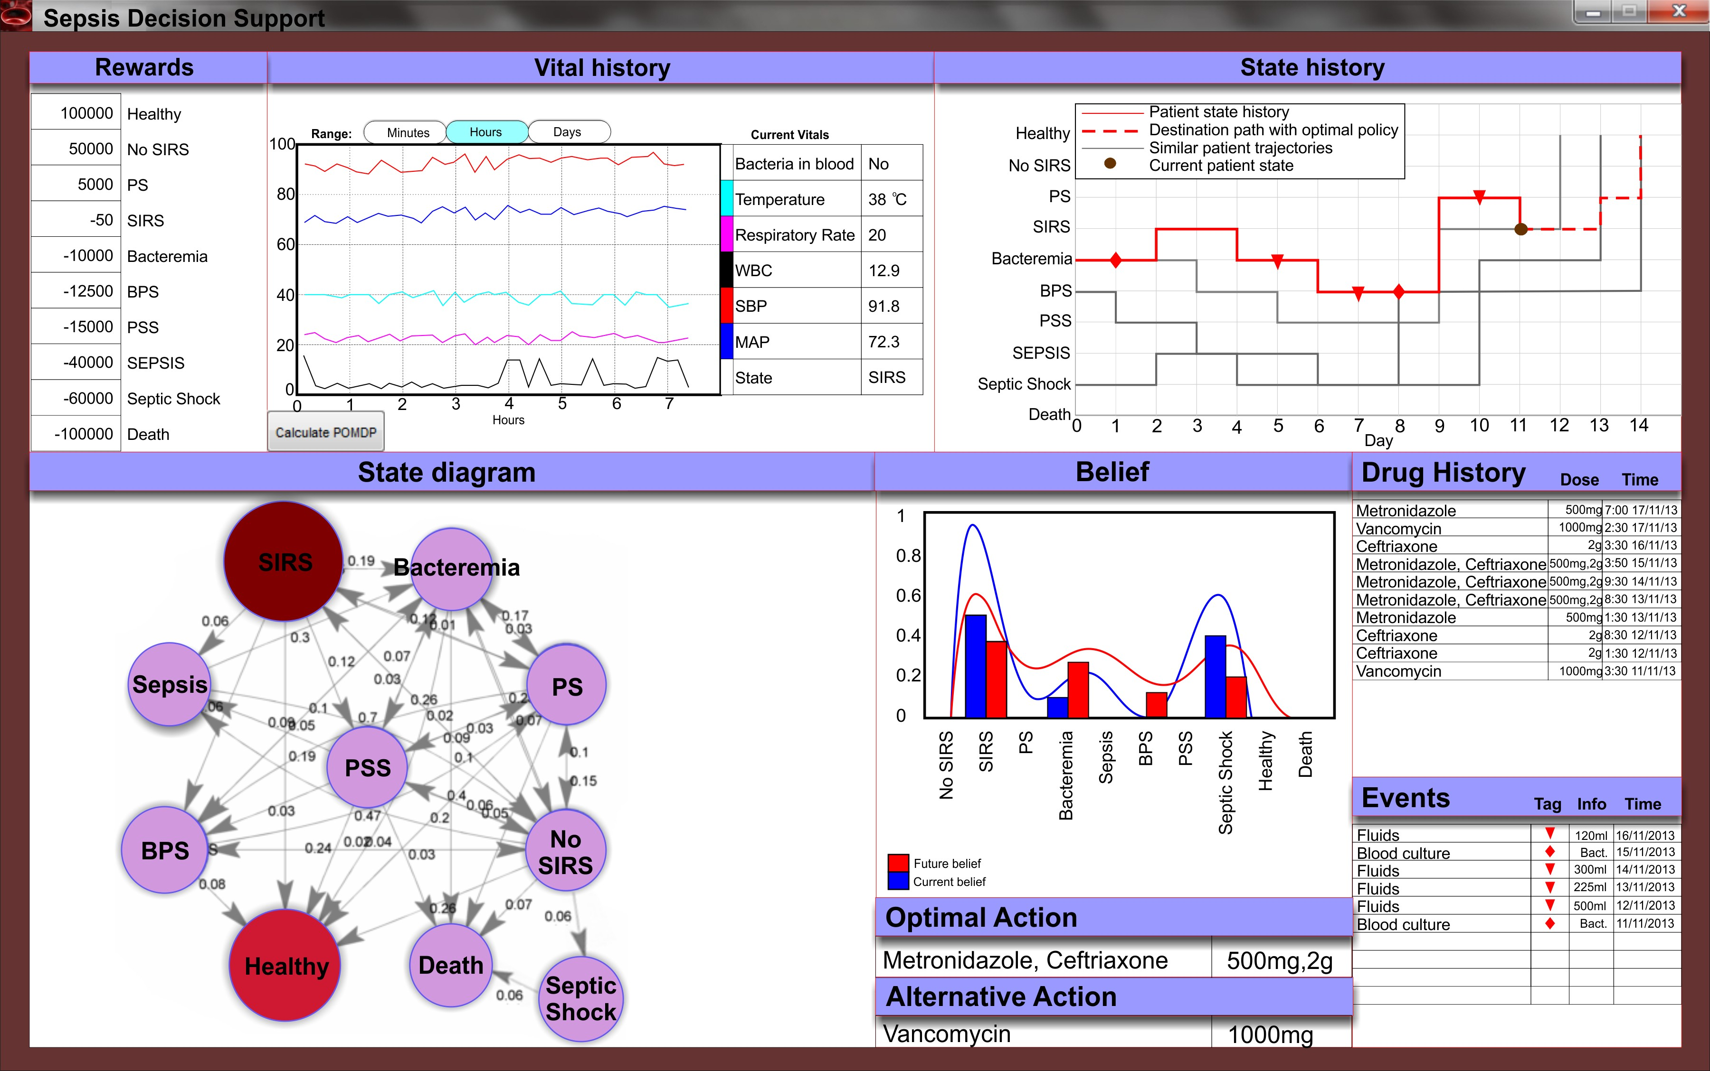
Text Chapter 1: Introduction
\

Slide 11
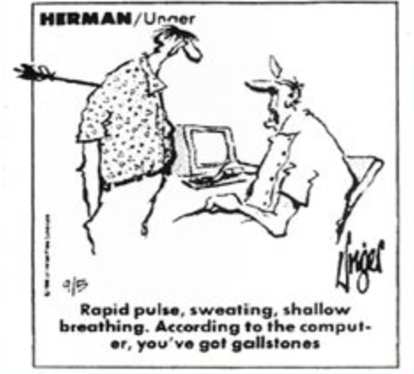
Text Chapter 1: Introduction

Slide 12
Text Chapter 1: Introduction

Slide 13
Text Chapter 1: Introduction
Reference:
Garg AX, Adhikari NKJ, McDonald H, et al. Effects of computerized clinical decision support systems on practitioner performance and
patient outcomes - a systematic review. JAMA 2005; 293(10):1223- 1238.
Abstract:
Context: Developers of health care software have attributed improvements in patient care to these applications. As with any health care intervention, such claims require confirmation in clinical trials. Objectives: To review controlled trials assessing the effects of computerized clinical decision support systems (CDSSs) and to identify study characteristics
predicting benefit.

Slide 14
Text Chapter 1: Introduction
Reference:
Garg AX, Adhikari NKJ, McDonald H, et al. Effects of computerized clinical decision support systems on practitioner performance and
patient outcomes - a systematic review. JAMA 2005; 293(10):1223- 1238.
Data Synthesis: One hundred studies met our inclusion criteria. The number and methodological quality of studies improved over time. The CDSS improved practitioner performance in 62 (64%) of the 97 studies assessing this outcome, including 4 (40%) of 10 diagnostic systems, 16 (76%) of 21
reminder systems, 23 (62%) of 37 disease management systems, and 19 (66%) of 29 drug-dosing or prescribing systems.

Slide 15
Text Chapter 1: Introduction
Reference:
Garg AX, Adhikari NKJ, McDonald H, et al. Effects of computerized clinical decision support systems on practitioner performance and
patient outcomes - a systematic review. JAMA 2005; 293(10):1223-38
Improved practitioner performance was associated with: [1] CDSSs that automatically prompted users compared with requiring users to activate the system (success in 73% of trials vs. 47%; P=.02) and [2] studies in which the authors also developed the CDSS software compared with studies in which the authors were not the developers (74% success versus 28%; respectively, P=.001).
Conclusions: To date, the effects on patient outcomes remain understudied and, when studied, inconsistent.

Slide 16
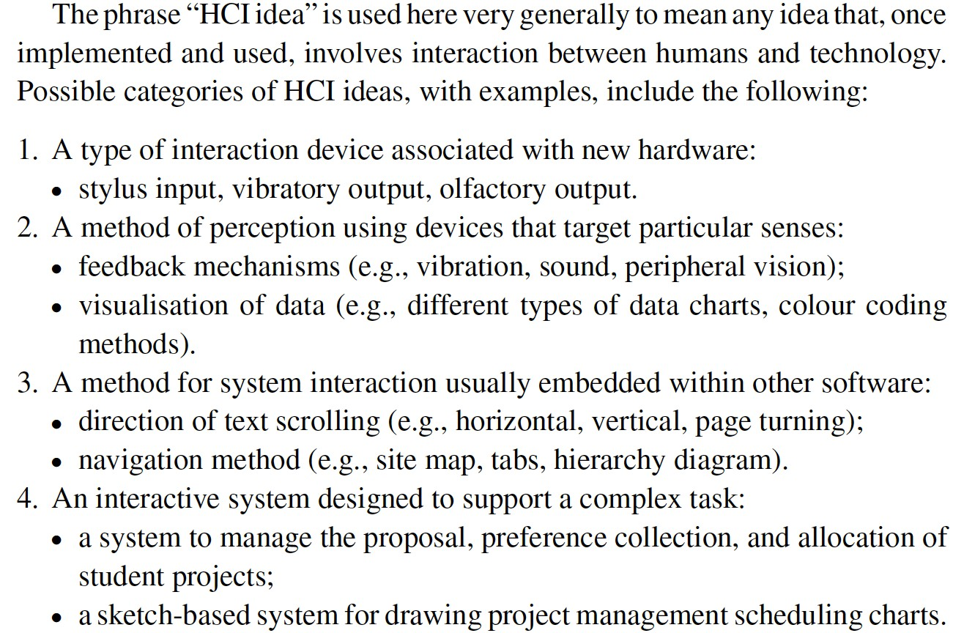
Text Chapter 1: Introduction

Slide 17
Text Chapter 1: Introduction
“Unfortunately, most HCI researchers (and, in particular, students)
do not have the luxury of time to wait and see if their novel idea takes off and is adopted at large.” Though this happens – examples?
Yet as such:
“Proving that their HCI idea is a “good” one will need to be done in the context of a test that involves other people who try out the idea.”
There are two different types of HCI test: formal comparative experiments and exploratory usability evaluations .”

Slide 18
Text Chapter 1: Introduction
“Experiments are objective tests that aim to demonstrate that the idea produces better results than an existing idea that performs the same function.
Experiments are more appropriate for ideas for which alternatives can readily be found and that are usually associated with well-defined tasks.
The outcome of an experiment is a conclusion indicating which idea results in better user performance.”
NOTE: The above is a somewhat narrow view of the role that experiments play in scientific and engineering research (with its focus on “which is better?”)”
In other areas of science (& even HCI), people often take a broader view. Why?

Slide 19
Text Chapter 1: Introduction
“Evaluations are exploratory tests that aim to show that the idea works in practice, in the context of typical uses.
Such evaluations (also called “usability studies”) are more appropriate for larger, more complex pieces of interactive software for which it is difficult or impossible to find alternatives that fulfill identical functions and that typically support a wide range of user tasks.
The outcome of an evaluation is a list of suggestions for system improvement (as part of a formative test), or it can be confirmation that the system performs its function sufficiently well for it to be deployed.”

Slide 20
Text Chapter 1: Introduction
Conclusion: The Organization and Focus of the (E-HCI) Text:
“[An] experiment is a one-off activity. It requires the cooperation of a large number of participants, all following the same experimental process.
Once it has started, it cannot be interrupted to correct any flaws in its design – not unless the whole experiment is to be redesigned and run again. It is important that an experiment be carefully designed because errors can cost
a great deal of time and effort.
The primary focus of this book is therefore on experiments because their design is more complex and more risky than evaluations. In addition, good experimental design requires knowledge and skills typically not taught in a computer science or software engineering curriculum in the same way that usability evaluation is often covered as part of the iterative design cycle.”
Yet, we will take a broader view.

