Slide 1

Fall 2026
CS 591 SCH
PhD Job Search Seminar
Lana Lazebnik
Director of Graduate Studies

Slide 2
What this seminar is about
Helping interested PhD students prepare for the job market
  Note 1: this seminar is not primarily focused on non-research industry jobs
    But we are trying to improve coverage
  Note 2: the main target audience are those going on the job market soon
  (this year or the next)
    Others are still welcome to attend and participate
  Note 3: this seminar is complementary to other university initiatives, e.g., Grainger’s Mavis Future Faculty Fellows Program
  Note 4: this seminar is not intended as a jobs announcement board

Slide 3
Minimal logistics
One credit hour
  Meeting on Fridays 11AM-noon(ish) – come on time!
  To pass, you need to attend most meetings and complete a few tasks
    Survey – out in a few days
    Practice and present “elevator pitch” or intro of job talk (full practice job talks can be done in the spring as part of the PILOT seminar)
    Prepare or comment on draft application materials
Communication
  Enroll in the course to get important announcements
  Class webpage (https://courses.grainger.illinois.edu/CS591SCH/fa2026/) for schedule, useful links

Slide 4

DGS office hours
Fridays 1-3PM in 1218 Siebel (but watch Grad Office announcements for changes)

Slide 5

Introduction and disclaimer
Senior faculty giving advice
(i.e., me)
Current job candidates
(i.e., you)
Adapted from Jia-Bin Huang

Slide 6
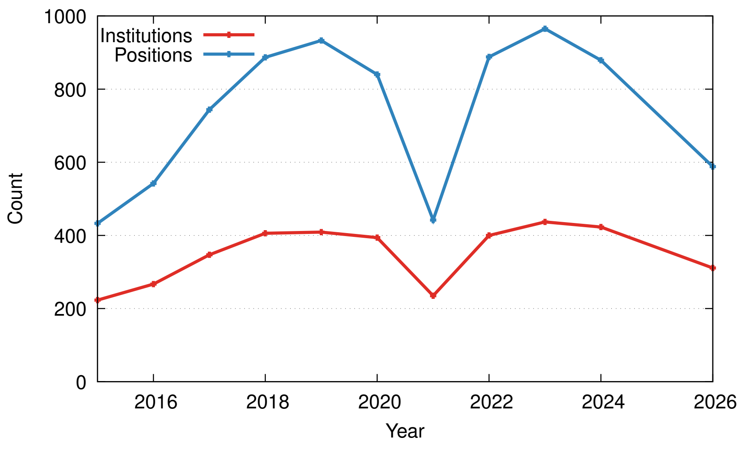
Disclaimer 2: We know these are tough times…
Academic hiring is down
311 institutions (274 in the U.S.) – down by 26% from 2024
Source: CRA

Slide 7

Disclaimer 2: We know these are tough times…
Will AI disrupt both industry and academia?
Source: Wiikipedia

Slide 8


The Road to Your First Position
Preparing application materials
Early to late fall
Before going on the job market
A year or two from graduation
Interviews
January - April
Post Interviews
April - June
I GOT A JOB!
Adapted from Jia-Bin Huang

Slide 9
The Road to Your First Position
Before going on the job market
A year or two from graduation

Slide 10
Before going on the job market
Figure out which types of positions might be right for you
  Industry
    Research scientist
    Developer/engineer
    Startup position
  Academia
    Post-doc
    Tenure-track faculty
    Teaching faculty
  Less common: government labs, non-profits

Slide 11
Before going on the job market
Acquiring stature in the research community
  Web/social media presence
  Networking
  Conferences, invited talks
  Service and leadership

Slide 12
The Road to Your First Position
Preparing application materials
Early to late fall

Slide 13
Application materials (for faculty positions)
CV
Research statement
Teaching statement
Recommendation letters

Slide 14
The Road to Your First Position
Interviewing
January - April

Slide 15
Interviewing (for faculty positions)
Possible screening calls
Job talk
Meetings with faculty and students
Possible follow-ups

Slide 16
The Road to Your First Position
Post Interviews
April - June

Slide 17
Post-interview period
Negotiating offers
Second visits
Making a decision
Possibly dealing with disappointment and going to plan B…

Slide 18
The Road to Your First Position
Starting your first position

Slide 19
Starting your first position (faculty)
Defining your research agenda
Recruiting students/collaborators
Looking for funding
Teaching
Juggling responsibilities
Possibly preparing to apply again…

