Slide 1
How to Write Research/Teaching Statements
Indranil Gupta
Professor
Department of Computer Science
UIUC

Slide 2
Takeaways
This talk is friendly advice and a conversation
This talk has no examples, it is not a tutorial
(and gives no guarantees)
Research Statement
What is your vision?
Tie vision to past work and future proposed work
80-16-4 Rule, Gartner Curve
Teaching Statement
Boast, boast, boast!
Talk about past experiences with lecturing, TAing, and mentoring
For both
Start early
Obtain feedback, overhaul/rewrite completely
Several times
Unless otherwise noted, images in this presentation were taken from Wikimedia Commons

Slide 3
The Secret to Research Statements

Slide 4
The Secret to Research Statements
No one reads research statements

Slide 5
The Secret to Research Statements
No one wants to reads research statements

Slide 6
Research Statement - Audience
Think of your audience
Members on Recruiting Committees
Faculty in academia
Researchers/engineers in companies
Your audience is general, not experts in your field
Your audience has little time, so make their life easier
First paragraph is a summary of the rest
First page is a summary of the rest
Keep statement 1-2 pages, no more than 3 (excludes references)

Slide 7
80-16-4 Rule
80% of your audience will read the first 1/3rd of your statement and then stop
16% will stop after 2/3rds of your statement
4% will read the entire statement
80% of your readers are generalists
16% are somewhat knowledgeable
4% are experts
May not be the same set of people in both 4% groups

Slide 8
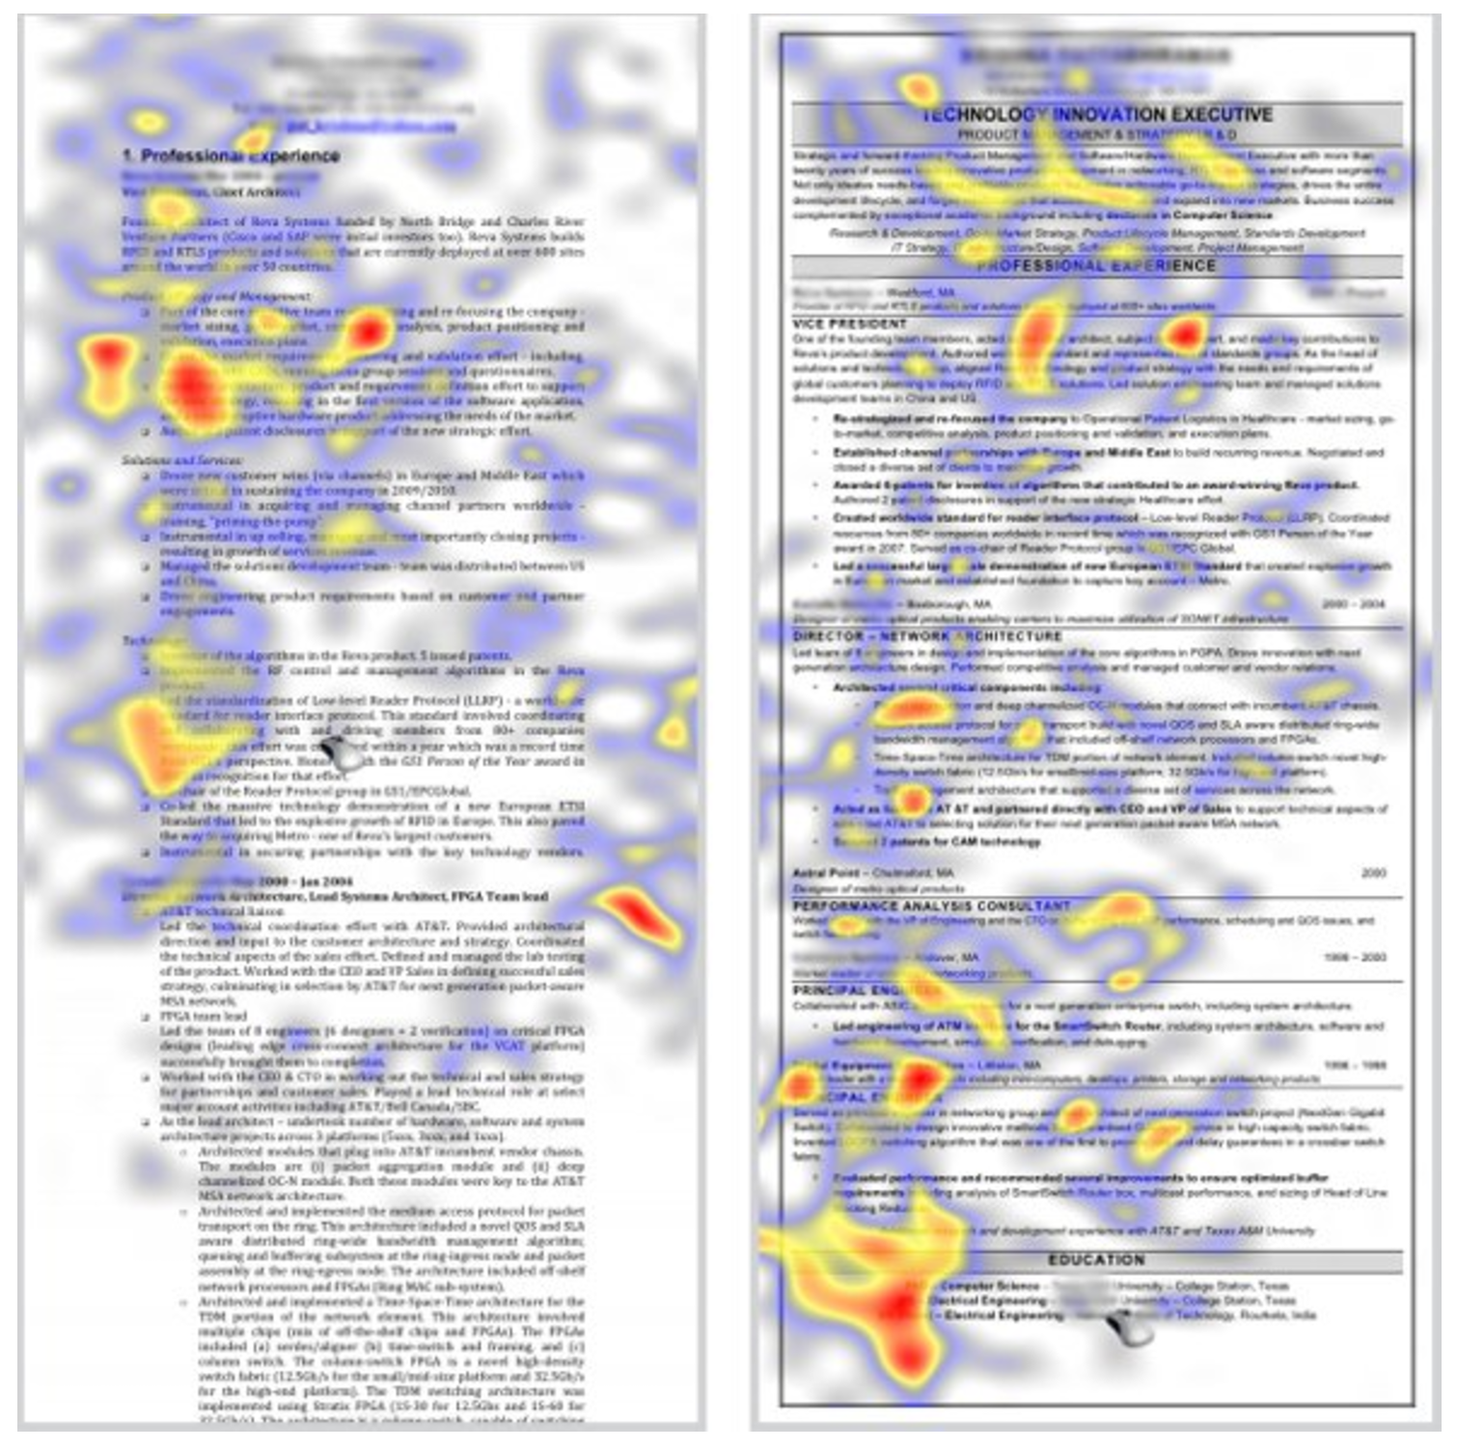
Heat Map
Image from:
http://www.businessinsider.com/heres-what-recruiters-
look-at-during-the-
6-seconds-they-spend-on-your-resume-2012-4

Slide 9
Research Statement - Vision
Your audience is looking for one key takeaway
Does this candidate excite us, add value to our department/company, and will continue to excite us in the future?
The way you excite them is by your vision
Have a vision that ties your past work with your future
Think broadly, not just limited by your PhD work or recent work
Read up on trends, Gartner reports, Forrester reports, white papers by luminaries
Place your work in that context
Don’t just say “LLMs will solve everything…” (no research area stays hot forever)
Be bold! Readers love new and emerging (and hot) areas
CS/Engineering is multi-disciplinary naturally
Take courses outside your area
Take courses outside your department (Narrate Example)
Did I say - Be bold?

Slide 10
Gartner Curve (2025)

Slide 11
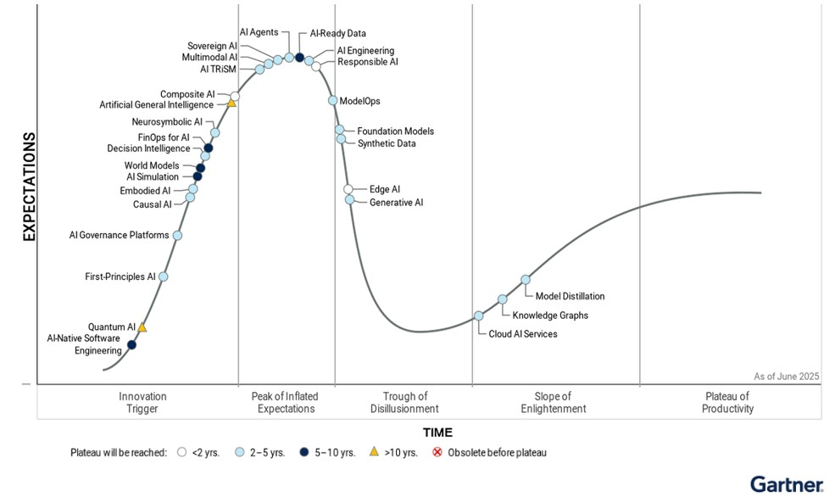
Gartner Curve (2025)
From: https://www.gartner.com/en/newsroom/press-releases/2025-08-05-gartner-hype-cycle-identifies-top-ai-innovations-in-2025

Slide 12
Gartner Curve (2025)
LLMs
LLMs
LLMs
LLMs
LLMs
LLMs
LLMs
LLMs
LLMs
LLMs
LLMs
LLMs
LLMs
LLMs
From: https://www.gartner.com/en/newsroom/press-releases/2025-08-05-gartner-hype-cycle-identifies-top-ai-innovations-in-2025

Slide 13
Gartner Curve (2025)
From: https://www.gartner.com/en/newsroom/press-releases/2025-08-05-gartner-hype-cycle-identifies-top-ai-innovations-in-2025

Slide 14
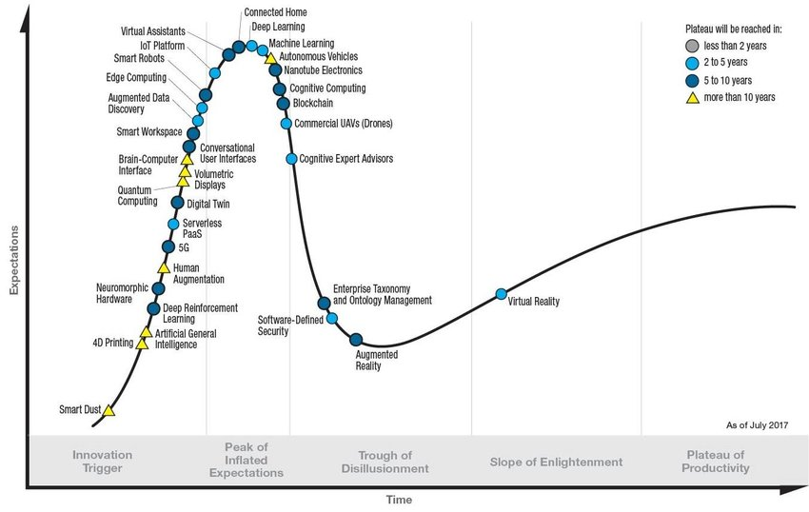
Gartner Curve (2017)
From: https://www.researchgate.net/figure/Gartner-Hype-Cycle-for-Emerging-Technologies-2017-C-Gartner-6_fig1_324137011

Slide 15
Life of a Research Area (Based on Gartner Curve)
First peak – end of hype (“This is a hot area!”)
Hype
- “Wow!”
POPULARITY
OF AREA
First trough – “I told you so!”
TIME
Young Adolescent Middle Age Old Age
(low-hanging
fruits)
(interesting
Problems)
(solid base,
hybrid algorithms)
(incremental
Solutions)
15

Slide 16
How to identify which stage a research area is in
If there have been no publications in research area more than 1-2 years old, it is in the “Young Phase”
Pick a paper in the last 1 year published in the research area. Read it. If you think that you could have come up with the core idea in that paper (given all the background etc.), then the research area is in its “Young” phase.
Find the latest published paper that you think you could have come up with the idea for. If this paper has been cited by one round of papers (but these citing papers themselves have not been cited), then the research area is in the “Adolescent” phase.
Do above step, and if you find that the citing papers themselves have been cited, and so on, then the research area is at least in the “Middle Age” phase.
Pick a paper in the last 1-2 years. If you find that there are only incremental developments in these latest published papers, and the ideas may be innovative but are not yielding large enough performance benefits, then the area is mature.
If no one works in the research area, or everyone you talk to thinks negatively about the area (except perhaps the inventors of the area), then the area is dead.

Slide 17
Vision, contd.
Your trajectory of areas/problems after PhD will be quite/very/completely different from your PhD work
Be bold!
(but not too bold)
Be broad
(but not too broad)
Remember – people do not (want to) read your research statement
Afterwards
(Narrate Example)
E.g., (CS example) if you worked on software security, you can talk of applying your techniques to new areas like IoT or broader security mechanisms
Or both
But be careful of saying – you plan to shift completely into hardware …

Slide 18
Suggested Framework for Research Statement
(Read statements (on Web) of last year’s top candidates)
Opening paragraph to hook reader
If you lose them here, you’re toast
Vision vision vision
2-3 paragraphs to expand a bit
Remember: many readers will not get beyond this paragraph, so here’s your chance
A section or two on your work so far (1-1.5 pages)
A section on your future work (0.5-1 pages)
Use references (your own work), but not too many
Make sure your vision themes reappear a few times in both past work section and future work section
But don’t overdo it

Slide 19
Teaching Statement
No PhD student knows for sure how good a teacher they will actually be in the future
Though you may know if you’ll like it or not
Talk about past experiences with lecturing, TAing, and mentoring
Recommend not putting a vision in your teaching statement
Remember – no one knows

Slide 20
Teaching Statement - What is your audience looking for?
That you like teaching
That you’re enthusiastic about it
That you will continue to grow and learn from your teaching experiences
That your teaching will augment and help your research
That your teaching will not hinder your research

Slide 21
A dirty lil’ secret of tenure and promotion
(Narrate)
Image from Simpsons Wiki

Slide 22
Suggested Framework for Teaching Statement
1-2 paragraphs that are enthusiastic about teaching
Not overly
A section on past teaching experiences
TAing
Lecturing
A section on mentoring students
Convinces committee you can advise students
Distinguishes many candidates

Slide 23
“Mentoring Students”?
Did you collaborate with junior PhD/MS students on projects where you were the lead student?
Did you see these students grow and learn from you?
Did those students end up in grad school at good places, or place in very well known companies?
Did you mentor anyone outside of a project?
Mention all these
But don’t overdo it
Remember the dirty secret

Slide 24
Revise revise revise
Give your statements to others
Advisor
Former graduates
Other faculty in your department
Treat their comments with respect, not as criticism
”I didn’t understand your first page.” → does not mean they had no time, means your first page needs to be rewritten from scratch
Rewrite from scratch the first few times
Mark Twain said: “If I had more time, I’d have written a shorter letter.”
This quote is not by Mark Twain

Slide 25
Takeaways
This talk was friendly advice and a conversation
This talk had no examples, was not a tutorial
(and gave no guarantees)
Research Statement
What is your vision?
Tie vision to past work and future proposed work
80-16-4 Rule, Gartner Curve
Teaching Statement
Boast, boast, boast!
Talk about past experiences with lecturing, TAing, and mentoring
For both
Start early
Obtain feedback, overhaul/rewrite completely
Several times

