Slide 1
Reminder: Ph.D. Requirements Quiz
Available on Canvas now, due Monday, October 26
20 multiple choice and T/F questions, no time limit
Consult https://siebelschool.illinois.edu/academics/graduate/phd-program to help you answer
Must get a score of at least 15 to pass

Slide 2
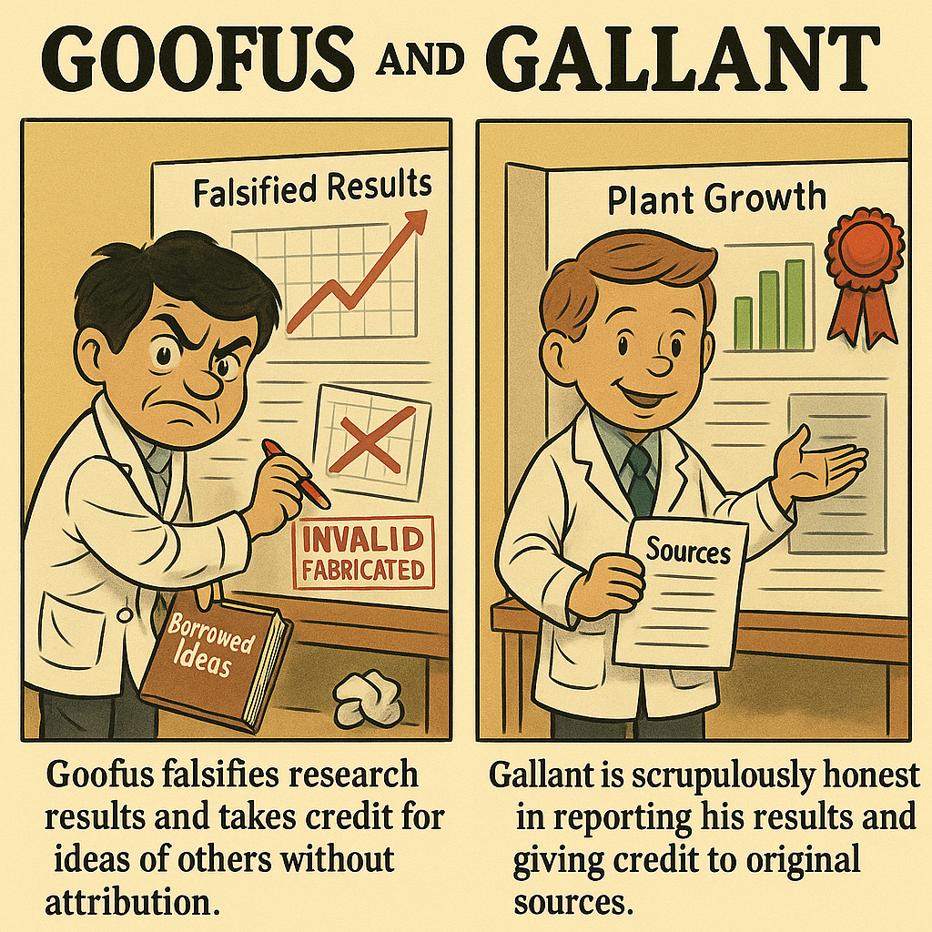
Fall 2026 CS 591 PHD Seminar
Responsible conduct
of research
Generated by ChatGPT 5 based on 1950s Goofus and Gallant comics

Slide 3
I’ve seen my share of the good and the bad
My CV:
Reviewer and Area Chair for numerous Computer Vision conferences for 20+ years
Program Chair for ECCV (2012), ICCV (2019), CVPR (2023)
Editor-in-Chief of International Journal of Computer Vision since 2018

Slide 4
Categories of ethical considerations
Integrity of research results
Authorship and paper preparation
Peer review
Human subjects

Slide 5
Integrity of research results
Do not fabricate or falsify your data, analyses, or reporting.

Slide 6

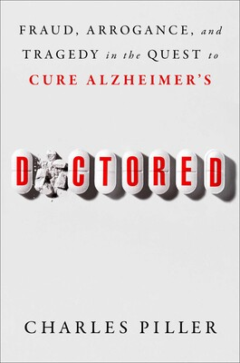
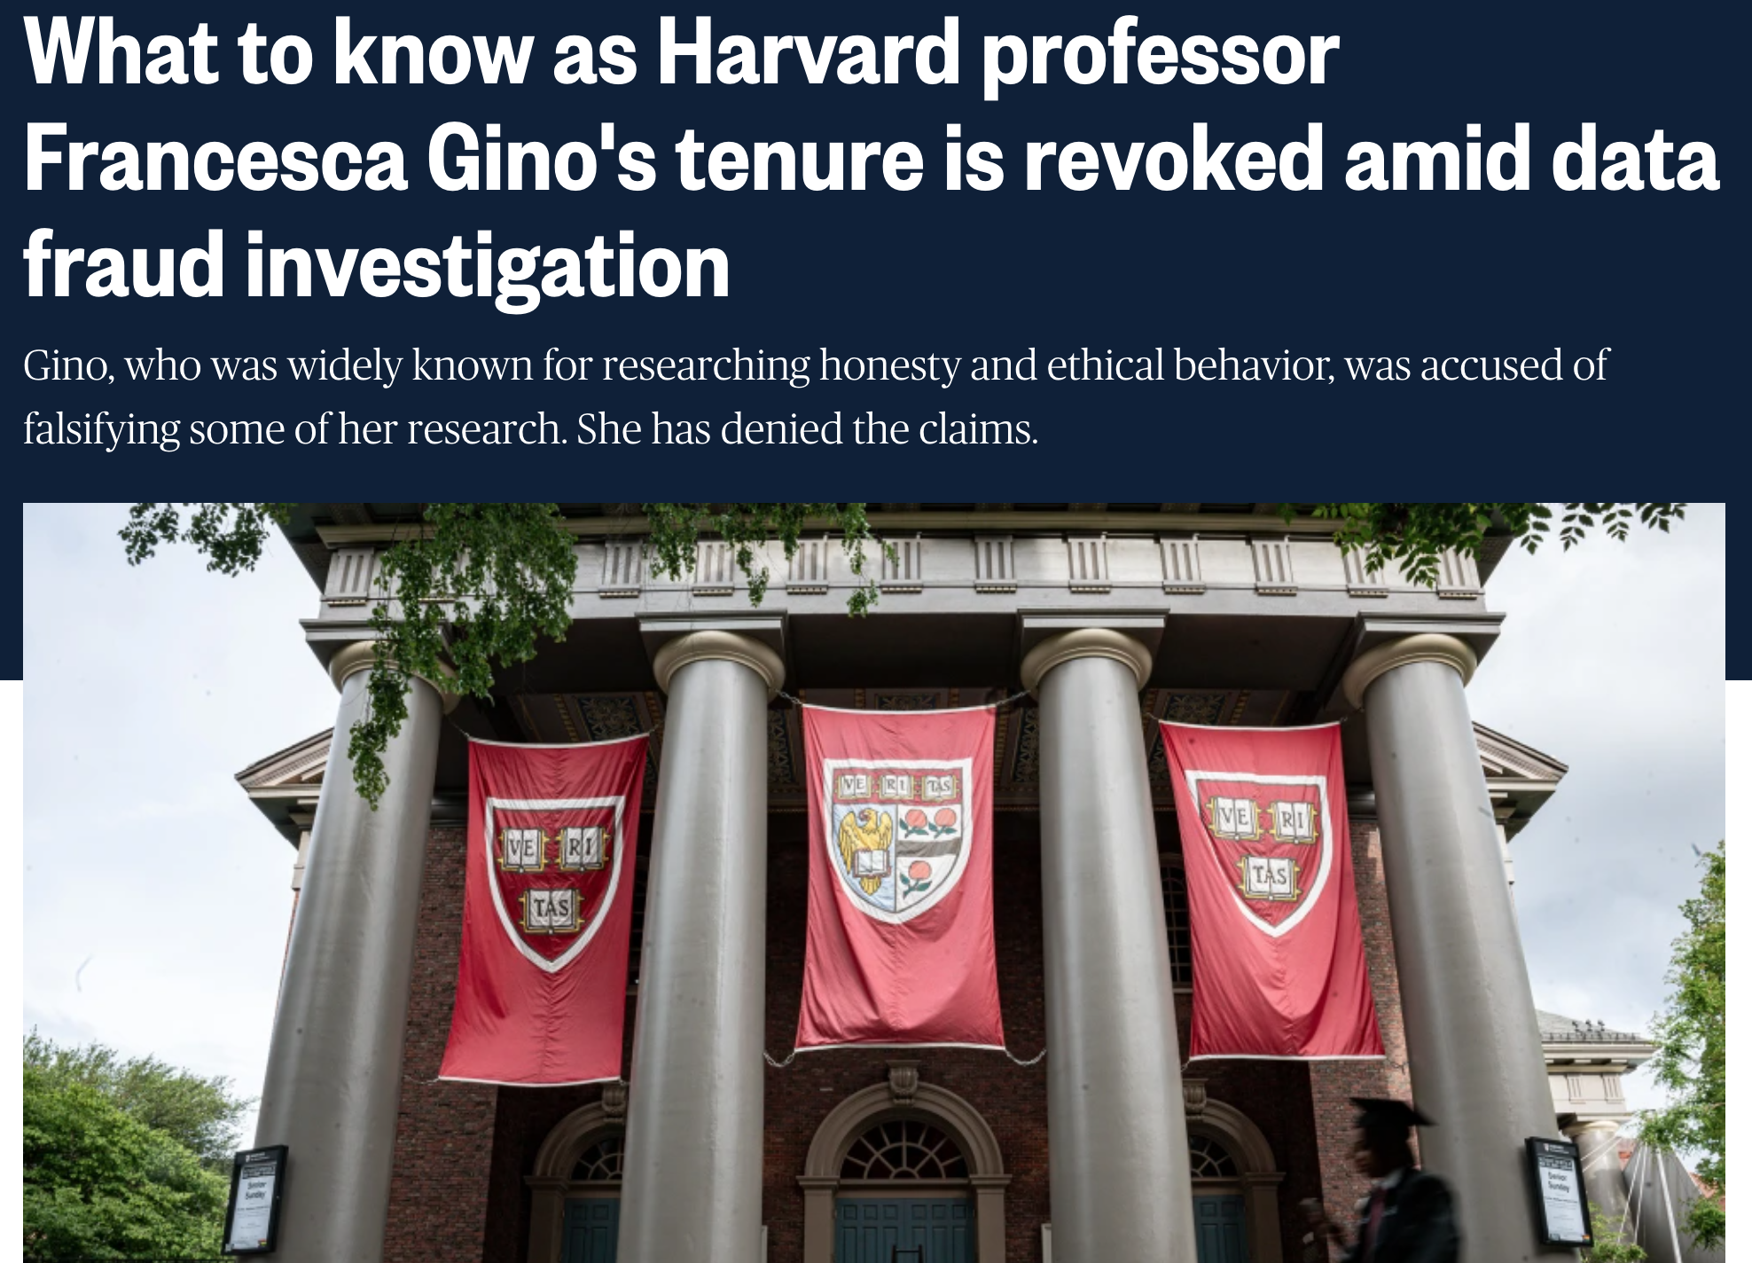
What could possibly go wrong?
https://www.nbcnews.com/news/us-news/know-harvard-professor-francesca-gino-tenure-revoked-data-fraud-invest-rcna209219
https://www.science.org/doi/10.1126/science.adv3711

Slide 7
Common ethical dilemmas
Right before a conference deadline, you obtain some negative results that would make your submission less convincing.
What should you do?
After the conference deadline, you discover that your submission contains errors in the results or reporting.
What should you do?

Slide 8
Categories of ethical considerations
Integrity of research results
Authorship and paper preparation
Peer review
Human subjects

Slide 9
Academic authorship
What are authorship criteria and ethical obligations for authors of academic publications?
Good sources for general guidelines: Nature and ACM

Slide 10
Authorship criteria
Nature authorship guidelines: Authorship provides credit for a researcher's contributions to a study and carries accountability.

Slide 11
Authorship criteria
Nature authorship guidelines: Authorship provides credit for a researcher's contributions to a study and carries accountability.
Authors are expected to fulfil the criteria below:
Each author is expected to have made substantial contributions to the conception or design of the work; or the acquisition, analysis, or interpretation of data; or the creation of new software used in the work;
or have drafted the work or substantively revised it;
AND to have approved the submitted version (and any substantially modified version that involves the author's contribution to the study);
AND to have agreed both to be personally accountable for the author's own contributions and to ensure that questions related to the accuracy or integrity of any part of the work, even ones in which the author was not personally involved, are appropriately investigated, resolved, and the resolution documented in the literature.

Slide 12
Authorship best practices
Discuss authorship at the outset of a project
Only include people as authors for whom you can articulate a meaningful contribution to the work or its presentation
People who made contributions not rising to the level of authorship should be listed in the Acknowledgments section
Remember: each author bears responsibility for the entire content of the paper!

Slide 13
Can AI be an author?
No!
ACM guidelines: “Generative AI software tools cannot be listed as authors on ACM Works under any conditions.”

Slide 14
Can AI be used in paper preparation?
ACM guidelines: Rather than attempt to limit the use of Artificial Intelligence (AI) to conduct research or report on the results of that research by placing expectations on authors to disclose all uses of large language models in their Works, this updated Policy attempts to set clear expectations for their responsible use, as follows:
  When using Artificial Intelligence to conduct research… the specific use(s) of AI tools must be described in detail in the methods section of the Work. This includes … code, datasets, and charts or figures that rely on the AI tools.
  When using Artificial Intelligence to assist with writing an ACM submission, ACM no longer requires the disclosure of information regarding the use of AI.

Slide 15
Btw, plagiarism is still wrong!
Nature guidelines: Plagiarism is unacknowledged copying or an attempt to misattribute original authorship, whether of ideas, text or results.
Plagiarism can be said to have clearly occurred when large chunks of text have been cut-and-pasted without appropriate and unambiguous attribution… Aside from wholesale verbatim reuse of text, due care must be taken to ensure appropriate attribution and citation when paraphrasing and summarizing the work of others.
"Text recycling" or reuse of parts of text from an author's previous research publication is a form of self-plagiarism. Here too, due caution must be exercised. When reusing text, whether from the author's own publication or that of others, appropriate attribution and citation is necessary to avoid creating a misleading perception of unique contribution for the reader.

Slide 16
Categories of ethical considerations
Integrity of research results
Authorship and paper preparation
Peer review
Human subjects

Slide 17
Peer review
When a paper is submitted, it will receive external reviews – almost always single blind, and often double-blind
You will soon be asked to review papers (if you haven’t already)
What are your ethical obligations as a reviewer?

Slide 18
Peer review dilemmas
Is it OK to review a paper co-authored by your friend?
Is it OK to try to discover who are the authors of the paper you’re reviewing?
Is it OK use ideas from a paper you’re reviewing to improve your own work?
Is it OK use ChatGPT to clean up your review?

Slide 19
Reviewer obligations
Meaningfully engage with the submission and provide a fair, constructive, and timely review
Respect the authors’ anonymity (if the process is double-blind)
Protect confidentiality of submitted papers
Avoid conflicts of interest

Slide 20
Protect confidentiality
CVPR guidelines: You have the responsibility to protect the confidentiality of the ideas represented in the papers you review:
  You should not show the paper to anyone else, including colleagues or students, unless you have permission from the program chairs
  You should not use ideas from papers you review to develop your own ideas
  After the review process, you should destroy all material related to papers under review

Slide 21
Avoid conflicts of interest
CVPR guidelines: It is important for you to avoid any conflict of interest. There should be absolutely no question about the impartiality of any review. Conflicts of interest include (but are not limited to) situations in which:
  You work at the same institution as one of the authors
  You have been directly involved in the work and will be receiving credit in some way
  You suspect that others might perceive a conflict of interest in your involvement

Slide 22
Can AI be used in writing reviews?
It depends – policies of different publication venues are all over the place and are changing rapidly
Make sure you understand the principles of responsible reviewing and use AI in a way that does not violate them

Slide 23
Categories of ethical considerations
Integrity of research results
Authorship and paper preparation
Peer review
Human subjects

Slide 24
Human subjects best practices
If your research involves collecting data from or about humans (including surveys, user studies, and crowdsourcing), contact the U of I Office for Protection of Research Subjects for IRB approval or exemption
If you are collecting any personally identifiable data, take care to store it securely in accordance with IRB guidelines
Maintain the raw data, record when it was collected and how, document all data cleaning or pre-processing operations, and report them in your publications

Slide 25
Data collection best practices
When scraping or downloading data, respect all relevant terms of service, copyright restrictions, and legal regulations
Consider open sharing of data – but see above
Data collection for the purpose of training machine learning models is currently a contentious topic. Ethical guidelines are still evolving – but you should be aware of the issues

Slide 26
Harms and benefits of research
Nature guidelines: Advancing knowledge and understanding is a public good and, as such, a key benefit of research, even when the research in question does not have an obvious, immediate, or direct application. Although the pursuit of knowledge is a fundamental public good, considerations of harm can occasionally supersede the goal of seeking or sharing new knowledge, and a decision not to undertake or not to publish a project may be warranted.

Slide 27
In conclusion
Your conduct matters!
Hold yourself to high standards for research integrity,
peer review, authorship, and professional relationships
When in doubt, err on the side of stricter adherence to ethical guidelines and talk to trusted faculty or peers

