Slide 1
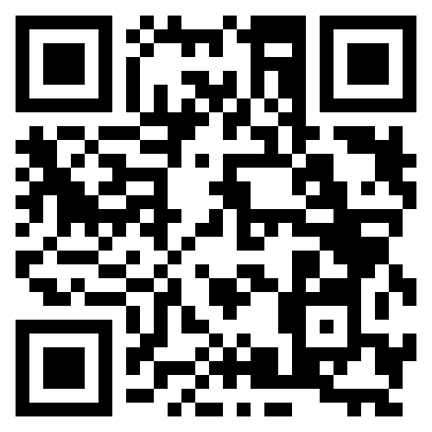



CSGSO
If you are interested in meeting other CS grad students please consider joining CSGSO or attending CSGSO events!
Happy hours (sometimes with other departments)
Friday extravaganza (free food)
Afternoon tea, holiday celebrations, and more
If you are interested in organizing an event as well, please feel to join us Mondays at 12pm in Siebel or on zoom (join #csgso in slack)

Slide 2

Fall 2026 CS 591 PHD Seminar
How to get started in research
C. Vanloo, Architecture, 1752-53

Slide 3
Last time: Ph.D. Requirements
The PhD program has many milestones designed to keep you on track and establish reasonable bounds – not to create arbitrary busywork
Take the requirements seriously and plan ahead as much as you can
Talk to the grad office and/or DGS if you think you may need extra flexibility or extensions

Slide 4
Goals for your first year
Complete Program of Study and start satisfying course requirements
Satisfy your language requirements (if not done already)
Start contributing to a research project – or leading your own
Secure a Ph.D. advising agreement

Slide 5
Today
How to navigate the research process and the student-advisor relationship
How to meet with your advisors/mentors/collaborators
How to do experiments
How to generate research ideas

Slide 6


Navigating the student-advisor relationship
From semester to semester
  Make sure you understand the advisor’s expectations for meeting major milestones
  Ask for a “status” meeting – ideally every semester, but at least once a year
From week to week
  You need to “manage” both yourself and
  your advisor to get useful guidance and
  make steady progress in research
Image source

Slide 7
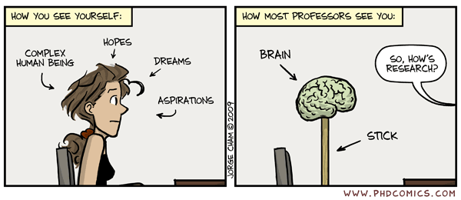
Navigating the student-advisor relationship
STUDENT’S POV
Ph.D. Comic #1126

Slide 8
Navigating the student-advisor relationship
STUDENT’S POV
Ph.D. Comic #1126

Slide 9
Navigating the student-advisor relationship
PROFESSOR’S POV
STUDENTS
SO, WHAT SHOULD I DO NEXT?
Ph.D. Comic #1126

Slide 10
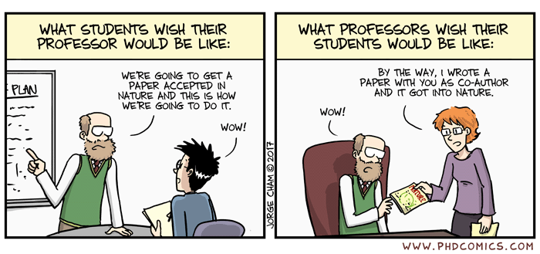
Navigating the student-advisor relationship
“Your advisor is an input-output machine: you throw them something, you get something out” – Jia-Bin Huang
❏ Input only: You do everything and report final results
❏ Output only: They tell you to do something and you do it
✅ Input and output: You get frequent and valuable guidance!
Ph.D. Comic #1936

Slide 11
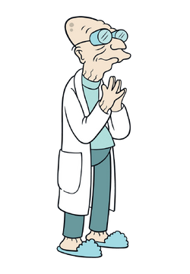
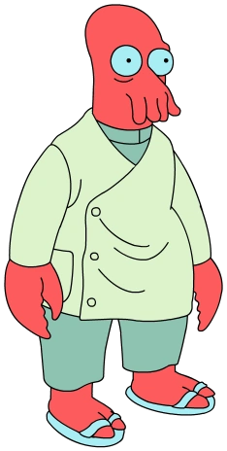
Some example interactions…
Try this approach on this problem, then come back and tell me how it worked.
Professor
Student 1
I’m not sure this is the best possible problem for me to work on. I need to go away and figure out what kind of problem could truly inspire me.
DON’T WAIT FOR THE PERFECT PROBLEM!
Image source

Slide 12

Some example interactions…
Try this approach on this problem, then come back and tell me how it worked.
Professor
Student 2
I don’t have experience doing this at all. Give me a year to take classes and do my homework. After that give me another year to TA and prepare for my qual. After that I will be too tired and will need to take some time off.
DON’T WAIT TILL YOU’RE PERFECTLY READY!
Image source

Slide 13
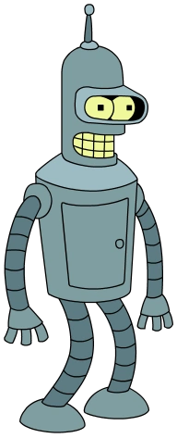
Some example interactions…
Try this approach on this problem, then come back and tell me how it worked.
Professor
Student 3
I tried it. It didn’t work.
CAN YOU DO BETTER?
Image source

Slide 14
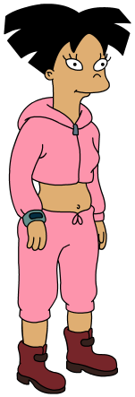
Some example interactions…
Try this approach on this problem, then come back and tell me how it worked.
Professor
Student 4
I tried your approach and it didn’t work.
I’ve narrowed down the problem to step D. Until step D, you put in X and get out Y as we expect. But you can see how it fails here at D. I’ve ruled out possible failure causes U and V, and think that W is the most likely cause. Next I will investigate W.
CAN YOU DO EVEN BETTER?
Image source

Slide 15

Some example interactions…
Try this approach on this problem, then come back and tell me how it worked.
Professor
Student 5
I tried your approach and it didn’t work.
Then I looked at related papers, talked to other students, had a different idea, implemented it, and it worked!
THIS SHOULD BE ALL OF YOU
IN FIVE YEARS!
Image source

Slide 16
The moral of the story so far
Don’t wait for the perfect problem and perfect knowledge –
take the plunge and learn as you go!
Don’t just say “it didn’t work” – figure out why or pivot to something different!
Don’t just do what your advisor tells you to do – do something better!

Slide 17
How to meet with your advisors/mentors
Start the meeting
❏ Your advisor is busy, so you should get right into
the technical details.
Source: Jia-Bin Huang

Slide 18
How to meet with your advisors/mentors
Start the meeting by establishing context and agenda
❏ Your advisor is busy, so you should get right into
the technical details.
✅ Remind your advisor where things stood at the end of
the last meeting. Manage the meeting to ensure you
cover all the topics you want to discuss.

Slide 19
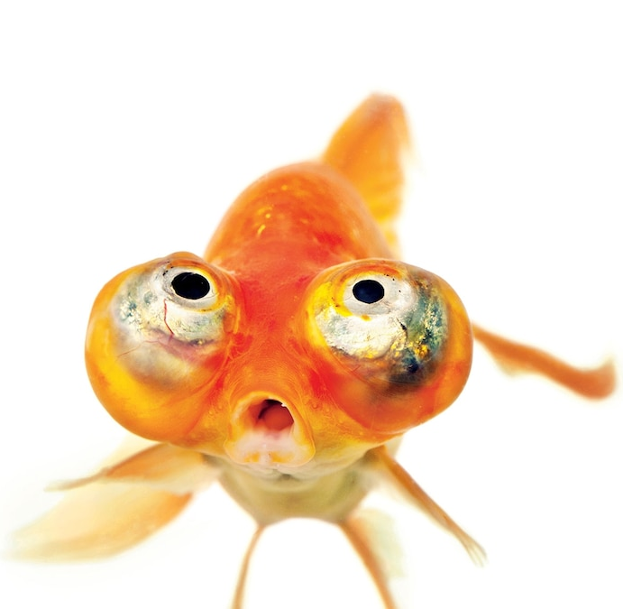
How to meet with your advisors/mentors
Start the meeting by establishing context and agenda
❏ Your advisor is busy, so you should get right into
the technical details.
✅ Remind your advisor where things stood at the end of
the last meeting. Manage the meeting to ensure you
cover all the topics you want to discuss.
    “Your advisor will forget everything you discuss the moment you step out the door. Treat your advisor as goldfish. Always provide high-level contexts first.” – Jia-Bin Huang

Slide 20
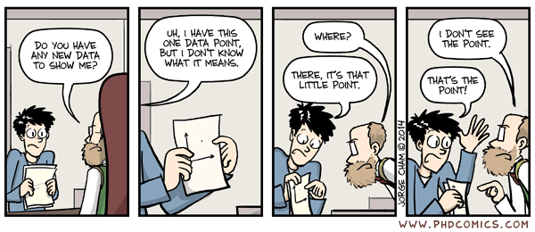
How to meet with your advisors/mentors
Start the meeting by establishing context and agenda
Show your results
❏ ”I got lots of results! Here are a bunch of plots."
Ph.D. Comic #1762
Source: Jia-Bin Huang

Slide 21
How to meet with your advisors/mentors
Start the meeting by establishing context and agenda
Show your results and interpret them
❏ ”I got lots of results! Here are a bunch of plots."
✅ Contextualize your results: What did you do?
Why and how did you do it? What did you find?
Does it make sense?
Source: Jia-Bin Huang

Slide 22
How to meet with your advisors/mentors
Start the meeting by establishing context and agenda
Show your results and interpret them
Discuss next steps
❏ "That's all my progress. What do you suggest I do next?"
Source: Jia-Bin Huang

Slide 23
How to meet with your advisors/mentors
Start the meeting by establishing context and agenda
Show your results and interpret them
Discuss next steps and propose a plan
❏ "That's all my progress. What do you suggest I do next?"
✅ "That's all my progress. Based on the results, I suggest
follow-up tasks A, B, C (and why). It should take me about
this long to do this."
Source: Jia-Bin Huang

Slide 24
How to meet with your advisors/mentors
Start the meeting by establishing context and agenda
Show your results and interpret them
Discuss next steps and propose a plan
Follow up
❏ You paid careful attention and memorized everything.
No need to send a summary – the professor won’t read it anyway
Source: Jia-Bin Huang

Slide 25
How to meet with your advisors/mentors
Start the meeting by establishing context and agenda
Show your results and interpret them
Discuss next steps and propose a plan
Follow up
❏ You paid careful attention and memorized everything.
No need to send a summary – the professor won’t read it anyway
✅ Summarize the meeting and the next steps. Email/post
on Slack right away. Don’t hesitate to ask for clarifications.
Source: Jia-Bin Huang

Slide 26
Last time: How to get started in research

Slide 27
Last time: How to get started in research
How to navigate the research process and the student-advisor relationship
  For your first-year 597s: find out the professor’s expectations,
  ask for feedback at the end of the semester
  Get in the right mindset for doing research
How to meet with your advisor (and other mentors and collaborators)

Slide 28
How to meet with your advisor
Start the meeting by establishing context and agenda
Show your results and interpret them
Discuss next steps and propose a plan
Follow up with a summary

Slide 29
Today
How to navigate the research process and the student-advisor relationship
How to meet with your advisors/mentors/collaborators
How to do experiments
How to generate research ideas
Use of AI for research

Slide 30
How to do experiments
Don’t just try stuff – formulate hypotheses and test them!
Think critically and analytically
  Present your results in a way that is easy to understand –
  both for your own sake and for your advisors/collaborators!
  If you don’t understand your results, sanity check and debug them
Be disciplined
  Use version control, document everything
  Break methods down into components and validate them one at a time
  Explore implementation choices systematically
Don’t be afraid to ask for help and feedback

Slide 31
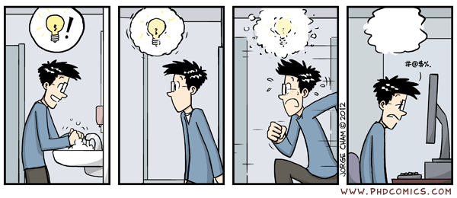
How to generate research ideas
https://phdcomics.com/comics.php?f=1481

Slide 32
How to generate research ideas
No foolproof recipe – if this were easy, we wouldn’t be here!
Read papers – and ask questions
Follow arXiv and social media – but don’t overdo it
Identify leading/inspirational researchers in your field and follow their work
Attend reading groups and talks
Talk to other Ph.D. students and join their projects – but don’t spread yourself too thin
Learn patterns of research ideas

Slide 33





A few patterns of research ideas
Build a hammer and find nails
Start small and then grow
Fill in the blank/check the checkboxes
 | Feature 1 | Feature 2 | Feature 3
Method 1 | ✔️
Method 2 |  | ✔️ | ✔️
My method | ✔️ | ✔️ | ✔️
Create datasets and benchmarks
Extend/expand on previous work
Reproduce previous work
Source

Slide 34
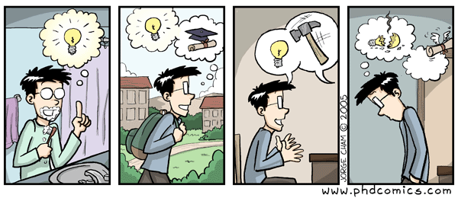
How do I know if my idea is good?
Always ask for feedback!
https://phdcomics.com/comics/archive.php?comicid=537

Slide 35
How do I know if my idea is good?
Always ask for feedback!
Ideas are cheap – it’s the execution that counts!
  Try lots of ideas and validate (or reject) them fast
  Know when to pivot – one of the hardest decisions

Slide 36
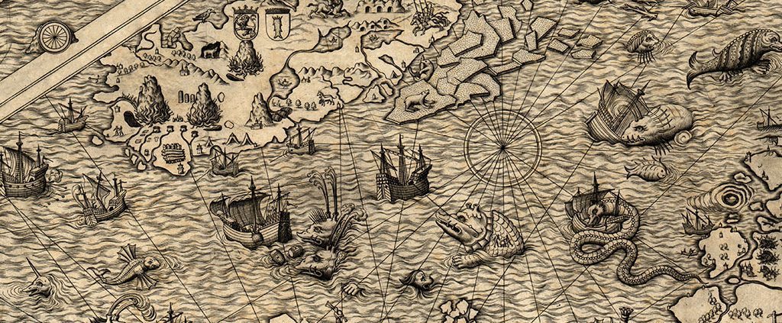
Use of AI for research

Slide 37
Use of AI for research
How is AI affecting research in your field?
How are you using AI tools for your own research?
What are the benefits and risks of AI-assisted research?

Slide 38
Use of AI for research
Remember: you are ultimately responsible for all your research outputs (code, results, writing, etc.)
Be transparent with your advisor and collaborators about your use of AI tools and follow any other relevant disclosure policies
Figure out your human reasons for doing research and don’t compromise on those

Slide 39
Parting thoughts: Some hard truths about research
There is no guaranteed recipe for success
There is not always a direct relationship between inputs
(time, effort) and outputs (papers, citations, fame, fortune)
You will experience failure and frustration
You will keep running into people who seem smarter and/or more successful than you
What to do about it?
Keep tending your own garden and do research for the right reasons!

