Slide 1
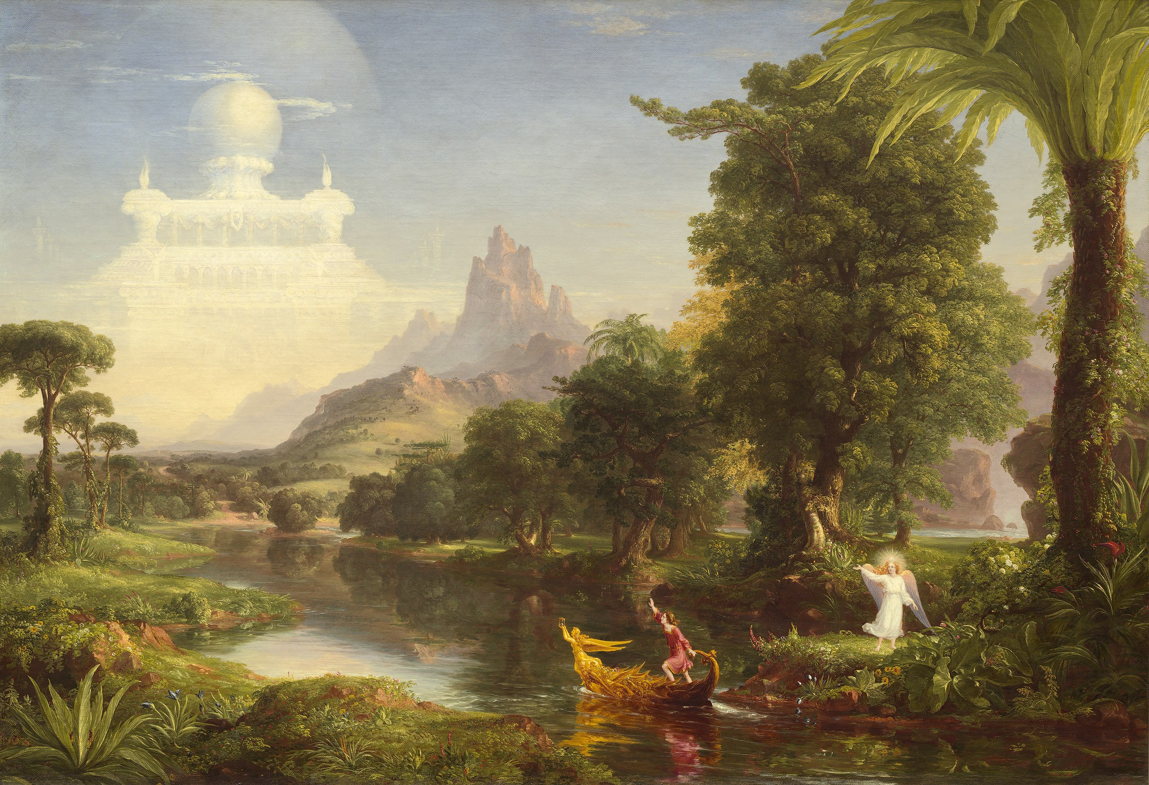
Fall 2026 CS 591 PHD Seminar
Beginning Your Journey Towards Earning a Ph.D.

Slide 2
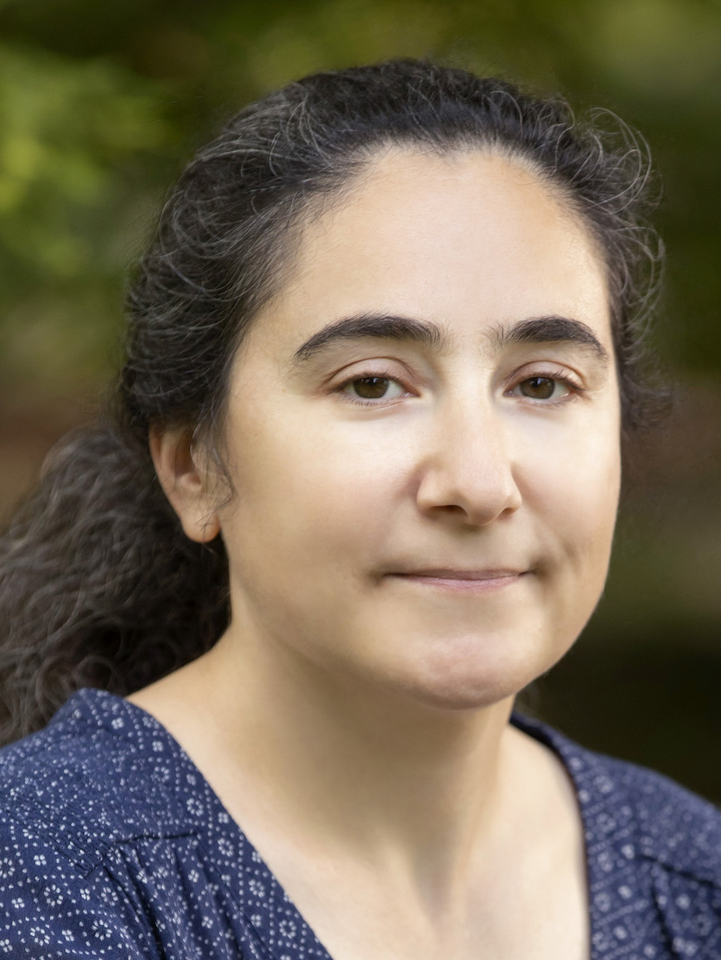
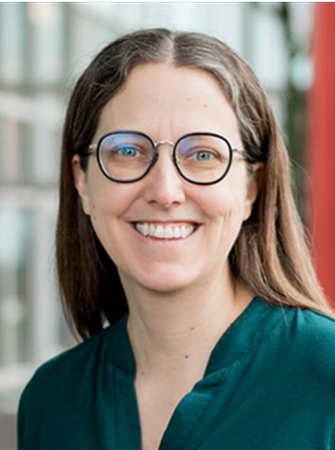
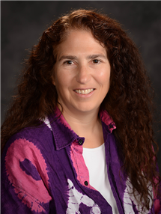
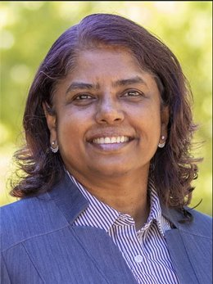
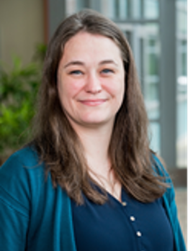
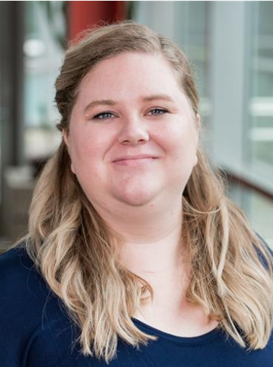
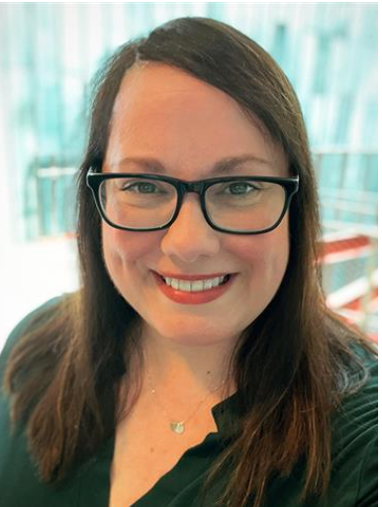
Introductions
Svetlana Lazebnik
DGS
Colleen Lewis
Associate DGS
Nancy Amato
Director of SSCDS
Viveka Kudaligama
Senior Assistant DGS
Jennifer Comstock
Program Coordinator and Senior Academic Advisor
Cassandra Phelps
Program Coordinator and Senior Academic Advisor
Celia Johnston
Senior Academic Advisor

Slide 3

Meet the DGS
DGS office hours:
Fridays 1-3PM in 1218 Siebel (also on Zoom)

Slide 4
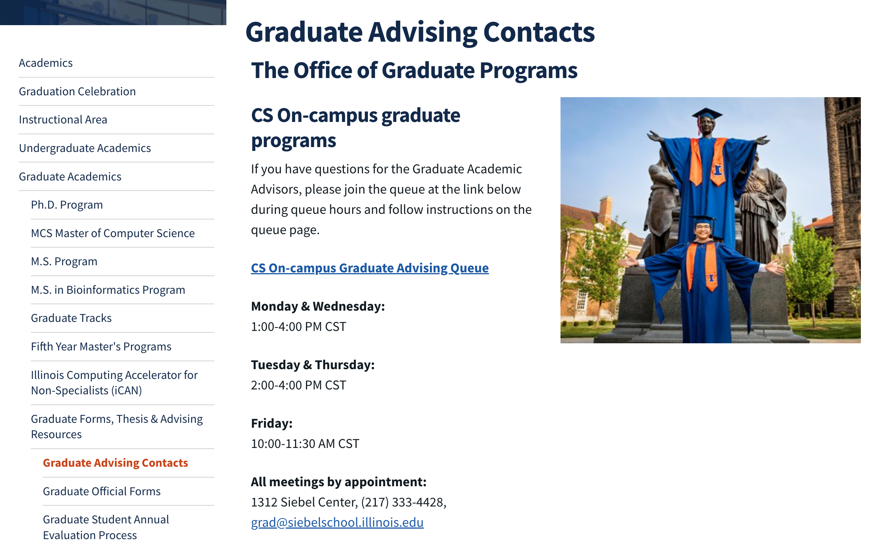
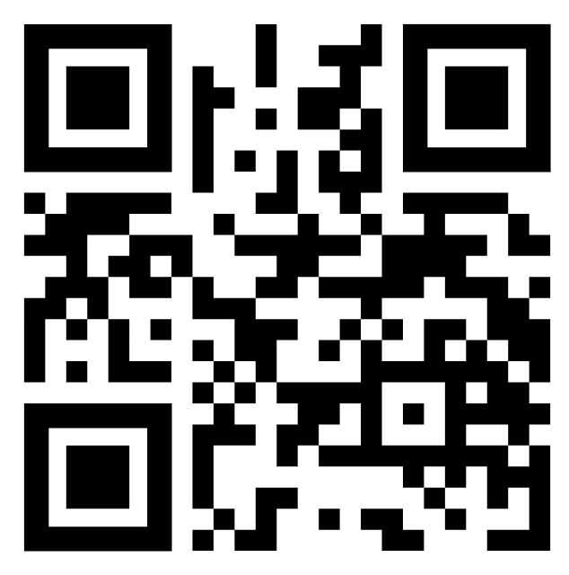
Meet the grad advisors
Grad office advising and contact info:
https://siebelschool.illinois.edu/academics/graduate/graduate-forms-advising-resources/graduate-advising-contacts

Slide 5

CS 591 PHD Logistics
Schedule and policies are posted on the website: https://courses.engr.illinois.edu/cs591phd/fa2026/
  Important announcements will be sent by mass email
  Canvas will be used for quiz submission, attendance recording
  Classroom videos will be posted to Mediaspace
Come on time, give us your attention, and put away electronics!
To receive a Satisfactory (“S”) grade:
  Have no more than two absences
  Complete a few required tasks: program of study form, requirements quiz
  If you receive a “U” you will have to take the seminar again and you will not be allowed to sign up for the qual until you pass

Slide 6
Attendance requirement
Attendance is taken electronically in the beginning of each class
  Be sure to bring your iCard so we can record your attendance!
  Arriving more than five minutes late will be counted as an absence
Everyone is allowed two absences with no questions asked
More than two absences require exceptional circumstances
  If you encounter any such circumstances, email Lana and Viveka with your documentation as soon as you can
  Job interviews and conference travel are expected to be covered by the two allowed absences

Slide 7
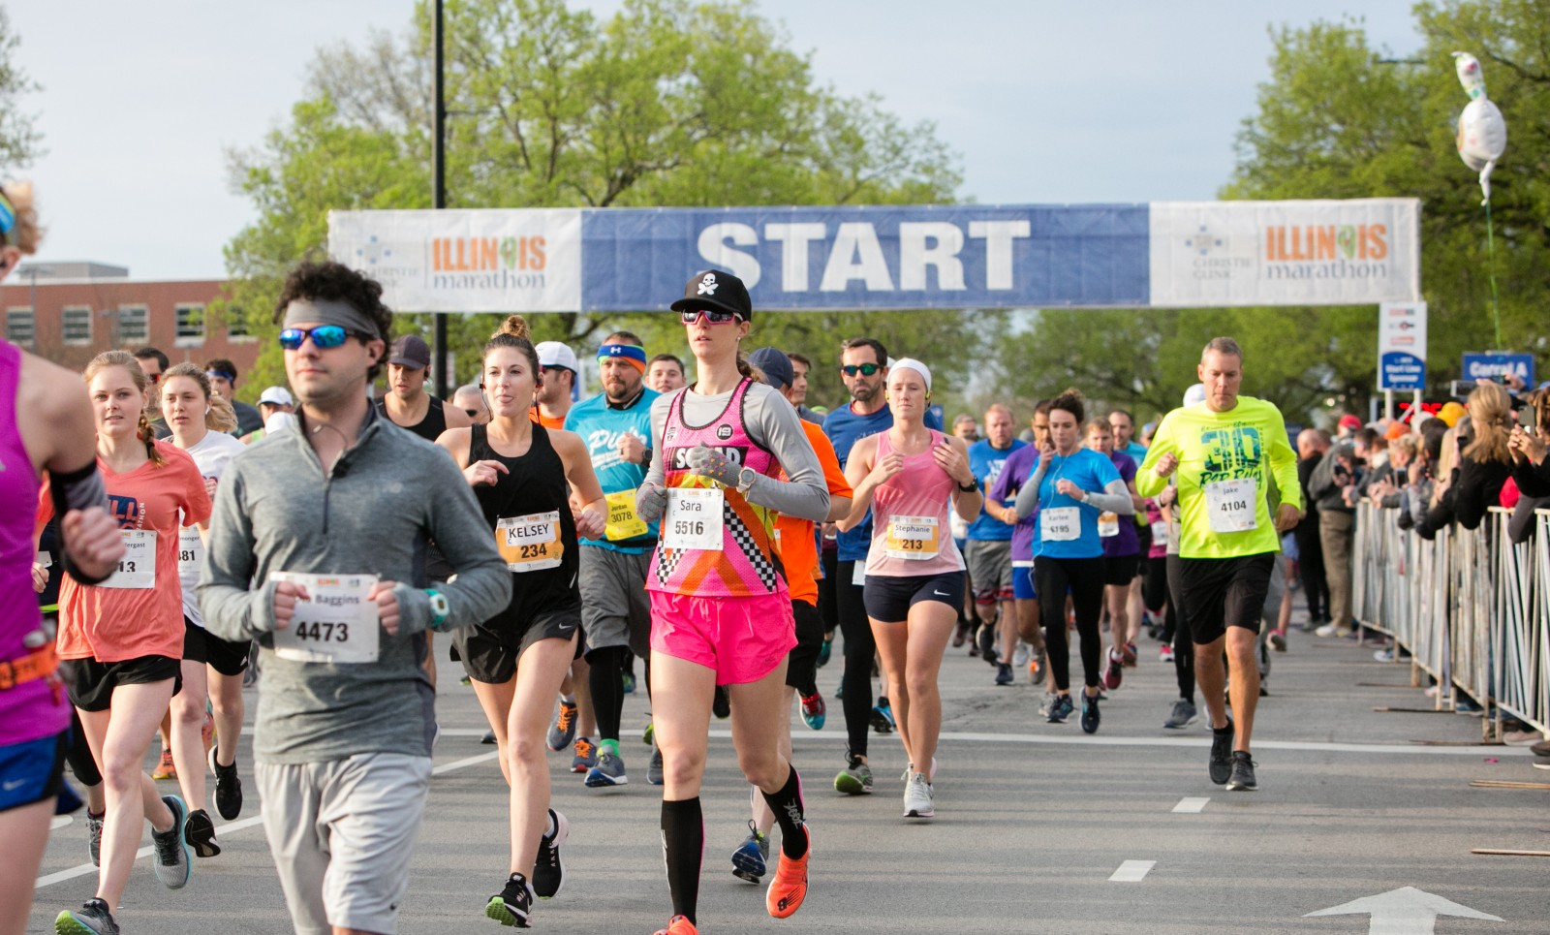
The path to a Ph.D. is like a marathon
Notes:
All of you start at the same time, but will proceed at a pace that works for you.
There will be periods when you are performing well, and periods when you struggle.
And what matters most is that you finish.
The purpose of the CS graduate office is to keep you on pace, and maybe to cheer you on when you need it

Slide 8
Challenges along the way
Transitioning from consuming to producing knowledge
Learning how to communicate your research findings
Building your professional profile and network
Managing time and stress
Dealing with setbacks, uncertainties, rejections
Notes:
That investment also comes with challenges. It requires more then putting in the work.

Slide 9
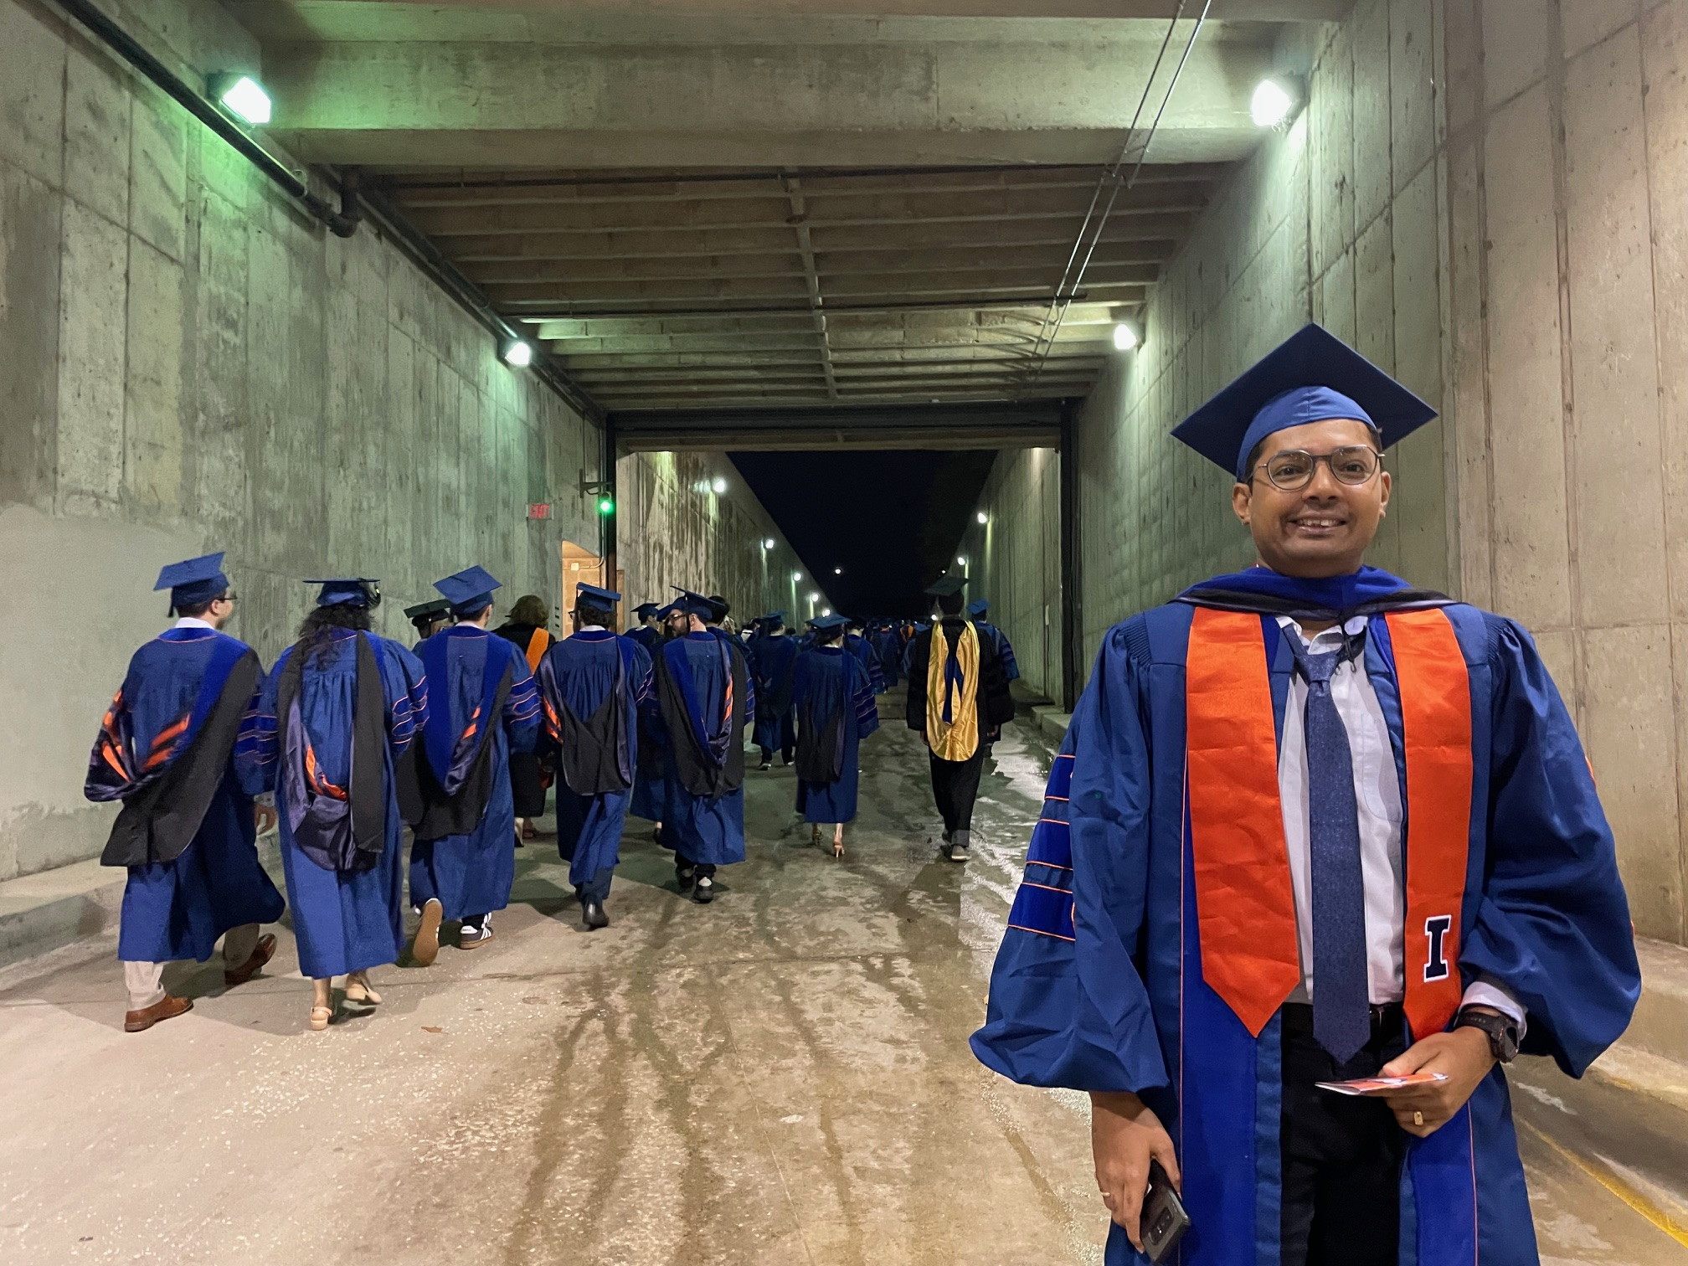
The light at the end of the tunnel
My former Ph.D. student Viraj Shah after the 2025 Hooding Ceremony
Notes:
After its all done, you will deserve a hug!

Slide 10

You are making a long-term investment
Achievement
Knowledge and discovery
Lifelong friends and professional connections
New career pathways
Image source
Notes:
We are all here because each of you would like to earn a PhD. I admire you because this is a big investment in your career. Most of you will spend 5 to 7 years working toward your degree, and these years come during a precious time in your life. Many of your friends will get married, grow in their professional career; all while you are pursuing a doctoral degree.

Slide 11
Goals of this seminar
Understand Ph.D. program requirements
Learn how to become a successful researcher
Get exposure to all the research areas in the school
Get connected to campus resources
Build community
Notes:
How to be a successful student (career paths and expectations, communication skills, ethics, etc.)
Skills (speaking, writing, people skills), need money (grant writing skills)

Slide 12
Goals for your first year
Find your advisor(s) and initial research topic
Take courses and plan your program of study
Start preparing for the qualifying exam

Slide 13
First year independent studies
You must be enrolled for a CS 597 Independent Study both in the Fall and Spring semesters
  The goal is to secure your advisor(s) and get started on research
  Can be with the same or different faculty
  The minimum is 4 credits but 8 is not uncommon
  Typical first-year course load: CS 597 plus one to two “real” courses

Slide 14
Student Employment (Non-Fellowship)
If you’re a new employee at the university, you need to complete work authorization paperwork
If you have paycheck or employment-related questions, please contact HR at cs-hr@cs.illinois.edu
If you have tuition waiver questions, please contact academic@siebelschool.illinois.edu

Slide 15
PhD Research Budget: $2500
Nick Shields and Greg Anderson

Slide 16
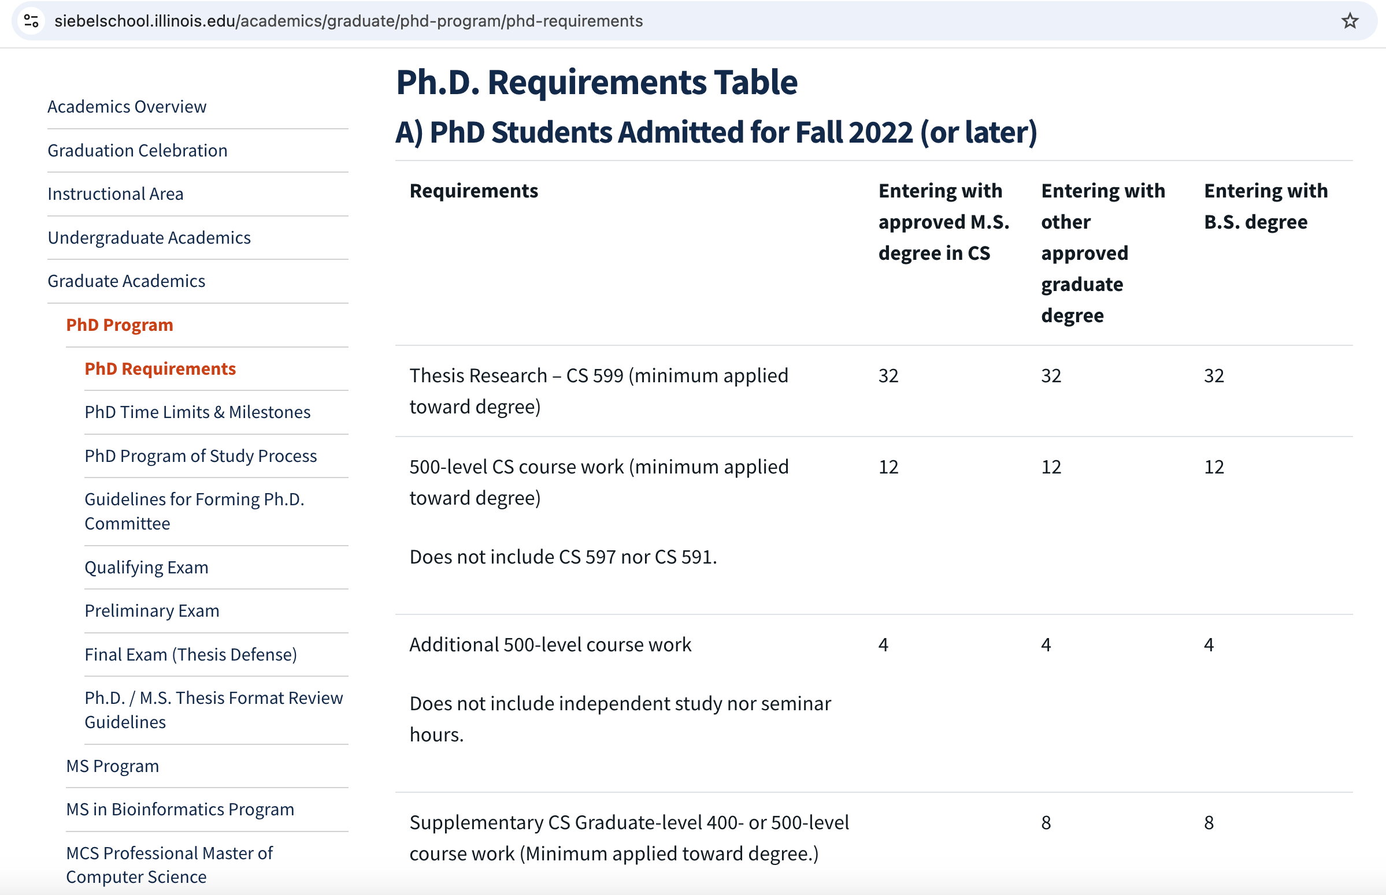
Next time: Ph.D. requirements

Slide 17
By Next Time
1. Skim the Ph.D. requirements page (https://siebelschool.illinois.edu/academics/graduate/phd-program/phd-requirements) and the Graduate College Handbook (http://www.grad.illinois.edu/gradhandbook)
2. Come to class with questions

Slide 18
Online Resources
SSCDS Grad Program: http://siebelschool.illinois.edu/current-students/graduate-students
My.siebelschool portal: http://my.siebelschool.illinois.edu
Grad College Website: http://www.grad.illinois.edu
Grad Handbook: http://www.grad.illinois.edu/gradhandbook

