Slide 1
Reminder: Program of Study Form
You should have received your PoS committee assignment
PoS form with committee approvals is due November 15th
Recommended procedure:
  Discuss your coursework and qual preparation with your advisor
  Email the other members of your committee:
    Introduce yourself
    List your chosen coursework
    Request a one-on-one meeting
  Once you have met with everybody, submit the PoS form on my.siebelschool and follow up with your committee to approve

Slide 2
Reminder: Program of Study Form
Required courses (a minimum of one and a maximum of three): can be either pre-qual or pre-prelim
  Cannot be 597, can be a 598
  Any changes must be approved by your Program of Study Committee and a revised form must be submitted
Recommended courses: helpful to your research, but not necessarily essential
  Changes do not require an update to the form
Justification for proposed curriculum: a few sentences

Slide 3
Ph.D. Requirements Quiz
Available on Canvas now, due Monday, October 26
20 multiple choice and T/F questions, no time limit
Consult https://siebelschool.illinois.edu/academics/graduate/phd-program to help you answer
Must get a score of at least 15 to pass

Slide 4
Last time: Use of AI for research
How is AI affecting research in your field?
How are you using AI tools for your own research?
What are the benefits and risks of AI-assisted research?

Slide 5
Last time: Use of AI for research
Remember: you are ultimately responsible for all your research outputs (code, results, writing, etc.)
Be transparent with your advisor and collaborators about your use of AI tools and follow any other relevant disclosure policies
Figure out your human reasons for doing research and don’t compromise on those

Slide 6

Fall 2026 CS 591 PHD Seminar
How to communicate your research

Slide 7
Overview
A “unified theory” of communication
How to write papers
How to give presentations

Slide 8
How to communicate your research
The idealized view: scholars, with plenty of time on their hands and undivided attention, poring over your manuscript or hanging on your every word
Adapted from Bill Freeman

Slide 9

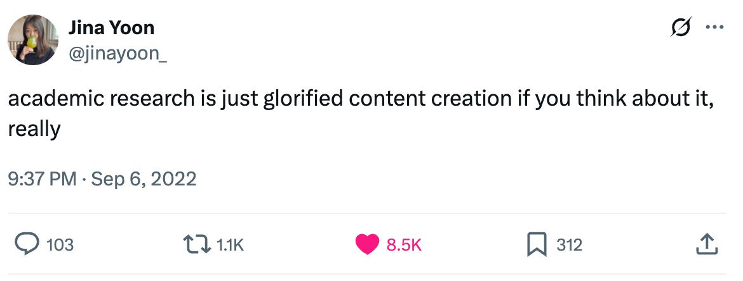

Sadly, we live in fallen times…
NeurIPS 2023 poster session: Source
Source

Slide 10
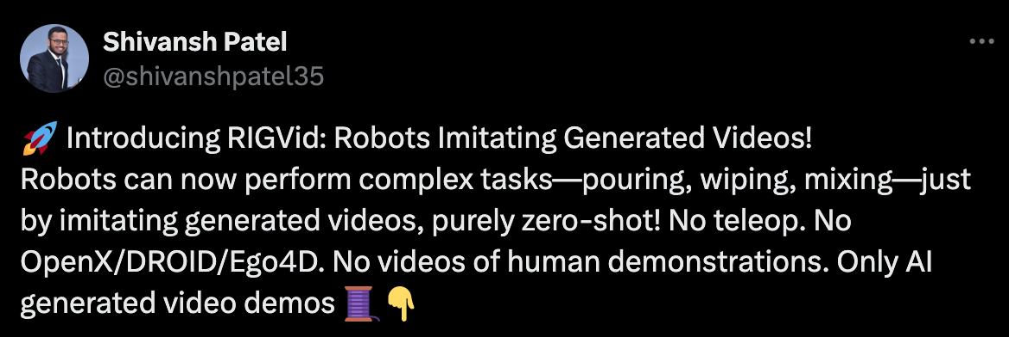
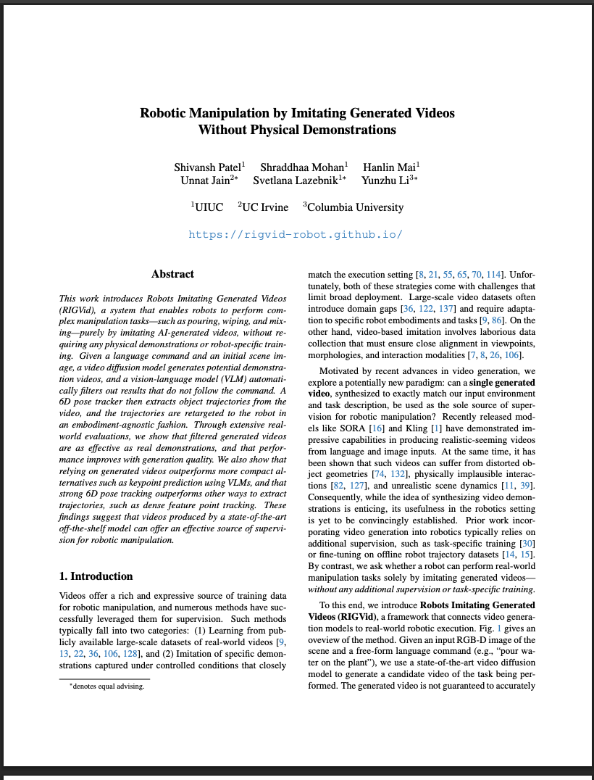
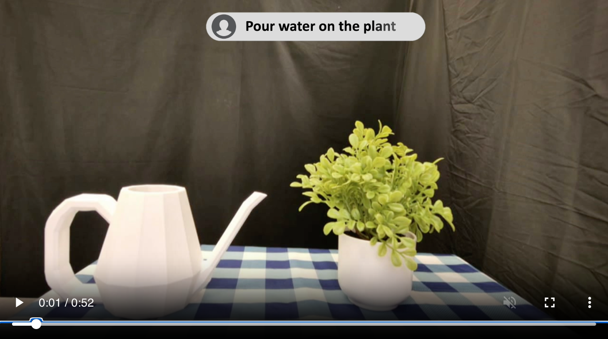
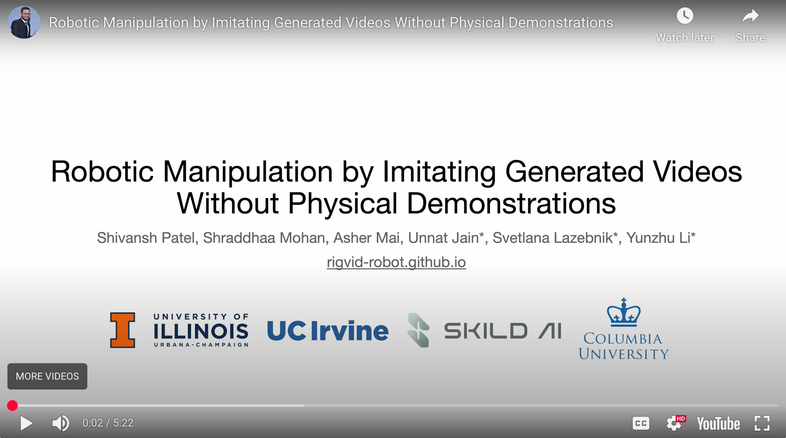
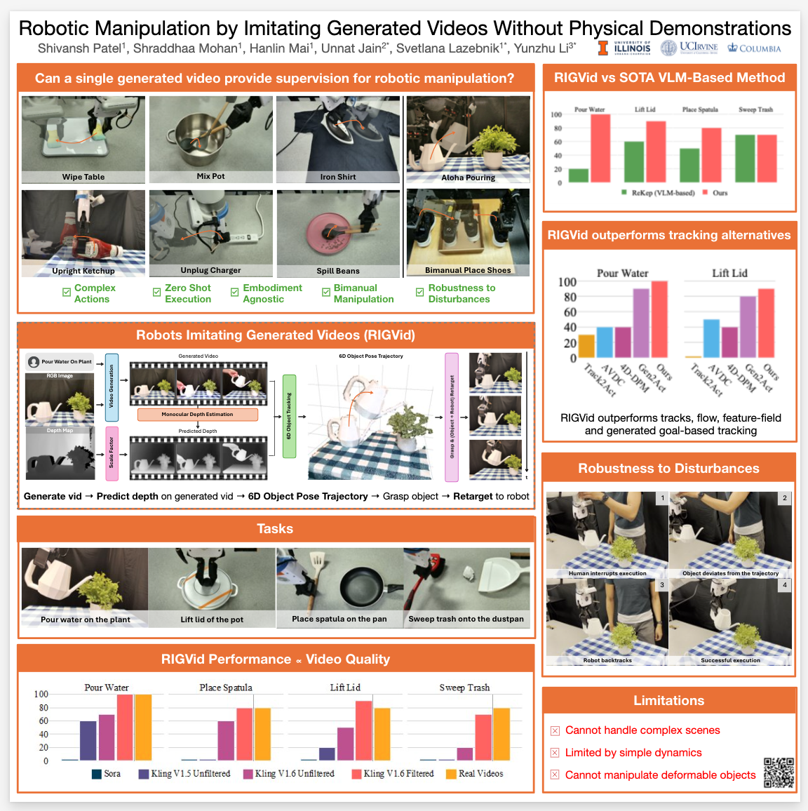
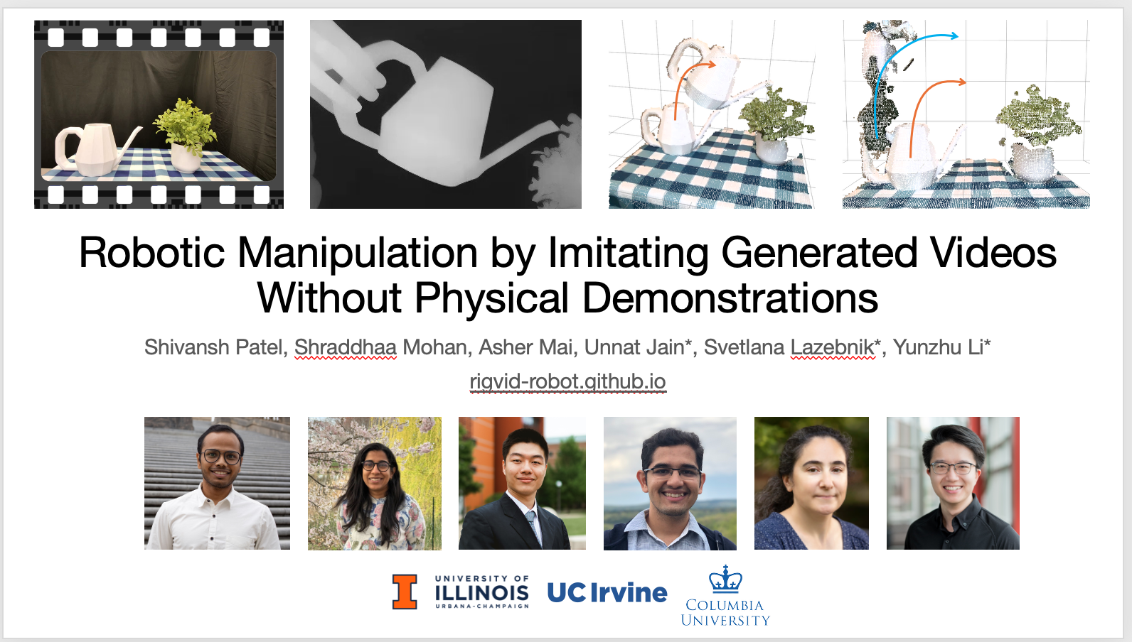

One project, lots of “content”
X post
Paper
1min ”teaser” video
Poster
5min “explainer” video
PowerPoint Presentation
Webpage
https://rigvid-robot.github.io/

Slide 11
A “unified theory” of communication

Slide 12


A “unified theory” of communication
The novice: Use what you know to fill the available time and space
Your brain
Information transfer
Your paper or presentation

Slide 13
A “unified theory” of communication
The pro: create your “content” to best achieve your goals
given the medium/situation and your audience

Slide 14
A “unified theory” of communication
The pro: create your “content” to best achieve your goals
given the medium/situation and your audience
You
Communication medium
Your audience
What are your goals?
To get your paper accepted, to advertise your work, to get other researchers to use your method,
to pass the qual, to get a job, etc.
What are the constraints
of the communication medium and situation?
Who is your audience?
What is their state of knowledge?
What are their goals?
To accept/reject papers, to find out about new work, to evaluate your knowledge, to decide who to hire, etc.
What is their state of mind?
Probably tired, distracted, preoccupied with their own affairs

Slide 15
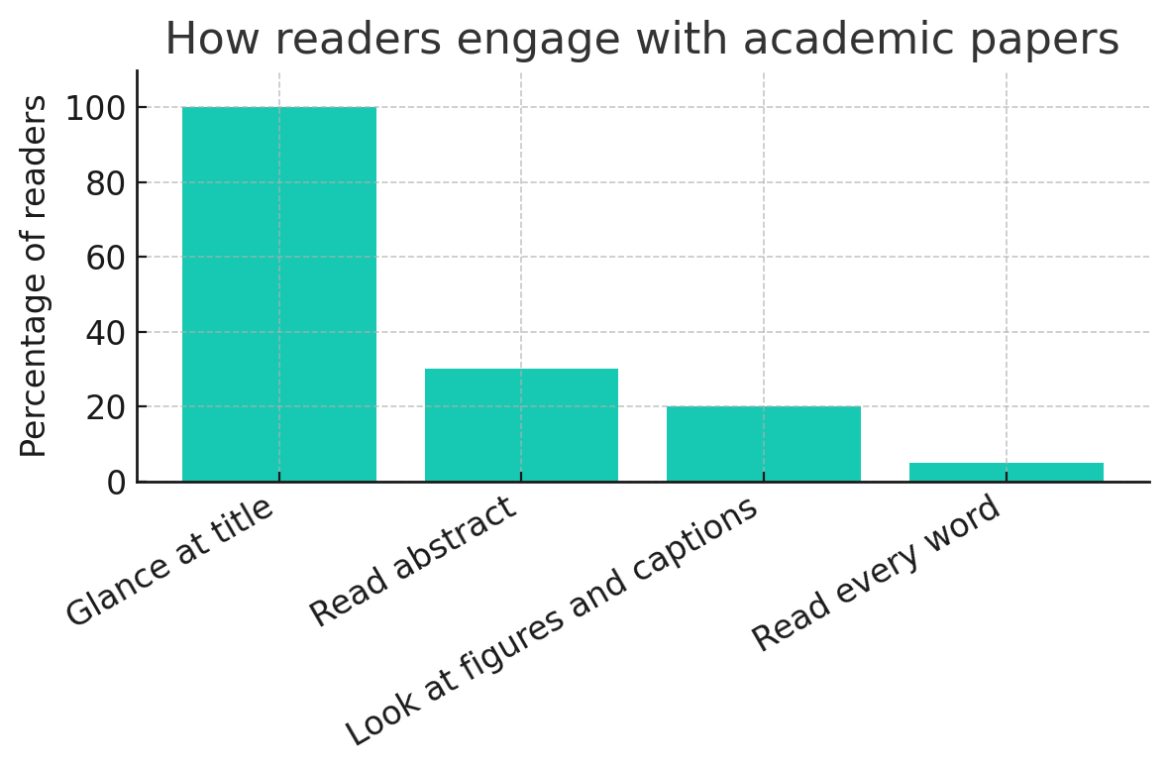
How to write papers
Step 1: Get a “theory of mind” of your readers
How readers engage with academic papers – a totally scientific precise chart I generated with ChatGPT
Adapted from Bill Freeman

Slide 16
How to write papers
It is really hard work to write a paper for readers who will probably ignore most of it!
“Perhaps the most important principle of good writing is to keep the reader uppermost in mind: What does the reader know so far? What does the reader expect next and why?” – Donald Knuth

Slide 17
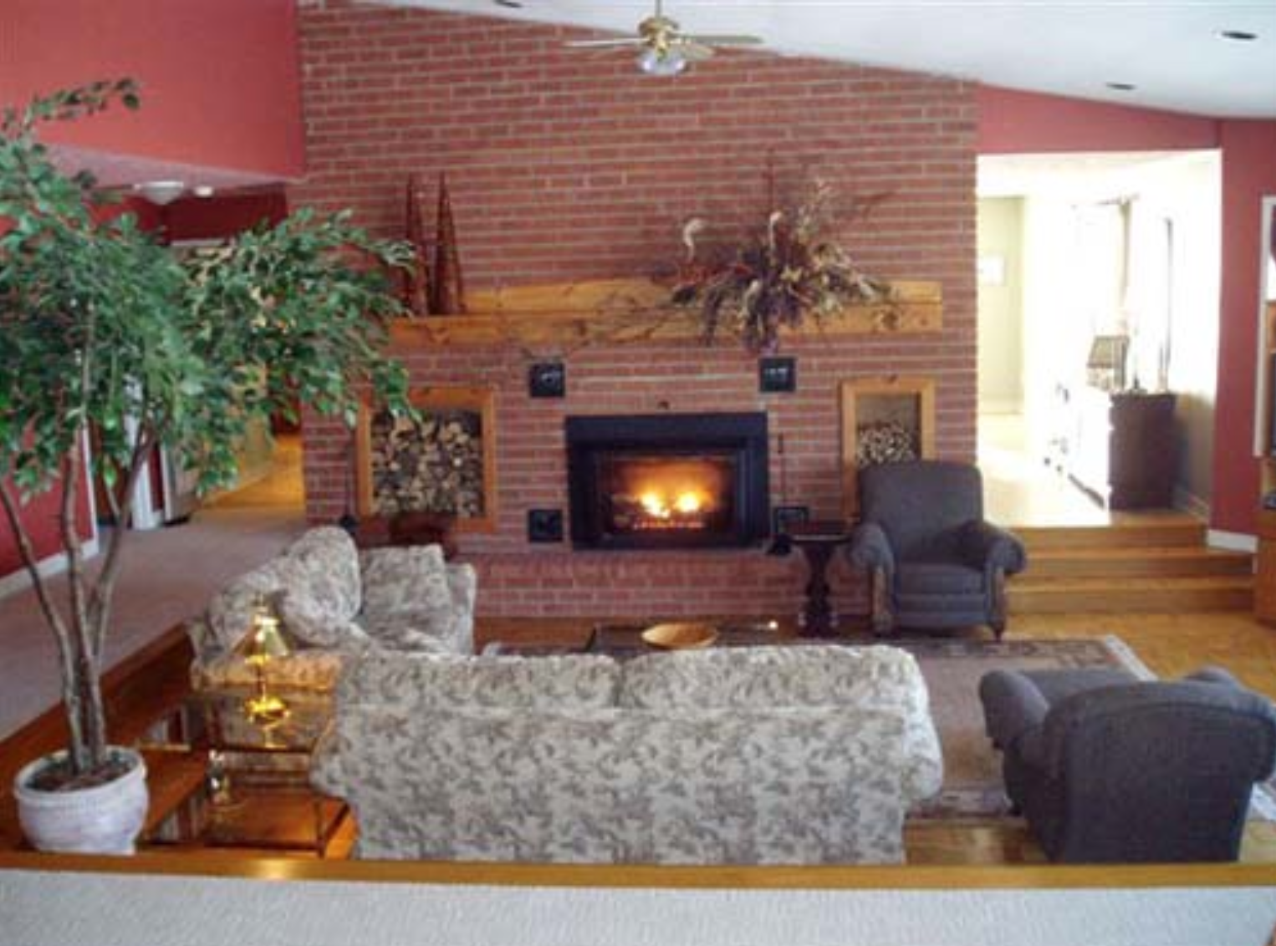
Treat the reader as you would a guest in your own house
Anticipate their needs: Would you like something to drink? Something to eat? Perhaps now, after eating, you’d like to rest?
Source: Bill Freeman

Slide 18
Typical paper organization
experimental
v
Introduction
Related work
The method
The experiments
Discussion/conclusion

Slide 19
Typical paper organization
Introduction
Related work
The method
The experiments
Discussion/conclusion

Slide 20
Typical paper organization
State the problem you’re addressing, keeping the audience in mind. If necessary, tell them why they should care about this problem
Explain what other solutions exist and why they aren't satisfactory. If they were satisfactory,
your paper wouldn’t need to exist
Summarize your own solution, highlight its contributions, and say why it's better than existing work
[Optional] Include a teaser figure
[Optional] Give an overview of the rest of the paper
Introduction
Related work
The method
The experiments
Discussion/conclusion
Adapted from Bill Freeman

Slide 21
Typical paper organization
Introduction
Related work
The method
The experiments
Discussion/conclusion
Be aware of the cognitive load on the reader and try to reduce it as much as possible
Do not introduce unnecessary or over-complicated notation
Titles of subsections/paragraph should provide signposts to guide the reader
  Consider including a toy or running example to illustrate the method

Slide 22
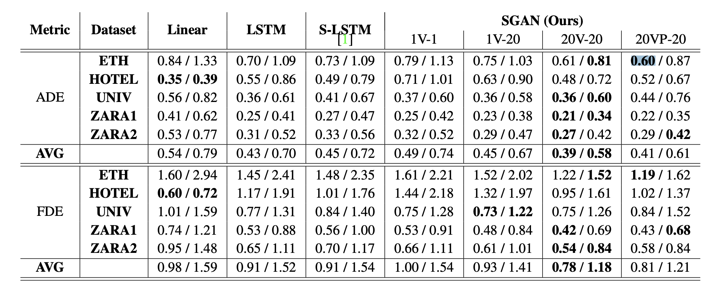
Typical paper organization
Introduction
Related work
The method
The experiments
Discussion/conclusion
❌ DO NOT do this:
1) Spend all your time generating
Giant Complicated Results Table
2) In the last minutes before the deadline,
throw in some miscellaneous remarks
about Giant Complicated Results Table
Source

Slide 23
Typical paper organization
✅ Instead:
Logically arrange your tables and figures and use the text to guide the reader through them
Your narrative should pose experimental questions that are likely to occur to the reader and then answer them.
Make figure and table captions as self-contained as possible – don’t make the reader hunt in the text for crucial explanations.
Discuss any unfavorable or confusing findings honestly. Do not attempt to sweep them under the rug.
Introduction
Related work
The method
The experiments
Discussion/conclusion

Slide 24
Typical paper organization
✅ Instead:
Logically arrange your tables and figures and use the text to guide the reader through them
Your narrative should pose experimental questions that are likely to occur to the reader and then answer them
Make figure and table captions as self-contained as possible – don’t make the reader hunt in the text for crucial explanations
Discuss any unfavorable or confusing findings honestly. Do not attempt to sweep them under the rug
Introduction
Related work
The method
The experiments
Discussion/conclusion

Slide 25
Typical paper organization
Introduction
Related work
The method
The experiments
Discussion/conclusion
Tbh it’s usually kind of an afterthought
Could end with a brief summary of contributions and/or discussion of future directions
My favorite use of this section: discuss limitations and show failure examples

Slide 26
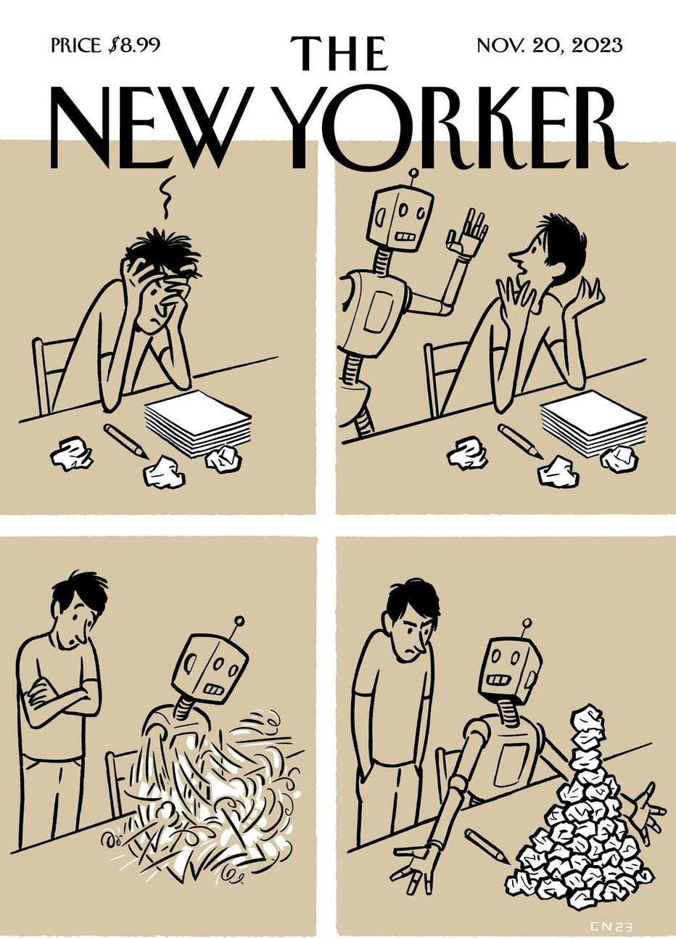
Use of AI in writing
Art by C. Niemann

Slide 27
How to communicate your research: Overview
A “unified theory” of communication
How to write papers
How to give presentations

Slide 28
How to give presentations
Your audience
You
Presentation situation
Step 1: think about your goals, the presentation situation,
and your audience

Slide 29
How to give presentations
Your audience
You
Presentation situation
Your goals:
To advertise your work,
to demonstrate your knowledge, to get a job, etc.
Type of presentation:
Short (2-5min)
Medium (20-30min)
Long (50-90min)
Audience goals:
To learn something, to find methods useful in their research, to evaluate your knowledge, to hire people, etc.
Venue:
Conference room
Seminar room
Giant conference hall
Audience state of knowledge:
What is the mixture of specialists and non-specialists?
Audience state of mind:
Probably tired, distracted, preoccupied with their own affairs

Slide 30
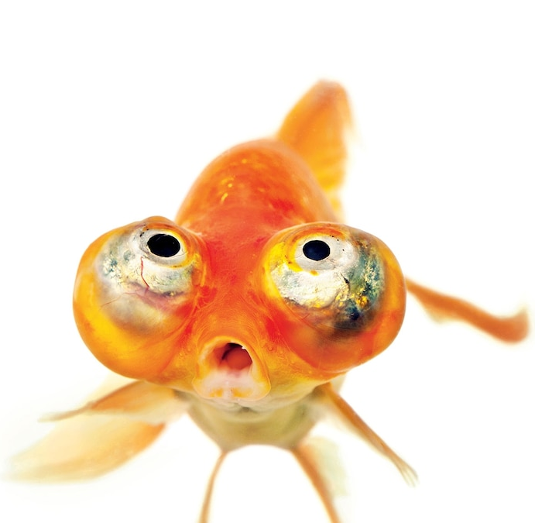
Flow and organization
Introduction: grab the attention of the audience.
You have a couple of minutes before they go back to their emails!
  Vividly motivate the problem you’re trying to solve
  Give the audience adequate context to understand your problem
  and get them to care
  Let them know what to expect in the rest of the talk

Slide 31
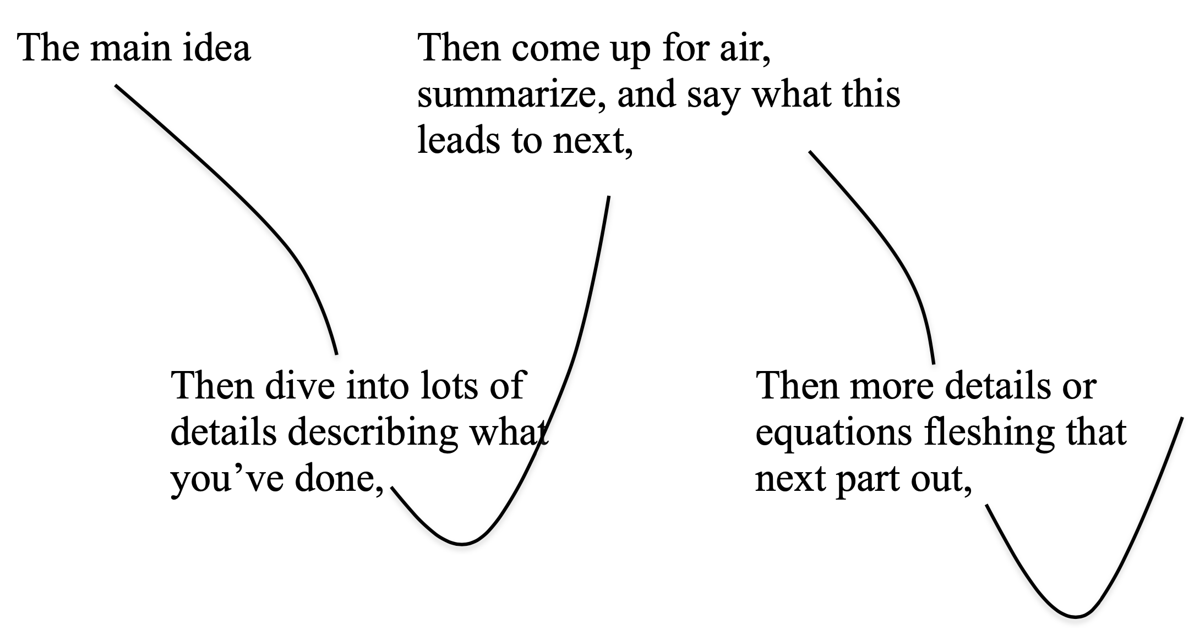
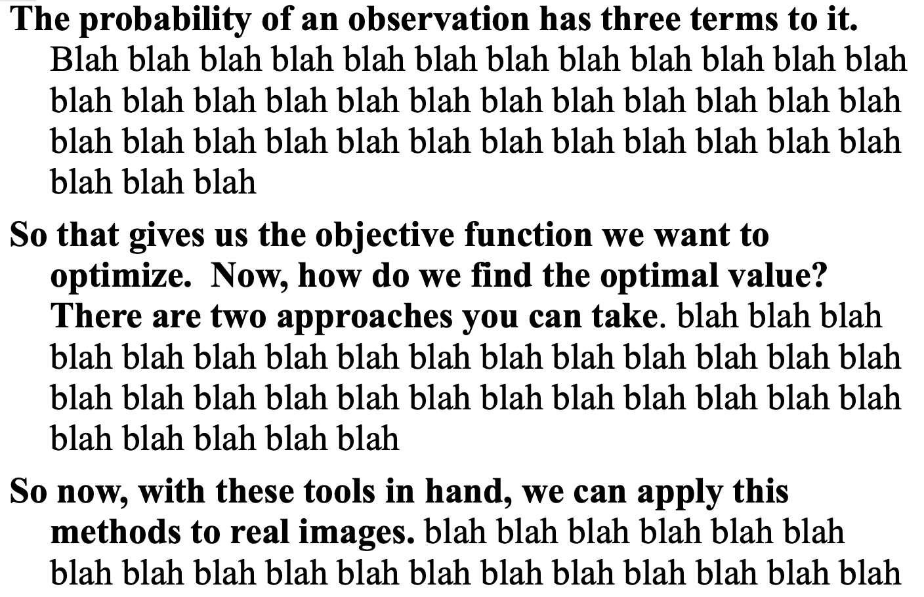
Flow and organization
Introduction: grab the attention of the audience.
You have a couple of minutes before they go back to their emails!
Signposts: In a paper, headings and sections help the reader follow the organization. Try to provide equivalent signposts with your language and your slide titles
Adapted from Bill Freeman

Slide 32
Flow and organization
Introduction: grab the attention of the audience.
You have a couple of minutes before they go back to their emails!
Signposts: In a paper, headings and sections help the reader follow the organization. Try to provide equivalent signposts with your language and your slide titles
Transitions: Make sure each part motivates the next. Explicitly point out the connections during the talk
Tell a story with mystery and suspense

Slide 33
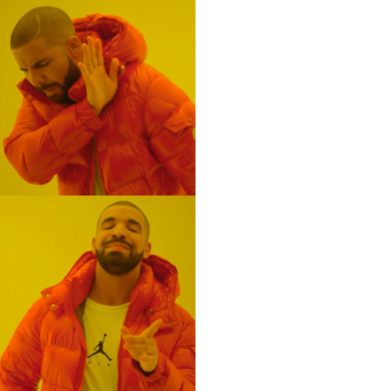
And Then
But / Therefore
  ❌ We do X.
  Then we do Y.
  Then we do Z.
  ✅ We do X.
  But then we have a problem… Therefore we do Y.
  But then we have another problem… Therefore we do Z.
Adapted from Jia-Bin Huang
Notes:
But how do we make sure our story flows?
Here’s a simple trick I always use: replace And Then with But or Therefore.

Slide 34
Flow and organization
Introduction: grab the attention of the audience.
You have a couple of minutes before they go back to their emails!
Signposts: In a paper, headings and sections help the reader follow the organization. Try to provide equivalent signposts with your language and your slide titles
Transitions: Make sure each part motivates the next and point out the connections during the talk
Tell a story with mystery and suspense
Engage the audience: ask the audience questions, don’t be afraid to show your excitement and your personality. If you’re really brave, consider adding humor

Slide 35
How to end a talk
People often say “Are there any questions?” but then people don’t know whether to applaud or to raise their hand
If you say “Thank you,” then everyone knows that they’re supposed to applaud now. After that is over, then you can ask for questions
Adapted from Bill Freeman

Slide 36
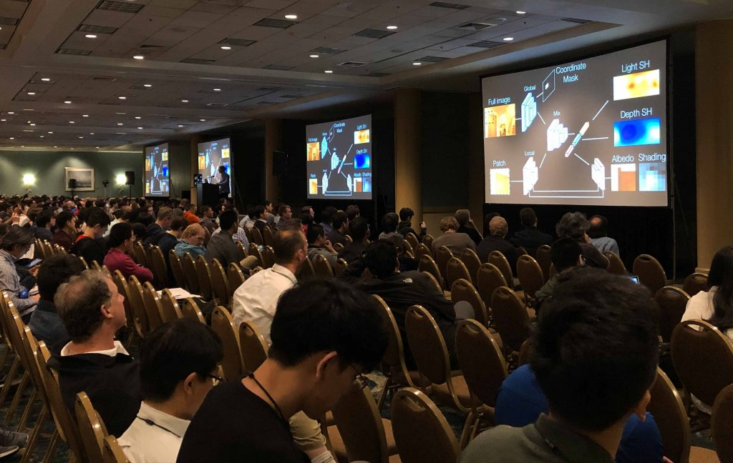
Tips on paper presentations
The following slides are adapted from “How to give a good talk at CVPR”
by CVPR 2025 Program Chairs

Slide 37
Your talk should NOT be your paper
presented in oral form!
Don’t try to squeeze all the information from your paper into your talk!

Slide 38
Have as little text as possible on your slides.
Otherwise, your audience won’t have time to read everything or will stop listening to read,
and you will lose them.

Slide 39
Be extra careful with formulas:
Understanding formulas is much more challenging in an oral presentation than when reading a paper.
Even for theoretical works, it is always possible to explain your key ideas and methods with a minimum of equations.

Slide 40
Be as clear as possible when you introduce a formula.
Compare:
The Pythagorean Theorem tells us:
a² + b² = c² ,
where a and b are the lengths of the sides of a right triangle and c the length of its hypotenuse.
and
(side #1)² + (side #2)² = hypotenuse²
The first version is adapted to a paper,
the second one is less rigorous but works much better for an oral presentation.
[Pythagorean theorem]

Slide 41
Don’t try to impress your audience with
complex formulas.
Impress your audience with a clear talk!

Slide 42


Make all graphics as legible as possible.
Compare:
and
v
v

Slide 43
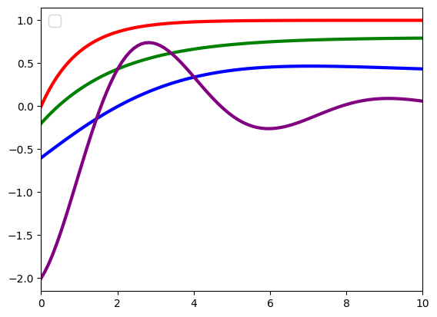
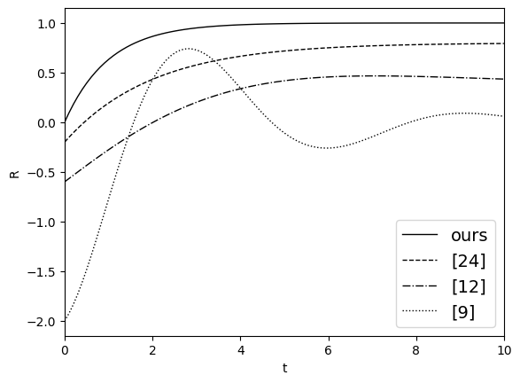
Same applies to graphs.
Compare:
and
Reward
Our method
CorNet
LuNet
GaliNet
time

Slide 44
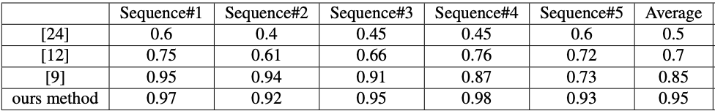
Don’t show tables, use bar plots.
Compare:
and
1
0.5
Avg. accuracy
0
GaliNet
LuNet
CorNet
our method

Slide 45
DO NOT, under any circumstances,
paste the Giant Complicated Table from your paper into your slides!
(c)
(a)
(b)

Slide 46

For a conference presentation, don’t put anything critical at the bottom
of the screen!

Slide 47
Rehearse your presentation as many times as possible:
in front of your advisor,
but as importantly, in front of people who don’t know your work.
Ask them for feedback,
fix your presentation accordingly,
and repeat.

