Slide 1
CS 591 PHD Seminar
Beginning the journey toward earning a PhD

Slide 2
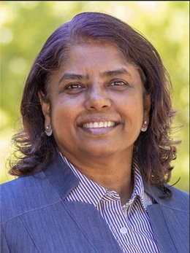
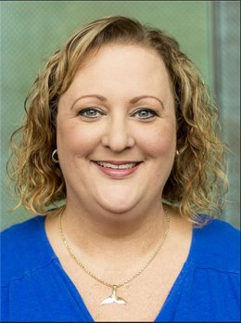
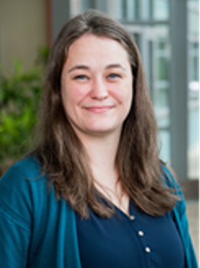
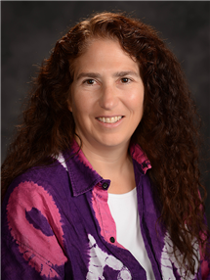
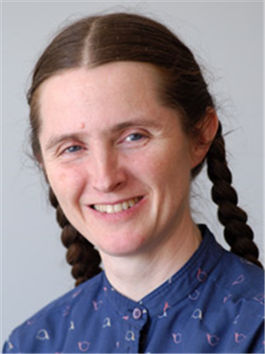
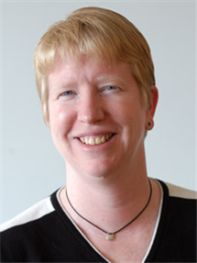
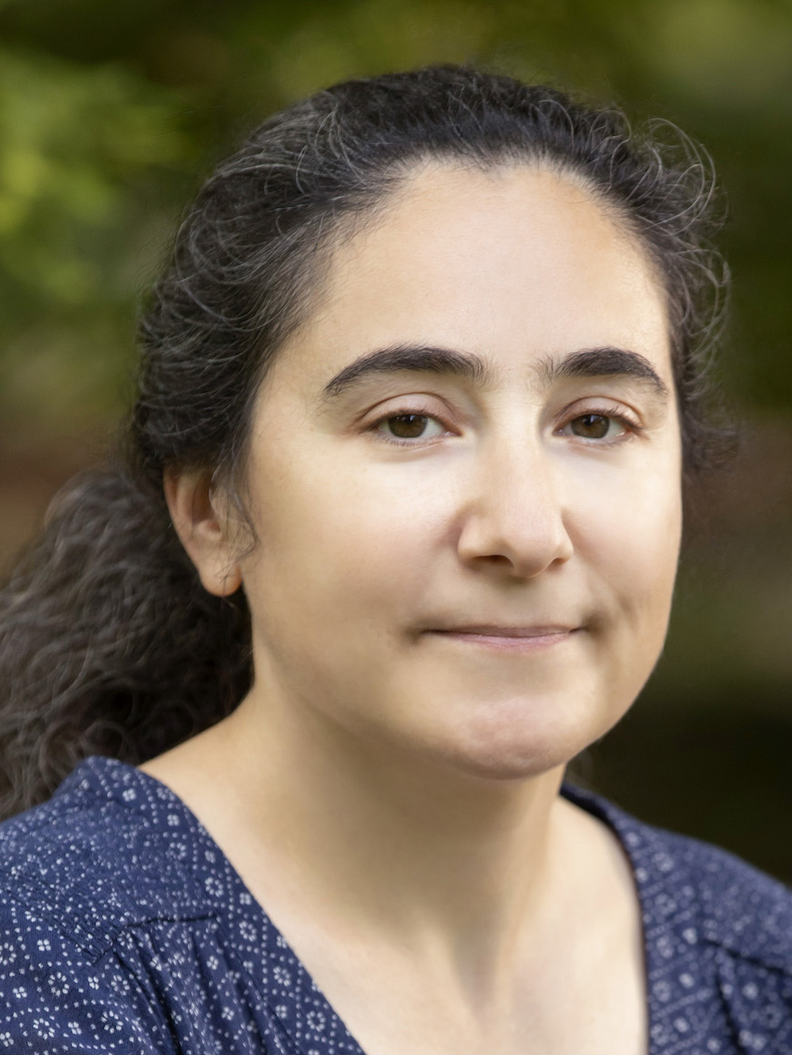
CS Graduate Office
Viveka Kudaligama Senior Assistant DGS
Kara McGregor Grad Program Coordinator
Jennifer Comstock Grad Advisor - PhD
Nancy Amato Head of CS
Elsa Gunter Assoc Head of CS
Robin Kravets Dir. Grad Studies
Svetlana Lazebnik Associate DGS
Notes:
Viveka makes the entire program run smoothly. She coordinates admissions, orientation events, annual evaluations, and advising
Kara will advise students on course requirements. She also does the TA assignments.
Maggie facilitates communications between students and staff, and helps with many of the orientation and other department events

Slide 3
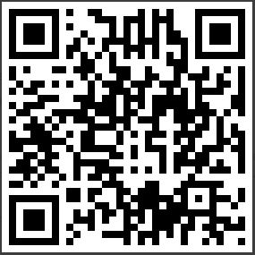
Virtual Queue for Walk-in Advising
Online graduate advising hours
Monday, Wednesday: 10:00-11:30 AM & 1:00-4:00 PM CST
Tuesday: 10:00-11:30 AM & 1:00-4:00 PM CST
Thursday: 10:00-11:30 AM & 2:00-4:00 PM CST
Friday 10:00 - 11:30 AM CST
https://queue.illinois.edu/q/cs-grad-advising/

Slide 4
Meet with the DGS
Office hours
Wednesday 3:00pm
In 1218 B Siebel Center
(West end of in south hallway)
Coffee hour
Wednesday 4:00pm
In 1218 B Siebel Center
(West end of in south hallway)

Slide 5
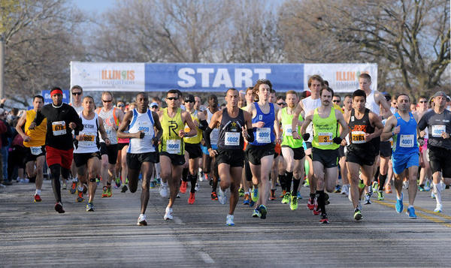
The path to a PhD is like a marathon.
Notes:
All of you start at the same time, but will proceed at a pace that works for you.
There will be periods when you are performing well, and periods when you struggle.
And what matters most is that you finish.
The purpose of the CS graduate office is to keep you on pace, and maybe to cheer you on when you need it

Slide 6
Some of the Challenges
Transition from consuming to producing knowledge
Develop professional communication skills
Manage time and stress
Deal with rejections
Develop people skills
Notes:
That investment also comes with challenges. It requires more then putting in the work.

Slide 7
You are investing BIG in your career
Image from: http://nursinglink.monster.com/nfs/nursinglink/attachment_images/0017/5576/PhD_crop380w.jpg?1299173897
Notes:
We are all here because each of you would like to earn a PhD. I admire you because this is a big investment in your career. Most of you will spend 5 to 7 years working toward your degree, and these years come during a precious time in your life. Many of your friends will get married, grow in their professional career; all while you are pursuing a doctoral degree.

Slide 8
A PhD is worth the investment
Achievement (only about 2% of U.S. population has a PhD)
Knowledge and discovery
New career pathways
Entrepreneurship
Notes:
Earning the degree is worth the investment

Slide 9
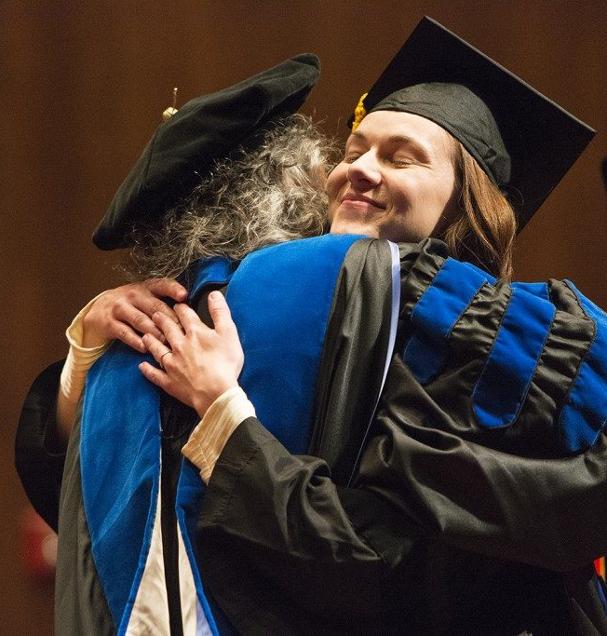
Image: https://finishyourthesis.com/worth-getting-your-phd-degree/
Notes:
After its all done, you will deserve a hug!

Slide 10
Learning and Other Goals
How to be a successful graduate student and researcher
Develop professional skills needed for research
Campus resources for research
Program requirements and strategies
Build student and faculty community
Get exposure to all of the areas in the department
Notes:
How to be a successful student (career paths and expectations, communication skills, ethics, etc.)
Skills (speaking, writing, people skills), need money (grant writing skills)

Slide 11
PhD Timeline
Desired
Required
Internship
Internship
Seek jobs
Write paper
Write paper
Write paper
Write paper
Write paper
Find advisor + topic
Qual exam (1st)
Qual exam (2nd)
Prelim exam
Write dissertation
Defend
Satisfy course requirements
FY1
SY1
FY2
SY2
FY3
SY3
FY4
SY4
FY5
SY5
FY6
SY6

Slide 12
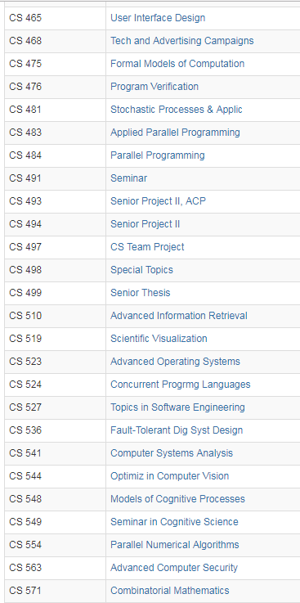
Plan coursework (many options per semester)
Notes:
About 70 courses each semester. There is something for everybody. You can choose the curriculum path you want and we will help you do that through the program of study process. We will have some sessions to talk about program requirements and get the program of study completed.

Slide 13
Find an Advisor
Standout in a course of interest
Attend seminars and research group meetings
Perform independent study
Schedule meetings with potential advisors

Slide 14
Find a Thesis Topic
Discuss ideas with your advisor and peers
Learn about peer research projects
Attend seminars
Perform independent study
Extend course projects
Read papers

Slide 15
University research
Industry research
Careers
University teaching
Entrepreneurship
Notes:
I don’t anticipate anyone graduating before the end of the semester.

Slide 16
First Year Schedule and Funding
Department RA
Minimum of 4 hours of CS 597 for Fall and Spring semester
Can be with the same or different faculty
Use these independent study hours to find an advisor
Minimum 12 credit hours for Fall and Spring semester
Recommended: 1 or 2 “true” course plus 4 or 8 hours of CS 597

Slide 17
First Year Travel/Equipment Budget
Department Grant
$2500
Meant for research travel or research equipment
Meant to replace any support from RA funding sources
Using it
Must go through your assigned admin (coming soon)
Subject to all university restrictions
Any equipment purchase is the property of the department
Not for use for personal property or travel
Must be used in your first year, by June 30, 2025. Deadline to submit requests is May 31, 2025.

Slide 18
By the end of the semester
Familiarize your self with required coursework for the PhD program
Pick a primary area (plus potential secondary areas)
Make new friends!

Slide 19
Expectations of Conduct
We are committed to the creation of an anti-racist, inclusive community that welcomes diversity along a number of dimensions, including, but not limited to, race, ethnicity and national origins, gender and gender identity, sexuality, disability status, class, and religion.
We support a safe and encouraging learning and work environment that allows all students, staff and faculty equitable opportunities and respect.
We expect professional and respectful interaction and communication from all students, staff, and faculty.

Slide 20
Student Employment (Non-Fellowship)
If you’re a new employee at the university
You need to update work authorization (I-9 employment form or a W-8BEN form)
You have paycheck or tuition waiver questions
You have any employment related questions
Please contact CS HR at cs-hr@cs.illinois.edu

Slide 21
Organization
Meet on Mondays, 11:00-11:50 AM
Schedule posted on the web site (https://courses.engr.illinois.edu/cs591phd/fa2024/)
Lecture and discussion format
Must receive a Satisfactory (“S”) grade
receive credit for all assignments
have at most one unexcused absence, one excused absence
Notes:
All put together by thinking about what you need to be successful

Slide 22
By Next Time
1. Introduce yourself on slack
2. Skim the Graduate College Handbook http://www.grad.illinois.edu/gradhandbook
3. Come to class with questions

Slide 23
Assignment Policy
The seminar has several assignments. You must receive credit for all assignments to pass (receive “S” grade) the seminar.

Slide 24
Attendance Policy
We will be taking attendance in class (and monitoring attendance on zoom for approved students only)
Can have at most one unexcused absences and one excused absences.
Excused absences include personal illness and university travel
Notify the course staff before the absence (for travel) or as soon as possible (for illnesses)

Slide 25
Online Resources
CS Grad Program: http://cs.illinois.edu/current-students/graduate-students
My.CS portal: http://my.cs.illinois.edu
Grad College Website: http://www.grad.illinois.edu
Grad Handbook: http://www.grad.illinois.edu/gradhandbook

