Slide 1
Invariants and Abstract Interpretation
CS521 Fall 2022
Trustworthy AI Systems

Slide 2
Abstract Interpretation

Slide 3
Programs
Configurations:
Fix a finite set of variables $\overline{x}$ = $\{x_{1},…, x_{n}\}$ ranging over certain domains $\overline{D}=\{ D_{1}, …, D_{n}\}$
Configuration: valuation of variables over the domains
Note: pc, or “program counter” can also be a variable
Concrete semantics of statements s:
$s^{c}:Conf →Conf$
Takes any configuration to the next configuration
E.g., s:``x := x+1’’ has the semantics as the map $s^{c}$that maps $\text{conf}$ to $\text{c}\text{onf}\text{'}$ where $\text{con}f^{′}\text{(}\text{x}\text{)= }\text{conf}\text{(}\text{x}\text{) + 1; }\text{conf}\text{ ′(}\text{y}\text{) = }\text{conf}\text{(}\text{y}\text{) }\text{for} \text{every} y ≠x$

Slide 4
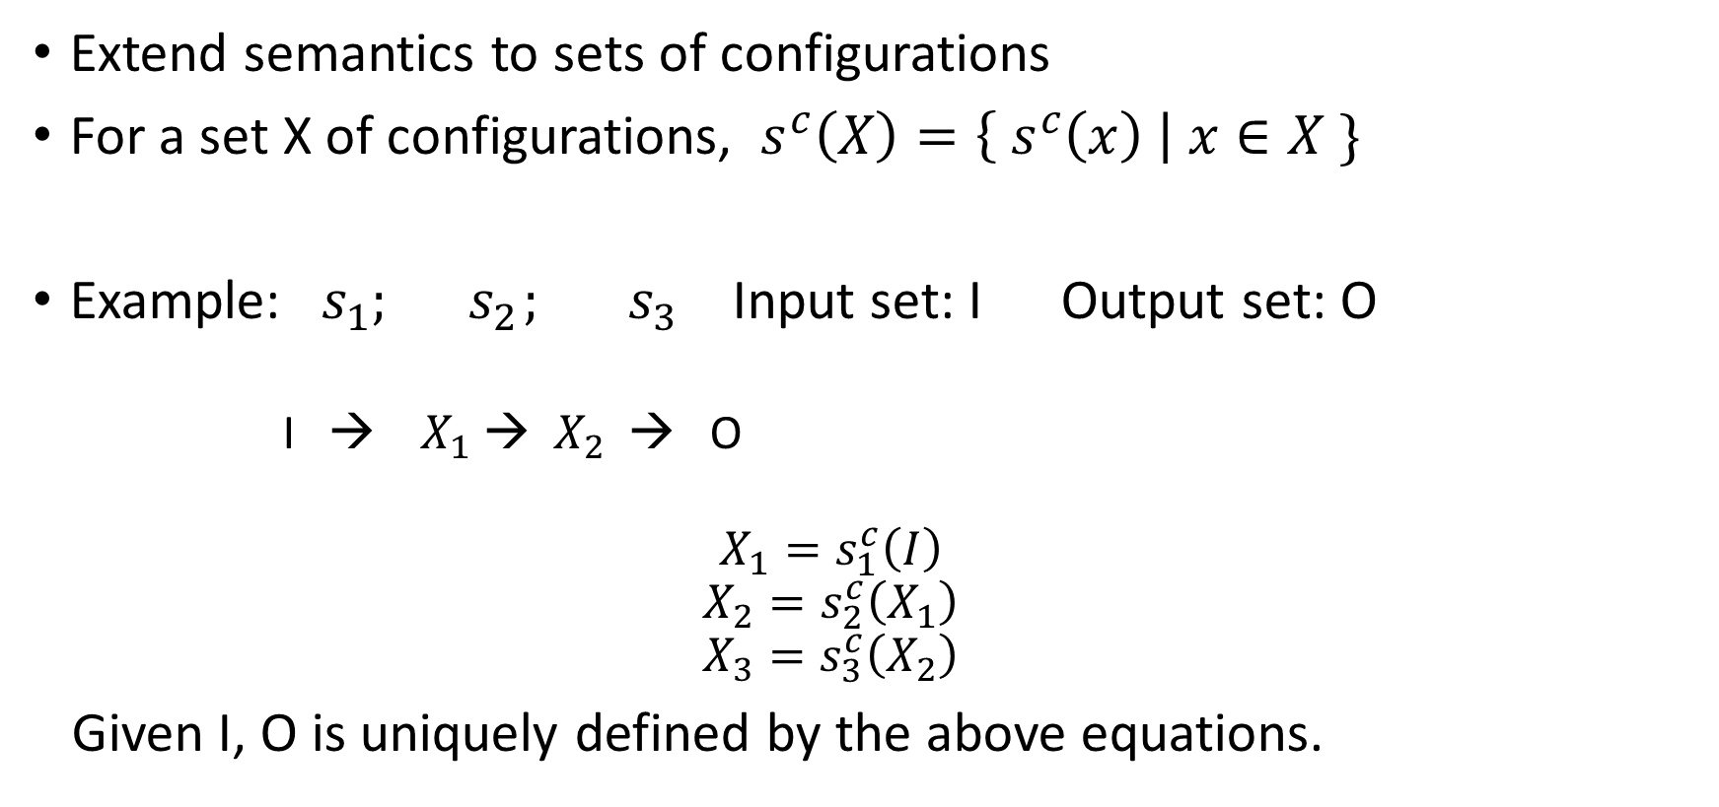
Set semantics
Extend semantics to sets of configurations
For a set X of configurations, $s^{c}\left(X\right)=\left\{ s^{c}\left(x\right) \right| x∈X \}$
Example: $s_{1};{ s}_{2};{ s}_{3}$ Input set: I Output set: O
I → $X_{1}$ → $X_{2}$ → O
$$X_{1}=s_{1}^{c}\left(I\right)$$
$$X_{2}=s_{2}^{c}\left(X_{1}\right)$$
$$X_{3}=s_{3}^{c}\left(X_{2}\right)$$
Given I, O is uniquely defined by the above equations.

Slide 5
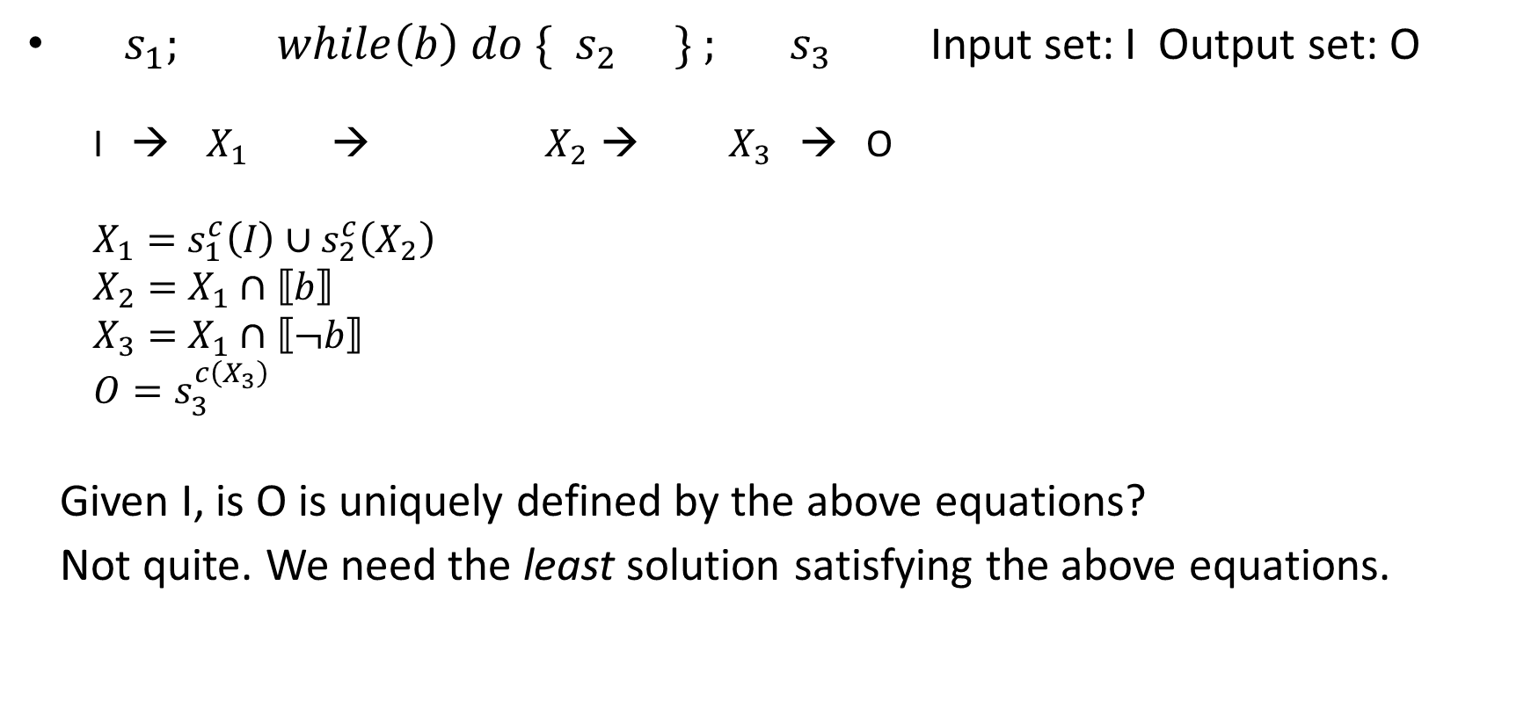
Set semantics for programs with loops
${ s}_{1};{ while\left(b\right) do \{ s}_{2} \} ;{ s}_{3}$ Input set: I Output set: O
I → $X_{1}$ → $X_{2 }$→ ${ X}_{3}$ → O
$X_{1}=s_{1}^{c}\left(I\right)∪s_{2}^{c}\left(X_{2}\right)$
$X_{2}=X_{1}∩⟦b⟧$
$X_{3}=X_{1}∩⟦¬b⟧$
$O=s_{3}^{c\left(X_{3}\right)}$
Given I, is O is uniquely defined by the above equations?
Not quite. We need the least solution satisfying the above equations.

Slide 6
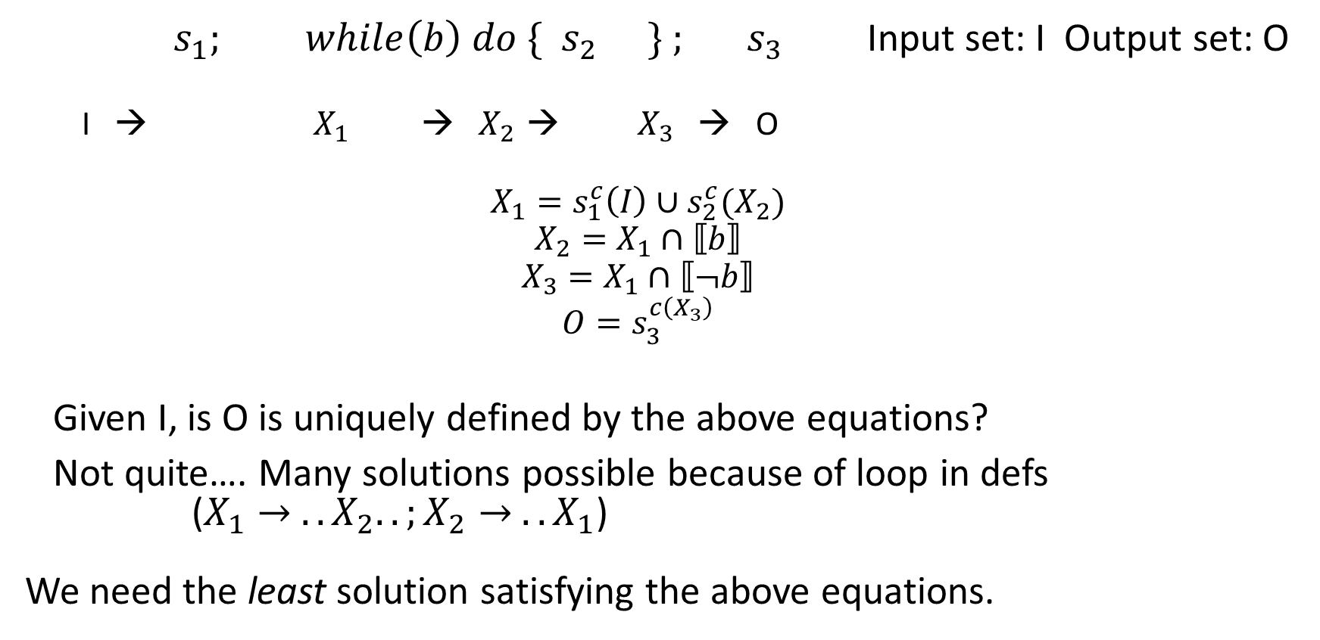
Set semantics for programs with loops
$s_{1};{ while\left(b\right) do \{ s}_{2} \} ;{ s}_{3}$ Input set: I Output set: O
I → $X_{1}$ → $X_{2 }$→ ${ X}_{3}$ → O
$$X_{1}=s_{1}^{c}\left(I\right)∪s_{2}^{c}(X_{2})$$
$$X_{2}=X_{1}∩⟦b⟧$$
$$X_{3}=X_{1}∩⟦¬b⟧$$
$$O=s_{3}^{c\left(X_{3}\right)}$$
Given I, is O is uniquely defined by the above equations?
Not quite…. Many solutions possible because of loop in defs ($X_{1}→ .. X_{2}..;X_{2}→ .. X_{1}$) We need the least solution satisfying the above equations.

Slide 7
Monotonic functions
Let $\left(T, ≤\right) be a set with a partial order$
$f:T →T is monotonic if$
For every $x,y∈T, if x≤y then f\left(x\right)≤f(y)$
“f takes larger values to larger values”
Are the functions applied in the concrete semantics monotonic?
(wrt to $\left(Sets of Confs, ⊆\right))$

Slide 8
Monotonic functions
Definition of monotonic functions does not say:
$f\left(x\right)≥x \text{for} \text{every} x∈X$
Functions need not map elements to larger elements.
E.g., Is $f\left(U\right)=U∖\left\{ n \right| n is even\}$monotonic? (over sets with $⊆)$
E.g., Is $f\left(U\right)=complement of U monotonic?$
E.g., Let $f$ be defined ``point-wise’’:
$f\left(U\right)=\bigcup_{x∈U}{g(u)}$
Is $f$ always monotonic?

Slide 9
General form for semantics
$X_{1} =f_{1}\left(\overline{X}\right)$
$X_{2} =f_{2}\left(\overline{X}\right)$
… where each $f_{i}$ is monotonic
$X_{n} =f_{n}\left(\overline{X}\right)$
In programs without loops, there are no interdependent definitions.
In programs with loops, there are interdependent definitions.

Slide 10
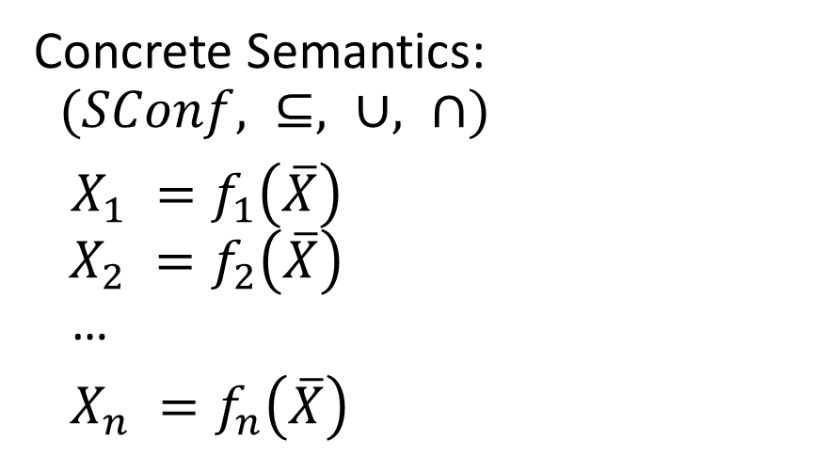
Abstract Interpretation
Concrete Semantics: $(SConf, ⊆, ∪, ∩)$
$X_{1} =f_{1}\left(\overline{X}\right)$ $X_{2} =f_{2}\left(\overline{X}\right)$ …
$X_{n} =f_{n}\left(\overline{X}\right)$
Imagine that I just swapped the domain! $$\left(Conf, ⊆, ∪, ∩\right) → (D, ⊑, ⊔, ⊓)$$
D is some set with a partial order $⊑$, least upper bound $⊔,$ greatest lower bound $⊓.$
But of course the f’s must change.

Slide 11
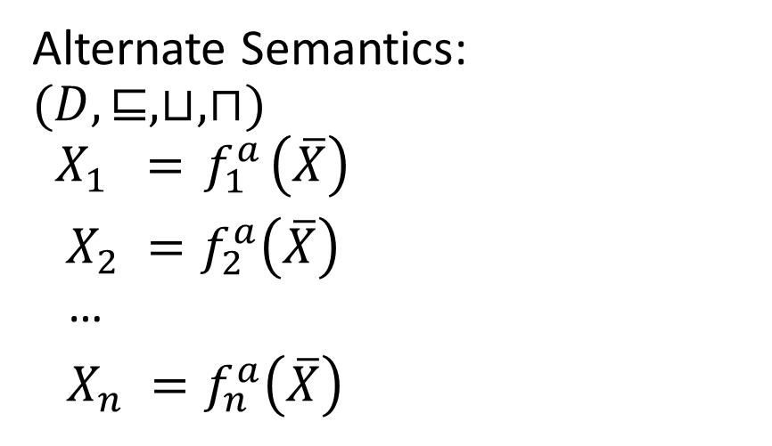
Abstract Interpretation
Concrete Semantics: $(SConf, ⊆, ∪, ∩)$
$X_{1} =f_{1}\left(\overline{X}\right)$ $X_{2} =f_{2}\left(\overline{X}\right)$ …
$X_{n} =f_{n}\left(\overline{X}\right)$
Alternate Semantics: $$(D, ⊑, ⊔, ⊓)$$
$$X_{1} ={ f}_{1}^{a}\left(\overline{X}\right)$$ $X_{2} =f_{2}^{a}\left(\overline{X}\right)$ …
$X_{n} =f_{n}^{a}\left(\overline{X}\right)$
Swap $\left(SConf, ⊆, ∪, ∩\right) → (D, ⊑, ⊔, ⊓)$
D is some set with a partial order $⊑$, lub $⊔,$ glb $⊓.$
$f_{i}^{a}:D →D$ are some monotonic functions

Slide 12
For programs with loops/eqns with loops
More structure is needed.
$$(D, ⊑, ⊔, ⊓)$$
Complete Lattice: Every subset S of D (including infinite subsets) has a least-upper-bound and a greatest lower bound.
Tarski-Knaster Theorem: If you have equations with monotonic functions on a complete lattice, then the lfp (and gfp) for them exist (and is unique of course).
Relaxation: we don’t need $⊓$, existence of greatest lower-bounds, etc. $⊔$ and existence of lub suffices.

Slide 13
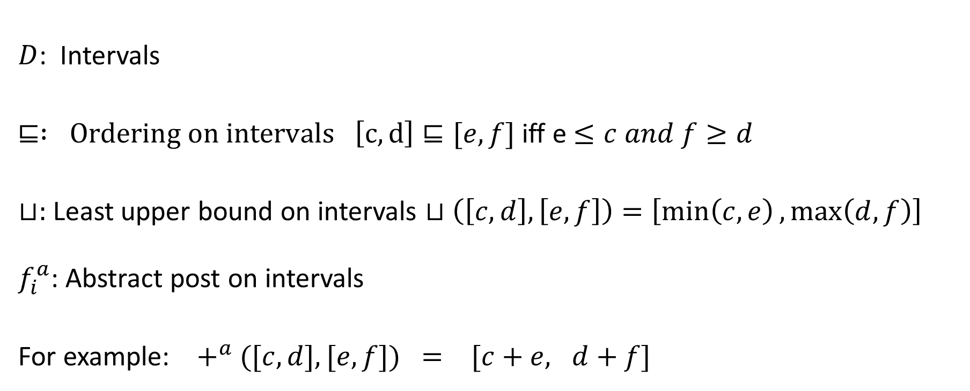
Box/Interval Domain
$D$: Intervals
$⊑ : Ordering on intervals \left[c,d\right]⊑[e,f]$ iff e $≤c and f≥d$
$⊔:$Least upper bound on intervals $⊔\left(\left[c, d\right], \left[e, f\right]\right)=\left[\min\left(c,e\right),\max\left(d, f\right)\right]$
$f_{i}^{a}$: Abstract post on intervals
For example: $+^{a}$ $([c,d], [e, f]) = [c+e, d+f]$

Slide 14
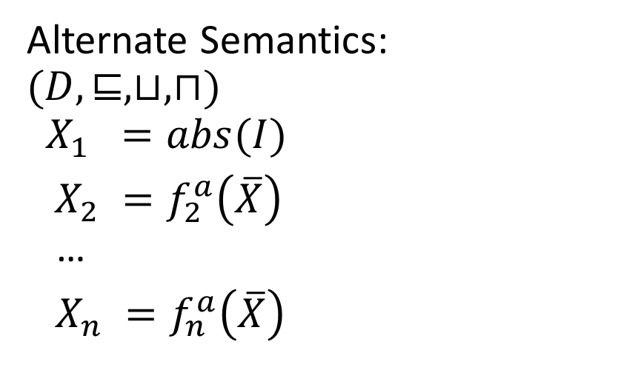
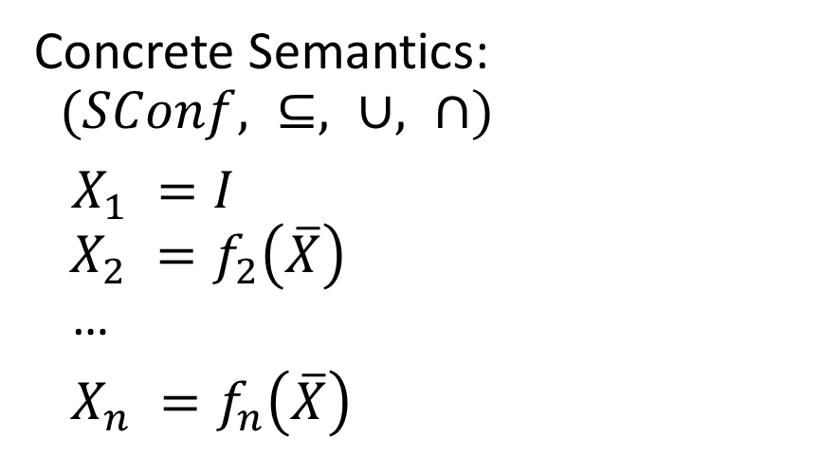
When is an alternate interpretation an abstraction?
Concrete Semantics: $(SConf, ⊆, ∪, ∩)$
$X_{1} =I$ $X_{2} =f_{2}\left(\overline{X}\right)$ …
$X_{n} =f_{n}\left(\overline{X}\right)$
Alternate Semantics: $$(D, ⊑, ⊔, ⊓)$$
$$X_{1} =abs(I)$$ $X_{2} =f_{2}^{a}\left(\overline{X}\right)$ …
$X_{n} =f_{n}^{a}\left(\overline{X}\right)$
Program is correct with concrete semantics if $X_{n}⊆O.$
Program is correct with alternate semantics if we start with $X_{1}=$abs(I) and find $X_{n}⊑abs(O)$.
Soundness: pgm correct with alt semantics => pgm correct with conc. Semantics
But surely we need to connect the domains in some way first!

Slide 15
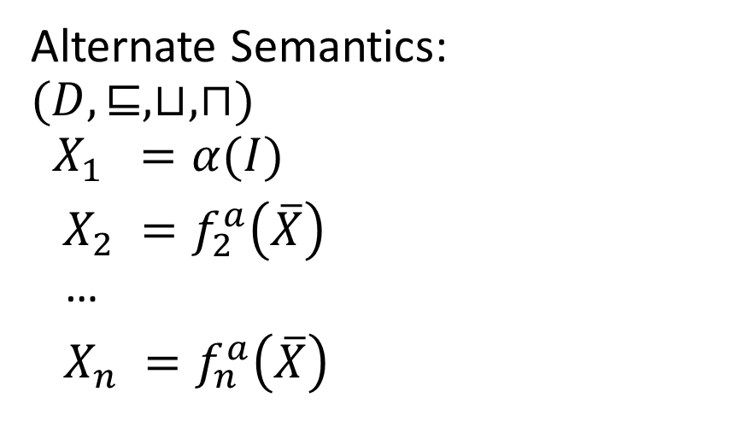

When is an alternate interpretation an abstraction?
Concrete Semantics: $(SConf, ⊆, ∪, ∩)$
$X_{1} =I$ $X_{2} =f_{2}\left(\overline{X}\right)$ …
$X_{n} =f_{n}\left(\overline{X}\right)$
Alternate Semantics: $$(D, ⊑, ⊔, ⊓)$$
$$X_{1} =α(I)$$ $X_{2} =f_{2}^{a}\left(\overline{X}\right)$ …
$X_{n} =f_{n}^{a}\left(\overline{X}\right)$
Introduce abstraction function $α: SConf →D$ and concretization function $γ: D →SConf$
Gives ``meaning’’ to the abstraction.

Slide 16

$α and γ$for Interval/Box
Example:
$α\left(R\right)=⟨x_{i}: \left[\min_{v∈R}{v(x_{i})},\max_{v∈R}{{v(x}_{i})}\right]>$
Maps R to smallest intervals that contain R
$γ\left( {⟨x}_{i}:\left[l_{x}, r_{x}\right]\right\rangle ) =\left\{ v \right| v(x_{i})∈\left[l_{x}, r_{x}\right], \text{for} \text{each} i\text{ \}}$

Slide 17
Overapproximation: requirement on domains
$$α$$
Galois connection:
$\left(SConf, ⊆, ∪, ∩\right)$ $(D, ⊑, ⊔, ⊓)$
$α and γ$are monotone If $X⊆Y, α\left(X\right)⊑α\left(Y\right);$
If $d⊑d^{′}, γ\left(d\right)⊆γ\left(d^{′}\right)$
$α\left(γ\left(d\right)\right)⊑d$ (in fact, this is usually =)
$γ\left(α\left(X\right)\right)⊇X$
Check these for box domain.
$$\overline{X}$$
$$\overline{X}$$
$$γ$$

Slide 18
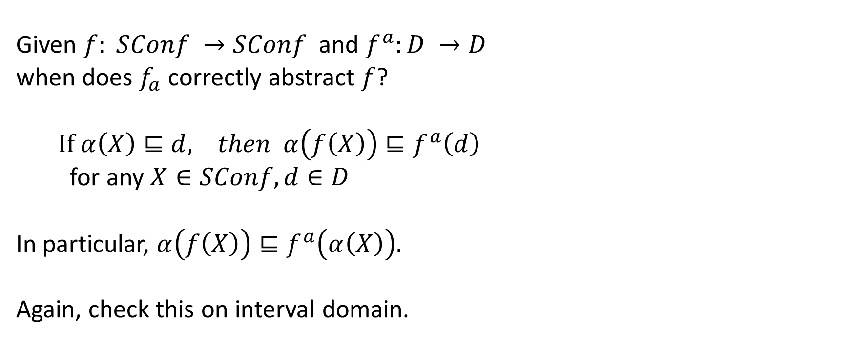
Overapproximation: requirement on abstract transfer functions
Given $f: SConf →SConf$ and $f^{a}:D →D$
when does $f_{a}$ correctly abstract $f$?
$If α\left(X\right)⊑d, then α\left(f\left(X\right)\right)⊑f^{a}\left(d\right)$
for any $X∈SConf, d∈D$
In particular, $α\left(f\left(X\right)\right)⊑f^{a}\left(α\left(X\right)\right).$
Again, check this on interval domain.

Slide 19
Soundness
If the conditions on the domain being related by Galois connection and the condition on the abstract transfer function hold, then the abstraction is correct.
If we prove in the abstract semantics, starting with $α\left(I\right)$ that $α\left(Bad\right)$is unreachable, then in the concrete system, starting with $I,$ $Bad$ is guaranteed to be unreachable.

Slide 20
Invariants, again
Concrete Semantics: $(SConf, ⊆, ∪, ∩)$
$X_{1} =I$ $X_{2} =f_{2}\left(\overline{X}\right)$ …
$X_{n} =f_{n}\left(\overline{X}\right)$
Alternate Semantics: $$(D, ⊑, ⊔, ⊓)$$
$$X_{1} =α(I)$$ $X_{2} =f_{2}^{a}\left(\overline{X}\right)$ …
$X_{n} =f_{n}^{a}\left(\overline{X}\right)$
Take a solution for $X_{1},…, X_{n}$over the abs domain $d_{1},…, d_{n}$ that proves $α\left(O\right)$ is unreachable.
Consider for the concrete domain, setting each $X_{i}=γ\left(d_{i}\right).$
Then for each i, $X_{i}⊇ f_i(\overline{X}$), and $X_{n}∩Bad$is empty.
Which in fact means this valuation is an invariant of the system! And the invariant proves that O is unreachable! PREFIXPOINT

Slide 21
Invariants, again
So abstract interpretations can compute invariants.
Typical pros of fixed abstractions:
Fast computation as the abstract post can be reasoned with using human ingenuity, mathematics, and optimized algorithmically in advance.
Typical cons of fixed abstractions: Stuck if abstraction doesn’t prove property
Many other techniques in program verification
Counterexample guided abstraction refinement (CEGAR)
Change the abstraction according to property; e.g., CEGAR for predicate abstraction in proving device drivers correct (SLAM/SDV@Microsoft)
But refinements and dynamic abstractions are expensive (need SMT solvers)
Conjunctive invariant learning (Houdini, Sorcar): Used in SLAM/SDV
Interpolation and IC3 (McMillan; Bradley)
ICE learning (M’s group)
Program/expression synthesis (SyGuS, CEGIS)
Trace abstraction using automata and SMT unsat cores (Podelski et al)

Slide 22
Salient points to remember
Abstract analysis is really evaluating a program with an alternate semantics over an alternate domain (think about interval domain)
Semantics is given by monotonic functions
$α$ and $γ$ maps are useful ways of formalizing the meaning of the abstraction, formally
Galois connections and the condition on abstract transfer function formally tell you what you have to prove to show soundness
Abstractions eventually compute invariants.
In practice, some of the requirements for abs int we have can be relaxed a bit.

