Slide 1
Perfectly Secure MPC
The BGW Protocol

Slide 2

Perfect Security
Formally:
Sim( ) is identical to Real( ) even for unbounded
Informally:
Is error free, i.e, correctness / privacy hold with probability 1
Uses no cryptography

Slide 3
Perfect Security
Formally:
Sim( ) is identical to Real( ) even for unbounded
Informally:
Is error free, i.e, correctness / privacy hold with probability 1
Uses no cryptography
Post Quantum
Secure!

Slide 4


Prior protocols
Linear GMW
GMW
GMW with a Trusted Beaver Triple Dealer?
OT uses cryptography
What if we don’t have such a dealer?

Slide 5
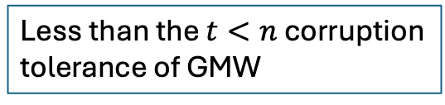

The BGW MPC protocol
Perfectly Secure
Semi-honest adversary
Works among multiple $n$ parties $P_{1},P_{2},…,P_{n}$
Tolerates $t<n/2$ corruptions
Less than the $t<n$ corruption
tolerance of GMW

Slide 6
















BGW Structure
$$x_{1}$$
$$x_{2}$$
$$x_{3}$$
$$x_{4}$$
Secret-share inputs
Evaluate an arithmetic circuit
Reconstruct output
$$\left[x_{1}\right]$$
$$\left[x_{2}\right]$$
$$\left[x_{3}\right]$$
$$\left[x_{4}\right]$$
Beaver
Triples
$$×$$
$$\left[x_{1}x_{2}\right]$$
$$×$$
$$\left[x_{1}x_{2}x_{3}\right]$$
$$+$$
Linear
$$y=x_{1}x_{2}x_{3}+x_{4}$$
Similar to GMW!
$$\left[y\right]$$
Reconstruction
$$y$$

Slide 7
BGW: Differences from GMW
Different Beaver Triple generation (without OT)
A different Secret Sharing scheme

Slide 8























Secret Sharing
$$D$$
$$P_{1}$$
$$P_{2}$$
$$…$$
$$P_{n}$$
$$s_{2}$$
$$s$$
$$s_{1}$$
$$s_{n}$$
Share
Reconstruct
$$s_{1}$$
$$s_{n}$$
$$s$$
$$s$$
$$s_{2}$$
$$s$$
$$P_{1}$$
$$P_{2}$$
$$…$$
$$P_{n}$$
$$P_{1}$$
$$P_{2}$$
$$…$$
$$P_{n}$$
Privacy: learns nothing about $s$
Correctness: Parties reconstruct $s$

Slide 9
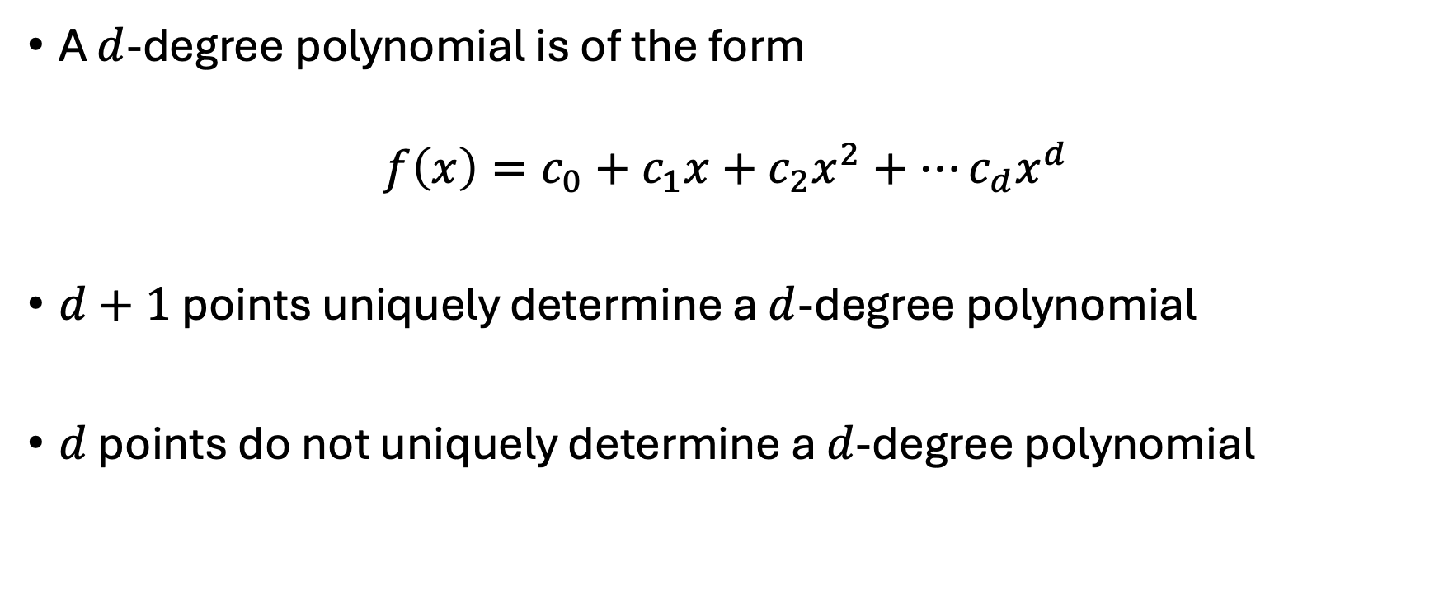
Properties of Polynomials
A $d$-degree polynomial is of the form
$$f\left(x\right)=c_{0}+c_{1}x+c_{2}x^{2}+…c_{d}x^{d}$$
$d+1$ points uniquely determine a $d$-degree polynomial
$d$ points do not uniquely determine a $d$-degree polynomial

Slide 10

Properties of Polynomials (Example)
A line is of the form
$f\left(x\right)=c_{0}+c_{1}x$

Slide 11

Properties of Polynomials (Example)
A line is of the form
$f\left(x\right)=c_{0}+c_{1}x$
$2$points uniquely determine a line.

Slide 12

Properties of Polynomials (Example)
A line is of the form
$f\left(x\right)=c_{0}+c_{1}x$
$2$points uniquely determine a line.
$1$ point does not uniquely determine a line

Slide 13
Properties of Polynomials
A $d$-degree polynomial is of the form
$$f\left(x\right)=c_{0}+c_{1}x+c_{2}x^{2}+…c_{d}x^{d}$$
$d+1$ points uniquely determine a $d$-degree polynomial
$d$ points do not uniquely determine a $d$-degree polynomial
Interpolation

Slide 14





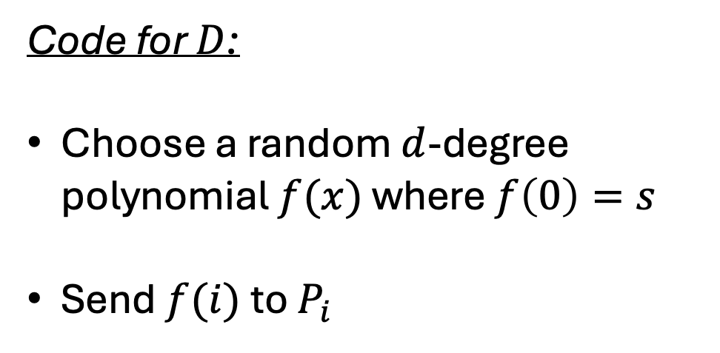




Shamir Secret Sharing
$$D$$
Code for $D$:
Choose a random $d$-degree polynomial $f(x)$ where $f\left(0\right)=s$
Send $f(i)$to $P_{i}$
$$s$$
Share
$$s_{1}$$
$$s_{n}$$
$$s_{2}$$
$$P_{1}$$
$$P_{2}$$
$$…$$
$$P_{n}$$

Slide 15






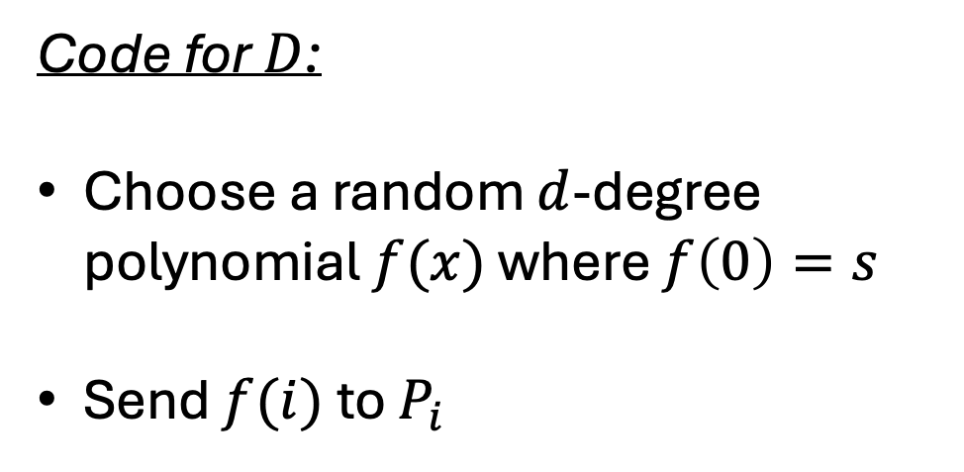









Shamir Secret Sharing
Code for $D$:
Choose a random $d$-degree polynomial $f(x)$ where $f\left(0\right)=s$
Send $f(i)$to $P_{i}$
$$(2,f(2))$$
$$(1,f(1))$$
$$(n,f(n))$$
$$(0,s)$$
$$1$$
$$2$$
$$…$$
$$n$$
$$(1,f(1))$$
$$(2,f(2))$$
$$(n,f(n))$$
$$P_{1}$$
$$P_{2}$$
$$…$$
$$P_{n}$$

Slide 16







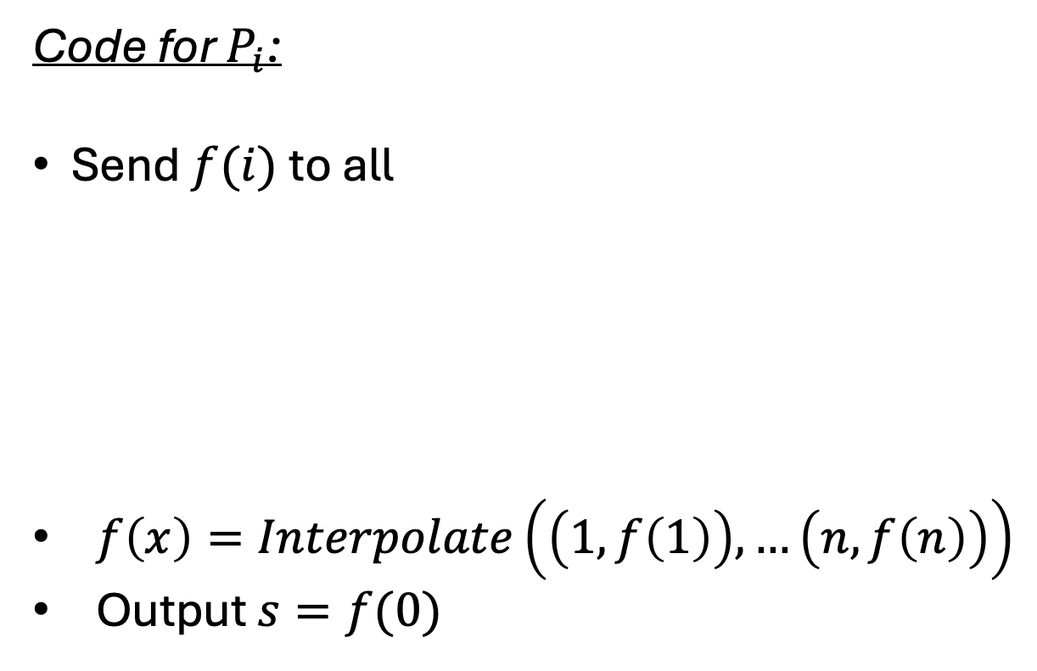













Shamir Secret Sharing
Code for $P_{i}$:
Send $f(i)$to all
$f\left(x\right)=Interpolate\left(\left(1,f\left(1\right)\right), …\left(n,f\left(n\right)\right)\right)$
Output $s=f(0)$
$$P_{1}$$
$$P_{2}$$
$$…$$
$$P_{n}$$
$$s_{2}$$
$$s_{n}$$
$$s_{1}$$
Reconstruct
$$P_{1}$$
$$P_{2}$$
$$…$$
$$P_{n}$$
$$s$$
$$s$$
$$s$$
$$f(1)$$
$$f(2)$$
$$f(n)$$
$$P_{1}$$
$$P_{2}$$
$$…$$
$$P_{n}$$

Slide 17

Shamir Secret Sharing (Analysis)
Suppose $t≤d<n$
Why is $s$ hidden during the Share phase?
How is $s$ correctly reconstructed?

Slide 18
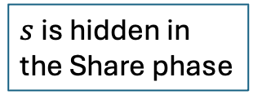

Properties of Polynomials
$$t≤d<n$$
A $d$-degree polynomial is of the form
$$f\left(x\right)=c_{0}+c_{1}x+c_{2}x^{2}+…c_{d}x^{d}$$
$d+1$ points uniquely determine a $d$-degree polynomial
$d$ points do not uniquely determine a $d$-degree polynomial
Correct
Reconstruction
$s$ is hidden in
the Share phase

Slide 19

Shamir Secret Sharing (Analysis)
Suppose $t≤d<n$
Why is $s$ hidden during the Share phase?
How is $s$ correctly reconstructed?
Why not $d<t$ or $d=n$?

Slide 20

Shamir Secret Sharing (Analysis)
Suppose $t≤d<n$
Why is $s$ hidden during the Share phase?
How is $s$ correctly reconstructed?
Why not $d<t$ or $d=n$?
Prevents correct
reconstruction
Cannot hide $s$

Slide 21

BGW Structure
$$x_{1}$$
$$x_{2}$$
$$x_{3}$$
$$x_{4}$$
Shamir secret-share inputs using
$t$-degree polynomials
Evaluate an arithmetic circuit
Reconstruct output
$$\left[x_{1}\right]$$
$$\left[x_{2}\right]$$
$$\left[x_{3}\right]$$
$$\left[x_{4}\right]$$
$$×$$
$$\left[x_{1}x_{2}\right]$$
$$×$$
$$\left[x_{1}x_{2}x_{3}\right]$$
$$+$$
$$y=x_{1}x_{2}x_{3}+x_{4}$$
$$\left[y\right]$$
Reconstruction
$$y$$

Slide 22

BGW: Linear gates
Shamir secret sharing is linear!
$[a+b] = [a] + [b]$
$\left[c × a\right]= c × \left[a\right]$ ($c$ is a constant)

Slide 23
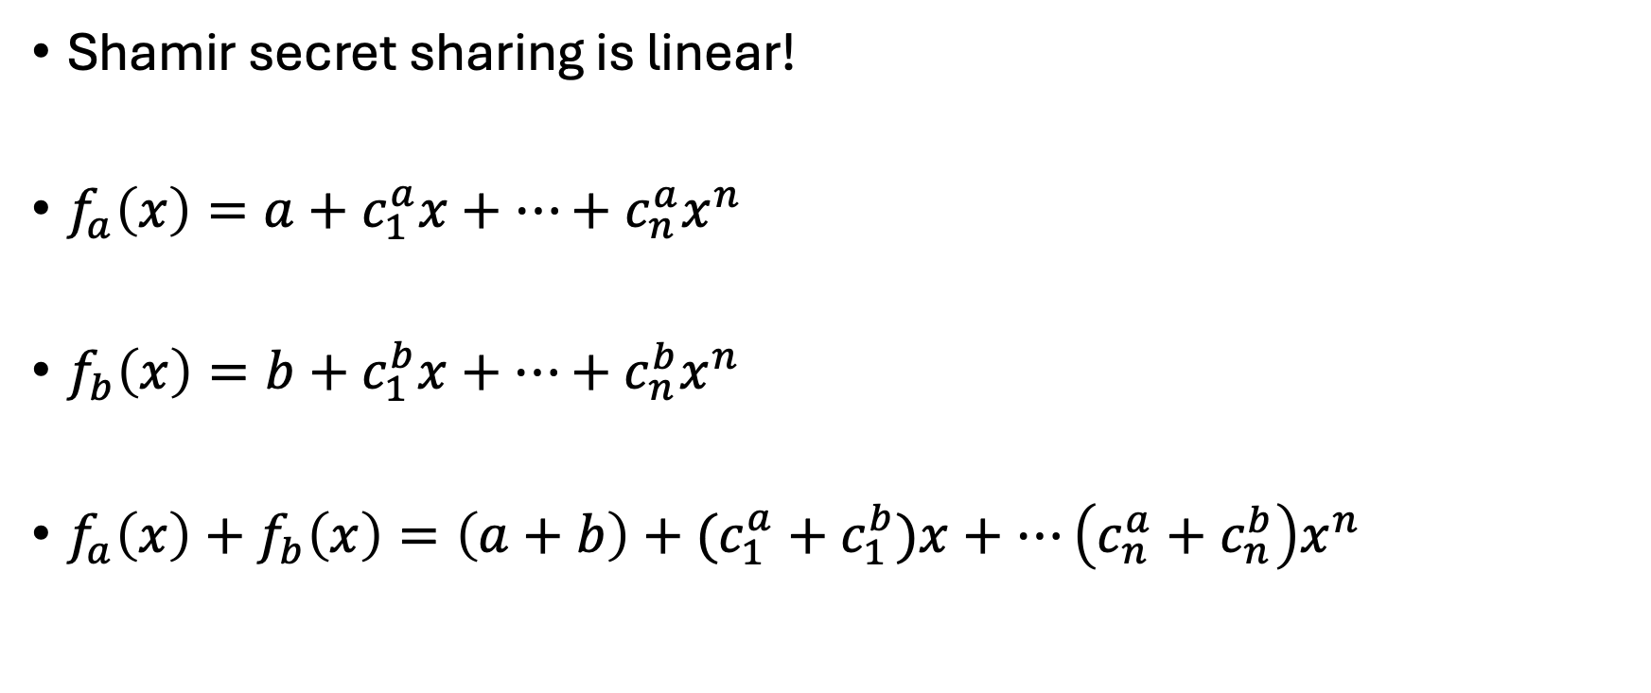
BGW: Linear gates
Shamir secret sharing is linear!
$f_{a}\left(x\right)=a+c_{1}^{a}x+…+c_{n}^{a}x^{n}$
$f_{b}\left(x\right)=b+c_{1}^{b}x+…+{c_{n}^{b}x}^{n}$
$f_{a}\left(x\right)+f_{b}\left(x\right)=\left(a+b\right)+(c_{1}^{a}+c_{1}^{b})x+…\left(c_{n}^{a}+c_{n}^{b}\right)x^{n}$

Slide 24
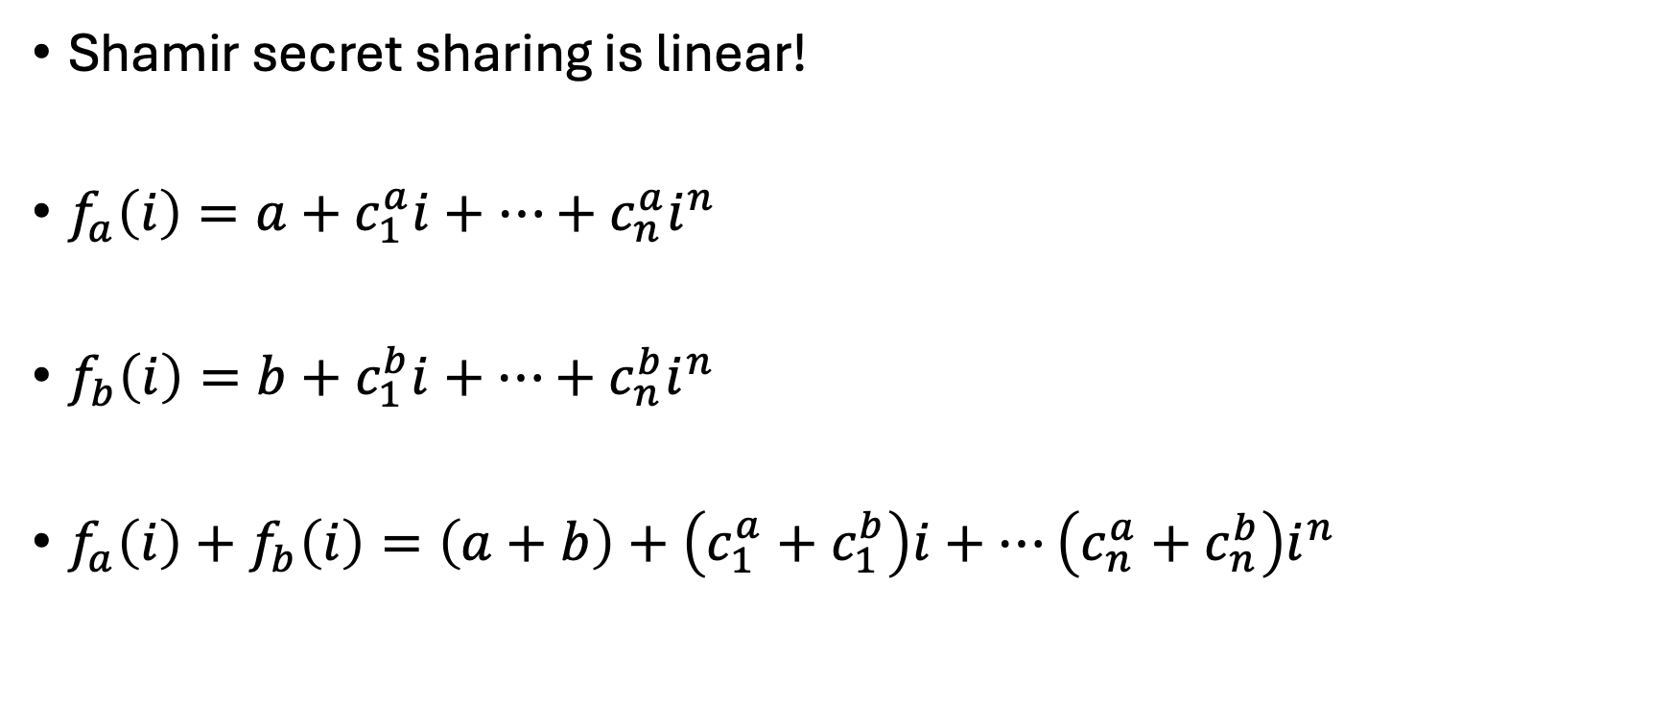
BGW: Linear gates
Shamir secret sharing is linear!
$f_{a}\left(i\right)=a+c_{1}^{a}i+…+c_{n}^{a}i^{n}$
$f_{b}\left(i\right)=b+c_{1}^{b}i+…+{c_{n}^{b}i}^{n}$
$f_{a}\left(i\right)+f_{b}\left(i\right)=\left(a+b\right)+\left(c_{1}^{a}+c_{1}^{b}\right)i+…\left(c_{n}^{a}+c_{n}^{b}\right)i^{n}$

Slide 25
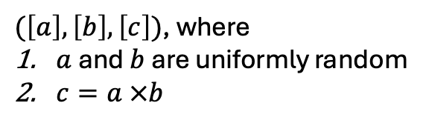
BGW: Beaver Triples
BeaverTriple
$(\left[a\right],\left[b\right],\left[c\right])$, where
$a$ and $b$ are uniformly random
$c=a ×b$

Slide 26


BGW: Random Share
Code for $P_{i}$
Sample uniformly random $r_{i}$
Shamir secret-share $[r_{i}]$
Output $\left[r\right]= \left[r_{1}\right]+… + [r_{n}]$
RandShare
$$[r]$$

Slide 27
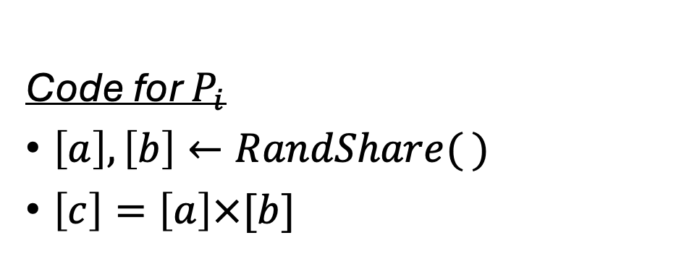
BGW: Beaver Triples
Code for $P_{i}$
$\left[a\right], \left[b\right]←RandShare( )$
$\left[c\right]=\left[a\right]×[b]$
BeaverTriple
Issues with this?
$(\left[a\right],\left[b\right],\left[c\right])$, where
$a$ and $b$ are uniformly random
$c=a ×b$

Slide 28
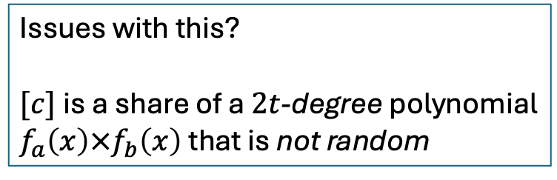
BGW: Beaver Triples
Code for $P_{i}$
$\left[a\right], \left[b\right]←RandShare( )$
$\left[c\right]=\left[a\right]×[b]$
BeaverTriple
Issues with this?
$[c]$is a share of a $2t$-degree polynomial
$f_{a}\left(x\right)×f_{b}\left(x\right)$ that is not random
$(\left[a\right],\left[b\right],\left[c\right])$, where
$a$ and $b$ are uniformly random
$c=a ×b$

Slide 29









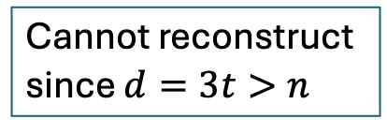

Issue with $2t$-degree sharing
$$x_{1}$$
$$x_{2}$$
$$x_{3}$$
$$x_{4}$$
$${\left[x_{1}\right]}_{t}$$
$${\left[x_{2}\right]}_{t}$$
$${\left[x_{3}\right]}_{t}$$
$${\left[x_{4}\right]}_{t}$$
$$×$$
$${\left[x_{1}x_{2}\right]}_{2t}$$
$$×$$
$${\left[x_{1}x_{2}x_{3}\right]}_{3t}$$
$$+$$
$$y=x_{1}x_{2}x_{3}+x_{4}$$
$${\left[y\right]}_{3t}$$
Reconstruction
Cannot reconstruct
since $d=3t>n$
$$y$$

Slide 30



BGW: Random Double shares
Code for $P_{i}$
Sample uniformly random $r_{i}$
Shamir secret-share ${\left[r_{i}\right]}_{t},{\left[r_{i}\right]}_{2t}$
Output
${\left[r\right]}_{t}= {\left[r_{1}\right]}_{t}+… + {\left[r_{n}\right]}_{t}$
${\left[r\right]}_{2t}= {\left[r_{1}\right]}_{2t}+… + {\left[r_{n}\right]}_{2t}$
RandDoubleShare
$$t≤2t<n$$
$${\left[r\right]}_{t},{\left[r\right]}_{2t}$$

Slide 31
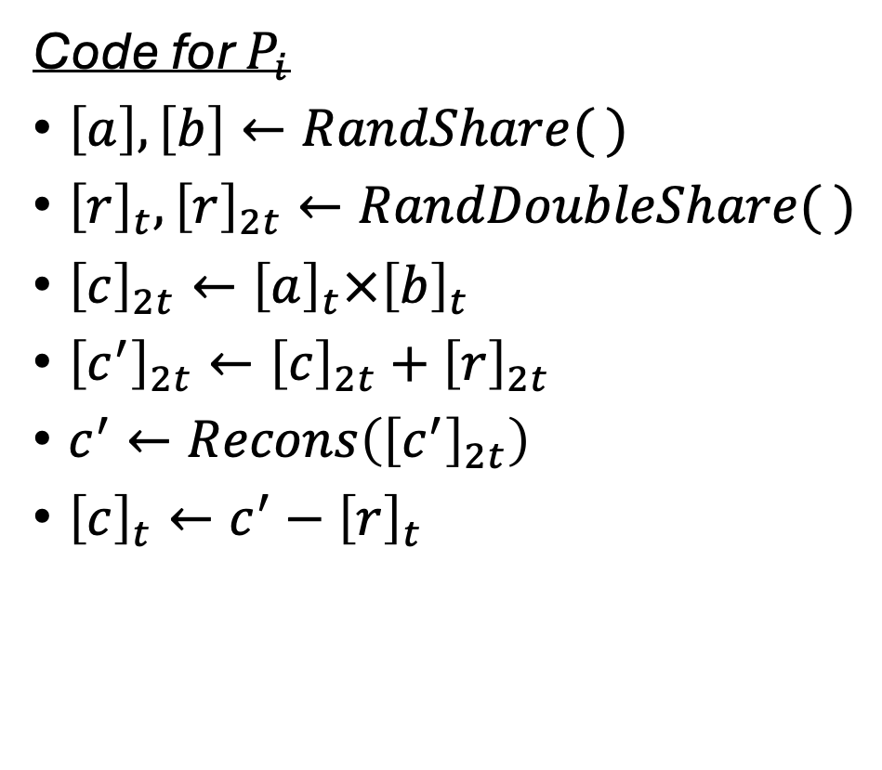
BGW: Beaver Triples (Degree Reduction)
Code for $P_{i}$
$\left[a\right], \left[b\right]←RandShare( )$
${\left[r\right]}_{t},{\left[r\right]}_{2t}←RandDoubleShare( )$
${\left[c\right]}_{2t}←{\left[a\right]}_{t}×{\left[b\right]}_{t}$
${\left[c^{′}\right]}_{2t}←{\left[c\right]}_{2t}+{\left[r\right]}_{2t}$
$c^{′}←Recons\left({\left[c^{′}\right]}_{2t}\right)$
${\left[c\right]}_{t}←c^{′}−{\left[r\right]}_{t}$
BeaverTriple
$(\left[a\right],\left[b\right],\left[c\right])$, where
$a$ and $b$ are uniformly random
$c=a ×b$

Slide 32

BGW: Beaver Triples
Why do we need $n>2t$ ?
To reconstruct a $2t$ degree polynomial

Slide 33
Next Time
BGW for malicious adversaries
Guaranteed output delivery (no abort)!

