Slide 1
MPC with Guaranteed Output Delivery (GOD)
extensions of BGW for malicious security

Slide 2



MPC with Abort
Tolerates $t<n$ corruptions
But even if one party deviates, parties can abort
Application crashes

Slide 3















MPC with Guaranteed Output Delivery (GOD)
Parties are guaranteed to learn the output
Tolerates $t<n/2$ corruptions
But less chance for application crash!
$$P_{1}$$
$$P_{2}$$
$$…$$
$$P_{n}$$
$$x_{2}$$
$$x_{1}$$
$$x_{n}$$
MPC with GOD
$$y=f(x_{1},…,x_{n})$$
$$y$$
$$y$$
$$y$$
$$P_{1}$$
$$P_{2}$$
$$…$$
$$P_{n}$$

Slide 4

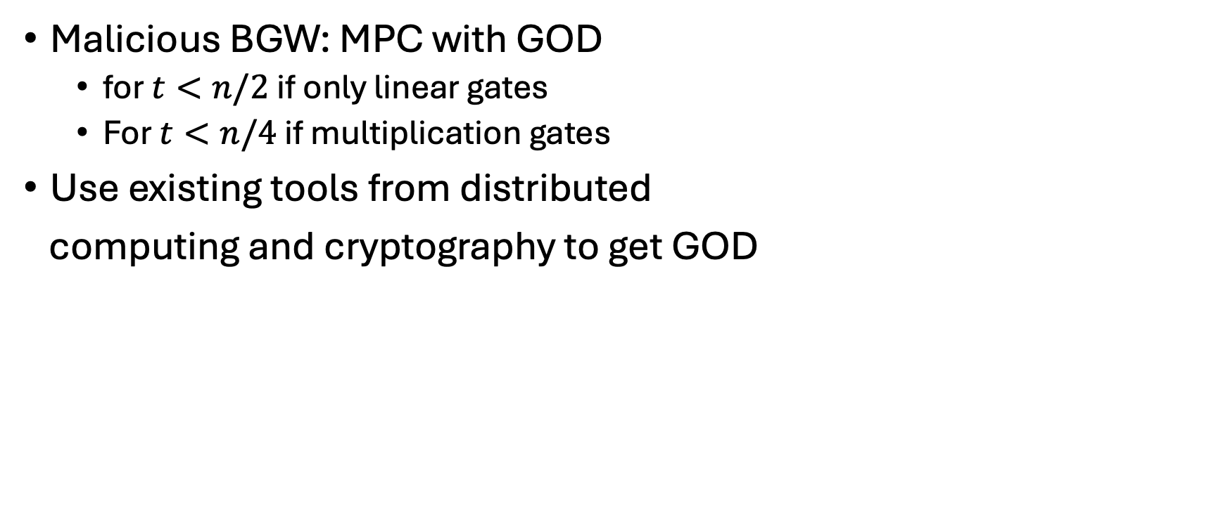
Today’s Class
Malicious BGW: MPC with GOD
  for $t<n/2$ if only linear gates
  For $t<n/4$ if multiplication gates
Use existing tools from distributed
computing and cryptography to get GOD
Sub-optimal
corruption tolerance
Won’t discuss how these
tools are constructed

Slide 5
















Recap: semi-honest BGW
Secret-share inputs
Evaluate an arithmetic circuit
Reconstruct output
$$x_{1}$$
$$x_{2}$$
$$x_{3}$$
$$x_{4}$$
$$\left[x_{1}\right]$$
$$\left[x_{2}\right]$$
$$\left[x_{3}\right]$$
$$\left[x_{4}\right]$$
Beaver
Triples
$$×$$
$$\left[x_{1}x_{2}\right]$$
$$×$$
$$\left[x_{1}x_{2}x_{3}\right]$$
$$+$$
Linear
$$y=x_{1}x_{2}x_{3}+x_{4}$$
$$\left[y\right]$$
Reconstruction
$$y$$

Slide 6







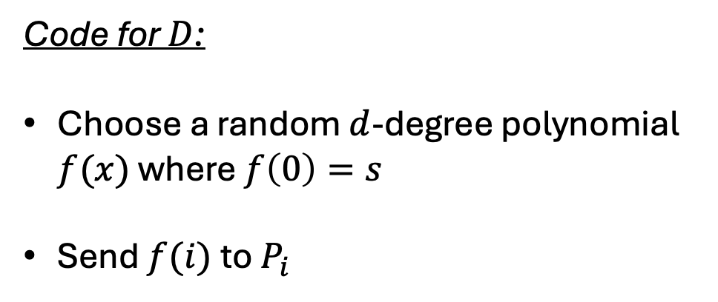









Recap: semi-honest Shamir Secret Sharing
Code for $D$:
Choose a random $d$-degree polynomial $f(x)$ where $f\left(0\right)=s$
Send $f(i)$to $P_{i}$
$$(2,f(2))$$
$$(1,f(1))$$
$$(n,f(n))$$
$$(0,s)$$
What can go wrong when $D$ is malicious?
$$1$$
$$2$$
$$…$$
$$n$$
$$(1,f(1))$$
$$(2,f(2))$$
$$(n,f(n))$$
$$P_{1}$$
$$P_{2}$$
$$…$$
$$P_{n}$$

Slide 7
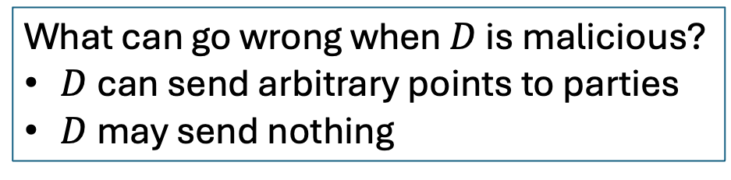
Recap: semi-honest Shamir Secret Sharing
Code for $D$:
Choose a random $d$-degree polynomial $f(x)$ where $f\left(0\right)=s$
Send $f(i)$to $P_{i}$
$$(2,f(2))$$
$$(1,f(1))$$
$$(n,f(n))$$
$$(0,s)$$
What can go wrong when $D$ is malicious?
$D$ can send arbitrary points to parties
$D$ may send nothing
$$1$$
$$2$$
$$…$$
$$n$$
$$(1,f(1))$$
$$(2,f(2))$$
$$(n,f(n))$$
$$P_{1}$$
$$P_{2}$$
$$…$$
$$P_{n}$$

Slide 8








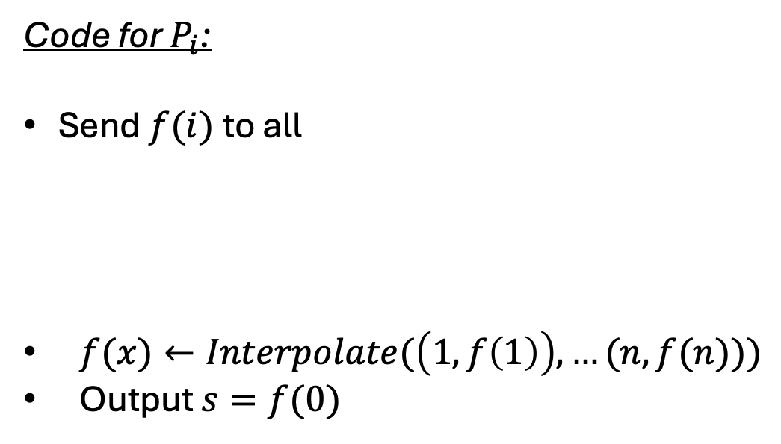














Recap: semi-honest reconstruct
Code for $P_{i}$:
Send $f(i)$to all
$f(x)←Interpolate(\left(1,f\left(1\right)\right), …(n,f(n)))$
Output $s=f(0)$
$$P_{1}$$
$$P_{2}$$
$$…$$
$$P_{n}$$
$$s_{2}$$
$$s_{n}$$
$$s_{1}$$
Reconstruct
$$P_{1}$$
$$P_{2}$$
$$…$$
$$P_{n}$$
$$f(1)$$
$$f(2)$$
$$f(n)$$
$$s$$
$$s$$
$$s$$
$$P_{1}$$
$$P_{2}$$
$$…$$
$$P_{n}$$
What can go wrong when parties are malicious?

Slide 9
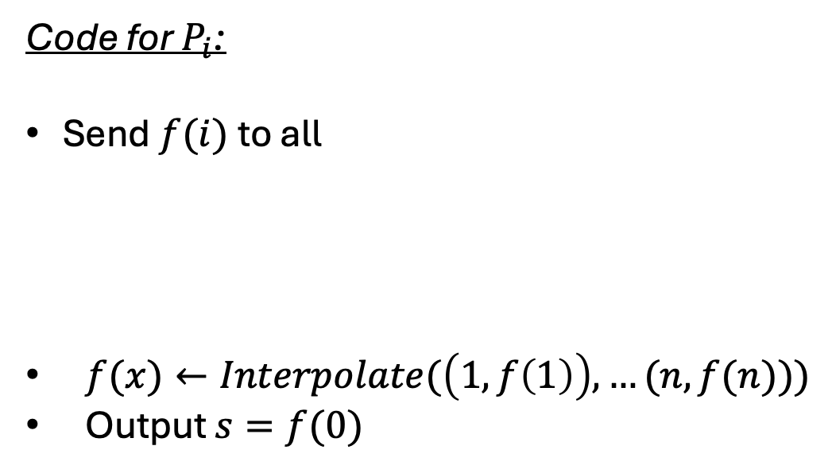
Recap: semi-honest reconstruct
Code for $P_{i}$:
Send $f(i)$to all
$f(x)←Interpolate(\left(1,f\left(1\right)\right), …(n,f(n)))$
Output $s=f(0)$
$$P_{1}$$
$$P_{2}$$
$$…$$
$$P_{n}$$
$$s_{2}$$
$$s_{n}$$
$$s_{1}$$
Reconstruct
$$P_{1}$$
$$P_{2}$$
$$…$$
$$P_{n}$$
$$f(1)$$
$$f(2)$$
$$f(n)$$
$$s$$
$$s$$
$$s$$
$$P_{1}$$
$$P_{2}$$
$$…$$
$$P_{n}$$
What can go wrong when parties are malicious?
Malicious parties may announce arbitrary points

Slide 10


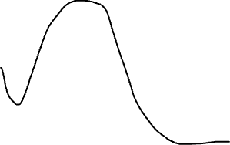








Possible Attack 1
Need to bind to the
shared polynomial
Honest $D$ secret shares $s$
A different $s′$ is reconstructed
$$(2,f(2))$$
$$(2,f(2))$$
$$(1,f(1))$$
$$(0,s′)$$
$$(n,f(n))$$
$$(n,f(n))$$
$$(0,s)$$
$$(1,f(1))$$
$$1$$
$$2$$
$$…$$
$$n$$
$$1$$
$$2$$
$$…$$
$$n$$

Slide 11





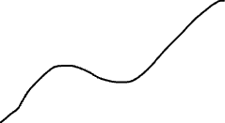












Possible Attack 2
$P_{1}$ reconstructs $s′$
$$(2,f(2))$$
$$(0,s′)$$
Honest $D$ secret shares $s$
$$(n,f(n))$$
$$(1,f(1))$$
Parties should agree
on the outcome
$$(2,f(2))$$
$$1$$
$$2$$
$$…$$
$$n$$
$$(1,f(1))$$
$$(n,f(n))$$
$$(0,s)$$
$P_{2}$ reconstructs $s′′$
$$(n,f(n))$$
$$(2,f(2))$$
$$1$$
$$2$$
$$…$$
$$n$$
$$(0,s′′)$$
$$(1,f(1))$$
$$1$$
$$2$$
$$…$$
$$n$$

Slide 12
Fix: binding

Slide 13

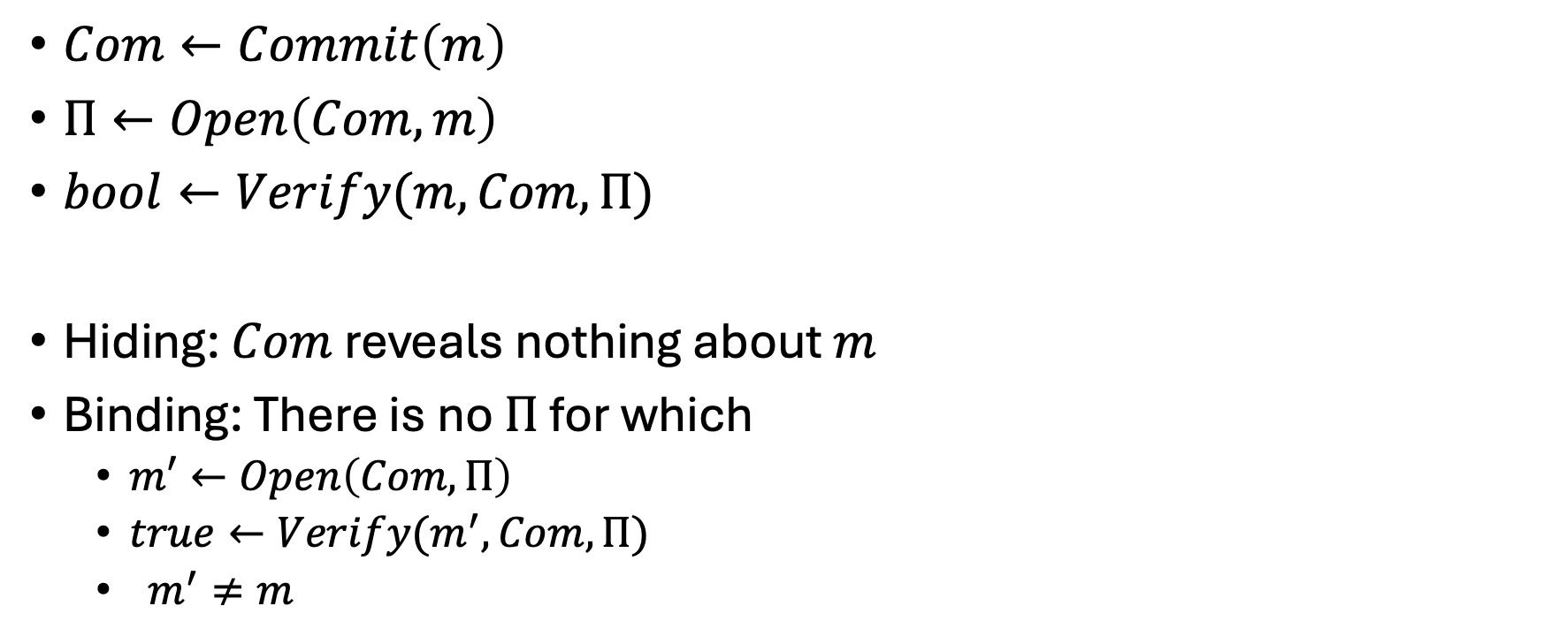
Fix: binding - A Commitment Scheme
$Com←Commit\left(m\right)$
$Π←Open\left(Com,m\right)$
$bool←Verify(m,Com,Π)$
Hiding: $Com$ reveals nothing about $m$
Binding: There is no $Π$ for which
  $m′←Open\left(Com, Π\right)$
  $true←Verify(m^{′}, Com,Π)$
  $m^{′}≠m$
Is a commitment
scheme enough?

Slide 14








An Attempt
$$(2,f(2))$$
Does this work?
$$(1,f(1))$$
$$(n,f(n))$$
$$D:Com←Commit(f)$$
$$(0,s)$$
$$1$$
$$2$$
$$…$$
$$n$$
$$Com,f(1)$$
$$Com,f(2)$$
$$Com,f(n)$$
$$P_{1}$$
$$P_{2}$$
$$…$$
$$P_{n}$$

Slide 15



An Attempt
$$(2,f(2))$$
Does this work?
$$(1,f(1))$$
$$(n,f(n))$$
$$D:Com←Commit(f)$$
$$(0,s)$$
$$1$$
$$2$$
$$…$$
$$n$$
$$Com,f\left(1\right),Π$$
$$Com,f\left(2\right),Π$$
$$Com,f\left(n\right),Π$$
$$P_{1}$$
$$P_{2}$$
$$…$$
$$P_{n}$$

Slide 16
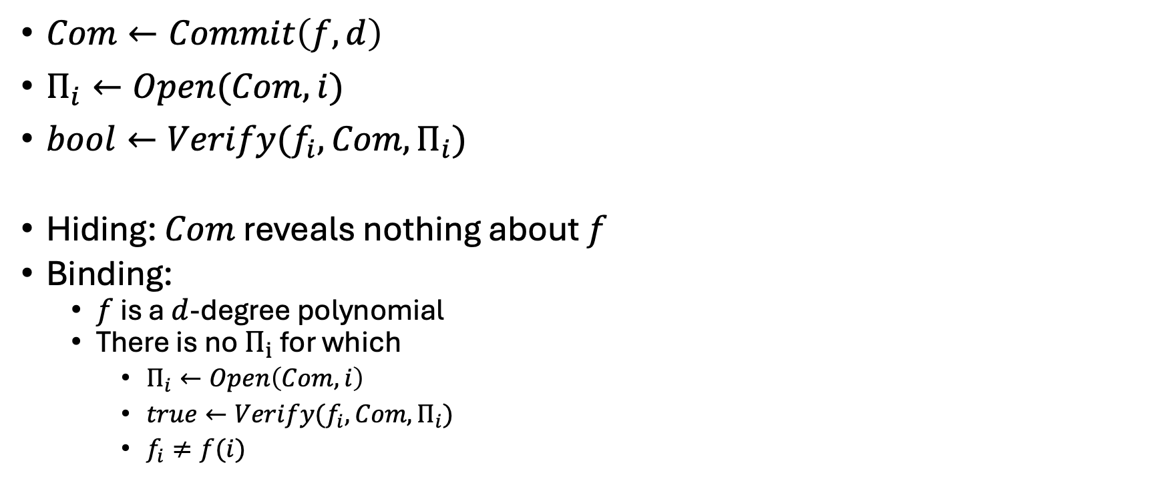
Fix: binding - A Polynomial Commitment
$Com←Commit\left(f,d\right)$
$Π_{i}←Open(Com,i)$
$bool←Verify(f_{i},Com,Π_{i})$
Hiding: $Com$ reveals nothing about $f$
Binding:
  $f$ is a $d$-degree polynomial
  There is no $Π_{i}$ for which
    $Π_{i}←Open\left(Com, i\right)$
    $true←Verify(f_{i}, Com,Π_{i})$
    $f_{i}≠f(i)$

Slide 17



Fix: binding - A Polynomial Commitment
$Com←Commit\left(f,d\right)$
$Π_{i}←Open(Com,i)$
$bool←Verify(f_{i},Com,Π_{i})$
Hiding: $Com$ reveals nothing about $f$
Binding:
  $f$ is a $d$-degree polynomial
  There is no $Π_{i}$ for which
    $Π_{i}←Open\left(Com, i\right)$
    $true←Verify(f_{i}, Com,Π_{i})$
    $f_{i}≠f(i)$
Alice
$$f(x)$$
Poly Commit
$$i$$
$$f(i)$$
Bob

Slide 18



An Attempt
$$(2,f(2))$$
Does this work?
$$(1,f(1))$$
$$(n,f(n))$$
$$D:Com←Commit(f)$$
$$(0,s)$$
$$1$$
$$2$$
$$…$$
$$n$$
$$Com,{f_{1},Π}_{1}$$
$$Com,f_{2},Π_{2}$$
$$Com,f_{n},Π_{n}$$
$$P_{1}$$
$$P_{2}$$
$$…$$
$$P_{n}$$

Slide 19





An Attempt
$$(2,f(2))$$
Does this work?
$$(1,f(1))$$
$$(n,f(n))$$
$$D:Com←Commit(f)$$
$$(0,s)$$
Parties should agree
on what $Com$ is
$$1$$
$$2$$
$$…$$
$$n$$
$$Com,{f_{1},Π}_{1}$$
$$Com^{′},f_{2},Π_{2}$$
$$Com^{′′},f_{n},Π_{n}$$
$$P_{1}$$
$$P_{2}$$
$$…$$
$$P_{n}$$

Slide 20



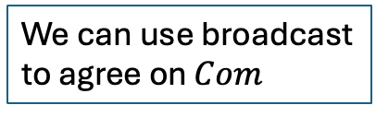






Fix agreement – A broadcast channel
Ensures that a sender $S$ sends the same message $m$ to all parties
$$S$$
$$m$$
Broadcast
We can use broadcast
to agree on $Com$
$$m$$
$$m$$
$$m$$
$$P_{1}$$
$$P_{2}$$
$$…$$
$$P_{n}$$

Slide 21
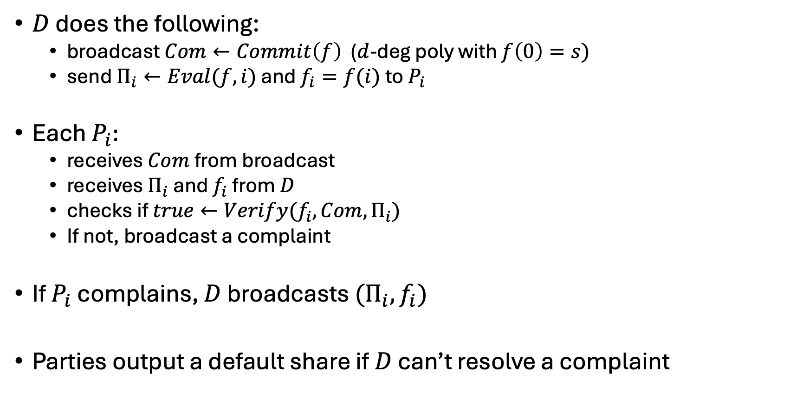
(Verifiable) Shamir Secret Sharing
$D$ does the following:
  broadcast $Com←Commit\left(f\right)$ ($d$-deg poly with $f\left(0\right)=s)$
  send $Π_{i}←Eval(f,i)$ and $f_{i}=f(i)$ to $P_{i}$
Each $P_{i}:$
  receives $Com$ from broadcast
  receives $Π_{i}$ and $f_{i}$ from $D$
  checks if $true←Verify(f_{i}, Com,Π_{i})$
  If not, broadcast a complaint
If $P_{i}$ complains, $D$ broadcasts ${(Π}_{i},f_{i})$
Parties output a default share if $D$ can’t resolve a complaint

Slide 22

(Verifiable) Shamir Secret Sharing
$D$ does the following:
  broadcast $Com←Commit\left(f\right)$ ($d$-deg poly with $f\left(0\right)=s)$
  send $Π_{i}←Eval(f,i)$ and $f_{i}=f(i)$ to $P_{i}$
Each $P_{i}:$
  receives $Com$ from broadcast
  receives $Π_{i}$ and $f_{i}$ from $D$
  checks if $true←Verify(f_{i}, Com,Π_{i})$
  If not, broadcast a complaint
If $P_{i}$ complains, $D$ broadcasts ${(Π}_{i},f_{i})$
Parties output a default share if $D$ can’t resolve a complaint
Each $f_{i}$ is verified…
…either locally by the party
…or globally

Slide 23
(Verifiable) Shamir Secret Sharing
$D$ does the following:
  broadcast $Com←Commit\left(f\right)$ ($d$-deg poly with $f\left(0\right)=s)$
  send $Π_{i}←Eval(f,i)$ and $f_{i}=f(i)$ to $P_{i}$
Each $P_{i}:$
  receives $Com$ from broadcast
  receives $Π_{i}$ and $f_{i}$ from $D$
  checks if $true←Verify(f_{i}, Com,Π_{i})$
  If not, broadcast a complaint
If $P_{i}$ complains, $D$ broadcasts ${(Π}_{i},f_{i})$
Parties output a default share if $D$ can’t resolve a complaint
Each $f_{i}$ is verified…
…either locally by the party
…or globally

Slide 24

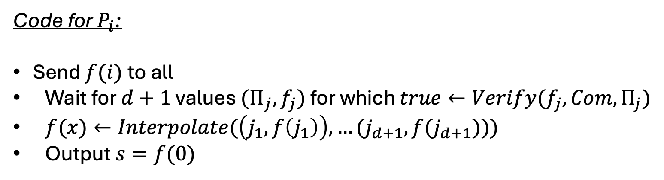
Reliable reconstruction
Code for $P_{i}$:
Send $f(i)$to all
Wait for $d+1$ values ${(Π}_{j},f_{j})$ for which $true←Verify(f_{j}, Com,Π_{j})$
$f(x)←Interpolate(\left(j_{1},f\left(j_{1}\right)\right), …(j_{d+1},f(j_{d+1})))$
Output $s=f(0)$
Parties output the same $s$

Slide 25
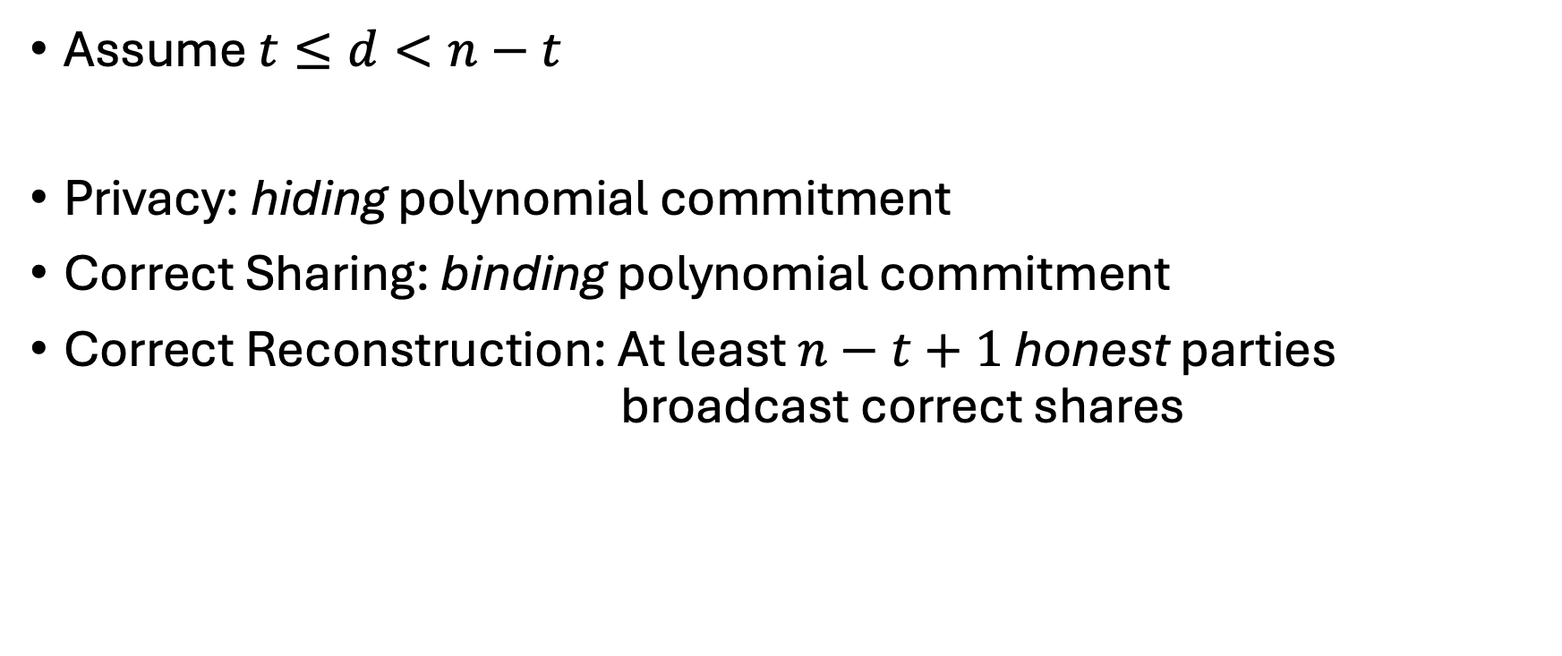
Verifiable Secret Sharing Analysis
Assume $t≤d<n−t$
Privacy: hiding polynomial commitment
Correct Sharing: binding polynomial commitment
Correct Reconstruction: At least $n−t+1$ honest parties broadcast correct shares

Slide 26
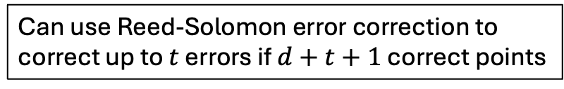
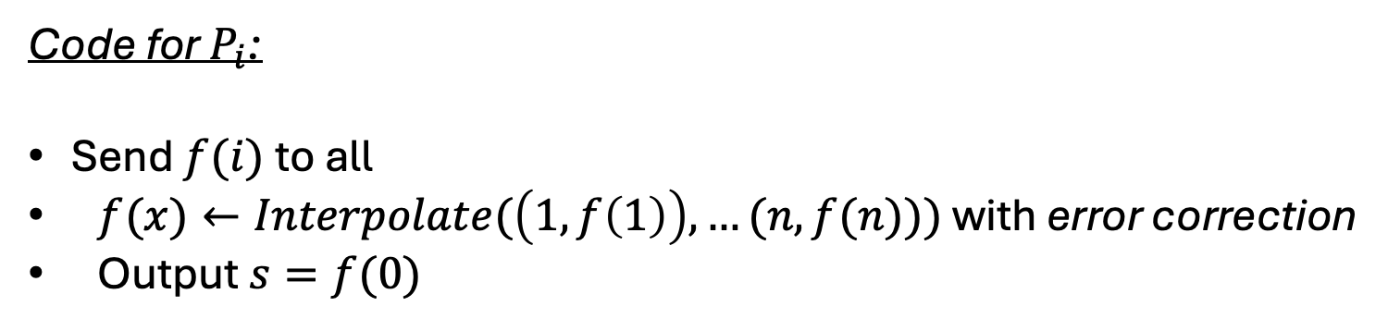
Reliable reconstruction: alternate method
Code for $P_{i}$:
Send $f(i)$to all
$f(x)←Interpolate(\left(1,f\left(1\right)\right), …(n,f(n)))$ with error correction
Output $s=f(0)$
Can use Reed-Solomon error correction to
correct up to $t$ errors if $d+t+1$ correct points

Slide 27
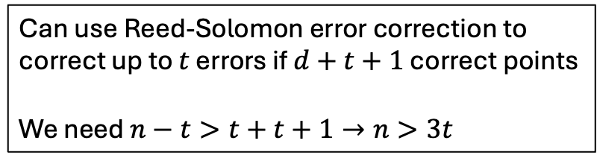
Reliable reconstruction: alternate method
Code for $P_{i}$:
Send $f(i)$to all
$f(x)←Interpolate(\left(1,f\left(1\right)\right), …(n,f(n)))$ with error correction
Output $s=f(0)$
Can use Reed-Solomon error correction to
correct up to $t$ errors if $d+t+1$ correct points
We need $n−t>t+t+1→n>3t$

Slide 28
Recap: BGW
Secret-share inputs
Evaluate an arithmetic circuit
Reconstruct output
$$x_{1}$$
$$x_{2}$$
$$x_{3}$$
$$x_{4}$$
$$\left[x_{1}\right]$$
$$\left[x_{2}\right]$$
$$\left[x_{3}\right]$$
$$\left[x_{4}\right]$$
Beaver
Triples
$$×$$
$$\left[x_{1}x_{2}\right]$$
$$×$$
$$\left[x_{1}x_{2}x_{3}\right]$$
$$+$$
Linear
$$y=x_{1}x_{2}x_{3}+x_{4}$$
$$\left[y\right]$$
Reconstruction
$$y$$

Slide 29
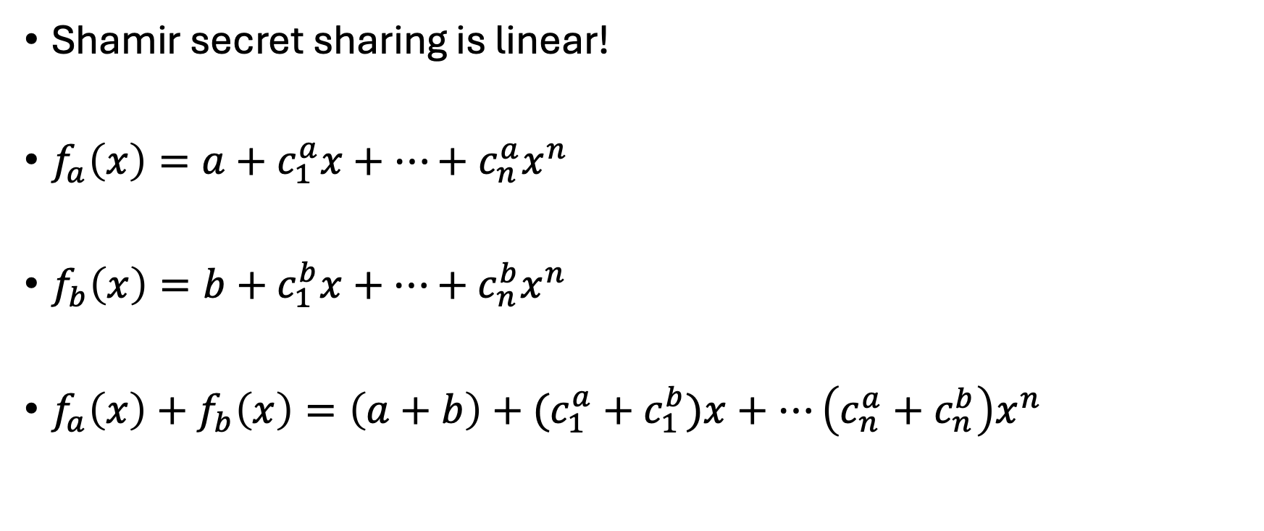
BGW: Linear gates
Shamir secret sharing is linear!
$f_{a}\left(x\right)=a+c_{1}^{a}x+…+c_{n}^{a}x^{n}$
$f_{b}\left(x\right)=b+c_{1}^{b}x+…+{c_{n}^{b}x}^{n}$
$f_{a}\left(x\right)+f_{b}\left(x\right)=\left(a+b\right)+(c_{1}^{a}+c_{1}^{b})x+…\left(c_{n}^{a}+c_{n}^{b}\right)x^{n}$

Slide 30
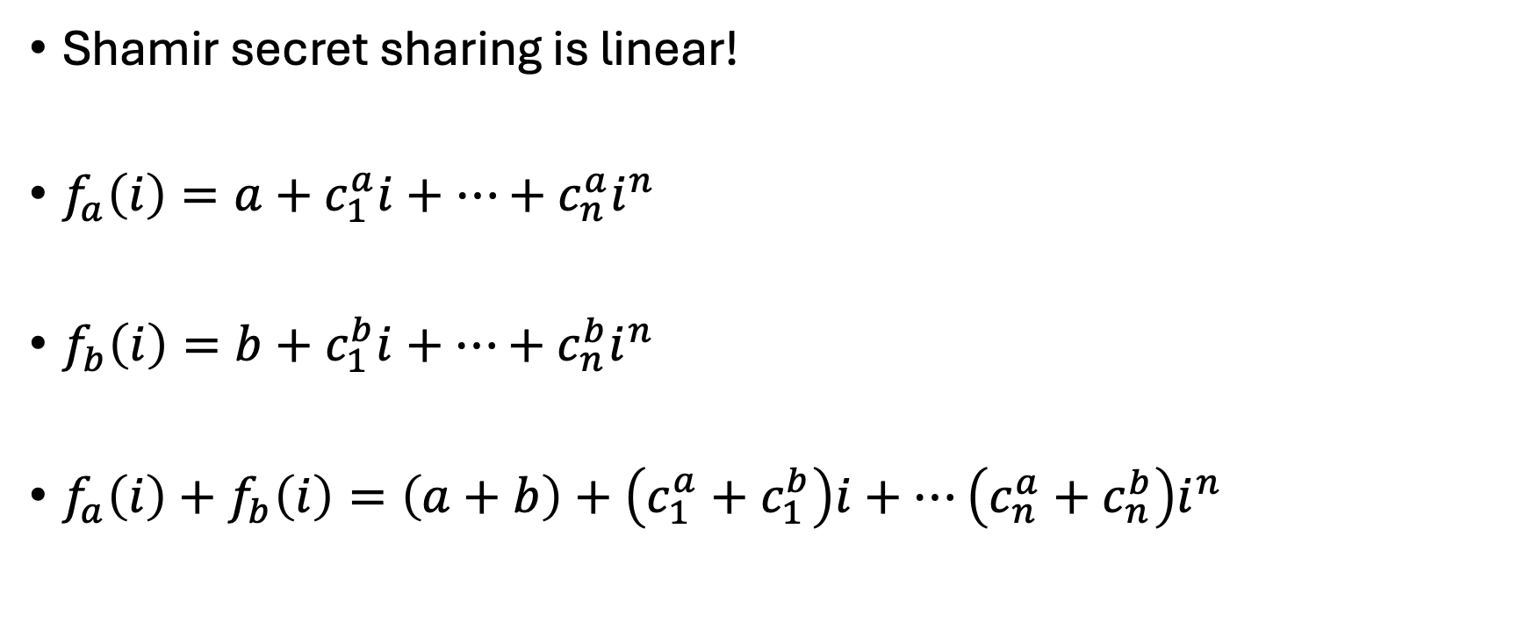
BGW: Linear gates
Shamir secret sharing is linear!
$f_{a}\left(i\right)=a+c_{1}^{a}i+…+c_{n}^{a}i^{n}$
$f_{b}\left(i\right)=b+c_{1}^{b}i+…+{c_{n}^{b}i}^{n}$
$f_{a}\left(i\right)+f_{b}\left(i\right)=\left(a+b\right)+\left(c_{1}^{a}+c_{1}^{b}\right)i+…\left(c_{n}^{a}+c_{n}^{b}\right)i^{n}$

Slide 31
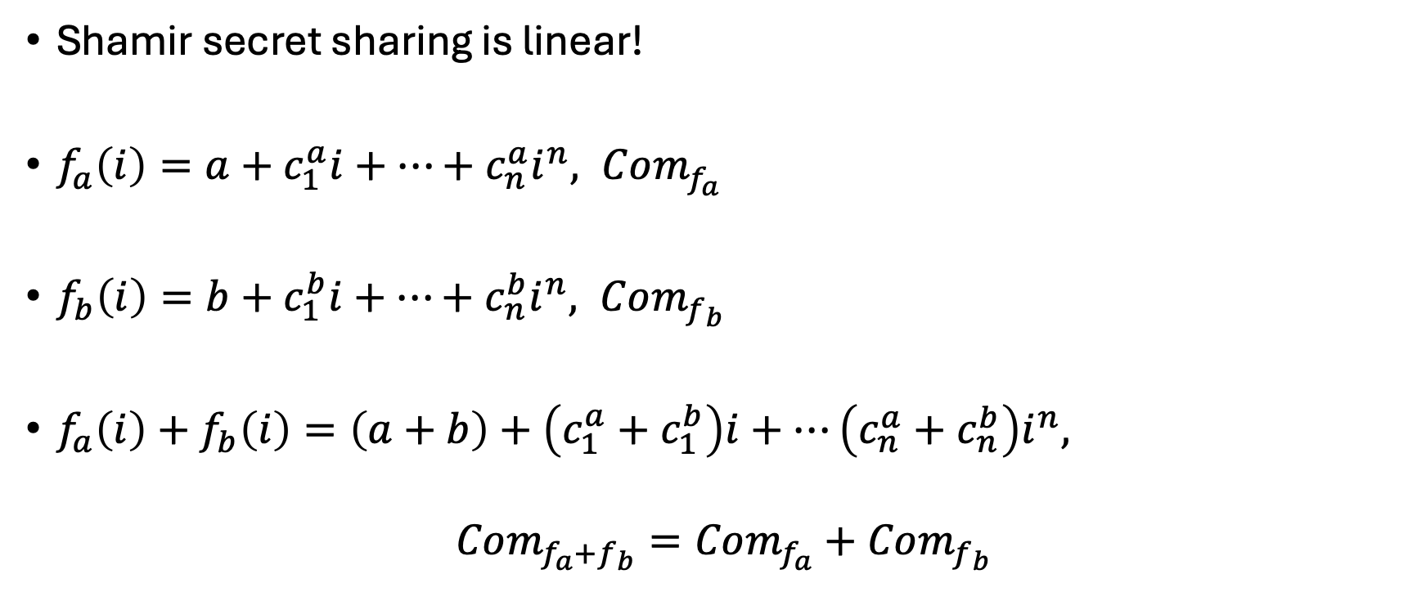
BGW: Linear gates
Shamir secret sharing is linear!
$f_{a}\left(i\right)=a+c_{1}^{a}i+…+c_{n}^{a}i^{n}, Com_{f_{a}}$
$f_{b}\left(i\right)=b+c_{1}^{b}i+…+{c_{n}^{b}i}^{n}, Com_{f_{b}}$
$f_{a}\left(i\right)+f_{b}\left(i\right)=\left(a+b\right)+\left(c_{1}^{a}+c_{1}^{b}\right)i+…\left(c_{n}^{a}+c_{n}^{b}\right)i^{n},$
$$Com_{f_{a}+f_{b}}=Com_{f_{a}}+Com_{f_{b}}$$

Slide 32
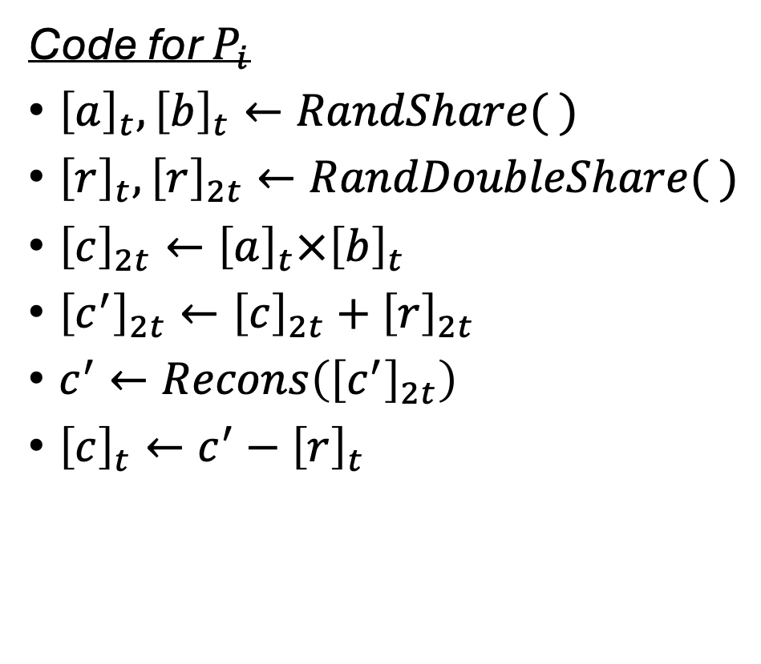
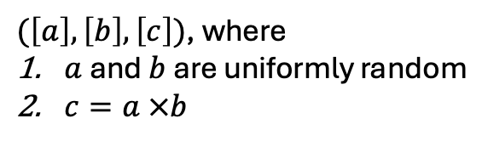
Recap: Beaver Triples
Code for $P_{i}$
${\left[a\right]}_{t}, {\left[b\right]}_{t}←RandShare( )$
${\left[r\right]}_{t},{\left[r\right]}_{2t}←RandDoubleShare( )$
${\left[c\right]}_{2t}←{\left[a\right]}_{t}×{\left[b\right]}_{t}$
${\left[c^{′}\right]}_{2t}←{\left[c\right]}_{2t}+{\left[r\right]}_{2t}$
$c^{′}←Recons\left({\left[c^{′}\right]}_{2t}\right)$
${\left[c\right]}_{t}←c^{′}−{\left[r\right]}_{t}$
BeaverTriple
$(\left[a\right],\left[b\right],\left[c\right])$, where
$a$ and $b$ are uniformly random
$c=a ×b$
What can go wrong if parties are malicious?

Slide 33
Recap: Beaver Triples
Code for $P_{i}$
${\left[a\right]}_{t}, {\left[b\right]}_{t}←RandShare( )$
${\left[r\right]}_{t},{\left[r\right]}_{2t}←RandDoubleShare( )$
${\left[c\right]}_{2t}←{\left[a\right]}_{t}×{\left[b\right]}_{t}$
${\left[c^{′}\right]}_{2t}←{\left[c\right]}_{2t}+{\left[r\right]}_{2t}$
$c^{′}←Recons\left({\left[c^{′}\right]}_{2t}\right)$
${\left[c\right]}_{t}←c^{′}−{\left[r\right]}_{t}$
BeaverTriple
$(\left[a\right],\left[b\right],\left[c\right])$, where
$a$ and $b$ are uniformly random
$c=a ×b$
What can go wrong if parties are malicious?

Slide 34
Recap: Beaver Triples
Code for $P_{i}$
${\left[a\right]}_{t}, {\left[b\right]}_{t}←RandShare( )$
${\left[r\right]}_{t},{\left[r\right]}_{2t}←RandDoubleShare( )$
${\left[c\right]}_{2t}←{\left[a\right]}_{t}×{\left[b\right]}_{t}$
${\left[c^{′}\right]}_{2t}←{\left[c\right]}_{2t}+{\left[r\right]}_{2t}$
$c^{′}←Recons\left({\left[c^{′}\right]}_{2t}\right)$
${\left[c\right]}_{t}←c^{′}−{\left[r\right]}_{t}$
BeaverTriple
Polynomial commitment
schemes are not multiplicative
homomorphic
$(\left[a\right],\left[b\right],\left[c\right])$, where
$a$ and $b$ are uniformly random
$c=a ×b$
What can go wrong if parties are malicious?

Slide 35


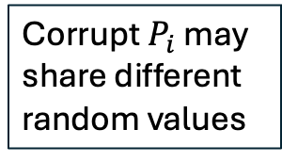
Recap: Random Double shares
Code for $P_{i}$
Sample uniformly random $r_{i}$
Shamir secret-share ${\left[r_{i}\right]}_{t},{\left[r_{i}\right]}_{2t}$
Output
  ${\left[r\right]}_{t}= {\left[r_{1}\right]}_{t}+… + {\left[r_{n}\right]}_{t}$
  ${\left[r\right]}_{2t}= {\left[r_{1}\right]}_{2t}+… + {\left[r_{n}\right]}_{2t}$
RandDoubleShare
Corrupt $P_{i}$ may
share different
random values
$${\left[r\right]}_{t},{\left[r\right]}_{2t}$$

Slide 36


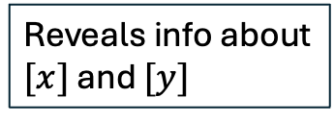
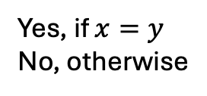
Check if Equal Shares
Code for $P_{j}$
${\left[d\right]}_{2t}←\left({\left[x\right]}_{t}−{\left[y\right]}_{2t}\right)$
$d←Recons\left(\left[d\right]\right)$
Output $d==0$?
$${P_{i},\left[x\right]}_{t},{\left[y\right]}_{2t}$$
EqualShares?
Reveals info about
$[x]$ and $[y]$
Yes, if $x=y$
No, otherwise

Slide 37
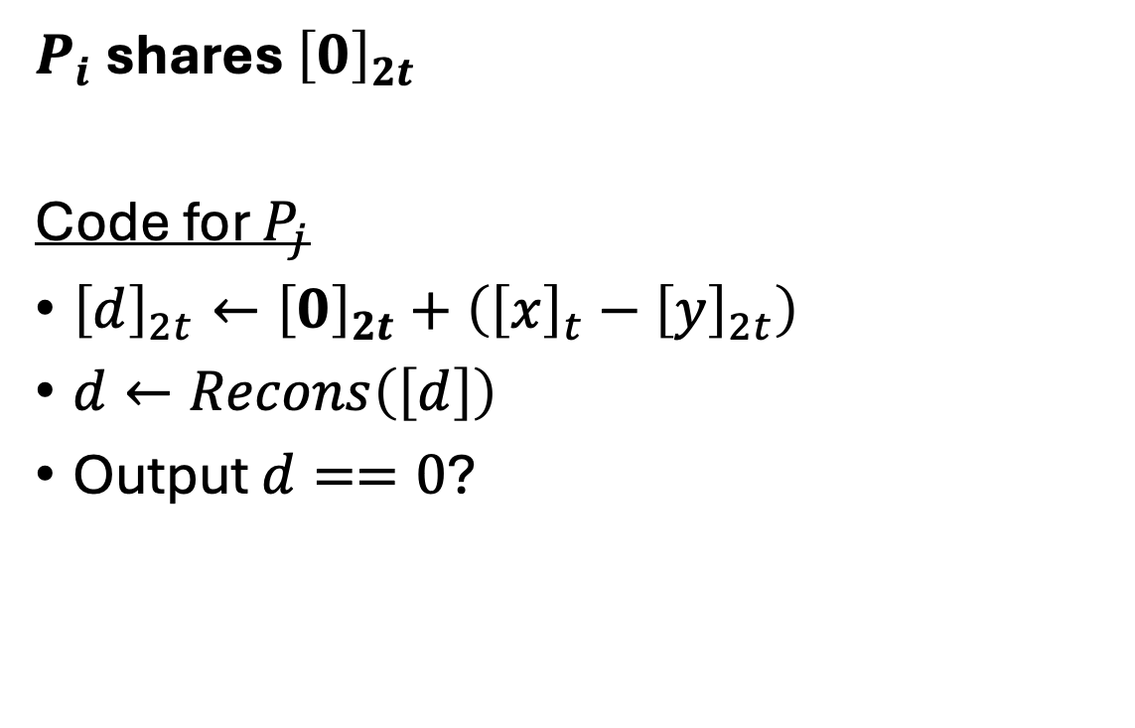

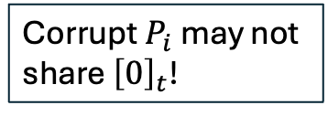
Check if Equal Shares
$P_{i}$ shares ${\left[0\right]}_{2t}$
Code for $P_{j}$
${\left[d\right]}_{2t}←{\left[0\right]}_{2t}+\left({\left[x\right]}_{t}−{\left[y\right]}_{2t}\right)$
$d←Recons\left(\left[d\right]\right)$
Output $d==0$?
Masks ${\left[x\right]}_{t}−{\left[y\right]}_{2t}$
$${P_{i},\left[x\right]}_{t},{\left[y\right]}_{2t}$$
EqualShares?
Corrupt $P_{i}$ may not
share ${\left[0\right]}_{t}$!
Yes, if $x=y$
No, otherwise

Slide 38
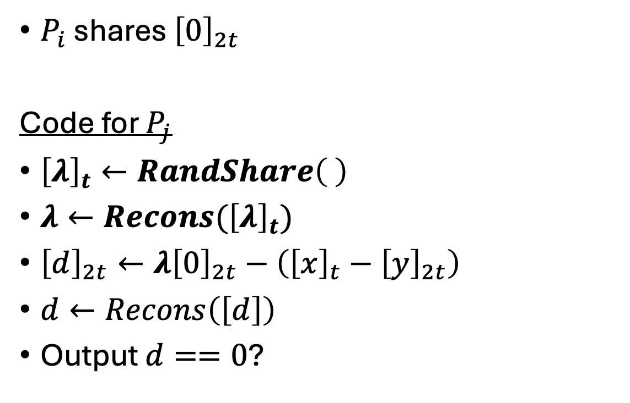

Check if Equal Shares
$P_{i}$ shares ${\left[0\right]}_{2t}$
Code for $P_{j}$
${\left[λ\right]}_{t}←RandShare\left( \right)$
$λ←Recons({\left[λ\right]}_{t})$
${\left[d\right]}_{2t}←{λ\left[0\right]}_{2t}−\left({\left[x\right]}_{t}−{\left[y\right]}_{2t}\right)$
$d←Recons\left(\left[d\right]\right)$
Output $d==0$?
$${P_{i},\left[x\right]}_{t},{\left[y\right]}_{2t}$$
EqualShares?
To check that $P_{i}$ shares ${\left[0\right]}_{2t}$
Yes, if $x=y$
No, otherwise

Slide 39
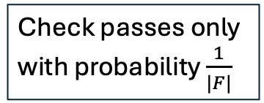
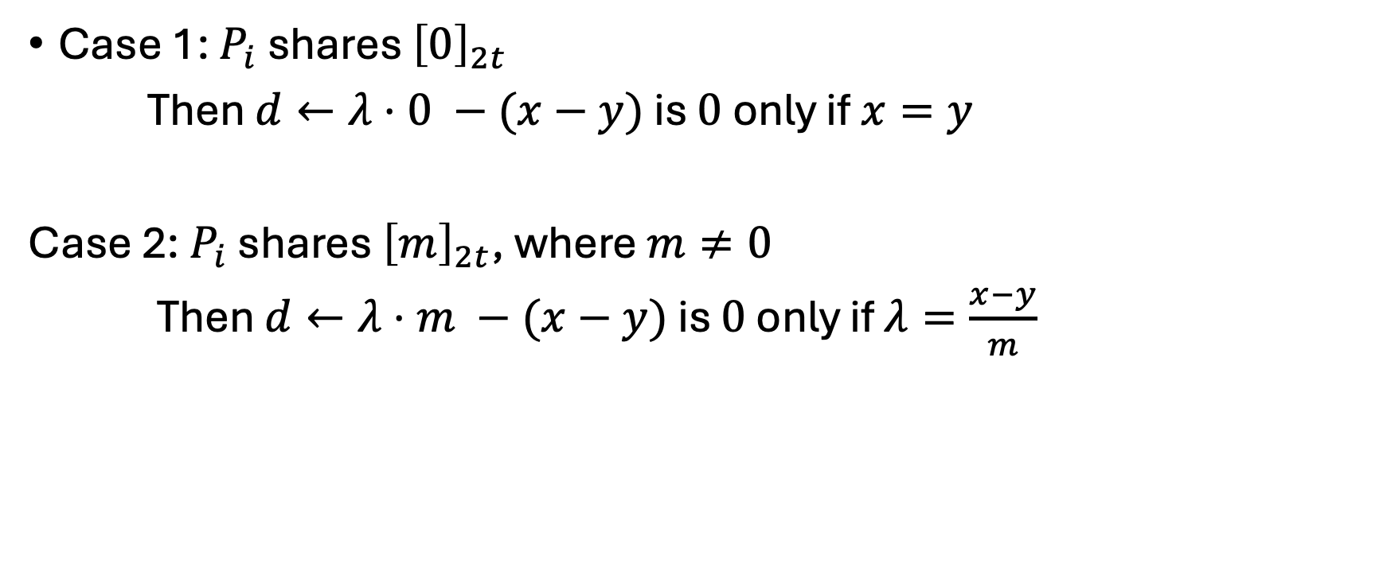

Check if Equal Shares Analysis
$${\left[d\right]}_{2t}←{λ\left[0\right]}_{2t}−\left({\left[x\right]}_{t}−{\left[y\right]}_{2t}\right)$$
Case 1: $P_{i}$ shares ${\left[0\right]}_{2t}$
Then $d←λ⋅0 −(x−y)$ is $0$ only if $x=y$
Case 2: $P_{i}$ shares ${\left[m\right]}_{2t}$, where $m≠0$
Then $d←λ⋅m −(x−y)$ is $0$ only if $λ=\frac{x−y}{m}$
Check passes only
with probability $\frac{1}{|F|}$

Slide 40
Random Double shares
Code for $P_{i}$
Sample uniformly random $r_{i}$
Shamir secret-share ${\left[r_{i}\right]}_{t},{\left[r_{i}\right]}_{2t}$
Output
  ${\left[r\right]}_{t}= {\left[r_{1}\right]}_{t}+… + {\left[r_{n}\right]}_{t}$
  ${\left[r\right]}_{2t}= {\left[r_{1}\right]}_{2t}+… + {\left[r_{n}\right]}_{2t}$
RandDoubleShare
Can use
EqualShares to
ensure equality
$${\left[r\right]}_{t},{\left[r\right]}_{2t}$$

Slide 41
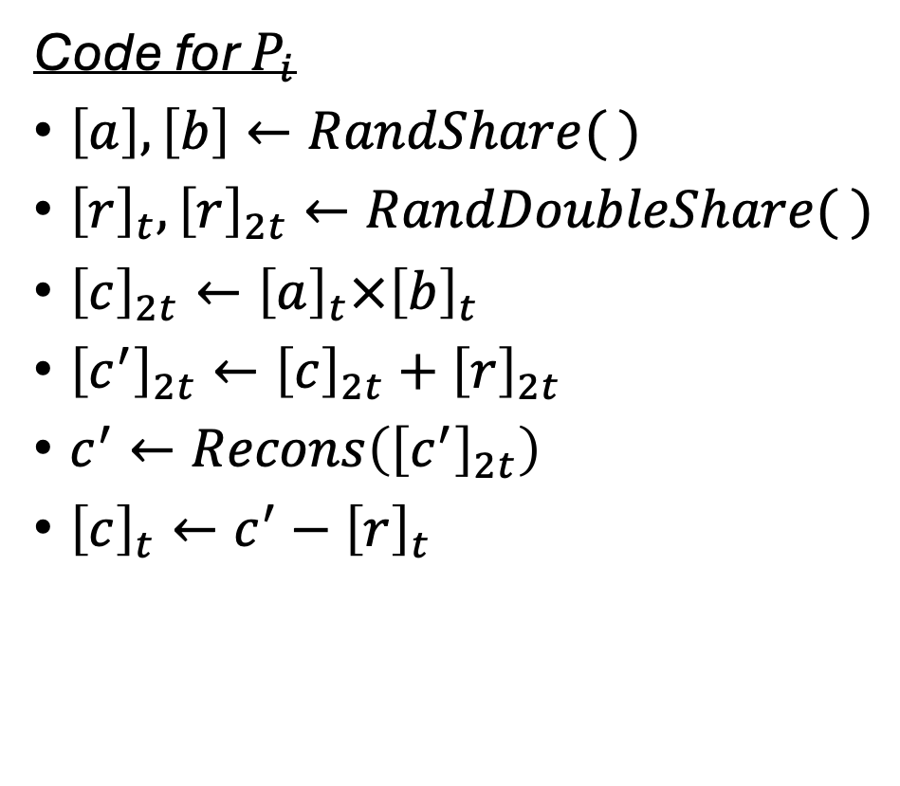
Beaver Triples
Code for $P_{i}$
$\left[a\right], \left[b\right]←RandShare( )$
${\left[r\right]}_{t},{\left[r\right]}_{2t}←RandDoubleShare( )$
${\left[c\right]}_{2t}←{\left[a\right]}_{t}×{\left[b\right]}_{t}$
${\left[c^{′}\right]}_{2t}←{\left[c\right]}_{2t}+{\left[r\right]}_{2t}$
$c^{′}←Recons\left({\left[c^{′}\right]}_{2t}\right)$
${\left[c\right]}_{t}←c^{′}−{\left[r\right]}_{t}$
BeaverTriple
$(\left[a\right],\left[b\right],\left[c\right])$, where
$a$ and $b$ are uniformly random
$c=a ×b$

Slide 42
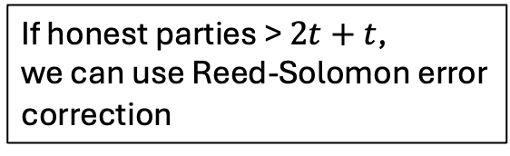
Beaver Triples
Code for $P_{i}$
$\left[a\right], \left[b\right]←RandShare( )$
${\left[r\right]}_{t},{\left[r\right]}_{2t}←RandDoubleShare( )$
${\left[c\right]}_{2t}←{\left[a\right]}_{t}×{\left[b\right]}_{t}$
${\left[c^{′}\right]}_{2t}←{\left[c\right]}_{2t}+{\left[r\right]}_{2t}$
$c^{′}←Recons\left({\left[c^{′}\right]}_{2t}\right)$
${\left[c\right]}_{t}←c^{′}−{\left[r\right]}_{t}$
BeaverTriple
If honest parties > $2t+t$,
we can use Reed-Solomon error
correction
$(\left[a\right],\left[b\right],\left[c\right])$, where
$a$ and $b$ are uniformly random
$c=a ×b$

Slide 43

Beaver Triples
Code for $P_{i}$
$\left[a\right], \left[b\right]←RandShare( )$
${\left[r\right]}_{t},{\left[r\right]}_{2t}←RandDoubleShare( )$
${\left[c\right]}_{2t}←{\left[a\right]}_{t}×{\left[b\right]}_{t}$
${\left[c^{′}\right]}_{2t}←{\left[c\right]}_{2t}+{\left[r\right]}_{2t}$
$c^{′}←Recons\left({\left[c^{′}\right]}_{2t}\right)$
${\left[c\right]}_{t}←c^{′}−{\left[r\right]}_{t}$
BeaverTriple
Assume $n>4t$
$(\left[a\right],\left[b\right],\left[c\right])$, where
$a$ and $b$ are uniformly random
$c=a ×b$

Slide 44

Conclusion
MPC with Abort may not be robust enough
A malicious MPC protocol with GOD when $t<\frac{n}{4}$

