Slide 1
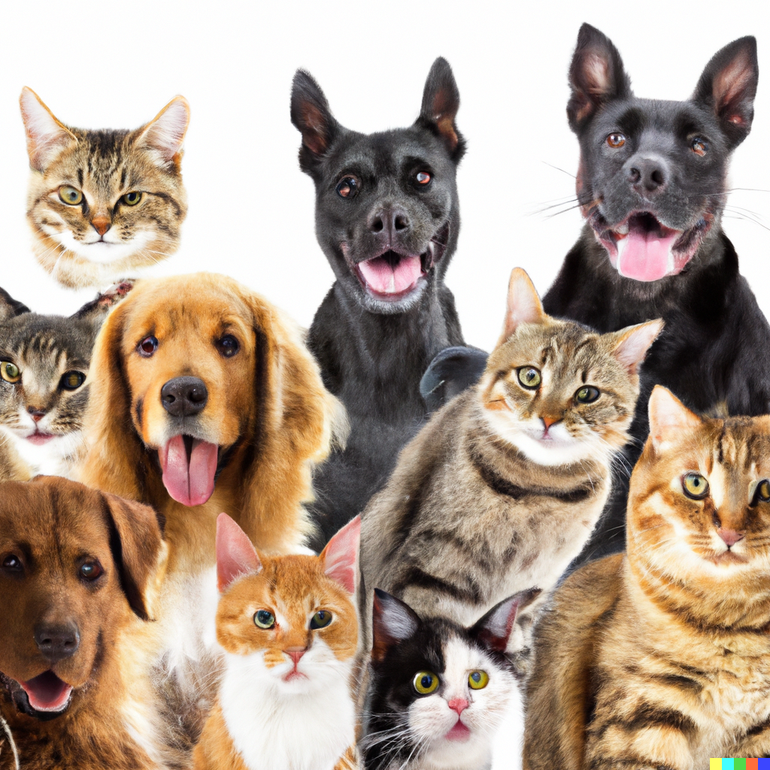
Clustering and Retrieval
Applied Machine Learning Derek Hoiem
Dall-E

Slide 2
Recall from last lecture: What are three ways to mitigate problems in bias from AI algorithms?
Model cards
Data sheets
Intersectional performance analysis
Adversarial algorithm to prevent using features that predict sensitive attributes such as race or gender
Multi-task learning to facilitate learning of less common classes

Slide 3
We’ve learned a lot about supervised prediction algorithms – now we will learn about methods to organize and analyze data without labels
Clustering and retrieval
EM and missing data
Estimating probabilities for continuous variables
Projections for compression and visualization
Topic modeling
Anomaly detection

Slide 4
Today’s lecture
Clustering
Kmeans
Hierarchical Kmeans
Agglomerative Clustering
Retrieval
Using Hierarchical Kmeans
LSH
Faiss library

Slide 5
Clustering
Assign a label to each data point based on the similarities between points
Why cluster
Represent data point with a single integer instead of a floating point vector
Saves space
Simple to count and estimate probability
Discover trends in the data
Make predictions based on groupings

Slide 6
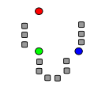
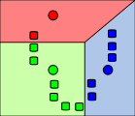
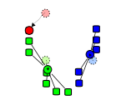
K-means algorithm
1. Randomly select K centers
2. Assign each point to nearest center
3. Compute new center (mean) for each cluster
Illustration: http://en.wikipedia.org/wiki/K-means_clustering

Slide 7
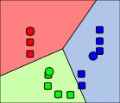
K-means algorithm
1. Randomly select K centers
2. Assign each point to nearest center
Back to 2
3. Compute new center (mean) for each cluster
Illustration: http://en.wikipedia.org/wiki/K-means_clustering

Slide 8
K-means Demo
https://www.naftaliharris.com/blog/visualizing-k-means-clustering/

Slide 9
What is the cost minimized by K means?
$$id∗, centers∗=argmin_{id, centers}\sum_{n}{{\left|\left|centers_{id_{n}}−X_{n}\right|\right|}^{2}}$$
Choose ids that minimizes square cost given centers
Choose centers that minimize square cost given ids

Slide 10
Implementation issues
How to choose K?
Can use MDL (minimum description length) principle that minimizes a cost of parameters plus cost of negative data log likelihood, but in practice K is almost always hand chosen
Often based on the number of clusters you want considering time/space requirements
How do you initialize
Randomly choose points
Iterative furthest point

Slide 11
Evaluating clusters with purity
We often cluster when there is no definitively correct answer, but a purity measure can be used to check the consistency with labels
$$purity=\sum_{k}{\left(\max_{y}{\sum_{n:id_{n}=k}{δ(label_{n}=y)}}\right)}{/N}$$
Purity is the count of data points with the most common label in each cluster, divided by the total number of data points (N)
E.g., labels = {0, 0, 0, 0, 1, 1, 1, 1}, cluster ids = {0, 0, 0, 0, 0, 1, 1, 1}, purity = ?
purity = 7/8
Purity can be used to select the number of clusters, or to compare approaches with a given number of clusters
A relatively small number of labels can be used to estimate purity, even if there are many data points

Slide 12
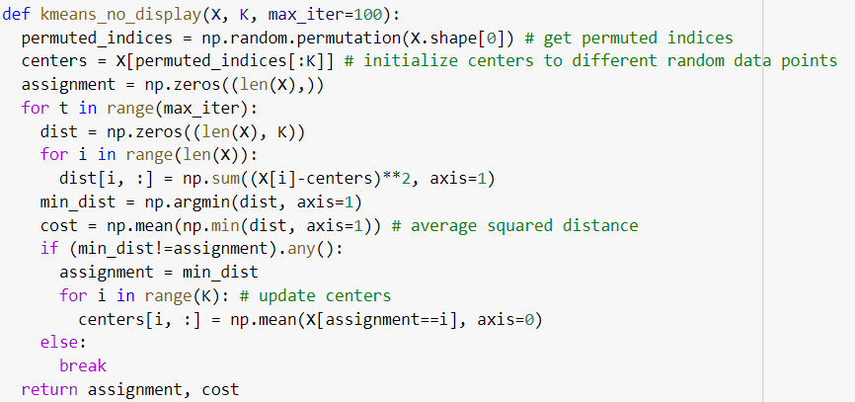
Kmeans code

Slide 13
What are some disadvantages of K-means in terms of clustering quality?
All feature dimensions equally important
Tends to break data into clusters of similar numbers of points (can be good or bad)
Does not take into account any local structure
Typically, not an easy way to choose K
Can be very slow if the number of data points and clusters is large

Slide 14
Hierarchical K-means
Iteratively cluster points into K groups, then cluster each group into K groups

Slide 16
Notes:
We then run k-means on the descriptor space. In this setting, k defines what we call the branch-factor of the tree, which indicates how fast the tree branches.
In this illustration, k is three. We then run k-means again, recursively on each of the resulting quantization cells.
This defines the vocabulary tree, which is essentially a hierarchical set of cluster centers and their corresponding Voronoi regions.
We typically use a branch-factor of 10 and six levels, resulting in a million leaf nodes. We lovingly call this the Mega-Voc.

Slide 26
Notes:
We now have the vocabulary tree, and the online phase can begin.
In order to add an image to the database, we perform feature extraction. Each descriptor vector is now dropped down from the root of the tree and quantized very efficiently into a path down the tree, encoded by a single integer.
Each node in the vocabulary tree has an associated inverted file index.
Indicies back to the new image are then added to the relevant inverted files.
This is a very efficient operation that is carried out whenever we want to add an image.

Slide 27
Advantages of Hierarchical K-Means
Fast cluster training
With a branching factor of 10, can cluster into 1M clusters by clustering into 10 clusters ~111,111 times, each time using e.g. 10K data points
Vs. e.g. clustering 1B data points into 1M clusters
Kmeans is O(K*N*D) per iteration so this is a 900,000x speedup!
Fast lookup
Find cluster number in O(log(K)*D) vs. O(K*D)
16,667x speedup in the example above

Slide 28
Are there any disadvantages of hierarchical Kmeans?
Yes, the assignment might not be quite as good, but often usually isn’t a huge deal since K means is used to approximate data points with centroid anyway
Notes:
Yes, the assignment might not be quite as good, but this usually isn’t a huge deal since K means is used to approximate data points with centroid anyway

Slide 29
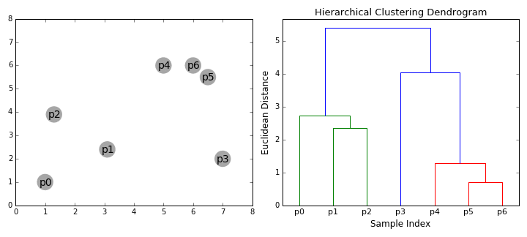
Agglomerative clustering
Iteratively merge the two most similar points or clusters
Can use various distance measures
Can use different “linkages”, e.g. distance of nearest points in two clusters or the cluster averages
Ideally the minimum distance between clusters should increase after each merge (e.g. if using the distance between cluster centers)
Number of clusters can be set based on when the cost to merge increases suddenly
https://dashee87.github.io/data%20science/general/Clustering-with-Scikit-with-GIFs/

Slide 30
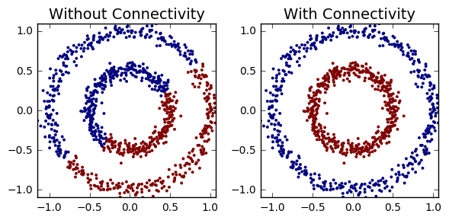
Agglomerative clustering
With good choices of linkage, agglomerative clustering can reflect the data connectivity structure (“manifold”)
Clustering based on distance of 5 nearest neighbors between clusters
https://dashee87.github.io/data%20science/general/Clustering-with-Scikit-with-GIFs/

Slide 31
Applications of clustering
K-means
Quantization (codebooks for image generation)
Search
Data visualization (show the average image of clusters of images)
Hierarchical K-means
Fast search (document / image search)
Agglomerative clustering
Finding structures in the data (image segmentation, grouping camera locations together)

Slide 32
2 minute break
Are there any times that you’ve used clustering, or that it would be useful?

Slide 33
Retrieval
Given a new sample, find the closest sample in a dataset
Applications
Finding information (web search)
Prediction (e.g. nearest neighbor algorithm)
Clustering (kmeans)

Slide 34
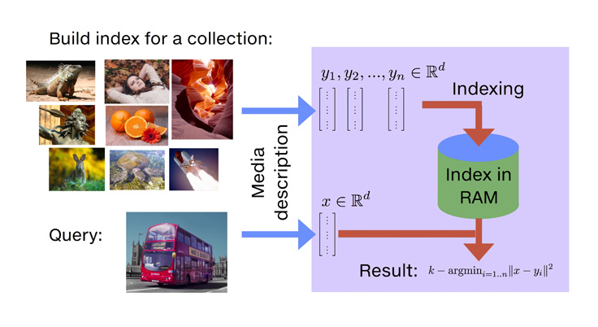
Vanilla Search
Compute distance between query and each dataset point and return closest point
https://engineering.fb.com/2017/03/29/data-infrastructure/faiss-a-library-for-efficient-similarity-search/

Slide 35
Faiss library makes even brute force search very fast
Multi-threading, BLAS libraries, SIMD vectorization, GPU implementations
KNN for MNIST takes seconds
https://engineering.fb.com/2017/03/29/data-infrastructure/faiss-a-library-for-efficient-similarity-search/

Slide 36
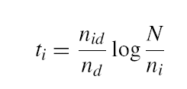
Inverse document file for retrieval of count-based docs
Applies to text (word counts), images (clustered keypoint counts), and other tokenized representations
Like a book index: keep a list of all the words (tokens) and all the pages (documents) that contain them.
Rank database documents based on summed tf-idf measure for each word/token in the query document
tf-idf: Term Frequency – Inverse Document Frequency
# documents
# times word appears in document
# documents that contain the word
# words in document

Slide 37
Locality Sensitive Hashing (LSH)
A fast approximate search method to return similar data points to query

Slide 38
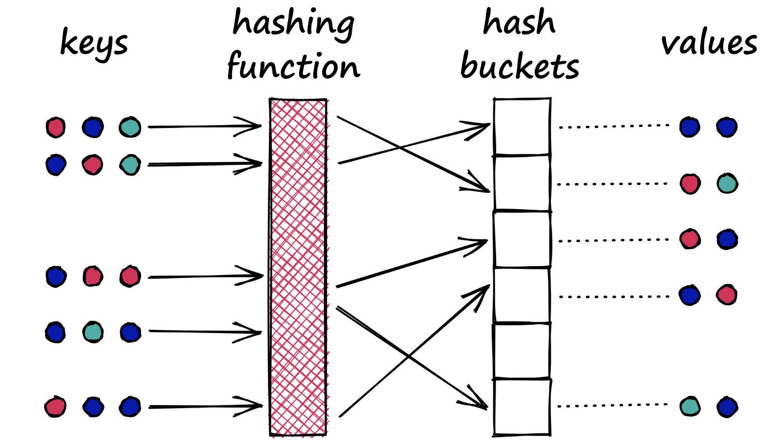
A typical hash function aims to place different values in separate buckets
https://www.pinecone.io/learn/locality-sensitive-hashing-random-projection/

Slide 39
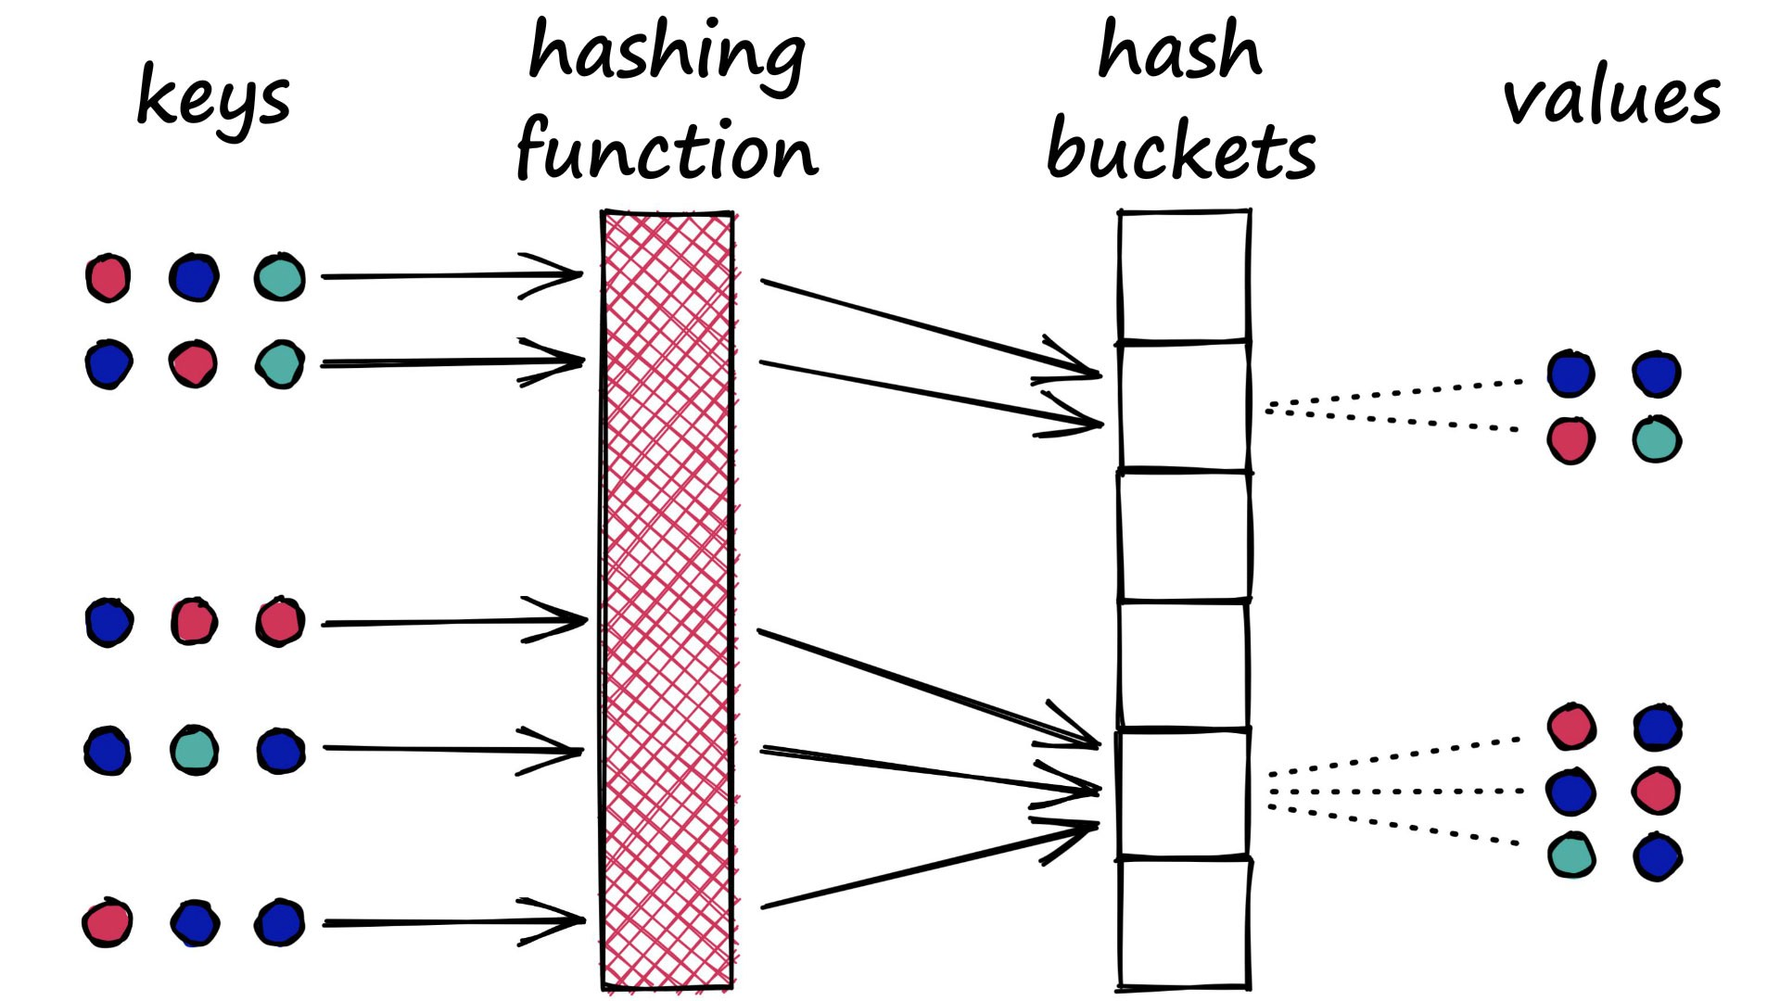
LSH aims to put similar keys in the same bucket
https://www.pinecone.io/learn/locality-sensitive-hashing-random-projection/

Slide 40
Basic LSH process
Convert each data point into an array of bits or integers, using the same conversion process/parameters for each
Map the arrays into buckets (e.g. with 10 bits, you have 2^10 buckets)
Can use subsets of arrays to create multiple sets of buckets
On query, return points in the same bucket(s)
Can check additional buckets by flipping bits to find points within hash distances greater than 0

Slide 41
Random Projection LSH
Data Preparation
Given data {X} with dimension d:
Center data on origin (subtract mean)
Create b random vectors h_{b} of length d
Convert each X_{n} to b bits: X_{n}h^{T} > 0
Query
Convert X_{q} to bits using h
Check buckets based on bit vector and similar bit vectors to return most similar data points
h= np.random.rand(nbits, d) - .5

Slide 42
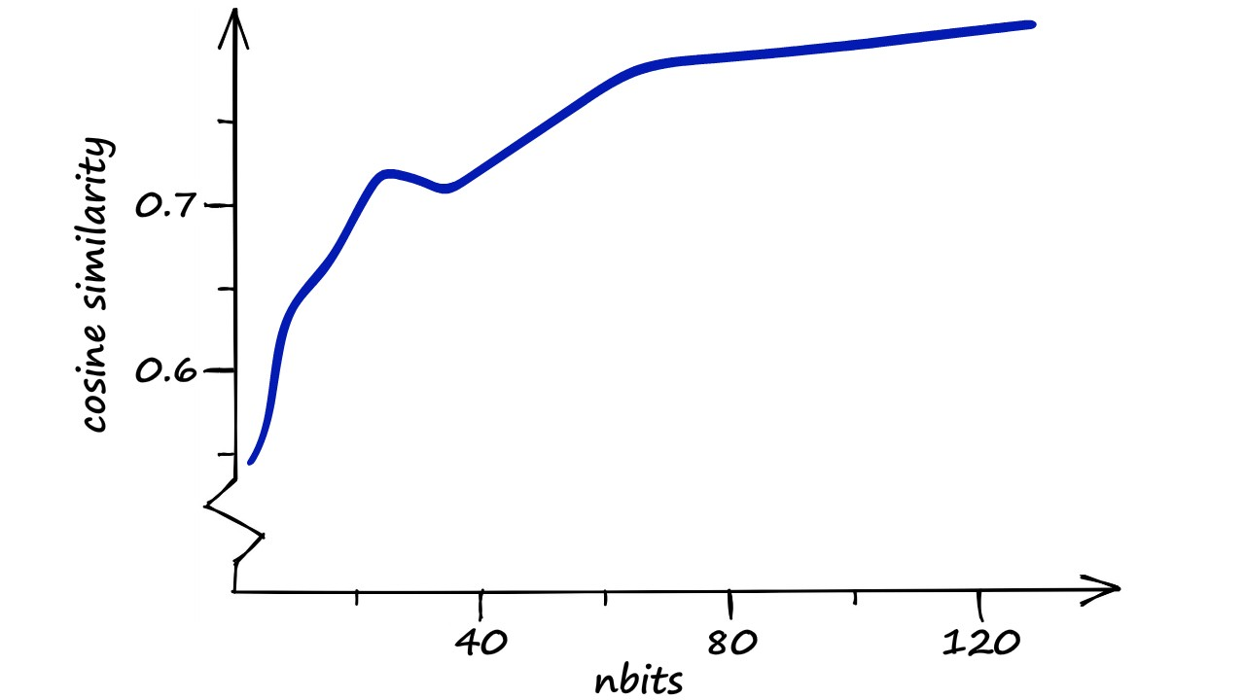
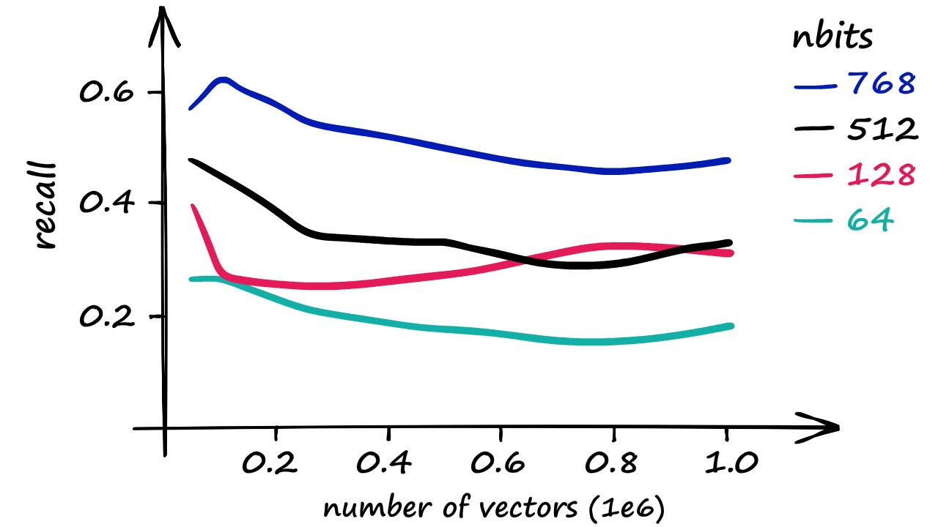
Key parameter: nbits
Example with 1M 128-bit SIFT vectors
More bits returns more similar vectors
Similarity of LSH-returned vector
Recall vs. exact nearest neighbor

Slide 43
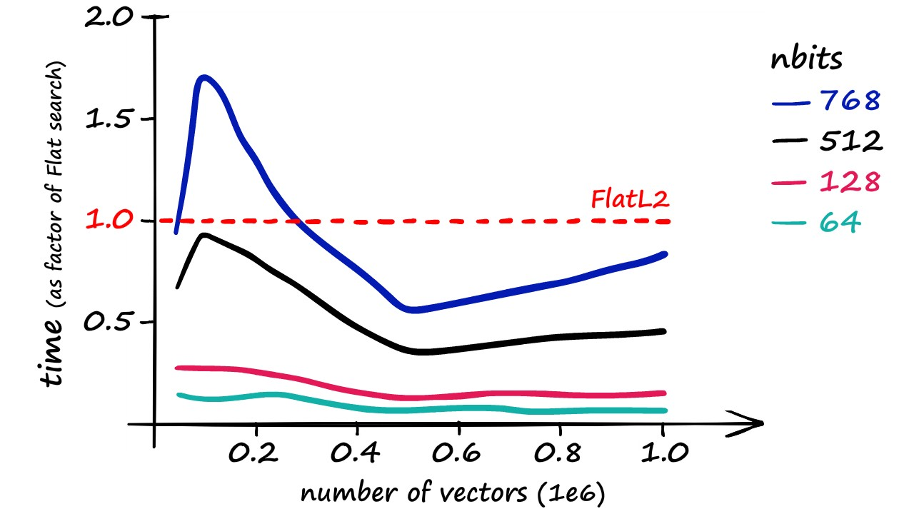
Key parameter: nbits
Example with 1M 128-bit SIFT vectors
But more bits takes more time to query because it needs to search more buckets to find a collision
Recall vs. exact nearest neighbor
Time compared to brute force search

Slide 44
Key parameter: nbits
Rule of thumb: nbits = dim is a decent choice (1 bit per feature dimension)
Optionally, can retrieve K closest data points and then use brute force search on those
Recall vs. exact nearest neighbor
Time compared to brute force search

Slide 45
Nice video about LSH in faiss: https://youtu.be/ZLfdQq_u7Eo which is part of this very detailed and helpful post: https://www.pinecone.io/learn/locality-sensitive-hashing-random-projection/

Slide 46
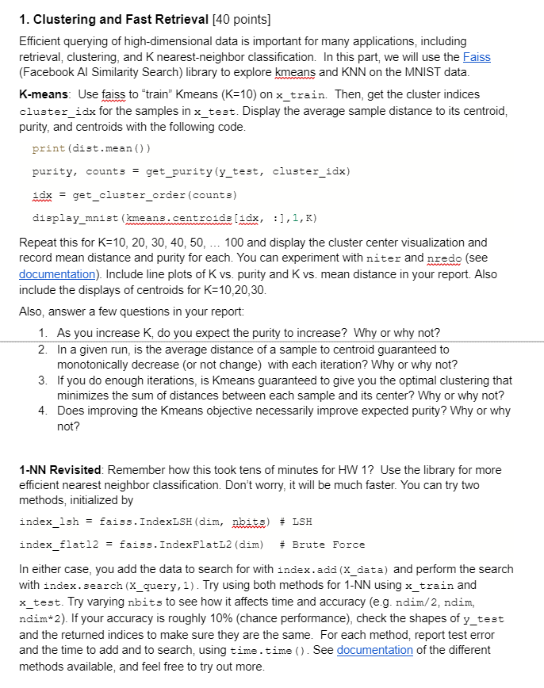

Slide 48
Things to remember
Clustering groups similar data points
K-means is the must-know method, but there are many others
TF-IDF is used for similarity of tokenized documents and used with index for fast search
Approximate search methods like LSH can be used to find similar points quickly
Use highly optimized libraries like FAISS

