Slide 1
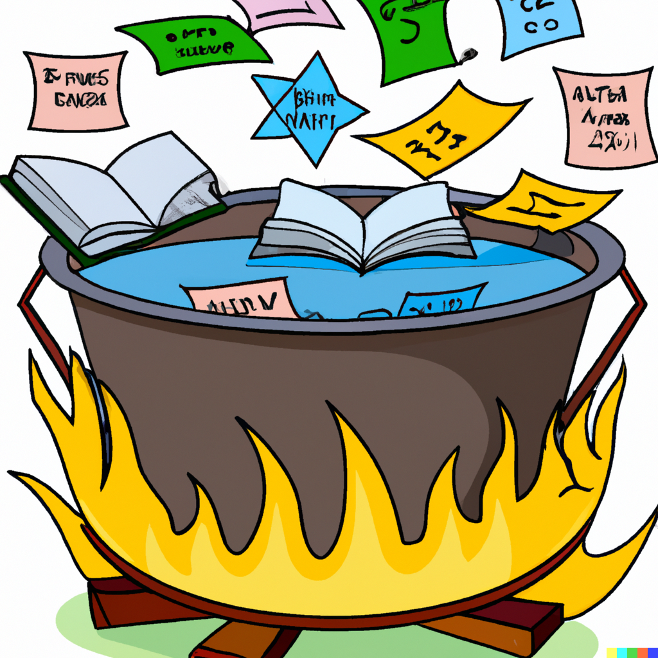
Consolidation and Review #2
Applied Machine Learning
Derek Hoiem

Slide 2
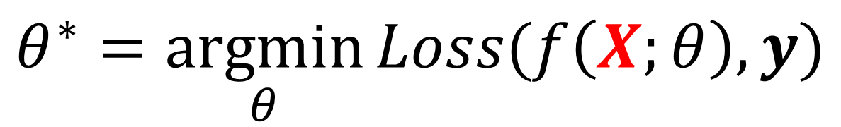
Let’s talk about $X$
$$θ^{∗}=\underset{θ}{argmin}{Loss(f\left(X;θ\right),y)}$$
Notes:
You see, when two bits love each other very much…

Slide 3
What is data?
Information that helps us make decisions
Numbers (bits)

Slide 4
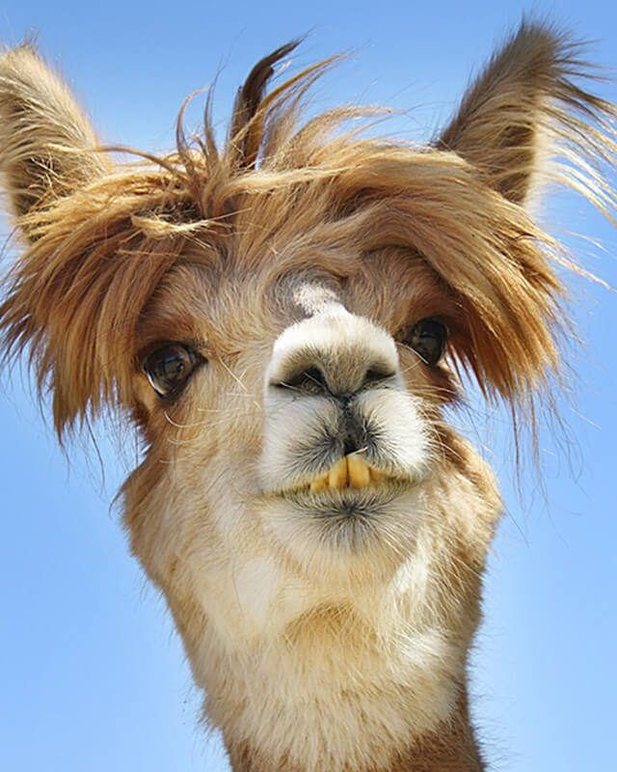
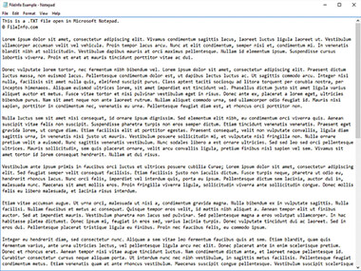
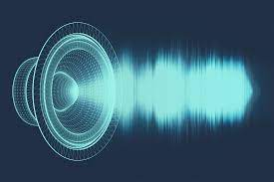
How do we represent data?
As humans: media we can see, read, and hear
  Words, imagery, sounds, tables, plots
https://www.canto.com/blog/audio-file-types/
https://www.rd.com/list/funny-photos/
https://fileinfo.com/extension/txt

Slide 5
Sometimes, we can transform the data while preserving much or all of the information
Resize an image
Rephrase a paragraph
1.5x an audio book

Slide 6
Sometimes, we can even transform the data so that it is more informative
Perform denoising on an image
Identify key points and insights in a document
Remove background noise from audio
None of these operations add information to the data, but they re-organize and/or remove distracting information

Slide 7
In computers, data are numbers
The numbers do not “mean” anything by themselves
The meaning comes from the way the numbers were produced and how they can inform
The meaning can be contained in each number by itself, or commonly by patterns in groups of numbers

Slide 8
Sometimes, we can transform the data while preserving much or all of the information
Add or multiply by a constant value
Represent as a 16-bit or 32-bit float or integer
Compress a document, or store in a different file format

Slide 9
Sometimes, we can even transform the data so that it is more informative
Center and rescale images of digits so they are easier to compare to each other
Normalize (subtract means and divide by standard deviations) cancer cell measurements to make simple similarity measures better reflect malignancy
Select features or create new ones out of combinations of inputs

Slide 10
Sometimes, we change the structure of data to make it easier to process
Image as matrix
Image as vector
0.92 | 0.93 | 0.94 | 0.97 | 0.62 | 0.37 | 0.85 | 0.97 | 0.93 | 0.92 | 0.99
0.95 | 0.89 | 0.82 | 0.89 | 0.56 | 0.31 | 0.75 | 0.92 | 0.81 | 0.95 | 0.91
0.89 | 0.72 | 0.51 | 0.55 | 0.51 | 0.42 | 0.57 | 0.41 | 0.49 | 0.91 | 0.92
0.96 | 0.95 | 0.88 | 0.94 | 0.56 | 0.46 | 0.91 | 0.87 | 0.90 | 0.97 | 0.95
0.71 | 0.81 | 0.81 | 0.87 | 0.57 | 0.37 | 0.80 | 0.88 | 0.89 | 0.79 | 0.85
0.49 | 0.62 | 0.60 | 0.58 | 0.50 | 0.60 | 0.58 | 0.50 | 0.61 | 0.45 | 0.33
0.86 | 0.84 | 0.74 | 0.58 | 0.51 | 0.39 | 0.73 | 0.92 | 0.91 | 0.49 | 0.74
0.96 | 0.67 | 0.54 | 0.85 | 0.48 | 0.37 | 0.88 | 0.90 | 0.94 | 0.82 | 0.93
0.69 | 0.49 | 0.56 | 0.66 | 0.43 | 0.42 | 0.77 | 0.73 | 0.71 | 0.90 | 0.99
0.79 | 0.73 | 0.90 | 0.67 | 0.33 | 0.61 | 0.69 | 0.79 | 0.73 | 0.93 | 0.97
0.91 | 0.94 | 0.89 | 0.49 | 0.41 | 0.78 | 0.78 | 0.77 | 0.89 | 0.99 | 0.93
0.92
0.95
0.89
0.96
0.71
0.49
0.86
0.96
0.69
0.79
0.91
0.93
0.89
0.72
0.95
0.81
0.62
0.84
0.67
0.49
0.73
0.94
…
0.93
Convenient for local pattern analysis
This does not change the information in the data, but it makes it harder to understand by people and more/less convenient for certain kinds of processing
Convenient for linear projection

Slide 11
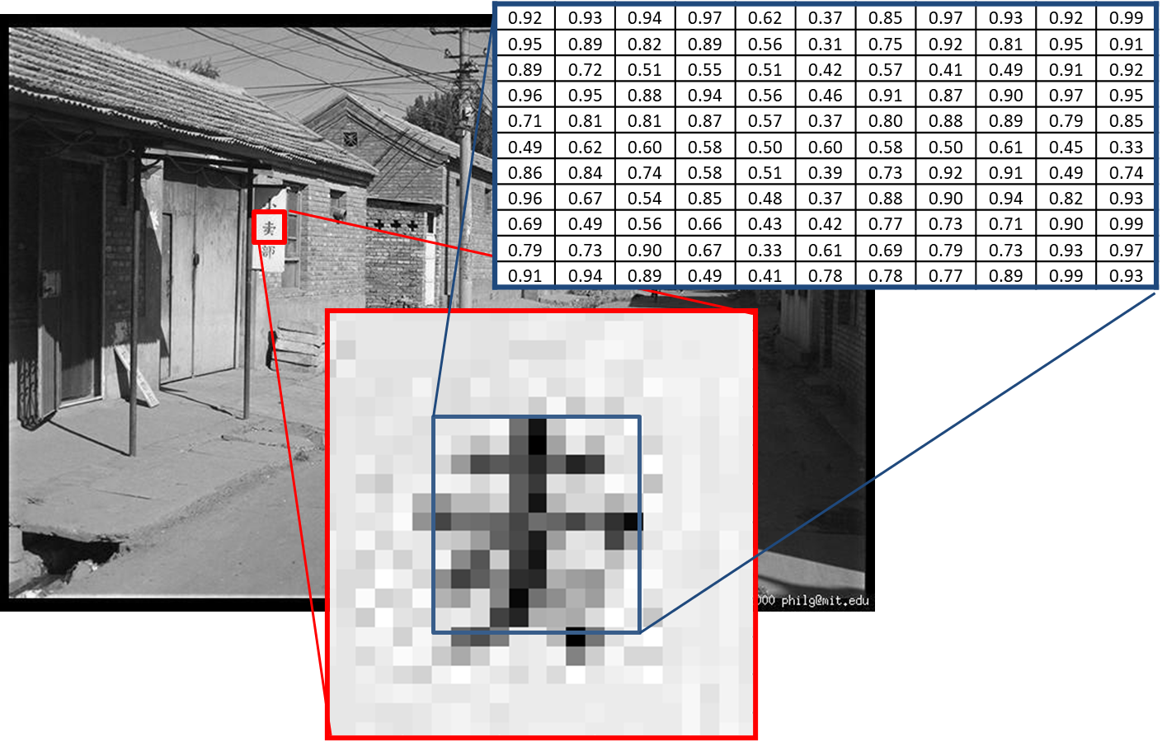
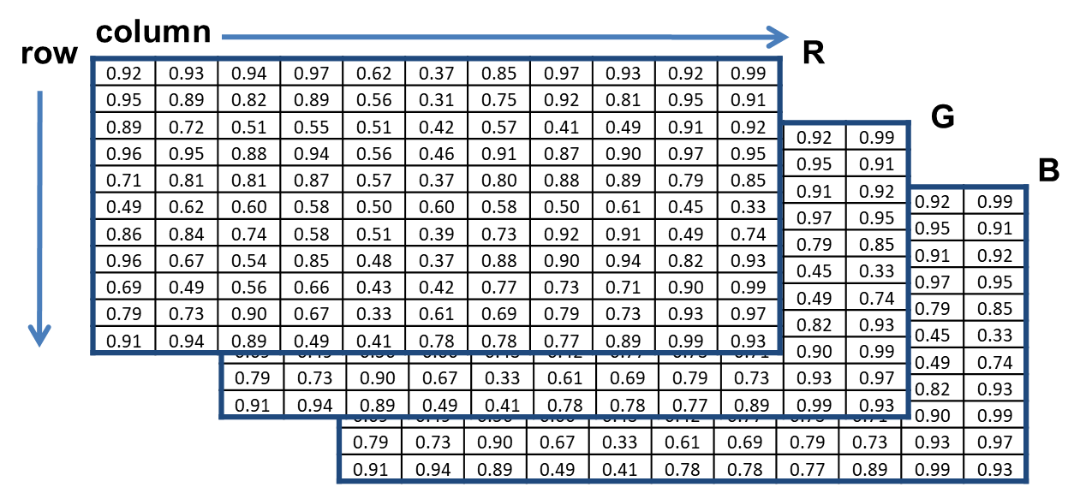
Images are represented as 3D matrices (row, col, color)

Slide 12
Text can be represented as a sequence of integers
Each character can map to a byte value, and then we have a sequence of bytes
  “Dog ate” → [4 15 7 27 1 20 5]
Each complete word can map to an integer value, and we have a sequence of integers
  “Dog ate” → [437 1256]
Common groups of letters can be mapped to subwords and then to integers
  “Bedroom 1521” → [bed-room- -1-5-2-1]→[125 631 27 28 32 29 27]

Slide 13
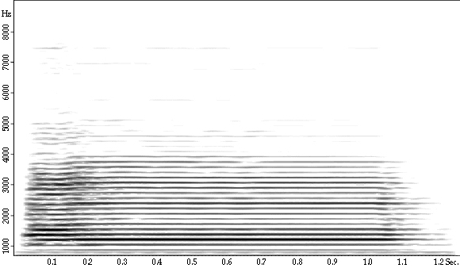
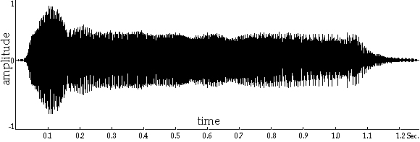
Audio can be represented as a waveform or spectrum
Amplitude vs Time
Frequency-Amplitude vs Time
Fig source

Slide 14
Other kinds of data
Measurements and continuous values typically represented as floating point numbers
  Temperature, length, area, dollars
Categorical values represented as integers
  Happy/Indifferent/Sad → 0/1/2
  Red/Green/Blue/Orange → 0/1/2/3/4
Different kinds of values (text, images, measurements) can be reshaped and concatenated into a long feature vector

Slide 15
The same information content can be represented in many ways. If the original numbers can be recovered, then a change in representation does not change the information content.
All types of data can be stored as 1D vectors/arrays.
Matrices and other data structures make code easier to program and read.

Slide 16
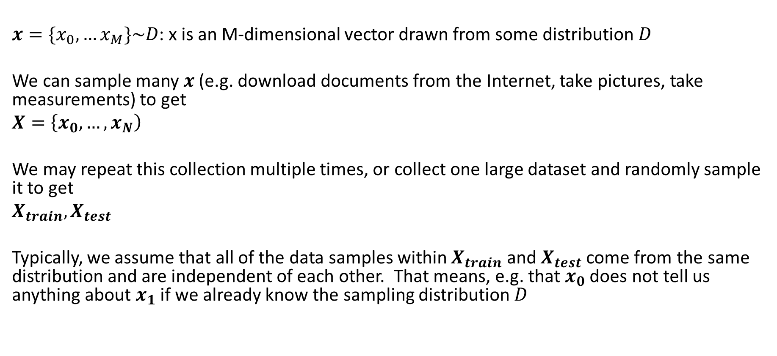
From data point to data set
$x=\{x_{0},…x_{M}\}\sim D$: x is an M-dimensional vector drawn from some distribution $D$
We can sample many $x$ (e.g. download documents from the Internet, take pictures, take measurements) to get
$X=\left\{x_{0}, …, x_{N}\right)$
We may repeat this collection multiple times, or collect one large dataset and randomly sample it to get
$X_{train}, X_{test}$
Typically, we assume that all of the data samples within $X_{train}$ and $X_{test}$ come from the same distribution and are independent of each other. That means, e.g. that $x_{0}$ does not tell us anything about $x_{1}$ if we already know the sampling distribution $D$

Slide 17
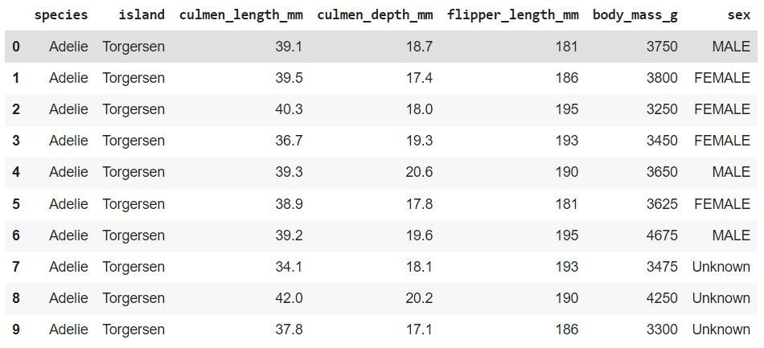
Consider an example from the penguins dataset

Slide 18
Convert the data into numbers
df_penguins = pd.read_csv(datadir + 'penguins_size.csv')
df_penguins.head(10)
# convert features with multiple string values to binary features so they can be used by sklearn
def get_penguin_xy(df_penguins):
data = np.array(df_penguins[['island', 'culmen_length_mm', 'culmen_depth_mm', 'flipper_length_mm’, \
'body_mass_g', 'sex']])
y = df_penguins['species']
ui = np.unique(data[:,0]) # unique island
us = np.unique(data[:,-1]) # unique sex
X = np.zeros((len(y), 10))
for i in range(len(y)):
f = 0
for j in range(len(ui)): # replace island name with three indicator variables
if data[i, f]==ui[j]:
X[i, f+j] = 1
f = f + len(ui)
X[i, f:(f+4)] = data[i, 1:5] # copy original measurement features
f=f+4
for j in range(len(us)): # replace sex with three indicator variables (male/female/unknown)
if data[i, 5]==us[j]:
X[i, f+j] = 1
feature_names = ['island_biscoe', 'island_dream', 'island_torgersen', 'culmen_length_mm’, \
'culmen_depth_mm', 'flipper_length_mm', 'body_mass_g', 'sex_female', 'sex_male', 'sex_unknown']
X = pd.DataFrame(X, columns=feature_names)
return(X, y, feature_names, np.unique(y))

Slide 19

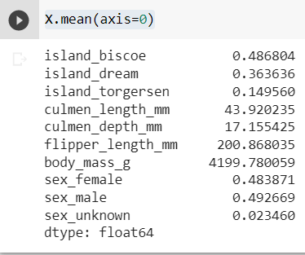
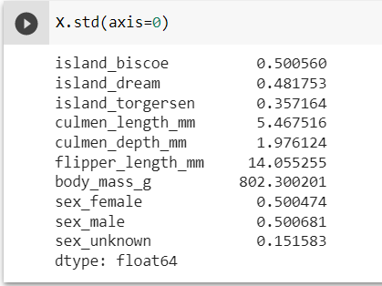
How do we measure $X$?
We can check the number of samples and dimensions
We can measure the distribution with statistics

Slide 20
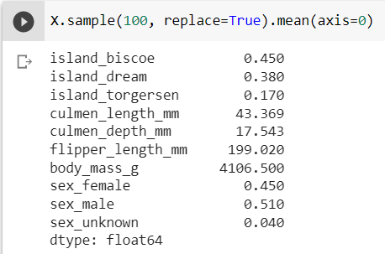
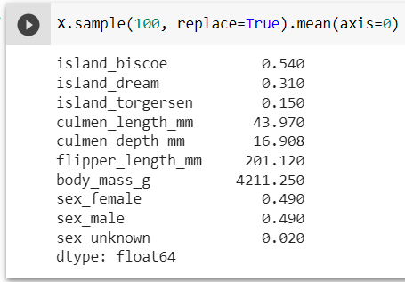
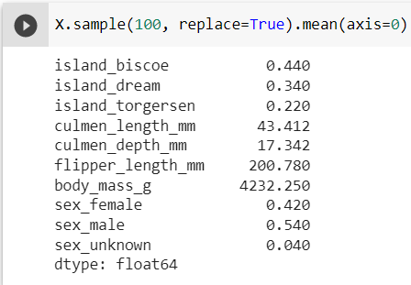
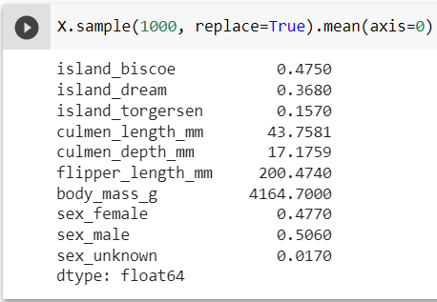
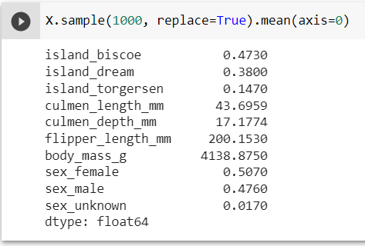
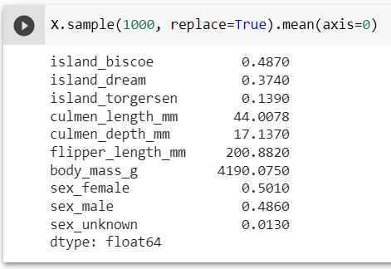
Different samples will give us different measurements of the distribution
The estimates from larger sample sizes will vary less

Slide 21
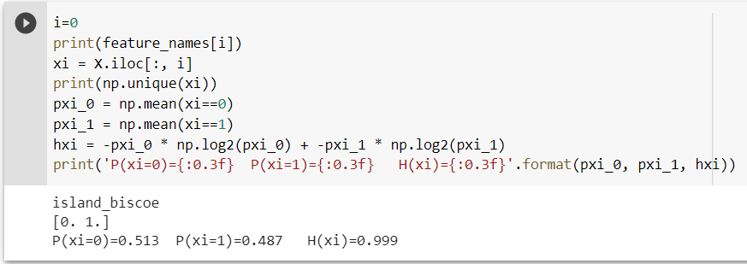
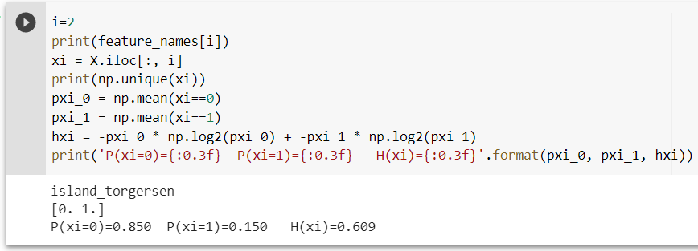

How do we measure $X$?
We can measure the entropy of a particular variable:
$H\left(x\right)=−\sum_{k}{\left[P\left(x=k\right)\log{P\left(x=k\right)}\right]}$ (if x is discrete, i.e. finite number of possible values)

Slide 22
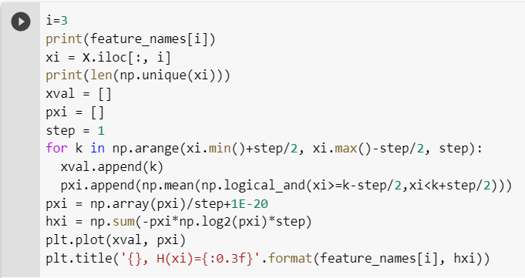
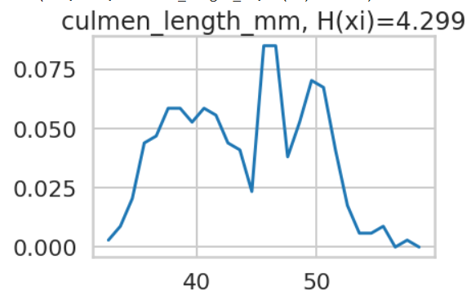

How do we measure $X$?
We can measure the entropy of a particular variable:
$H\left(x\right)=−\int{p\left(x\right)log⁡(p\left(x\right))}dx$ (if x is continuous)

Slide 23
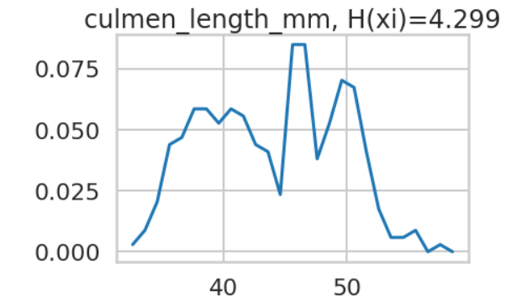
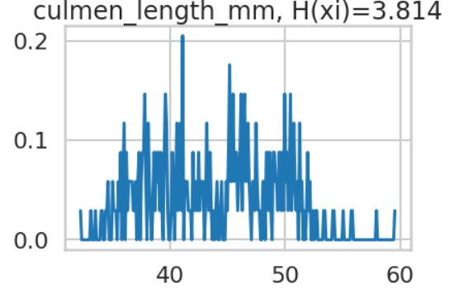

How do we measure $X$?
We can measure the entropy of a particular variable:
$H\left(x\right)=−\int{p\left(x\right)log⁡(p\left(x\right))}$ (if x is continuous)
But probability densities and entropy of continuous variables are tricky to estimate
Step = 1
Step = 0.1

Slide 24
Entropy measures how many bits are required to store an element of data
Does this mean that entropy is a measure of information?
Does a random array contain information?

Slide 25
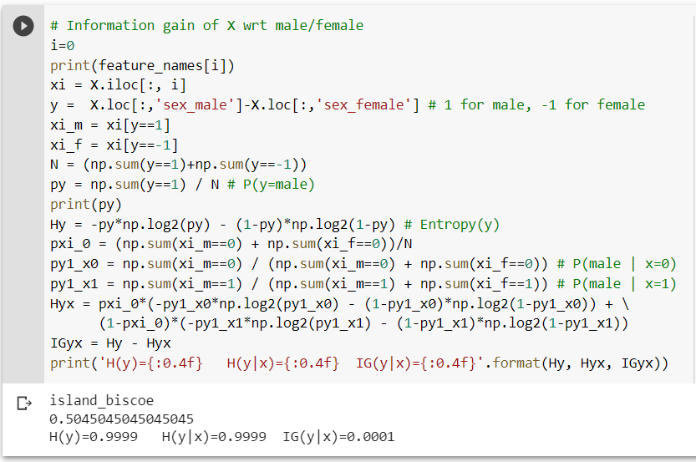
Information gain: IG(y|x) = H(y)-H(y|x)
Information gain measures how much a variable x reduces the entropy of y when known, i.e. how many fewer bits are needed to encode y given the value of x
Knowing the island is Biscoe tells us very little about whether a penguin is likely to be male or female

Slide 26
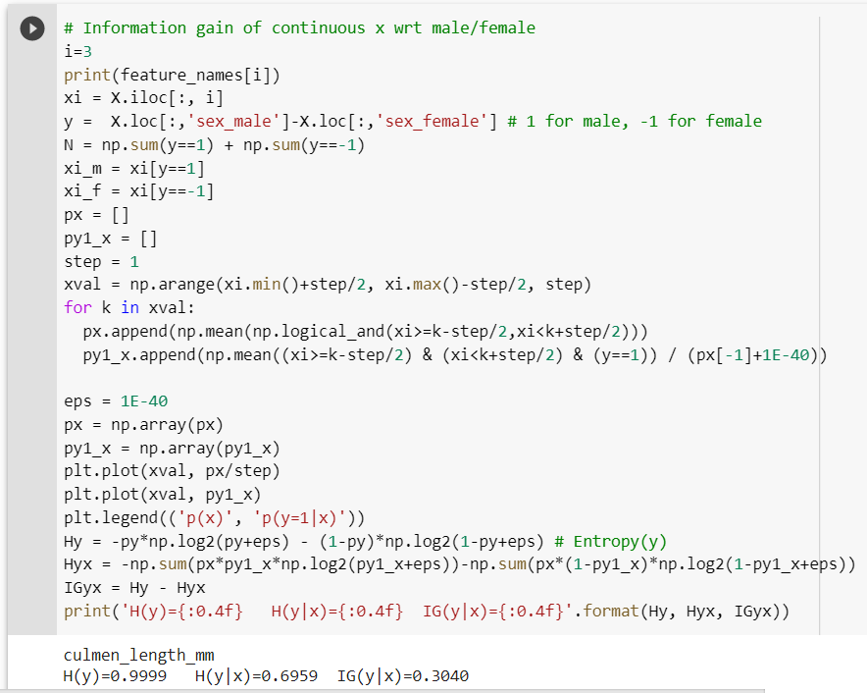
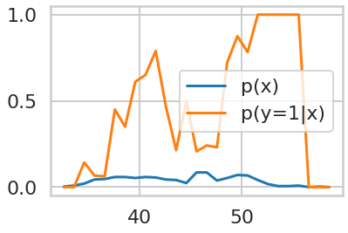
Information gain: IG(y|x) = H(y)-H(y|x)
Also applies when x is continuous
IG(y|x) = 0.304
Knowing the culmen length tells us a lot whether a penguin is likely to be male or female. Large culmens are always male, but smaller ones could be male (maybe young) or female.

Slide 27
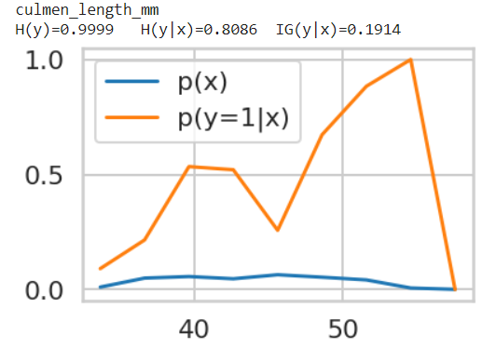
Information gain: IG(y|x) = H(y)-H(y|x)
Again, details on how continuous distribution is estimated can lead to different information gains
Step=1
Step=3
IG(y|x) = 0.304
IG(y|x) = 0.1904

Slide 28
How can the information gain be different depending our step size?
We have only an empirical estimate (based on observed samples) of probabilities used to compute information gain
With more data, we could obtain a better estimate
With continuous variables, there is a trade-off between over-smoothing or simplifying the distribution and making overly confident predictions based on small data samples
This is another example of the bias-variance trade-off
  The step size we choose would likely depend on the amount of data available
The true probability distributions and information gain cannot be known. We can only try to make our best estimate
Step=1
Step=3
IG(y|x) = 0.304
IG(y|x) = 0.190

Slide 29
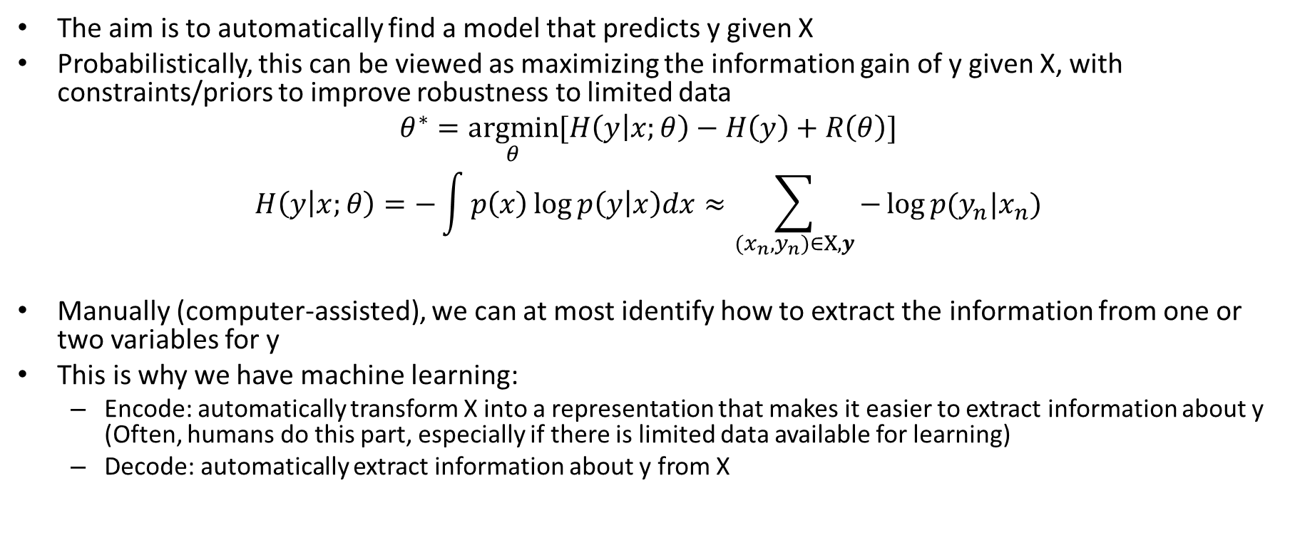
Coming back to
$$θ^{∗}=\underset{θ}{argmin}{Loss(f\left(X;θ\right),y)}$$
The aim is to automatically find a model that predicts y given X
Probabilistically, this can be viewed as maximizing the information gain of y given X, with constraints/priors to improve robustness to limited data
$$θ^{∗}=\underset{θ}{argmin}{[H\left(y | x;θ\right)−H\left(y\right)}+R\left(θ\right)]$$
$$H\left(y | x;θ\right)=−\int{p\left(x\right)\log{p\left(y | x\right)dx}}≈\sum_{{(x}_{n},y_{n})∈X,y}{−\log{p(y_{n}|x_{n})}}$$
Manually (computer-assisted), we can at most identify how to extract the information from one or two variables for y
This is why we have machine learning:
  Encode: automatically transform X into a representation that makes it easier to extract information about y (Often, humans do this part, especially if there is limited data available for learning)
  Decode: automatically extract information about y from X

Slide 30
The most powerful ML algorithms smoothly combine encoding (feature extraction) with decoding (prediction) and offer controls or protections against overfitting
Random Forests
Deep trees partition the feature space by optimizing information gain for a subset of features (individually low bias, high variance)
Vote averaging reduces variance/overfitting
Boosted Trees
Shallow trees partition the feature space by optimizing information gain (high bias, low variance)
Each tree is trained on weighted sample to focus on previous mispredictions, so combination reduces bias (but may increase variance if there are many deeper trees, as eventually all the weight will be on the few hardest examples)
Deep Networks
End-to-end learning (gradient flow from prediction to input) enables joint optimization of features and prediction
Intermediate layers represent transformations of the data that are more easily re-usable than tree partitions
The structure of the network (max feature width) controls overfitting
Massive datasets further reduce variance when training “from scratch”

Slide 31
Deep network optimization
The long-standing challenge in deep (many-layer) neural networks is how to optimize them
Optimization is by stochastic gradient descent (SGD) and back-propagation
  where weight updates are computed by summing products of error gradients from input of the weight to the network’s output
  SGD is performed efficiently using back-propagation, a dynamic program that re-uses weight gradient computations at each layer to compute the gradients for the previous layer
Deep networks are composed of layers and activations
  Sigmoid activations, traditionally used, have gradients less than 1 everywhere, and often much less than 1, so gradients “vanish” in earlier layers, due to a product of many values less than 1
  ReLU activations have gradients of 0 or 1 everywhere, so they do not have this problem as much, but you can have “dead” (gradient=0 for input of all/most samples) ReLUs that can hinder optimization
  Skip connections add the output of one layer to the output of a later layer (gradient=1), enabling error gradients to flow through the entire network
SGD has many variants and tricks to improve speed and stability of optimization
  Momentum accelerates the steps when sequential batches produce similar error gradients
  Gradient path length normalizations prevent focusing too much on a small number of weights
  Gradient clipping (for example, g = max(min(g, g_max), -gmax)) prevents gradients from “exploding” and improves stability of optimization
  SGD+momentum and Adam (SGD+momentum+normalization) are most widely used, but more advanced methods are available, such as RANGER (Rectified Adam with gradient centering and look-ahead)

Slide 32
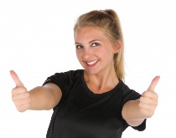
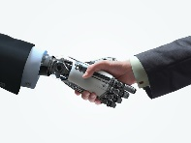
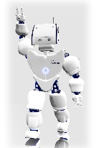
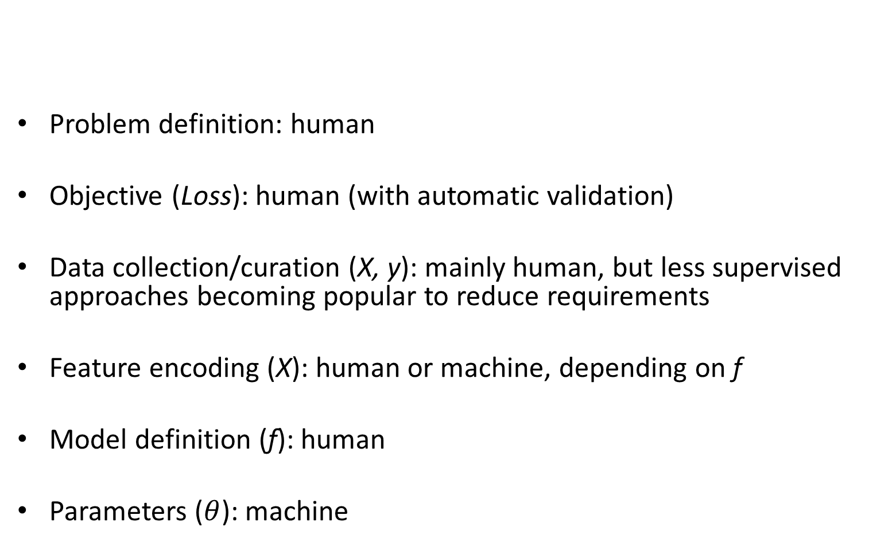
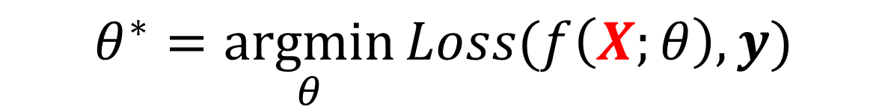
Whose job is ML – human or machine?
$$θ^{∗}=\underset{θ}{argmin}{Loss(f\left(X;θ\right),y)}$$
Problem definition: human
Objective (Loss): human (with automatic validation)
Data collection/curation (X, y): mainly human, but less supervised approaches becoming popular to reduce requirements
Feature encoding (X): human or machine, depending on f
Model definition (f): human
Parameters ($θ$): machine
Shake hands fig

Slide 33
Midterm Exam Logistics
Mar 9 (exam will be open for most of the day)
Exam will be 75 minutes long (or longer for those with DRES accommodations)
Mainly multiple choice / multiple select
  No coding or complex calculations; mainly tests conceptual understanding
You take it at home (open book) on PrairieLearn
Not cheating
  Consult notes, practice questions/answers, slides, internet, etc.
Cheating
  Talking to a classmate about the exam after one (but not both) of you has taken it
  Getting help from another person during the exam
You will not have time to look up all the answers, so do prepare by reviewing slides, lectures, AML book, and practice questions

Slide 34
Midterm Exam Central Topics
How does train/test error depend on
  Number of training samples
  Complexity of model
Bias-variance trade-off, including meaning of “bias” and “variance” for ML models and “overfitting”
Basic function/form/assumptions of classification/regression models (KNN, NB, linear/logistic regression, trees, SVMs, boosted trees, random forests, ensembles
Entropy/Information gain
SGD and activation layers

Slide 35
Bias-Variance Trade-off
Variance: due to limited data
Different training samples will give different models that vary in predictions for the same test sample
“Noise”: irreducible error due to data/problem
Bias: error when optimal model is learned from infinite data
Above is for regression.
But same error = variance + noise + bias² holds for classification error and logistic regression.
See this for derivation
Fig Sources

Slide 36
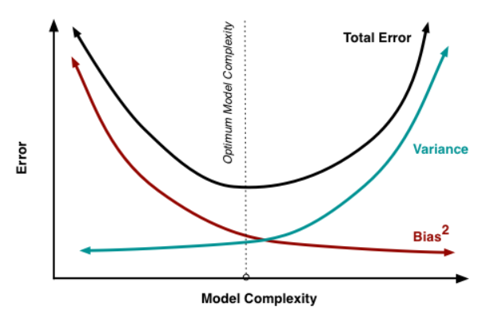

Slide 37
Performance vs training size
As we get more training data:
  The same model has more difficulty fitting the data
  But the test error becomes closer to training error (reduced generalization error)
  Overall test performance improves
Fixed model
Due to limited training data (model variance) and distribution shift
Testing
Error
Test error with infinite training examples
Due to difference in P(y|x) in training and test (function shift)
Train error with infinite training examples
Training
Number of Training Examples
Due to limited power of model (model bias) and unavoidable intrinsic error (Bayes optimal error)

Slide 38
Questions
What are ways to reduce model bias?
  More complex model
  Boosting ensemble
What are ways to reduce model variance?
  More training examples
  Averaging ensemble
  Simpler model
Which models are linear (in terms of input features)?
  KNN
  Linear regression
  Linear SVM
  SVM with RBF kernel
  Decision tree
  Random forest
  Naïve bayes with Gaussian/multinomial
  Perceptron
  MLP
  2,3,7,8

Slide 39
Upcoming schedule
Thursday: CNNs and Vision
Next week (Feb 27+)
  HW 2 due, HW3 released
  Word representations and language models
  Transformers in vision and language
Following week (Mar 7+)
  Foundation models
  Exam
Spring break

