Slide 1
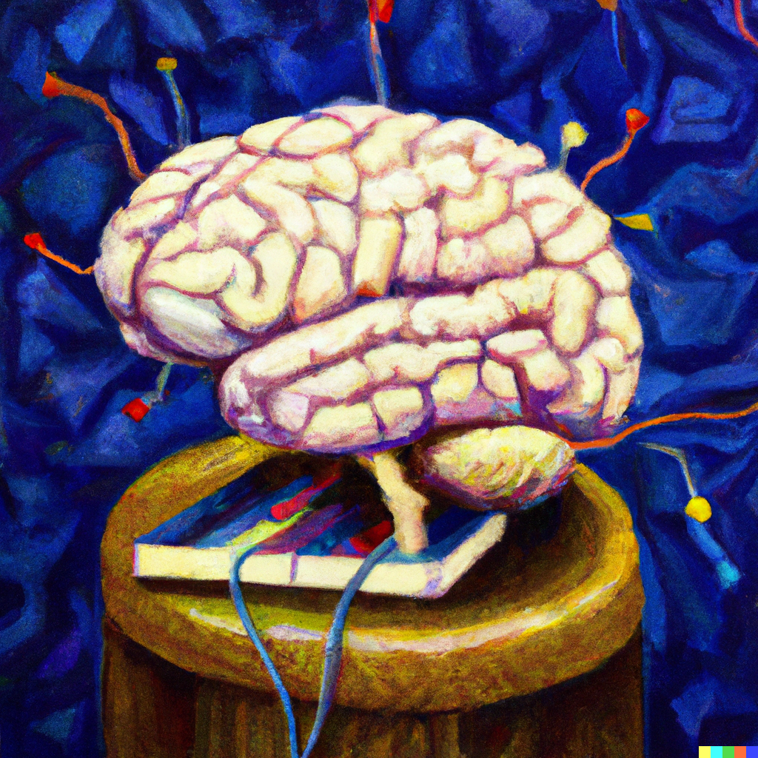
Deep Learning
Applied Machine Learning
Derek Hoiem
Dall-E

Slide 2
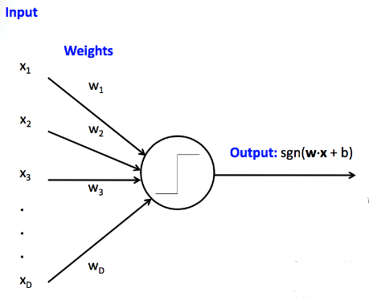
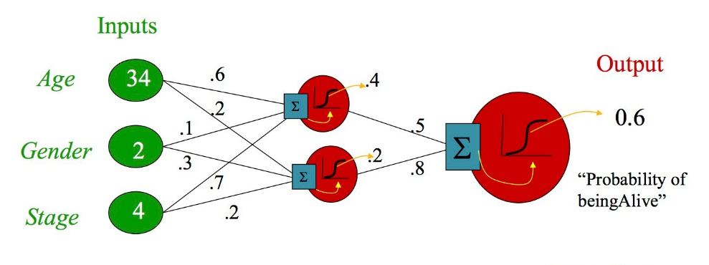
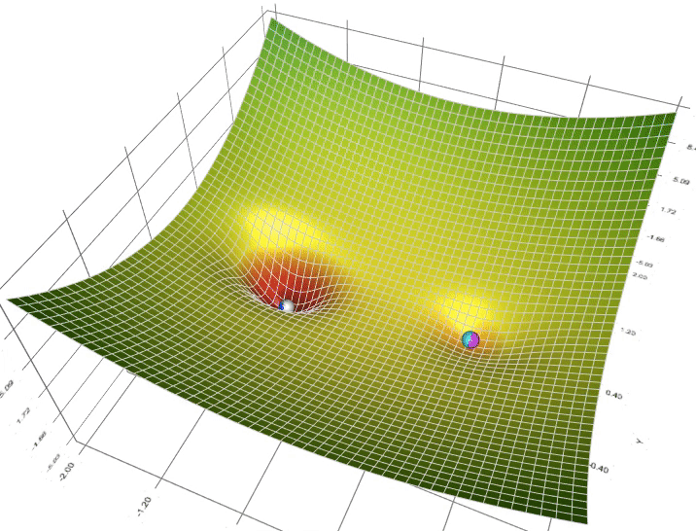
Last class
Perceptrons are linear prediction models
MLPs are non-linear prediction models, composed of multiple linear layers with non-linear activations
MLPs can model more complex functions, but are harder to optimize
Optimization is by stochastic gradient descent
Figure source

Slide 3
Another application example: mapping position/rays to color
L2 loss
ReLU MLP with 4 layers and 256 channels (nodes per layer)
Sigmoid activation on output
256 frequency positional encoding
Fourier Features (Tancik et al. 2020)
NeRF (Mildenhall et al. 2020)

Slide 4
HW 2
https://docs.google.com/document/d/13vTEGx3fdfc4rtcF86xoUyXm6eHmuvys5ZkMbcEgK4s/edit

Slide 5
Today’s Lecture
The story of how deep learning became so important
Optimization
Residual Networks

Slide 6
Brief history of deep learning
1950’s: neural nets (perceptron) invented by Rosenblatt
1980’s/1990’s: Neural nets are popularized and then abandoned as being interesting idea but impossible to optimize or “unprincipled”
1990’s: LeCun achieves state-of-art performance on character recognition with convolutional network
2000’s: Hinton, Bottou, Bengio, LeCun, Ng, and others keep trying stuff with deep networks but without much traction/acclaim
2010-2011: Substantial progress in some areas, but vision community still unconvinced
  Some neural net researchers get ANGRY at being ignored/rejected
2012: shock at ECCV 2012 with ImageNet challenge

Slide 7
Slide: Lazebnik
The Perceptron
Input
Weights
x₁
w₁
x₂
w₂
Output: sgn(w⋅x + b)
x₃
w₃
.
.
.
w_{D}
x_{D}
Rosenblatt, Frank (1958), The Perceptron: A Probabilistic Model for Information Storage and Organization in the Brain, Cornell Aeronautical Laboratory, Psychological Review, v65, No. 6, pp. 386–408.

Slide 8
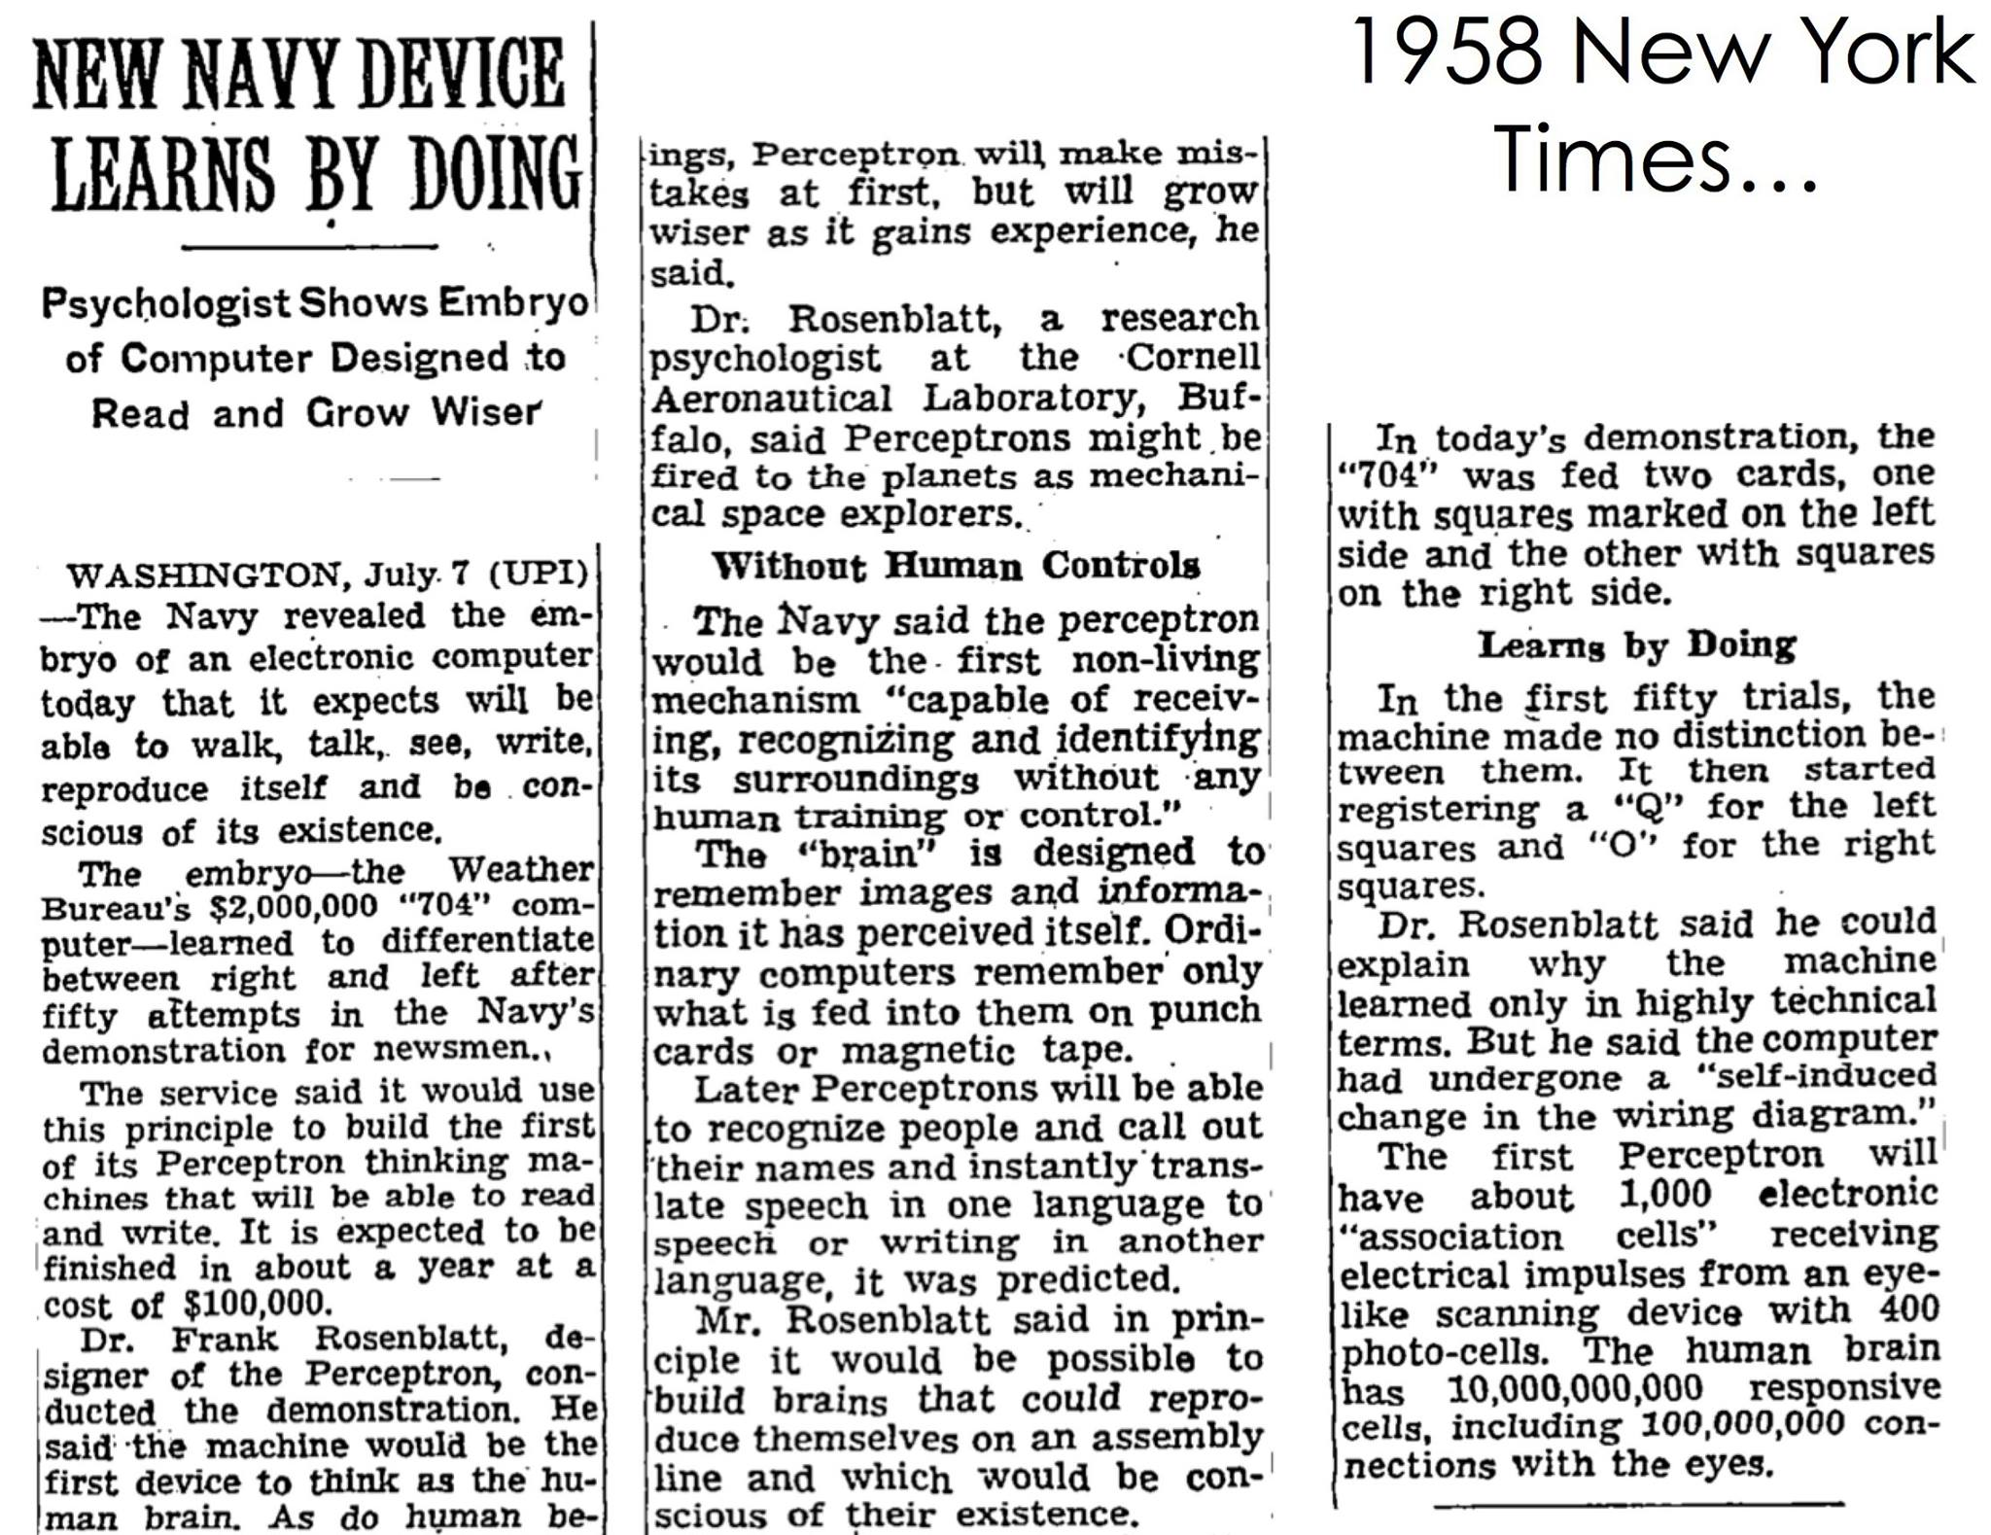
Slide: Lazebnik

Slide 9
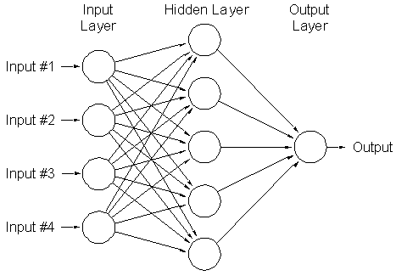
Two-layer neural network
Can learn nonlinear functions provided each perceptron has a differentiable nonlinearity
Sigmoid:
Slide: Lazebnik

Slide 10
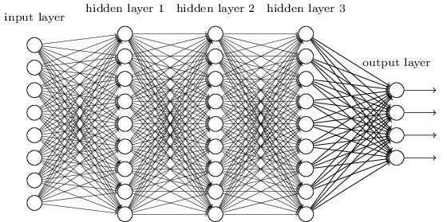
Multi-layer neural network
Slide: Lazebnik

Slide 11
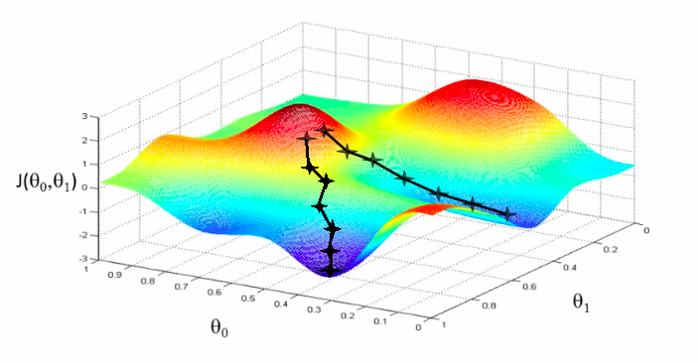
Training of multi-layer networks
Find network weights to minimize the training error between true and estimated labels of training examples, e.g.:
Update weights by gradient descent:
w₂
w₁
Slide: Lazebnik

Slide 12
Training of multi-layer networks
Find network weights to minimize the training error between true and estimated labels of training examples, e.g.:
Update weights by gradient descent:
Back-propagation: gradients are computed in the direction from output to input layers and combined using chain rule
Stochastic gradient descent: compute the weight update w.r.t. a small batch of examples at a time, cycle through training examples in random order in multiple epochs
Slide: Lazebnik

Slide 13
MLPs on Images

Slide 14
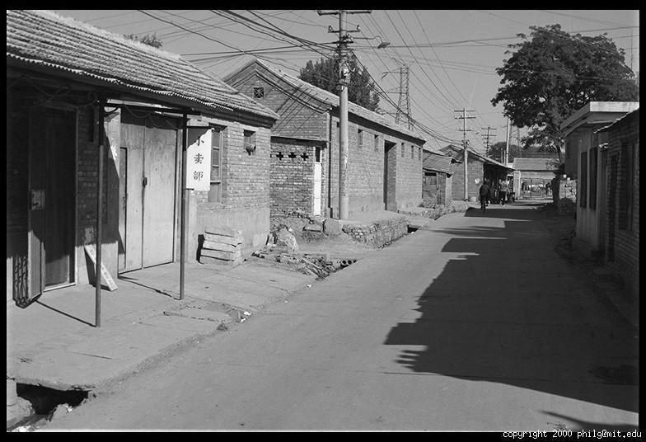
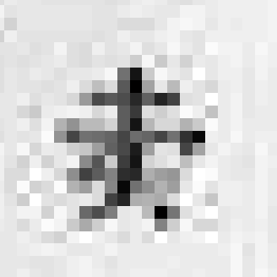
The raster image (pixel matrix)
0.92 | 0.93 | 0.94 | 0.97 | 0.62 | 0.37 | 0.85 | 0.97 | 0.93 | 0.92 | 0.99
0.95 | 0.89 | 0.82 | 0.89 | 0.56 | 0.31 | 0.75 | 0.92 | 0.81 | 0.95 | 0.91
0.89 | 0.72 | 0.51 | 0.55 | 0.51 | 0.42 | 0.57 | 0.41 | 0.49 | 0.91 | 0.92
0.96 | 0.95 | 0.88 | 0.94 | 0.56 | 0.46 | 0.91 | 0.87 | 0.90 | 0.97 | 0.95
0.71 | 0.81 | 0.81 | 0.87 | 0.57 | 0.37 | 0.80 | 0.88 | 0.89 | 0.79 | 0.85
0.49 | 0.62 | 0.60 | 0.58 | 0.50 | 0.60 | 0.58 | 0.50 | 0.61 | 0.45 | 0.33
0.86 | 0.84 | 0.74 | 0.58 | 0.51 | 0.39 | 0.73 | 0.92 | 0.91 | 0.49 | 0.74
0.96 | 0.67 | 0.54 | 0.85 | 0.48 | 0.37 | 0.88 | 0.90 | 0.94 | 0.82 | 0.93
0.69 | 0.49 | 0.56 | 0.66 | 0.43 | 0.42 | 0.77 | 0.73 | 0.71 | 0.90 | 0.99
0.79 | 0.73 | 0.90 | 0.67 | 0.33 | 0.61 | 0.69 | 0.79 | 0.73 | 0.93 | 0.97
0.91 | 0.94 | 0.89 | 0.49 | 0.41 | 0.78 | 0.78 | 0.77 | 0.89 | 0.99 | 0.93

Slide 15
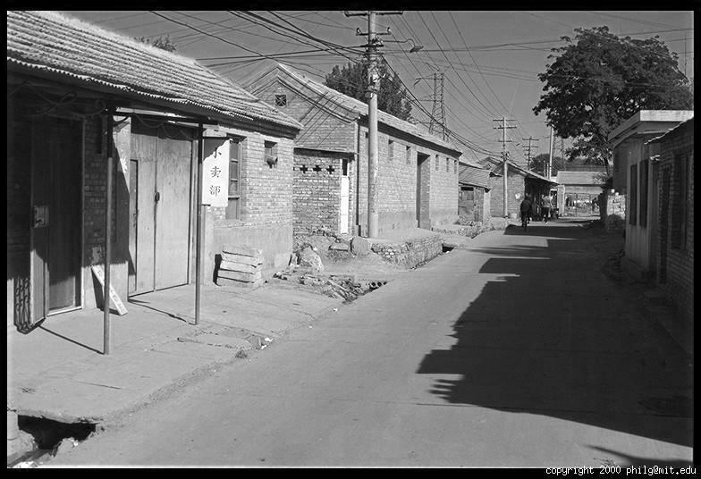
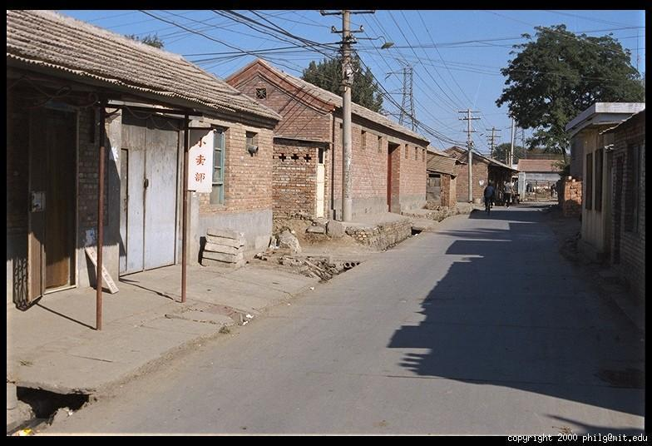
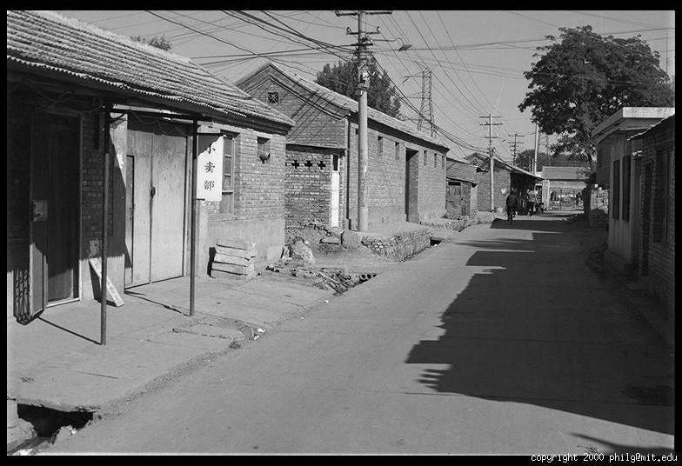
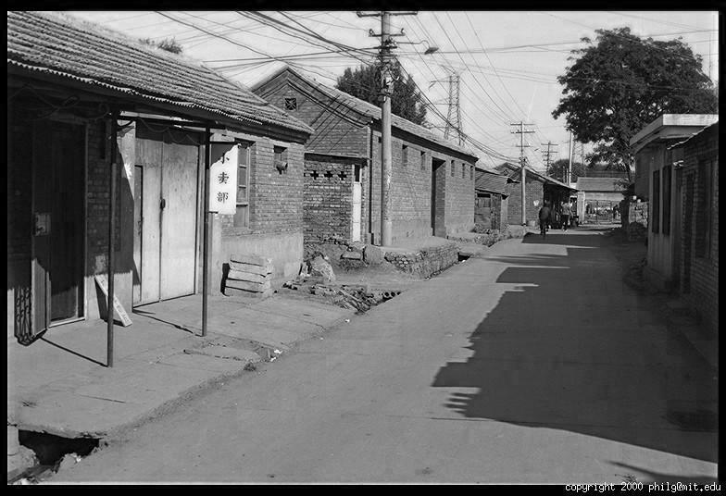
Color Image
R
G
B

Slide 16
Images in Python
im = cv2.imread(filename) # read image
im = cv2.cvtColor(im, cv2.COLOR_BGR2RGB) # order channels as RGB
im = im / 255 # values range from 0 to 1
RGB image im is a H x W x 3 matrix (numpy.ndarray)
im[0,0,0] = top-left pixel value in R-channel
im[y, x, c] = y+1 pixels down, x+1 pixels to right in the c^{th} channel
im[H-1, W-1, 2] = bottom-right pixel in B-channel
column
row
R
0.92 | 0.93 | 0.94 | 0.97 | 0.62 | 0.37 | 0.85 | 0.97 | 0.93 | 0.92 | 0.99
0.95 | 0.89 | 0.82 | 0.89 | 0.56 | 0.31 | 0.75 | 0.92 | 0.81 | 0.95 | 0.91
0.89 | 0.72 | 0.51 | 0.55 | 0.51 | 0.42 | 0.57 | 0.41 | 0.49 | 0.91 | 0.92
0.96 | 0.95 | 0.88 | 0.94 | 0.56 | 0.46 | 0.91 | 0.87 | 0.90 | 0.97 | 0.95
0.71 | 0.81 | 0.81 | 0.87 | 0.57 | 0.37 | 0.80 | 0.88 | 0.89 | 0.79 | 0.85
0.49 | 0.62 | 0.60 | 0.58 | 0.50 | 0.60 | 0.58 | 0.50 | 0.61 | 0.45 | 0.33
0.86 | 0.84 | 0.74 | 0.58 | 0.51 | 0.39 | 0.73 | 0.92 | 0.91 | 0.49 | 0.74
0.96 | 0.67 | 0.54 | 0.85 | 0.48 | 0.37 | 0.88 | 0.90 | 0.94 | 0.82 | 0.93
0.69 | 0.49 | 0.56 | 0.66 | 0.43 | 0.42 | 0.77 | 0.73 | 0.71 | 0.90 | 0.99
0.79 | 0.73 | 0.90 | 0.67 | 0.33 | 0.61 | 0.69 | 0.79 | 0.73 | 0.93 | 0.97
0.91 | 0.94 | 0.89 | 0.49 | 0.41 | 0.78 | 0.78 | 0.77 | 0.89 | 0.99 | 0.93
G
0.92 | 0.93 | 0.94 | 0.97 | 0.62 | 0.37 | 0.85 | 0.97 | 0.93 | 0.92 | 0.99
0.95 | 0.89 | 0.82 | 0.89 | 0.56 | 0.31 | 0.75 | 0.92 | 0.81 | 0.95 | 0.91
0.89 | 0.72 | 0.51 | 0.55 | 0.51 | 0.42 | 0.57 | 0.41 | 0.49 | 0.91 | 0.92
0.96 | 0.95 | 0.88 | 0.94 | 0.56 | 0.46 | 0.91 | 0.87 | 0.90 | 0.97 | 0.95
0.71 | 0.81 | 0.81 | 0.87 | 0.57 | 0.37 | 0.80 | 0.88 | 0.89 | 0.79 | 0.85
0.49 | 0.62 | 0.60 | 0.58 | 0.50 | 0.60 | 0.58 | 0.50 | 0.61 | 0.45 | 0.33
0.86 | 0.84 | 0.74 | 0.58 | 0.51 | 0.39 | 0.73 | 0.92 | 0.91 | 0.49 | 0.74
0.96 | 0.67 | 0.54 | 0.85 | 0.48 | 0.37 | 0.88 | 0.90 | 0.94 | 0.82 | 0.93
0.69 | 0.49 | 0.56 | 0.66 | 0.43 | 0.42 | 0.77 | 0.73 | 0.71 | 0.90 | 0.99
0.79 | 0.73 | 0.90 | 0.67 | 0.33 | 0.61 | 0.69 | 0.79 | 0.73 | 0.93 | 0.97
0.91 | 0.94 | 0.89 | 0.49 | 0.41 | 0.78 | 0.78 | 0.77 | 0.89 | 0.99 | 0.93
B
0.92 | 0.93 | 0.94 | 0.97 | 0.62 | 0.37 | 0.85 | 0.97 | 0.93 | 0.92 | 0.99
0.95 | 0.89 | 0.82 | 0.89 | 0.56 | 0.31 | 0.75 | 0.92 | 0.81 | 0.95 | 0.91
0.89 | 0.72 | 0.51 | 0.55 | 0.51 | 0.42 | 0.57 | 0.41 | 0.49 | 0.91 | 0.92
0.96 | 0.95 | 0.88 | 0.94 | 0.56 | 0.46 | 0.91 | 0.87 | 0.90 | 0.97 | 0.95
0.71 | 0.81 | 0.81 | 0.87 | 0.57 | 0.37 | 0.80 | 0.88 | 0.89 | 0.79 | 0.85
0.49 | 0.62 | 0.60 | 0.58 | 0.50 | 0.60 | 0.58 | 0.50 | 0.61 | 0.45 | 0.33
0.86 | 0.84 | 0.74 | 0.58 | 0.51 | 0.39 | 0.73 | 0.92 | 0.91 | 0.49 | 0.74
0.96 | 0.67 | 0.54 | 0.85 | 0.48 | 0.37 | 0.88 | 0.90 | 0.94 | 0.82 | 0.93
0.69 | 0.49 | 0.56 | 0.66 | 0.43 | 0.42 | 0.77 | 0.73 | 0.71 | 0.90 | 0.99
0.79 | 0.73 | 0.90 | 0.67 | 0.33 | 0.61 | 0.69 | 0.79 | 0.73 | 0.93 | 0.97
0.91 | 0.94 | 0.89 | 0.49 | 0.41 | 0.78 | 0.78 | 0.77 | 0.89 | 0.99 | 0.93

Slide 17
From fully connected to convolutional networks
You could treat the image like a vector of values and add fully connected layers (which is what we do in HW 1 and 2)
But this doesn’t take advantage of the 2D structure of images
image
Fully connected layer
Slide: Lazebnik

Slide 18
Image filtering
Image filtering: compute function of local neighborhood at each position
  Enhance images
    Denoise, resize, increase contrast, etc.
  Extract information from images
    Texture, edges, distinctive points, etc.
  Detect patterns
    Template matching

Slide 19
From fully connected to convolutional networks
image
Convolutional layer
Slide: Lazebnik

Slide 20
From fully connected to convolutional networks
feature map
learned weights
image
Convolutional layer
Slide: Lazebnik

Slide 21
From fully connected to convolutional networks
feature map
learned weights
image
Convolutional layer
Slide: Lazebnik

Slide 22
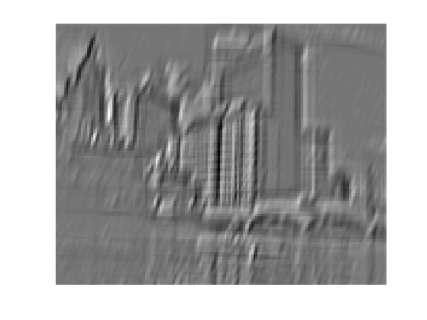
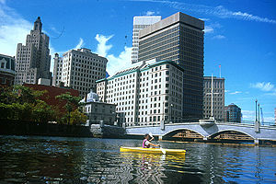
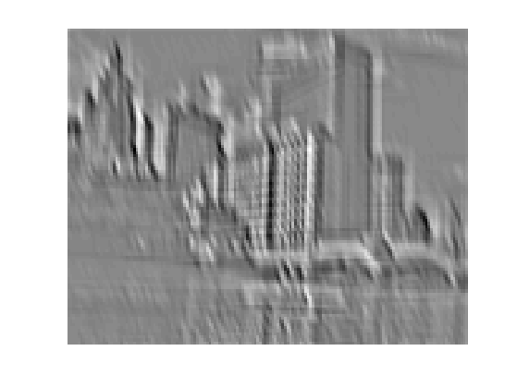
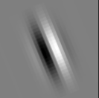
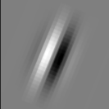
Convolution as feature extraction
...
Input
Feature Map
Slide: Lazebnik

Slide 23
From fully connected to convolutional networks
feature map
learned weights
image
Convolutional layer
Slide: Lazebnik

Slide 24
From fully connected to convolutional networks
next layer
image
Convolutional layer
Slide: Lazebnik

Slide 25
Key operations in a CNN
Feature maps
Spatial pooling
Non-linearity
Convolution (Learned)
...
Input Image
Input
Feature Map
Source: R. Fergus, Y. LeCun
Slide: Lazebnik

Slide 26
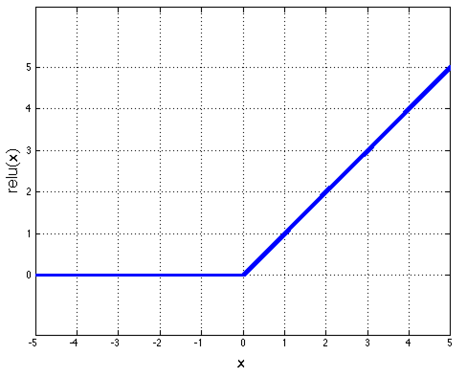
Key operations
Feature maps
Spatial pooling
Rectified Linear Unit (ReLU)
Non-linearity
Convolution (Learned)
Input Image
Source: R. Fergus, Y. LeCun
Slide: Lazebnik

Slide 27
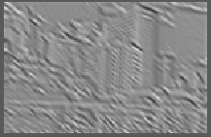
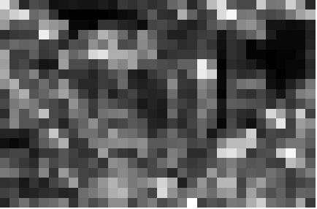
Key operations
Feature maps
Spatial pooling
  Max
Non-linearity
Convolution (Learned)
Input Image
Source: R. Fergus, Y. LeCun
Slide: Lazebnik

Slide 28
Key idea: learn features and classifier that work well together (“end-to-end training”)
Label
Dense
Dense
Dense
Convolution/pool
Convolution/pool
Convolution/pool
Convolution/pool
Convolution/pool
Image

Slide 29
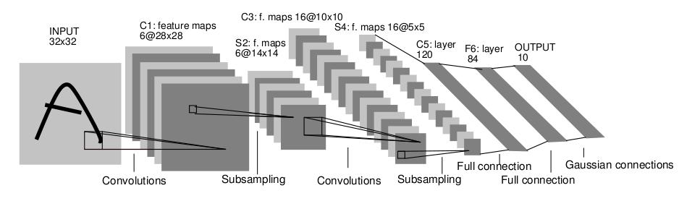
LeNet-5 for character/digit recognition
Average pooling
Sigmoid or tanh nonlinearity
Fully connected layers at the end
Trained on MNIST digit dataset with 60K training examples
Y. LeCun, L. Bottou, Y. Bengio, and P. Haffner, Gradient-based learning applied to document recognition, Proc. IEEE 86(11): 2278–2324, 1998.

Slide 30
Fast forward to the arrival of big visual data…
~14 million labeled images, 20k classes
Images gathered from Internet
Human labels via Amazon MTurk
ImageNet Large-Scale Visual Recognition Challenge (ILSVRC):
1.2 million training images, 1000 classes
www.image-net.org/challenges/LSVRC/
Slide: Lazebnik

Slide 31
2012 ImageNet 1K
(Fall 2012)
Slide: Jia-bin Huang

Slide 32

2012 ImageNet 1K (Fall 2012)
Slide: Jia-bin Huang

Slide 33
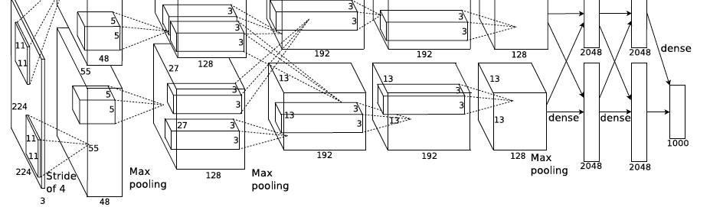
AlexNet: ILSVRC 2012 winner
Similar framework to LeNet but:
  Max pooling, ReLU nonlinearity
  More data and bigger model (7 hidden layers, 650K units, 60M params)
  GPU implementation (50x speedup over CPU)
    Trained on two GPUs for a week
  Dropout regularization
A. Krizhevsky, I. Sutskever, and G. Hinton, ImageNet Classification with Deep Convolutional Neural Networks, NIPS 2012
Notes:
Two-GPU architecture

Slide 34

What enabled the breakthrough?
ReLU activation enabled large models to be optimized
ImageNet provided diverse and massive annotation to take advantage of the models
GPU processing made the optimization practicable

Slide 35
R-CNN demonstrates major detection improvement by pre-training on ImageNet and fine-tuning on PASCAL
R-CNN
Deep learning detection
Regionlets
Deformable Parts Model (v1-v5)
HOG Template
HOG: Dalal-Triggs 2005 DPM: Felzenszwalb et al. 2008-2012 Regionlets: Wang et al. 2013 R-CNN: Girshick et al. 2014

Slide 36
“CNN Features off-the-shelf: an Astounding Baseline for Recognition”
Razavian et al. CVPR 2014

Slide 37
How it felt to be an object recognition researcher
https://youtu.be/XCtuZ-fDL2E?t=140

Slide 38
My Deep Reflections on Deep Learning
Deep learning does not help solve ML problems that we were solving.
DL enables taking advantage of large amounts of data by creating high capacity models that can be optimized well.
Creating a model that predicts y from X given available data is table stakes
  Application engineering is getting the data you need in the form you need to so that current ML algorithms can learn from it
  ML research makes it easier or possible to benefit from new data sources

Slide 39
2 Minute Stretch Break
How it felt to be an object recognition researcher
https://youtu.be/XCtuZ-fDL2E?t=140
A1:
Deep networks couldn’t be optimized
Needed bigger datasets
  Datasets were created to be sufficiently big for existing algorithms
  A2:
  ReLU activation (easier optimization)
  Big dataset
  GPU processing
Recall
Q1: Why were neural networks less effective than other approaches for many years?
Q2: What were the three most important ingredients to the breakthrough?

Slide 40
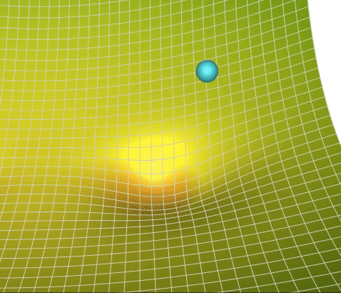

Optimization: check out this great site
Great site by Lili Jiang
https://towardsdatascience.com/a-visual-explanation-of-gradient-descent-methods-momentum-adagrad-rmsprop-adam-f898b102325c
Basic SGD:
$Δw_{t}=−ηg_{t}\left(w_{t}\right)$
$w_{t+1}=w_{t}+Δw_{t}$
Gradient of loss wrt weights

Slide 41
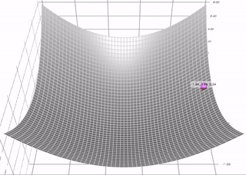
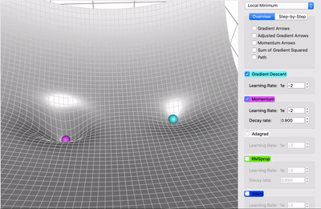

SGD + Momentum
SGD + Momentum:
$m\left(w_{t}\right)=β⋅m\left(w_{t}\right)+g_{t}(w_{t})$
$Δw_{t}=−η⋅m(w_{t})$
$w_{t+1}=w_{t}+Δw_{t}$
Momentum (magenta) converges faster and carries the ball through a local minimum
Figure source

Slide 42
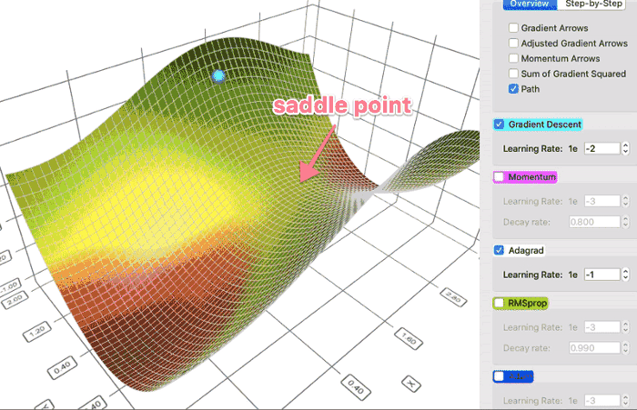

AdaGrad: Adaptive Gradient
AdaGrad:
$g_{mag}\left(w_{t}\right)=g_{mag}\left(w_{t−1}\right)+g_{t}{\left(w_{t}\right)}^{2}$
$Δw_{t}=−ηg_{t}\left(w_{t}\right)/\sqrt{g_{mag}(w_{t})}$ (normalize by path length of all previous updates)
$w_{t+1}=w_{t}+Δw_{t}$
AdaGrad (white) avoids moving in only one weight direction, and can lead to smoother convergence
Figure source

Slide 43
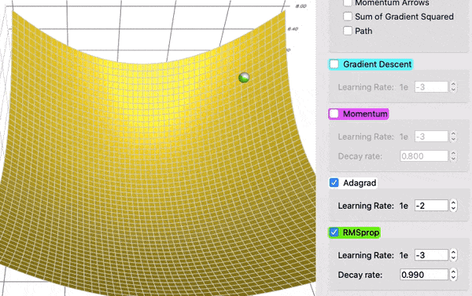

RMSProp: Root Mean Squared Propagation
RMSProp:
$g_{mag}\left(w_{t}\right)={ε⋅g}_{mag}\left(w_{t−1}\right)+\left(1−ε\right)⋅g_{t}{\left(w_{t}\right)}^{2}$ (introducing decay rate turns this into moving avg)
$Δw_{t}=−ηg_{t}\left(w_{t}\right)/\sqrt{g_{mag}(w_{t})}$ (normalize by path length of all previous updates)
$w_{t+1}=w_{t}+Δw_{t}$
RMSProp (green) moves faster than AdaGrad (white)
Figure source

Slide 44

Adam: Adaptive Moment Estimation
Adam:
$m\left(w_{t}\right)=β⋅m\left(w_{t}\right)+\left(1−β\right)⋅g_{t}(w_{t})$ [momentum, $β=0.9$]
$g_{mag}\left(w_{t}\right)={ε⋅g}_{mag}\left(w_{t−1}\right)+\left(1−ε\right)⋅g_{t}{\left(w_{t}\right)}^{2}$ [RMSProp, $ε=0.999$]
$Δw_{t}=−η⋅m\left(w_{t}\right)/\sqrt{g_{mag}(w_{t})}$
$w_{t+1}=w_{t}+Δw_{t}$
Adam is widely used and easier to tune than SGD + momentum
Videos
Figure source

Slide 45
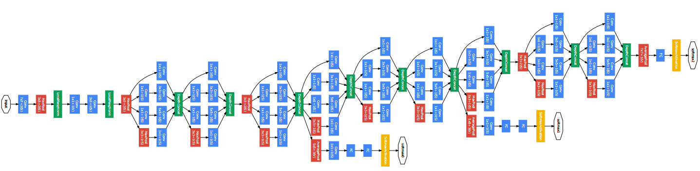
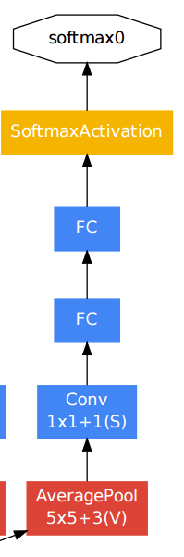
Even with ReLU and Adam optimization, it was hard to get very deep networks to work well
GoogLeNet: add bottlenecks and multiple stages of supervision
Auxiliary classifier
C. Szegedy et al., Going deeper with convolutions, CVPR 2015

Slide 46
What was the problem?
Were deeper networks overfitting the training data?
Or was the problem just that we couldn’t optimize them?
How could we answer this question?

Slide 47
Look at the training error!
With deeper networks, the training error goes up!?!
Fig: He et al. 2016

Slide 48
Very deep networks, vanishing gradients, and information propagation
Vanishing gradients
Early weights have a long path to reach output
Any zeros along that path kill the gradient
Early layers cannot be optimized
Multiple stages of supervision can help, but it’s complicated and time-consuming
Information propagation
Without residual connections, networks need to continually maintain and add to information represented in previous layers

Slide 49
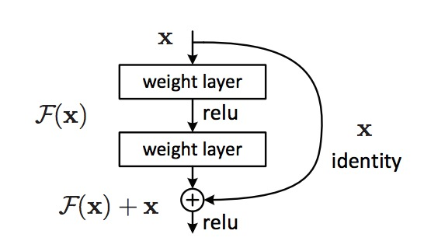
ResNet: the residual module
Use skip or shortcut connections around 2-3 layer MLPs
Gradients can flow quickly back through skip connections
Each module needs only add information to the previous layers
Kaiming He, Xiangyu Zhang, Shaoqing Ren, and Jian Sun, Deep Residual Learning for Image Recognition, CVPR 2016 (Best Paper), 150K+ citations

Slide 50
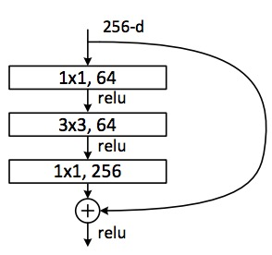
ResNet: Residual Bottleneck Module
Used in 50+ layer networks
  Directly performing 3x3 convolutions with 256 feature maps at input and output:
  256 x 256 x 3 x 3 ~ 600K operations
  Using 1x1 convolutions to reduce 256 to 64 feature maps, followed by 3x3 convolutions, followed by 1x1 convolutions to expand back to 256 maps:
  256 x 64 x 1 x 1 ~ 16K
  64 x 64 x 3 x 3 ~ 36K
  64 x 256 x 1 x 1 ~ 16K
  Total: ~70K
Kaiming He, Xiangyu Zhang, Shaoqing Ren, and Jian Sun, Deep Residual Learning for Image Recognition, CVPR 2016 (Best Paper)
Slide: Lazebnik

Slide 51
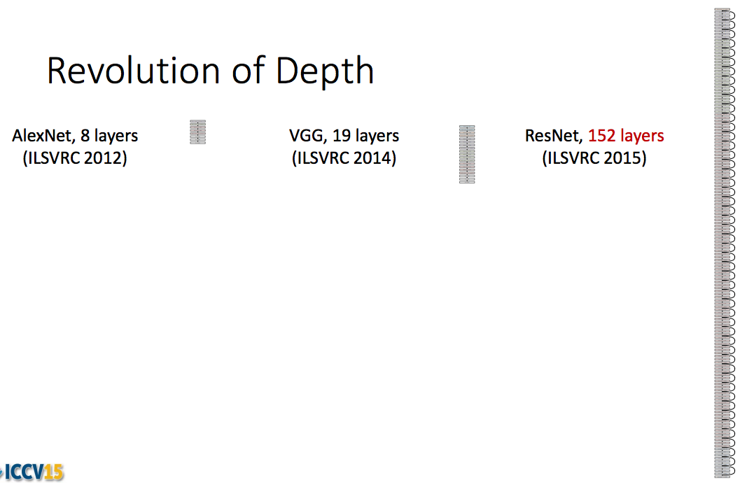
ResNet: going real deep
Despite depth, the residual connections enable error gradients to “skip” all the way back to the beginning
Kaiming He, Xiangyu Zhang, Shaoqing Ren, and Jian Sun, Deep Residual Learning for Image Recognition, CVPR 2016

Slide 52
Example code: ResBlock
class ResBlock(nn.Module):
def __init__(self, in_channels, out_channels, downsample):
super().__init__()
if downsample:
self.conv1 = nn.Conv2d(in_channels, out_channels, kernel_size=3, stride=2, padding=1)
self.shortcut = nn.Sequential(
nn.Conv2d(in_channels, out_channels, kernel_size=1, stride=2),
nn.BatchNorm2d(out_channels)
)
else:
self.conv1 = nn.Conv2d(in_channels, out_channels, kernel_size=3, stride=1, padding=1)
self.shortcut = nn.Sequential()
self.conv2 = nn.Conv2d(out_channels, out_channels, kernel_size=3, stride=1, padding=1)
self.bn1 = nn.BatchNorm2d(out_channels)
self.bn2 = nn.BatchNorm2d(out_channels)
def forward(self, input):
shortcut = self.shortcut(input)
input = nn.ReLU()(self.bn1(self.conv1(input)))
input = nn.ReLU()(self.bn2(self.conv2(input)))
input = input + shortcut
return nn.ReLU()(input)

Slide 53
Example code: ResNet-18 architecture for ImageNet
class Network(nn.Module):
def __init__(self, num_classes=37):
super().__init__()
resblock = ResBlock
self.layer0 = nn.Sequential(
nn.Conv2d(3, 64, kernel_size=7, stride=2, padding=3),
nn.MaxPool2d(kernel_size=3, stride=2, padding=1),
nn.BatchNorm2d(64),
nn.ReLU()
)
self.layer1 = nn.Sequential(
resblock(64, 64, downsample=False),
resblock(64, 64, downsample=False)
)
self.layer2 = nn.Sequential(
resblock(64, 128, downsample=True),
resblock(128, 128, downsample=False)
)
self.layer3 = nn.Sequential(
resblock(128, 256, downsample=True),
resblock(256, 256, downsample=False)
)
self.layer4 = nn.Sequential(
resblock(256, 512, downsample=True),
resblock(512, 512, downsample=False)
)
self.gap = torch.nn.AdaptiveAvgPool2d(1)
self.fc = torch.nn.Linear(512, num_classes)
def forward(self, input):
input = self.layer0(input)
input = self.layer1(input)
input = self.layer2(input)
input = self.layer3(input)
input = self.layer4(input)
input = self.gap(input)
input = torch.flatten(input, 1)
input = self.fc(input)
return input

Slide 54
ResNet Architectures and Results

Slide 55
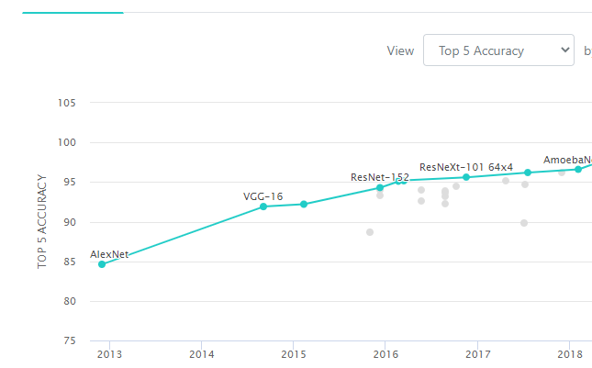
What to remember
ImageNet
Deep networks provide huge gains in performance
  Large capacity, optimizable models
  Learn from new large datasets
ReLU and skip connections simplify optimization
SGD is still often used in practice, but Adam is most widely used

Slide 56
Next consolidation and review
How to represent and measure data
Q & A

