Slide 1
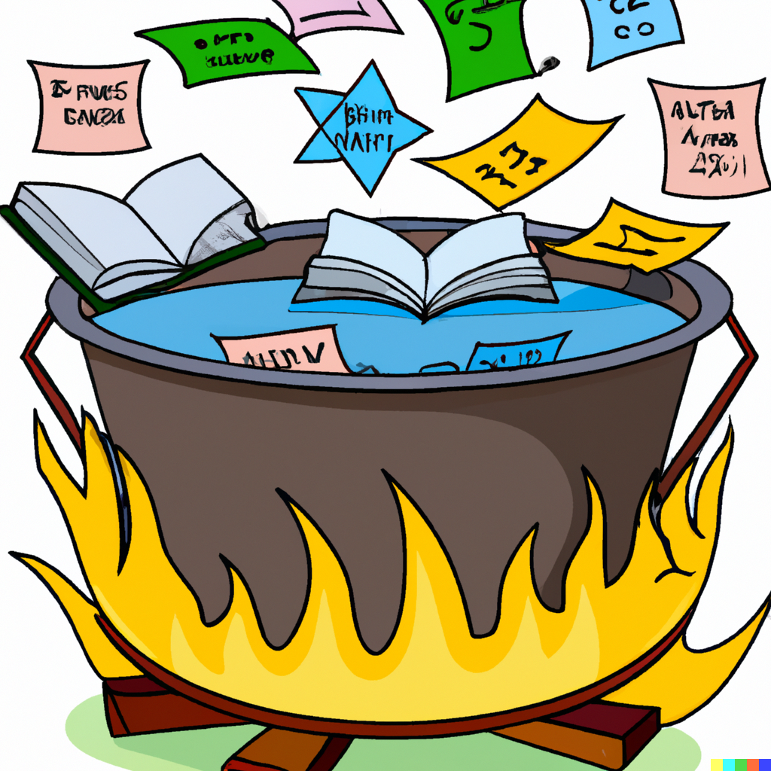
Recap and Review
Applied Machine Learning
Derek Hoiem

Slide 2
Midterm Exam Logistics
Thurs, Mar 7 (start exam between 9:30 AM and 10:30 PM)
Exam will be 75 minutes long (or longer for those with DRES accommodations)
Mainly multiple choice / multiple select
  No coding or complex calculations; mainly tests conceptual understanding
You take it at home (open book) on PrairieLearn
Not cheating
  Consult notes, practice questions/answers, slides, internet, etc.
Cheating
  Talking to a classmate about the exam after one (but not both) of you has taken it
  Getting help from another person during the exam
  Obtaining past exam questions/answers
You will not have time to look up all the answers, so do prepare by reviewing slides, lectures, AML book, and practice questions

Slide 3
Midterm Exam Central Topics
How does train/test error depend on
  Number of training samples
  Complexity of model
Bias-variance trade-off, including meaning of “bias” and “variance” for ML models and “overfitting”
Basic function/form/assumptions of classification/regression models (KNN, NB, linear/logistic regression, trees, SVMs, boosted trees, random forests, ensembles)
Entropy/Information gain
Data organization and transformation: clustering, PCA
Latent variables and robustness: EM, density estimation, robust estimation and fittting
Gradient descent, SGD

Slide 4
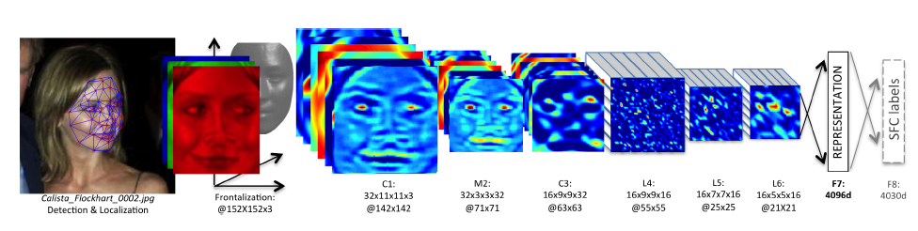
KNN Usage Example: Deep Face
CVPR 2014
Detect facial features
Align faces to be frontal
Extract features using deep network while training classifier to label image into person (dataset based on employee faces)
In testing, extract features from deep network and use nearest neighbor classifier to assign identity
Performs similarly to humans in the LFW dataset (labeled faces in the wild)
Can be used to organize photo albums, identifying celebrities, or alert user when someone posts an image of them
If this is used in a commercial deployment, what might be some unintended consequences?
This algorithm is used by Facebook (though with expanded training data)

Slide 5
Example application of SVM: Dalal-Triggs 2005
Detection by scanning window
  Resize image to multiple scales and extract overlapping windows
  Classify each window as positive or negative
Very highly cited (40,000+) paper, mainly for HOG
One of the best pedestrian detectors for several years
https://lear.inrialpes.fr/people/triggs/pubs/Dalal-cvpr05.pdf

Slide 6
Example application of SVM: Dalal-Triggs 2005
Very highly cited (40,000+) paper, mainly for HOG
One of the best pedestrian detectors for several years

Slide 7
Example application of SVM: Dalal-Triggs 2005

Slide 8
“Semi-naïve Bayes” object detection
Best performing face/car detector in 2000-2005
Model probabilities of small groups of features (wavelet coefficients)
Search for groupings, discretize features, estimate parameters
https://www.cs.cmu.edu/afs/cs.cmu.edu/user/hws/www/CVPR00.pdf

Slide 9
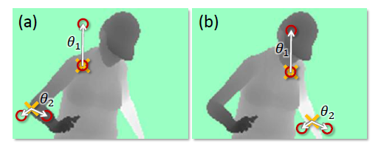
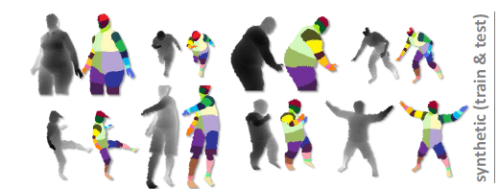
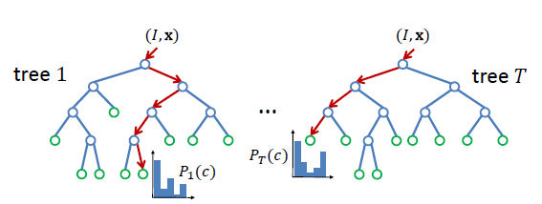
Human pose estimation with random forest
Very simple features
Lots of data
Random Forest

Slide 10
Training (Parameter Learning)
Target Labels
Model
Raw Features
Encoder
Decoder
Prediction
Discrete/continuous values
Text
Images
Audio
Structured/unstructured
Few/many features
Clean/noisy labels
Trees
Feature selection
Clustering
Kernels
Density estimation
Manual feature design
Deep networks
Linear regressor
Logistic regressor
Nearest Neighbor
Probabilistic model
SVM
Category
Continuous value
Clusters
Low dimensional embedding
Pixel labels
Generated text, image, audio
Positions

Slide 11
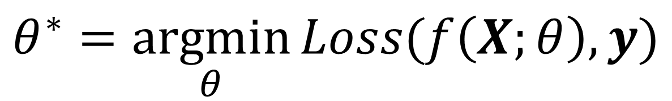
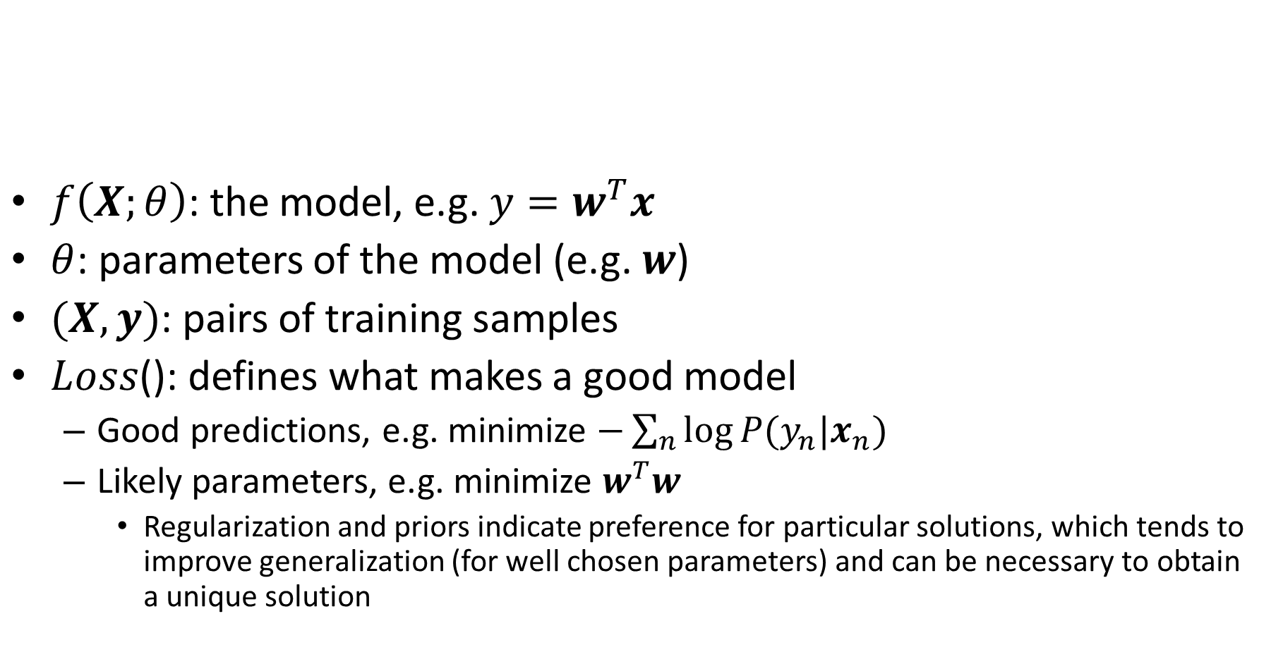
Learning a model
$f\left(X;θ\right)$: the model, e.g. ${y=w}^{T}x$
$θ$: parameters of the model (e.g. $w$)
$(X, y)$: pairs of training samples
$Loss$(): defines what makes a good model
  Good predictions, e.g. minimize $−\sum_{n}{log⁡P(y_{n}|x_{n})}$
  Likely parameters, e.g. minimize $w^{T}w$
    Regularization and priors indicate preference for particular solutions, which tends to improve generalization (for well chosen parameters) and can be necessary to obtain a unique solution
$$θ^{∗}=\underset{θ}{argmin}{Loss(f\left(X;θ\right),y)}$$

Slide 12
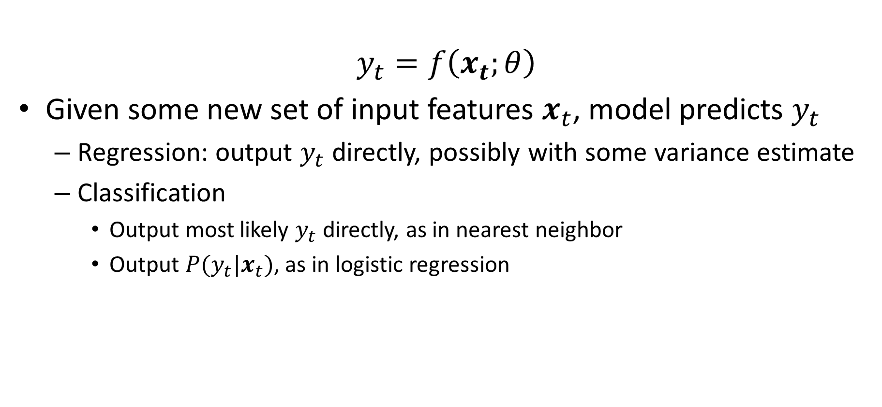
Prediction using a model
$$y_{t}=f\left(x_{t};θ\right)$$
Given some new set of input features $x_{t}$, model predicts $y_{t}$
  Regression: output $y_{t}$ directly, possibly with some variance estimate
  Classification
    Output most likely $y_{t}$ directly, as in nearest neighbor
    Output $P(y_{t}|x_{t})$, as in logistic regression

Slide 13
Model evaluation process
Collect/define training, validation, and test sets
Decide on some candidate models and hyperparameters
For each candidate:
  Learn parameters with training set
  Evaluate trained model on the validation set
Select best model
Evaluate best model’s performance on the test set
  Cross-validation can be used as an alternative
  Common measures include error or accuracy, root mean squared error, precision-recall

Slide 14
How to think about ML algorithms
What is the model?
  What kinds of functions can it represent?
  What functions does it prefer? (regularization/prior)
What is the objective function?
  What “values” are implied?
  The objective function does not always match the final evaluation metric
  Objectives are designed to be optimizable and improve generalization
How do I optimize the model?
  How long does it take to train, and how does it depend on the amount of training data or number of features?
  Can I reach a global optimum?
How does the prediction work?
  How accurate is the prediction?
  How fast can I make a prediction for a new sample?
  Does my algorithm provide a confidence on its prediction?

Slide 15
Bias-Variance Trade-off
Variance: due to limited data
Different training samples will give different models that vary in predictions for the same test sample
“Noise”: irreducible error due to data/problem
Bias: error when optimal model is learned from infinite data
Above is for regression.
But same error = variance + noise + bias² holds for classification error and logistic regression.
See this for derivation
Fig Sources

Slide 16
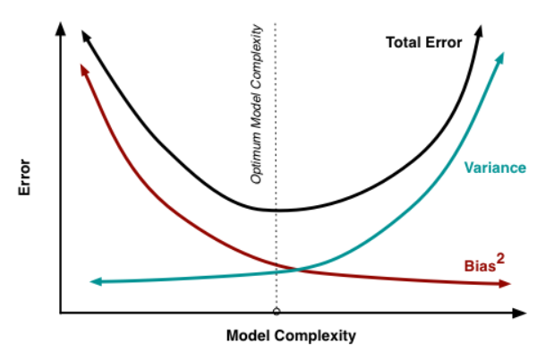
Underfitting
Overfitting
How to detect high variance:
Test error is much higher than training error
How to detect high bias or noise:
The training error is high
As you increase model complexity:
Training error will decrease
Test error may decrease (if you are currently “underfitting”) or increase (if you are “overfitting”)

Slide 17
What does “model complexity” mean?
More parameters in the same structure, e.g. a deeper tree is more complex than a shallow tree
Less regularization, e.g. smaller regularization penalty

Slide 18
Performance vs training size
As we get more training data:
  The same model has more difficulty fitting the training data
  But the test error becomes closer to training error (reduced generalization error)
  Overall test performance improves
Fixed model
Due to limited training data (model variance) and distribution shift
Testing
Error
Test error with infinite training examples
Due to difference in P(y|x) in training and test (function shift)
Train error with infinite training examples
Training
Number of Training Examples
Due to limited power of model (model bias) and unavoidable intrinsic error (Bayes optimal error)

Slide 19
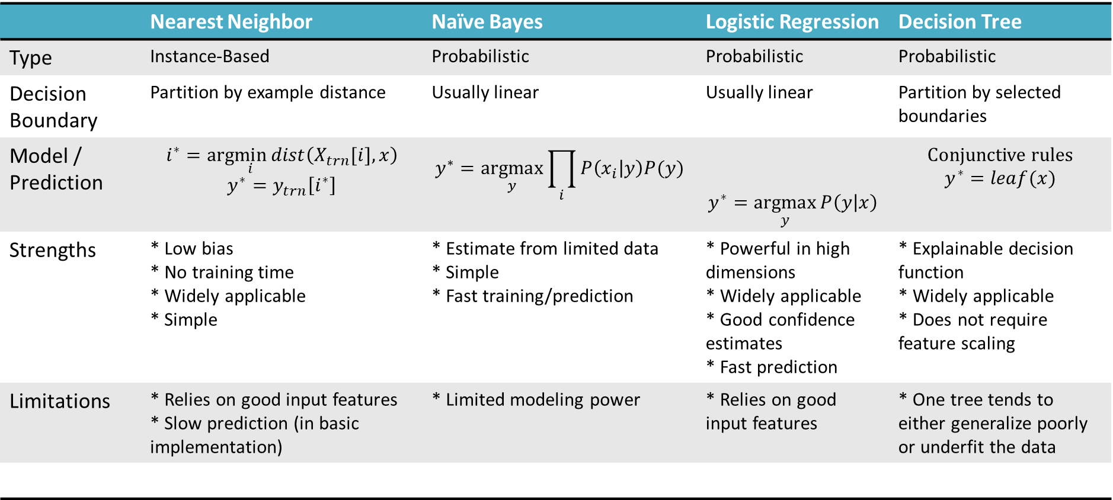
Classification methods
 | Nearest Neighbor | Naïve Bayes | Logistic Regression | Decision Tree
Type | Instance-Based | Probabilistic | Probabilistic | Probabilistic
Decision Boundary | Partition by example distance | Usually linear | Usually linear | Partition by selected boundaries
Model / Prediction | $$i^{∗}=arg\min_{i}{dist\left(X_{trn}[i],x\right)}$$ $$y^{∗}=y_{trn}\left[i^{∗}\right]$$ | $$y^{∗}=\underset{y}{argmax}{\prod_{i}{P\left(x_{i} | y\right)P(y)}}$$ | $$y^{∗}=\underset{y}{argmax}{P\left(y | x\right)}$$ | Conjunctive rules $$y^{∗}=leaf(x)$$
Strengths | * Low bias * No training time * Widely applicable * Simple | * Estimate from limited data * Simple * Fast training/prediction | * Powerful in high dimensions * Widely applicable * Good confidence estimates * Fast prediction | * Explainable decision function * Widely applicable * Does not require feature scaling
Limitations | * Relies on good input features * Slow prediction (in basic implementation) | * Limited modeling power | * Relies on good input features | * One tree tends to either generalize poorly or underfit the data

Slide 20
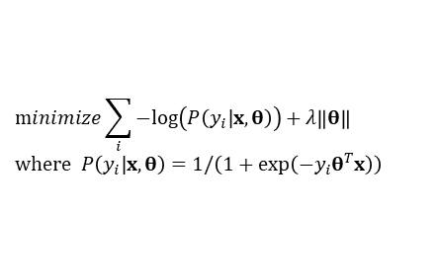
Classification methods (extended)
assuming x in {0 1}
Learning Objective
Training
Inference
Naïve Bayes
Logistic Regression
$$\operatorname{minimize}{\sum_{i}{−log\left(P\left(y_{i}|x,θ\right)\right)}}+λ\left\|θ\right\| \\ \text{where} P\left(y_{i}|x,θ\right)=1/\left(1+\exp\left(−y_{i}θ^{T}x\right)\right)$$
Gradient descent
Linear SVM
Quadratic programming or subgradient opt.
Kernelized SVM
complicated to write
Quadratic programming
Nearest Neighbor
most similar features → same label
Record data
* Notation may differ from previous slide

Slide 21
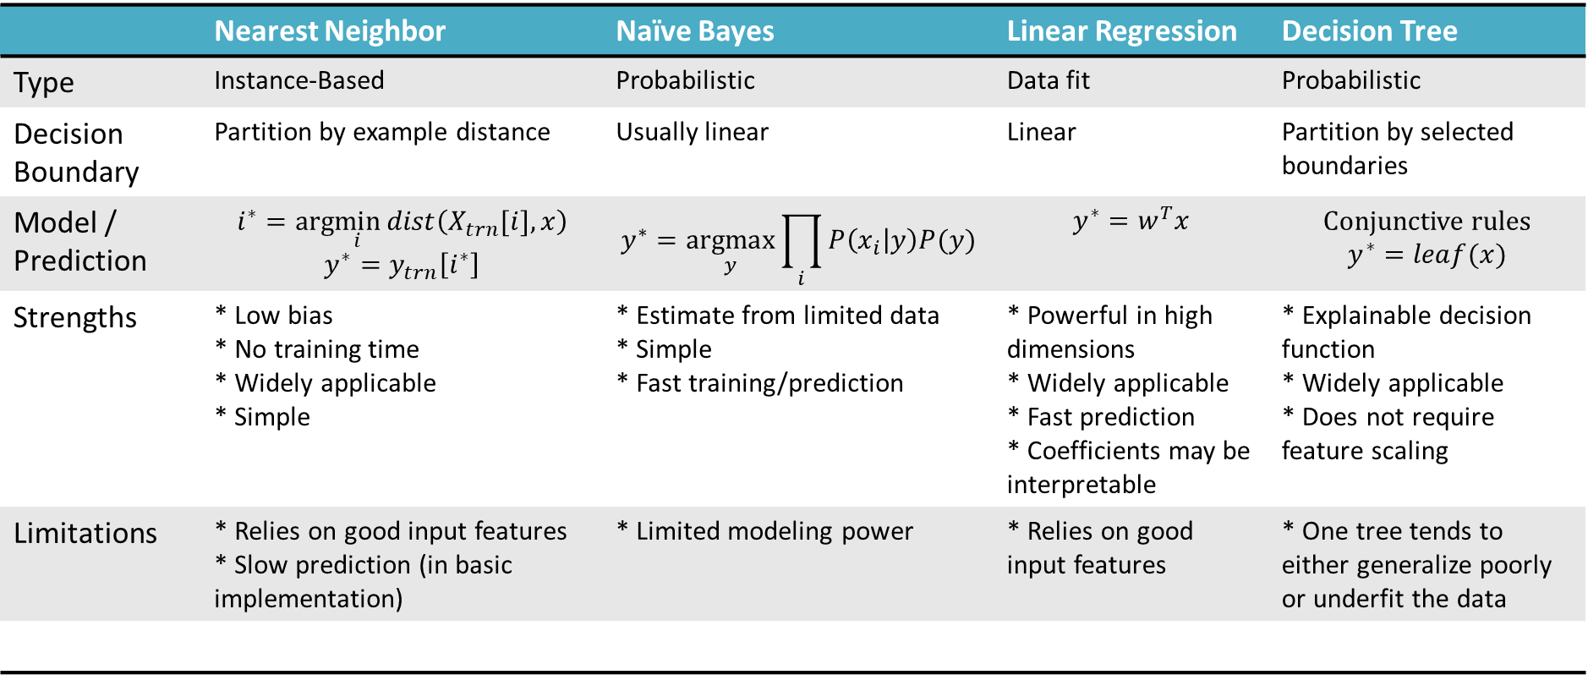
Regression methods
 | Nearest Neighbor | Naïve Bayes | Linear Regression | Decision Tree
Type | Instance-Based | Probabilistic | Data fit | Probabilistic
Decision Boundary | Partition by example distance | Usually linear | Linear | Partition by selected boundaries
Model / Prediction | $$i^{∗}=arg\min_{i}{dist\left(X_{trn}[i],x\right)}$$ $$y^{∗}=y_{trn}\left[i^{∗}\right]$$ | $$y^{∗}=\underset{y}{argmax}{\prod_{i}{P\left(x_{i} | y\right)P(y)}}$$ | $$y^{∗}=w^{T}x$$ | Conjunctive rules $$y^{∗}=leaf(x)$$
Strengths | * Low bias * No training time * Widely applicable * Simple | * Estimate from limited data * Simple * Fast training/prediction | * Powerful in high dimensions * Widely applicable * Fast prediction * Coefficients may be interpretable | * Explainable decision function * Widely applicable * Does not require feature scaling
Limitations | * Relies on good input features * Slow prediction (in basic implementation) | * Limited modeling power | * Relies on good input features | * One tree tends to either generalize poorly or underfit the data

Slide 22
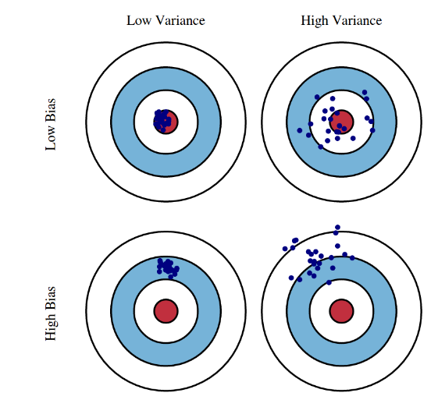
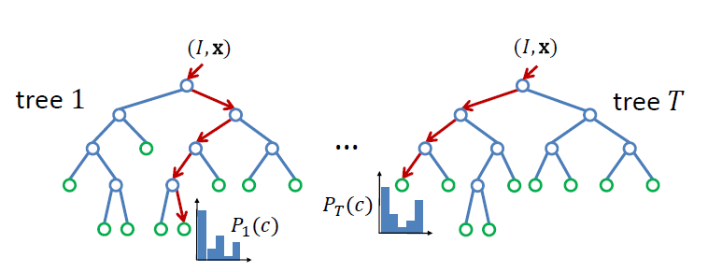
Ensembles
Ensembles improve accuracy by reducing bias and/or variance
Boosting minimizes bias by fixing previous mistakes, e.g. Boosted Decision Tree classifier
Averaging over predictions from multiple models minimizes variance, e.g. Random Forests
Random forests and boosted trees are powerful classifiers and useful for a wide variety of problems

Slide 23
Questions
https://tinyurl.com/cs441midtermreview

Slide 24
Summaries

Slide 25
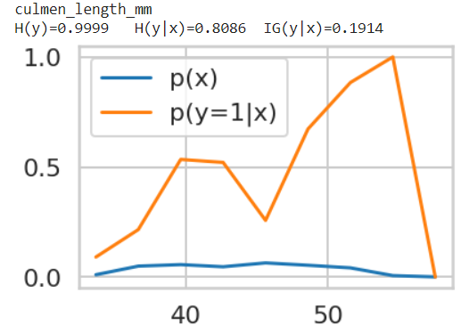

Working with Data (L2)
Machine learning is fitting parameters of a model so that you can accurately predict one set of numbers from another set of numbers
Something can take a lot of data storage but provide little information, or vice versa
The predictiveness or information gain of the features depends on how they are modeled
$$f\left(x;θ\right)→y$$

Slide 26
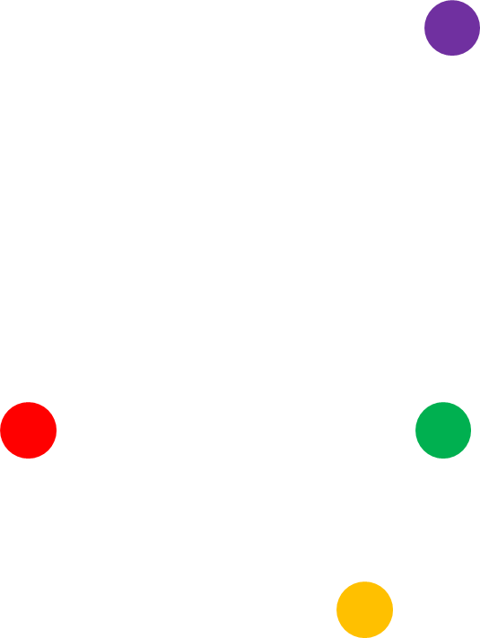
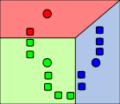
Clustering (L3)
Similarity is foundational to machine learning
Use highly optimized libraries like FAISS for search/retrieval
Approximate search methods like LSH can be used to find similar points quickly
TF-IDF is used for similarity of tokenized documents and used with index for fast search
Clustering groups similar data points
K-means is the must-know method, but there are many others

Slide 27
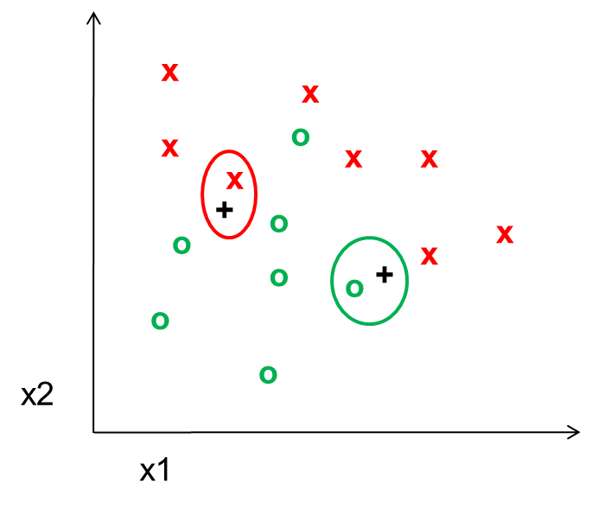
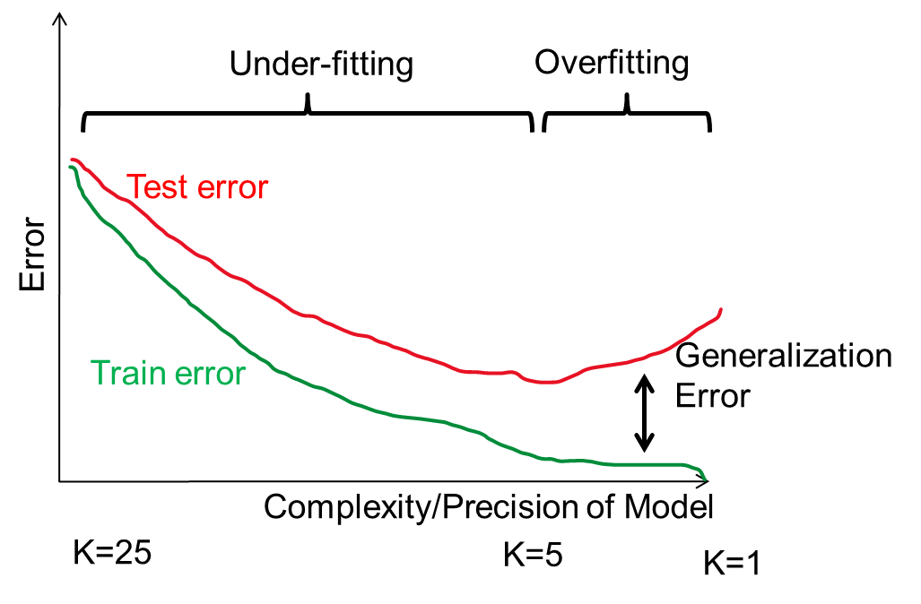
KNN (L4)
KNN is a simple but effective classifier/regressor that predicts the label of the most similar training example(s)
Larger K gives a smoother prediction function
Test error is composed of bias (model too simple/smooth to fit data) and variance (model too complex to learn from training data)

Slide 28
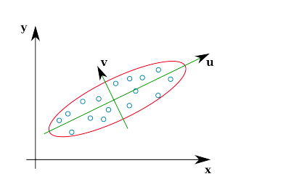
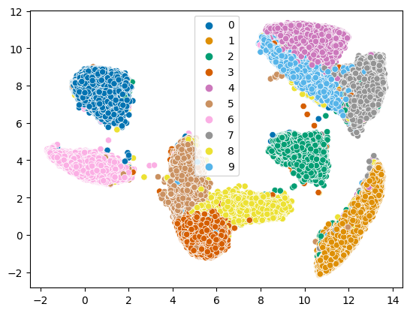
PCA/Embedding (L5)
PCA reduces dimensions by linear projection
  Preserves variance to reproduce data as well as possible, according to mean squared error
  May not preserve local connectivity structure or discriminative information
Other methods try to preserve relationships between points
  MDS: preserve pairwise distances
  IsoMap: MDS but using a graph-based distance
  t-SNE: preserve a probabilistic distribution of neighbors for each point (also focusing on closest points)
  UMAP: incorporates k-nn structure, spectral embedding, and more to achieve good embeddings relatively quickly

Slide 29
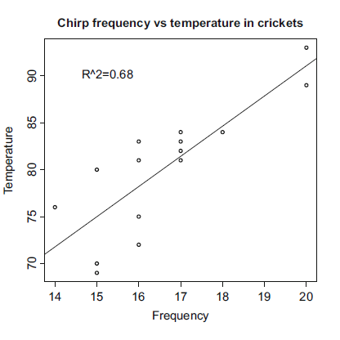
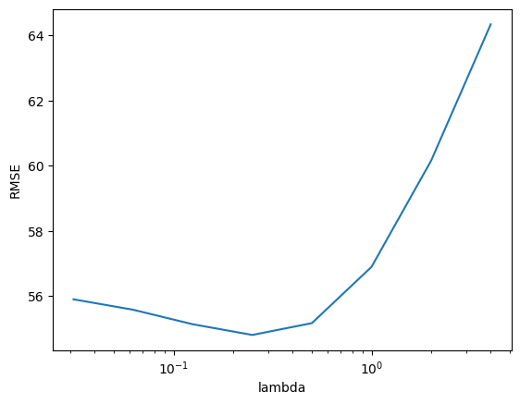
Linear Regression (L6)
Linear regression fits a linear model to a set of feature points to predict a continuous value
  Explain relationships
  Predict values
  Extrapolate observations
Regularization prevents overfitting by restricting the magnitude of feature weights
  L1: prefers to assign a lot of weight to the most useful features
  L2: prefers to assign smaller weight to everything

Slide 30
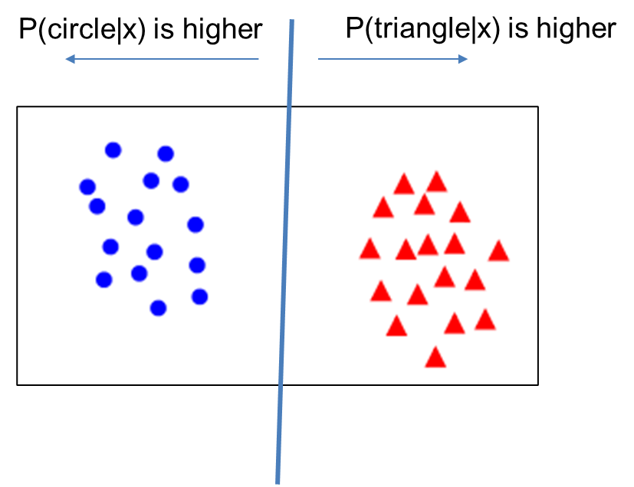
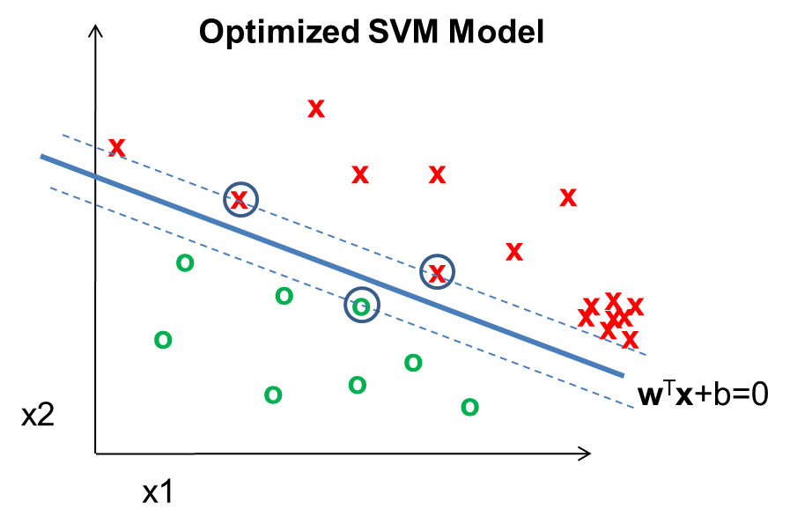
Linear Classifiers (L7)
Linear logistic regression and linear SVM are classification techniques that aims to split features between two classes with a linear model
  Predict categorical values with confidence
Logistic regression maximizes confidence in the correct label, while SVM just tries to be confident enough
Non-linear versions of SVMs can also work well and were once popular (but almost entirely replaced by deep networks)
Nearest neighbor and linear models are the final predictors of most ML algorithms – the complexity lies in finding features that work well with NN or linear models

Slide 31
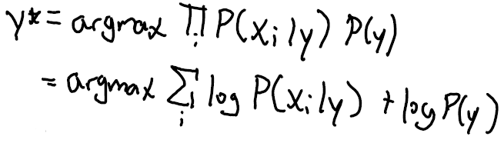
Probability / Naïve Bayes (L8)
Probabilistic models are a large class of machine learning methods
Naïve Bayes assumes that features are independent given the label
  Easy/fast to estimate parameters
  Less risk of overfitting when data is limited
You can look up how to estimate parameters for most common probability models
  Or take partial derivative of total data/label likelihood given parameter
Prediction involves finding y that maximizes $P(x,y)$, either by trying all $y$ or solving partial derivative
Maximizing $log⁡P(x,y)$ is equivalent to maximizing $P(x,y)$ and often much easier
$$P\left(x,y\right)=\prod_{i}{P\left(x_{i} | y\right)P(y)}$$

Slide 32
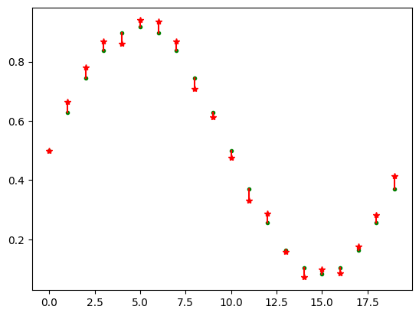
EM (L9)
EM is a widely applicable algorithm to solve for latent variables and parameters that make the observed data likely
  E-step: compute the likelihoods of the values of the latent variables
  M-step: solve for most likely model parameters, using the likelihoods from the E-step as weights
While derivation is long and somewhat complicated, the application is simple
EM is used, for example, in mixture of Gaussian and topic models
Estimated scores
(Green = true; red = prediction)
Good annotators: 0, 1, 3

Slide 33
PDF Estimation (L10)
 | Parametric Models | Semi-Parametric | Non-Parametric
Description | Assumes a fixed form for density | Can fit a broad range of functions with limited parameters | Can fit any distribution
Examples | Gaussian, exponential | Mixture of Gaussians | Discretization, kernel density estimation
Good when | Model is able to approximately fit the distribution | Low dimensional or smooth distribution | 1-D data
Not good when | Model cannot approximate the distribution | Distribution is not smooth, challenging in high dimensions | Data is high dimensional

Slide 34
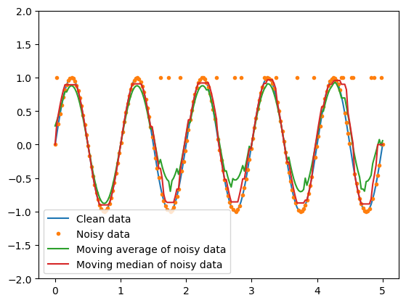
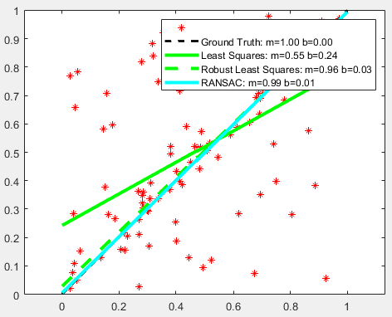
Robust Estimation (L11)
Median and quantiles are robust to outliers, while mean/min/max aren’t
Outliers can be detected as low probability points, low density points, poorly compressible points, or through 2D visualizations
Least squares is not robust to outliers. Use RANSAC or IRLS or robust loss function instead.

Slide 35
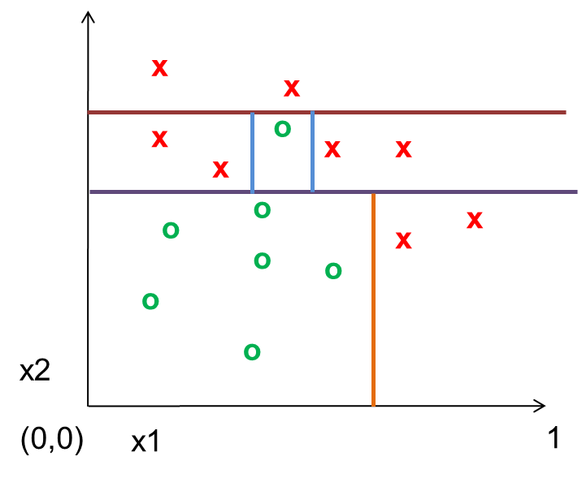
Trees (L12)
Decision/regression trees learn to split up the feature space into partitions with similar values
Entropy is a measure of uncertainty
Information gain measures how much particular knowledge reduces prediction uncertainty

Slide 36
Ensembles (L13)
Ensembles improve accuracy and confidence estimates by reducing bias and/or variance
Boosted trees minimize bias by fixing previous mistakes
Random forests minimize variance by averaging over multiple different trees
Random forests and boosted trees are powerful classifiers and useful for a wide variety of problems

Slide 37
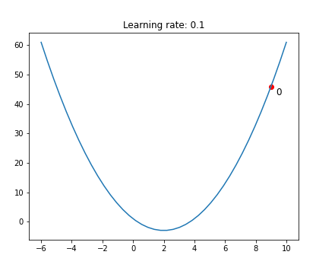
SGD (L14)
Gradient descent iteratively takes a step in the negative gradient direction of the full objective function, to minimize a loss function
Stochastic gradient descent (SGD) estimates the gradient using a subset of examples
  Smaller batches require much less compute to evaluate but give a noisier estimate of the gradient
  Faster than GD
  Can escape local minima
Learning rate (step size) and schedule are important factors in the speed and stability of the optimization
Optimization problems for linear models are convex, and have a single local optimum
MLPs and deep networks have many local optima, so are harder to optimize well

