Slide 1
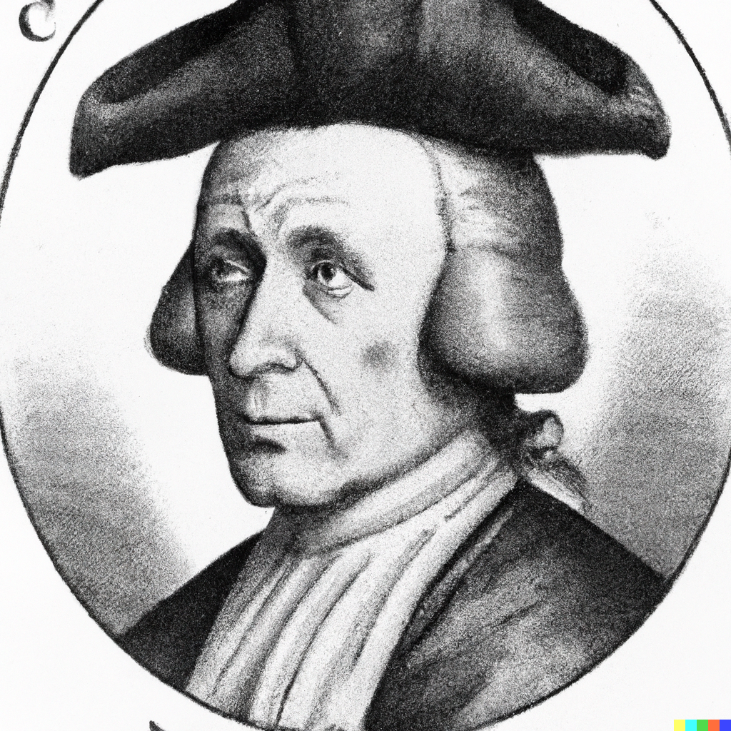
Probability and Naïve Bayes
Applied Machine Learning
Derek Hoiem
Dall-E: portrait of Thomas Bayes with a Dunce Cap on his head
Notes:
This took much too long and wasn’t very coherent. Next time, re-organize:
Estimate P(x,y) where x is one discrete variable
Estimate P(x,y) where x is two discrete variables
Estimate P(x,y) where x is 768 discrete variables? Can’t do it… need an assumption, Naïve Bayes
Introduce Naïve Bayes assumption
Apply naïve bayes to MNIST in code
Use prior probability
What if x and/or y is continuous?
If x is continuous… Gaussian or discretize
If y is continuous… Gaussian, solve for most likely y using calculus: first if there is one x, then if there are multiple xs

Slide 2
Recap of approaches we’ve seen so far
Nearest neighbor is widely used
  Super-powers: can instantly learn new classes and predict from one or many examples
Logistic Regression is widely used
  Super-powers: Effective prediction from high-dimensional features
Linear Regression is widely used
  Super-powers: Can extrapolate, explain relationships, and predict continuous values from many variables
Almost all algorithms involve nearest neighbor, logistic regression, or linear regression
  The main learning challenge is typically feature learning

Slide 3
Today’s Lecture
Introduce probabilistic models
Review of probability
Naïve Bayes Classifier
  Assumptions / model
  How to estimate from data
  How to predict given new features
“Semi-naïve Bayes” object detector

Slide 4
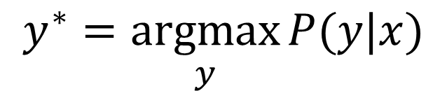
Probabilistic model
$$y^{∗}=\underset{y}{argmax}{P(y|x)}$$

Slide 5
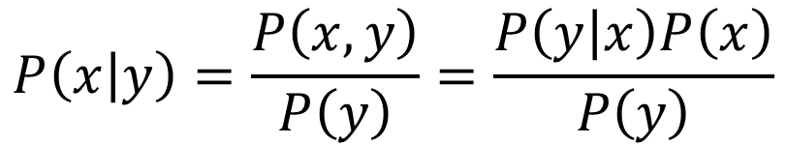
Joint and conditional probability
$$P\left(x,y\right)=P\left(x | y\right)P\left(y\right)=P\left(y | x\right)P(x)$$
$$P\left(a,b,c\right)=P\left(a | b,c\right)P\left(b | c\right)P(c)$$
$$P\left(x | y\right)=\frac{P\left(x,y\right)}{P\left(y\right)}=\frac{P\left(y | x\right)P\left(x\right)}{P\left(y\right)}$$
Bayes Rule:

Slide 6
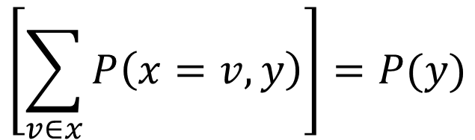
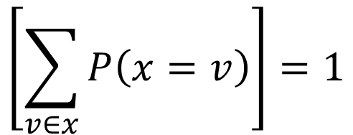
$$\left[\sum_{v∈x}{P\left(x=v\right)}\right]=1$$
Law of total probability
$$\left[\sum_{v∈x}{P\left(x=v,y\right)}\right]=P(y)$$
Marginalization
For continuous variables, replace sum over possible values with integral over domain

Slide 7
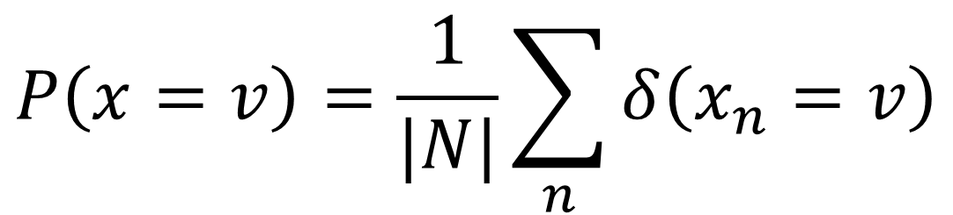
Estimate probabilities of discrete variables by counting
$$P\left(x=v\right)=\frac{1}{|N|}\sum_{n}{δ\left(x_{n}=v\right)}$$

Slide 8

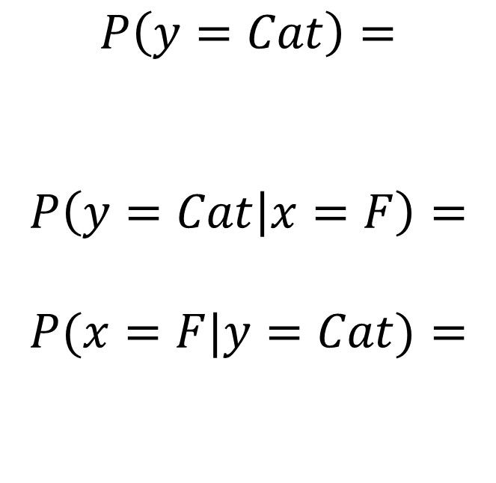

Example
$x$:
Larger than 10 lbs?
 | F | T
Cat | 15 | 25
Dog | 5 | 40
$$P\left(y=Cat\right)=$$
$$P\left(y=Cat | x=F\right)=$$
$$P(x=F|y=Cat)=$$
$$y$$

Slide 9
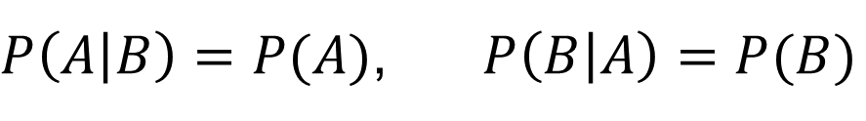

A is independent of B if (and only if)
$$P\left(A,B\right)=P\left(A\right)P\left(B\right)$$
$P\left(A | B\right)=P(A)$, $P\left(B | A\right)=P(B)$

Slide 10
What if you have 100 variables? How can you count all combinations?
Fully modeling dependencies between many variables (more than 3 or 4) is challenging and requires a lot of data

Slide 11
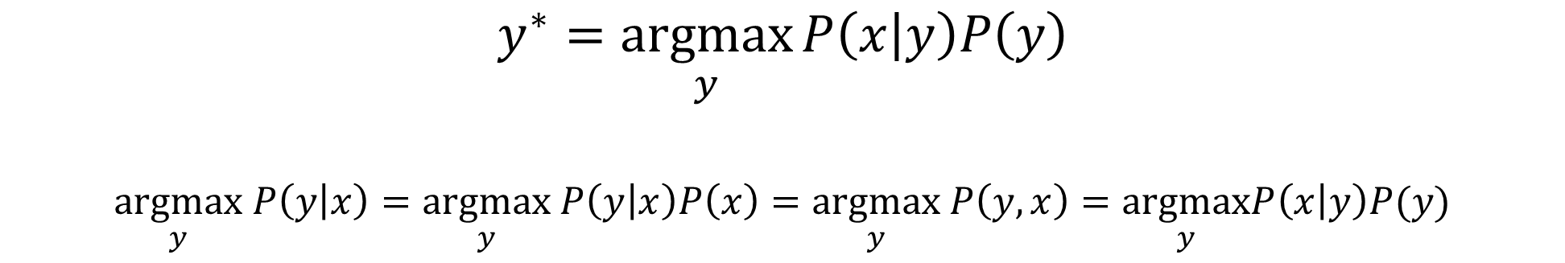
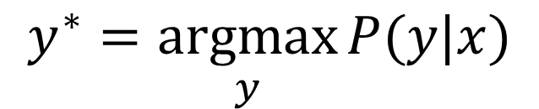
Probabilistic model
$$y^{∗}=\underset{y}{argmax}{P(y|x)}$$
Or equivalently…
$$y^{∗}=\underset{y}{argmax}{P\left(x | y\right)P\left(y\right)}$$
$$\underset{y}{argmax} P\left(y | x\right)=\underset{y}{argmax} P\left(y | x\right)P\left(x\right)=\underset{y}{argmax} P\left(y,x\right)=\underset{y}{argmax}P\left(x | y\right)P(y)$$

Slide 12
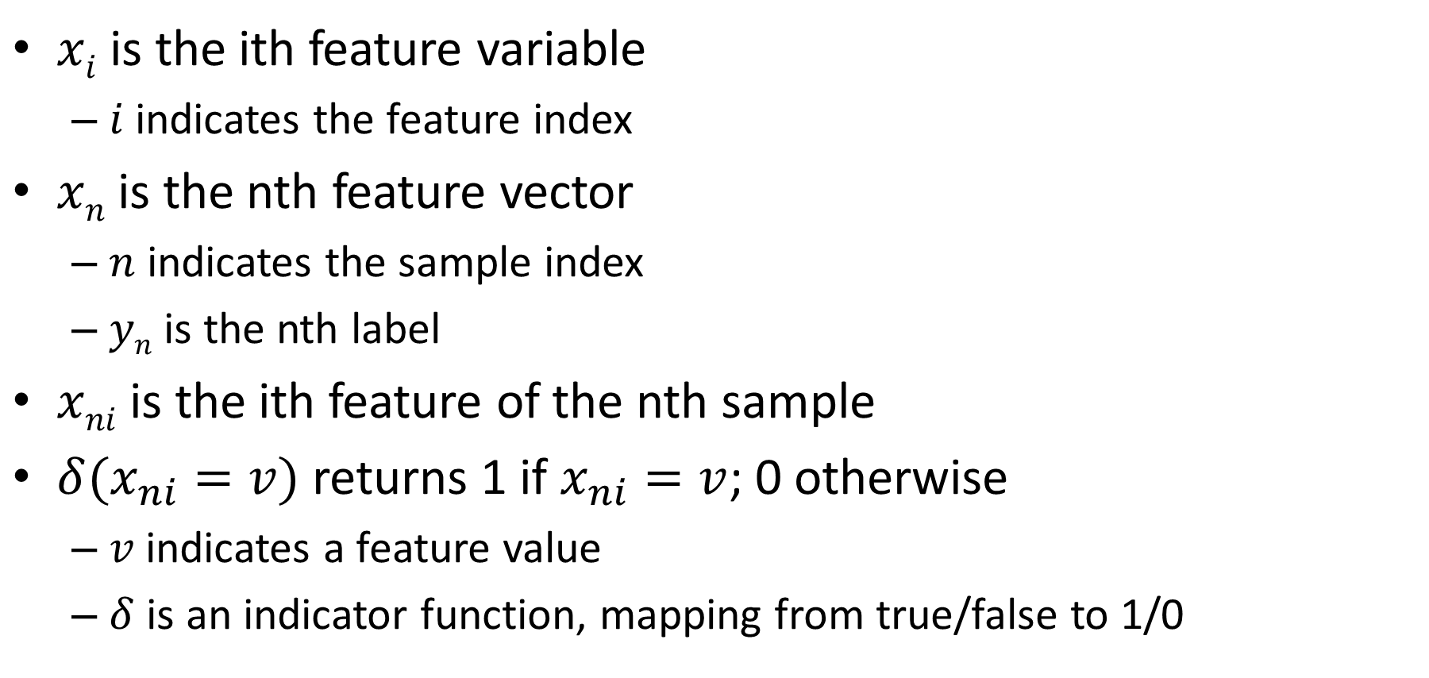
Notation
$xi$ is the ith feature variable
  $i$ indicates the feature index
$xn$ is the nth feature vector
  $n$ indicates the sample index
  $yn$ is the nth label
$xni$ is the ith feature of the nth sample
$δ(x_{ni}=v)$ returns 1 if $x_{ni}=v$; 0 otherwise
  $v$ indicates a feature value
  $δ$ is an indicator function, mapping from true/false to 1/0

Slide 13
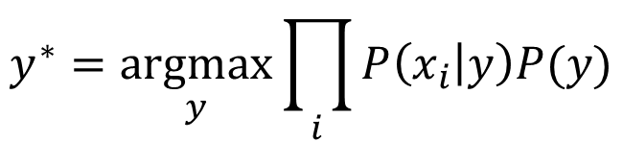

Naïve Bayes Model
Assume features x₁..x_{m} are independent given the label y:
Then
$$P\left(x | y\right)=\prod_{i}{P(x_{i}|y)}$$
$$y^{∗}=\underset{y}{argmax}{\prod_{i}{P\left(x_{i} | y\right)P(y)}}$$

Slide 14
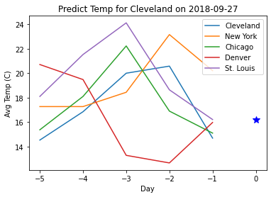
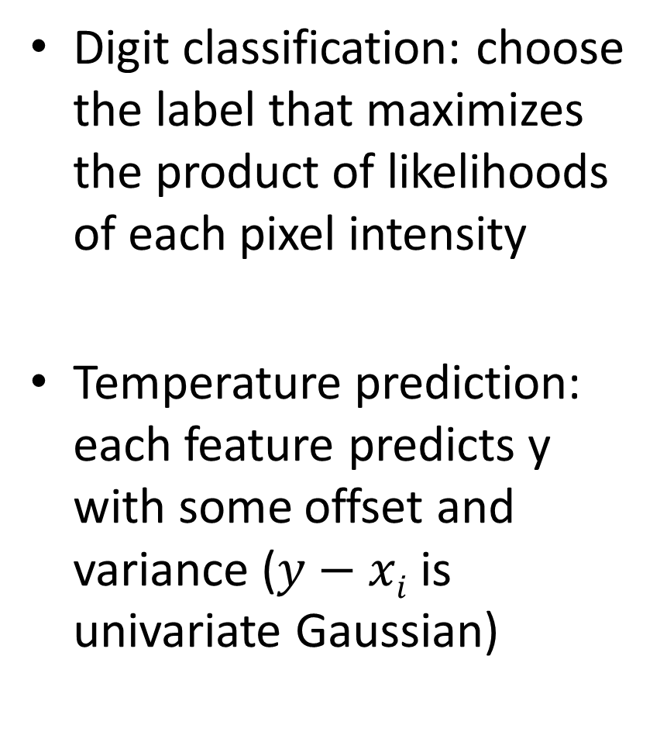
Examples
Digit classification: choose the label that maximizes the product of likelihoods of each pixel intensity
Temperature prediction: each feature predicts y with some offset and variance ($y−xi$ is univariate Gaussian)

Slide 15


Naïve Bayes Algorithm
Training
  Estimate parameters for $P(xi|y)$for each $i$
  Estimate parameters for $P(y)$
Prediction
  Solve for $y$ that maximizes $P(x,y)$
$$y^{∗}=\underset{y}{argmax}{\prod_{i}{P\left(x_{i} | y\right)P(y)}}$$

Slide 16
How to estimate $P(xi|y)$from data?
Basic principles of fitting likelihood parameters from data
  MLE (maximum likelihood estimation): Choose the parameter that maximizes the likelihood of the data
  MAP (maximum a priori): Choose the parameter that maximizes the data likelihood and its own prior
    As Warren Buffet says, it’s not just about maximizing expected return – it’s about making sure there are no zeros.

Slide 17

How to estimate $P(xi|y)$ from data?
Bernoulli (x is binary; y is discrete)
  $$P\left(x_{i} | y=k\right)=θ_{ki}^{x_{i}}{{(1−θ}_{ki})}^{1−x_{i}}$$
Categorical (x is has multiple discrete values, y is discrete)
theta_ki[k,i] = np.sum((X[:,i]==1) & (y==k)) / np.sum(y==k)

Slide 18
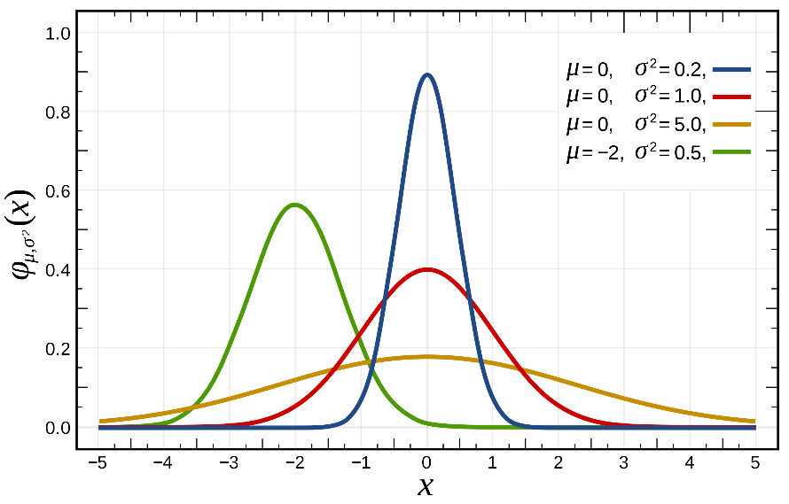
How to estimate $P(xi|y)$from data?
x_{i} is Gaussian (aka Normal), y is discrete

Slide 19

How to estimate $P(xi|y)$ from data?
$(y−xi)$is Gaussian
mu[i] = np.mean(y-X[:,i], axis=0)
std[i] = np.std(y-X[:,i], axis=0)

Slide 20

How to estimate $P(xi|y)$from data?
x_{i} and y are jointly Gaussian
  $N(.)$stands for normal distribution with given value, mean, and (co-)variance

Slide 21

How to estimate $P(xi|y)$from data?
$xi$ is continuous (non-Gaussian), $y$ is discrete
  First turn $x$ into discrete (e.g. if values range [0, 1), assign x=floor(x*10)
  Now can estimate as categorical

Slide 22

How to estimate $P(xi|y)$from data?
If $x$ is text, e.g. “blue”, “orange”, “green”
  Map each possible text value into an integer and solve as categorical

Slide 23
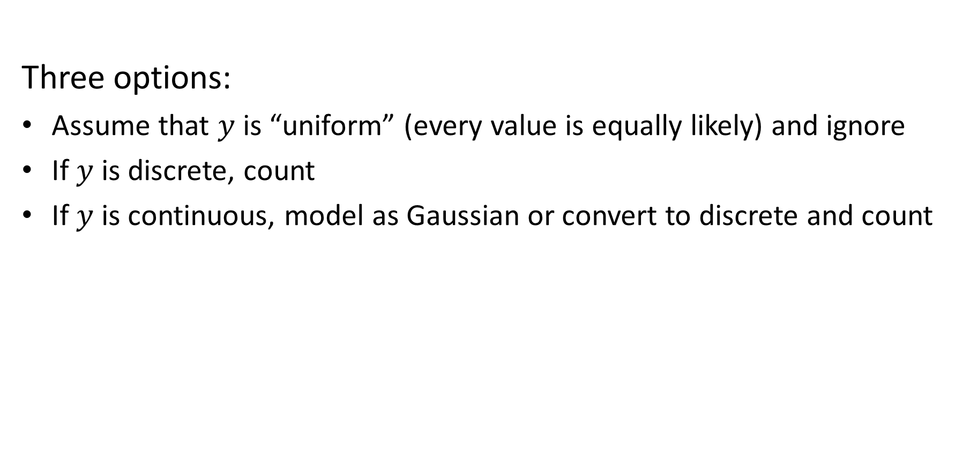
How to estimate $P(y)$?
Three options:
Assume that $y$ is “uniform” (every value is equally likely) and ignore
If $y$ is discrete, count
If $y$ is continuous, model as Gaussian or convert to discrete and count

Slide 24
Stretch break: Simple Naive Bayes example
Suppose I want to classify a fruit based on description
  Features: weight, color, shape, whether it’s hard
  E.g.
    0.5 lb, “red”, “round”, yes
    15 lb, “green”, “oval”, yes
    0.01 lb, “purple”, “round”, no
    Q1: What are these three fruit?
    Q2: How might you model P(x_{i}|fruit) for each of these four features?

Slide 25
Simple Naive Bayes example
Suppose I want to classify a fruit based on description
  Features: weight, color, shape, whether it’s hard
  E.g.
    0.5 lb, “red”, “round”, yes
    15 lb, “green”, “oval”, yes
    0.01 lb, “purple”, “round”, no
  Model P(weight | fruit) as a Gaussian
  Model P(color | fruit) as a discrete distribution (multinomial)
  Model P(shape | fruit) as a categorical
  Model P(is_hard | fruit) as a Bernoulli (binary)
Apple
Watermelon
Grape

Slide 26
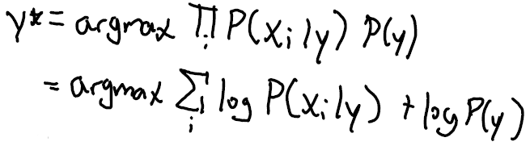
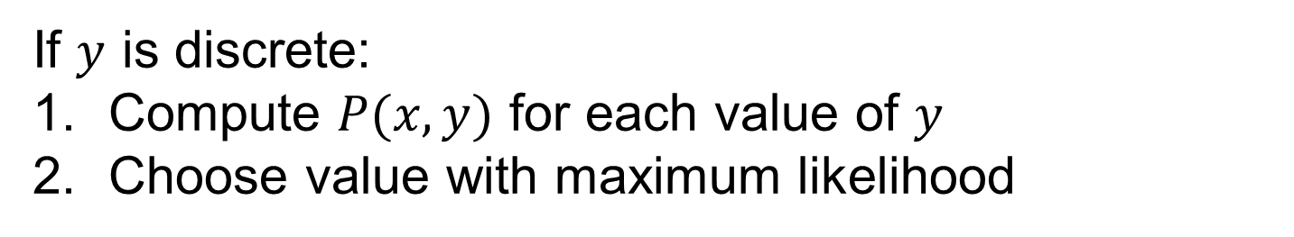
How to predict y from x?
If $y$ is discrete:
Compute $P(x,y)$ for each value of $y$
Choose value with maximum likelihood
Turning product into sum of logs is an important frequently used trick for argmax/argmin!

Slide 27

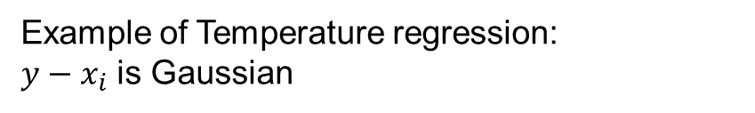
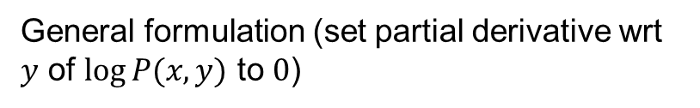
How to predict $y$ from $x$ when $(y−x_{i})$ is Gaussian
General formulation (set partial derivative wrt $y$ of $log⁡P(x,y)$ to $0$)
Example of Temperature regression:
$y−x_{i}$ is Gaussian
$$P\left(x_{i} | y\right)\sim N\left(y−x_{i},σ^{2}\right)=$$
Prediction is weighted average of means, where weights are inverse variance

Slide 28
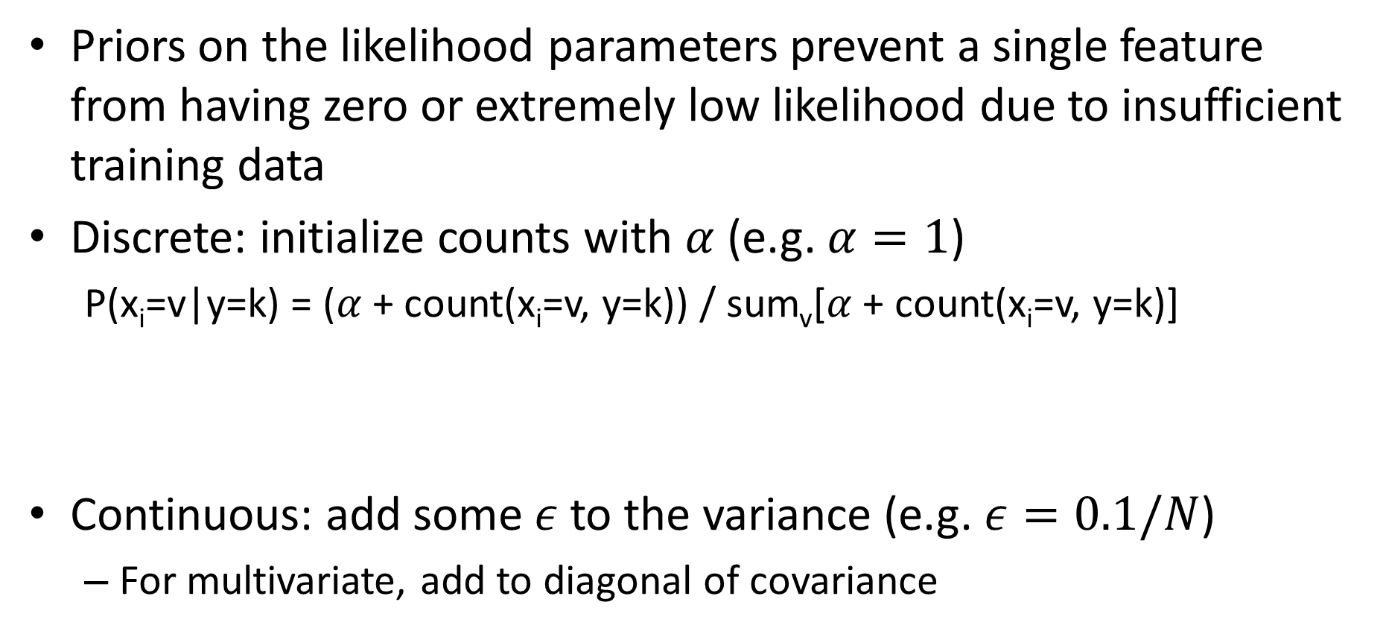
Using priors
Priors on the likelihood parameters prevent a single feature from having zero or extremely low likelihood due to insufficient training data
Discrete: initialize counts with $α$ (e.g. $α=1$)
  P(x_{i}=v|y=k) = ($α$+ count(x_{i}=v, y=k)) / sum_{v}[$α$+ count(x_{i}=v, y=k)]
Continuous: add some $ε$ to the variance (e.g. $ε=0.1/N$)
  For multivariate, add to diagonal of covariance
theta_kiv[k,i,v] = (np.sum((X[:,i]==v) & (y==k))+alpha) / (np.sum(y==k)+alpha*num_v)
std[i] = np.std(y-X[:,i], axis=0)+np.sqrt(0.1/len(X))

Slide 29
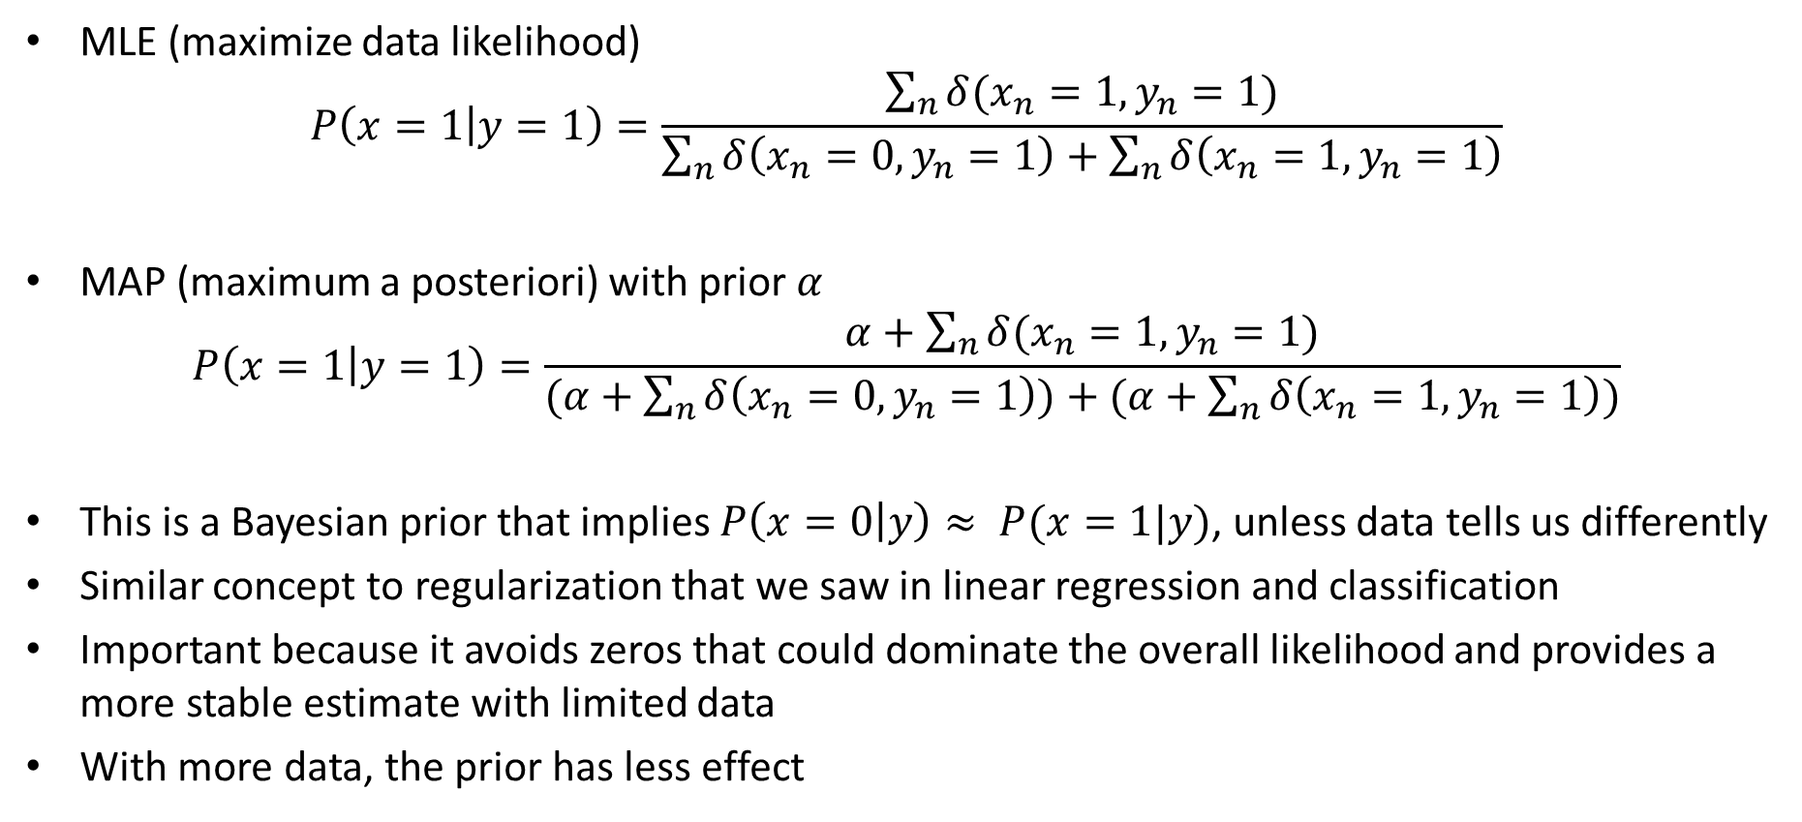
MLE and MAP estimates of binary variable likelihoods
MLE (maximize data likelihood)
$$P\left(x=1 | y=1\right)=\frac{\sum_{n}{δ(x_{n}=1,y_{n}=1)}}{\sum_{n}{δ\left(x_{n}=0,y_{n}=1\right)+\sum_{n}{δ\left(x_{n}=1,y_{n}=1\right)}}}$$
MAP (maximum a posteriori) with prior $α$
$$P\left(x=1 | y=1\right)=\frac{α+\sum_{n}{δ(x_{n}=1,y_{n}=1)}}{(α+\sum_{n}{δ\left(x_{n}=0,y_{n}=1\right))+(α+\sum_{n}{δ\left(x_{n}=1,y_{n}=1\right)})}}$$
This is a Bayesian prior that implies $P\left(x=0 | y\right)≈ P(x=1|y)$, unless data tells us differently
Similar concept to regularization that we saw in linear regression and classification
Important because it avoids zeros that could dominate the overall likelihood and provides a more stable estimate with limited data
With more data, the prior has less effect

Slide 30

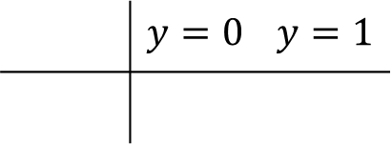
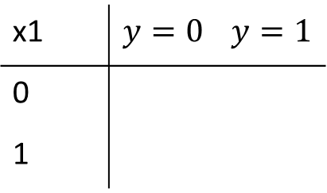


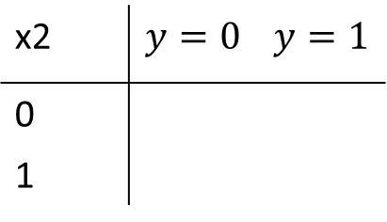
Example: estimate joint probability under Naïve Bayes assumption
x1 | $$y=0$$ | $$y=1$$
0
1
# | x1 | x2 | y
1 | 1 | 1 | 1
2 | 0 | 1 | 1
3 | 1 | 0 | 0
4 | 0 | 1 | 0
5 | 1 | 1 | 1
6 | 1 | 0 | 0
7 | 1 | 0 | 1
8 | 0 | 1 | 0
$$P(x1|y)$$
x2 | $$y=0$$ | $$y=1$$
0
1
$$P(x2|y)$$
$$P(y=0,x1=1,x2=1)= ?$$
$$P(y=1,x1=1,x2=1)= ?$$
$$P(y=0|x1=1,x2=1)= ?$$
 | $$y=0$$ | $$y=1$$
$$P(y)$$

Slide 31
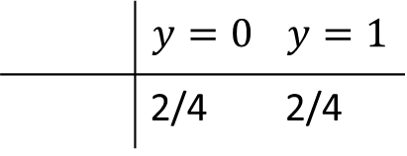
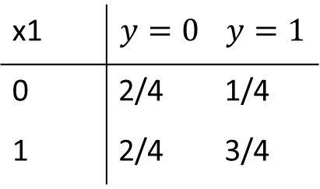
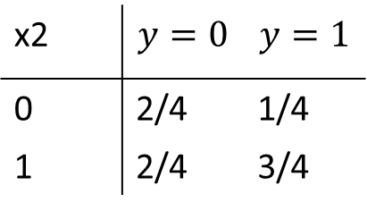
x1 | $$y=0$$ | $$y=1$$
0 | 2/4 | 1/4
1 | 2/4 | 3/4
# | x1 | x2 | y
1 | 1 | 1 | 1
2 | 0 | 1 | 1
3 | 1 | 0 | 0
4 | 0 | 1 | 0
5 | 1 | 1 | 1
6 | 1 | 0 | 0
7 | 1 | 0 | 1
8 | 0 | 1 | 0
$$P(x1|y)$$
x2 | $$y=0$$ | $$y=1$$
0 | 2/4 | 1/4
1 | 2/4 | 3/4
$$P(x2|y)$$
$$P(y=0,x1=1,x2=1)=1/8$$
$$P(y=1,x1=1,x2=1)=9/32$$
 | $$y=0$$ | $$y=1$$
 | 2/4 | 2/4
$$P(y=0|x1=1,x2=1)=4/13$$
$$P(y)$$

Slide 32
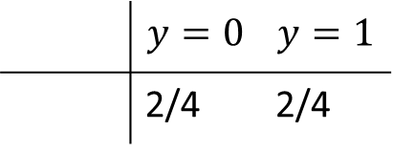
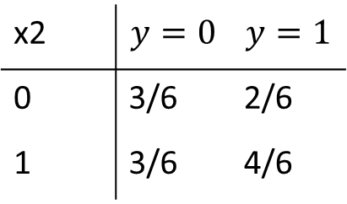
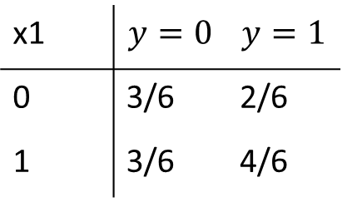
Prior over parameters: initialize each count with $α$
$$α=1$$
x1 | $$y=0$$ | $$y=1$$
0 | 2/4 | 1/4
1 | 2/4 | 3/4
x1 | $$y=0$$ | $$y=1$$
0 | 3/6 | 2/6
1 | 3/6 | 4/6
# | x1 | x2 | y
1 | 1 | 1 | 1
2 | 0 | 1 | 1
3 | 1 | 0 | 0
4 | 0 | 1 | 0
5 | 1 | 1 | 1
6 | 1 | 0 | 0
7 | 1 | 0 | 1
8 | 0 | 1 | 0
$$P(x1|y)$$
x2 | $$y=0$$ | $$y=1$$
0 | 2/4 | 1/4
1 | 2/4 | 3/4
x2 | $$y=0$$ | $$y=1$$
0 | 3/6 | 2/6
1 | 3/6 | 4/6
$$P(x2|y)$$
 | $$y=0$$ | $$y=1$$
 | 2/4 | 2/4
 | $$y=0$$ | $$y=1$$
 | 2/4 | 2/4
$$P(y)$$

Slide 33
Use case: “Semi-naïve Bayes” object detection
Best performing face/car detector in 2000-2005
Model probabilities of small groups of features (wavelet coefficients)
Search for groupings, discretize features, estimate parameters
https://www.cs.cmu.edu/afs/cs.cmu.edu/user/hws/www/CVPR00.pdf

Slide 34
Naïve Bayes Summary
Key Assumptions
  Features are independent, given the labels
Model Parameters
  Parameters of probability functions P(x_{i}|y) and P(y)
Designs
  Choice of probability function
When to Use
  Limited training data
  Features are not highly interdependent
  Want something fast to code, train, and test
When Not to Use
  Logistic or linear regression will usually work better if there is sufficient data (more flexible / fewer assumptions than Naïve Bayes)
  Does not provide a good confidence estimate because it “overcounts” influence of dependent variables

Slide 35
Naïve Bayes
Pros
  Easy and fast to train
  Fast inference
  Can be used with continuous, discrete, or mixed features
Cons
  Does not account for feature interactions
  Does not provide good confidence estimate
Notes
  Best when used with discrete variables, variables that are well fit by Gaussian, or kernel density estimation

Slide 36
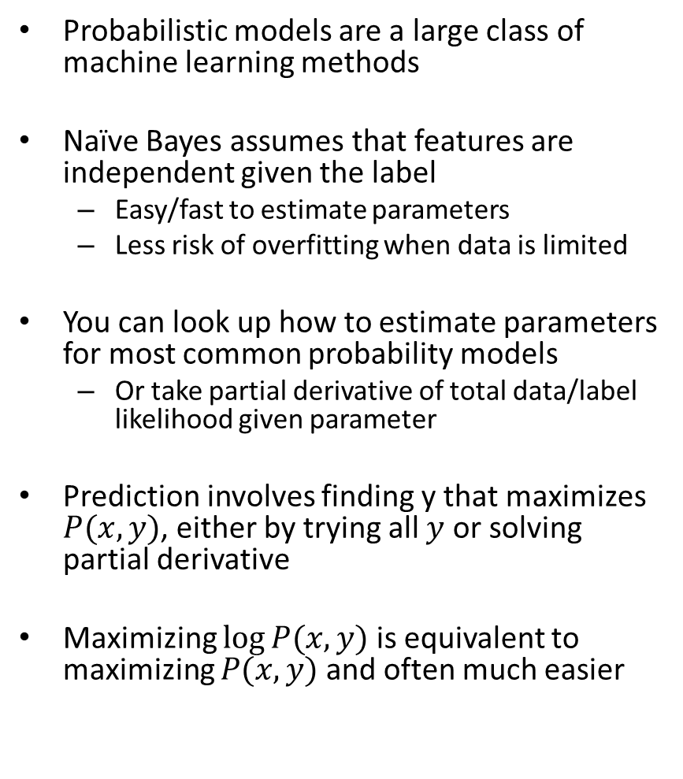
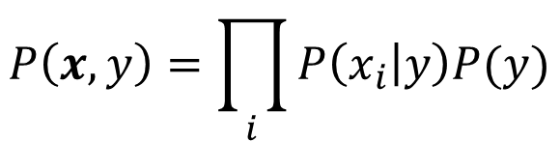
Things to remember
Probabilistic models are a large class of machine learning methods
Naïve Bayes assumes that features are independent given the label
  Easy/fast to estimate parameters
  Less risk of overfitting when data is limited
You can look up how to estimate parameters for most common probability models
  Or take partial derivative of total data/label likelihood given parameter
Prediction involves finding y that maximizes $P(x,y)$, either by trying all $y$ or solving partial derivative
Maximizing $log⁡P(x,y)$ is equivalent to maximizing $P(x,y)$ and often much easier
$$P\left(x,y\right)=\prod_{i}{P\left(x_{i} | y\right)P(y)}$$

Slide 37
Next week
EM and Density Estimation

