Slide 1
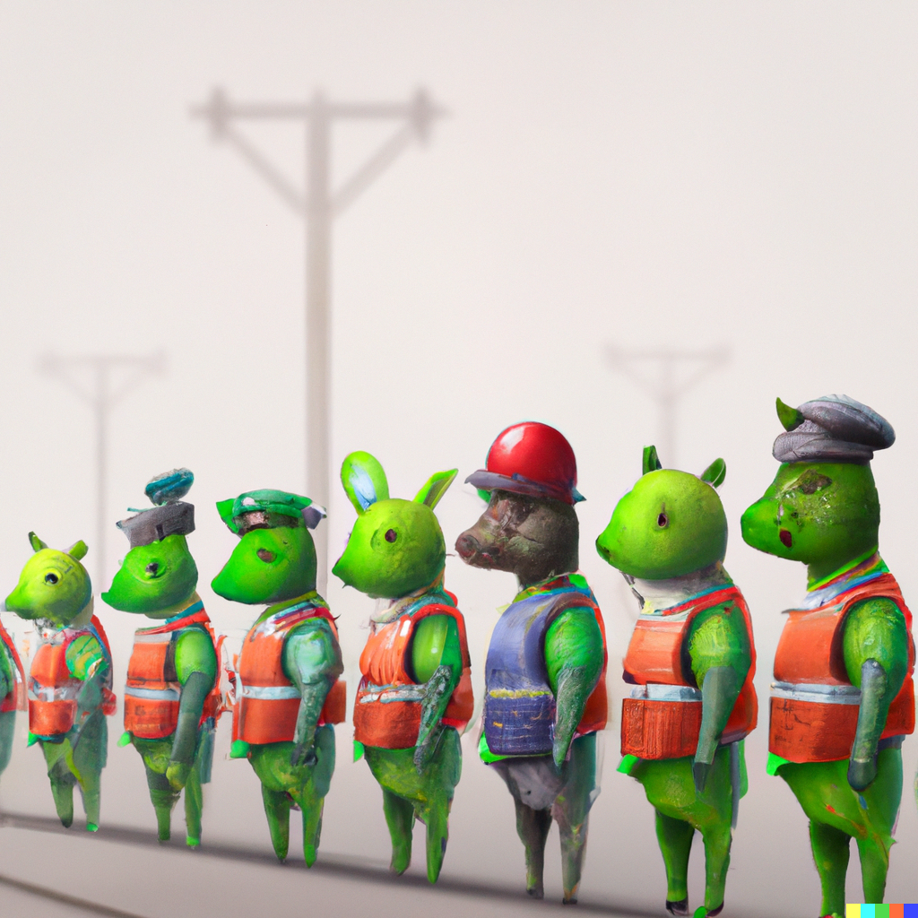
K-Nearest Neighbor
Go to tinyurl.com/cs441chat to ask questions during lecture (CampusWire in-lecture chat room)
Applied Machine Learning
Derek Hoiem
Dall-E
Notes:
https://campuswire.com/c/GED75FB26/rooms/C05707CC4
http://tinyurl.com/441knn

Slide 2
Last Class
How to compute similarity
Using similarity to retrieve and cluster

Slide 3
Today’s Lecture
K-Nearest Neighbor Algorithm
Example application
  Deep Face
Measuring and understanding error

Slide 4
What class do you think the ‘+’ belongs to?
x
x
x
o
x
x
x
+
o
x
o
x
o
o
o
o
x2
x1

Slide 5
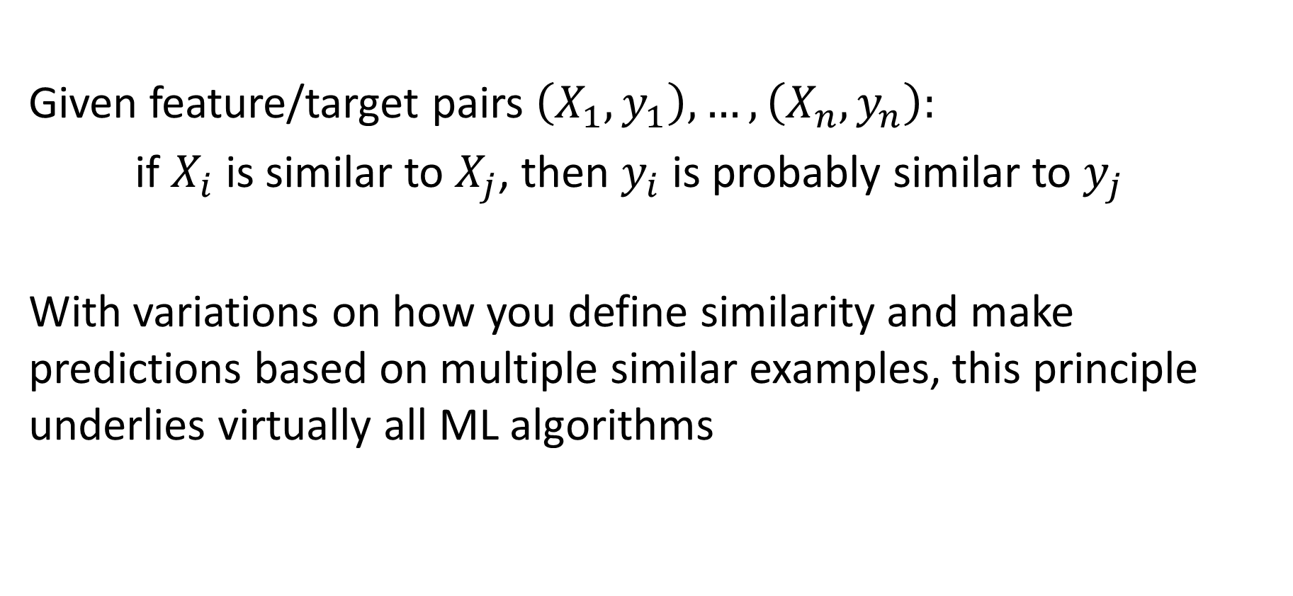
Key principle of machine learning
Given feature/target pairs $\left(X_{1},y_{1}\right),…,\left(X_{n},y_{n}\right):$
if $X_{i}$ is similar to $X_{j}$, then $y_{i}$ is probably similar to $y_{j}$
With variations on how you define similarity and make predictions based on multiple similar examples, this principle underlies virtually all ML algorithms

Slide 6
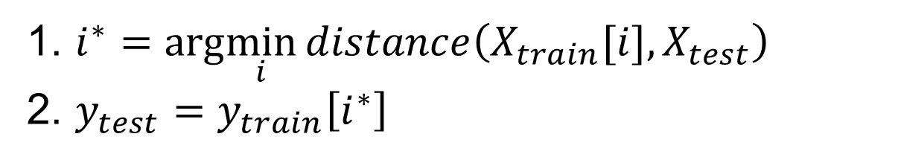
Nearest neighbor algorithm
For given test features, assign the label / target value of the most similar training features
1. $i^{∗}=arg\min_{i}{distance\left(X_{train}[i],X_{test}\right)}$
2. $y_{test}=y_{train}\left[i^{∗}\right]$
Distance function is up to designer. Simplest is L2 distance.

Slide 7
K-nearest neighbor: predict based on K closest training samples
x
x
x
o
x
x
x
+
o
o
x
x
o
o
+
o
o
x2
x1

Slide 8
1-nearest neighbor
x
x
x
o
x
x
x
+
o
o
x
x
o
o
+
o
o
x2
x1

Slide 9
3-nearest neighbor
x
x
x
o
x
x
x
+
o
o
x
x
o
o
+
o
o
x2
x1

Slide 10
5-nearest neighbor
x
x
x
o
x
x
x
+
o
o
x
x
o
o
+
o
o
x2
x1

Slide 11
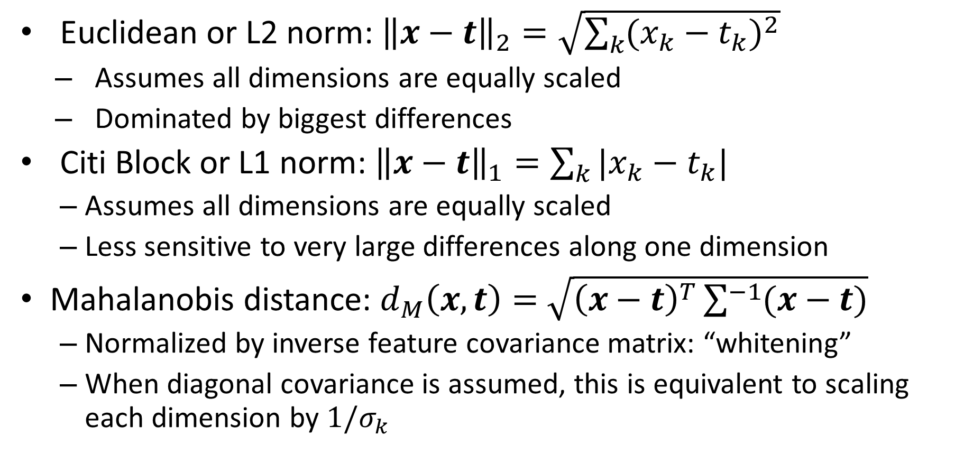
KNN Distance Function
Euclidean or L2 norm: ${\left\|x−t\right\|}_{2}=\sqrt{\sum_{k}{{(x_{k}−t_{k})}^{2}}}$
  Assumes all dimensions are equally scaled
  Dominated by biggest differences
Citi Block or L1 norm: ${\left\|x−t\right\|}_{1}=\sum_{k}{|x_{k}−t_{k}|}$
  Assumes all dimensions are equally scaled
  Less sensitive to very large differences along one dimension
Mahalanobis distance: $d_{M}\left(x, t\right)=$ $\sqrt{{\left(x−t\right)}^{T}\sum^{−1}{(x−t)}}$
  Normalized by inverse feature covariance matrix: “whitening”
  When diagonal covariance is assumed, this is equivalent to scaling each dimension by $1/σ_{k}$
$x$ and $t$ are training and test sample feature vectors

Slide 12
KNN Classification vs Regression
For classification, prediction is usually the mode or most common class of the returned labels
For regression, prediction is usually the arithmetic mean (average, informally) of the returned values

Slide 13
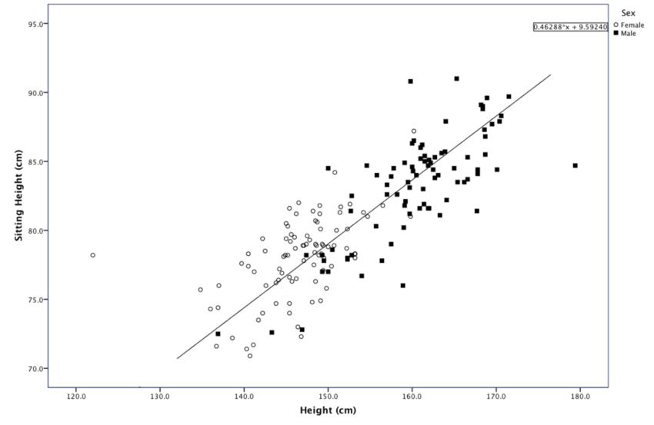
Classification: Predict sex from standing/sitting heights
o
+
x
https://www.researchgate.net/figure/Scatter-plot-of-Sitting-Height-over-Height-for-males-and-females_fig3_301724988

Slide 14
Regression: Predict sitting height from standing height
x
+
o
https://www.researchgate.net/figure/Scatter-plot-of-Sitting-Height-over-Height-for-males-and-females_fig3_301724988

Slide 15
KNN Classification Demo
http://vision.stanford.edu/teaching/cs231n-demos/knn/

Slide 16
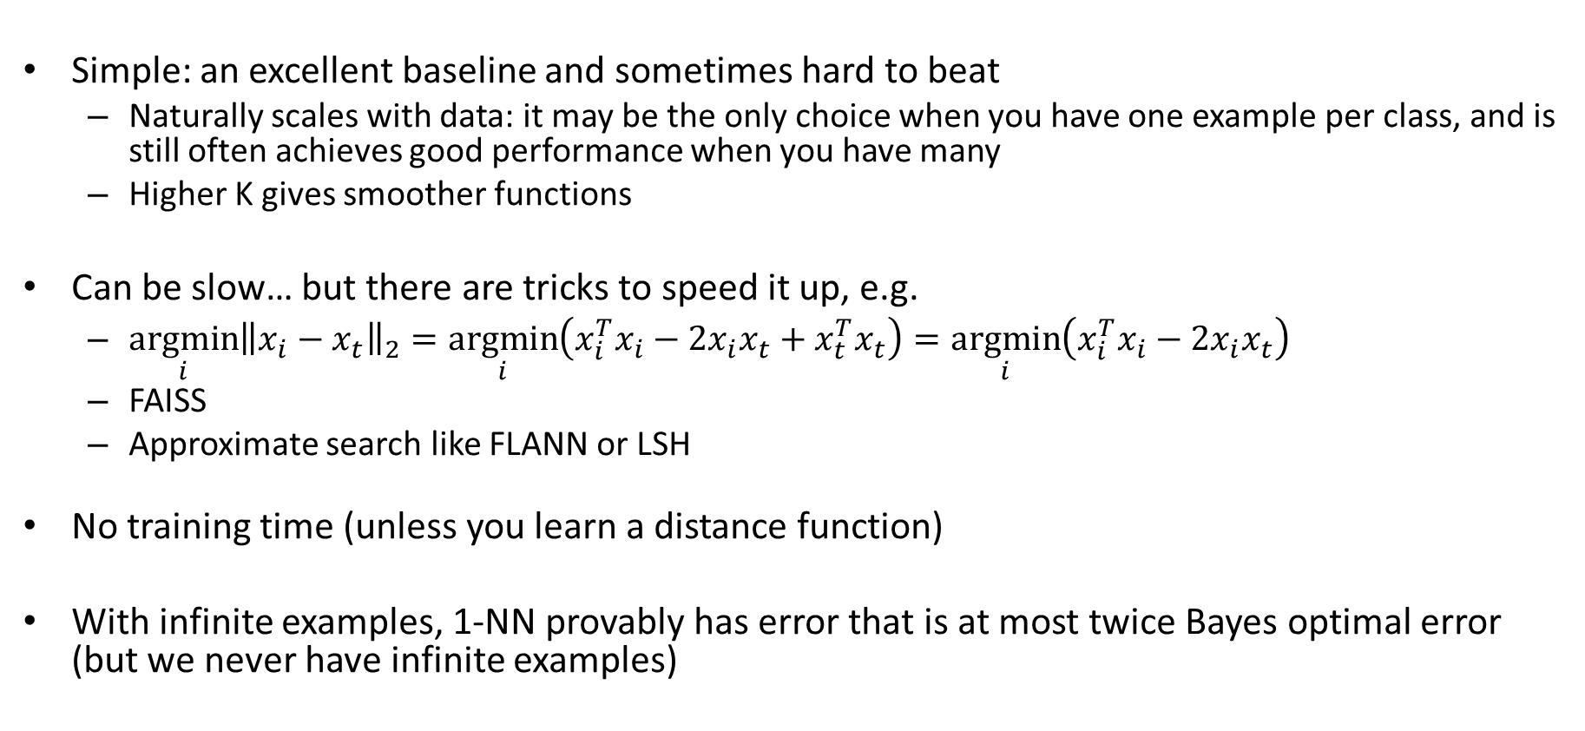
Comments on K-NN
Simple: an excellent baseline and sometimes hard to beat
  Naturally scales with data: it may be the only choice when you have one example per class, and is still often achieves good performance when you have many
  Higher K gives smoother functions
Can be slow… but there are tricks to speed it up, e.g.
  $\underset{i}{argmin}{{\left\|x_{i}−x_{t}\right\|}_{2}}=\underset{i}{argmin}\left(x_{i}^{T}x_{i}−{2x}_{i}x_{t}+x_{t}^{T}x_{t}\right)=\underset{i}{argmin}\left(x_{i}^{T}x_{i}−{2x}_{i}x_{t}\right)$
  FAISS
  Approximate search like FLANN or LSH
No training time (unless you learn a distance function)
With infinite examples, 1-NN provably has error that is at most twice Bayes optimal error (but we never have infinite examples)
can be precomputed

Slide 17
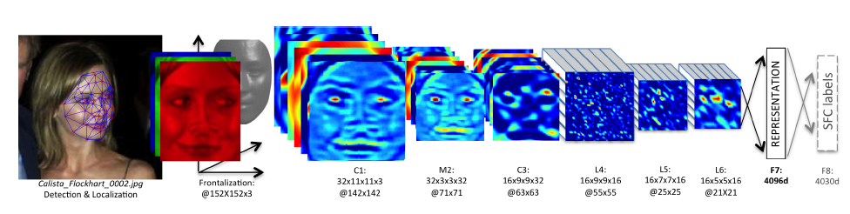
KNN Usage Example: Deep Face
CVPR 2014
Detect facial features
Align faces to be frontal
Extract features using deep network while training classifier to label image into person (dataset based on employee faces)
In testing, extract features from deep network and use nearest neighbor classifier to assign identity
Performs similarly to humans in the LFW dataset (labeled faces in the wild)
Can be used to organize photo albums, identifying celebrities, or alert user when someone posts an image of them
If this is used in a commercial deployment, what might be some unintended consequences?
This algorithm is used by Facebook (though with expanded training data)

Slide 18
KNN Summary
Key Assumptions
  Samples with similar input features will have similar output predictions
  Depending on distance measure, may assume all dimensions are equally important
Model Parameters
  Features and predictions of the training set
Designs
  K (number of nearest neighbors to use for prediction)
  How to combine multiple predictions if K > 1
  Feature design (selection, transformations)
  Distance function (e.g. L2, L1, Mahalanobis)
When to Use
  Few examples per class, many classes
  Features are all roughly equally important
  Training data available for prediction changes frequently
  Can be applied to classification or regression, with discrete or continuous features
  Most powerful when combined with feature learning
When Not to Use
  Many examples are available per class (feature learning with linear classifier may be better)
  Limited storage (cannot store many training examples)
  Limited computation (linear model may be faster to evaluate)

Slide 19
3 minute break
T/F (and why): 1-NN will never have higher training error than 3-NN for classification and regression.
T/F (and why): For 1-NN classification, you cannot remove a training sample without affecting at least some portion of the decision boundary.

Slide 20
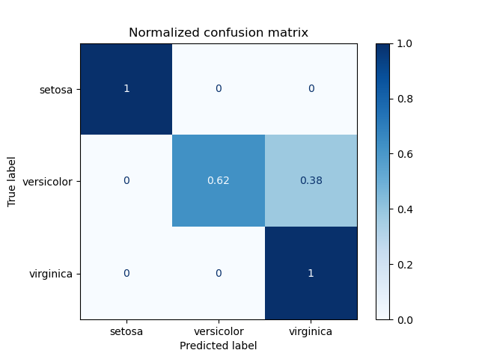
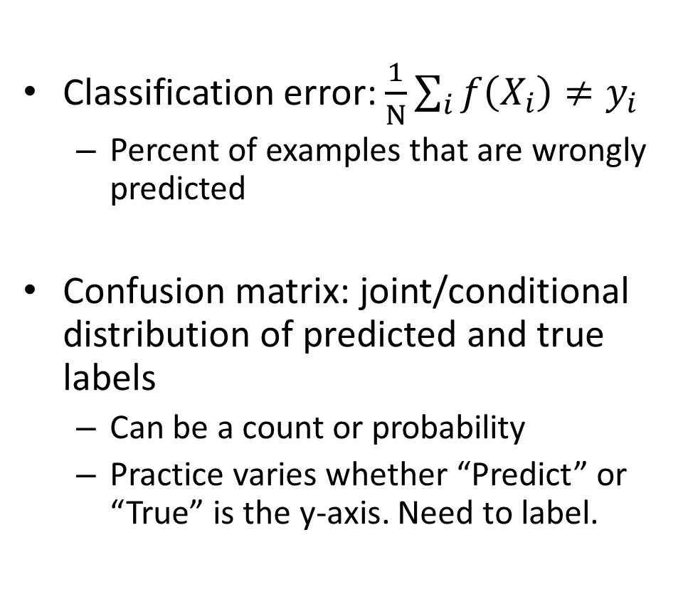
How do we measure and analyze classification error?
Classification error: $\frac{1}{N}\sum_{i}{f\left(X_{i}\right)≠y_{i}}$
  Percent of examples that are wrongly predicted
Confusion matrix: joint/conditional distribution of predicted and true labels
  Can be a count or probability
  Practice varies whether “Predict” or “True” is the y-axis. Need to label.
https://scikit-learn.org/stable/auto_examples/model_selection/plot_confusion_matrix.html

Slide 21
Measuring error example
Confusion Matrix:
Count
True | Predicted
Y | Y
N | Y
Y | Y
Y | N
N | N
N | Y
N | N
 |  | Predicted | N
 |  | N | Y
True | N
 | Y
Classification Error:
P(predicted | true)
 |  | Predicted | N
 |  | N | Y
True | N
 | Y

Slide 22
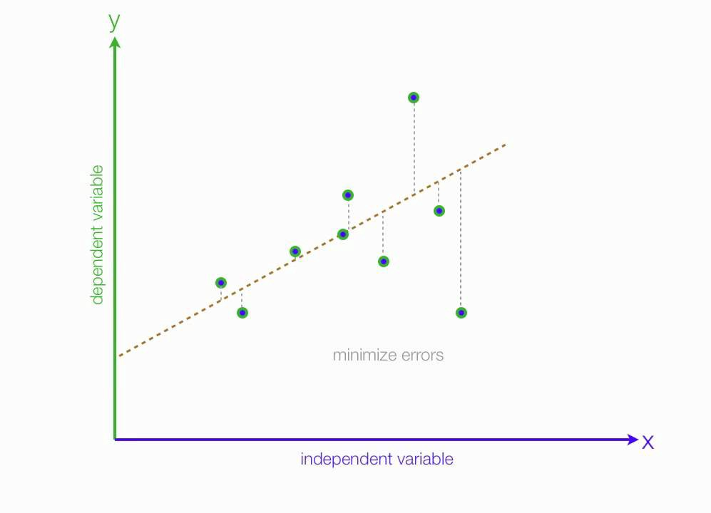
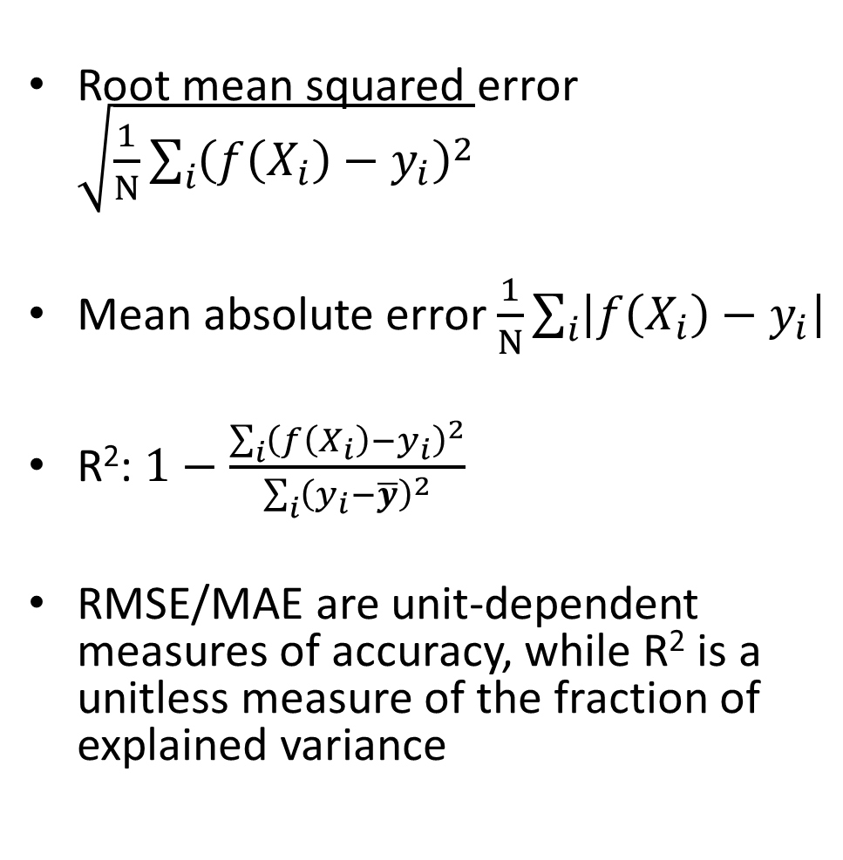
How do we measure and analyze regression error?
Root mean squared error $\sqrt{\frac{1}{N}\sum_{i}{{\left(f\left(X_{i}\right)−y_{i}\right)}^{2}}}$
Mean absolute error $\frac{1}{N}\sum_{i}{\left|f\left(X_{i}\right)−y_{i}\right|}$
R²: $1−\frac{\sum_{i}{{\left(f\left(X_{i}\right)−y_{i}\right)}^{2}}}{\sum_{i}{{\left(y_{i}−\overline{y}\right)}^{2}}}$
RMSE/MAE are unit-dependent measures of accuracy, while R² is a unitless measure of the fraction of explained variance
$$f\left(x\right)$$
(unexplained variance)
(total variance)
Fig: https://medium.com/analytics-vidhya/mae-mse-rmse-coefficient-of-determination-adjusted-r-squared-which-metric-is-better-cd0326a5697e

Slide 23
Error and Bias Variance Trade-off
When model parameters are fit to a training set and evaluated on a test set
Training error: The error on the training set
Test error: The error on the test set
Generalization error: test error – training error
Test error has three important sources in common ML settings:
Intrinsic: sometimes it is not possible to achieve zero error given available features (e.g. handwriting, weather prediction)
  Bayes optimal error: The error if the true function P(y|x) is known
Model Bias: the model is limited so that it can’t fit perfectly to the true data distribution (e.g. there will be error, even if you have infinite training data)
Model Variance: given finite training data, different parameters and predictions would result from different samplings of data
A more complex or specific model will have
Lower bias: better fit to training set
Higher variance: more uncertainty in best parameters, so more generalization error

Slide 24
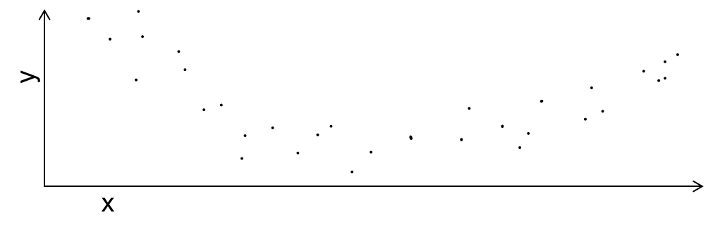

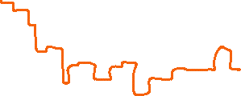


Error and Bias Variance Trade-off
K=1
K=5
K=25

Slide 25
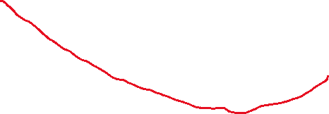
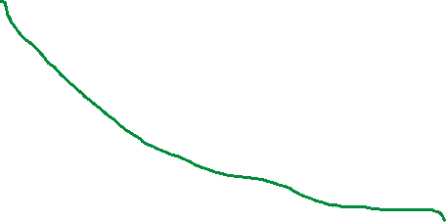
Error and Bias Variance Trade-off
K=1
Under-fitting
Overfitting
K=5
Test error
Error
Train error
Generalization Error
K=25
Complexity/Precision of Model
K=25
K=5
K=1

Slide 26
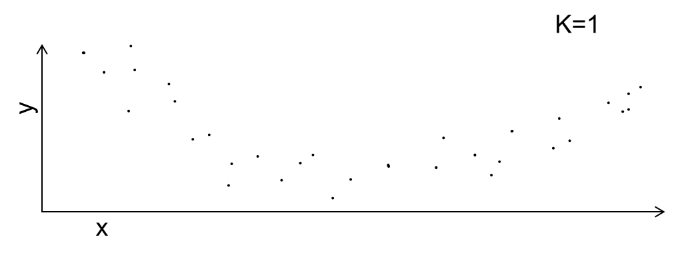
Error and Bias Variance Trade-off
K=1
y
x
Error
Generalization Error
Complexity/Precision of Model
K=25
K=1

Slide 27
Sources of test error for a trained model
Intrinsic: sometimes it is not possible to achieve zero error given available features (e.g. handwriting, weather prediction)
  Bayes optimal error: The error if the true function P(y|x) is known
Model Bias: the model is limited so that Bayes optimal error cannot be achieved for an infinite training set
Model Variance: given finite training data, different parameters and predictions would result from different samplings of data
Distribution Shift: some examples are more likely in test than training, i.e. true P(x) is different for train and test
  E.g., datasets are collected at different times and frequency of content has changed
Function Shift: P(y|x) is changed between train and test
  E.g., the predicted answer to “What is your favorite TV show?” changes over time
Others: imperfect optimization, final performance measure is different than training loss

Slide 28
Effect of Training Size
Fixed model
Error
Testing
Generalization Error
Training
Number of Training Examples

Slide 29
Sources of error and training size
Fixed model
Due to limited training data (model variance) and distribution shift
Testing
Error
Test error with infinite training examples
Due to difference in P(y|x) in training and test (function shift)
Train error with infinite training examples
Training
Number of Training Examples
Due to limited power of model (model bias) and unavoidable intrinsic error (Bayes optimal error)

Slide 30
HW 1

Slide 31
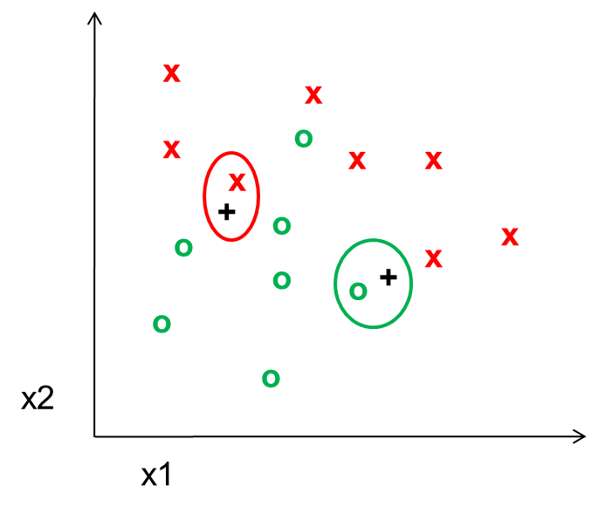
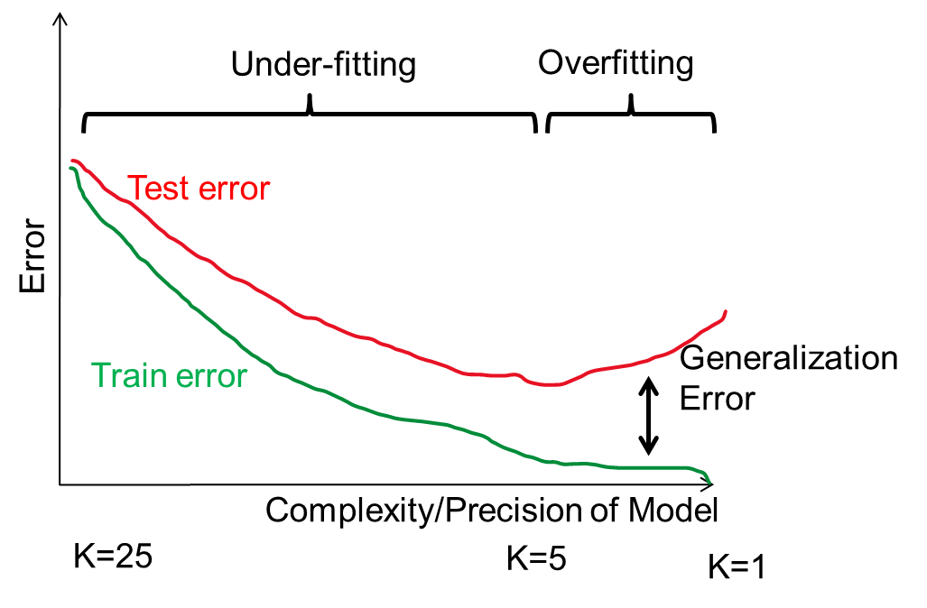
Things to remember
KNN is a simple but effective classifier/regressor that predicts the label of the most similar training example(s)
Larger K gives a smoother prediction function
Test error is composed of bias (model too simple/smooth to fit data) and variance (model too complex to learn from training data)

Slide 32
Next week
Dimensionality reduction
Linear regression

