Slide 1
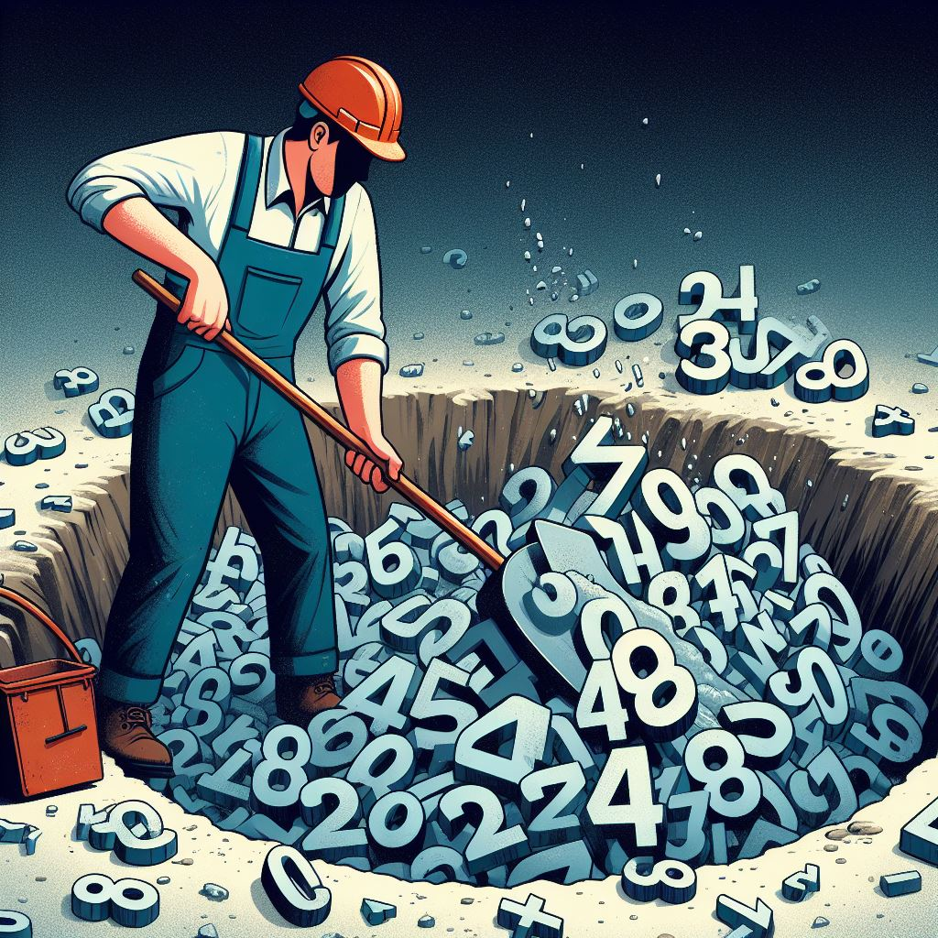
Working with Data
Applied Machine Learning
Derek Hoiem
Dall-E 3

Slide 2

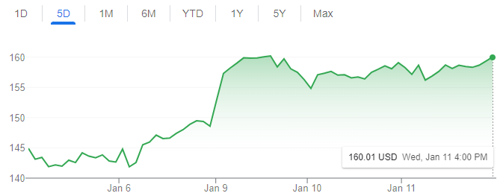
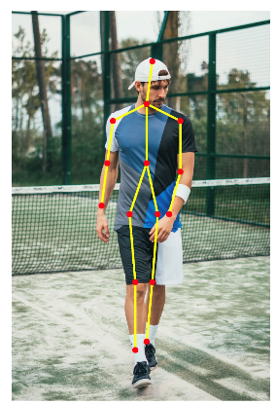
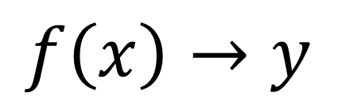
Machine learning model maps from features to prediction
$$f\left(x\right)→y$$
Features
Prediction
Examples
Classification: predict label
  Is this a dog or a cat?
  Is this email spam or not?
Regression: predict value
  What will the stock price be tomorrow?
  What will be the high temperature tomorrow?
Structured prediction
  What is the pose of this person?

Slide 3
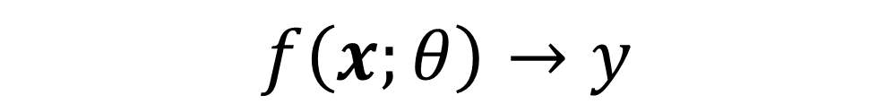


Classification problem
$$f\left(x;θ\right)→y$$
Input features
Model parameters
Predicted label
Digit classification example
$$x$$
$$y$$
3 8 7 9 9 0 1 1 5 2
Developing a classifier involves training and testing with training, validation, and test data
Training data: used to fit parameters of the model
Validation data: used to select the best model and any parameters that need to be manually set (“hyperparameters”)
Test data: used to evaluate the final version of the model

Slide 4
This lecture
Representing data points
Data sets
Measuring data and information

Slide 5
What is data?
Information that helps us make decisions
Numbers (bits)

Slide 6
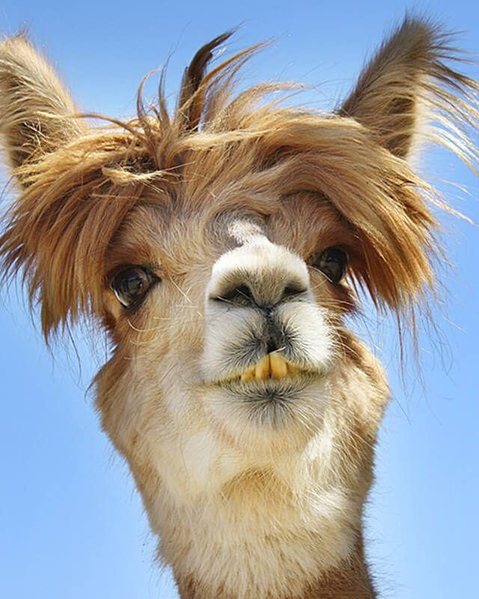
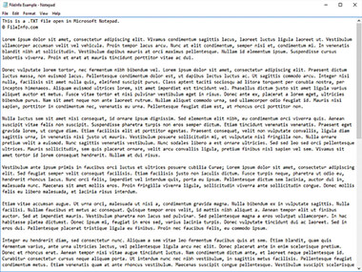
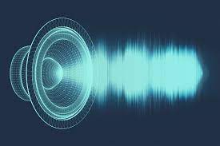
How do we represent data?
As humans: media we can see, read, and hear
  Words, imagery, sounds, tables, plots
https://www.canto.com/blog/audio-file-types/
https://www.rd.com/list/funny-photos/
https://fileinfo.com/extension/txt

Slide 7
Sometimes, we can transform the data while preserving much or all of the information
Resize an image
Rephrase a paragraph
1.5x an audio book

Slide 8
Sometimes, we can even transform the data so that it is more informative
Perform denoising on an image
Identify key points and insights in a document
Remove background noise from audio
None of these operations add information to the data, but they re-organize and/or remove distracting information

Slide 9
In computers, data are numbers
The numbers do not “mean” anything by themselves
The meaning comes from the way the numbers were produced and how they can inform
The meaning can be contained in each number by itself, or commonly by patterns in groups of numbers

Slide 10
Sometimes, we can transform the data while preserving much or all of the information
Add or multiply by a constant value
Represent as a 16-bit or 32-bit float or integer
Compress a document, or store in a different file format

Slide 11
Sometimes, we can even transform the data so that it is more informative
Center and rescale images of digits so they are easier to compare to each other
Normalize (subtract means and divide by standard deviations) cancer cell measurements to make simple similarity measures better reflect malignancy
Select features or create new ones out of combinations of inputs

Slide 12
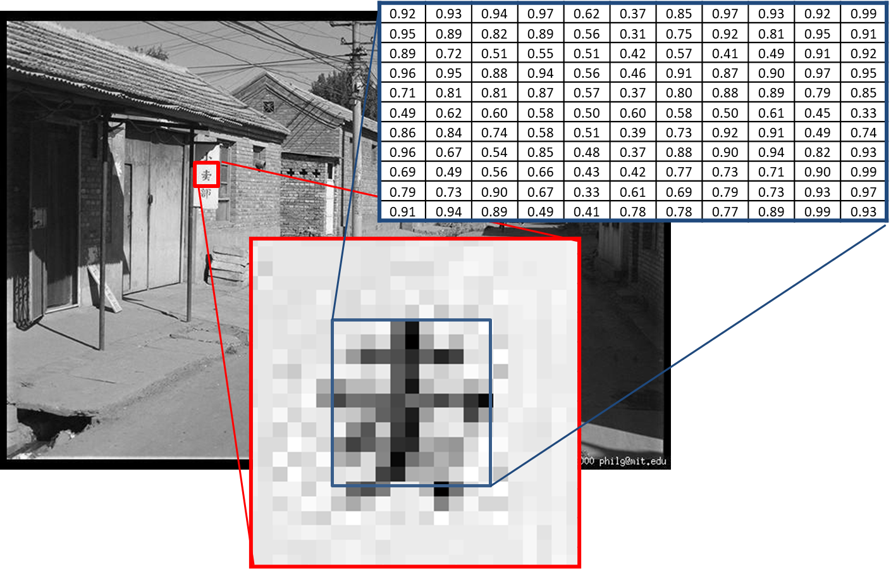
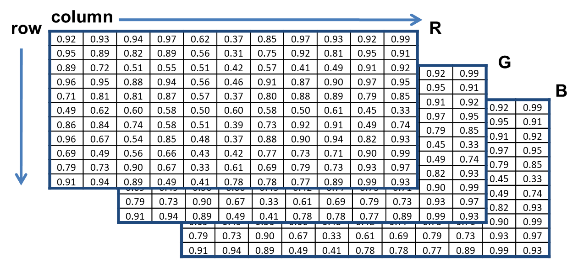
Images can be represented as 3D matrices (row, col, color)

Slide 13
Sometimes, we change the structure of data to make it easier to process
Image as matrix
Image as vector
0.92 | 0.93 | 0.94 | 0.97 | 0.62 | 0.37 | 0.85 | 0.97 | 0.93 | 0.92 | 0.99
0.95 | 0.89 | 0.82 | 0.89 | 0.56 | 0.31 | 0.75 | 0.92 | 0.81 | 0.95 | 0.91
0.89 | 0.72 | 0.51 | 0.55 | 0.51 | 0.42 | 0.57 | 0.41 | 0.49 | 0.91 | 0.92
0.96 | 0.95 | 0.88 | 0.94 | 0.56 | 0.46 | 0.91 | 0.87 | 0.90 | 0.97 | 0.95
0.71 | 0.81 | 0.81 | 0.87 | 0.57 | 0.37 | 0.80 | 0.88 | 0.89 | 0.79 | 0.85
0.49 | 0.62 | 0.60 | 0.58 | 0.50 | 0.60 | 0.58 | 0.50 | 0.61 | 0.45 | 0.33
0.86 | 0.84 | 0.74 | 0.58 | 0.51 | 0.39 | 0.73 | 0.92 | 0.91 | 0.49 | 0.74
0.96 | 0.67 | 0.54 | 0.85 | 0.48 | 0.37 | 0.88 | 0.90 | 0.94 | 0.82 | 0.93
0.69 | 0.49 | 0.56 | 0.66 | 0.43 | 0.42 | 0.77 | 0.73 | 0.71 | 0.90 | 0.99
0.79 | 0.73 | 0.90 | 0.67 | 0.33 | 0.61 | 0.69 | 0.79 | 0.73 | 0.93 | 0.97
0.91 | 0.94 | 0.89 | 0.49 | 0.41 | 0.78 | 0.78 | 0.77 | 0.89 | 0.99 | 0.93
0.92
0.95
0.89
0.96
0.71
0.49
0.86
0.96
0.69
0.79
0.91
0.93
0.89
0.72
0.95
0.81
0.62
0.84
0.67
0.49
0.73
0.94
…
0.93
Convenient for local pattern analysis
This does not change the information in the data, but it makes it harder to understand by people and more/less convenient for certain kinds of processing
Convenient for linear projection

Slide 14
Text can be represented as a sequence of integers
Each character can map to a byte value, and then we have a sequence of bytes
  “Dog ate” → [4 15 7 27 1 20 5]
Each complete word can map to an integer value, and we have a sequence of integers
  “Dog ate” → [437 1256]
Common groups of letters can be mapped to subwords and then to integers
  “Bedroom 1521” → [bed-room- -1-5-2-1]→[125 631 27 28 32 29 27]

Slide 15
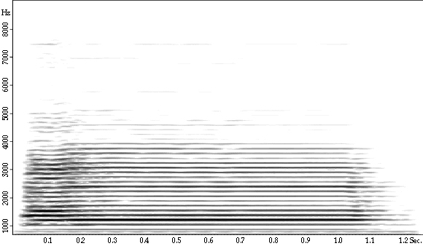
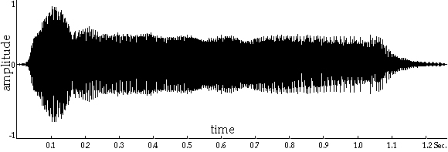
Audio can be represented as a waveform or spectrum
Amplitude vs Time
Frequency-Amplitude vs Time
Fig source

Slide 16
Other kinds of data
Measurements and continuous values typically represented as floating point numbers
  Temperature, length, area, dollars
Categorical values represented as integers or one-hot vectors
  Integer: Happy/Indifferent/Sad → 0/1/2
  One-hot: Happy → [1 0 0]
  Another example: Red/Green/Blue/Orange/Other → 0/1/2/3/4
Different kinds of values (text, images, measurements) can be reshaped and concatenated into a long feature vector

Slide 17
The same information content can be represented in many ways. If the original numbers can be recovered, then a change in representation does not change the information content.
All types of data can be stored as 1D vectors/arrays.
Matrices and other data structures can make code easier to program and read.

Slide 18
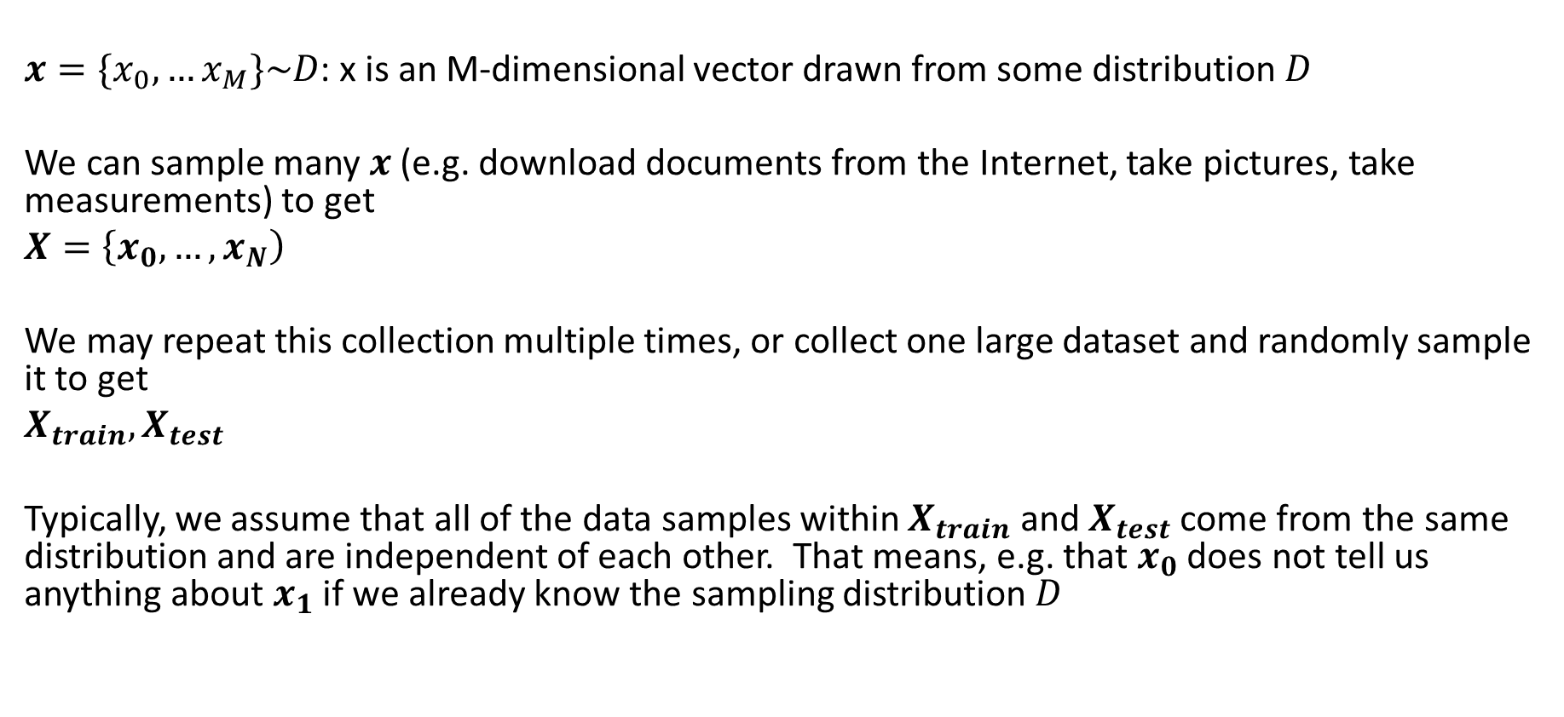
From data point to data set
$x=\{x_{0},…x_{M}\}\sim D$: x is an M-dimensional vector drawn from some distribution $D$
We can sample many $x$ (e.g. download documents from the Internet, take pictures, take measurements) to get
$X=\left\{x_{0}, …, x_{N}\right)$
We may repeat this collection multiple times, or collect one large dataset and randomly sample it to get
$X_{train}, X_{test}$
Typically, we assume that all of the data samples within $X_{train}$ and $X_{test}$ come from the same distribution and are independent of each other. That means, e.g. that $x_{0}$ does not tell us anything about $x_{1}$ if we already know the sampling distribution $D$

Slide 19
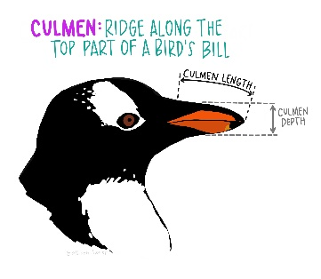
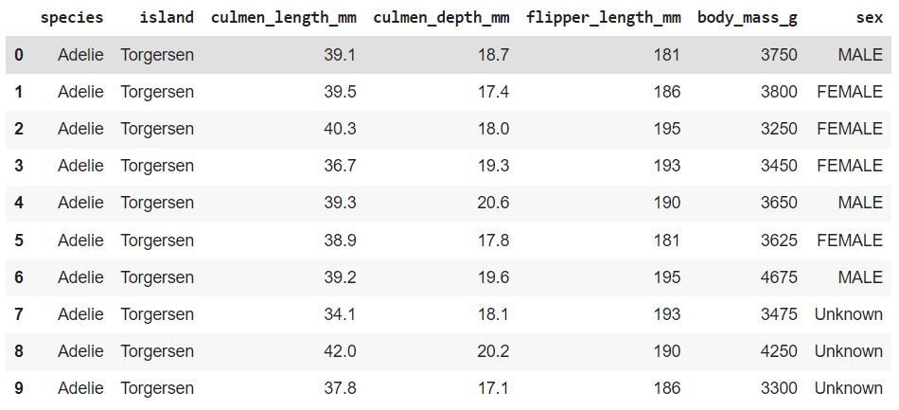
Consider an example from the penguins dataset
By Allison Horst

Slide 20
Convert the data into numbers
df_penguins = pd.read_csv(datadir + 'penguins_size.csv')
df_penguins.head(10)
# convert features with multiple string values to binary features so they can be used by sklearn
def get_penguin_xy(df_penguins):
data = np.array(df_penguins[['island', 'culmen_length_mm', 'culmen_depth_mm', 'flipper_length_mm’, \
'body_mass_g', 'sex']])
y = df_penguins['species']
ui = np.unique(data[:,0]) # unique island
us = np.unique(data[:,-1]) # unique sex
X = np.zeros((len(y), 10))
for i in range(len(y)):
f = 0
for j in range(len(ui)): # replace island name with three indicator variables
if data[i, f]==ui[j]:
X[i, f+j] = 1
f = f + len(ui)
X[i, f:(f+4)] = data[i, 1:5] # copy original measurement features
f=f+4
for j in range(len(us)): # replace sex with three indicator variables (male/female/unknown)
if data[i, 5]==us[j]:
X[i, f+j] = 1
feature_names = ['island_biscoe', 'island_dream', 'island_torgersen', 'culmen_length_mm’, \
'culmen_depth_mm', 'flipper_length_mm', 'body_mass_g', 'sex_female', 'sex_male', 'sex_unknown']
X = pd.DataFrame(X, columns=feature_names)
return(X, y, feature_names, np.unique(y))

Slide 21

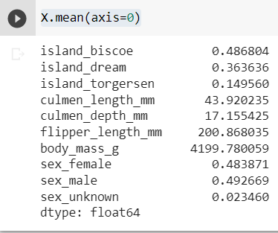
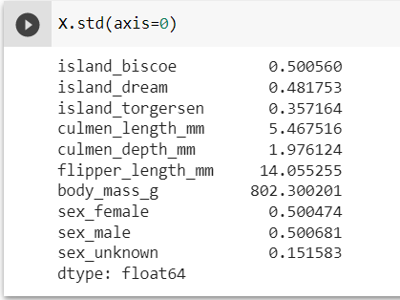
How do we measure $X$?
We can check the number of samples and dimensions
We can measure the distribution with statistics

Slide 22
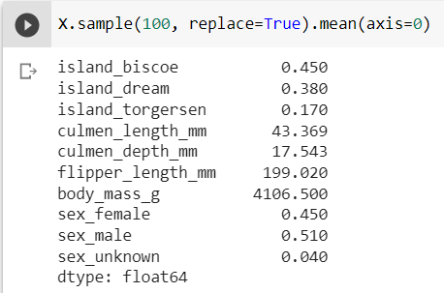
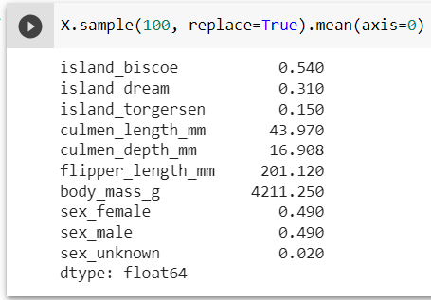
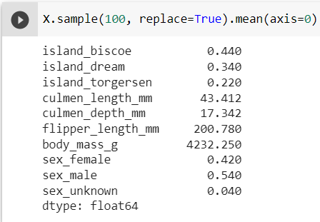
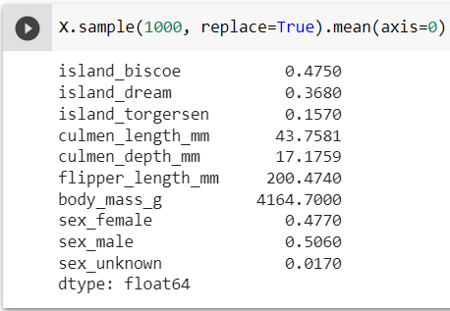
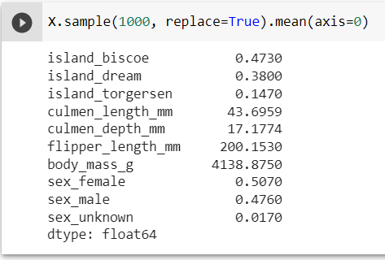
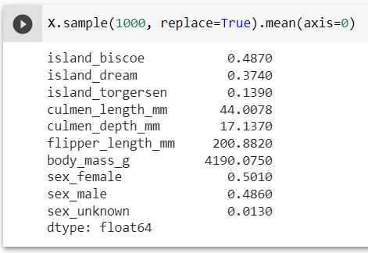
Different samples will give us different measurements of the distribution
The estimates from larger sample sizes will vary less

Slide 23
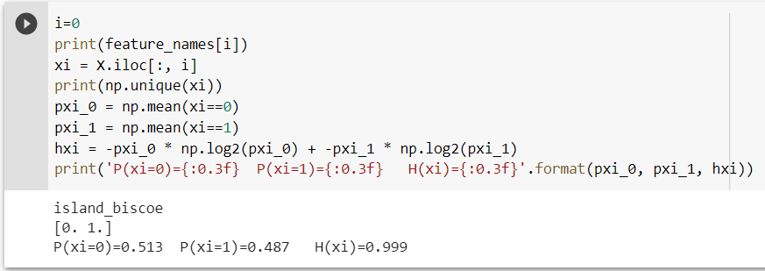
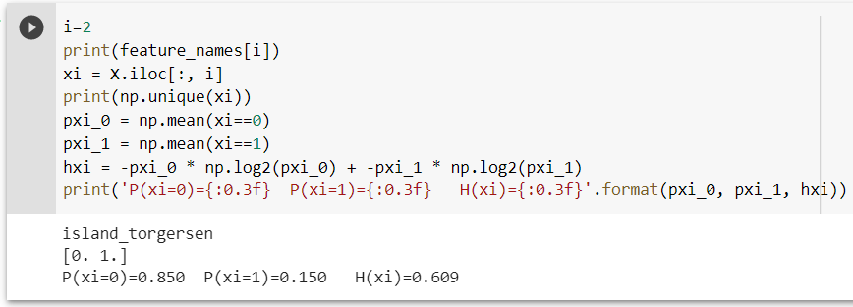

How do we measure $X$?
We can measure the entropy of a particular variable:
$H\left(x\right)=−\sum_{k}{\left[P\left(x=k\right)\log{P\left(x=k\right)}\right]}$ (if x is discrete, i.e. finite number of possible values)

Slide 24
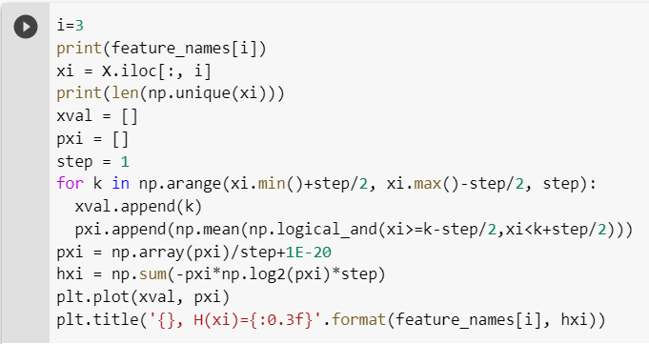
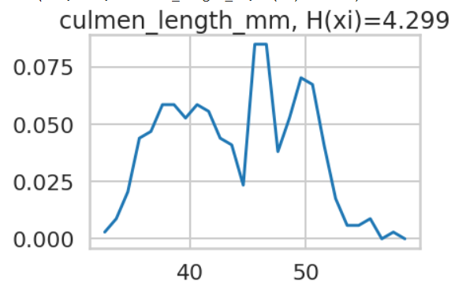

How do we measure $X$?
We can measure the entropy of a particular variable:
$H\left(x\right)=−\int{p\left(x\right)log⁡(p\left(x\right))}dx$ (if x is continuous)

Slide 25
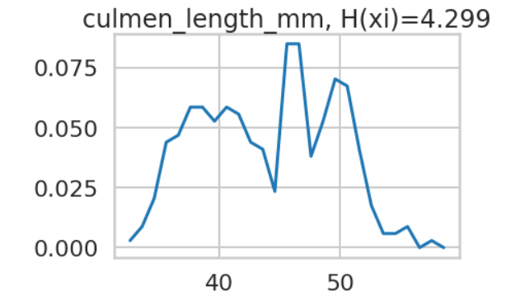
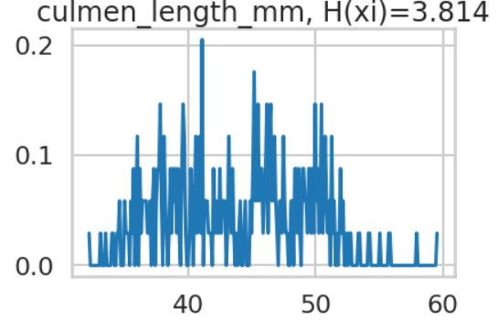

How do we measure $X$?
We can measure the entropy of a particular variable:
$H\left(x\right)=−\int{p\left(x\right)log⁡(p\left(x\right))}$ (if x is continuous)
But probability densities and entropy of continuous variables are tricky to estimate
Step = 1
Step = 0.1

Slide 26
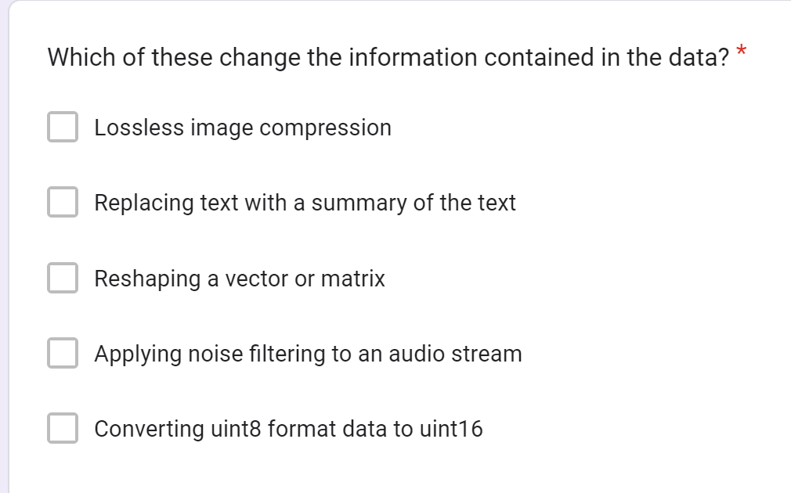
3-minute Break
What is the difference between data and information?

Slide 27
Entropy measures how many bits are required to store an element of data
Does this mean that entropy is a measure of information?
Does a random array contain information?

Slide 28
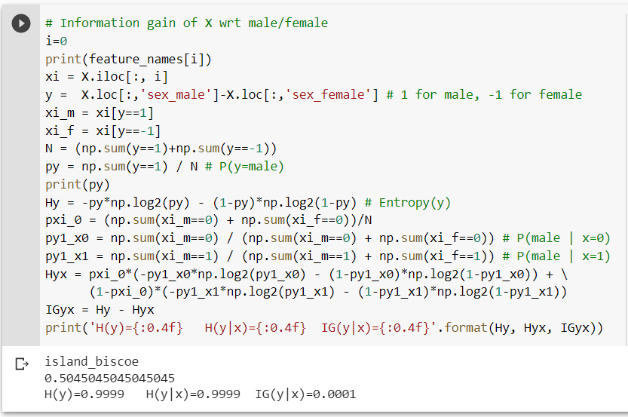
Information gain: IG(y|x) = H(y)-H(y|x)
Information gain measures how much a variable x reduces the entropy of y when known, i.e. how many fewer bits are needed to encode y given the value of x
Knowing the island is Biscoe tells us very little about whether a penguin is likely to be male or female

Slide 29
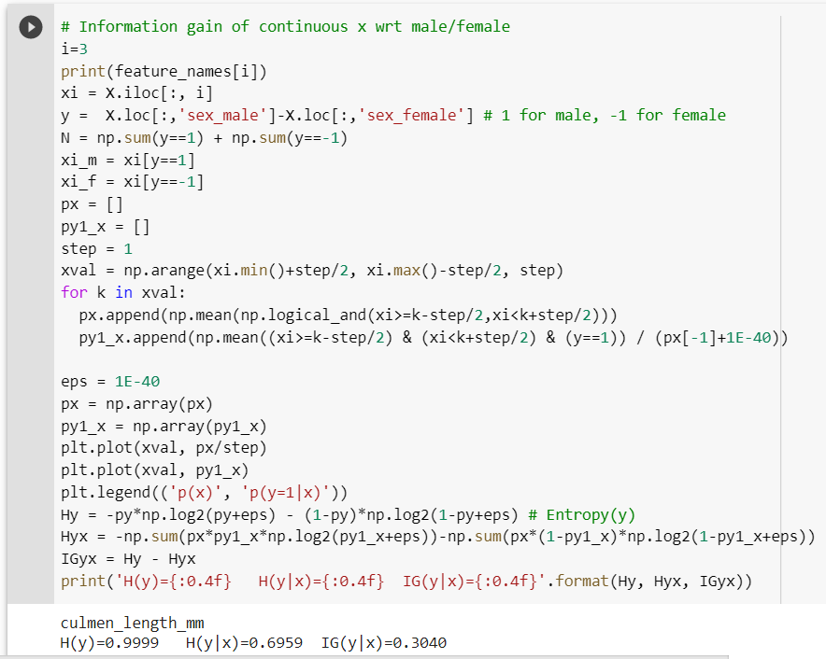
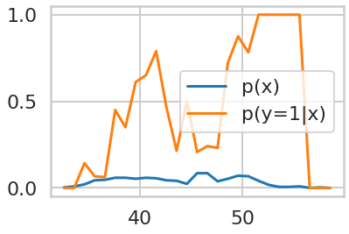
Information gain: IG(y|x) = H(y)-H(y|x)
Also applies when x is continuous
IG(y|x) = 0.304
Knowing the culmen length tells us a lot whether a penguin is likely to be male or female. Large culmens are always male, but smaller ones could be male (maybe young) or female.

Slide 30
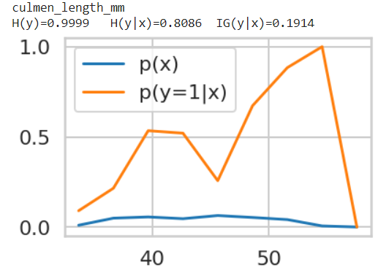
Information gain: IG(y|x) = H(y)-H(y|x)
Again, details on how continuous distribution is estimated can lead to different information gains
Step=1
Step=3
IG(y|x) = 0.304
IG(y|x) = 0.1904

Slide 31
How can the information gain be different depending our step size?
We have only an empirical estimate (based on observed samples) of probabilities used to compute information gain
With more data, we could obtain a better estimate
With continuous variables, there is a trade-off between over-smoothing or simplifying the distribution and making overly confident predictions based on small data samples
The true probability distributions and information gain cannot be known. We can only try to make our best estimate, and it depends on our representation and model
Step=1
Step=3
IG(y|x) = 0.304
IG(y|x) = 0.190

Slide 32
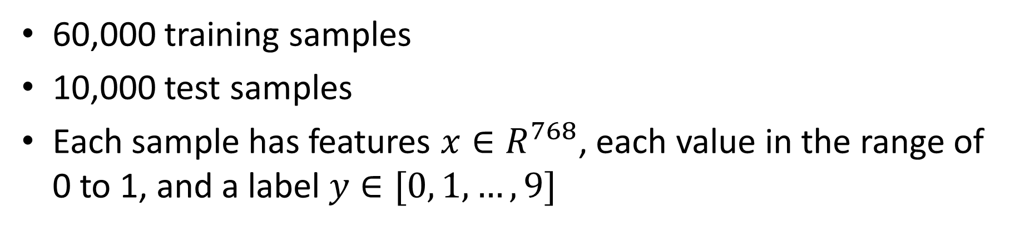
Introduction to MNIST, a classification benchmark
x
y
3 8 7 9 9 0 1 1 5 2
60,000 training samples
10,000 test samples
Each sample has features $x∈R^{768}$, each value in the range of 0 to 1, and a label $y∈[0, 1, …, 9]$

Slide 33
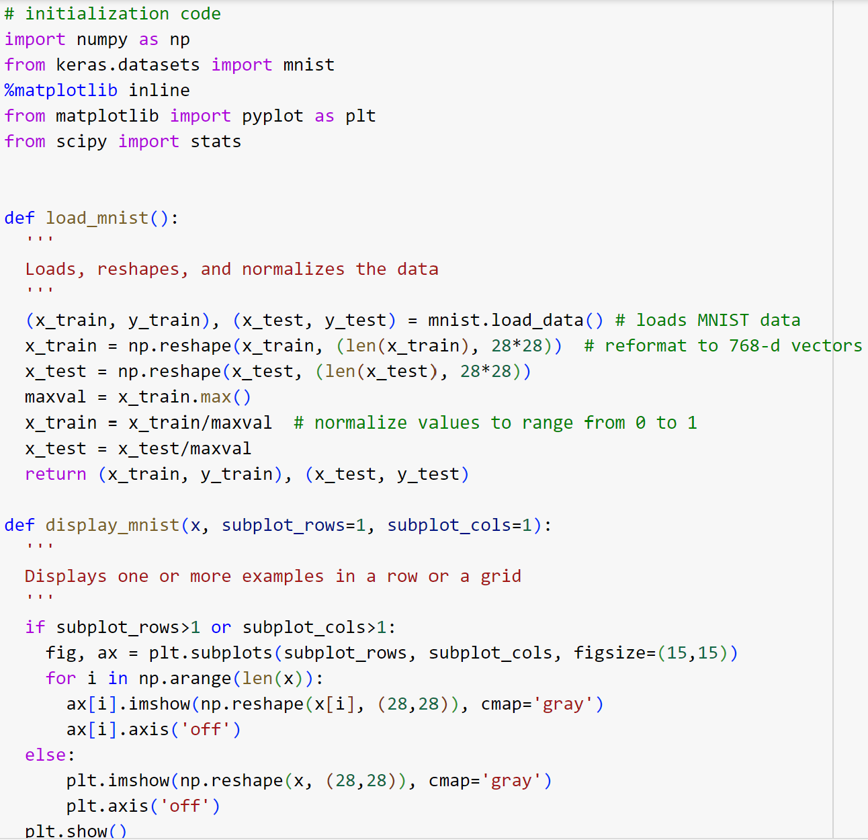
MNIST Processing
x_train[0] is the features of the first training sample
y_train[0] is the label of the first training sample
x_train[:1000] is the features of the first 1000 training samples

Slide 34
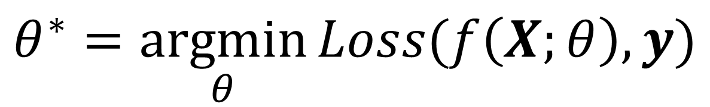
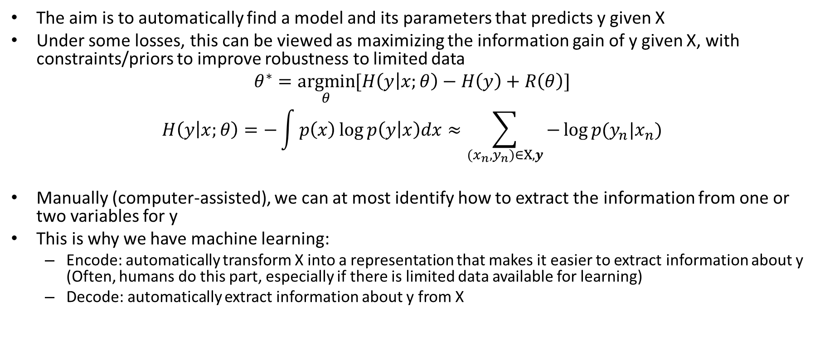
An ML formulation
$$θ^{∗}=\underset{θ}{argmin}{Loss(f\left(X;θ\right),y)}$$
The aim is to automatically find a model and its parameters that predicts y given X
Under some losses, this can be viewed as maximizing the information gain of y given X, with constraints/priors to improve robustness to limited data
$$θ^{∗}=\underset{θ}{argmin}{[H\left(y | x;θ\right)−H\left(y\right)}+R\left(θ\right)]$$
$$H\left(y | x;θ\right)=−\int{p\left(x\right)\log{p\left(y | x\right)dx}}≈\sum_{{(x}_{n},y_{n})∈X,y}{−\log{p(y_{n}|x_{n})}}$$
Manually (computer-assisted), we can at most identify how to extract the information from one or two variables for y
This is why we have machine learning:
  Encode: automatically transform X into a representation that makes it easier to extract information about y (Often, humans do this part, especially if there is limited data available for learning)
  Decode: automatically extract information about y from X

Slide 35
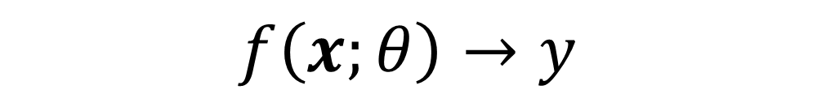
Things to remember
Machine learning is fitting parameters of a model so that you can accurately predict one set of numbers from another set of numbers
Something can take a lot of data storage but provide little information, or vice versa
The predictiveness or information gain of the features depends on how they are modeled
$$f\left(x;θ\right)→y$$

Slide 36
Next week
Similarity, clustering, and retrieval
K-NN classification and regression

Slide 37
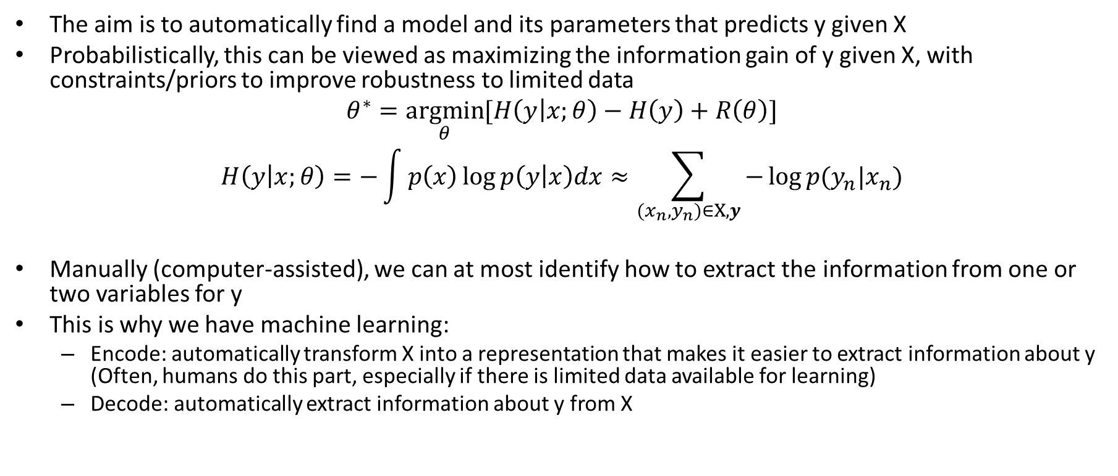
An ML formulation
$$θ^{∗}=\underset{θ}{argmin}{Loss(f\left(X;θ\right),y)}$$
The aim is to automatically find a model and its parameters that predicts y given X
Probabilistically, this can be viewed as maximizing the information gain of y given X, with constraints/priors to improve robustness to limited data
$$θ^{∗}=\underset{θ}{argmin}{[H\left(y | x;θ\right)−H\left(y\right)}+R\left(θ\right)]$$
$$H\left(y | x;θ\right)=−\int{p\left(x\right)\log{p\left(y | x\right)dx}}≈\sum_{{(x}_{n},y_{n})∈X,y}{−\log{p(y_{n}|x_{n})}}$$
Manually (computer-assisted), we can at most identify how to extract the information from one or two variables for y
This is why we have machine learning:
  Encode: automatically transform X into a representation that makes it easier to extract information about y (Often, humans do this part, especially if there is limited data available for learning)
  Decode: automatically extract information about y from X

Slide 38

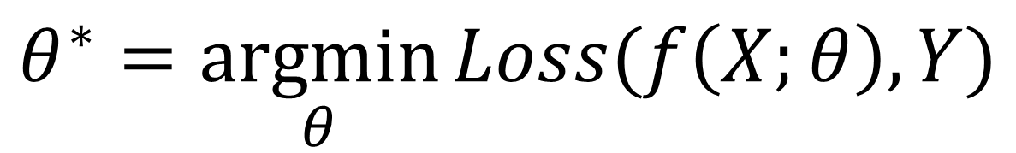

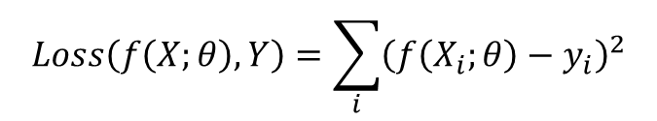

Training: the model is fit to data to minimize a loss or maximize an objective function
$$θ^{∗}=\underset{θ}{argmin}{Loss(f\left(X;θ\right),Y)}$$
Model parameters that minimize loss
Features of all training examples
“Ground Truth” predictions of all training examples
$$X$$
$$Y$$
Loss: sum squared error
Example
Learn to predict next day’s temperature given preceding days’ temperatures
$$Loss\left(f\left(X;θ\right),Y\right)=\sum_{i}{{\left(f\left(X_{i};θ\right)−y_{i}\right)}^{2}}$$
37.5 | 41.2 | 51.0 | 48.3
47.0 | 46.5 | 48.9 | 50.5
…
67.0 | 64.7 | 63.0 | 61.4
50.5
47.6
…
60.2
1 row per example
Model: linear
$$f(X_{i};θ)=AX_{i}+b$$
1 column per feature
Optimization via ordinary least squares regression

Slide 39
Machine Learning
Representation
E.g., from manual design, tree, or deep network
Data
+
Model
+
Objective
+
Optimization
Trained Model
w/ parameters fit to training data to achieve objective over the training set

Slide 40
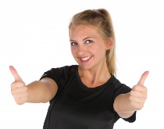
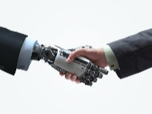
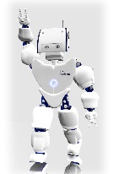
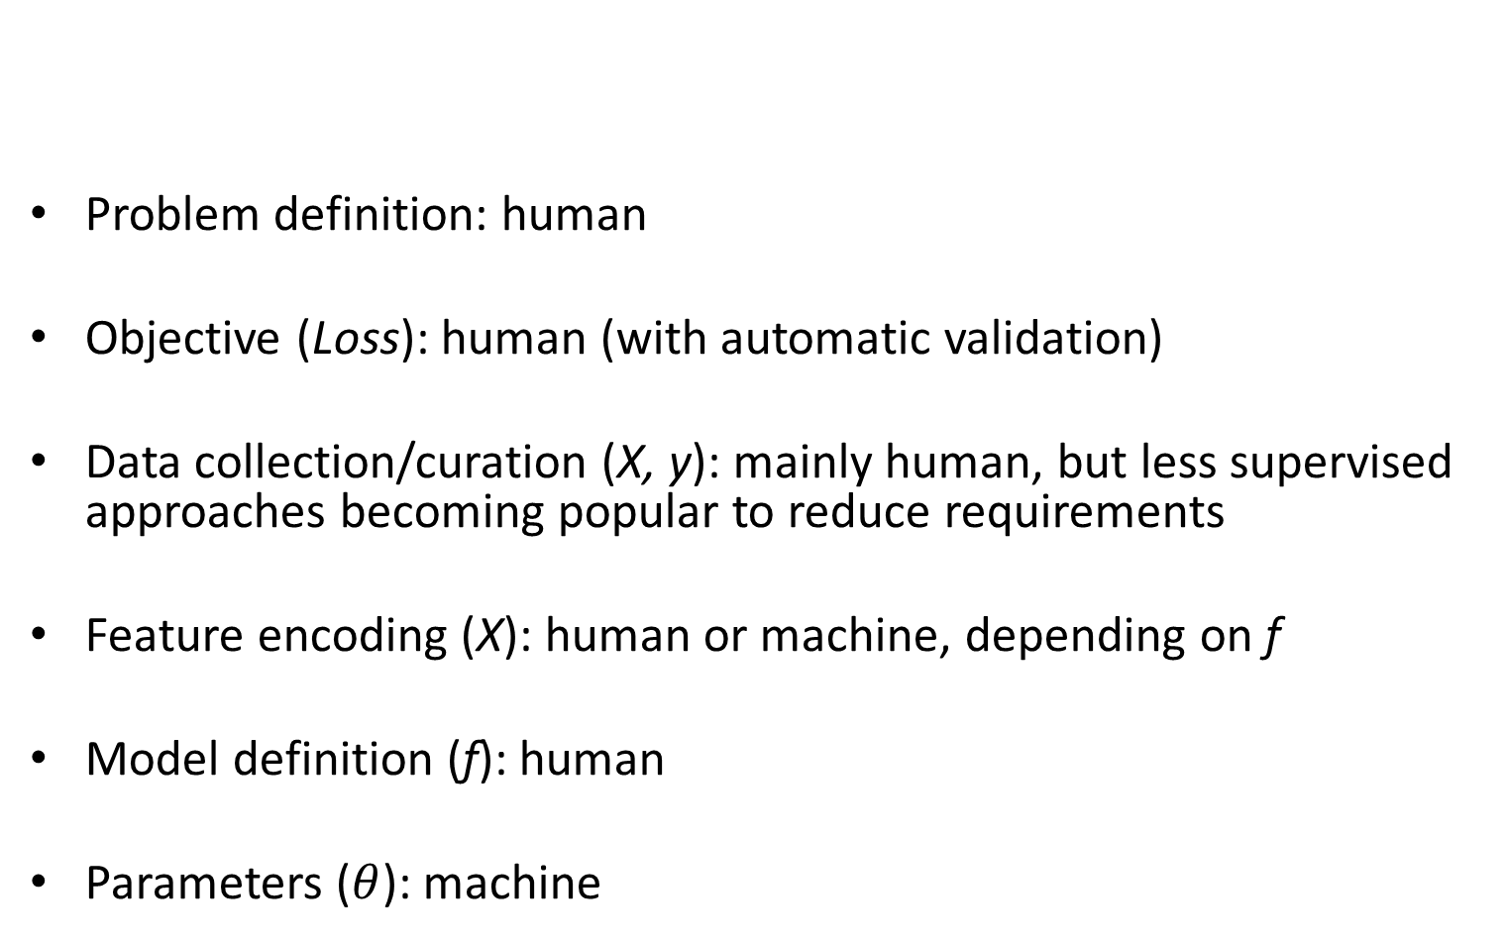
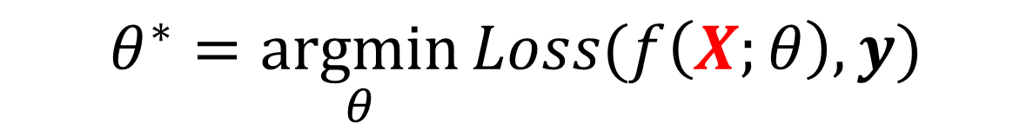
Whose job is ML – human or machine?
$$θ^{∗}=\underset{θ}{argmin}{Loss(f\left(X;θ\right),y)}$$
Problem definition: human
Objective (Loss): human (with automatic validation)
Data collection/curation (X, y): mainly human, but less supervised approaches becoming popular to reduce requirements
Feature encoding (X): human or machine, depending on f
Model definition (f): human
Parameters ($θ$): machine
Shake hands fig

