Slide 1

MLPs and Backprop
Applied Machine Learning
Derek Hoiem
Dall-E

Slide 2
Multi-layer Perceptrons (MLPs)
Recap of Perceptrons and SGD
What is an MLP
  Layers
  Activations
  Losses
How do we optimize with SGD and back-propagation

Slide 3
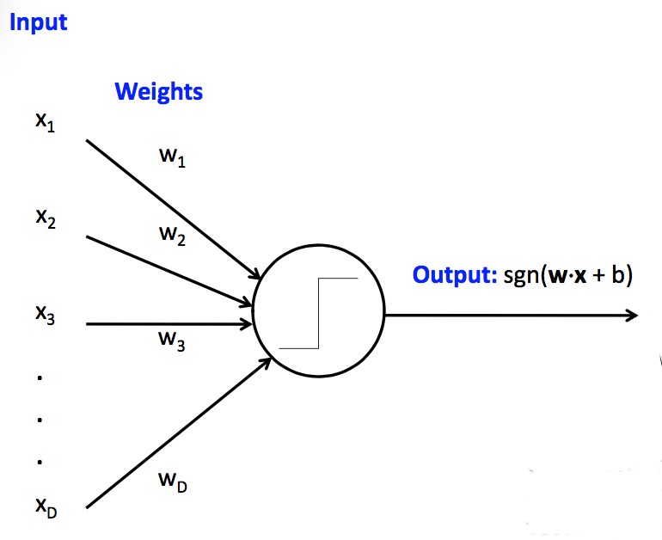
Perceptron
Perceptron = thresholded linear prediction model for classification
Very similar to linear logistic regression, though perceptron does not imply a particular error or training objective
sgn returns -1 for negative inputs and +1 for positive inputs
Fig source: CS 440

Slide 4
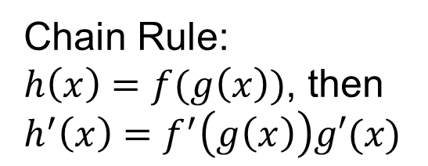
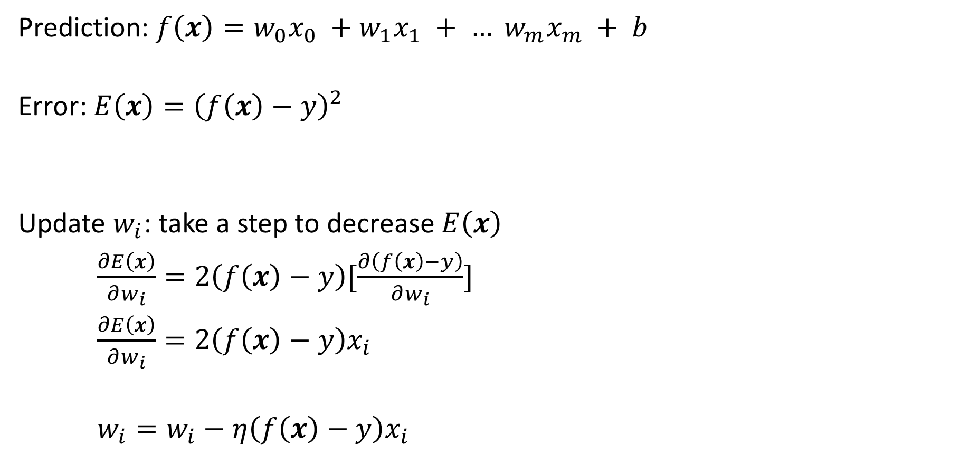
Perceptron Training
Prediction: $f\left(x\right)=w_{0}x_{0} +w_{1}x_{1} + … w_{m}x_{m} + b$
Error: $E\left(x\right)={\left(f\left(x\right)−y\right)}^{2}$
Update $w_{i}$: take a step to decrease $E\left(x\right)$
$\frac{∂E\left(x\right)}{∂w_{i}}=2\left(f\left(x\right)−y\right)[\frac{∂\left(f\left(x\right)−y\right)}{∂w_{i}}]$
$\frac{∂E\left(x\right)}{∂w_{i}}=2\left(f\left(x\right)−y\right)x_{i}$
$w_{i}=w_{i}−η\left(f\left(x\right)−y\right)x_{i}$
prediction
target
Chain Rule:
$h\left(x\right)=f(g\left(x\right))$, then
$h^{′}\left(x\right)=f^{′}\left(g\left(x\right)\right)g′(x)$
Make error lower
Learning rate

Slide 5
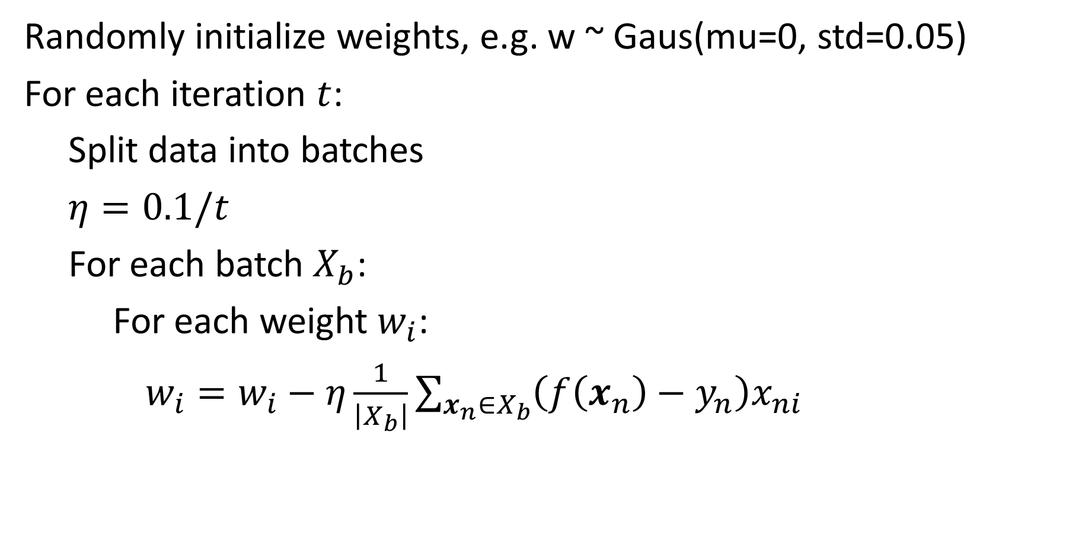
Perceptron Optimization by SGD
Randomly initialize weights, e.g. w ~ Gaus(mu=0, std=0.05)
For each iteration $t$:
Split data into batches
$η=0.1/t$
For each batch $X_{b}$:
For each weight $w_{i}$:
$w_{i}=w_{i}−η\frac{1}{\left|X_{b}\right|}\sum_{x_{n}∈X_{b}}{\left(f\left(x_{n}\right)−y_{n}\right)x_{ni}}$

Slide 6
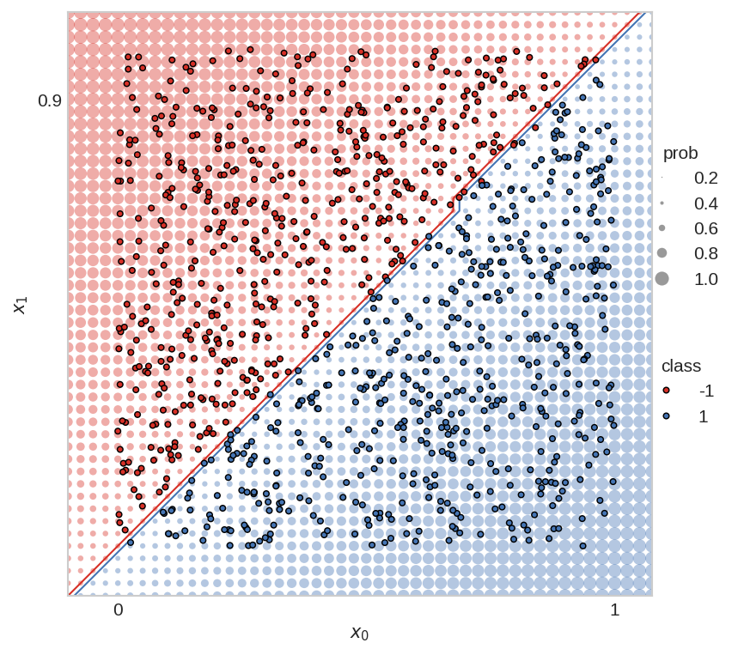
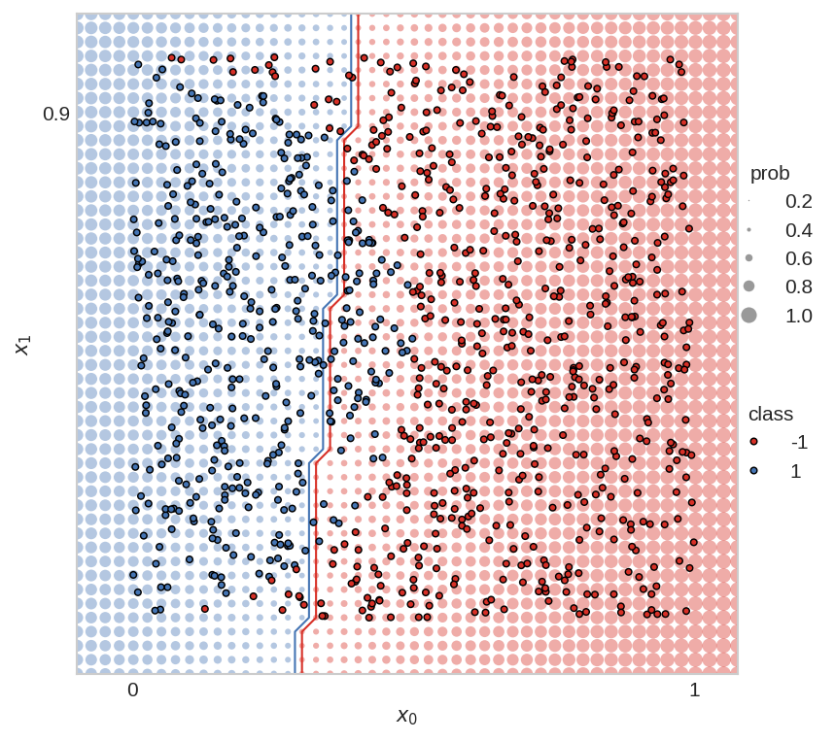
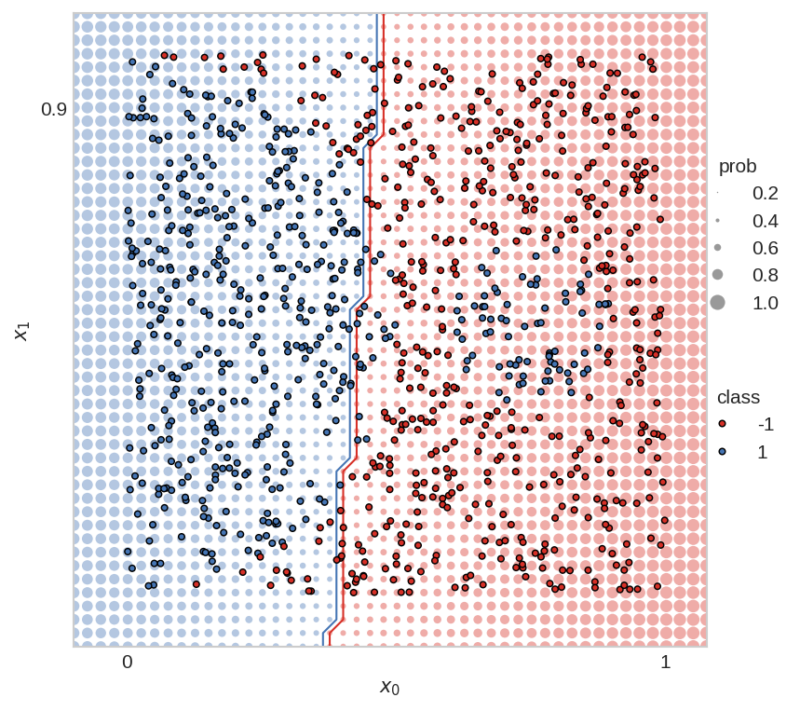
Perceptron is often not enough
Perceptron is linear, but we often need a non-linear prediction function
Which of these can a perceptron solve (fit with zero training error)?
Yes
No
Not even close

Slide 7
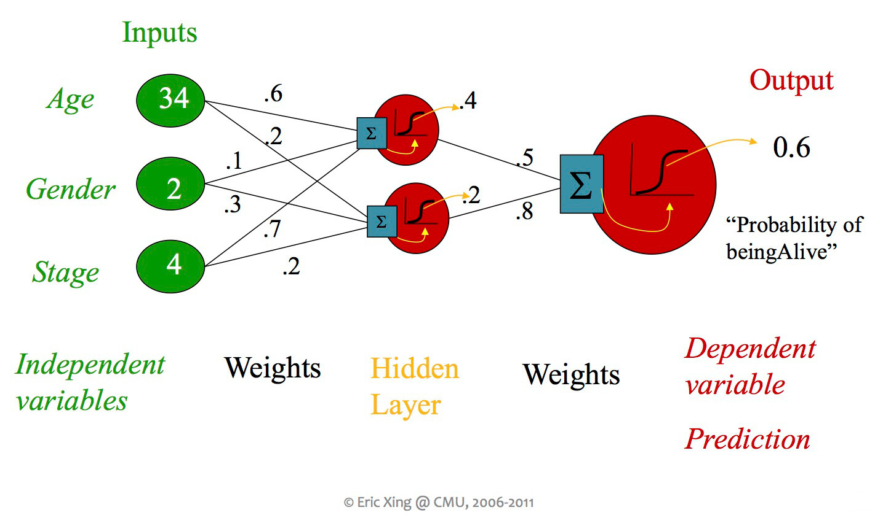
Multi-Layer Perceptron (MLP)
Look up: activate concept based on input pattern
Apply: activated concepts influence prediction
Nodes in hidden layer(s) encode latent relationships
Latent = hidden, not explicitly identified
Fig source: CS 440

Slide 8
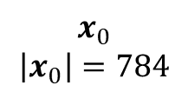
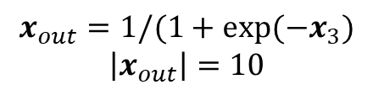
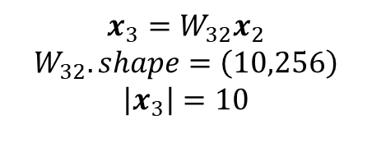
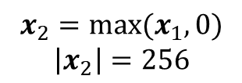
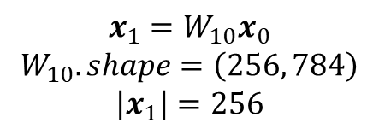
Example MLP for MNIST Digits
$$x_{0}$$
$$\left|x_{0}\right|=784$$
Input: # of features (one per pixel)
Fully connected (FC) layer(s): linear feature transformations
Non-linear activation: enables complex functions to be modeled by multiple FC layers
Output: score per class
Input Values (28x28=784)
$$x_{1}=W_{10}x_{0}$$
$$W_{10}.shape=\left(256, 784\right)$$
$$\left|x_{1}\right|=256$$
Fully Connected Layer (784->256)
$$x_{2}=\max{(x_{1},0)}$$
$$\left|x_{2}\right|=256$$
ReLU Activation
$$x_{3}=W_{32}x_{2}$$
$$W_{32}.shape=\left(10,256\right)$$
$$\left|x_{3}\right|=10$$
Fully Connected Layer (256->10)
$$x_{out}=1/(1+exp⁡(−x_{3})$$
$$\left|x_{out}\right|=10$$
Softmax Activation Output (10)
Total parameters: (256 x 784) + (10 x 256)
Bias terms omitted for simplicity

Slide 9
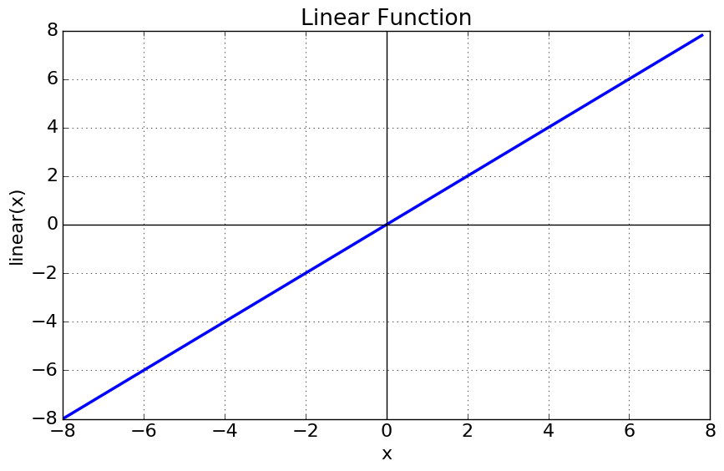
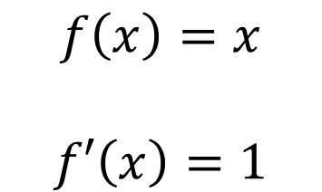
Linear activation
A no-op activation (i.e. nothing happens)
Could be used for information compression or data alignment
Multiple stacked linear layers are equivalent to a single linear layer
$$f\left(x\right)=x$$
$$f′\left(x\right)=1$$

Slide 10
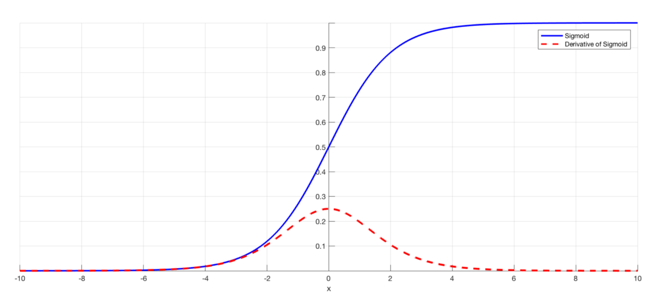
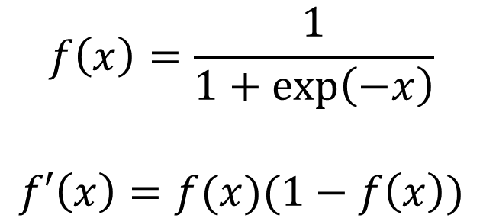
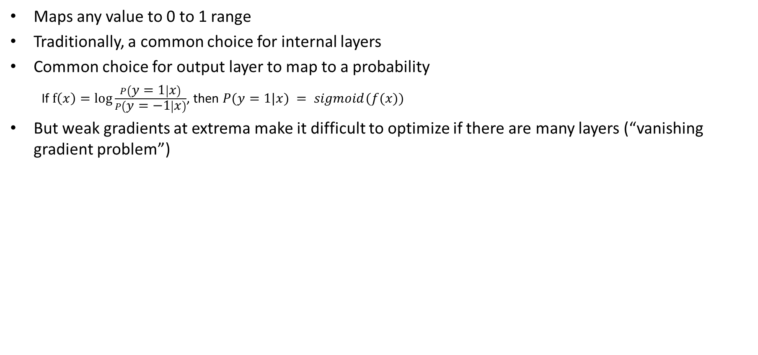
Sigmoid activation
Maps any value to 0 to 1 range
Traditionally, a common choice for internal layers
Common choice for output layer to map to a probability
  If $f\left(x\right)=\log{\frac{P\left(y=1 | x\right)}{P\left(y=−1 | x\right)}}$, then $P(y=1|x) = sigmoid(f(x))$
But weak gradients at extrema make it difficult to optimize if there are many layers (“vanishing gradient problem”)
$$f\left(x\right)=\frac{1}{1+\exp\left(−x\right)}$$
$$f′\left(x\right)=f(x)(1−f\left(x\right))$$
Fig source

Slide 11
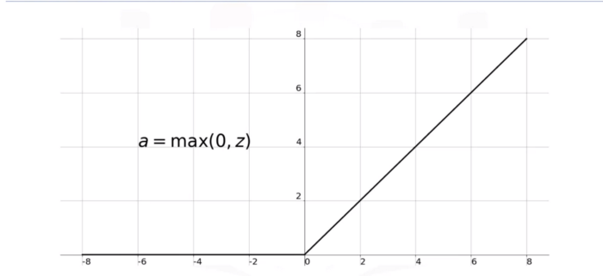
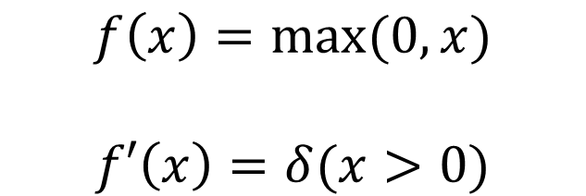
ReLU (Rectified Linear Unit) activation
Maps negative values to zero; others pass through
Typical choice for internal layers in current deep networks
Results in sparse network activations, and all positive values have gradient of 1
$$f\left(x\right)=max⁡(0, x)$$
$$f′\left(x\right)=δ(x>0)$$
Fig source

Slide 12
MLP Architectures: Hidden Layers and Nodes
Number of internal (“hidden”) layers
  Without hidden layers, neural networks (a.k.a. perceptron or linear logistic regressor) can fit linear decision boundaries
  With enough nodes in one hidden layer, any Boolean function can be fit but the number of nodes required grows exponentially in the worst case (because the nodes can enumerate all joint combinations)
  Every bounded continuous function in a compact domain can be approximated with one hidden sigmoid layer and one linear output layer (Cybenko 1989, Hornik et al. 1989)
  Any continuous function can be approximated to arbitrary accuracy by a network with two hidden layers with sigmoid activation (Cybenko 1988)
  Does it ever make sense to have more than two internal layers?
Number of nodes per hidden layer (often called the “width”)
  More nodes means more representational power and more parameters
Each layer has an activation function

Slide 13
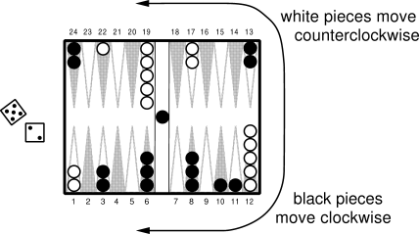
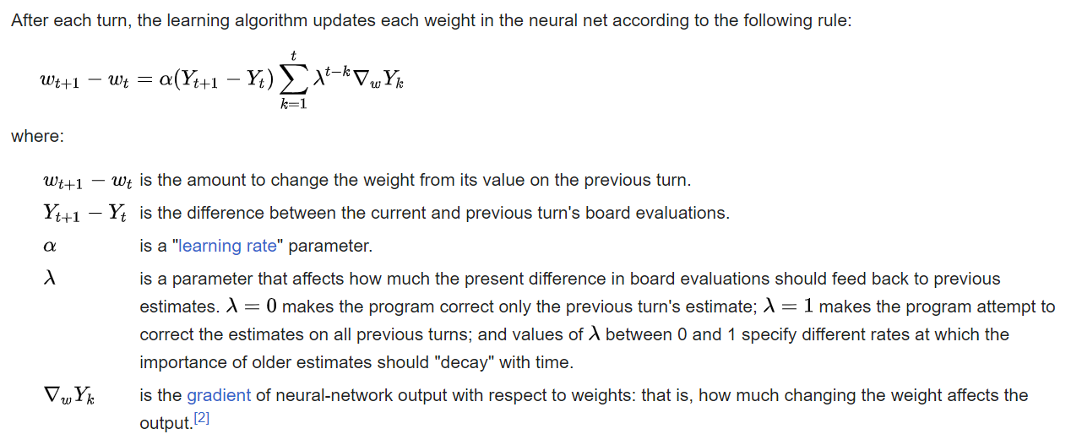
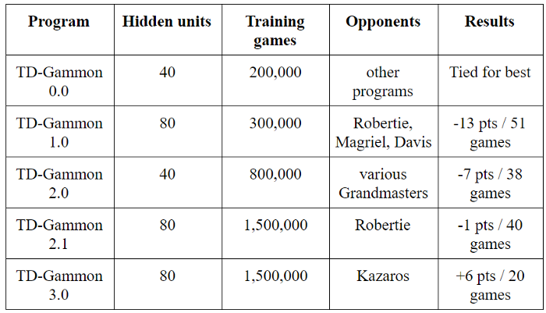
Application Example: Backgammon (1992)
198 inputs: how many pieces on each space
  Later versions had expert-defined features
1 internal FC layer with sigmoid activation
Reinforcement learning: reward is game result
Network competed well with world experts, demonstrating power of ML
https://en.wikipedia.org/wiki/TD-Gammon
Fig source

Slide 14

Q1-Q3
https://tinyurl.com/441AML-L15
Notes:
https://forms.gle/tJLTF2eFyYQGxycHA

Slide 15
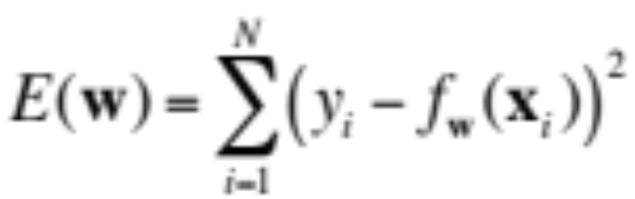
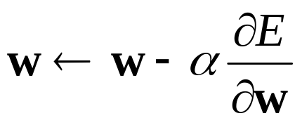
Training of multi-layer networks
Find network weights to minimize the training error between true and estimated labels of training examples, e.g.:
Update weights by gradient descent:
Back-propagation: gradients are computed in the direction from output to input layers and combined using chain rule
Stochastic gradient descent: compute the weight update w.r.t. a small batch of examples at a time, cycle through training examples in random order in multiple epochs
Slide: Lazebnik

Slide 16





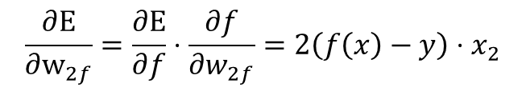

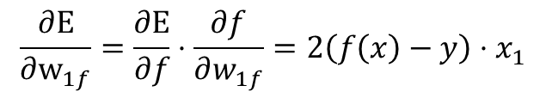
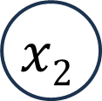

Backpropagation
$$f\left(x\right)=w_{1f}x_{1}+w_{2f}x_{2}$$
input
$$w1f$$
prediction
target
$$x1$$
$$f$$
Error
$$y$$
$$x2$$
$$w2f$$
$$E(x, y;w)={(f(x)−y)}^{2}$$
$$\frac{∂E}{∂w_{1f}}=\frac{∂E}{∂f}⋅\frac{∂f}{∂w_{1f}}=2\left(f\left(x\right)−y\right){⋅x}_{1}$$
Apply chain rule to compute gradient (amount that an increase in the weight will increase the error)
$$\frac{∂E}{∂w_{2f}}=\frac{∂E}{∂f}⋅\frac{∂f}{∂w_{2f}}=2\left(f\left(x\right)−y\right){⋅x}_{2}$$

Slide 17






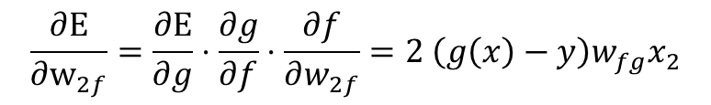
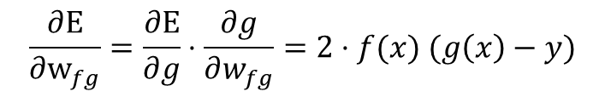
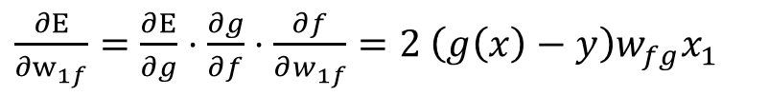


Backpropagation: add “hidden” node
$$f\left(x\right)=w_{1f}x_{1}+w_{2f}x_{2}$$
$$g\left(x\right)=w_{fg}f(x)$$
input
$$x1$$
$$w1f$$
$$wfg$$
prediction
target
$$f$$
$$g$$
Error
$$y$$
$$x2$$
$$w2f$$
$$E(x, y;w)={(g(x)−y)}^{2}$$
$\frac{∂E}{∂w_{1f}}=\frac{∂E}{∂g}⋅\frac{∂g}{∂f}⋅\frac{∂f}{∂w_{1f}}=2 \left(g\left(x\right)−y\right)w_{fg}x_{1}$
$$\frac{∂E}{∂w_{fg}}=\frac{∂E}{∂g}⋅\frac{∂g}{∂w_{fg}}=2⋅f(x) (g\left(x\right)−y)$$
$$\frac{∂E}{∂w_{2f}}=\frac{∂E}{∂g}⋅\frac{∂g}{∂f}⋅\frac{∂f}{∂w_{2f}}=2 \left(g\left(x\right)−y\right)w_{fg}x_{2}$$
Same concept as before, but deeper computation graph, i.e. application of chain rule

Slide 18



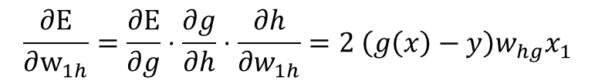



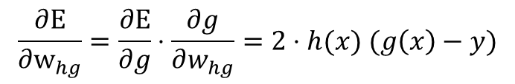
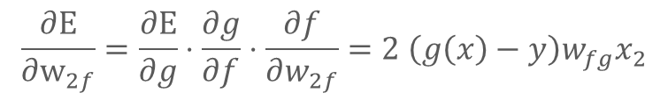

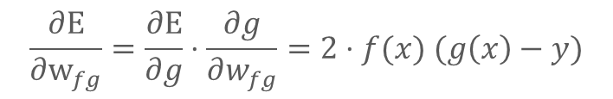

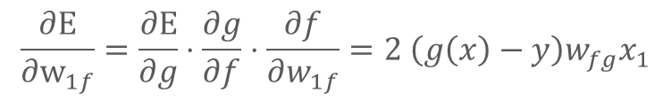


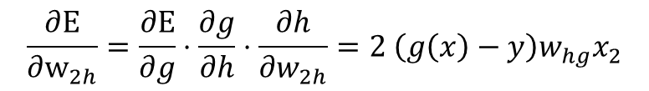
Backpropagation: add second hidden node (h has same function as f)
$$f\left(x\right)=w_{1f}x_{1}+w_{2f}x_{2}$$
$$h\left(x\right)=w_{1h}x_{1}+w_{2h}x_{2}$$
$$g\left(x\right)=w_{fg}f\left(x\right)+w_{hg}h(x)$$
input
$$x1$$
$$w1f$$
target
$$f$$
$$wfg$$
prediction
$$g$$
Error
$$y$$
$$w2f$$
$$w1h$$
$$x2$$
$$h$$
$$whg$$
$$w2h$$
$$E(x, y;w)={(g(x)−y)}^{2}$$
$$\frac{∂E}{∂w_{1f}}=\frac{∂E}{∂g}⋅\frac{∂g}{∂f}⋅\frac{∂f}{∂w_{1f}}=2 \left(g\left(x\right)−y\right)w_{fg}x_{1}$$
$$\frac{∂E}{∂w_{fg}}=\frac{∂E}{∂g}⋅\frac{∂g}{∂w_{fg}}=2⋅f(x) (g\left(x\right)−y)$$
$$\frac{∂E}{∂w_{2f}}=\frac{∂E}{∂g}⋅\frac{∂g}{∂f}⋅\frac{∂f}{∂w_{2f}}=2 \left(g\left(x\right)−y\right)w_{fg}x_{2}$$
$$\frac{∂E}{∂w_{1h}}=\frac{∂E}{∂g}⋅\frac{∂g}{∂h}⋅\frac{∂h}{∂w_{1h}}=2 \left(g\left(x\right)−y\right)w_{hg}x_{1}$$
$$\frac{∂E}{∂w_{hg}}=\frac{∂E}{∂g}⋅\frac{∂g}{∂w_{hg}}=2⋅h(x) (g\left(x\right)−y)$$
$$\frac{∂E}{∂w_{2h}}=\frac{∂E}{∂g}⋅\frac{∂g}{∂h}⋅\frac{∂h}{∂w_{2h}}=2 \left(g\left(x\right)−y\right)w_{hg}x_{2}$$

Slide 19
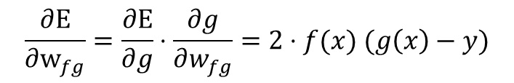
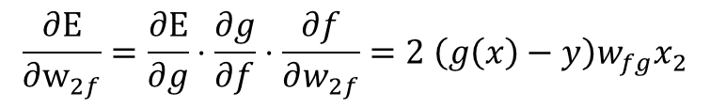


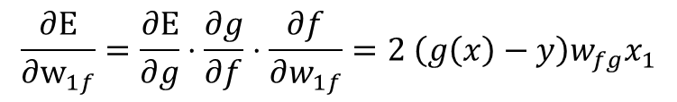

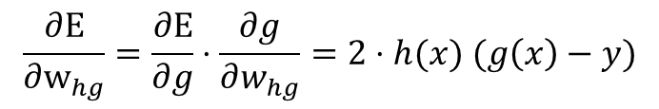
Backpropagation: add ReLU activation
$$f\left(x\right)=max⁡(w_{1f}x_{1}+w_{2f}x_{2} , 0)$$
$$g\left(x\right)=w_{fg}f\left(x\right)+w_{hg}h(x)$$
input
$$x1$$
$$w1f$$
target
$$f$$
$$wfg$$
prediction
$$g$$
Error
$$y$$
$$w2f$$
$$w1h$$
$$x2$$
$$h$$
$$whg$$
$$w2h$$
$$E(x, y;w)={(g(x)−y)}^{2}$$
$$\frac{∂E}{∂w_{1f}}=\frac{∂E}{∂g}⋅\frac{∂g}{∂f}⋅\frac{∂f}{∂w_{1f}}=2 \left(g\left(x\right)−y\right)w_{fg}x_{1}$$
$$\frac{∂E}{∂w_{2f}}=\frac{∂E}{∂g}⋅\frac{∂g}{∂f}⋅\frac{∂f}{∂w_{2f}}=2 \left(g\left(x\right)−y\right)w_{fg}x_{2}$$
$$\frac{∂E}{∂w_{fg}}=\frac{∂E}{∂g}⋅\frac{∂g}{∂w_{fg}}=2⋅f(x) (g\left(x\right)−y)$$
Since $f(x)$ and $h(x)$ are changing, we need to update their gradient equations
$$\frac{∂E}{∂w_{1h}}=\frac{∂E}{∂g}⋅\frac{∂g}{∂h}⋅\frac{∂h}{∂w_{1h}}=2 \left(g\left(x\right)−y\right)w_{hg}x_{1}$$
$$\frac{∂E}{∂w_{hg}}=\frac{∂E}{∂g}⋅\frac{∂g}{∂w_{hg}}=2⋅h(x) (g\left(x\right)−y)$$
$$\frac{∂E}{∂w_{2h}}=\frac{∂E}{∂g}⋅\frac{∂g}{∂h}⋅\frac{∂h}{∂w_{2h}}=2 \left(g\left(x\right)−y\right)w_{hg}x_{2}$$

Slide 20
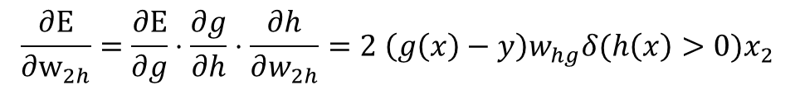
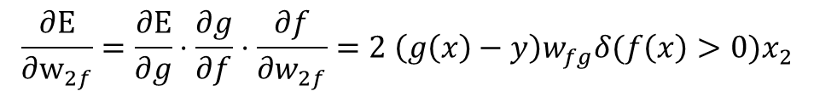
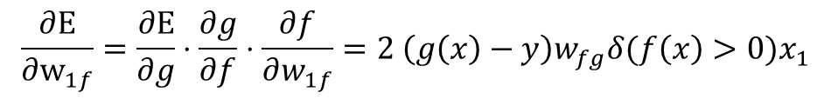
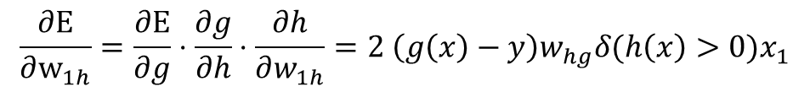
Backpropagation: add ReLU activation
$$f\left(x\right)=max⁡(w_{1f}x_{1}+w_{2f}x_{2} , 0)$$
$$g\left(x\right)=w_{fg}f\left(x\right)+w_{hg}h(x)$$
input
$$x1$$
$$w1f$$
target
$$f$$
$$wfg$$
prediction
$$g$$
Error
$$y$$
$$w2f$$
$$w1h$$
$$x2$$
$$h$$
$$whg$$
$$w2h$$
$$E(x, y;w)={(g(x)−y)}^{2}$$
$$\frac{∂E}{∂w_{1f}}=\frac{∂E}{∂g}⋅\frac{∂g}{∂f}⋅\frac{∂f}{∂w_{1f}}=2 \left(g\left(x\right)−y\right)w_{fg}{δ(f\left(x\right)>0)x}_{1}$$
$$\frac{∂E}{∂w_{2f}}=\frac{∂E}{∂g}⋅\frac{∂g}{∂f}⋅\frac{∂f}{∂w_{2f}}=2 \left(g\left(x\right)−y\right)w_{fg}δ(f\left(x\right)>0)x_{2}$$
$$\frac{∂E}{∂w_{fg}}=\frac{∂E}{∂g}⋅\frac{∂g}{∂w_{fg}}=2⋅f(x) (g\left(x\right)−y)$$
$$\frac{∂E}{∂w_{1h}}=\frac{∂E}{∂g}⋅\frac{∂g}{∂h}⋅\frac{∂h}{∂w_{1h}}=2 \left(g\left(x\right)−y\right)w_{hg}δ(h\left(x\right)>0)x_{1}$$
$$\frac{∂E}{∂w_{hg}}=\frac{∂E}{∂g}⋅\frac{∂g}{∂w_{hg}}=2⋅h(x) (g\left(x\right)−y)$$
$$\frac{∂E}{∂w_{2h}}=\frac{∂E}{∂g}⋅\frac{∂g}{∂h}⋅\frac{∂h}{∂w_{2h}}=2 \left(g\left(x\right)−y\right)w_{hg}{δ(h\left(x\right)>0)x}_{2}$$

Slide 21
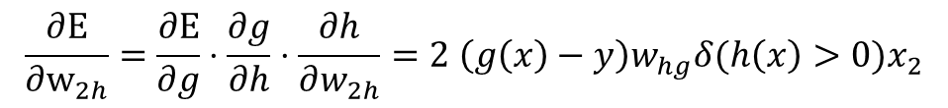
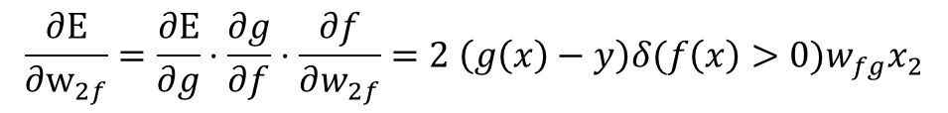
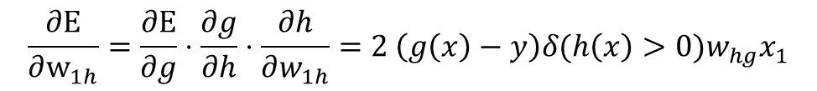
Backpropagation: add ReLU activation
$$f\left(x\right)=max⁡(w_{1f}x_{1}+w_{2f}x_{2} , 0)$$
$$g\left(x\right)=w_{fg}f\left(x\right)+w_{hg}h(x)$$
input
$$x1$$
$$w1f$$
target
$$f$$
$$wfg$$
prediction
$$g$$
Error
$$y$$
$$w2f$$
$$w1h$$
$$x2$$
$$h$$
$$whg$$
$$w2h$$
$$E(x, y;w)={(g(x)−y)}^{2}$$
$$\frac{∂E}{∂w_{1f}}=\frac{∂E}{∂g}⋅\frac{∂g}{∂f}⋅\frac{∂f}{∂w_{1f}}=2 \left(g\left(x\right)−y\right)w_{fg}δ(f\left(x\right)>0)x_{1}$$
$$\frac{∂E}{∂w_{2f}}=\frac{∂E}{∂g}⋅\frac{∂g}{∂f}⋅\frac{∂f}{∂w_{2f}}=2 \left(g\left(x\right)−y\right){δ(f\left(x\right)>0)w}_{fg}x_{2}$$
$$\frac{∂E}{∂w_{fg}}=\frac{∂E}{∂g}⋅\frac{∂g}{∂w_{fg}}=2⋅f(x) (g\left(x\right)−y)$$
Shared computation. Use dynamic program for efficiency
$$\frac{∂E}{∂w_{1h}}=\frac{∂E}{∂g}⋅\frac{∂g}{∂h}⋅\frac{∂h}{∂w_{1h}}=2 \left(g\left(x\right)−y\right){δ(h\left(x\right)>0)w}_{hg}x_{1}$$
$$\frac{∂E}{∂w_{hg}}=\frac{∂E}{∂g}⋅\frac{∂g}{∂w_{hg}}=2⋅h(x) (g\left(x\right)−y)$$
$$\frac{∂E}{∂w_{2h}}=\frac{∂E}{∂g}⋅\frac{∂g}{∂h}⋅\frac{∂h}{∂w_{2h}}=2 \left(g\left(x\right)−y\right)w_{hg}{δ(h\left(x\right)>0)x}_{2}$$

Slide 22
Backpropagation: General Concept
Each weight’s gradient sums the product of the gradients along each path from the weight to error function
The gradients can be computed using a kind of dynamic program, i.e., recursively propagating the gradient from the prediction error to the input

Slide 23





Another backpropagation example
Assume all linear layers (and linear activation, for simplicity), fill in the terms for the squared error gradients
x1
w1
h1
w2
g1
$$h1= w1∗x1+w5∗x2$$
w4
w3
$$h2= w4∗x1+w8∗x2$$
w5
w6
w7
out
$$g1= w2∗h1+w7∗h2$$
$$g2= w6∗h1+w9∗h2$$
x2
h2
g2
w0
$$out = w3∗g1+w0∗g2$$
w8
w9
$$∂E/∂w2 =∂E/∂out⋅∂out/∂g1⋅∂g1/∂w2$$
Error gradient wrt w2 = 2*(out-y)*(____) * _____
w3
h1
Grad loss wrt out
Grad g1 wrt w2
Grad out wrt g1
w0
w9
w3
w7
x2
Error gradient wrt w8 = 2*(out-y)*(___*___ + ____*____) * ____
$$∂E/∂w8 =∂E/∂out⋅(∂out/∂g1⋅∂g1/∂h2+∂out/∂g2⋅∂g2/∂h2)⋅∂h2/∂w8$$

Slide 24
Another backpropagation example
Assume all linear layers (and linear activation, for simplicity), fill in the terms for the squared error gradients
x1
w1
h1
w2
g1
$$h1= w1∗x1+w5∗x2$$
w4
w3
$$h2= w4∗x1+w8∗x2$$
w5
w6
w7
out
$$g1= w2∗h1+w7∗h2$$
$$g2= w6∗h1+w9∗h2$$
x2
h2
g2
w0
$$out = w3∗g1+w0∗g2$$
w8
w9
$$∂E/∂w2 =∂E/∂out⋅∂out/∂g1⋅∂g1/∂w2$$
Parts of the gradient path in common don’t need to be recomputed
$$∂E/∂w8 =∂E/∂out⋅(∂out/∂g1⋅∂g1/∂h2+∂out/∂g2⋅∂g2/∂h2)⋅∂h2/∂w8$$

Slide 25
Q4
https://tinyurl.com/441AML-L15
Notes:
https://forms.gle/tJLTF2eFyYQGxycHA

Slide 26
Good 3blue1brown video (for later)
https://www.youtube.com/watch?v=tIeHLnjs5U8

Slide 27
What is the benefit and cost of going from a perceptron to MLP?
Benefit
  Much greater expressivity, can model non-linear functions
Cost
  Optimization is no longer convex, globally optimal solution no longer guaranteed (or even likely)
  Larger model = more training and inference time
  Larger model = more data required to obtain a good fit
  In summary: MLP has lower bias and higher variance, and additional error due to optimization challenges

Slide 28
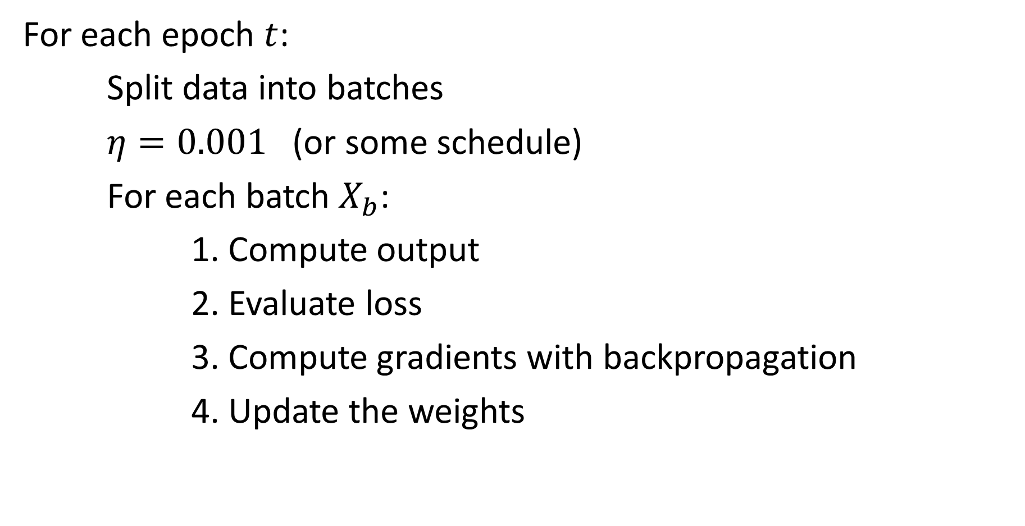
MLP Optimization by SGD
For each epoch $t$:
Split data into batches
$η=0.001$ (or some schedule)
For each batch $X_{b}$:
1. Compute output
2. Evaluate loss
3. Compute gradients with backpropagation
4. Update the weights

Slide 29
Demo: Part 2
https://colab.research.google.com/drive/1nKNJyolqgzW53Rz59M2BZtyQM8bbrExb?usp=sharing

Slide 30
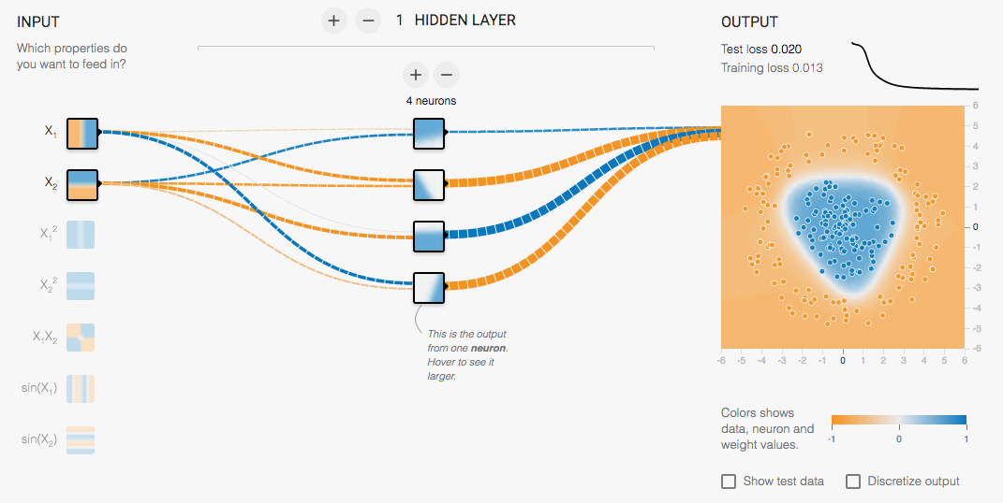
Multi-Layer Network Demo
http://playground.tensorflow.org/
Try many layers with sigmoid vs relu
Slide: Lazebnik

Slide 31

Another application example: mapping position/rays to color
L2 loss
ReLU MLP with 4 layers and 256 channels (nodes per layer)
Sigmoid activation on output
256 frequency positional encoding
Fourier Features (Tancik et al. 2020)
NeRF (Mildenhall et al. 2020)

Slide 32

Generalized insight from “Fourier Features”
Input matters – it’s best to represent data in a way that makes it linearly predictive, even if you have a non-linear model
$f\left(x, y\right)→R,G,B$ requires a complex network to model because $x_{i}^{T}x_{j}$ is a bad similarity function (maximized when $x_{j}$ is large, instead of similar to $x_{i}$)
Representing $x$ with a Fourier encoding, e.g. $γ\left(x\right)=\left[\sin\left(x\right),\cos\left(x\right),\sin\left(2x\right),\cos\left(2x\right), …\right]$ enables a simpler network because $γ{\left(x_{i}\right)}^{T}γ\left(x_{j}\right)$ falls off smoothly as $x_{j}$ moves away from $x_{i}$
  This means the initial network layer can model similarity to different positions with each hidden unit

Slide 33

HW 4 (due Nov 2)

Slide 34



HW 4

Slide 35



What to remember
Perceptrons are linear prediction models
MLPs are non-linear prediction models, composed of multiple linear layers with non-linear activations
MLPs can model more complex functions, but are harder to optimize
Optimization is by a form of stochastic gradient descent
Deeper networks are subject to vanishing gradient problems that are reduced (but not eliminated) with ReLU activations
Figure source

Slide 36
Next lectures
Convolutional networks (CNNs)
Deep networks
  (Brief) history of deep networks
  What made deep networks work?
  Residual networks
More about deep network optimization
  Improvements on SGD
  Normalization and data augmentation
  Linear probe and fine-tuning
Mask-RCNN line of work

