Slide 1

Optimization and Stochastic Gradient Descent
Applied Machine Learning
Derek Hoiem
Dall-E

Slide 2

Talk to a neighbor
https://tinyurl.com/441AML-L14
Think for 2 minutes.
  What is an idea for an application built around ML?
  How will someone use the application?
  What is the input and output of the ML model that is within the application?
Share with your neighbor(s)
Write down someone else’s idea here

Slide 3
Deep Learning
Deep learning is a way of learning effective representations, especially when the inputs have important structures, such as images, audio, text
Today: Stochastic Gradient Descent (SGD)
Thurs: MLPs and backpropagation
Oct 20: Convolutional networks, residual blocks, advanced SGD
Oct 22: Training and adapting deep networks, computer vision
Oct 27: Representing words, transformer blocks
Oct 29: More transformers, use in vision and language
Nov 3: Foundation models: CLIP and GPT

Slide 4
Machine learning optimization
 | Optimization | Solution Depends on Initialization or Randomized Optimization? | Optimization Strategy is Important to Effectiveness?
KNN | N/A | No | No
K-means | Coordinate Descent | Yes | No
Linear Regression | Iterative | No | No
Logistic Regression | Iterative | No | No
Linear SVM | Iterative | No | No
Kernelized SVM | Iterative | No | No
EM Algorithm | Coordinate Descent | Yes | No
Decision Tree | Greedy selection | No | No
For methods we learned so far, one optimizer may be faster or more memory efficient than another, but they will generally be able to achieve similar solutions.

Slide 5
Machine learning optimization
 | Optimization | Solution Depends on Initialization or Randomized Optimization? | Optimization Strategy is Important to Effectiveness?
KNN | N/A | No | No
K-means | Coordinate Descent | Yes | No
Linear Regression | Iterative | No | No
Logistic Regression | Iterative | No | No
Linear SVM | Iterative | No | No
Kernelized SVM | Iterative | No | No
EM Algorithm | Coordinate Descent | Yes | No
Decision Tree | Greedy selection | No | No
MLPs, Deep Networks | Iterative | Yes | Yes
For methods we learned so far, one optimizer may be faster or more memory efficient than other, but they will generally be able to achieve similar solutions.
For MLPs and deep networks, optimization is an important part of design.

Slide 6
This lecture
Batch gradient descent
PEGASOS: Stochastic Gradient Descent for SVM
Perceptrons

Slide 7
Gradient descent
gradient_descent(f’(x), x0, lr, niter)
x = x0
for t in range(niter):
x = x – lr*f’(x)
return x

Slide 8
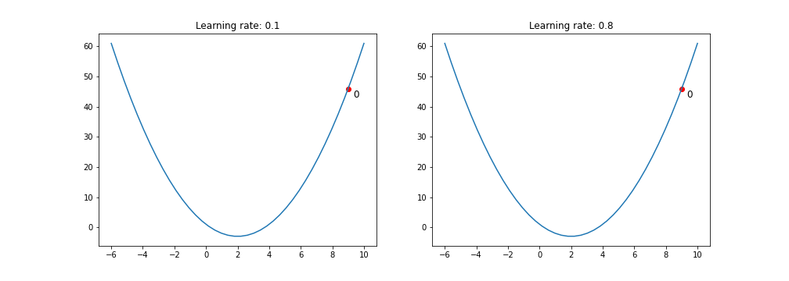
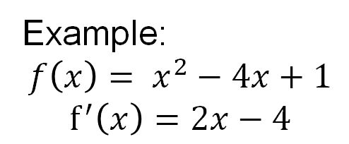
Gradient descent
gradient_descent(f’(x), x0, lr, niter)
x = x0
for t in range(niter):
x = x – lr*f’(x)
return x
Example:
$$f\left(x\right)= x^{2}−4x+1$$
$$f^{′}\left(x\right)=2x−4$$
Example: https://towardsdatascience.com/gradient-descent-algorithm-a-deep-dive-cf04e8115f21

Slide 9
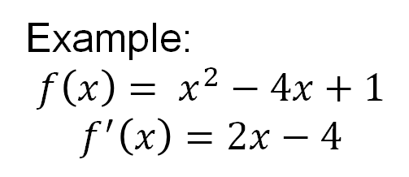
Gradient descent
gradient_descent(f’(x), x0, lr, niter)
x = x0
for t in range(niter):
x = x – lr*f’(x)
return x
Example:
$$f\left(x\right)= x^{2}−4x+1$$
$$f^{′}\left(x\right)=2x−4$$
Example: https://towardsdatascience.com/gradient-descent-algorithm-a-deep-dive-cf04e8115f21

Slide 10
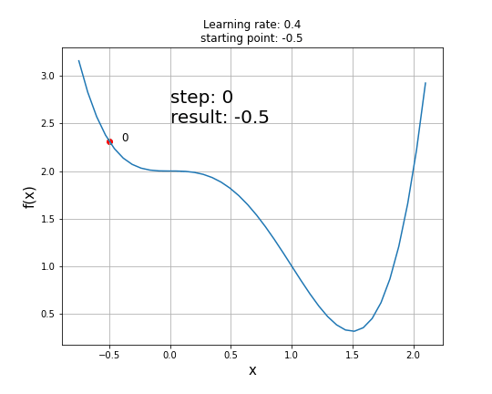
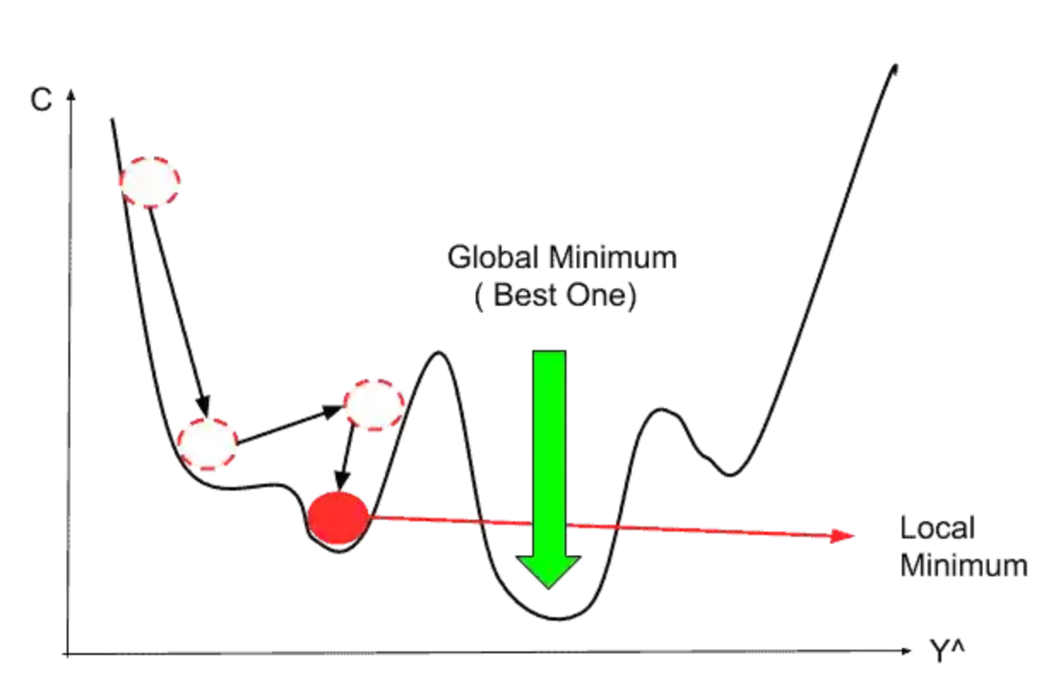
Gradient descent challenge cases
Saddle points (gradient = 0 in some parts of solution space)
Multiple local minima
Many models we’ve learned so far (e.g., SVM, logistic regression, linear regression) are convex, so they don’t have these challenges.
Example: https://towardsdatascience.com/gradient-descent-algorithm-a-deep-dive-cf04e8115f21
Fig: https://www.mltut.com/stochastic-gradient-descent-a-super-easy-complete-guide/

Slide 11
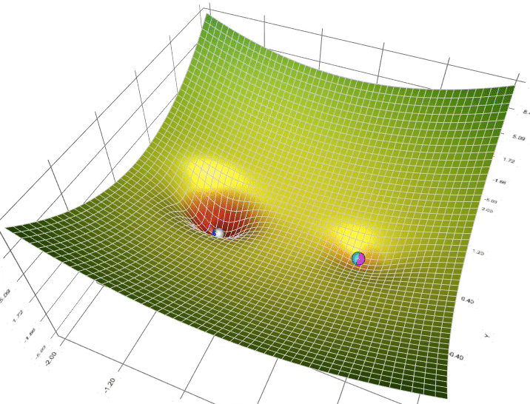
Gradient Descent Visualization with Local Minima
Figure source

Slide 12
Learning rates and learning schedules
Learning rate = step size that is multiplied by gradient direction/magnitude
  Large rate allows big movements toward optimum but might over-step
  Small rate is less likely to over-step but could take longer or get stuck in local minima
Learning schedule: change learning rate over time
  Constant
  Exponential decay, e.g. lr = lr * 0.95
  Linear, e.g. lr = lr0 *(1 – iter / max_iter)

Slide 13
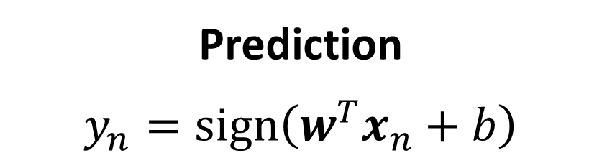
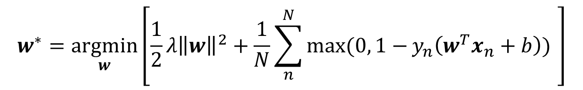
SVM Formulation
Prediction
$$y_{n}=sign\left(w^{T}x_{n}+b\right)$$
Optimization
Known as “hinge loss”
Penalty is paid if margin is less than 1
$$w^{∗}=\underset{w}{argmin}\left[{\frac{1}{2}λ\left\|w\right\|}^{2}+\frac{1}{N}\sum_{n}^{N}{\max{(0, 1−}}y_{n}\left(w^{T}x_{n}+b\right)) \right]$$
Here, $y∈\{−1,1\}$ which is a common convention that simplifies notation for binary classifiers

Slide 14

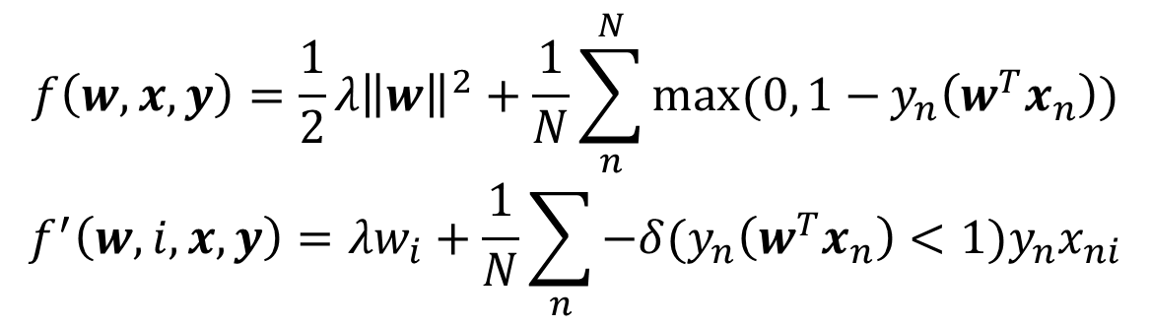
Gradient descent with SVM
gradient_descent(f’(w,i,x,y), lr, niter)
w = zeros(x.shape[1],)
for t in range(niter):
for i in range(len(w)):
w[i] = w[i] – lr*f’(w,i,x,y)
return w
Only examples with score of correct answer less than 1 contribute to the gradient
$$f\left(w,x,y\right)={\frac{1}{2}λ\left\|w\right\|}^{2}+\frac{1}{N}\sum_{n}^{N}{\max{(0, 1−}}y_{n}\left(w^{T}x_{n}\right))$$
$$f^{′}\left(w,i, x,y\right)={λw}_{i}+\frac{1}{N}\sum_{n}{−δ(y_{n}\left(w^{T}x_{n}\right)<1)y_{n}x_{ni}}$$
$$∂\left(x_{n0}w_{0}+x_{n1}w_{1}+…+x_{ni}w_{i}+…\right)/∂w_{i}=x_{ni}$$
Slow with large datasets, because need to compute scores for all examples in each step

Slide 15
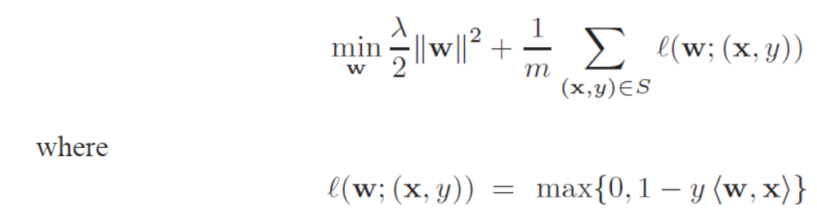
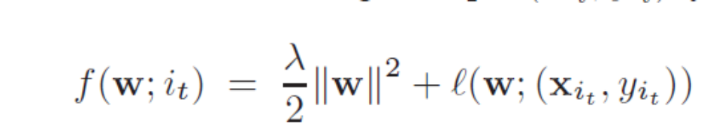

Pegasos: Primal Estimated sub-GrAdient SOlver for SVM (2011)
SVM problem that we want to solve
(Minimize weights square + sum of hinge losses on all samples)
Problem in terms of one sample
Gradient in terms of one sample
- Direction to move to improve solution
https://home.ttic.edu/~nati/Publications/PegasosMPB.pdf

Slide 16
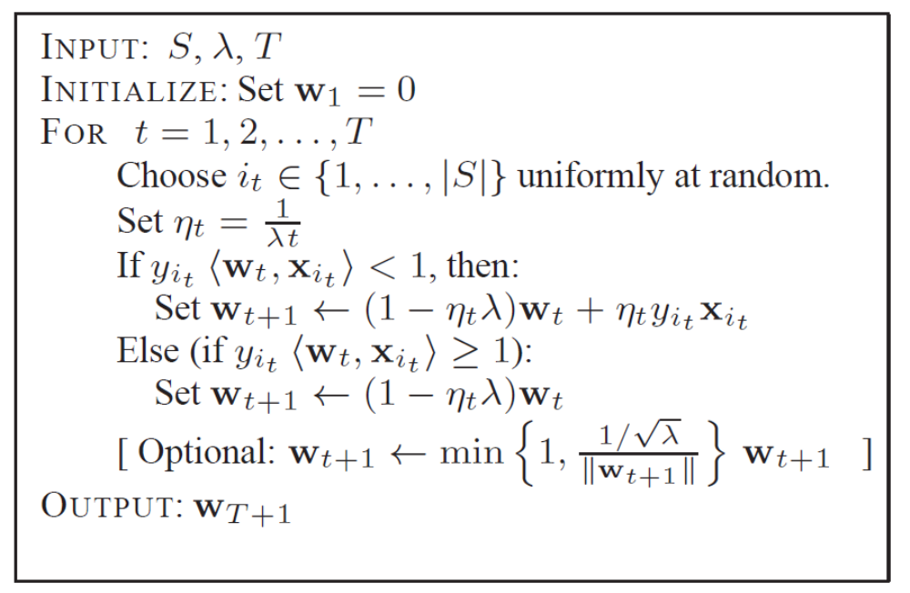
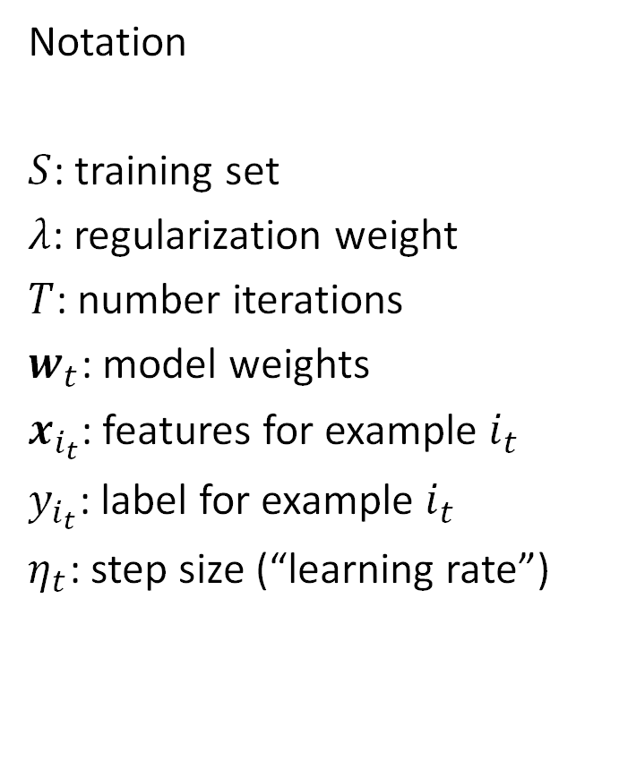
Pegasos algorithm: Stochastic Gradient Descent (SGD)
Notation
$S$: training set
$λ$: regularization weight
$T$: number iterations
$w_{t}$: model weights
$x_{i_{t}}$: features for example $i_{t}$
$y_{i_{t}}$: label for example $i_{t}$
$η_{t}$: step size (“learning rate”)

Slide 17
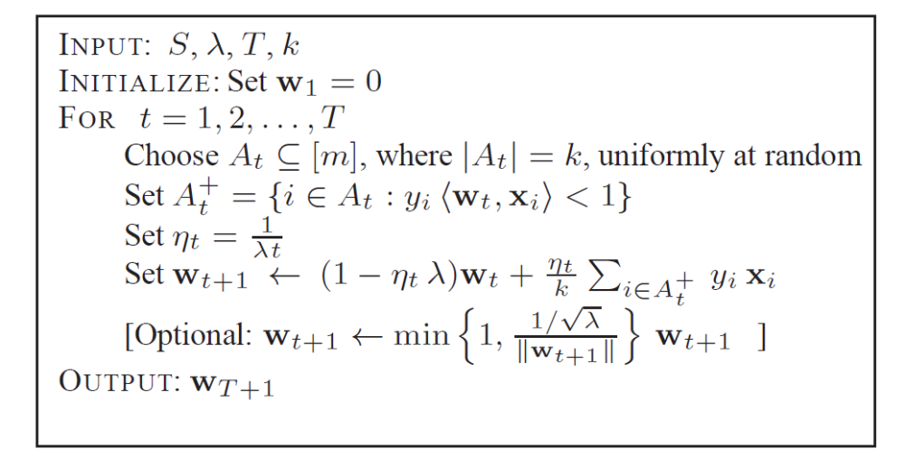
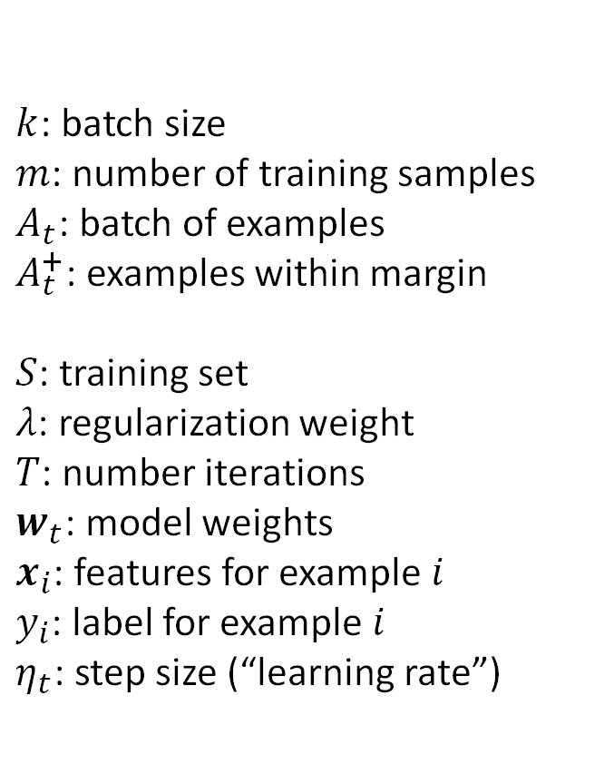
Pegasos with mini-batch
Calculating gradient based on multiple examples reduces variance of gradient estimate
$k$: batch size
$m$: number of training samples
$A_{t}$: batch of examples
$A_{t}^{+}$: examples within margin
$S$: training set
$λ$: regularization weight
$T$: number iterations
$w_{t}$: model weights
$x_{i}$: features for example $i$
$y_{i}$: label for example $i$
$η_{t}$: step size (“learning rate”)

Slide 18
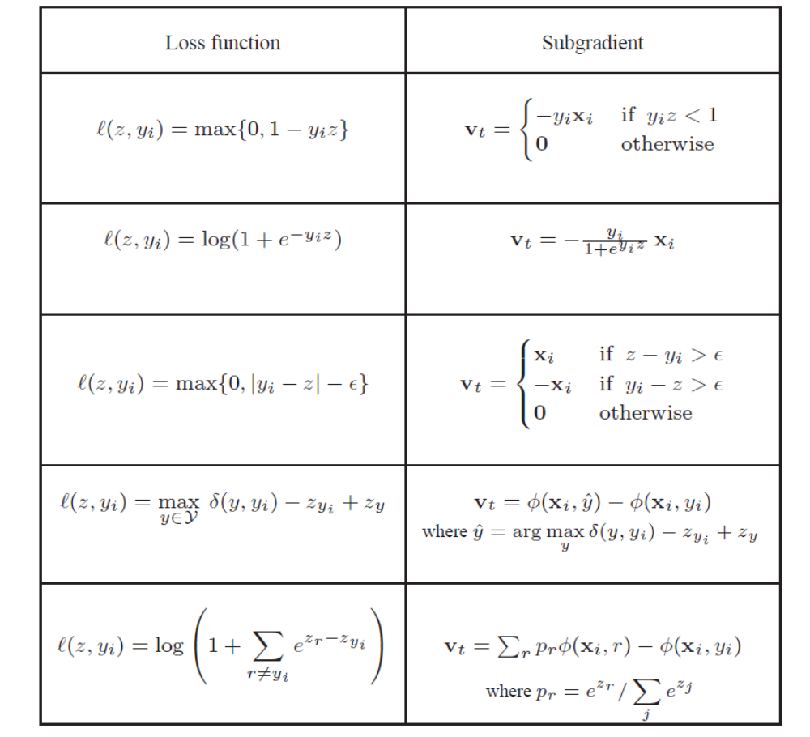
SGD applies to many losses
z is the score for y=1
SVM (hinge loss)
Logistic regression / sigmoid loss
Hinge L1 regression
Margin loss between scores of most likely and correct label
Variant of a logistic loss

Slide 19
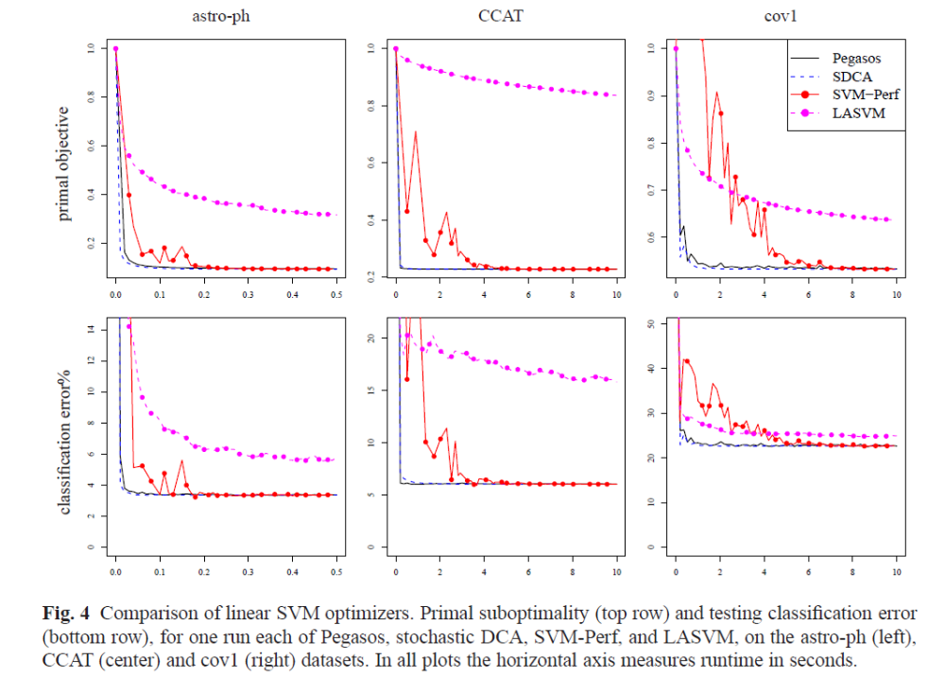
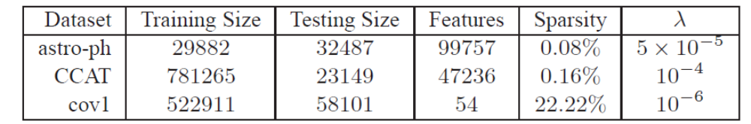
SGD is fast compared to other optimization approaches
SDCA = stochastic dual coordinate descent, another form of stochastic gradient optimization that chooses learning rate dynamically

Slide 20
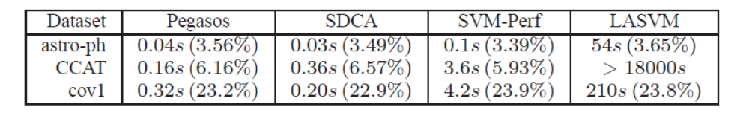
Experiments with Linear SVM
Training time and test error

Slide 21
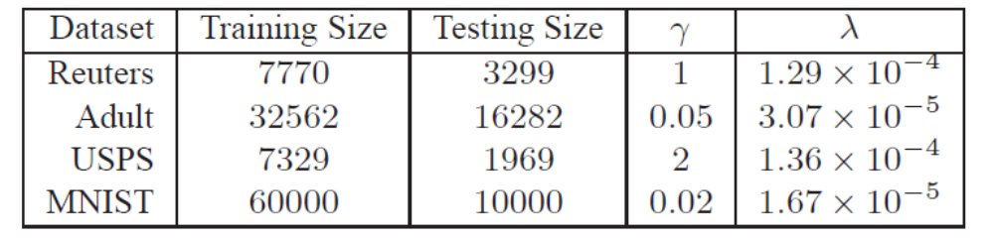
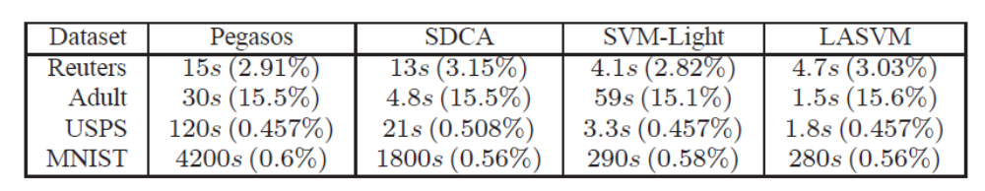
Experiments using Gaussian kernel SVM (see paper for kernelized Pegasos algorithm)

Slide 22
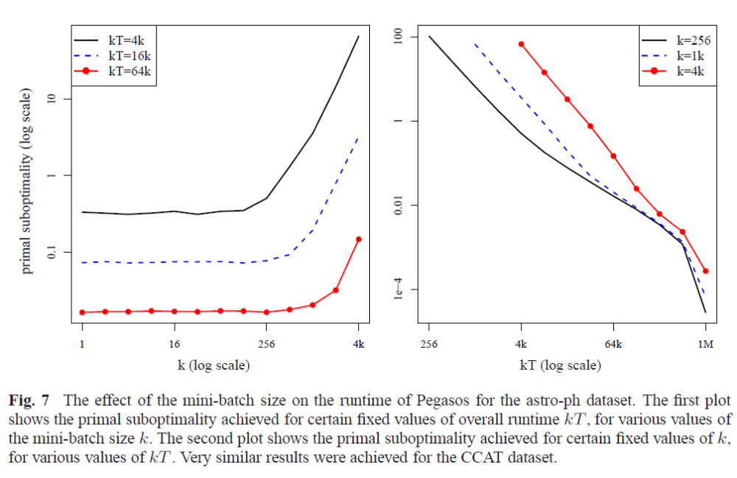
Effect of mini-batch size
With fixed computation, a batch of 1-256 gets the lowest loss
(but with GPUs, large batches can sometimes reach lower loss in less wall clock time due to parallelization)

Slide 23
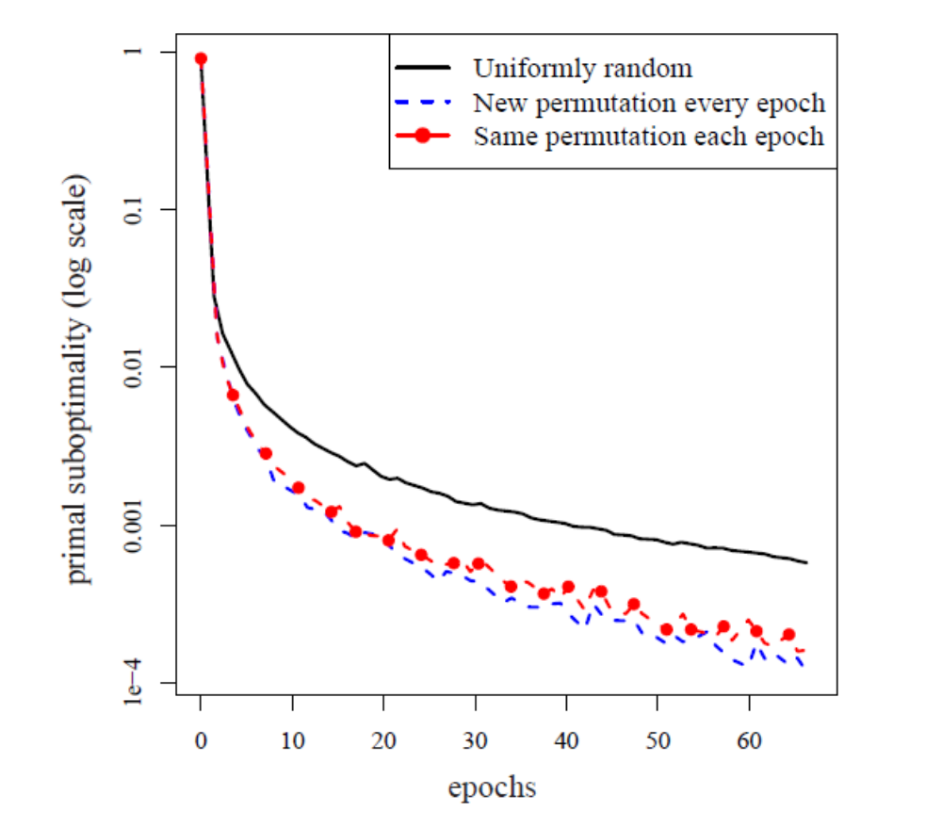
Effect of sampling procedure: randomly ordered epochs is best
Sampling with replacement
Use different random order for each “epoch”
Use same order for each epoch
Epoch: one run through the training set

Slide 24
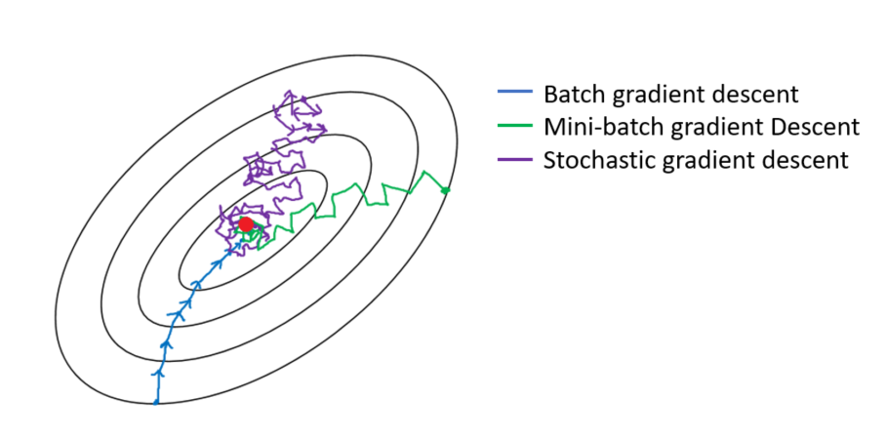
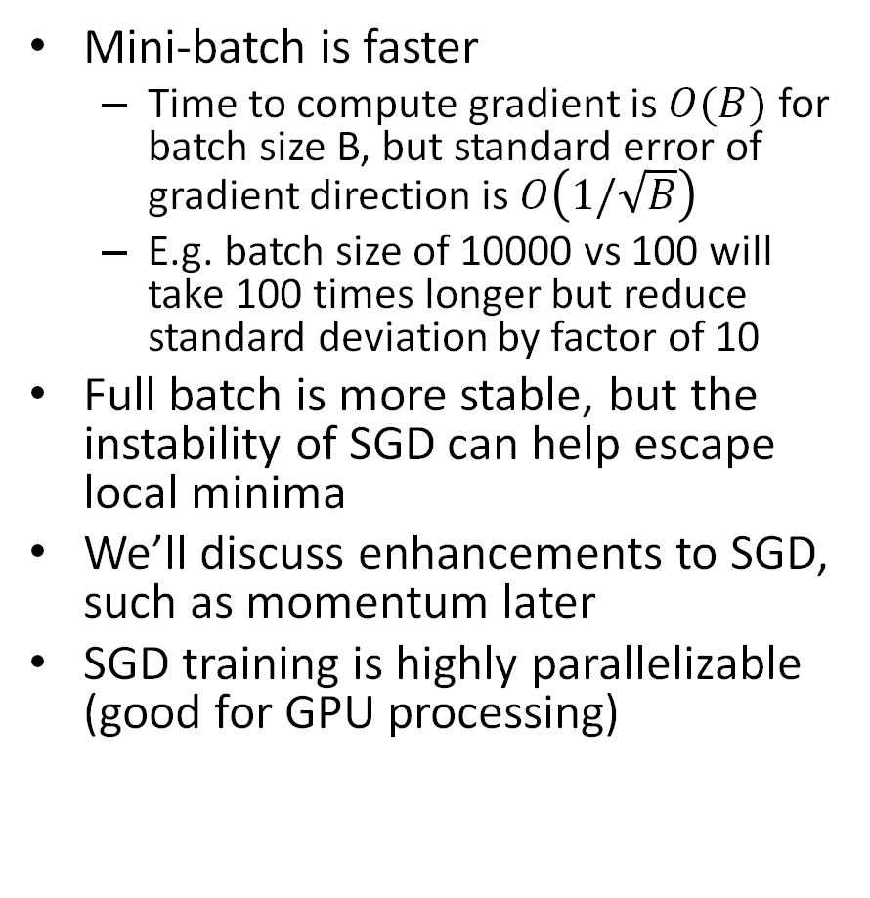
Mini-Batch SGD vs. Full Batch Gradient Descent
Mini-batch is faster
  Time to compute gradient is $O(B)$ for batch size B, but standard error of gradient direction is $O\left(1/\sqrt{B}\right)$
  E.g. batch size of 10000 vs 100 will take 100 times longer but reduce standard deviation by factor of 10
Full batch is more stable, but the instability of SGD can help escape local minima
We’ll discuss enhancements to SGD, such as momentum later
SGD training is highly parallelizable (good for GPU processing)
https://medium.com/analytics-vidhya/gradient-descent-vs-stochastic-gd-vs-mini-batch-sgd-fbd3a2cb4ba4
Terminology: when people say “SGD” they usually mean mini-batch SGD

Slide 25
Pegasos: take-ways and surprising facts
SGD is very simple and effective optimization algorithm – step toward better solution based on a small sample of training data
Not very sensitive to mini-batch size (but larger batches can be much faster with GPU parallel processing)
The same learning schedule is effective across several problems
A larger training set makes it faster to obtain the same test performance

Slide 26
Q1-Q2
https://tinyurl.com/441AML-L14

Slide 27
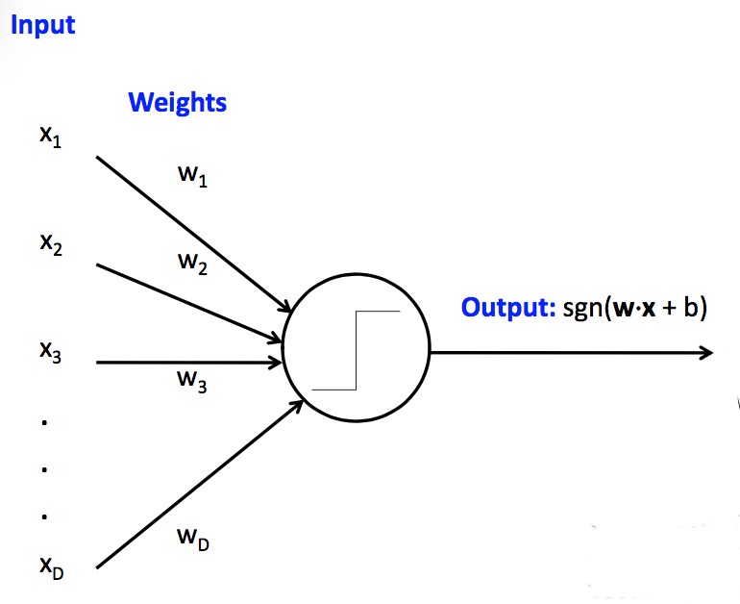
Perceptron
Perceptron = thresholded linear prediction model for classification
Classically, the loss is a hinge loss (like SVM), but we’ll consider MSE and logistic losses
sgn returns -1 for negative inputs and +1 for positive inputs
Fig source: CS 440

Slide 28
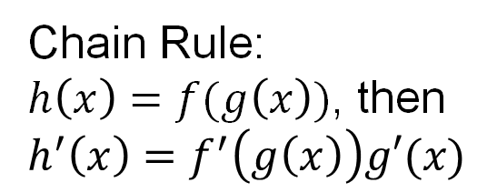
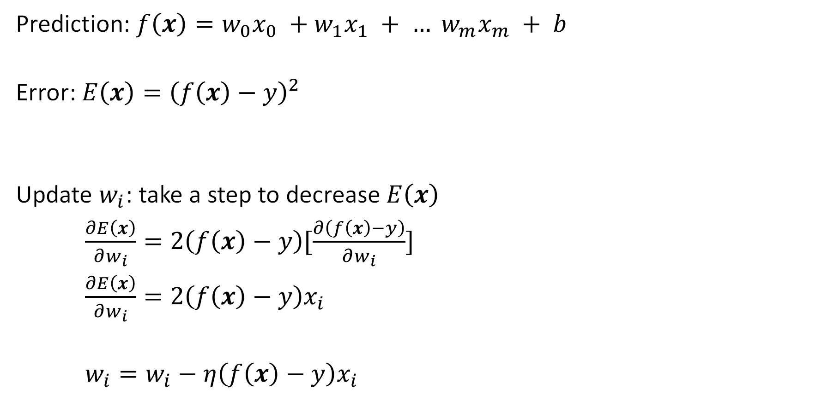
Perceptron Update Rule with MSE Loss
Prediction: $f\left(x\right)=w_{0}x_{0} +w_{1}x_{1} + … w_{m}x_{m} + b$
Error: $E\left(x\right)={\left(f\left(x\right)−y\right)}^{2}$
Update $w_{i}$: take a step to decrease $E\left(x\right)$
$\frac{∂E\left(x\right)}{∂w_{i}}=2\left(f\left(x\right)−y\right)[\frac{∂\left(f\left(x\right)−y\right)}{∂w_{i}}]$
$\frac{∂E\left(x\right)}{∂w_{i}}=2\left(f\left(x\right)−y\right)x_{i}$
$w_{i}=w_{i}−η\left(f\left(x\right)−y\right)x_{i}$
prediction
target
Chain Rule:
$h\left(x\right)=f(g\left(x\right))$, then
$h^{′}\left(x\right)=f^{′}\left(g\left(x\right)\right)g′(x)$
(the 2 is folded into the learning rate)
Make error lower
Learning rate

Slide 29
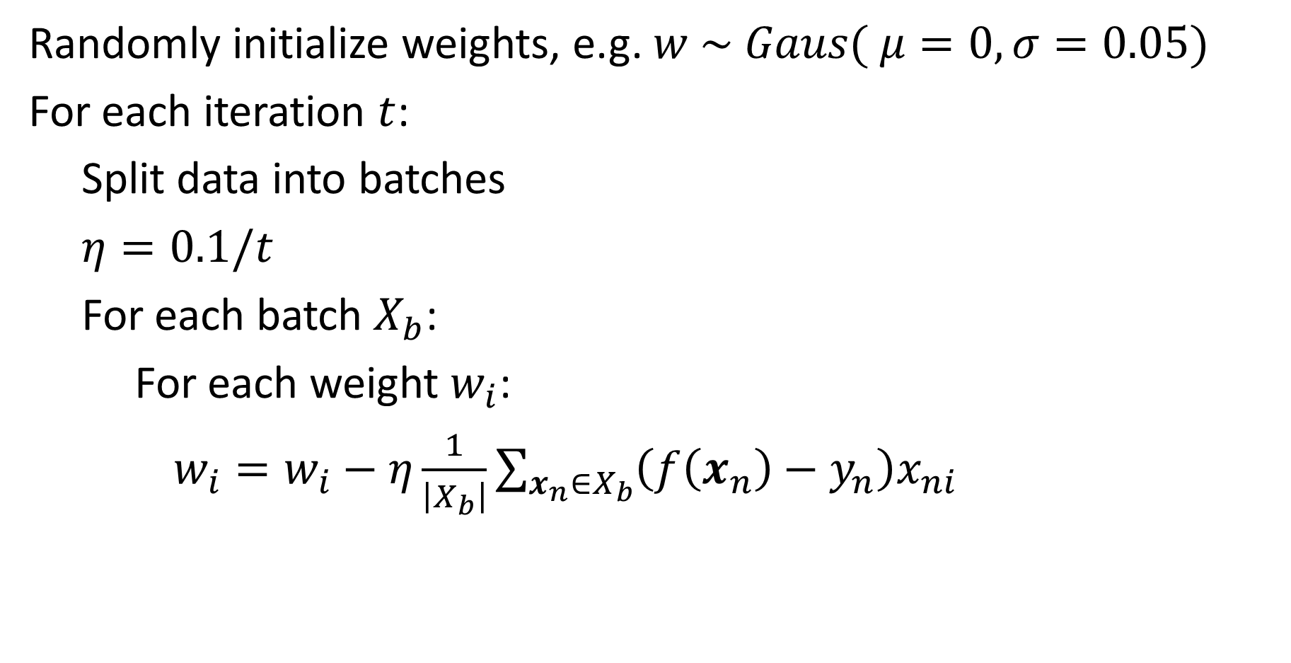
Perceptron Optimization by SGD (MSE Loss)
Randomly initialize weights, e.g. $w \sim Gaus( μ=0, σ=0.05)$
For each iteration $t$:
Split data into batches
$η=0.1/t$
For each batch $X_{b}$:
For each weight $w_{i}$:
$w_{i}=w_{i}−η\frac{1}{\left|X_{b}\right|}\sum_{x_{n}∈X_{b}}{\left(f\left(x_{n}\right)−y_{n}\right)x_{ni}}$

Slide 30
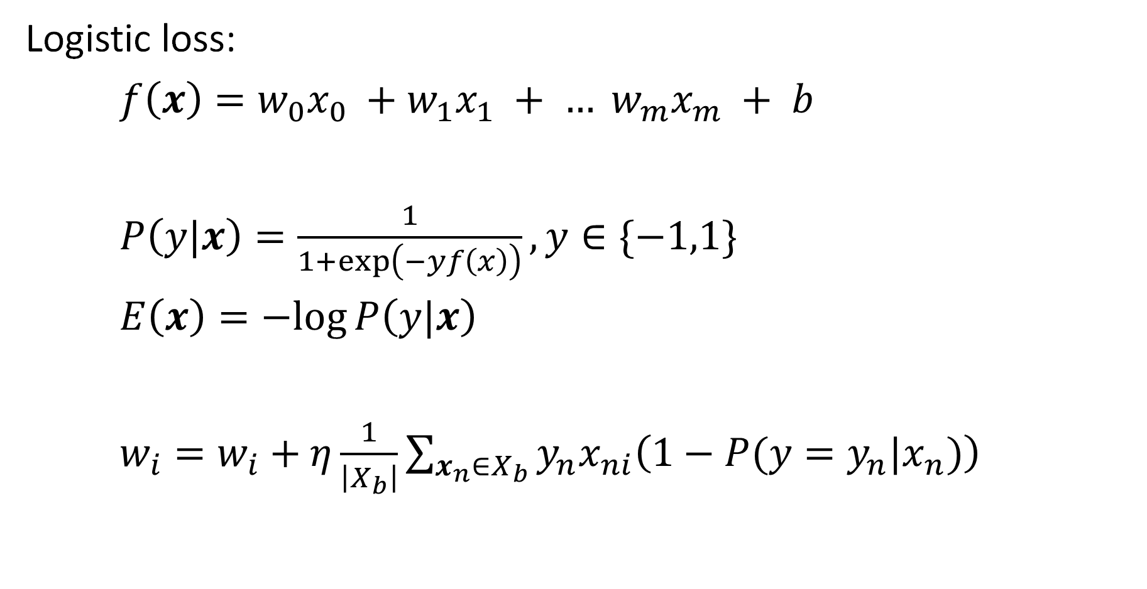
With different loss, the update changes accordingly
Logistic loss:
$f\left(x\right)=w_{0}x_{0} +w_{1}x_{1} + … w_{m}x_{m} + b$
$P\left(y|x\right)=\frac{1}{1+\exp\left(−yf\left(x\right)\right)}, y∈\{−1,1\}$
$E\left(x\right)=−log{P\left(y|x\right)}$
$w_{i}=w_{i}+η\frac{1}{\left|X_{b}\right|}\sum_{x_{n}∈X_{b}}{y_{n}x_{ni}\left(1−P(y=y_{n}|x_{n})\right)}$
decrease –logP(y|x) → increase logP(y|x)

Slide 31
Q3
https://tinyurl.com/441AML-L14

Slide 32
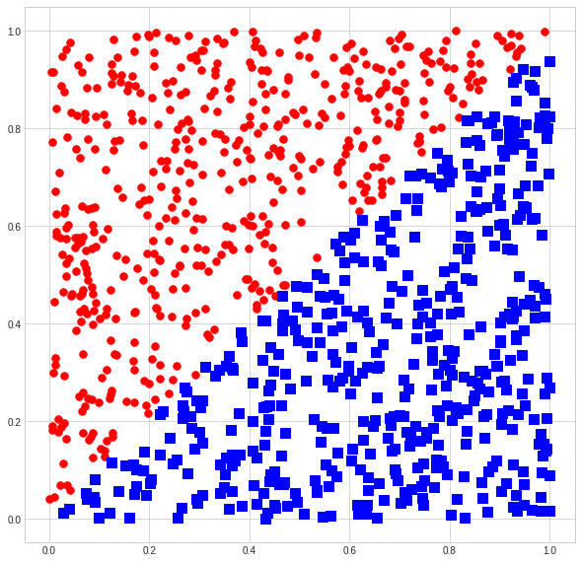
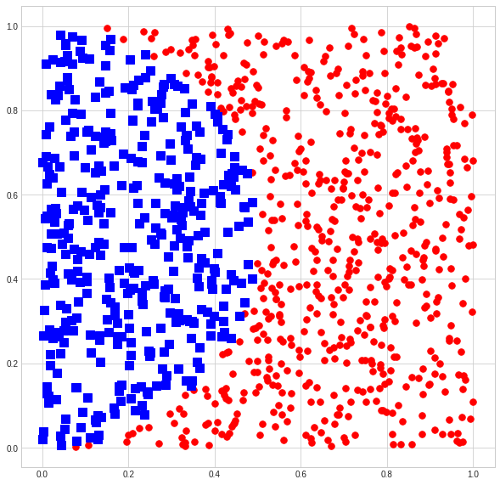
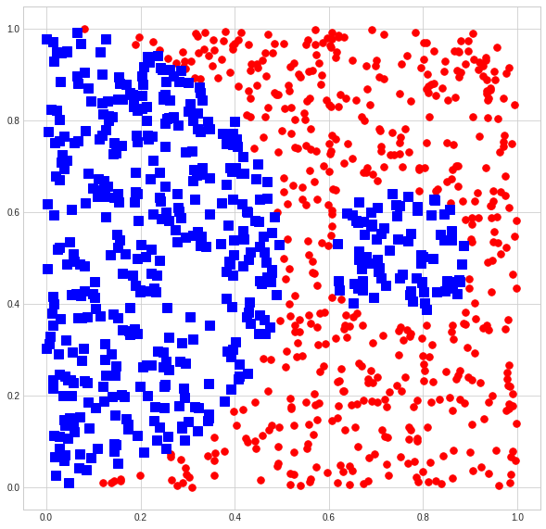
Demo
https://colab.research.google.com/drive/1nKNJyolqgzW53Rz59M2BZtyQM8bbrExb?usp=sharing
Which of these can a perceptron solve (fit with zero training error)?
(a)
(b)
(c)

Slide 33
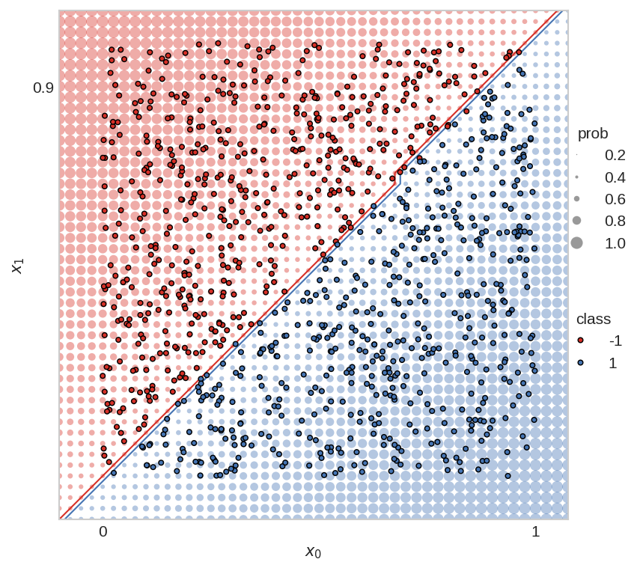
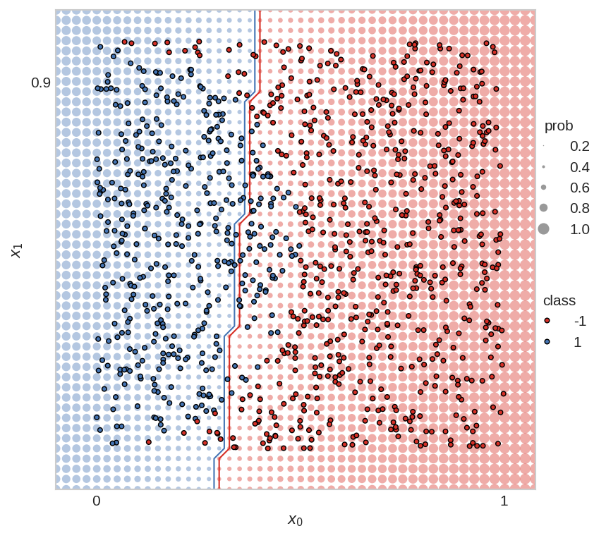
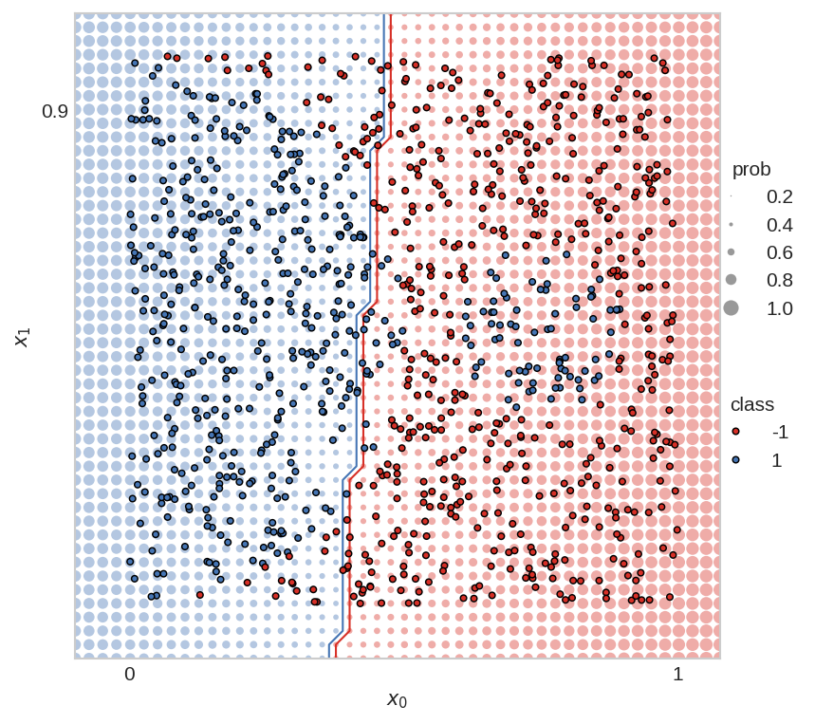
Perceptron is often not enough
Perceptron is linear, but we often need a non-linear prediction function
Which of these can a perceptron solve (fit with zero training error)?
Yes
No
Not even close

Slide 34
Q4
https://tinyurl.com/441AML-L14

Slide 35
Things to Remember
Gradient descent iteratively steps in direction of negative gradient of loss
Stochastic gradient descent estimates gradient using small batches of samples
  Faster than full gradient descent
Linear models have limited ability to fit the data – often need non-linear models like multilayer networks

Slide 36
Coming up
Thursday: MLPs

