Slide 1

PDF Estimation
Applied Machine Learning
Derek Hoiem
Dall-E

Slide 2
Last class: EM
True or False
The EM algorithm is a method for maximum likelihood estimation in the presence of missing or incomplete data.
The EM algorithm guarantees convergence to the global maximum of the likelihood function for any given dataset
The E-step of the EM algorithm computes the maximum likelihood estimate of the parameters given the observed data.
In the EM algorithm, the likelihood of the observed data increases after each iteration of the algorithm.
True
False
False
True
Notes:
tinyurl.com/cs441em (skip)

Slide 3
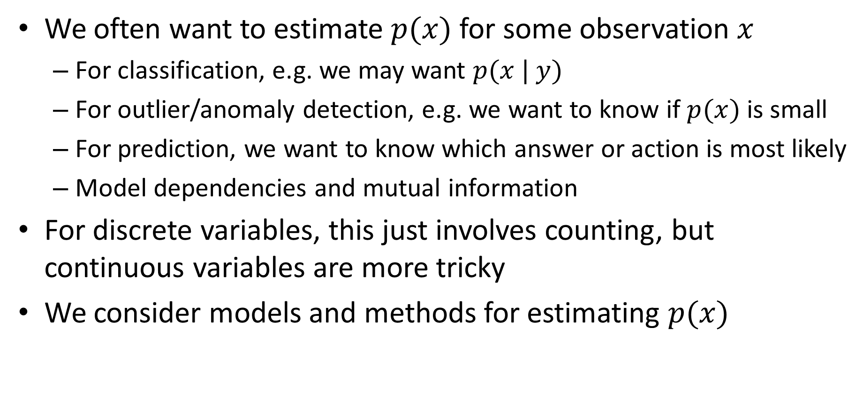
This class – PDF Estimation
We often want to estimate $p(x)$ for some observation $x$
  For classification, e.g. we may want $p(x | y)$
  For outlier/anomaly detection, e.g. we want to know if $p(x)$ is small
  For prediction, we want to know which answer or action is most likely
  Model dependencies and mutual information
For discrete variables, this just involves counting, but continuous variables are more tricky
We consider models and methods for estimating $p(x)$
PDF = probability density function

Slide 4
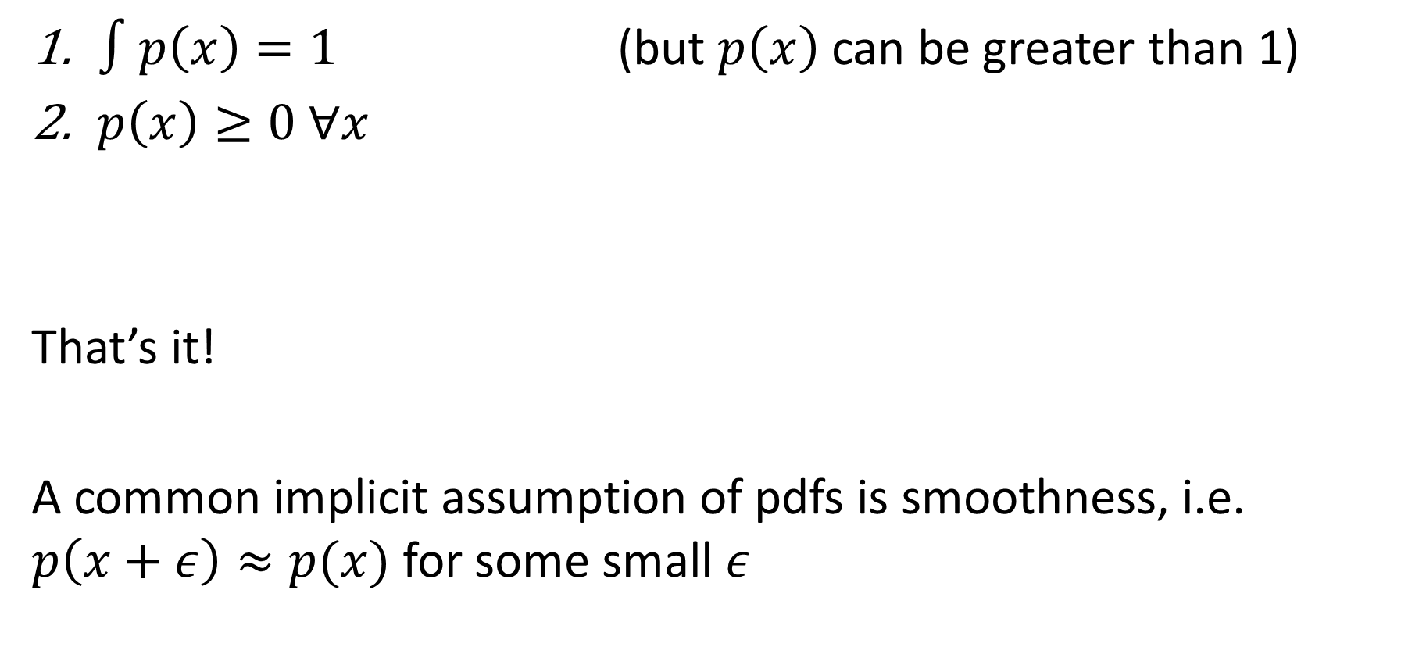
Basic rules of PDFs
$∫p\left(x\right)=1$ (but $p\left(x\right)$ can be greater than 1)
$p\left(x\right)≥0 ∀x$
That’s it!
A common implicit assumption of pdfs is smoothness, i.e. $p\left(x+ε\right)≈p(x)$ for some small $ε$

Slide 5
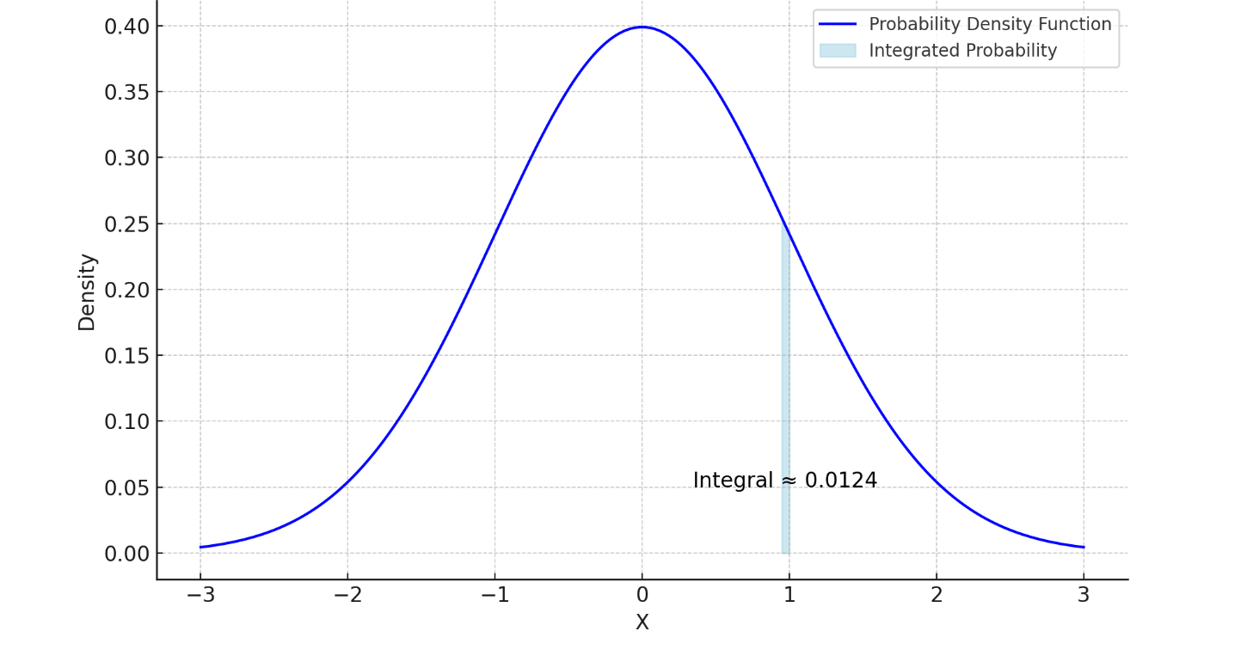
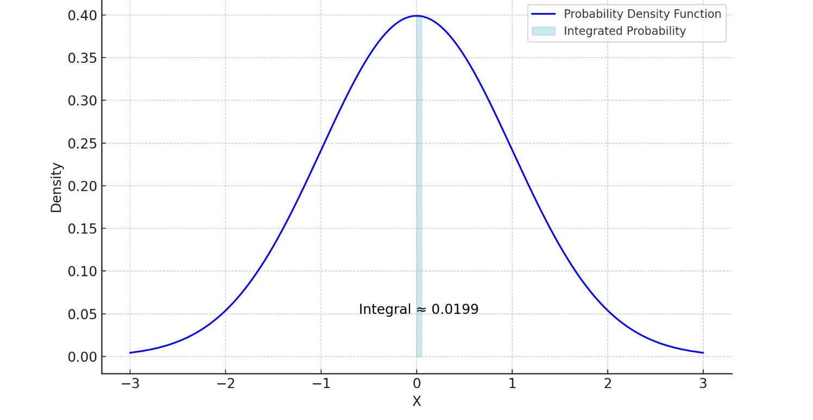



Probability density function (PDF) → Probability
$$P(0.95 < X < 1) ≈0.012$$
$$P\left(0 < X < 0.05\right)≈0.02$$
$$P(−0.05< X < 0.05) ≈0.04$$

Slide 6
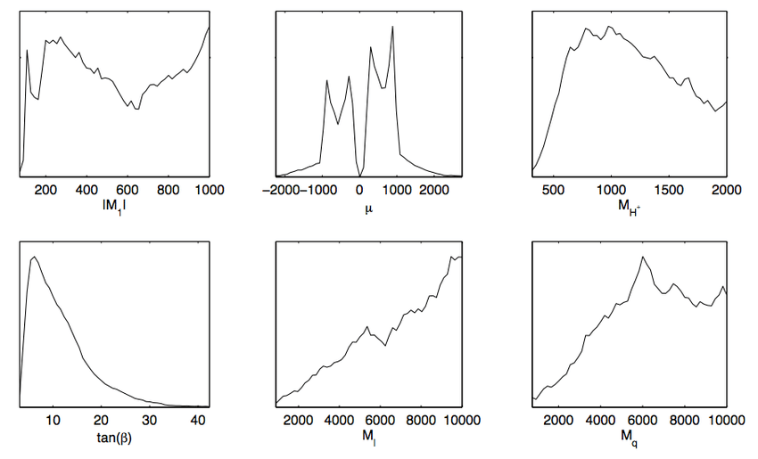
1D PDFs
E.g.
  x is a temperature
  Intensity
  Sensor reading
  Height of a person
  Number of dolphins in a body of water
x could be continuous or have too many possible values to count frequency for each
  E.g. how many people are in NYC at a given day in the year
Fig src

Slide 7
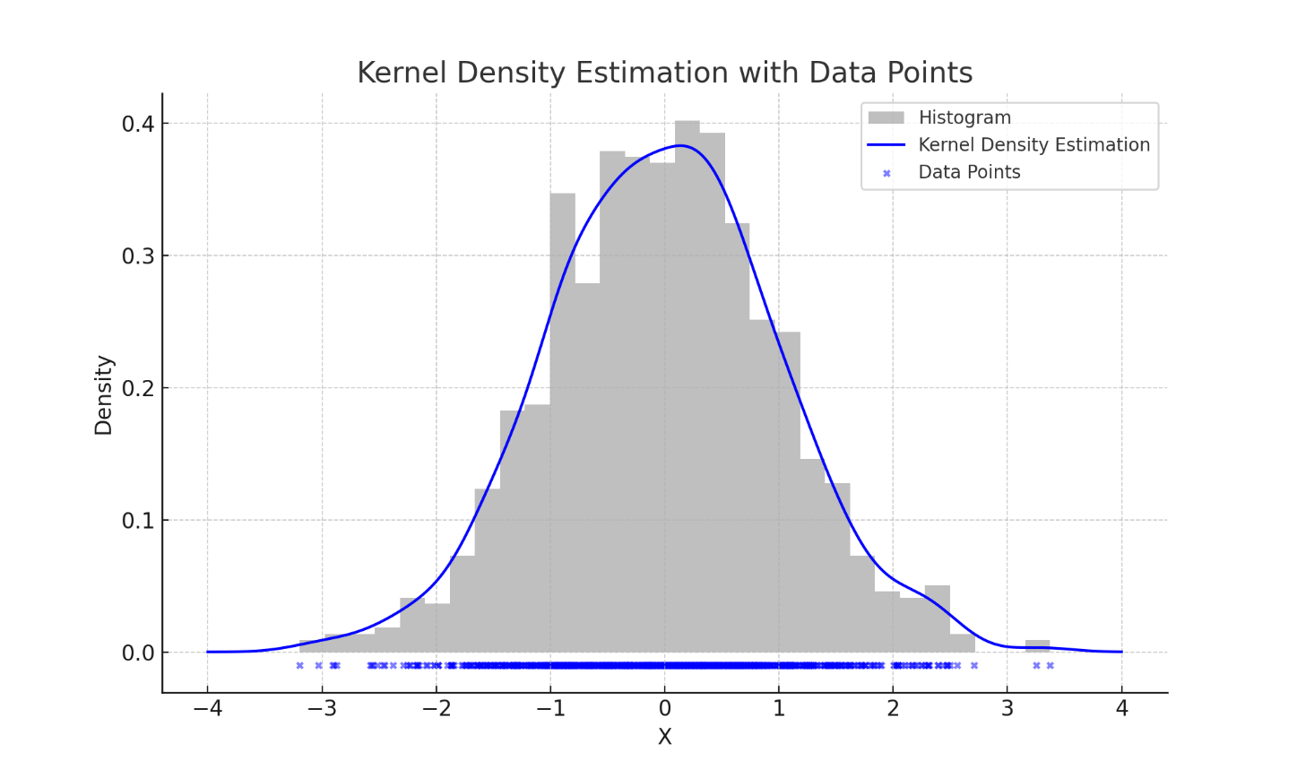
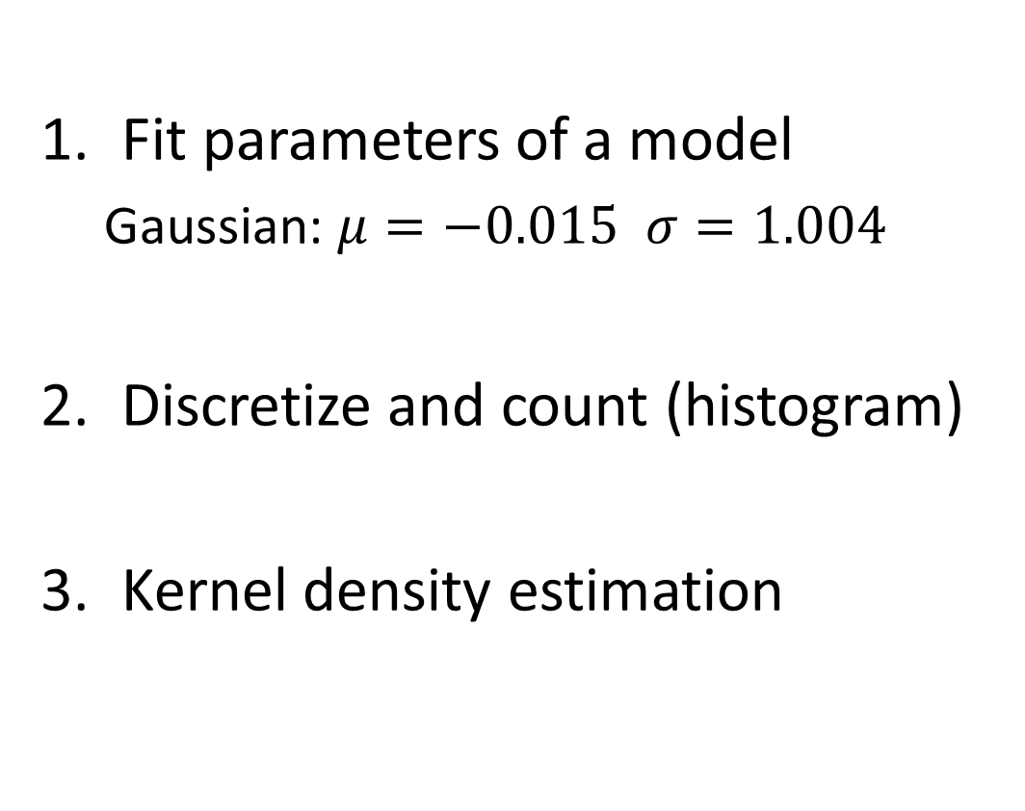
How to estimate probability density functions from samples
Fit parameters of a model
  Gaussian: $μ=−0.015 σ=1.004$
Discretize and count (histogram)
Kernel density estimation

Slide 8
Methods to estimate PDFs
 | Parametric Models | Semi-Parametric | Non-Parametric
Description | Assumes a fixed form for density | Can fit a broad range of functions with limited parameters | Can fit any distribution
Examples | Gaussian, exponential | Mixture of Gaussians | Discretization, kernel density estimation
Good when | Model is able to approximately fit the distribution | Low dimensional or smooth distribution | 1-D data
Not good when | Model cannot approximate the distribution | Distribution is not smooth, challenging in high dimensions | Data is high dimensional

Slide 9
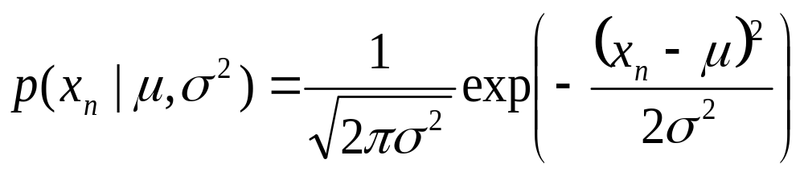
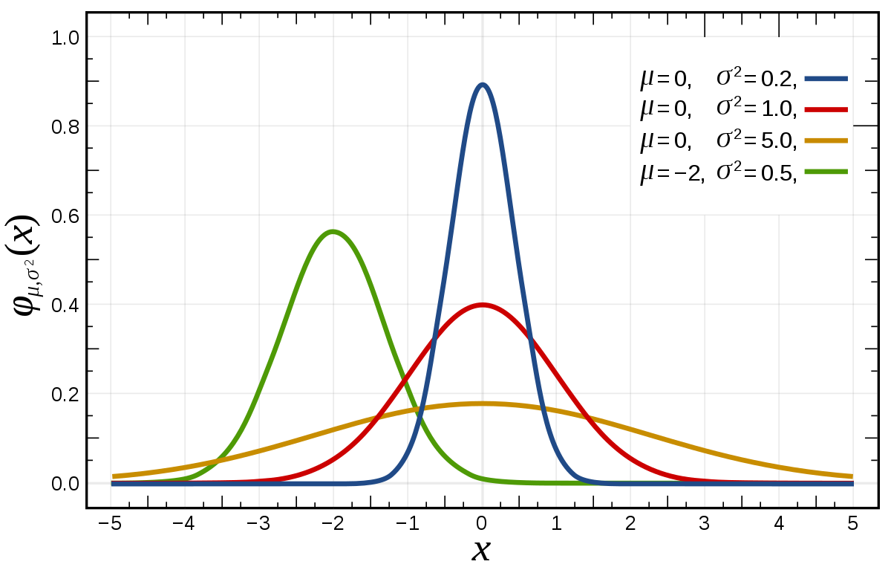
Gaussian distribution
Easy to estimate parameters
Symmetric, unimodal
Products of Gaussian variables is Gaussian
Sums of Gaussian random variables are Gaussian
The sum of many random variables is approximately Gaussian (Central Limit Theorem) [animation]
  Often used as a noise model
Light tail (values become small quickly away from the mean)
Examples of distributions fit well by Gaussian
  Heights of adult males
  Image intensity noise
  Weights of newborn babies

Slide 10

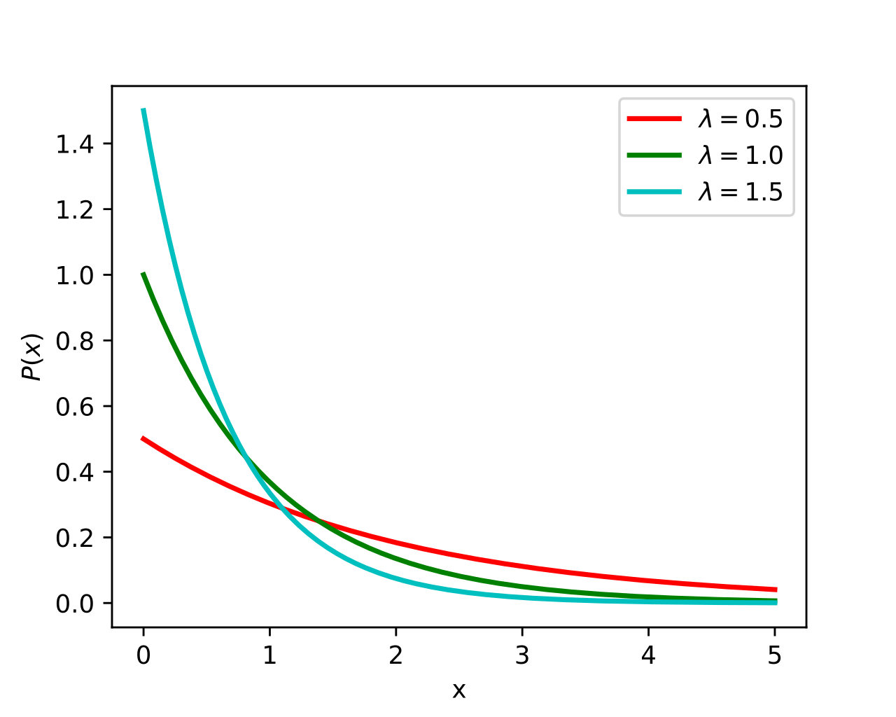
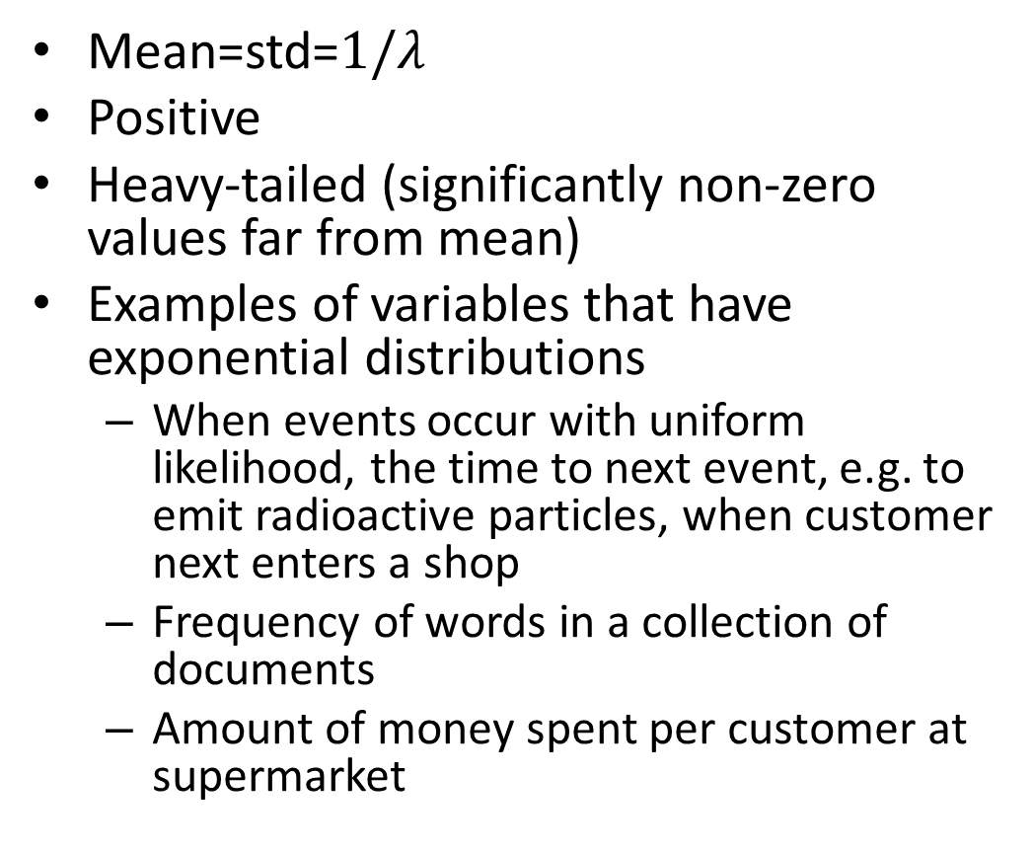
Exponential distribution
Mean=std=$1/λ$
Positive
Heavy-tailed (significantly non-zero values far from mean)
Examples of variables that have exponential distributions
  When events occur with uniform likelihood, the time to next event, e.g. to emit radioactive particles, when customer next enters a shop
  Frequency of words in a collection of documents
  Amount of money spent per customer at supermarket

Slide 11

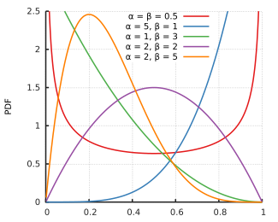
Beta distribution
Range is 0 to 1
Lots of different shapes, depending on parameters
Used when a variable has a finite range of possible values

Slide 12
Estimating parameters of models
Usually computable in closed form
Easy to look up the MLE estimates (parameter values that maximize data likelihood)

Slide 13
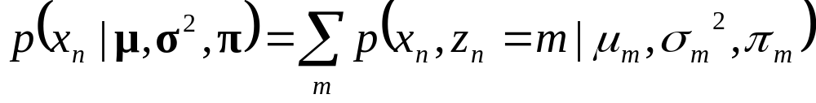
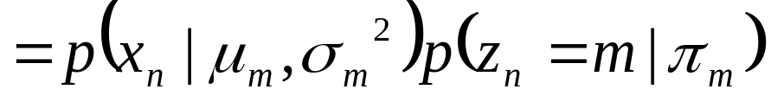
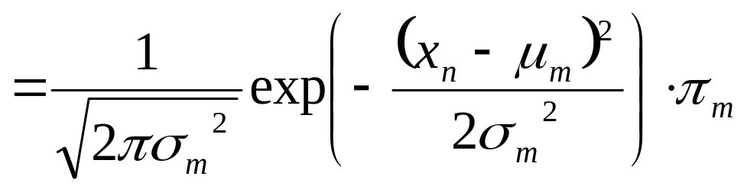
Mixture of Gaussians
mixture component
component model parameters
component prior

Slide 14
Mixture of Gaussians
With enough components, can represent any probability density function
  Widely used as general purpose pdf estimator
Bias toward smooth density functions
Animation

Slide 15
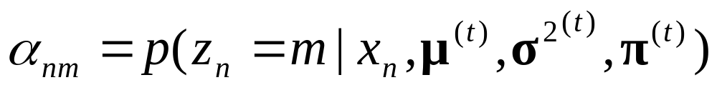
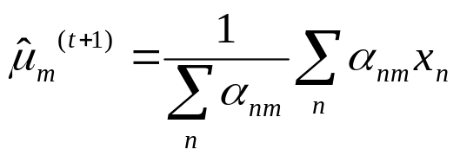
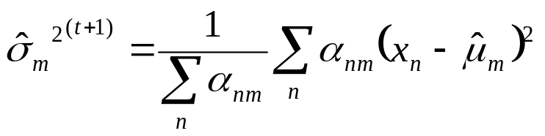
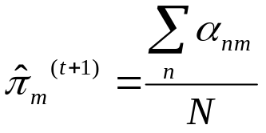
Estimate Mixture of Gaussians with EM Algorithm
Initialize parameters
Compute likelihood of hidden variables for current parameters
Estimate new parameters for each model, weighted by likelihood

Slide 16
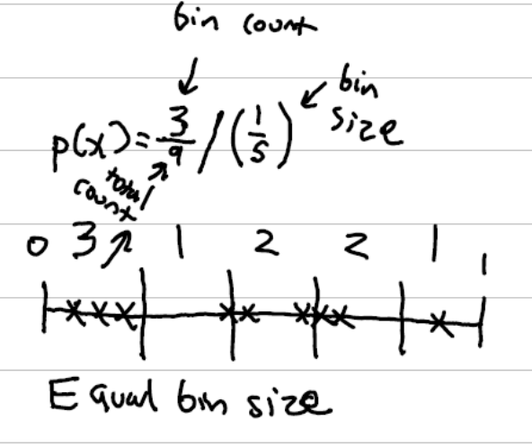
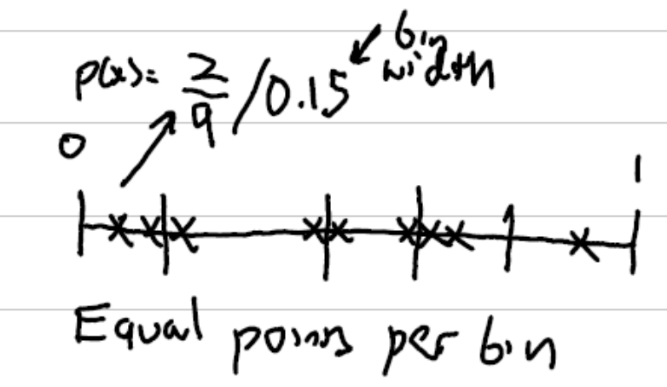
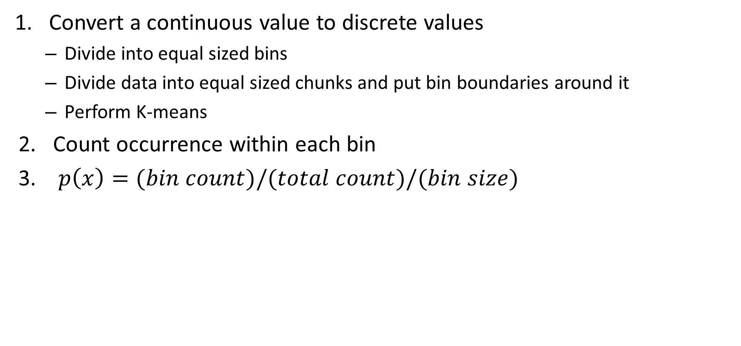
“Normalized Histograms”, Discretized Functions
Convert a continuous value to discrete values
  Divide into equal sized bins
  Divide data into equal sized chunks and put bin boundaries around it
  Perform K-means
Count occurrence within each bin
$p\left(x\right)=(bin count)/(total count)/(bin size)$

Slide 17
Guidelines of how to “bin” or discretize 1-D data
Is the x-axis meaningfully interval-scaled (time, dollars, cm)? → Equal width
Is the distribution very skewed/heavy-tailed and you’re exploring tails/quantiles? → Equal count (or log-transform + equal width)
Comparing multiple groups on one axis? → Equal width (shared edges)
Tails important but width hides them? → Show both: equal width for overall shape + equal count (or ECDF) for tail detail
https://www.ncbi.nlm.nih.gov/pmc/articles/PMC9041617/

Slide 18

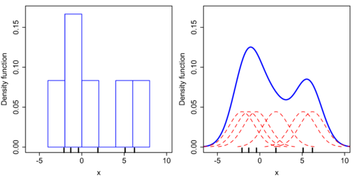

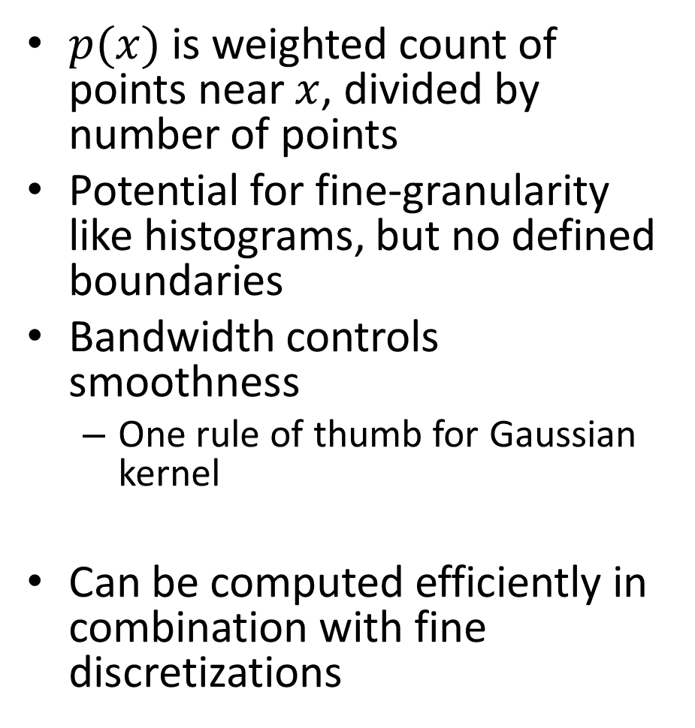
Kernel density estimation
$p(x)$ is weighted count of points near $x$, divided by number of points
Potential for fine-granularity like histograms, but no defined boundaries
Bandwidth controls smoothness
  One rule of thumb for Gaussian kernel
Can be computed efficiently in combination with fine discretizations
Histogram
Kernel Density

Slide 19

Q1-2
https://tinyurl.com/AML441-L10

Slide 20
How to select parameters and evaluate
Hyperparameters
  Histogram: num bins
  Kernel Density: bandwidth
  MoG: num components
  Also may set priors on bin count or variance
To select hyperparameters:
  Split data into a train and val set
  For each candidate parameter:
    Fit to train
    Compute average log likelihood on val
    Record best
  Fit with best parameter on train+val
To compare different models
  Evaluate average log likelihood on a held out test set

Slide 21
Let’s experiment
https://colab.research.google.com/drive/1uoHUbOjZIJsP4zM8M1mNdZakJcDkB-nH
Methods
Gaussian
Histogram, equal size bins
Histogram, equal data bins
KDE
Mixture of Gaussians
Data
Student exam scores
Image intensities
Government payroll data¹
Penguins
Simple distributions
https://tinyurl.com/AML441-L10
¹https://data.ct.gov/Government/State-Employee-Payroll-Data-Calendar-Year-2015-thr/virr-yb6n/data

Slide 22
Evaluation (2023)
 | # Times Best | # Times Close to Best | Pros | Cons
Gaussian | 1 |  | Works for its own category, but even then KDE also works well | Doesn’t work if data is not gaussian distributed
Hist, equal width | 2-3 | Two thirds of time | Always reasonable as long as you search over bin width | Sometimes too sharp, discrete and not smooth
Hist, equal data | 1 | Almost always | Works reliably with few samples, but gets peaky and not smooth with a lot of data
Kernel density | 4+ | Almost always | Smooth, always works, stable | Doesn’t necessarily find modes
Mix of Gauss | 3 | 4 | Good for salary/midterm with multiple modes | Sometimes overfits and creates weird squiggles
https://colab.research.google.com/drive/1H4_jS1oxiOxZkfvh5w5KEWF2zFs4axty?usp=sharing

Slide 23
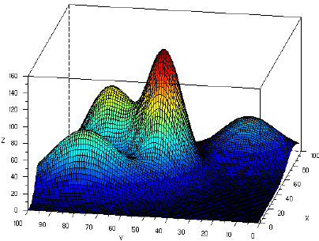
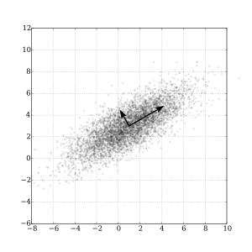
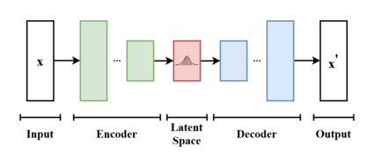
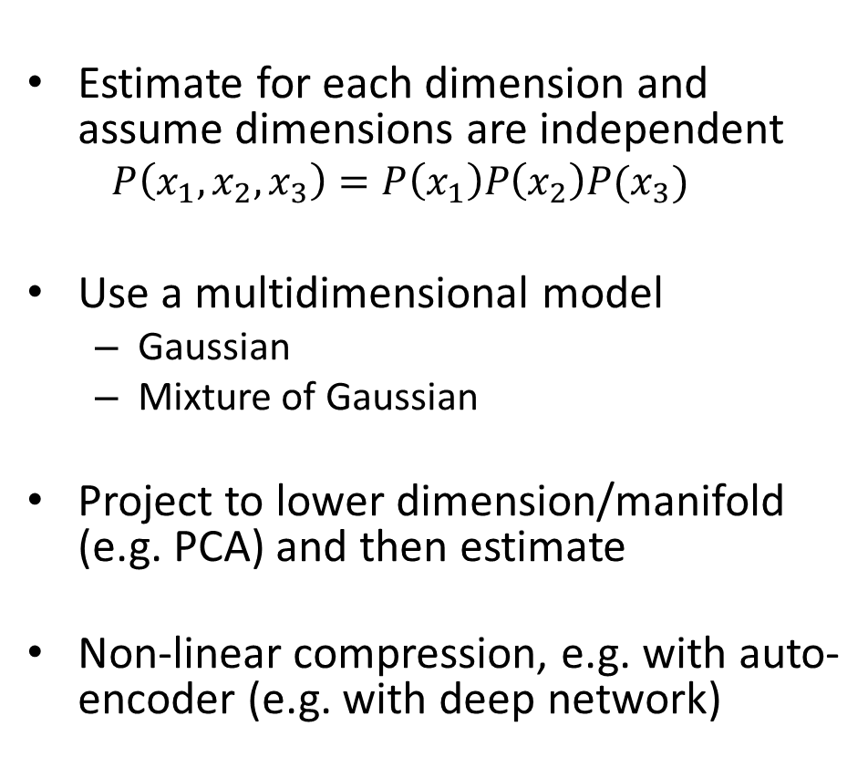
Estimating probability for more than 1 dimension
Estimate for each dimension and assume dimensions are independent
  $$P\left(x_{1}, x_{2},x_{3}\right)=P\left(x_{1}\right)P\left(x_{2}\right)P(x_{3})$$
Use a multidimensional model
  Gaussian
  Mixture of Gaussian
Project to lower dimension/manifold (e.g. PCA) and then estimate
Non-linear compression, e.g. with auto-encoder (e.g. with deep network)
Fig src

Slide 24
Next week
Robust estimation
Exam (optional review in Thurs class period in lecture room)

