Slide 1

EM Algorithm
Applied Machine Learning
Derek Hoiem
Dall-E

Slide 2
Upcoming events
Sept 28: HW2 due
Oct 1: Optional review
Oct 1-4: Exam 1 at CBTF (see pinned CampusWire post)
  Can reserve time now

Slide 3
I will describe three problems. Think about what they have in common.

Slide 4

“Bad Annotators” Problem
You want to train an algorithm to predict whether a photograph is attractive. You collect annotations from Mechanical Turk. Some annotators try to give accurate ratings, but others answer randomly.
Challenge: Determine which people to trust and the average rating by accurate annotators.
Annotator Ratings
10
8
9
2
8
Photo: Jam343 (Flickr)

Slide 5

Foreground/Background Segmentation
You are given an image and want to assign foreground/background pixels.
Challenge: Segment the image into figure and ground without knowing what the foreground looks like in advance.
Foreground
Background

Slide 6
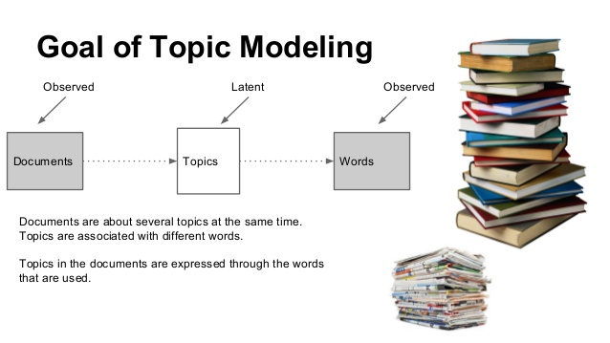
Topic Models
Documents have a “topic” that is predictive of the words
Challenge: We don’t know what the topics are, or what distribution of words each has
Fig source

Slide 7
What do these problems have in common?
We think there is some underlying factor that is not known
  Whether annotator is good or bad
  Whether pixel is in foreground or background
  Topic of a document
We have some model for the probability of data given that underlying factor
But we don’t know the parameters of the model
These are “missing data” or “latent variable” problems – a critical piece of information is not observed

Slide 8
Today’s Class
Examples of problems with hidden or latent variables
  Untrustworthy annotators
  Pixel segmentation
  Topic models
Background
  Maximum Likelihood Estimation
  Probabilistic Inference
Dealing with Latent Variables (latent = hidden, not observed)
  EM algorithm, Bad annotator problem
  Hard EM

Slide 9
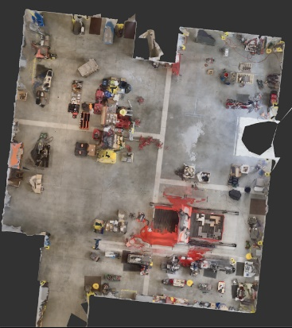
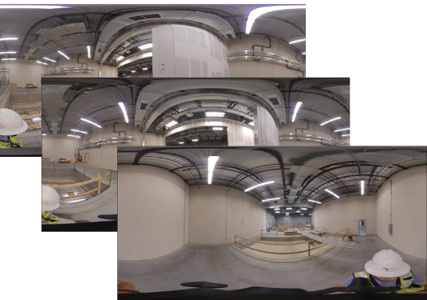
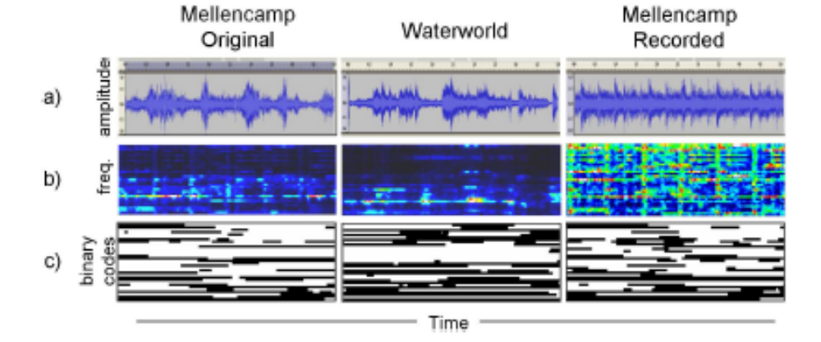
I have used EM in research and practice many times, e.g.
Given multiple images and scene geometry, estimate true color of each floor map pixel
  Latent variables: which pixels are occluded
For an audio clip of music with background noise, which extracted sound signatures are due to music vs background noise?
  Latent variables: whether each extracted sound signature at a given time is due to background or music
Mixture of Gaussian probability model (next class)

Slide 10
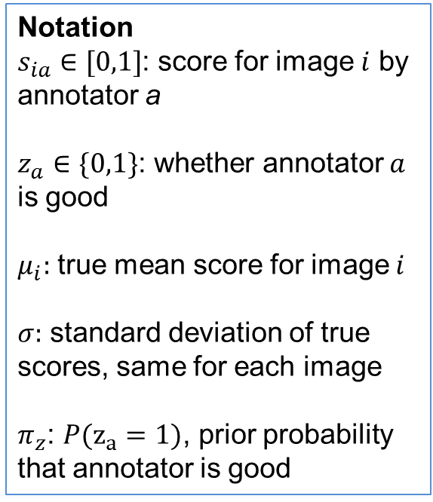
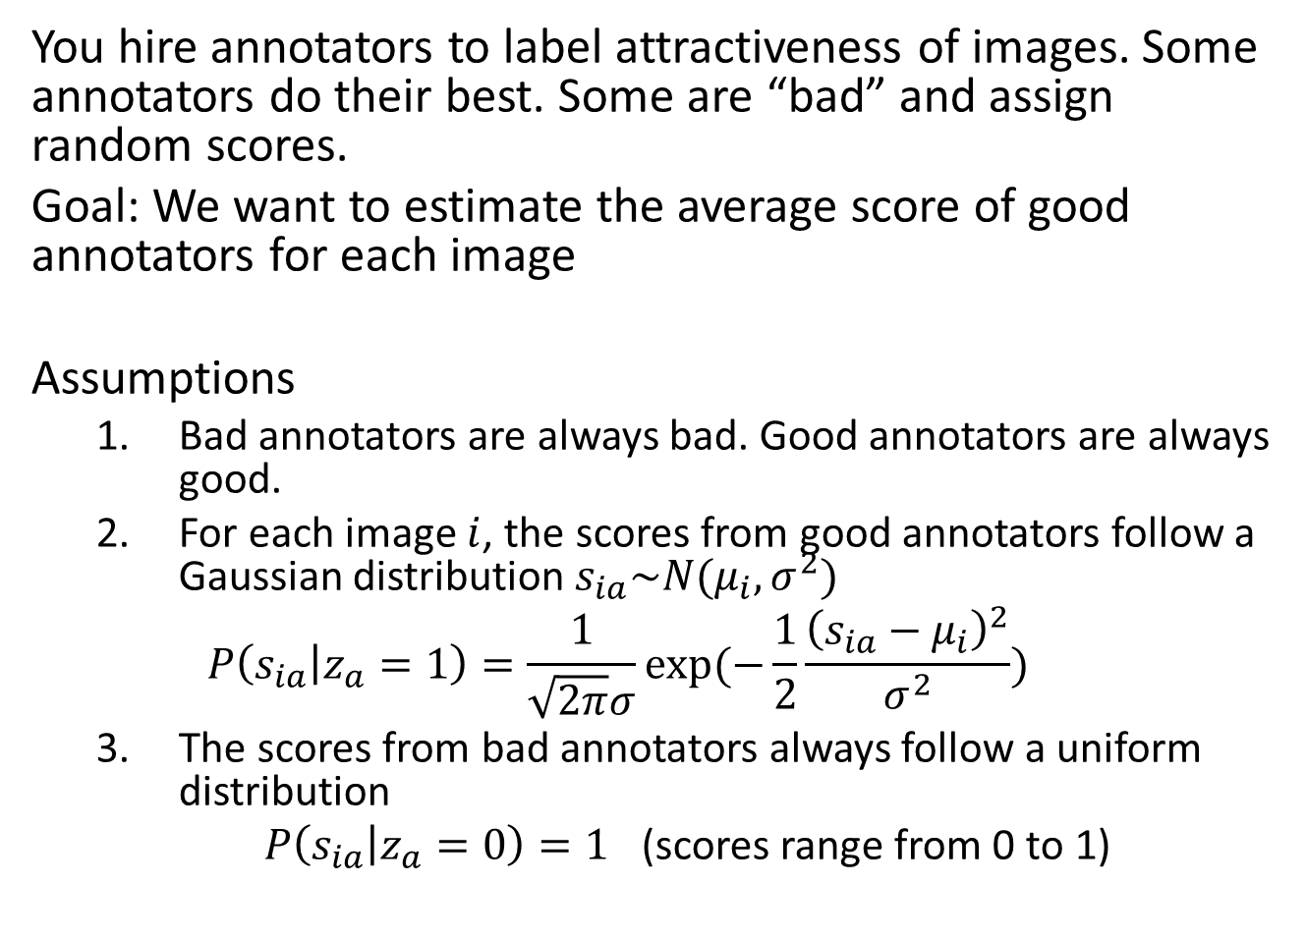
Bad Annotator Problem
You hire annotators to label attractiveness of images. Some annotators do their best. Some are “bad” and assign random scores.
Goal: We want to estimate the average score of good annotators for each image
Assumptions
  Bad annotators are always bad. Good annotators are always good.
  For each image $i$, the scores from good annotators follow a Gaussian distribution $s_{ia}\sim N(μ_{i},σ^{2})$
  $$P\left(s_{ia} | z_{a}=1\right)=\frac{1}{\sqrt{2π}σ}exp(−\frac{1}{2}\frac{{\left(s_{ia}−μ_{i}\right)}^{2}}{σ^{2}})$$
  The scores from bad annotators always follow a uniform distribution
  $P\left(s_{ia} | z_{a}=0\right)=1$ (scores range from 0 to 1)
Notation
$s_{ia}∈[0,1]$: score for image $i$ by annotator a
$z_{a}∈\{0,1\}$: whether annotator $a$ is good
$μ_{i}:$ true mean score for image $i$
$σ:$ standard deviation of true scores, same for each image
$π_{z}$: $P(z_{a}=1)$, prior probability that annotator is good

Slide 11
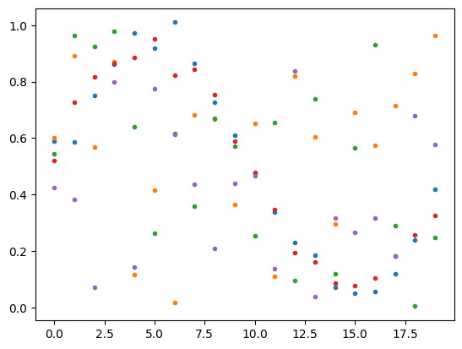
Latent Variable Problems: Bad Annotator
Challenge: Figure out which annotators are good and estimate the true mean score for each image
Three steps:
If we knew which annotators were good, how would we estimate the score distribution for each image?
Given the distribution parameters, how do we compute the likelihood that an annotator is good?
How can we get annotator labels and score models at once?
i=0 | i=1 | i=2 | …
0.59 | 0.88 | 0.7
0.52 | 0.96 | 0.71
0.50 | 0.88 | 0.52
0.39 | 0.94 | 0.65
0.65 | 0.69 | 0.46
Annotated Scores
Image Index

Slide 12
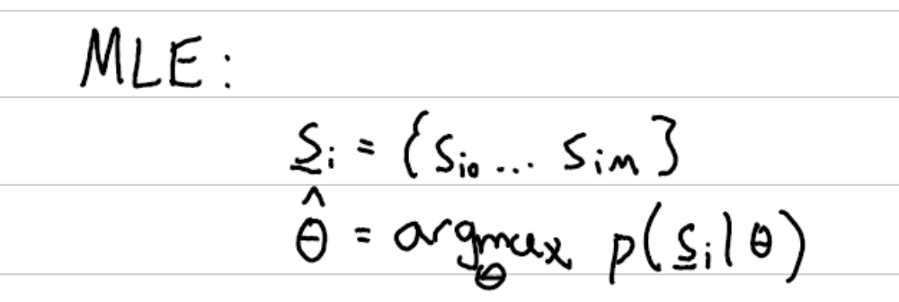
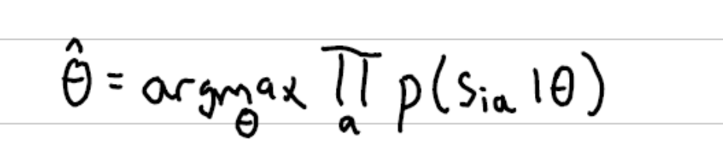
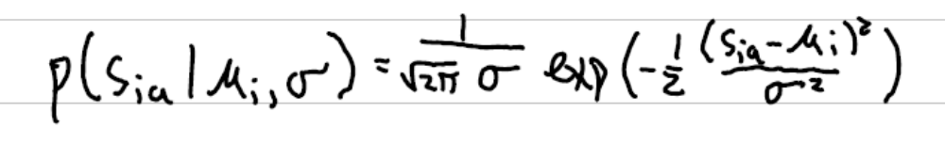
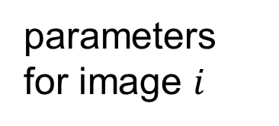
Maximum Likelihood Estimation
If we knew which annotators were good, how would we estimate the score distribution for each image?
data
parameters for image $i$
Solve for parameters that maximize the data likelihood
Scores are independent of each other, given the model
Model is Gaussian

Slide 13
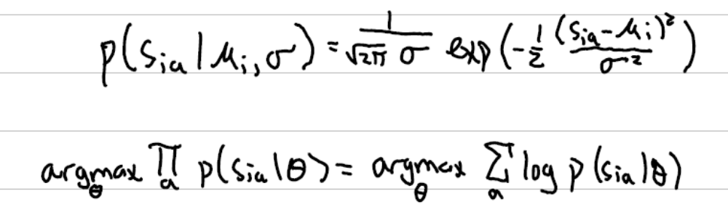
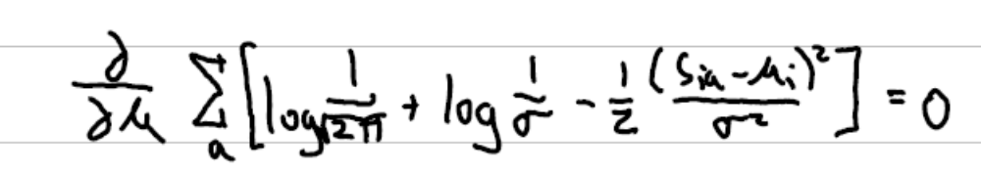
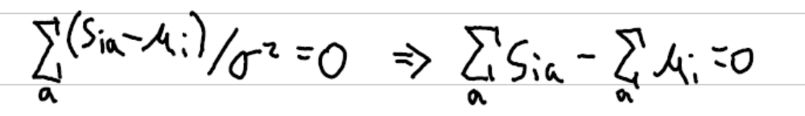
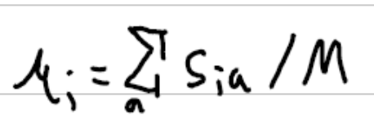
Solving for mean
Easier to take derivative of sum of logs than a product, and f(x) and log(f(x)) are always maximized by the same x
To find max wrt a variable, set the partial derivative wrt that variable to 0
Do the math
Solve. M is number of “a”s

Slide 14
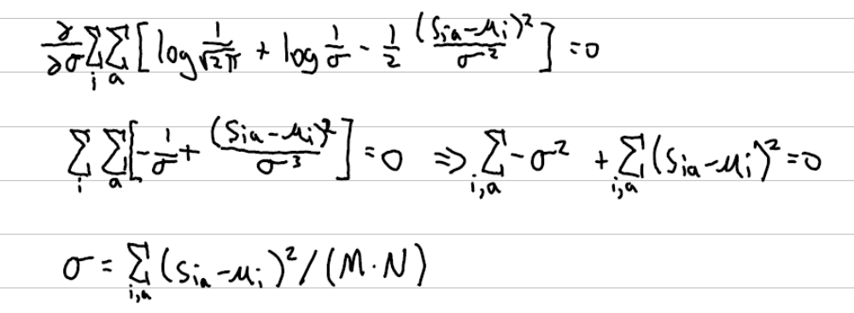
Solving for standard deviation
Now take partial derivative wrt sigma. Since sigma is the same for all images, we are now summing over all images and annotations
Solution is average squared difference from mean
2

Slide 15
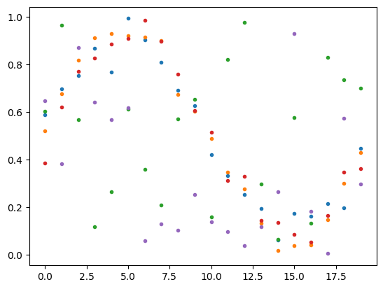
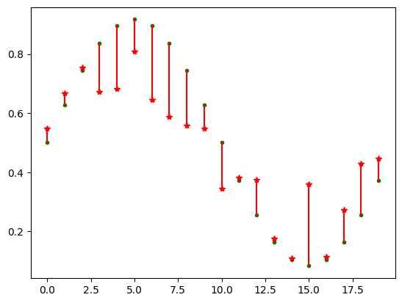
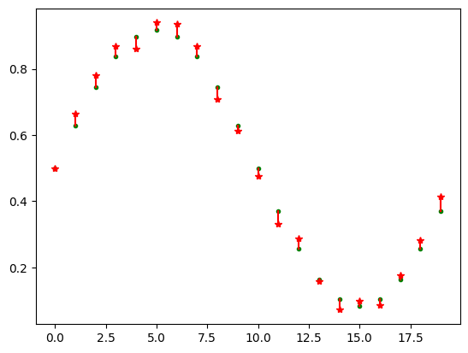
Applying MLE in code
2
Assuming all the scores are good (when they are not)
If we knew somehow which annotators are good
Annotated Scores
Image Index
(Green = true; red = prediction)
(Green = true; red = prediction)

Slide 16
Probabilistic Inference
2. Given the distribution parameters, how do we compute the likelihood that an annotator is good?
Good annotators
(red, orange, blue)
Bad annotators
(green, purple)
Note: In this example, I know what is good and bad because I made up the scores, but otherwise it wouldn’t be obvious

Slide 17
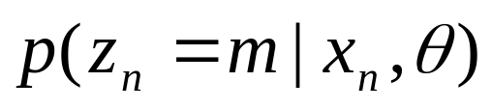
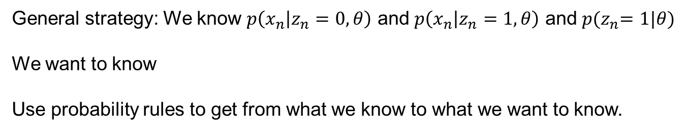
Probabilistic Inference (general case)
Given the model parameters, compute the likelihood that a particular model generated a sample
component or label
z_{n} is the unknown label of data point x_{n}
General strategy: We know $p\left(x_{n} | z_{n}=0, θ\right)$ and $p\left(x_{n} | z_{n}=1, θ\right)$ and $p{(z}_{n}=1|θ)$
We want to know
Use probability rules to get from what we know to what we want to know.

Slide 18
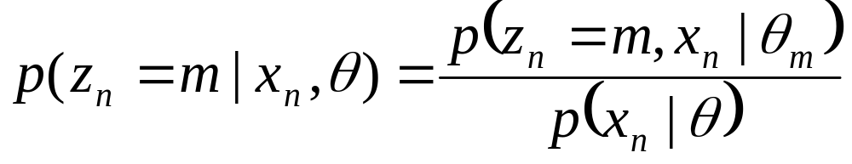
Probabilistic Inference (general case)
Given the model parameters, compute the likelihood that a particular model generated a sample
component or label
Rule of conditional probability

Slide 19
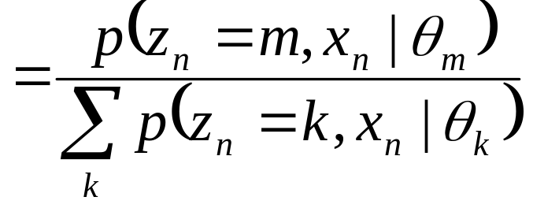
Probabilistic Inference (general case)
Given the model parameters, compute the likelihood that a particular model generated a sample
component or label
Law of total probability

Slide 20
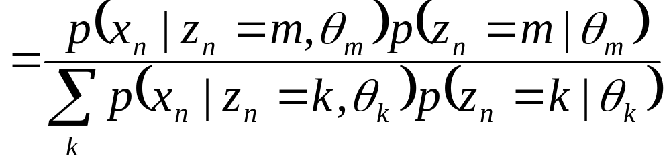
Probabilistic Inference (general case)
Given the model parameters, compute the likelihood that a particular model generated a sample
component or label
Chain rule of probability

Slide 21
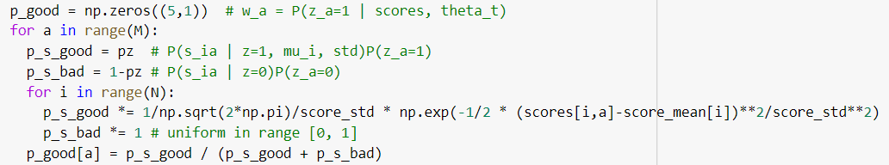
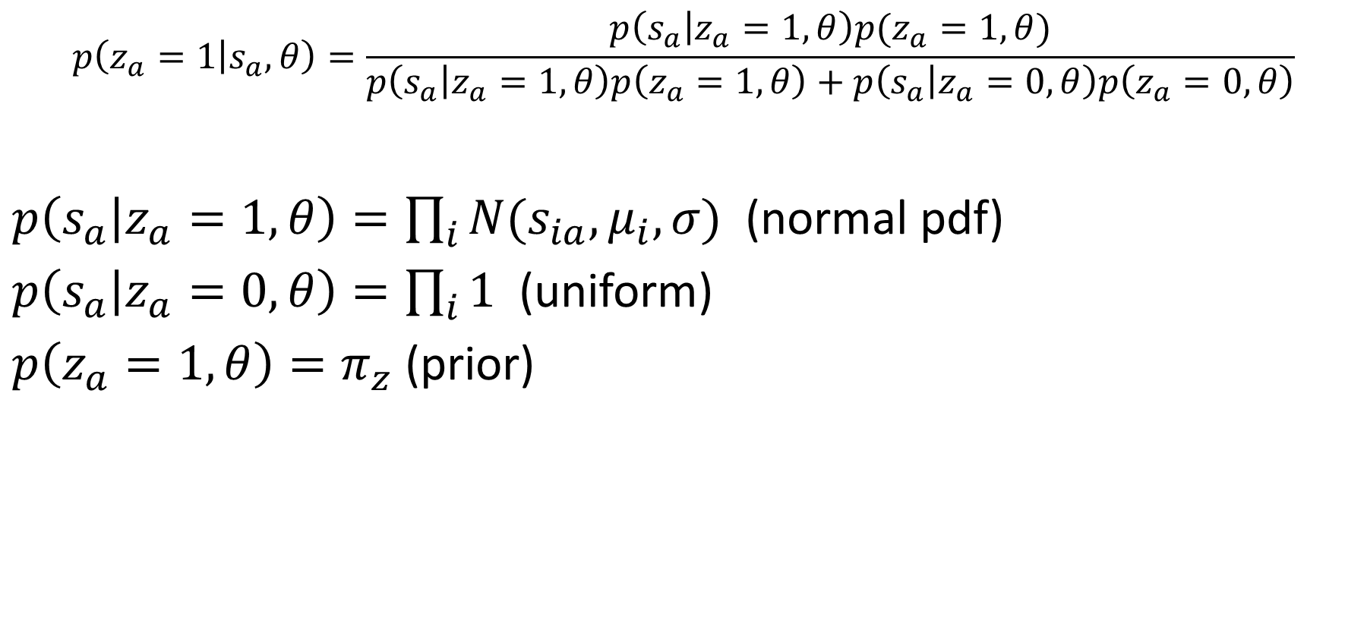
Example: Inference for Annotator Labels
$$p\left(z_{a}=1 | s_{a},θ\right)=\frac{p\left(s_{a} | z_{a}=1,θ\right)p(z_{a}=1,θ)}{p\left(s_{a} | z_{a}=1,θ\right)p\left(z_{a}=1,θ\right)+p\left(s_{a} | z_{a}=0,θ\right)p\left(z_{a}=0,θ\right)}$$
$p\left(s_{a} | z_{a}=1,θ\right)=\prod_{i}{N(s_{ia}, μ_{i},σ) }$ (normal pdf)
$p\left(s_{a} | z_{a}=0,θ\right)=\prod_{i}{1}$ (uniform)
$p\left(z_{a}=1,θ\right)=π_{z}$ (prior)

Slide 22
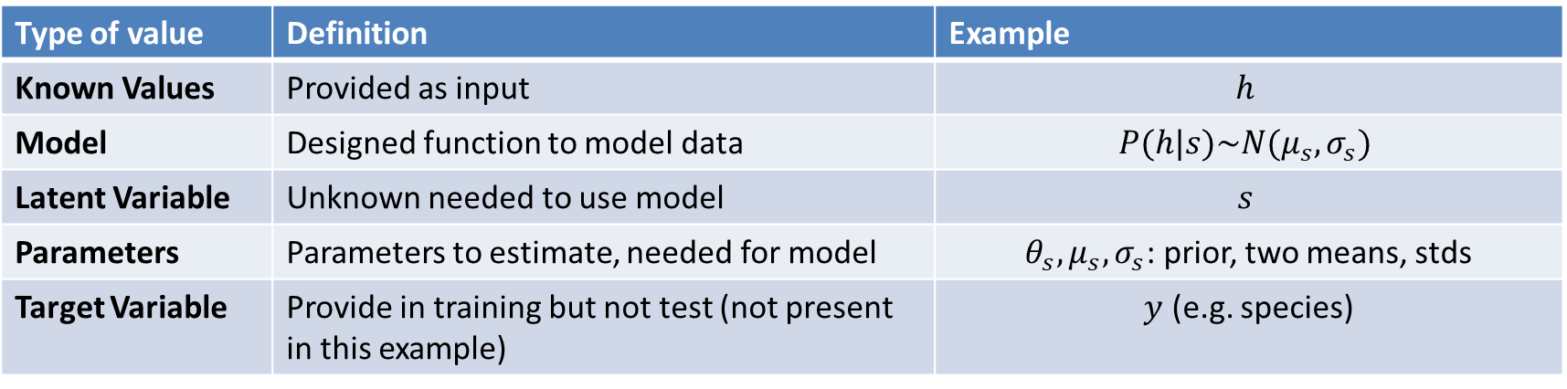
Suppose I want to model the probability of a penguin's height. I think there are probably two groups of penguins (e.g. male or female) and the height has a Gaussian distribution for each group, but all I have recorded is the heights of many penguins.
Distinguishing between known/latent/target variables and parameters
Type of value | Definition | Example
Known Values | Provided as input | $$h$$
Model | Designed function to model data | $$P(h|s)\sim N(μ_{s},σ_{s})$$
Latent Variable | Unknown needed to use model | $$s$$
Parameters | Parameters to estimate, needed for model | $θ_{s}, μ_{s},σ_{s}$: prior, two means, stds
Target Variable | Provide in training but not test (not present in this example) | $y$ (e.g. species)

Slide 23

Q1-2
https://tinyurl.com/AML441-L9
After this:
  Intuitive solution to solving for parameters and latent variables
  Derive that the intuitive solution is correct
  Demo for the untrustworthy annotator problem

Slide 24
Dealing with Latent Variables
3. How can we get annotator labels and score models at once?
Estimated scores
Annotated Scores
Image Index
(Green = true; red = prediction)
Good annotators: 0, 1, 3

Slide 25

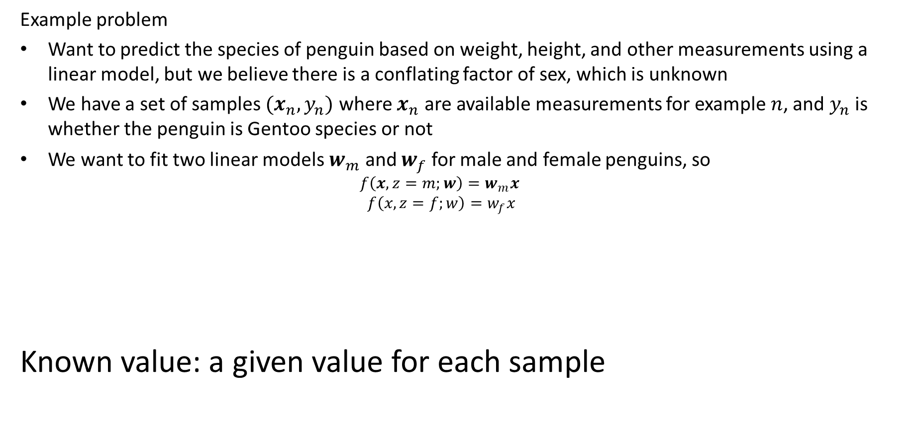



Latent variable vs. target variable vs. known value vs. parameter
Example problem
Want to predict the species of penguin based on weight, height, and other measurements using a linear model, but we believe there is a conflating factor of sex, which is unknown
We have a set of samples $(x_{n}, y_{n})$ where $x_{n}$ are available measurements for example $n$, and $y_{n}$ is whether the penguin is Gentoo species or not
We want to fit two linear models $w_{m}$ and $w_{f}$ for male and female penguins, so
  $$f\left(x,z=m;w\right)=w_{m}x$$
  $$f\left(x,z=f;w\right)=w_{f}x$$
Known value: a given value for each sample
$$x$$
$$f(x,z;θ)$$
$$y$$
$$z$$

Slide 26
Simple solution
Initialize parameters
Compute the probability of each hidden variable given the current parameters
Compute new parameters for each model, weighted by likelihood of hidden variables
Repeat 2-3 until convergence

Slide 27
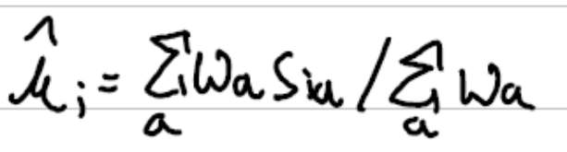
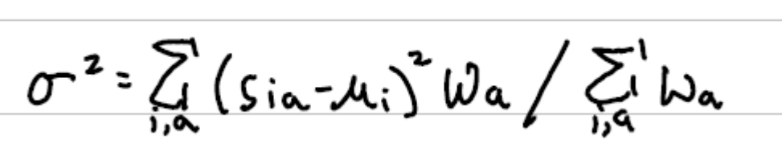
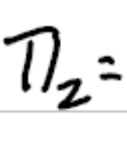
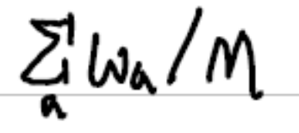
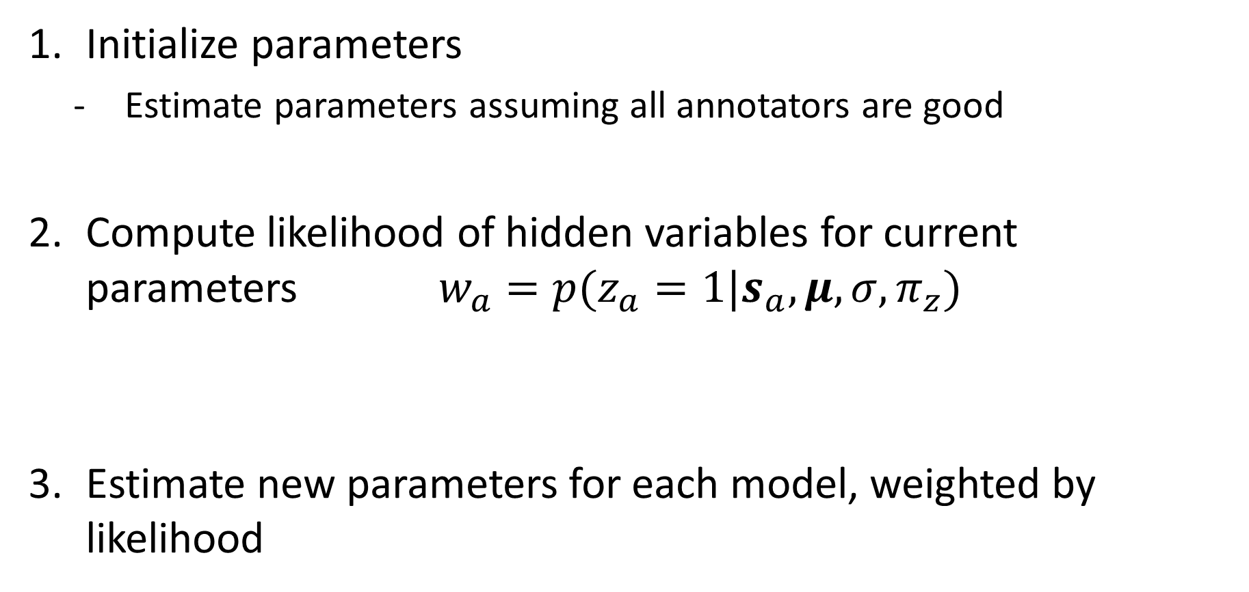
Annotator Problem: Simple Solution
Initialize parameters
  Estimate parameters assuming all annotators are good
Compute likelihood of hidden variables for current parameters $w_{a}=p(z_{a}=1|s_{a}, μ, σ, π_{z})$
Estimate new parameters for each model, weighted by likelihood
^

Slide 28
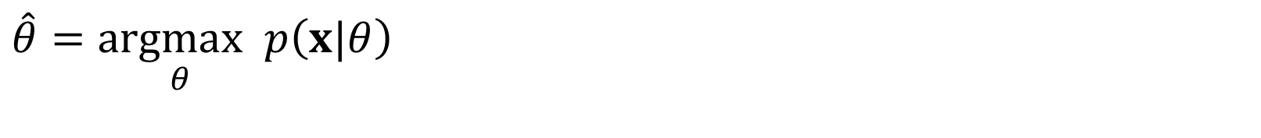
Expectation Maximization (EM) Algorithm
Goal: Solve for distribution parameters that maximize data likelihood.
$$\hat{θ}=\underset{θ}{argmax}p\left(x|θ\right)$$

Slide 29
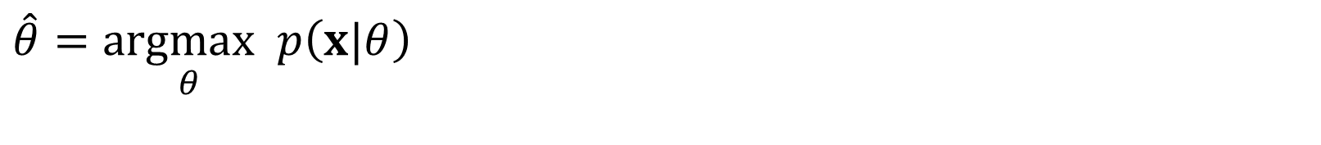
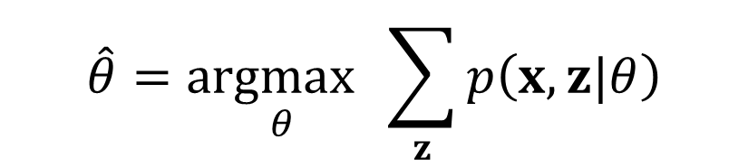
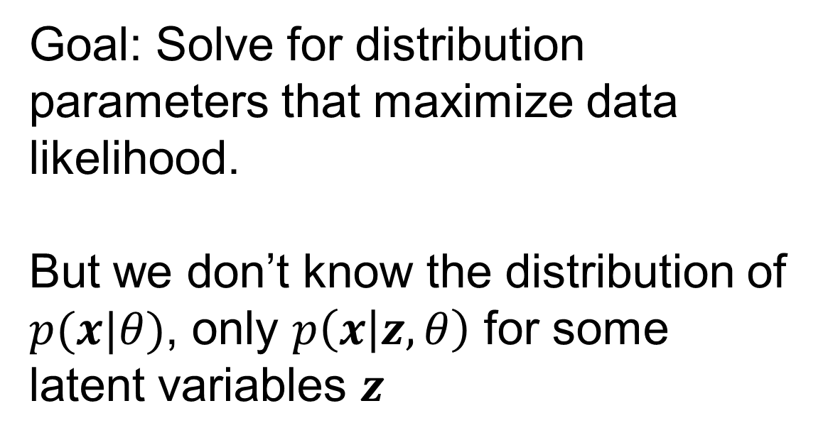
Expectation Maximization (EM) Algorithm
Goal: Solve for distribution parameters that maximize data likelihood.
But we don’t know the distribution of $p(x|θ)$, only $p\left(x | z,θ\right)$ for some latent variables $z$
$$\hat{θ}=\underset{θ}{argmax}p\left(x|θ\right)$$
$$\hat{θ}=\underset{θ}{argmax}\sum_{z}{p\left(x,z|θ\right)}$$

Slide 30
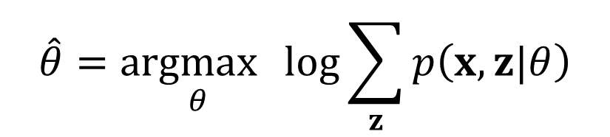
Expectation Maximization (EM) Algorithm
Goal: Solve for distribution parameters that maximize data likelihood.
But we don’t know the distribution of $p(x|θ)$, only $p\left(x | z,θ\right)$ for some latent variables $z$
$$\hat{θ}=\underset{θ}{argmax}p\left(x|θ\right)$$
$$\hat{θ}=\underset{θ}{argmax}\sum_{z}{p\left(x,z|θ\right)}$$
Joint probability involves an intractable product of probabilities. Log it?
$$\hat{θ}=\underset{θ}{argmax}\log{\sum_{z}{p\left(x,z|θ\right)}}$$

Slide 31
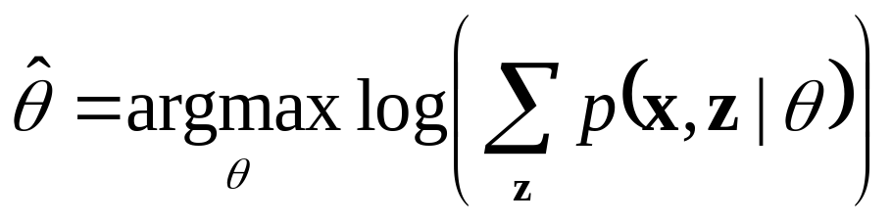
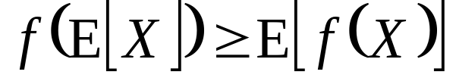
Expectation Maximization (EM) Algorithm
Goal:
Log of sums is intractable
Jensen’s Inequality
for concave functions f(x) such as log(x)
So we maximize the lower bound by maximizing a sum of logs instead of a log of sums!

Slide 32
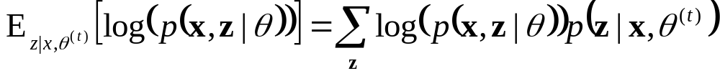
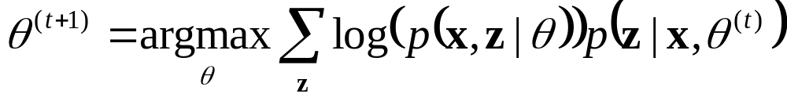
Expectation Maximization (EM) Algorithm
Goal:
E-step: compute
M-step: solve
Notes:
The expectation is a lower bound on the marginal probability of x

Slide 33

Expectation Maximization (EM) Algorithm
log of expectation of p(x|z) over p(z)
Goal:
E-step: compute
M-step: solve
expectation of log of P(x|z) over estimated P(z)
Notes:
The expectation is a lower bound on the marginal probability of x

Slide 34
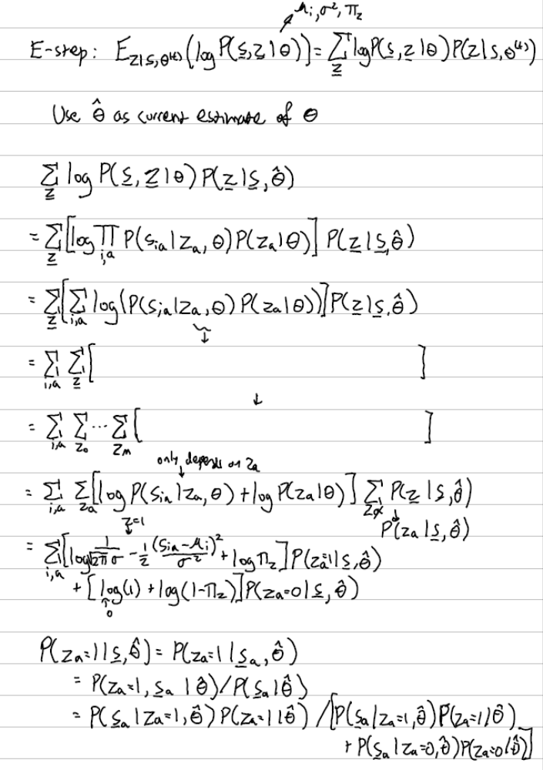
EM for Annotator Problem: E-Step
These sums over all combinations of z and joint probabilities are complicated!
1. Write down the expectation equation
First, let’s expand the joint probabilities

Slide 35
EM for Annotator Problem: E-Step
2. Write joint as product of individual samples
3. Log of product is sum of logs
Now I want to deal with this joint z and complex sum over z

Slide 36
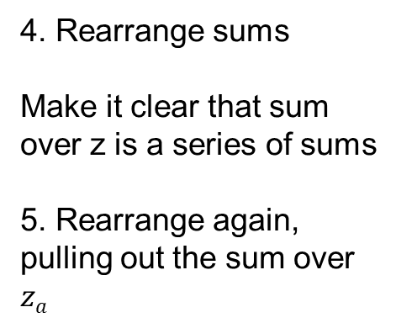
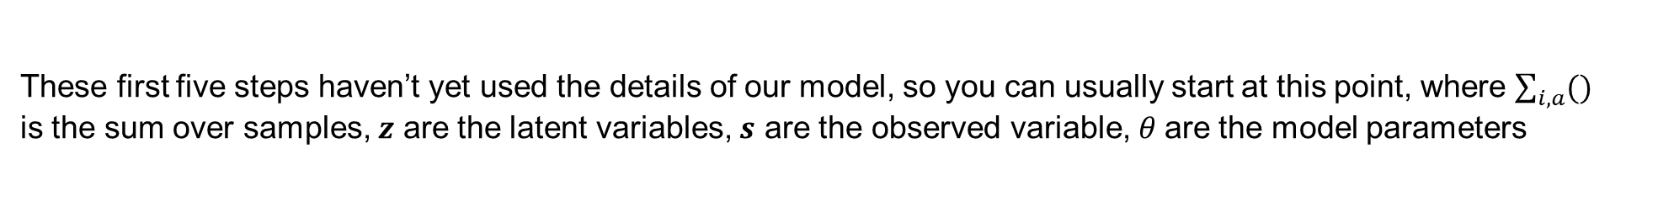
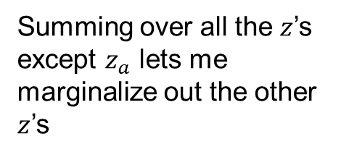
EM for Annotator Problem: E-Step
4. Rearrange sums
Make it clear that sum over z is a series of sums
5. Rearrange again, pulling out the sum over $za$
Summing over all the $z$’s except $z_{a}$ lets me marginalize out the other $z$’s
These first five steps haven’t yet used the details of our model, so you can usually start at this point, where $\sum_{i,a}{()}$ is the sum over samples, $z$ are the latent variables, $s$ are the observed variable, $θ$are the model parameters

Slide 37
EM for Annotator Problem: E-Step
6. Now, plug in the functions for score probabilities of good and bad annotators
And calculate how to get P(z|s), as we did before

Slide 38
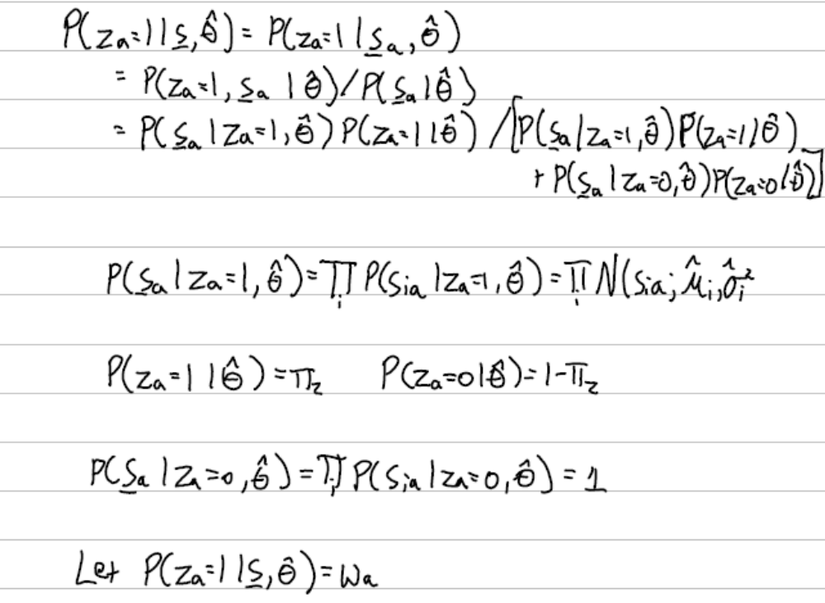
EM for Annotator Problem: E-Step
Writing out the inference computations

Slide 39
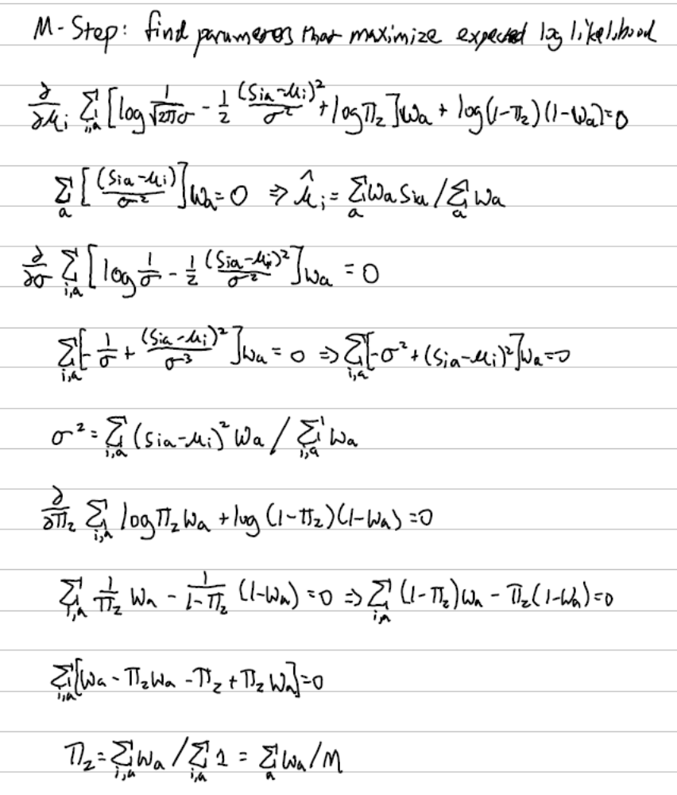
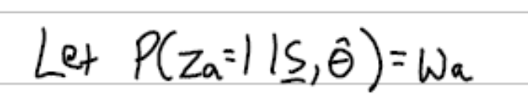



EM for Annotator Problem: M-Step
$$\hat{μ_{i}}$$
Calculate parameters that maximize the expression from the E-step, given our current estimates of P(z|s)
This is very similar to the MLE derivation
$$\hat{σ}$$
$$\hat{π_{z}}$$

Slide 40
EM Annotator Problem Demo
https://colab.research.google.com/drive/1sutnFg-xe-IjgiY8qAJt5USf2MEBZS2L?usp=sharing

Slide 41
EM Algorithm
Maximizes a lower bound on the data likelihood at each iteration
Each step increases the data likelihood
  Converges to local maximum
  Like K-means, you may want to do multiple restarts with random initializations
Common tricks to derivation
  Find terms that sum or integrate to 1
  Lagrange multiplier to deal with constraints
Although the derivation is long, it pretty much always boils down to iteratively
  Estimating likelihood of latent variables given parameters
  Computing estimates of parameters that are weighted by the latent variable likelihoods

Slide 42
Q3-6
https://tinyurl.com/AML441-L9

Slide 43
“Hard EM”
Same as EM except compute z* as most likely values for hidden variables
K-means is an example
Advantages
  Simpler: can be applied when cannot derive EM
  Sometimes works better if you want to make hard predictions at the end
But
  Generally, pdf parameters are not as accurate as EM

Slide 44
What to remember
EM is a widely applicable algorithm to solve for latent variables and parameters that make the observed data likely
While derivation is long and somewhat complicated, the application is simple
We’ll see other examples of EM use in mixture of Gaussian
Estimated scores
(Green = true; red = prediction)
Good annotators: 0, 1, 3

Slide 45
Next class
Estimating probability density functions

