Slide 1
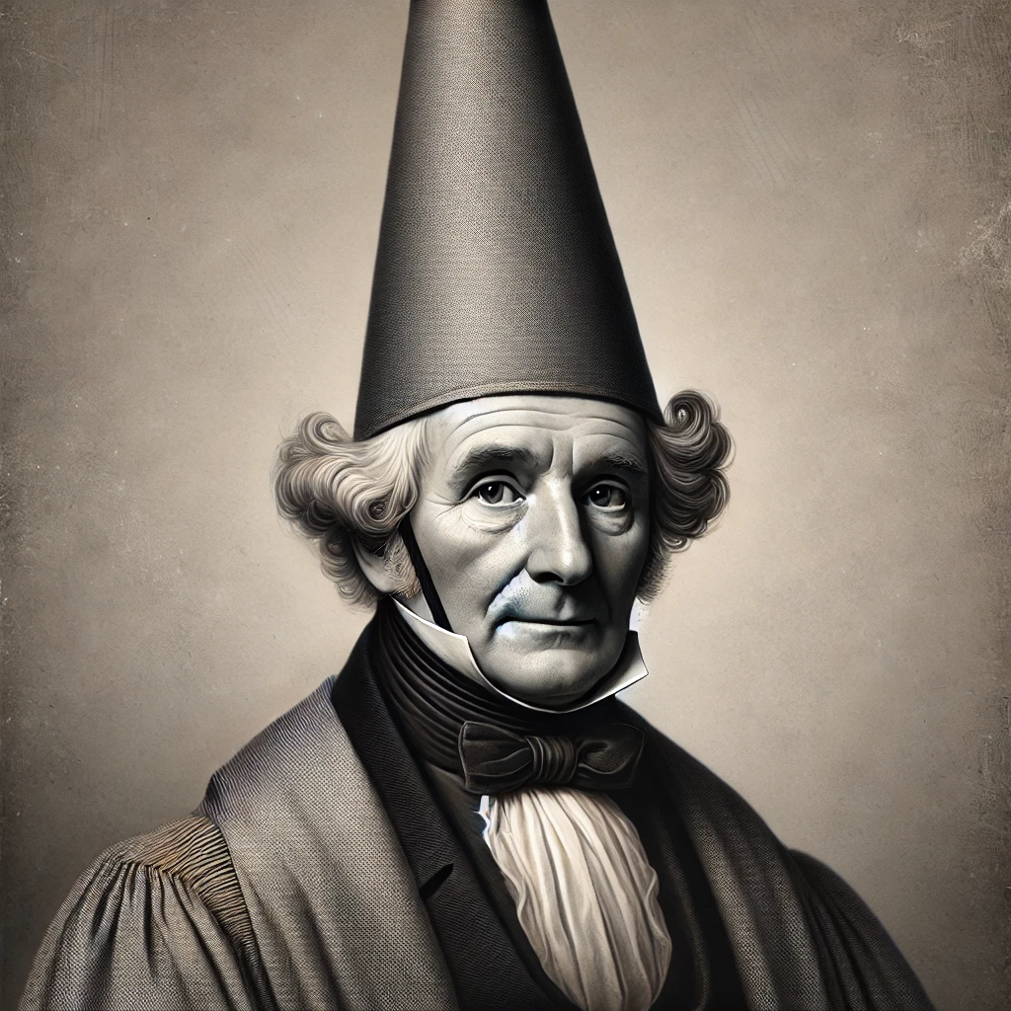
Naïve Bayes Classifier
Applied Machine Learning
Derek Hoiem
Dall-E: portrait of Thomas Bayes with a Dunce Cap on his head

Slide 2
Approaches to classification and regression
We’ve learned about two of the most widely used
  Nearest neighbor
  Linear models
Next, we’ll learn about probabilistic models and trees
Everything else is representation learning

Slide 3
Today’s Lecture
Introduce probabilistic models
Naïve Bayes Classifier
  Assumptions / model
  How to estimate from data
  How to predict given new features
  Cases of discrete and continuous variables
“Semi-naïve Bayes” object detector

Slide 4
What is a probability
A belief, a confidence, a likelihood
“There’s a 60% chance it will rain tomorrow.”
  Based on the information I have, if we were to simulate the future 100 times, I’d expect it to rain 60 of them.
  I think it’s a little more likely to rain than not
You have a 1/18 chance of rolling a 3 with two dice.
  If you roll an infinite number of pairs of dice, 1 out of 18 of them will sum to 3.
Probabilities are expectations, according to some information and assumptions.
  E.g., it will either rain tomorrow or not

Slide 5
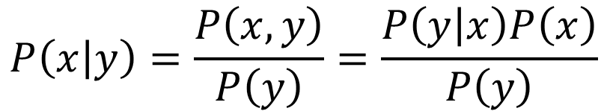
Joint and conditional probability
$$P\left(x,y\right)=P\left(x | y\right)P\left(y\right)=P\left(y | x\right)P(x)$$
$$P\left(a,b,c\right)=P\left(a | b,c\right)P\left(b | c\right)P(c)$$
$$P\left(x | y\right)=\frac{P\left(x,y\right)}{P\left(y\right)}=\frac{P\left(y | x\right)P\left(x\right)}{P\left(y\right)}$$
Bayes Rule:

Slide 6
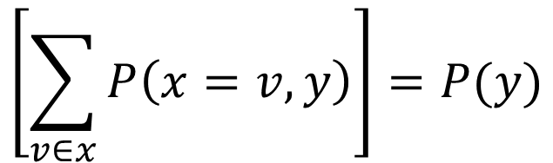
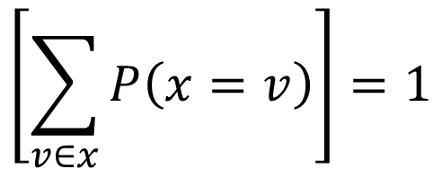
$$\left[\sum_{v∈x}{P\left(x=v\right)}\right]=1$$
Law of total probability
$$\left[\sum_{v∈x}{P\left(x=v,y\right)}\right]=P(y)$$
Marginalization
For continuous variables, replace sum over possible values with integral over domain

Slide 7
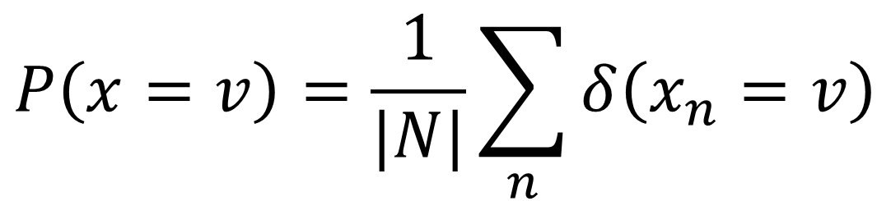
Estimate probabilities of discrete variables by counting
$$P\left(x=v\right)=\frac{1}{|N|}\sum_{n}{δ\left(x_{n}=v\right)}$$

Slide 8
Example
Rained
1
0
0
0
1
0
0
1
P(rains) = ?

Slide 9
Example
Rained
1
0
0
0
1
0
0
1
P(rains) = 3/8

Slide 10

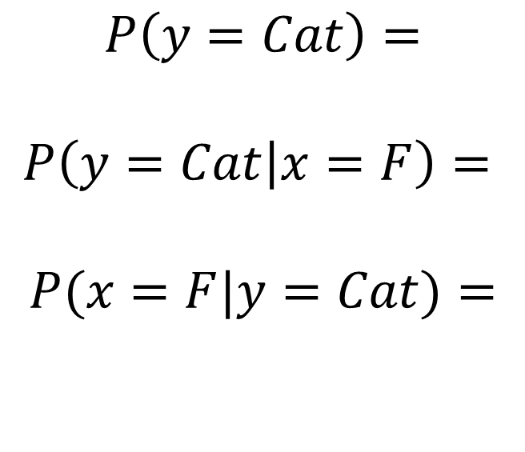

Example, converting counts to probabilities
$x$:
Larger than 10 lbs?
 | F | T
Cat | 15 | 25
Dog | 5 | 40
$$P\left(y=Cat\right)=$$
$$P\left(y=Cat | x=F\right)=$$
$$P(x=F|y=Cat)=$$
$$y$$

Slide 11
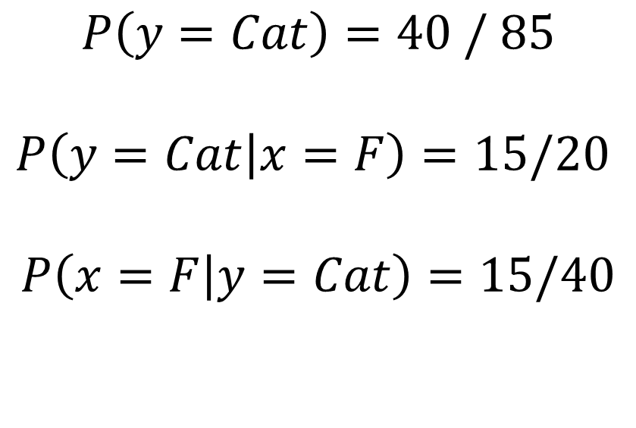
Example
$x$:
Larger than 10 lbs?
 | F | T
Cat | 15 | 25
Dog | 5 | 40
$$P\left(y=Cat\right)=\text{40 / 85}$$
$$P\left(y=Cat | x=F\right)=15/20$$
$$P\left(x=F | y=Cat\right)=15/40$$
$$y$$

Slide 12
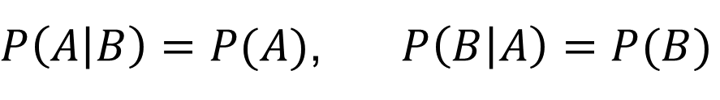

A is independent of B if (and only if)
$$P\left(A,B\right)=P\left(A\right)P\left(B\right)$$
$P\left(A | B\right)=P(A)$, $P\left(B | A\right)=P(B)$

Slide 13
What if you have 100 variables? How can you count all combinations?
Fully modeling dependencies between many variables (more than 3 or 4) is challenging and requires a lot of data

Slide 14
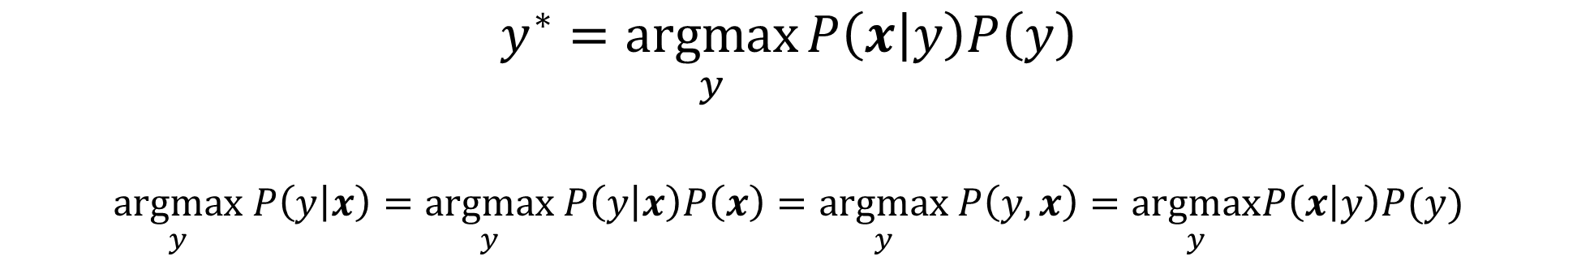
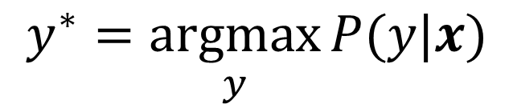
Probabilistic model
$$y^{∗}=\underset{y}{argmax}{P(y|x)}$$
Or equivalently…
$$y^{∗}=\underset{y}{argmax}{P\left(x | y\right)P\left(y\right)}$$
$$\underset{y}{argmax} P\left(y | x\right)=\underset{y}{argmax} P\left(y | x\right)P\left(x\right)=\underset{y}{argmax} P\left(y,x\right)=\underset{y}{argmax}P\left(x | y\right)P(y)$$

Slide 15
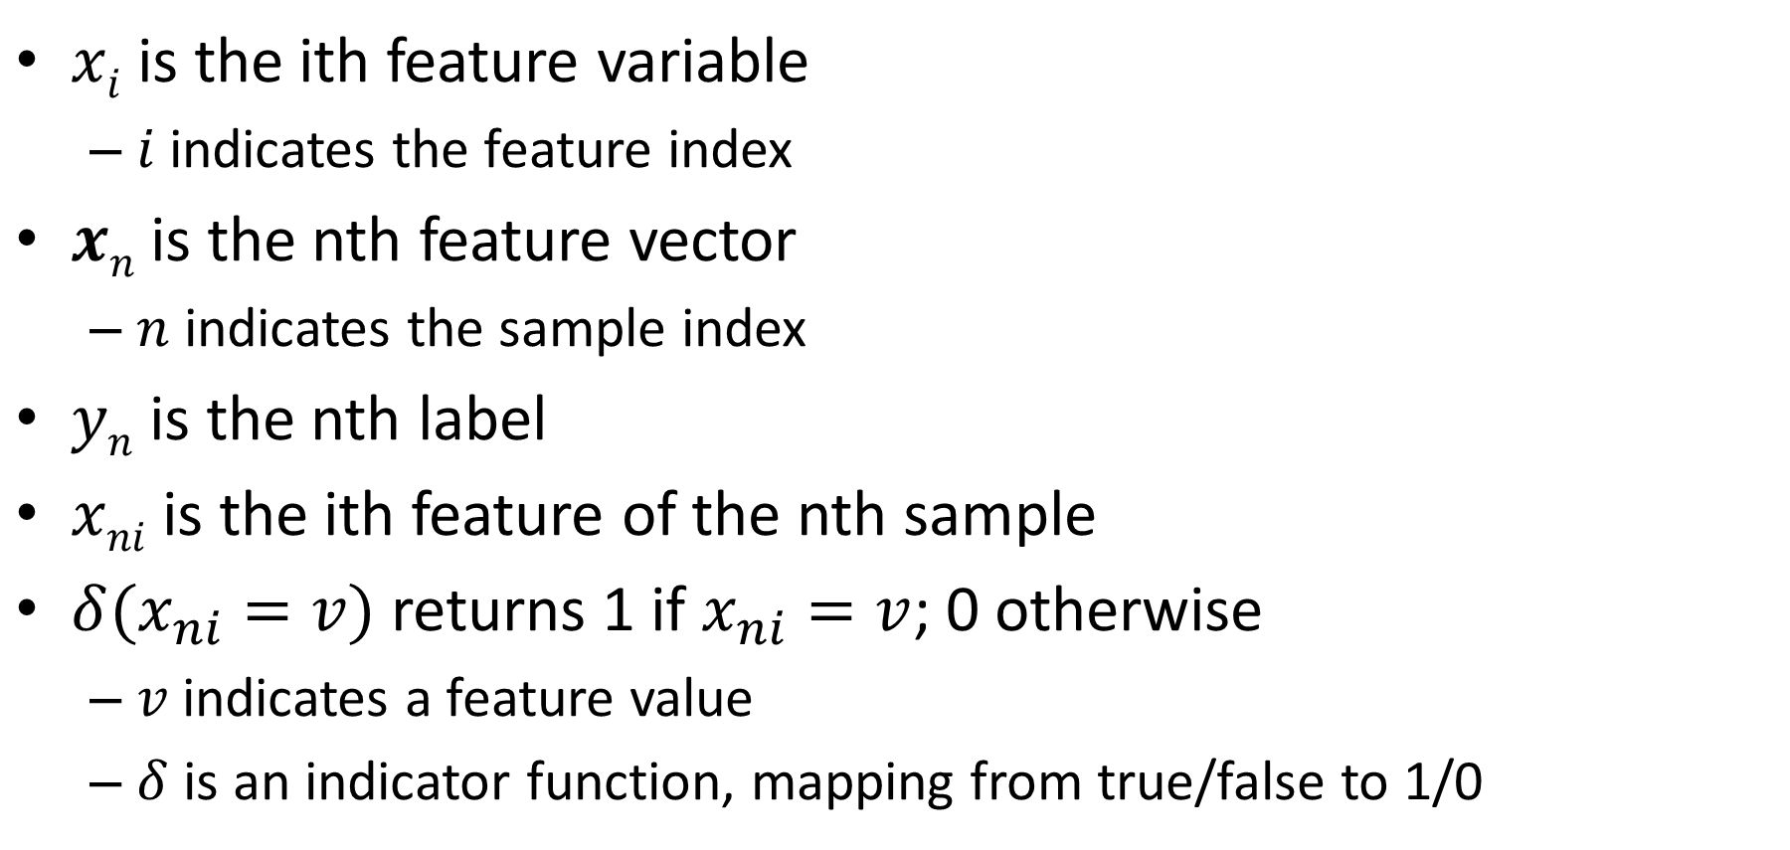
Notation
$xi$ is the ith feature variable
  $i$ indicates the feature index
$xn$ is the nth feature vector
  $n$ indicates the sample index
$yn$ is the nth label
$xni$ is the ith feature of the nth sample
$δ(x_{ni}=v)$ returns 1 if $x_{ni}=v$; 0 otherwise
  $v$ indicates a feature value
  $δ$ is an indicator function, mapping from true/false to 1/0

Slide 16
https://www.kaggle.com/datasets/uciml/sms-spam-collection-dataset
Suppose you want to classify whether a text message is spam
ham
Go until jurong point, crazy.. Available only in bugis n great world la e buffet... Cine there got a...
ham
Ok lar... Joking wif u oni...
spam
Free entry in 2 a wkly comp to win FA Cup final tkts 21st May 2005. Text FA to 87121 to receive entr...
ham
U dun say so early hor... U c already then say...
ham
Nah I don't think he goes to usf, he lives around here though
spam
FreeMsg Hey there darling it's been 3 week's now and no word back! I'd like some fun you up for it s...

Slide 17
https://www.kaggle.com/datasets/uciml/sms-spam-collection-dataset
Suppose you want to classify whether a text message is spam or not
P(“Ok lar... Joking wif u oni...”) probably is 0 in the training set because you might not get exactly the same message twice
How to model?

Slide 18

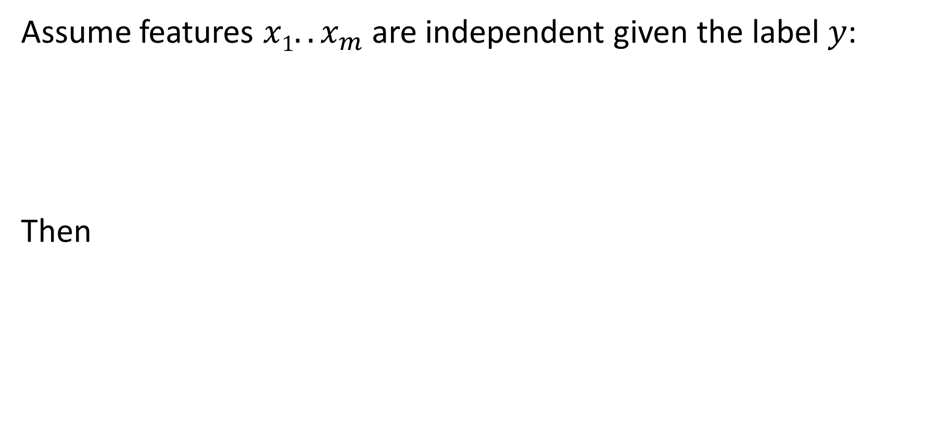
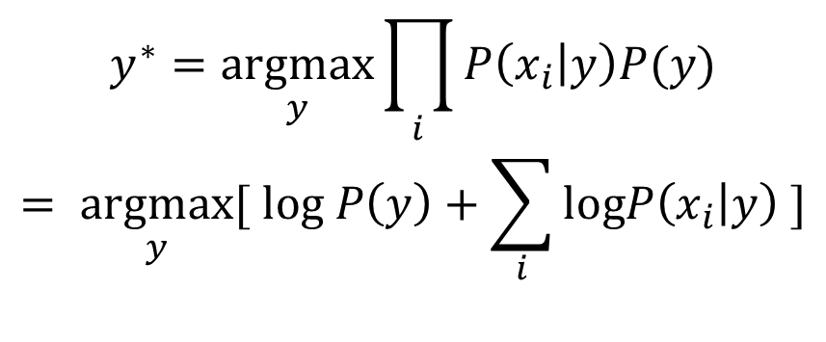
Naïve Bayes Model
Assume features $x1..x_{m}$are independent given the label $y$:
Then
$$P\left(x | y\right)=\prod_{i}{P(x_{i}|y)}$$
$$y^{∗}=\underset{y}{argmax}{\prod_{i}{P\left(x_{i} | y\right)P(y)}}$$
$$= \underset{y}{argmax}{[ log P\left(y\right)+\sum_{i}{logP\left(x_{i} | y\right) }]}$$

Slide 19
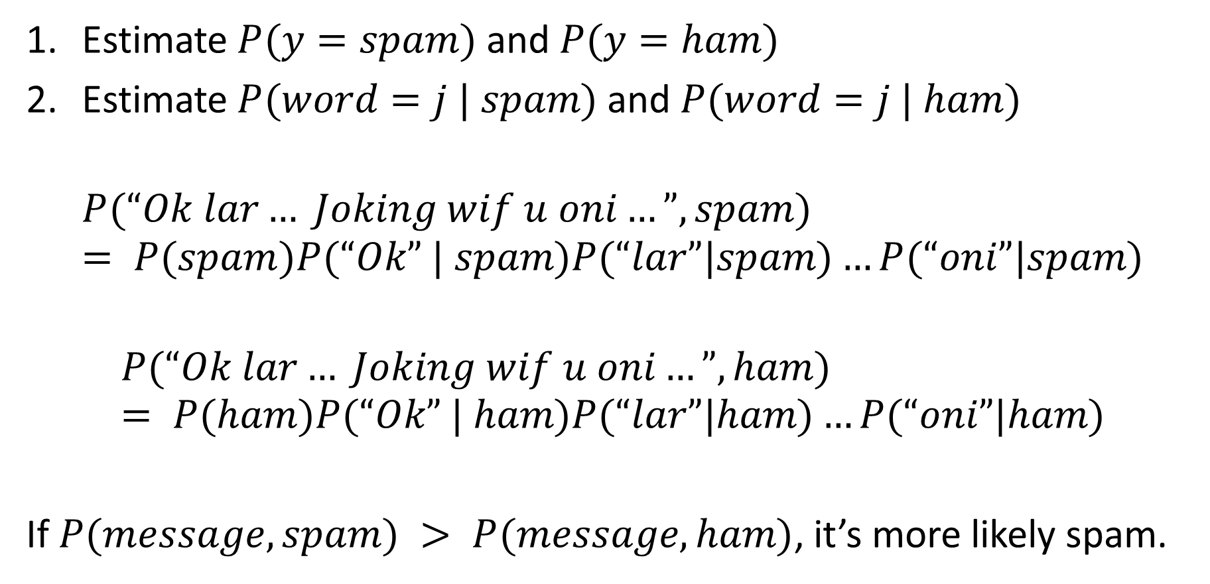
Naïve Bayes Classifier
https://www.kaggle.com/datasets/uciml/sms-spam-collection-dataset
Estimate $P(y=spam)$and $P(y=ham)$
Estimate $P(word=j | spam)$and $P(word=j | ham)$
$$P(“Ok lar… Joking wif u oni…”, spam) = P(spam)P(“Ok” | spam)P(“lar”|spam)…P(“oni”|spam)$$
$$P(“Ok lar… Joking wif u oni…”, ham) = P(ham)P(“Ok” | ham)P(“lar”|ham)…P(“oni”|ham)$$
If $P(message, spam) > P(message, ham)$, it’s more likely spam.

Slide 20

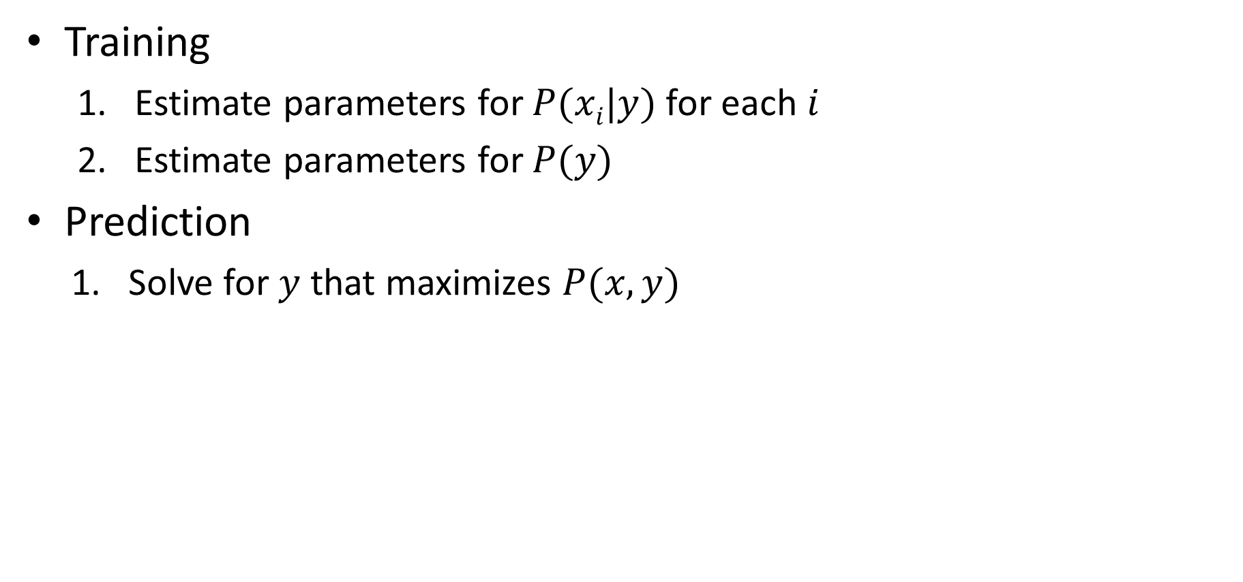
Naïve Bayes Algorithm
Training
  Estimate parameters for $P(xi|y)$for each $i$
  Estimate parameters for $P(y)$
Prediction
  Solve for $y$ that maximizes $P(x,y)$
$$y^{∗}=\underset{y}{argmax}{\prod_{i}{P\left(x_{i} | y\right)P(y)}}$$

Slide 21

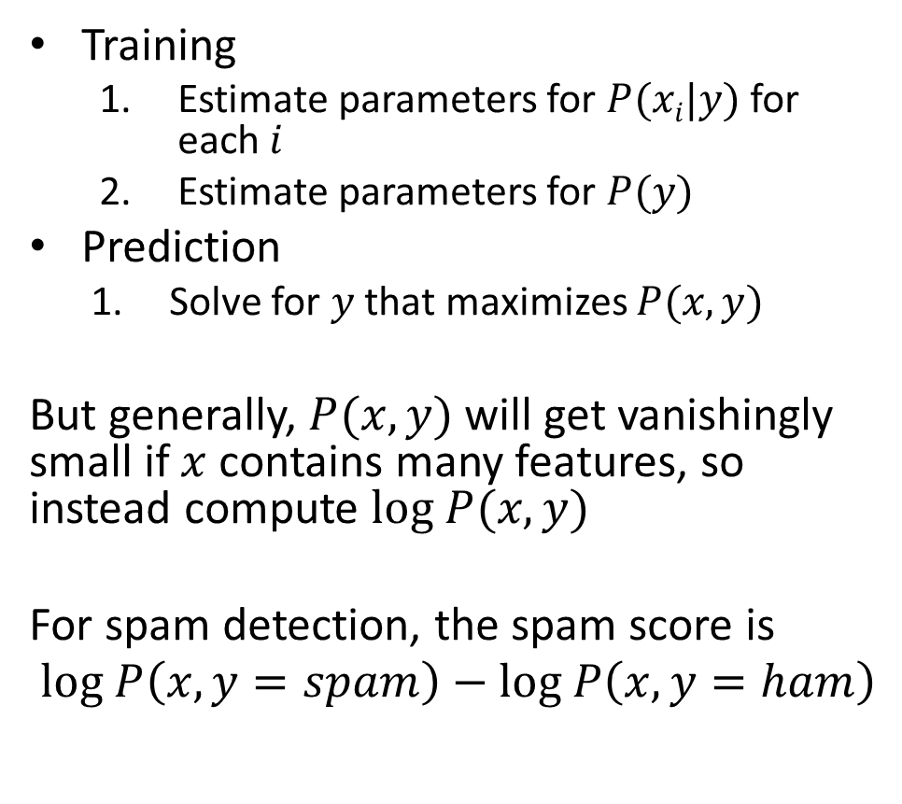
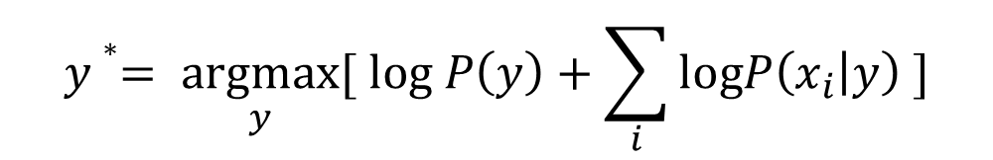
Naïve Bayes Algorithm
Training
  Estimate parameters for $P(xi|y)$for each $i$
  Estimate parameters for $P(y)$
Prediction
  Solve for $y$ that maximizes $P(x,y)$
But generally, $P(x,y)$ will get vanishingly small if $x$ contains many features, so instead compute $log P(x,y)$
For spam detection, the spam score is
$$log P\left(x,y=spam\right)−log P\left(x,y=ham\right)$$
$$y^{∗}=\underset{y}{argmax}{\prod_{i}{P\left(x_{i} | y\right)P(y)}}$$
$$y∗= \underset{y}{argmax}{[ log P\left(y\right)+\sum_{i}{logP\left(x_{i} | y\right) }]}$$

Slide 22
How to estimate $P(xi|y)$from data?
  MLE (maximum likelihood estimation): Choose the parameter that maximizes the likelihood of the data
  MAP (maximum a priori): Choose the parameter that maximizes the data likelihood and its own prior

Slide 23
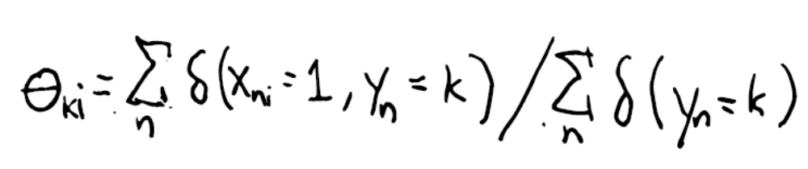
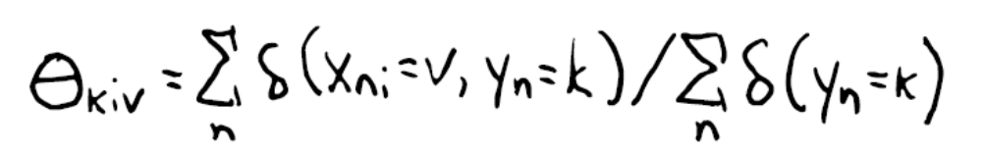
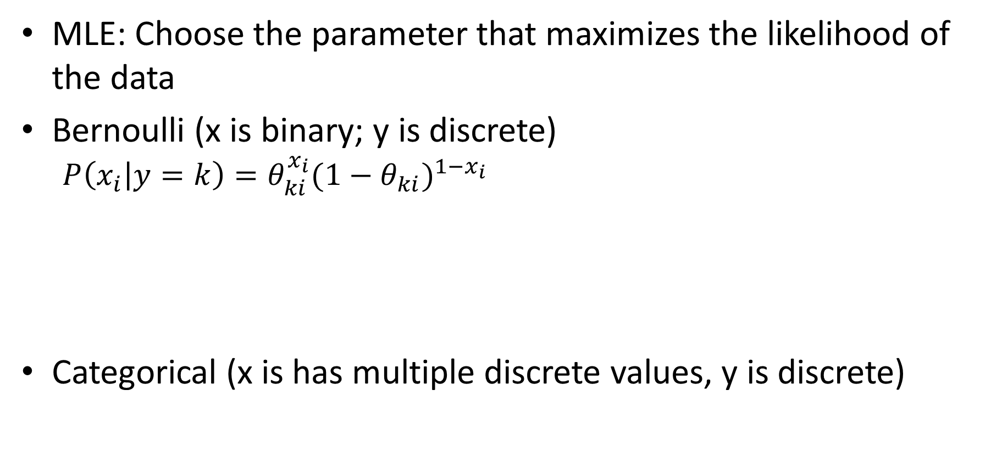
MLE (maximum likelihood estimation)
MLE: Choose the parameter that maximizes the likelihood of the data
Bernoulli (x is binary; y is discrete)
  $$P\left(x_{i} | y=k\right)=θ_{ki}^{x_{i}}{{(1−θ}_{ki})}^{1−x_{i}}$$
Categorical (x is has multiple discrete values, y is discrete)
theta_ki[k,i] = np.sum((X[:,i]==1) & (y==k)) / np.sum(y==k)
theta_kiv[k,i,v] = np.sum((X[:,i]==v) & (y==k)) / (np.sum(y==k))

Slide 24
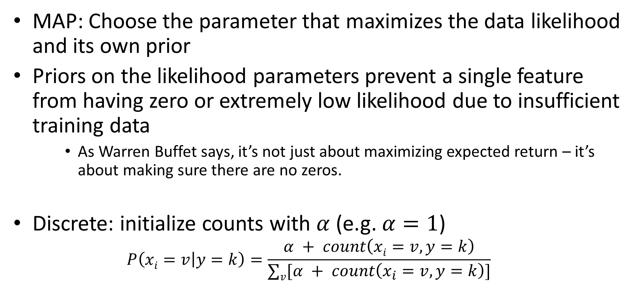
Priors and MAP (maximum a priori)
MAP: Choose the parameter that maximizes the data likelihood and its own prior
Priors on the likelihood parameters prevent a single feature from having zero or extremely low likelihood due to insufficient training data
    As Warren Buffet says, it’s not just about maximizing expected return – it’s about making sure there are no zeros.
Discrete: initialize counts with $α$ (e.g. $α=1$)
  $$P\left(xi=v | y=k\right)=\frac{α + count\left(xi=v, y=k\right)}{∑v[α + count\left(x_{i}=v, y=k\right)]}$$
theta_kiv[k,i,v] = (np.sum((X[:,i]==v) & (y==k))+alpha) / (np.sum(y==k)+alpha*num_v)

Slide 25
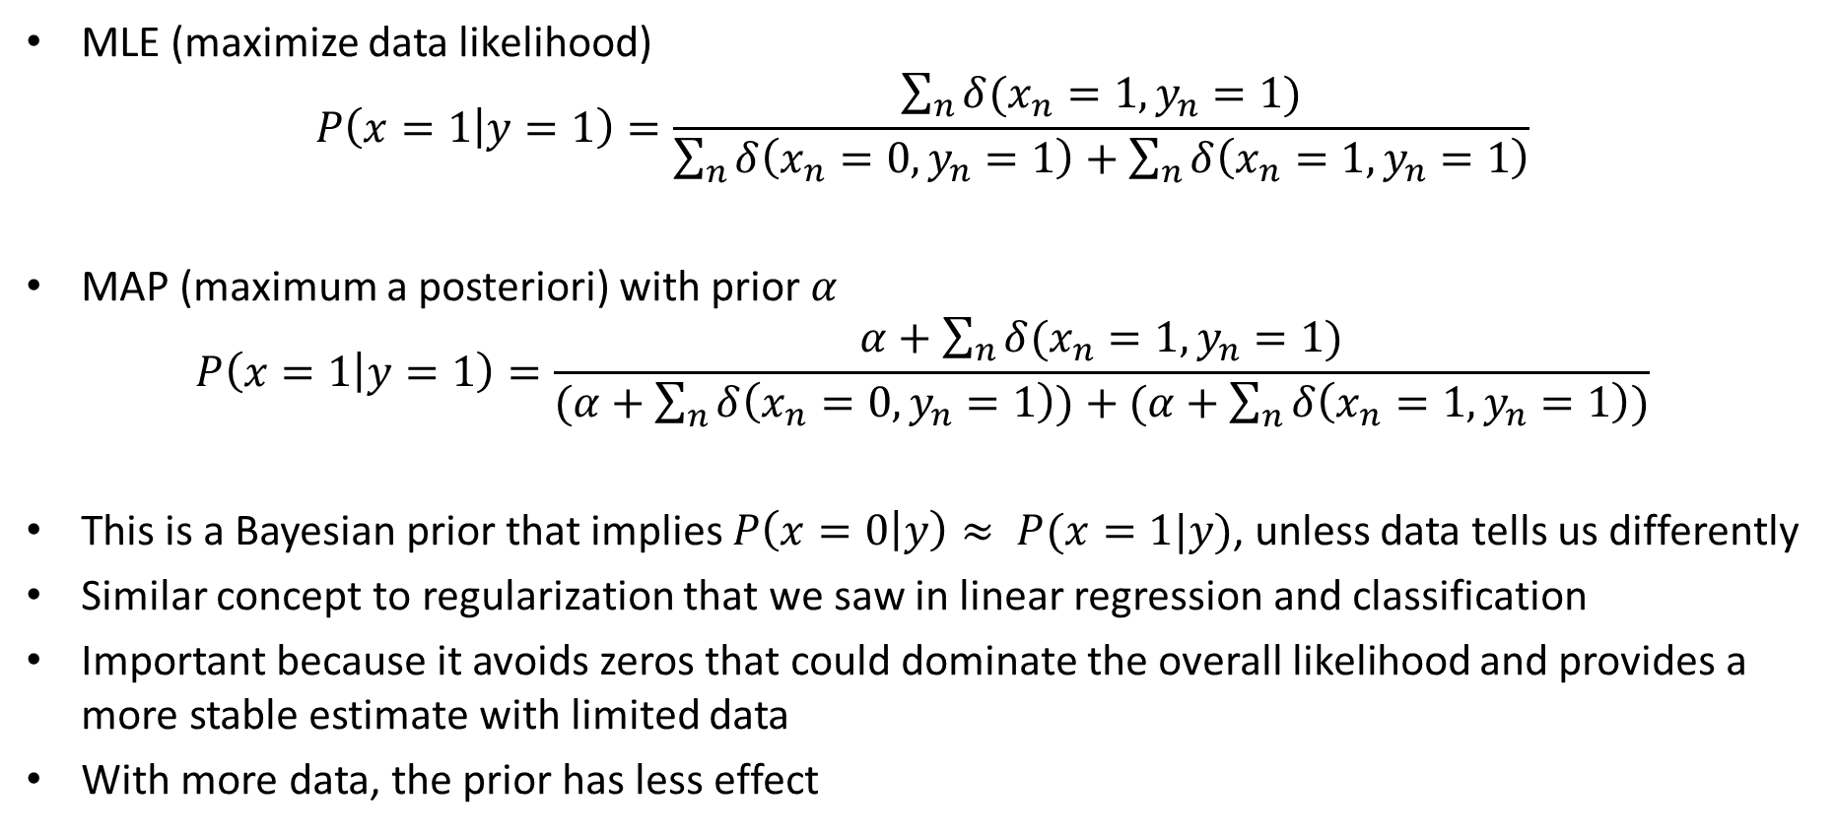
MLE and MAP estimates of binary variable likelihoods
MLE (maximize data likelihood)
$$P\left(x=1 | y=1\right)=\frac{\sum_{n}{δ(x_{n}=1,y_{n}=1)}}{\sum_{n}{δ\left(x_{n}=0,y_{n}=1\right)+\sum_{n}{δ\left(x_{n}=1,y_{n}=1\right)}}}$$
MAP (maximum a posteriori) with prior $α$
$$P\left(x=1 | y=1\right)=\frac{α+\sum_{n}{δ(x_{n}=1,y_{n}=1)}}{(α+\sum_{n}{δ\left(x_{n}=0,y_{n}=1\right))+(α+\sum_{n}{δ\left(x_{n}=1,y_{n}=1\right)})}}$$
This is a Bayesian prior that implies $P\left(x=0 | y\right)≈ P(x=1|y)$, unless data tells us differently
Similar concept to regularization that we saw in linear regression and classification
Important because it avoids zeros that could dominate the overall likelihood and provides a more stable estimate with limited data
With more data, the prior has less effect

Slide 26

Q1-Q3
https://tinyurl.com/AML441-L8r

Slide 27
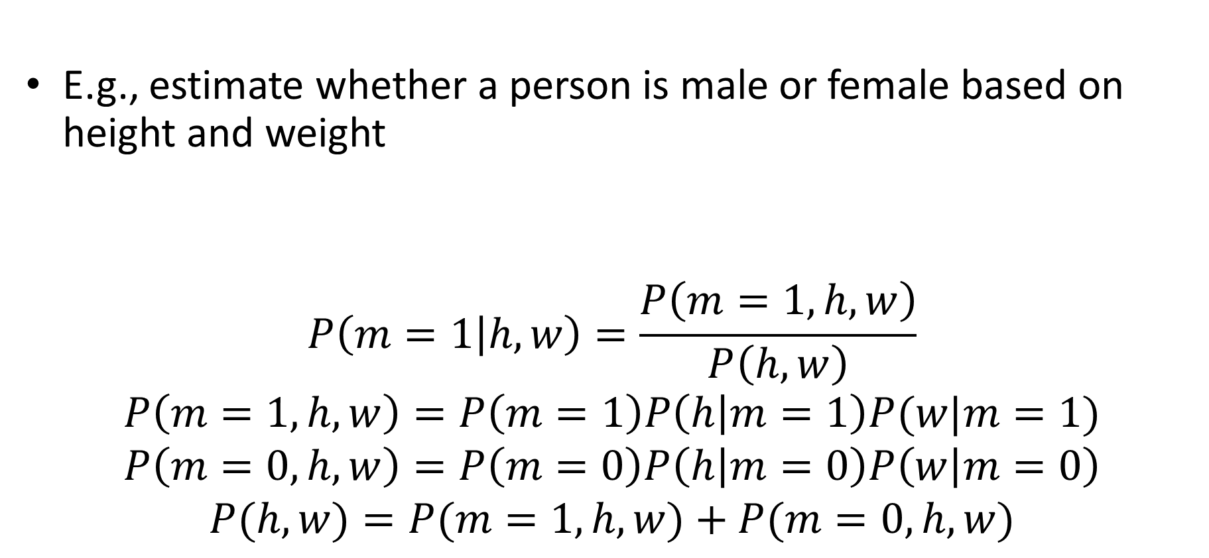
What if $x$ is continuous? Can we still use Naïve Bayes?
E.g., estimate whether a person is male or female based on height and weight
$$P\left(m=1 | h,w\right)=\frac{P\left(m=1,h,w\right)}{P\left(h,w\right)}$$
$$P\left(m=1,h,w\right)=P\left(m=1\right)P\left(h | m=1\right)P(w|m=1)$$
$$P\left(m=0,h,w\right)=P\left(m=0\right)P\left(h | m=0\right)P\left(w | m=0\right)$$
$$P(h,w)=P(m=1,h,w)+P(m=0,h,w)$$

Slide 28
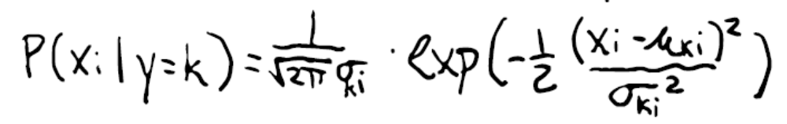
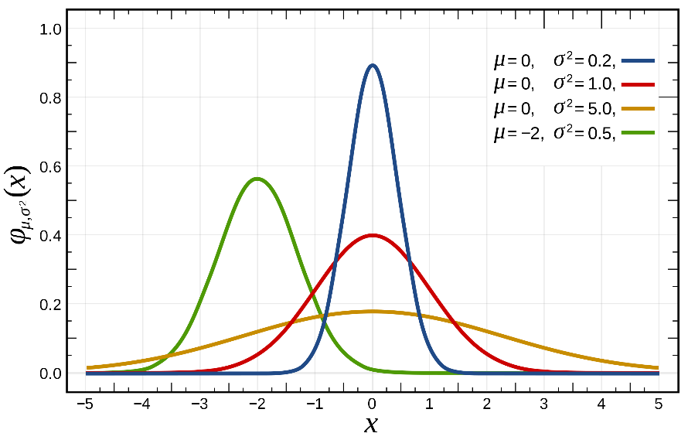
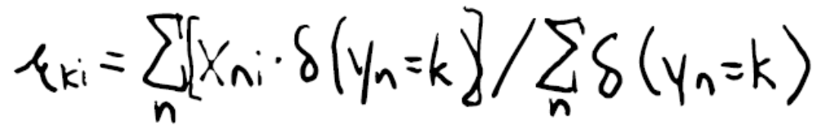
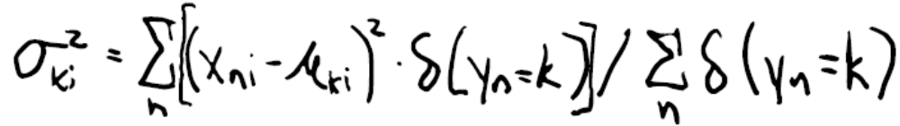
Suppose $x_{i}$ is Gaussian, and y is discrete
mu[k,i] = np.mean(X[y==k,i], axis=0)
sigma[k, i] = np.std(X[y==k,i], axis=0)

Slide 29
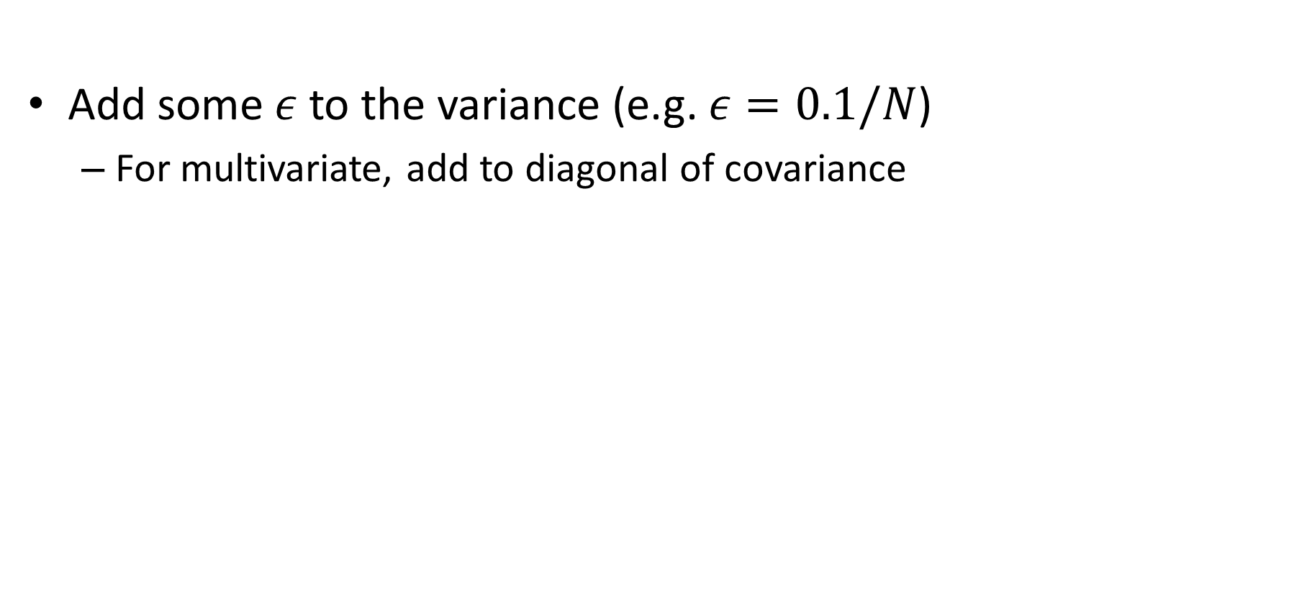
Prior for Gaussian distributions
Add some $ε$ to the variance (e.g. $ε=0.1/N$)
  For multivariate, add to diagonal of covariance
sigma[k, i] = np.std(X[y==k,i], axis=0) + np.sqrt(0.1/len(X))

Slide 30
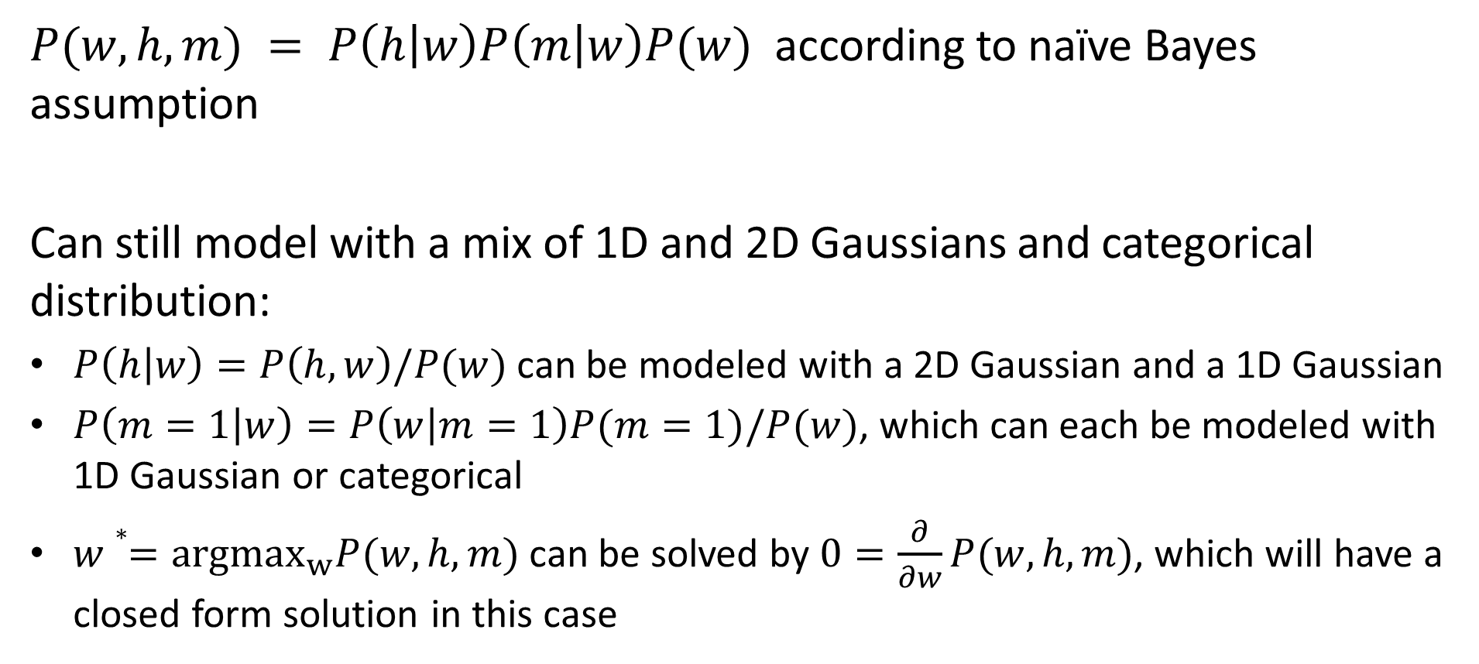
Suppose we want to predict weight $w$ given height $h$ and sex $m$?
$P(w, h, m) = P\left(h | w\right)P\left(m | w\right)P(w)$ according to naïve Bayes assumption
Can still model with a mix of 1D and 2D Gaussians and categorical distribution:
$P\left(h | w\right)=P\left(h,w\right)/P(w)$can be modeled with a 2D Gaussian and a 1D Gaussian
$P\left(m=1 | w\right)=P\left(w | m=1\right)P(m=1)/P(w)$, which can each be modeled with 1D Gaussian or categorical
$w∗=argmax_{w}P(w, h, m)$ can be solved by $0=\frac{∂}{∂w}P(w,h,m)$, which will have a closed form solution in this case

Slide 31
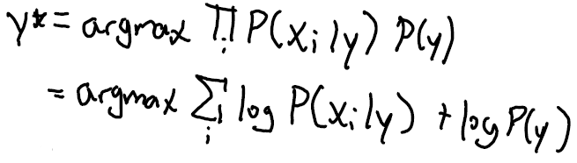
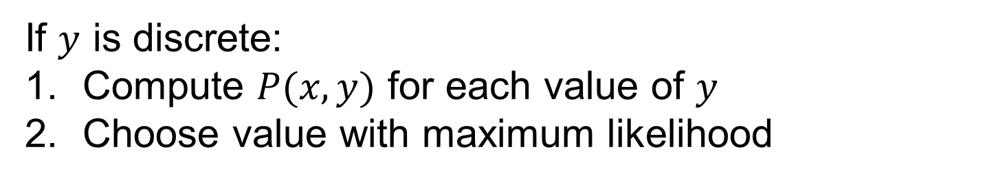
How to predict y from x?
If $y$ is discrete:
Compute $P(x,y)$ for each value of $y$
Choose value with maximum likelihood
Turning product into sum of logs is an important frequently used trick for argmax/argmin!

Slide 32
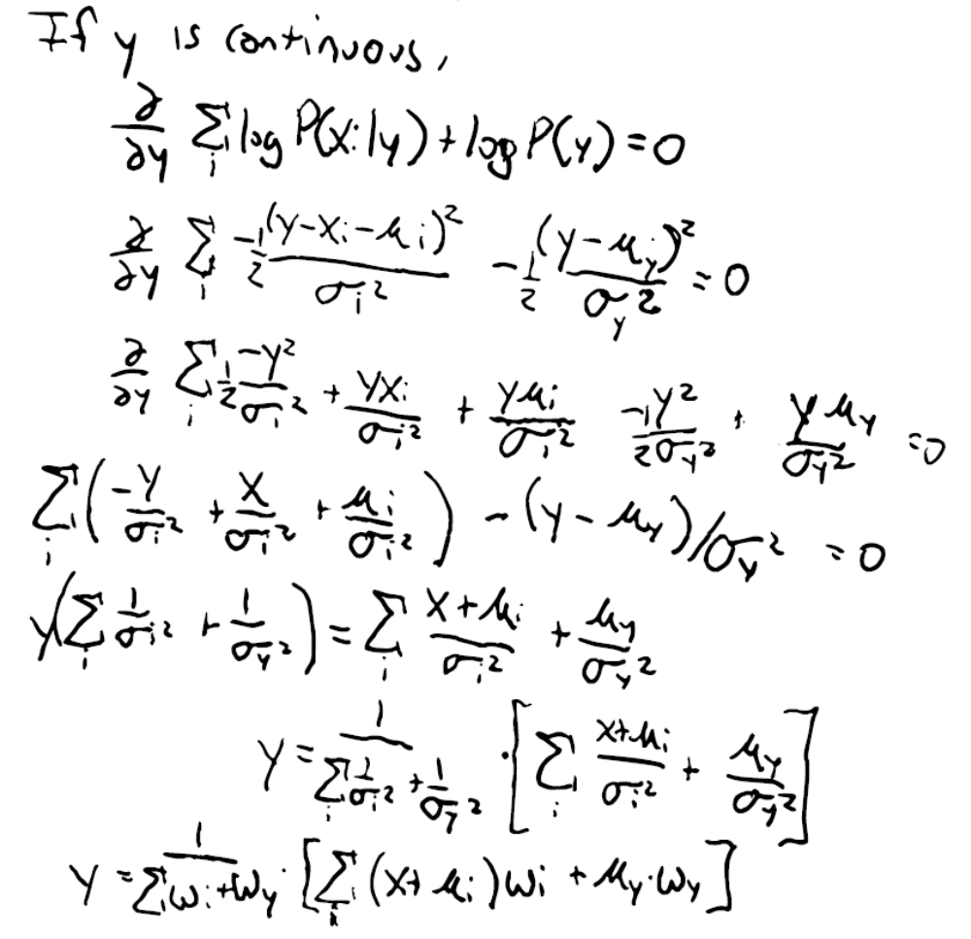
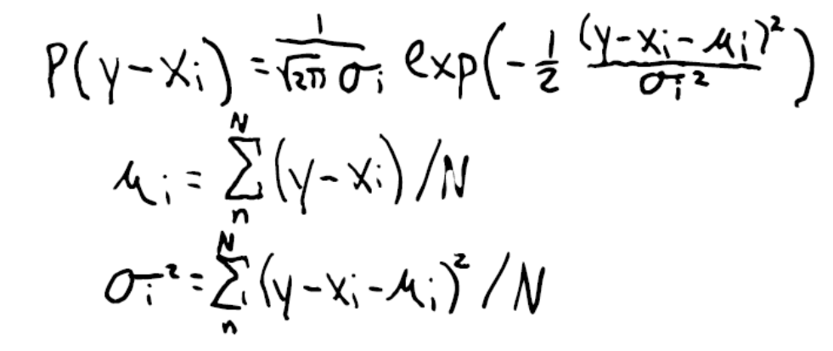

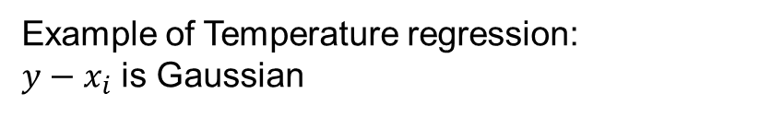
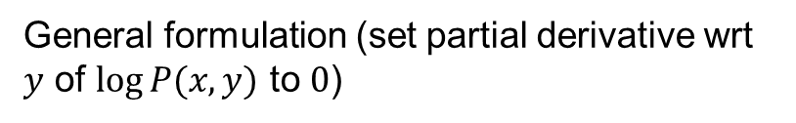
How to predict $y$ from $x$ when $(y−x_{i})$ is Gaussian
General formulation (set partial derivative wrt $y$ of $log⁡P(x,y)$ to $0$)
Example of Temperature regression:
$y−x_{i}$ is Gaussian
$$P\left(x_{i} | y\right)\sim N\left(y−x_{i},σ^{2}\right)=$$
Prediction is weighted average of means, where weights are inverse variance

Slide 33
Q4-Q6
https://tinyurl.com/AML441-L8r

Slide 34
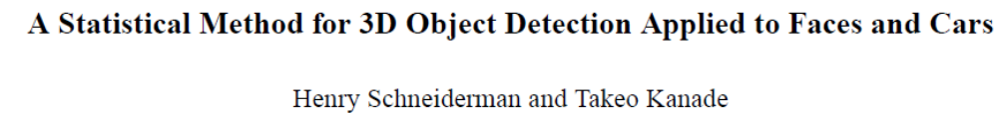
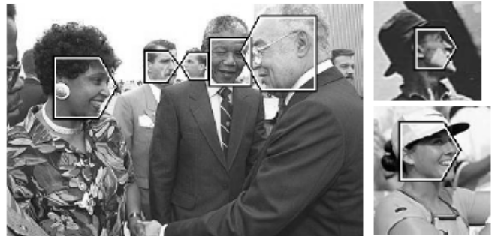
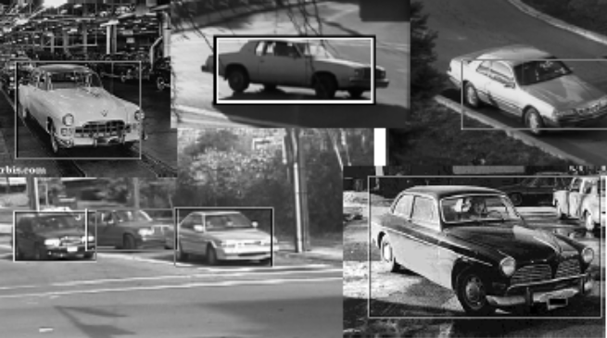
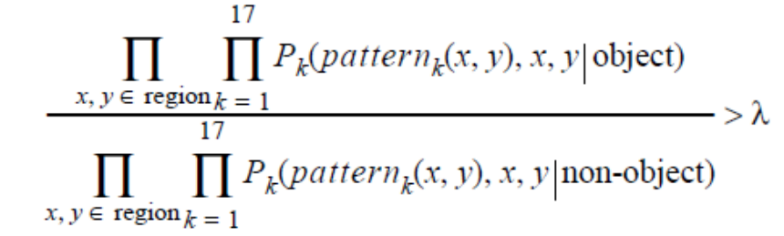
Use case: “Semi-naïve Bayes” object detection
Best performing face/car detector in 2000-2005
Model probabilities of small groups of features (wavelet coefficients)
Search for groupings, discretize features, estimate parameters
https://www.cs.cmu.edu/afs/cs.cmu.edu/user/hws/www/CVPR00.pdf

Slide 35
Naïve Bayes Summary
Key Assumptions
  Features are independent, given the labels
Model Parameters
  Parameters of probability functions P(x_{i}|y) and P(y)
Designs
  Choice of probability function
When to Use
  Limited training data
  Features are not highly interdependent
  Want something fast to code, train, and test
When Not to Use
  Logistic or linear regression will usually work better if there is sufficient data (more flexible / fewer assumptions than Naïve Bayes)
  Does not provide a good confidence estimate because it “overcounts” influence of dependent variables

Slide 36
Naïve Bayes
Pros
  Easy and fast to train
  Fast inference
  Can be used with continuous, discrete, or mixed features
Cons
  Does not account for feature interactions
  Does not provide good confidence estimate
Notes
  Best when used with discrete variables, variables that are well fit by Gaussian, or kernel density estimation

Slide 37
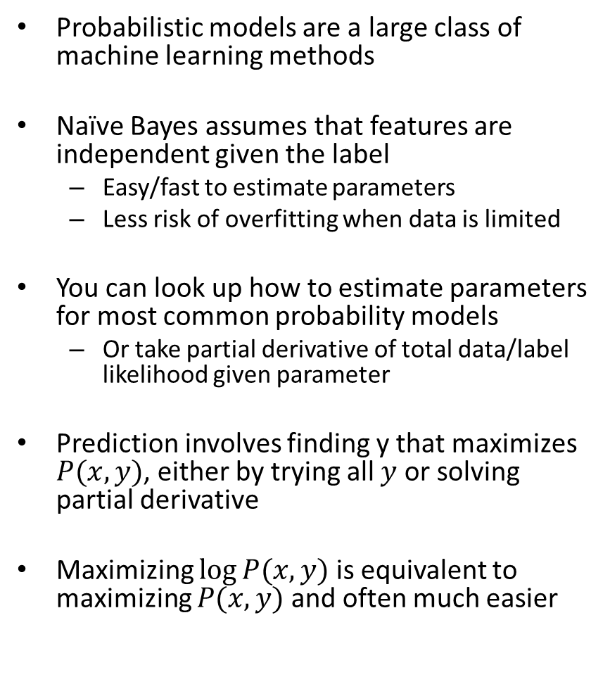
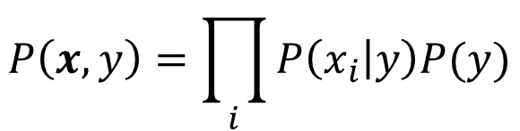
Things to remember
Probabilistic models are a large class of machine learning methods
Naïve Bayes assumes that features are independent given the label
  Easy/fast to estimate parameters
  Less risk of overfitting when data is limited
You can look up how to estimate parameters for most common probability models
  Or take partial derivative of total data/label likelihood given parameter
Prediction involves finding y that maximizes $P(x,y)$, either by trying all $y$ or solving partial derivative
Maximizing $log⁡P(x,y)$ is equivalent to maximizing $P(x,y)$ and often much easier
$$P\left(x,y\right)=\prod_{i}{P\left(x_{i} | y\right)P(y)}$$

Slide 38
Next week
EM and Density Estimation

