Slide 1
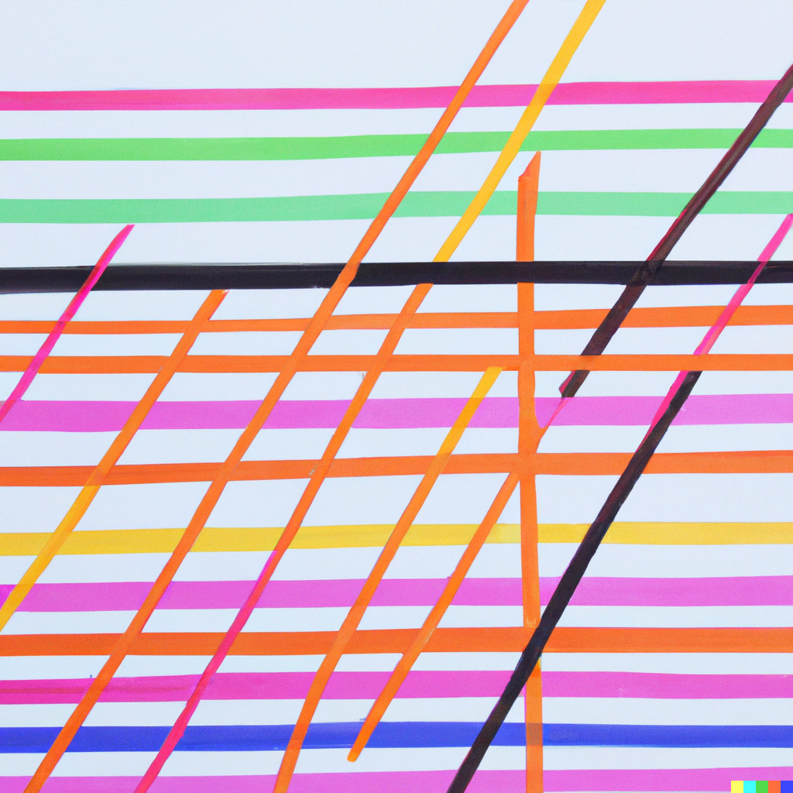
Linear Classifiers: Logistic Regression and SVM
Applied Machine Learning
Derek Hoiem
Dall-E

Slide 2
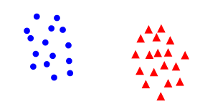

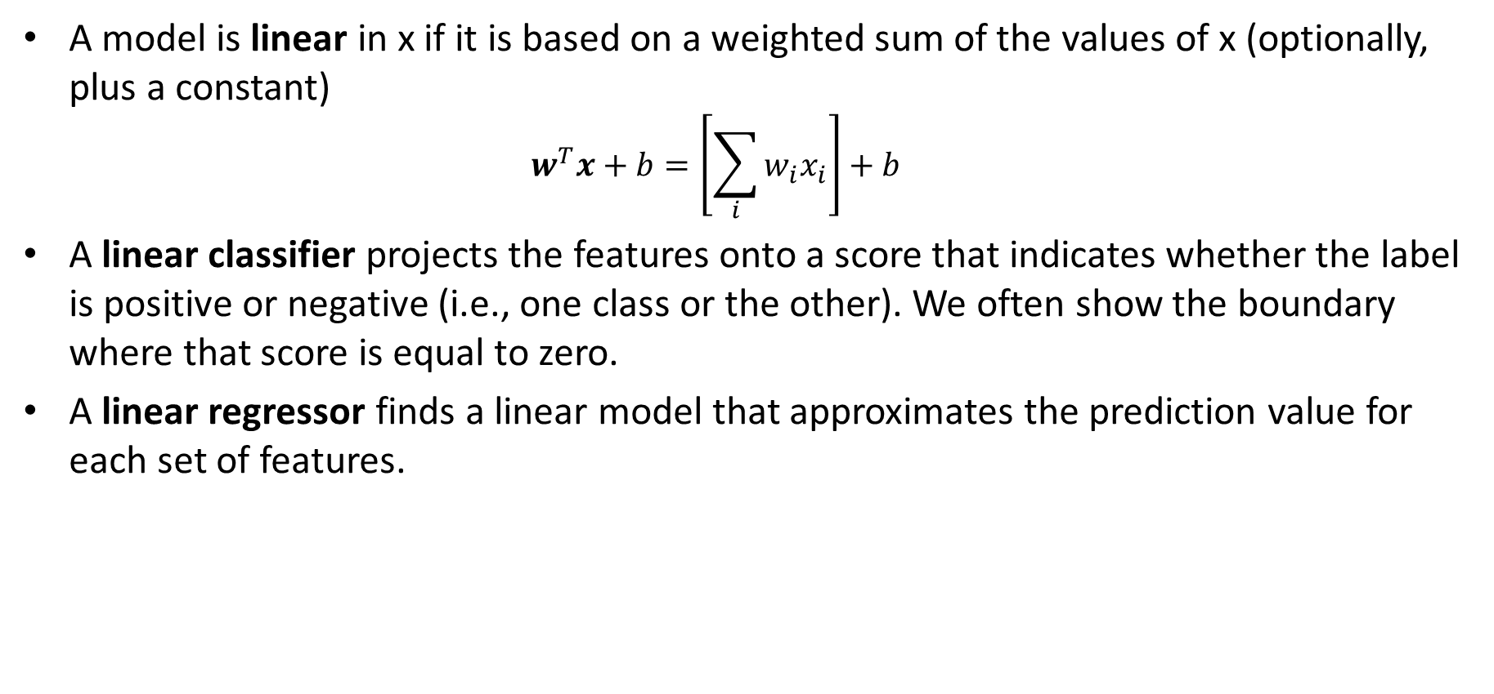

Linear Models
A model is linear in x if it is based on a weighted sum of the values of x (optionally, plus a constant)
  $$w^{T}x+b=\left[\sum_{i}{w_{i}x_{i}}\right]+b$$
A linear classifier projects the features onto a score that indicates whether the label is positive or negative (i.e., one class or the other). We often show the boundary where that score is equal to zero.
A linear regressor finds a linear model that approximates the prediction value for each set of features.
.
.
.
Target ($y$)
.
$$y=w^{T}x+b$$
$$score\left(y=1\right)=w^{T}x+b$$
Feature ($x$)
$w^{T}x+b$=0

Slide 3
Today’s Lecture
Linear logistic regression: maximize likelihood of target labels given the features
SVM: maximize the number of data points with confidently correct predictions

Slide 4
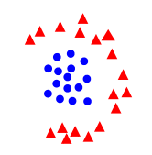

Linear Classifiers and Linear Separability
Linear classifier: $y=1 if w^{T}x+b>0$
Linearly separable: a line (or hyperplane) in feature space can split the two labels
Which of these are linearly separable?

Slide 5
Linear Classifiers and Linear Separability
In high dimensions, a lot more things are linearly separable
If you have D dimensions, you can separate D+1 points with any arbitrary labeling
1D
2D
x
o
Separable
Not Separable
Separable
o
x
o
x
Not Separable
o
x
o
x
o
o

Slide 6
Linear Classifiers and Linear Separability
But how do you choose which line is best?
Different classifiers use different objectives to choose the line

Slide 7
Linear Classifiers and Linear Separability
Different classifiers use different objectives to choose the line
Common principles are that you want training samples on the correct side of the line (low classification error) by some margin (high confidence)
Thick line is better classification function than thin line because all the examples have a good margin

Slide 8
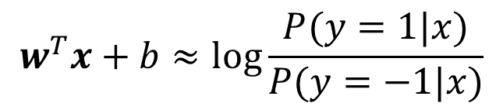
Linear Logistic Regression
Regress probability by modeling the log odds ratio with a linear function of the features
P(circle|x) is higher
P(triangle|x) is higher
$$w^{T}x+b≈\log{\frac{P(y=1|x)}{P(y=−1|x)}}$$
Why model the log odds ratio instead of the probability directly?
Infinite range
0 = neutral prediction
P(circle|x)=P(triangle|x) on the line

Slide 9
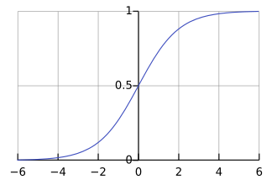
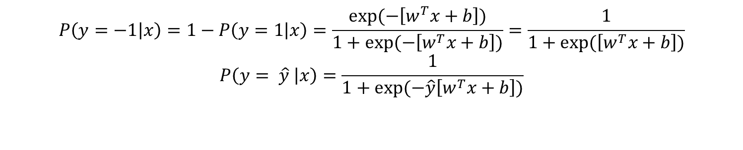
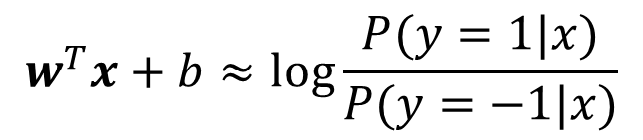
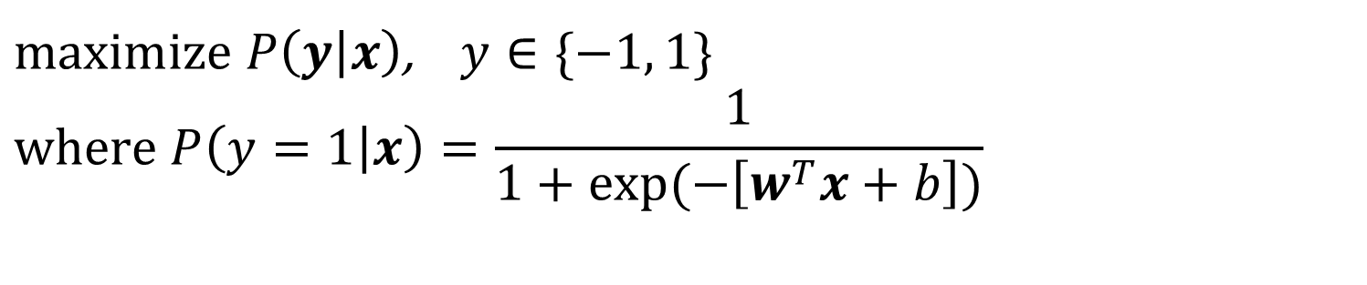
(Linear) Logistic Regression Model
$maximize P\left(y | x\right)$, $y∈\{−1, 1\}$
$$where P\left(y=1 | x\right)=\frac{1}{1+exp⁡(−\left[w^{T}x+b\right])}$$
“Logistic function”
* To simplify notation, I may omit the “b”, which can be avoided by adding a “1” to each feature vector
$$w^{T}x+b≈\log{\frac{P(y=1|x)}{P(y=−1|x)}}$$
“Logit”
$$P\left(y=−1 | x\right)=1−P\left(y=1 | x\right)=\frac{exp⁡(−\left[w^{T}x+b\right])}{1+exp⁡(−\left[w^{T}x+b\right])}=\frac{1}{1+exp⁡(\left[w^{T}x+b\right])}$$
$$P\left(y= \hat{y} | x\right)=\frac{1}{1+exp⁡(−\hat{y}\left[w^{T}x+b\right])}$$
Note:

Slide 10
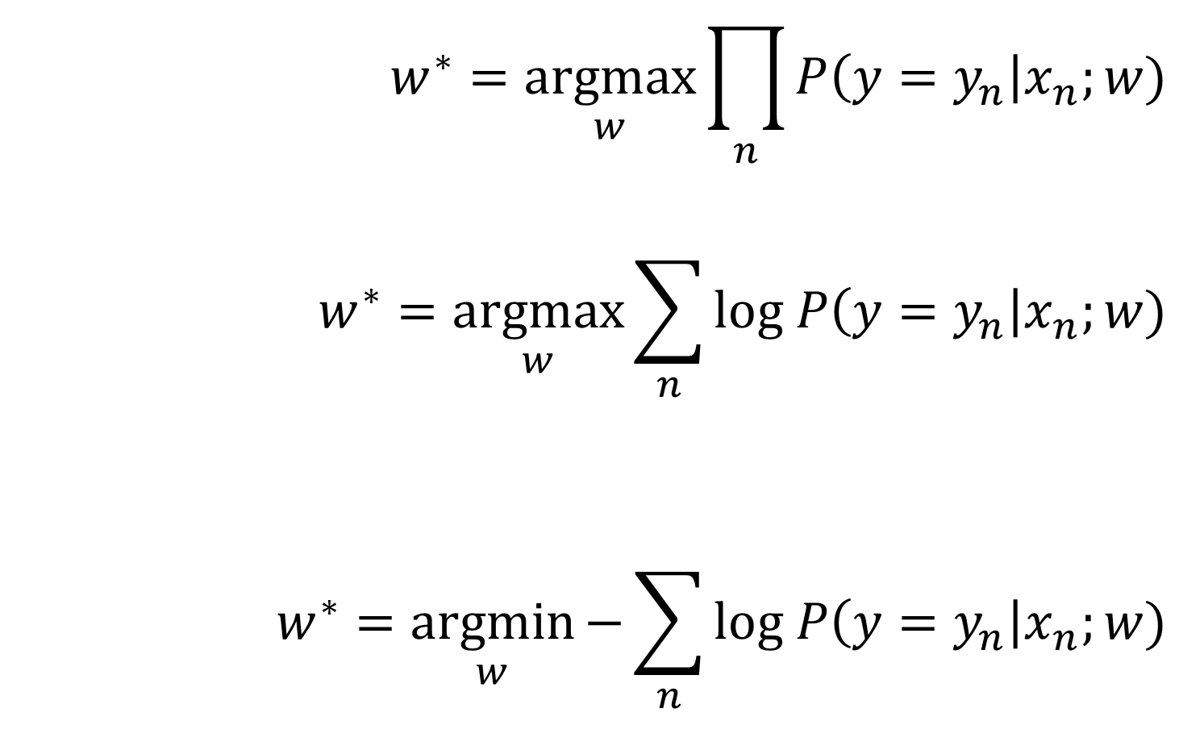

Deriving the loss of logistic regression
Maximize probability of correct label given features of each data point, assuming the data points are conditionally independent
$$w^{∗}=\underset{w}{argmax}{\prod_{n}{P\left({y=y}_{n}\right|x_{n};w)}}$$
$$w^{∗}=\underset{w}{argmax}{\sum_{n}{log P\left({y=y}_{n}\right|x_{n};w)}}$$
$$w^{∗}=\underset{w}{argmin}{−\sum_{n}{log P\left({y=y}_{n}\right|x_{n};w)}}$$
Maximizing $\log\left(f\left(x\right)\right)$ is the same as maximizing $f\left(x\right)$ because $\log\left(x\right)$ monotonically increases with $x$
Log of product is the sum of logs.
Turn it into a minimization problem (as a convention)

Slide 11

Linear Logistic Regression algorithm
Training
  $w^{∗}=\underset{w}{argmin}{−\sum_{n}{log P\left({y=y}_{n}\right|x_{n};w)+r(w)}}$
Prediction
  $y=1$ if $w^{T}x>0$
  $P\left(y=1 | x\right)=\frac{1}{1+\exp\left(−w^{T}x\right)}=\frac{\exp\left(w^{T}x\right)}{\exp\left(w^{T}x\right)+1}$
  $P\left(y=k | x\right)=\frac{\exp\left(w_{k}^{T}x\right)}{\sum_{j}{\exp\left(w_{j}^{T}x\right)}}$
regularization
log probability of all labels given features, assuming that each example is i.i.d.
Binary (two-class) case
Multiclass case (one w per class)

Slide 12
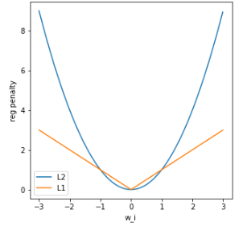

Training Logistic Regression
  $w^{∗}=\underset{w}{argmin}{−\sum_{n}{log P_{w}\left(y=y_{n}\right|x_{n})+r(w)}}$
L2 regularization: $r\left(w\right)=λ{\left\|w\right\|}_{2}^{2}=λ\sum_{i}{w_{i}^{2}}$
L1 regularization: $r\left(w\right)=λ{\left\|w\right\|}_{1}=λ\sum_{i}{|w_{i}|}$
L2 strongly penalizes really big weights
L1 penalizes increasing the magnitude of big and small weights the same
L1 leads to a sparse weight vector (many zeros) – why?
L1 regularization can be used to select features!
When is regularization absolutely essential?
There are many optimizers for L2 and L1 logistic regression. You will want to use a library.

Slide 13

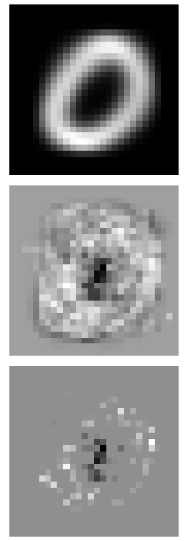
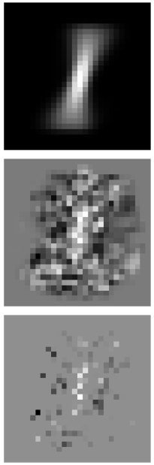
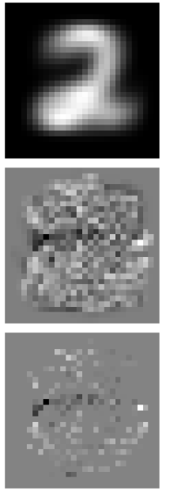
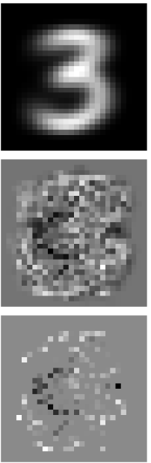
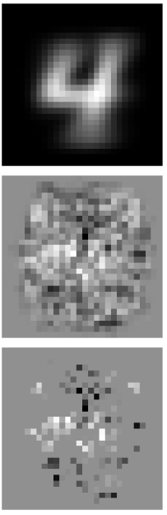
Inspecting weights for digits
Average Pixels
L2 weights
L1 weights

Slide 14
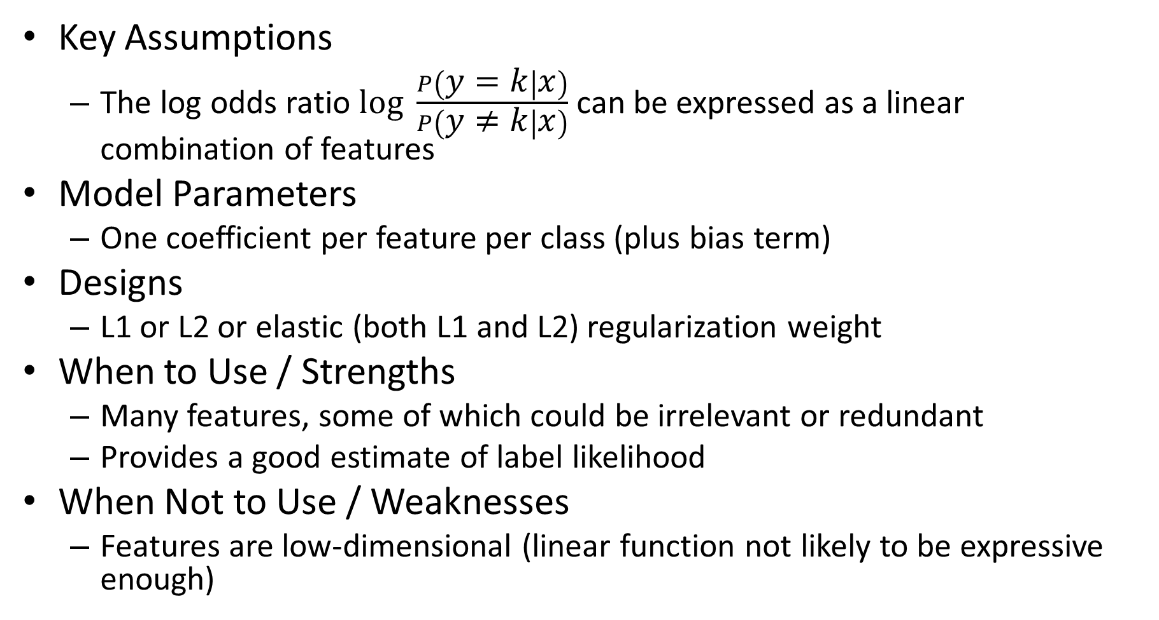
Logistic Regression Summary
Key Assumptions
  The log odds ratio $log \frac{P\left(y=k | x\right)}{P\left(y≠k | x\right)}$ can be expressed as a linear combination of features
Model Parameters
  One coefficient per feature per class (plus bias term)
Designs
  L1 or L2 or elastic (both L1 and L2) regularization weight
When to Use / Strengths
  Many features, some of which could be irrelevant or redundant
  Provides a good estimate of label likelihood
When Not to Use / Weaknesses
  Features are low-dimensional (linear function not likely to be expressive enough)

Slide 15
Linear logistic regression is typically the last layer of a classification neural network

Slide 16
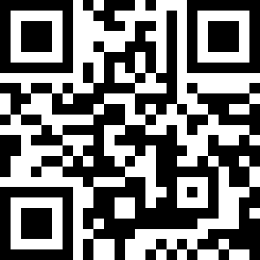
Q1-Q2
  https://tinyurl.com/AML441-L7

Slide 17
What is the best linear classifier?
Logistic regression
  Maximize expected likelihood of true label given features
  Every example contributes to loss
SVM
  Make all examples at least minimally confident
  Base decision on a minimal set of examples
x
x
x
x
x
x
o
x
x
o
o
o
o
x2
x1

Slide 18
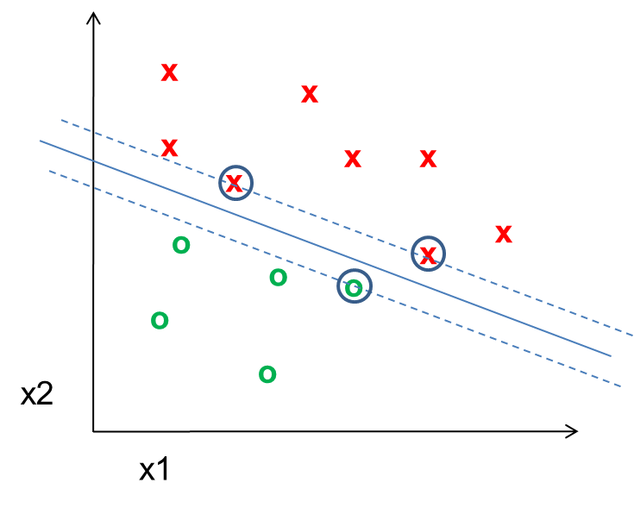
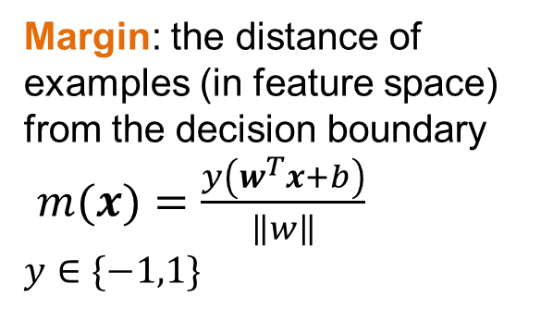
SVM Terminology
Support Vector: an example that lies on the margin (circled points)
Margin: the distance of examples (in feature space) from the decision boundary
$m(x)=\frac{y\left(w^{T}x+b\right)}{\left\|w\right\|}$
$y∈\{−1,1\}$

Slide 19
SVMs minimize $w^{T}w$ while preserving a margin of 1
Optimized SVM Model
Optimized Linear Logistic Regression Model
x
x
x
x
x
x
x
x
x
x
x
x
o
x
o
x
x
x
o
x
o
x
o
x
x
o
x
x
x
x
x
x
x
x
x
o
x
x
o
x
o
o
o
o
w^{T}x+b=0
o
o
x2
o
x2
o
w^{T}x+b=0
x1
x1
Minimizes the sum of logistic error on all samples, so boundary should be further from dense regions
Decision boundary depends only on “support vectors” (circled)
Notes:
5 min

Slide 20
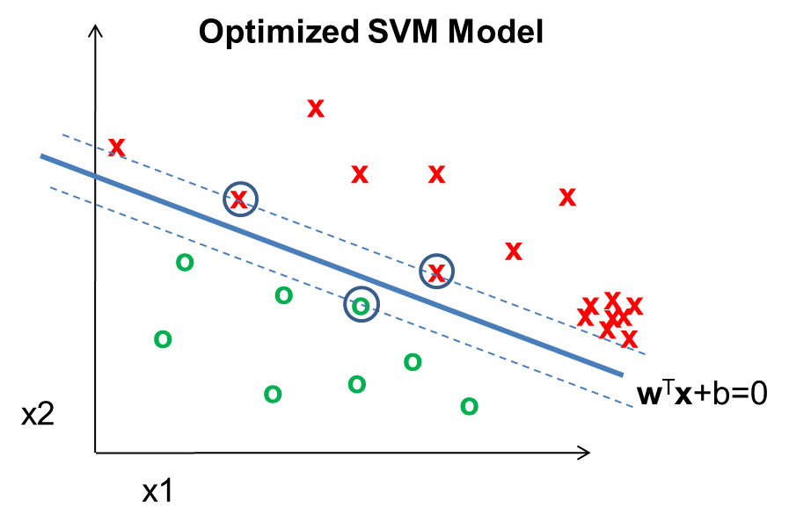
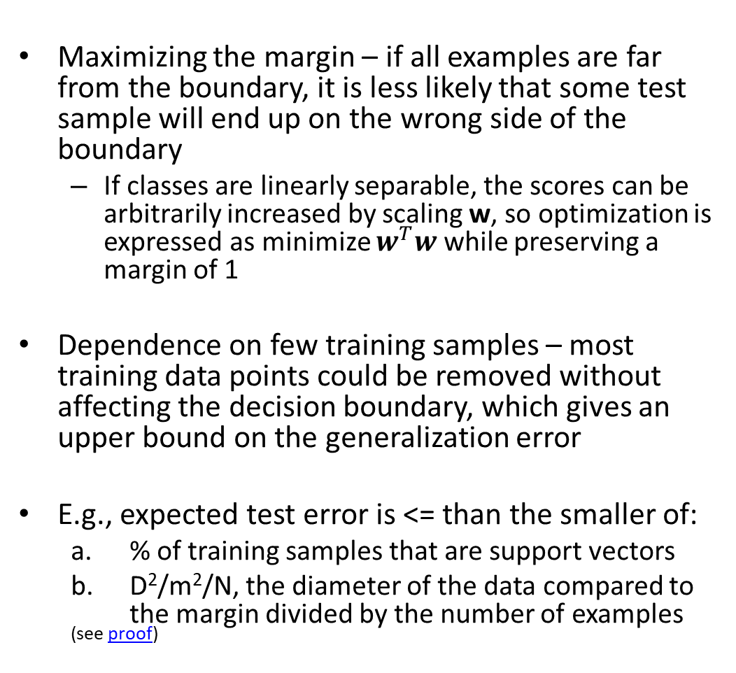
Why SVMs achieve good generalization
Maximizing the margin – if all examples are far from the boundary, it is less likely that some test sample will end up on the wrong side of the boundary
  If classes are linearly separable, the scores can be arbitrarily increased by scaling w, so optimization is expressed as minimize $w^{T}w$ while preserving a margin of 1
Dependence on few training samples – most training data points could be removed without affecting the decision boundary, which gives an upper bound on the generalization error
E.g., expected test error is <= than the smaller of:
  % of training samples that are support vectors
  D²/m²/N, the diameter of the data compared to the margin divided by the number of examples
  ^{(see proof)}

Slide 21
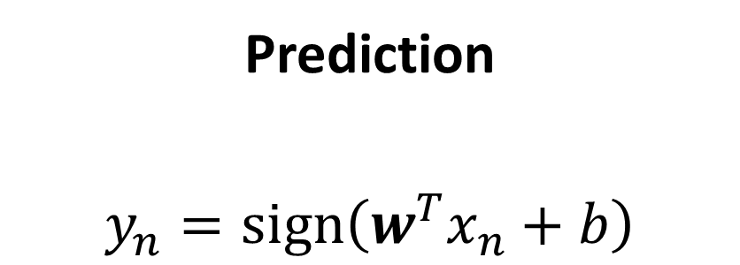
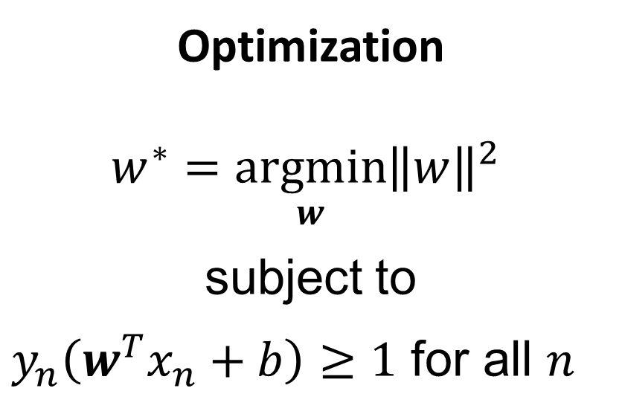
SVM in Linearly Separable Case
Prediction
$$y_{n}=sign\left(w^{T}x_{n}+b\right)$$
Optimization
$$w^{∗}=\underset{w}{argmin}{{\left\|w\right\|}^{2}}$$
subject to
$y_{n}\left(w^{T}x_{n}+b\right)≥1$ for all $n$
Here, $y∈\{−1,1\}$ which is a common convention that simplifies notation for binary classifiers

Slide 22
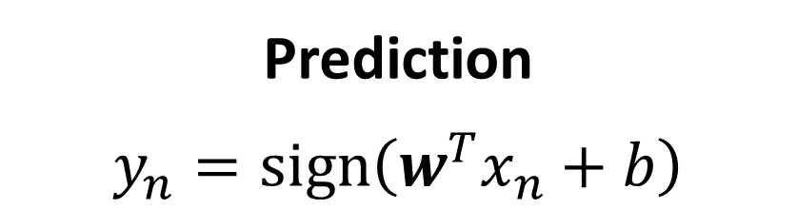
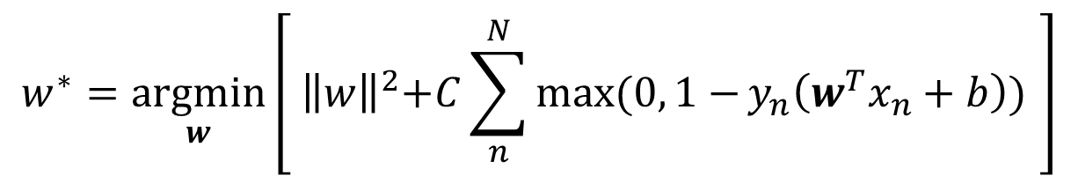
SVM in Non-Linearly Separable Case
Prediction
$$y_{n}=sign\left(w^{T}x_{n}+b\right)$$
Optimization
Known as “hinge loss”
Penalty is paid if margin is less than 1
$$w^{∗}=\underset{w}{argmin}\left[{ \left\|w\right\|}^{2}+C\sum_{n}^{N}{\max{(0, 1−}}y_{n}\left(w^{T}x_{n}+b\right)) \right]$$
Here, $y∈\{−1,1\}$ which is a common convention that simplifies notation for binary classifiers

Slide 23
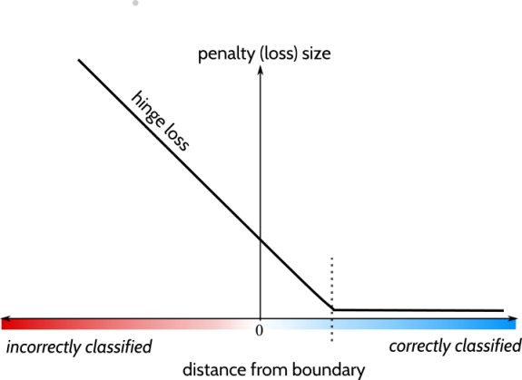
Fig source

Slide 24
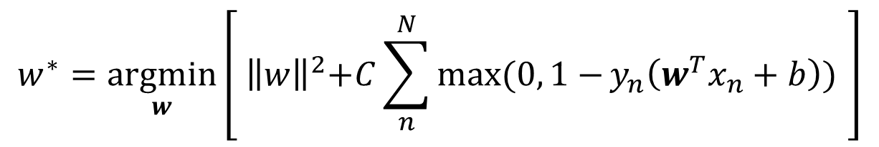
Sometimes non-linear optimization is written in terms of “slack variables”
$$w^{∗}=\underset{w}{argmin}\left[{ \left\|w\right\|}^{2}+C\sum_{n}^{N}{\max{(0, 1−}}y_{n}\left(w^{T}x_{n}+b\right)) \right]$$
is equivalent to
slack variables
Pay slack penalty

Slide 25
Pays a “slack” penalty for violating the margin
Slide credit: Zisserman [link]

Slide 26
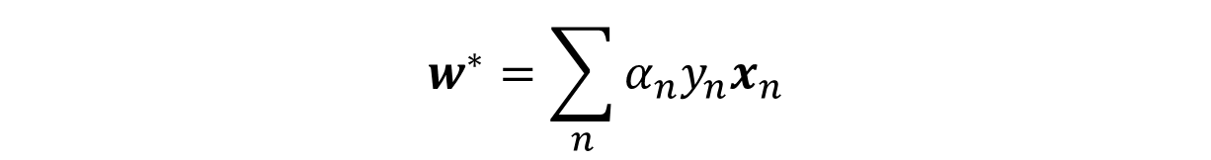
Representer theorem
Optimal weights for many L2-regularized classification and regression functions can be expressed as a weighted combination of training examples
So linear SVM is a kind of weighted nearest neighbor with dot product similarity
$$w^{∗}=\sum_{n}{α_{n}y_{n}x_{n}}$$
$$α_{n}{≥0, y}_{n}∈\{−1,1\}$$
Conditions apply, e.g. function must be regularized in a Reproducing Kernel Hilbert Space (details)
Does not apply to L1 weight regularization because that can’t be expressed as a dot product of weights

Slide 27
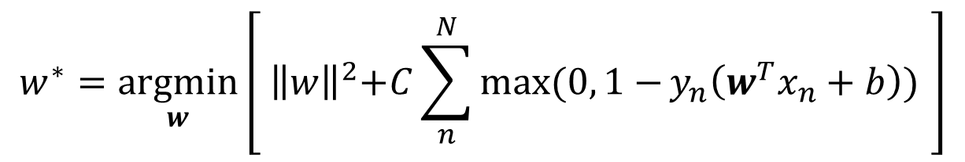
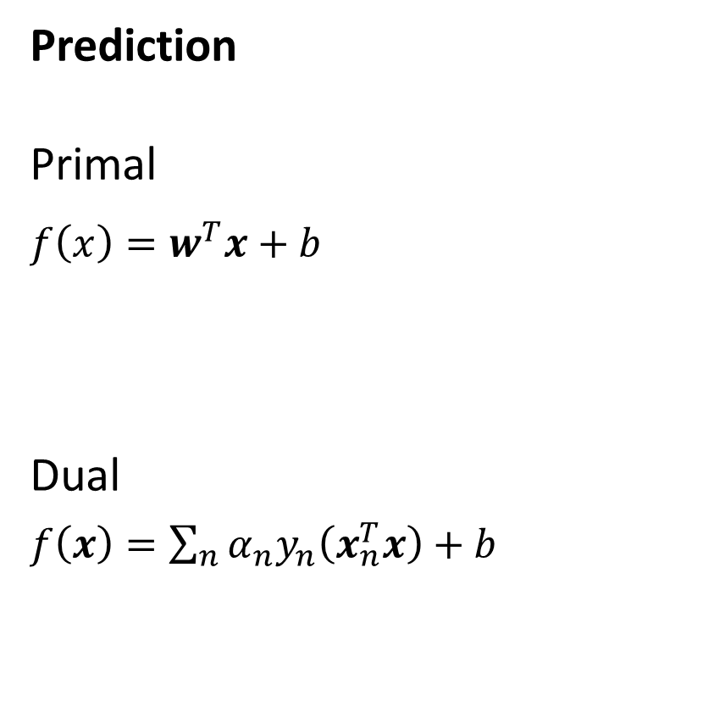
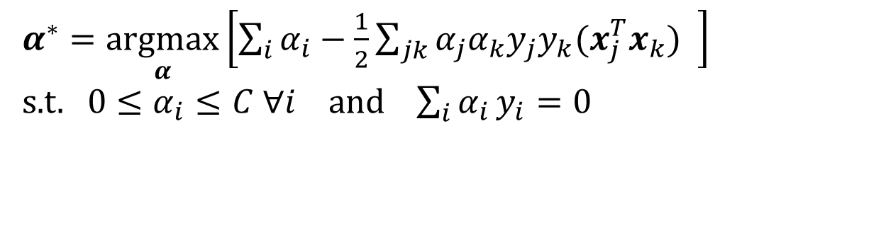
Primal vs. Dual Formulations of SVM
Prediction
Primal
$f\left(x\right)=w^{T}x+b$
Dual
$f\left(x\right)=\sum_{n}{{α_{n}y}_{n}\left(x_{n}^{T}x\right)+b}$
Training Objective
$$w^{∗}=\underset{w}{argmin}\left[{ \left\|w\right\|}^{2}+C\sum_{n}^{N}{\max{(0, 1−}}y_{n}\left(w^{T}x_{n}+b\right)) \right]$$
$α^{∗}=\underset{α}{argmax}\left[\sum_{i}{α_{i}}−\frac{1}{2}\sum_{jk}{α_{j}α_{k}y_{j}y_{k}(x_{j}^{T}x_{k})} \right]$
s.t.$0≤α_{i}≤C ∀i$ and $\sum_{i}{α_{i}}y_{i}=0$
Primal: parameter for each feature
Dual: parameter for each training example

Slide 28
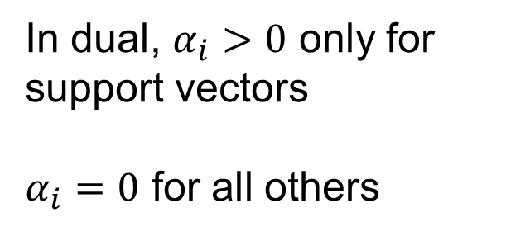
For SVM, $α$ is sparse (most values are zero)
In dual, $α_{i}>0$ only for support vectors
$α_{i}=0$ for all others
Slide credit: Zisserman [link]

Slide 29

Non-linear SVMs use a different similarity measure, called a “kernel function”, than dot product
Linear: $k(x_{i}, x_{j})=x_{i}^{T}x_{j}$
Polynomial: $k(x_{i}, x_{j})={\left(1+x_{i}^{T}x_{j}\right)}^{d}$
Gaussian: $k(x_{i}, x_{j})=\exp{(−\frac{{\left\|x_{i}−x_{j}\right\|}^{2}}{2σ^{2}}) }$

Slide 30
Slide credit: Zisserman [link]

Slide 31
Decreasing sigma makes it more like nearest neighbor
SVM with RBF Kernel Shown
Fig credit: Zisserman [link]

Slide 32
Q3-Q4
  https://tinyurl.com/AML441-L7

Slide 33
Example application of SVM: Dalal-Triggs 2005
Detection by scanning window
  Resize image to multiple scales and extract overlapping windows
  Classify each window as positive or negative
Very highly cited (40,000+) paper, mainly for HOG
One of the best pedestrian detectors for several years
https://lear.inrialpes.fr/people/triggs/pubs/Dalal-cvpr05.pdf

Slide 34
Example application of SVM: Dalal-Triggs 2005
Very highly cited (40,000+) paper, mainly for HOG
One of the best pedestrian detectors for several years

Slide 35
Example application of SVM: Dalal-Triggs 2005

Slide 36
Using SVMs
Good broadly applicable classifier
  Strong foundation in statistical learning theory
  Works well with many weak features
  Requires parameter tuning for C
  Non-linear SVM requires defining a kernel, and slower optimization/prediction
    RBF: related to neural networks, nearest neighbor (requires additional tuning)
    Chi-squared, histogram intersection: good for histograms (but slower, esp. chi-squared)
    Can learn a kernel function
Negatives
  Feature learning is not part of the framework (vs trees and neural nets)
  Slow training (especially for kernels) – until Pegasos!

Slide 37
Recap
Nearest neighbor is widely used
  Super-powers: can instantly learn new classes and predict from one or many examples
Logistic Regression is widely used
  Super-powers: Effective prediction from high-dimensional features
Linear Regression is widely used
  Super-powers: Can extrapolate, explain relationships, and predict continuous values from many variables
Almost all algorithms involve nearest neighbor, logistic regression, or linear regression
  The main learning challenge is typically feature learning

Slide 38
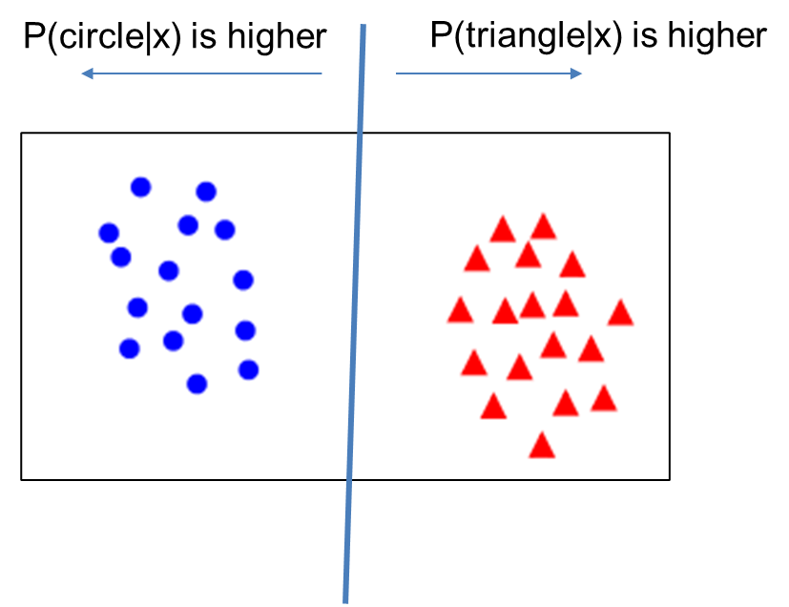
Things to remember
Linear logistic regression and linear SVM are classification techniques that aims to split features between two classes with a linear model
  Predict categorical values with confidence
Logistic regression maximizes confidence in the correct label, while SVM just tries to be confident enough
Non-linear versions of SVMs can also work well and were once popular (but almost entirely replaced by deep networks)
Nearest neighbor and linear models are the final predictors of most ML algorithms – the complexity lies in finding features that work well with NN or linear models

Slide 39
Next class
Naïve Bayes Classifier

