Slide 1
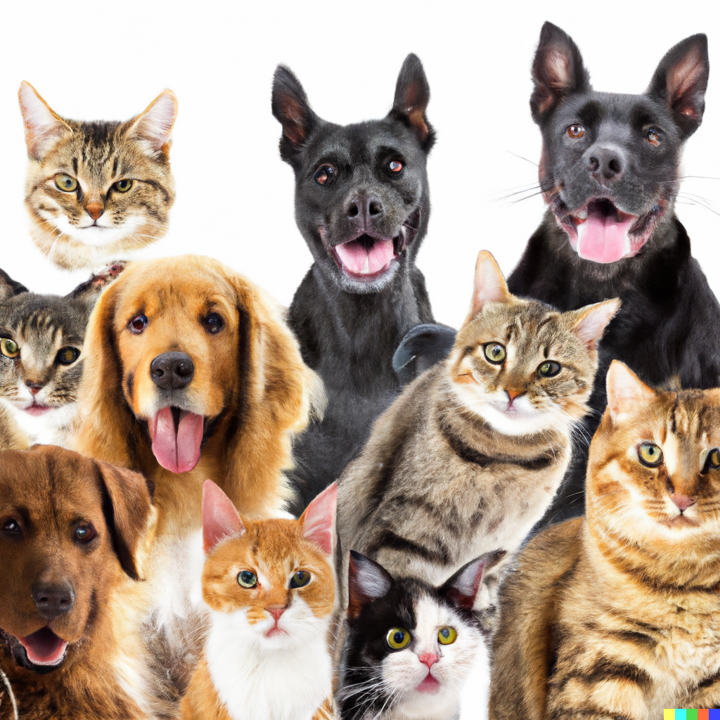
Retrieval and Clustering
Applied Machine Learning
Derek Hoiem
Dall-E

Slide 2
Previously
K-nearest neighbor algorithm
Application to classification and regression
Basics of datasets and generalization

Slide 3
Today’s lecture
Retrieval
  “Brute force”
  Faiss library
  Approximate: LSH
Clustering
  Kmeans
  Hierarchical Kmeans
  Agglomerative Clustering

Slide 4
Retrieval
Given a new sample, find the closest sample(s) in a dataset
Applications
  Finding information (web search)
  Prediction (e.g. nearest neighbor algorithm)
  Clustering (kmeans)

Slide 5
“Brute force” search
Compute distance between query and each dataset point and return closest point

Slide 6
Brute force search pseudo-code
getNearest(x_q, X)
dist_min = Inf
idx_min = -1
For each nth sample in X:
dist = sum((X[n]-x_q)**2) # sum square diff
if dist < dist_min:
dist_min = dist
idx_min = n
return idx_min

Slide 7
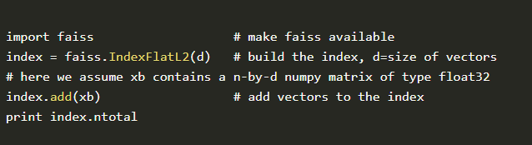
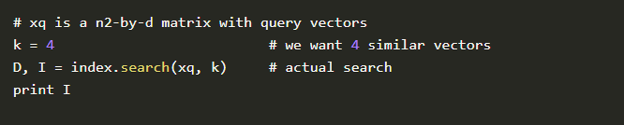
FAISS library makes even brute force search very fast
Multi-threading, BLAS libraries, SIMD vectorization, GPU implementations
KNN for MNIST takes seconds
Also contains many approximate search methods
https://engineering.fb.com/2017/03/29/data-infrastructure/faiss-a-library-for-efficient-similarity-search/

Slide 8
Repos for fast search
FAISS: https://github.com/facebookresearch/faiss (we use this for HW)
ScaNN: https://github.com/google-research/google-research/tree/master/scann
USearch: https://github.com/unum-cloud/usearch
FAISS seems the gold standard, but ScaNN and USearch claim to be faster/lighter for some uses

Slide 9
Approximate search
Many algorithms exist that are faster than brute force (especially for very large datasets) but don’t guarantee returning exact nearest neighbors, e.g.
  LSH – locality sensitive hashing
  HNSW – hierarchical navigable small world graphs
  IVF – inverted file (cluster-based)
We’ll discuss only LSH, but others are worth learning about if fast search is helpful for your application
In practice, you should understand how different search methods work, but use an optimized library, not your own code

Slide 10
Locality Sensitive Hashing (LSH)
A fast approximate search method to return similar data points to query

Slide 11
Basic LSH process
Convert each data point into an array of bits or integers, using the same conversion process/parameters for each
Map the arrays into buckets (e.g. with 10 bits, you have 2^10 buckets)
  Can use subsets of arrays to create multiple sets of buckets
On query, return points in the same bucket(s)
  Can check additional buckets by flipping bits to find points within hash distances greater than 0

Slide 12
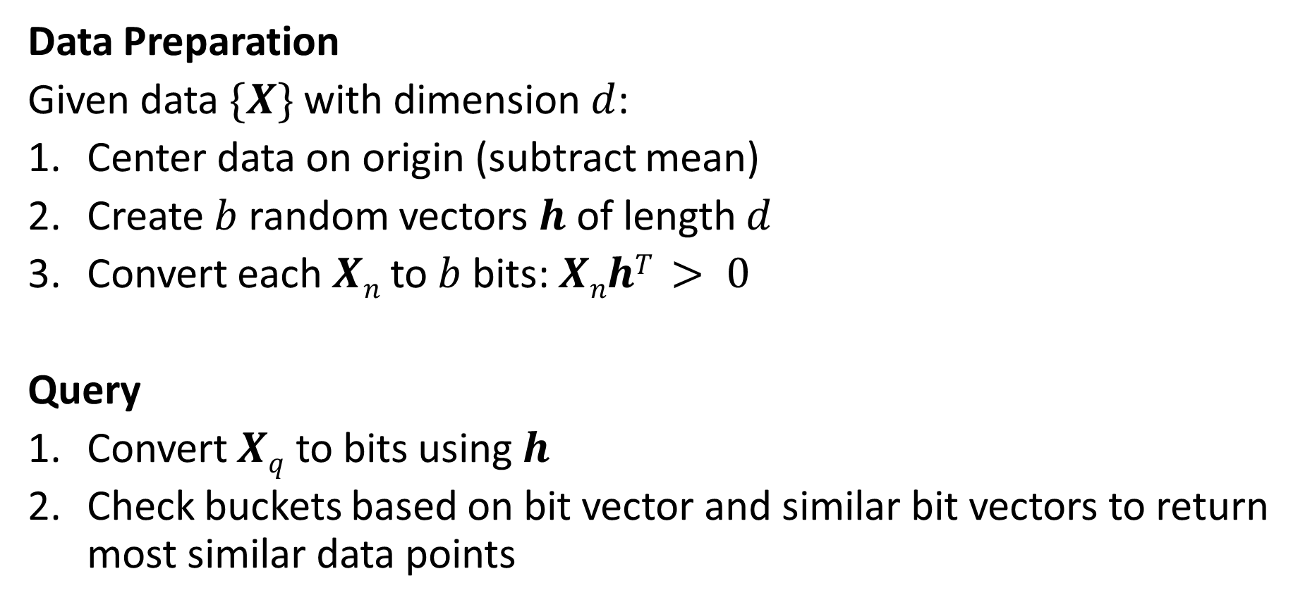
Random Projection LSH
Data Preparation
Given data $\{X\}$ with dimension $d$:
Center data on origin (subtract mean)
Create $b$ random vectors $h$ of length $d$
Convert each $Xn$ to $b$ bits: $XnhT > 0$
Query
Convert $Xq$ to bits using $h$
Check buckets based on bit vector and similar bit vectors to return most similar data points
h= np.random.rand(nbits, d) - .5

Slide 13
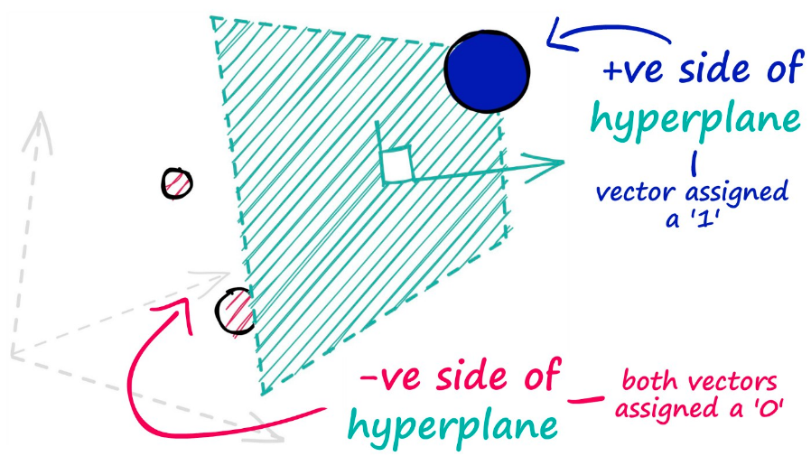
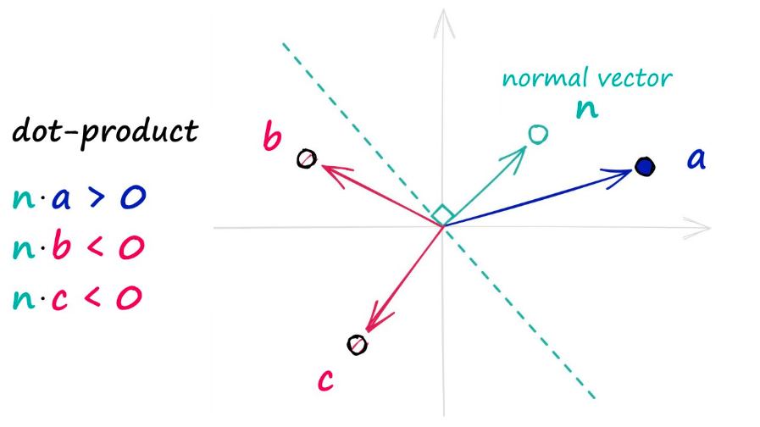
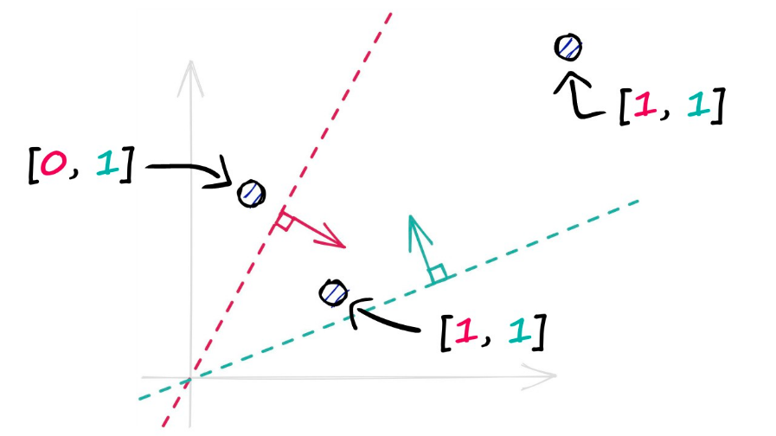
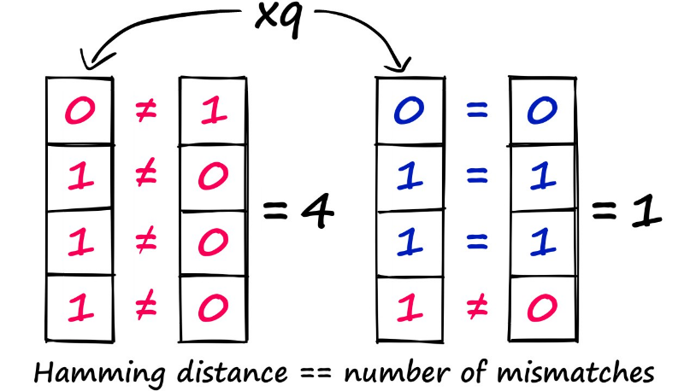
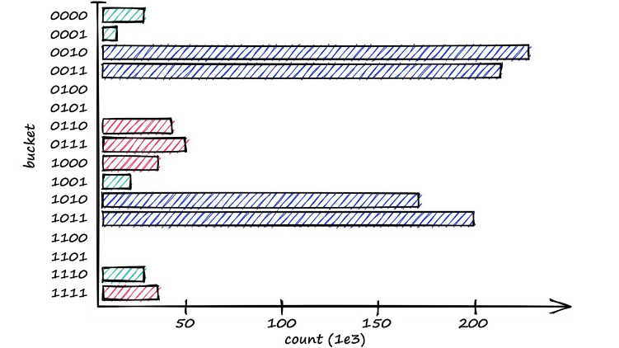
Representing the plane (that passes through origin) with a normal vector, the side is calculated by thresholding the dot product with datapoint
With multiple (randomly generated) planes, each datapoint is represented as a bit vector
Continuous vector is converted to bit vector, with each bit representing the datapoint’s side of a hyperplane
Point similarity is now a bit distance
Can retrieve points in the same “bucket” and either randomly pick one or search within it
Illustration source: https://www.pinecone.io/learn/series/faiss/locality-sensitive-hashing-random-projection/

Slide 14
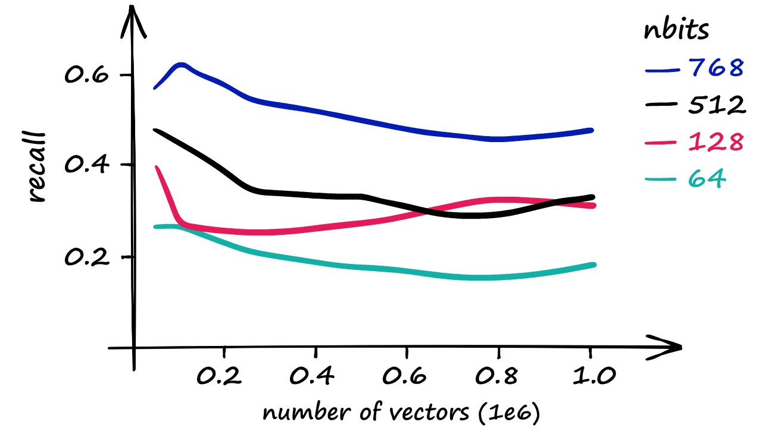
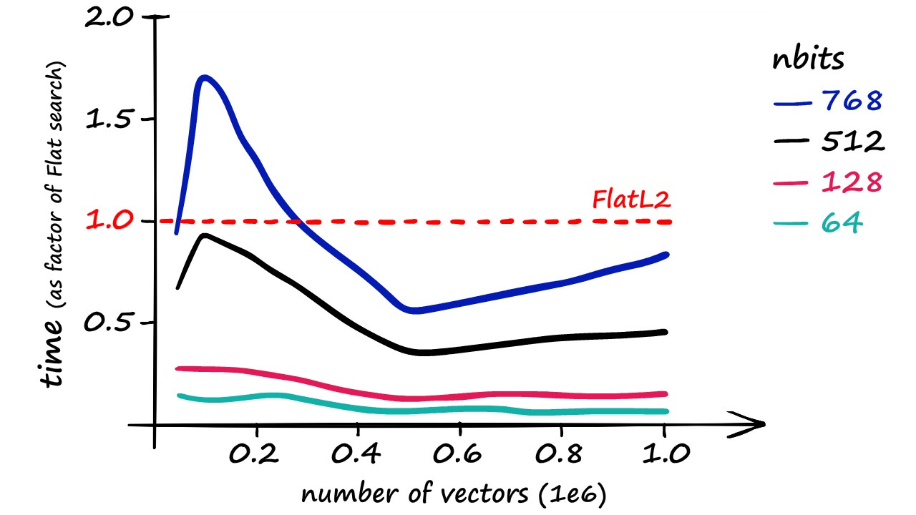
Key parameter: nbits
Rule of thumb: nbits = dim is a decent choice (1 bit per feature dimension)
Optionally, can retrieve K closest data points and then use brute force search on those
Recall vs. exact nearest neighbor
Time compared to brute force search
Source: https://www.pinecone.io/learn/series/faiss/locality-sensitive-hashing-random-projection/

Slide 15
Nice video about LSH in faiss: https://youtu.be/ZLfdQq_u7Eo which is part of this very detailed and helpful post: https://www.pinecone.io/learn/locality-sensitive-hashing-random-projection/

Slide 16
Comparison of search algorithms
Index | Idea | Time to Build | Memory (MB) | Query Time (ms) | Recall | Notes
Flat (L2 or IP) | Direct: Compare query to every data point | Fastest | ~500 | ~18 | 1.0 | Good for small datasets or where query time is irrelevant
LSH | Hash-based: Approximate search by approximating floating point vector with bit vector | Fast | 20 - 600 | 1.7 - 30 | 0.4 - 0.85 | Best for low dimensional data, or small datasets
HNSW | Graph-based: Search neighbors in a well-constructed graph | Slow | 600 - 1600 | 0.6 - 2.1 | 0.5 - 0.95 | Very good for quality, high speed, but large memory usage
IVF | Cluster-based: Assign query to cluster and also search nearby clusters | Medium | ~520 | 1 - 9 | 0.7 - 0.95 | Good scalable option. High-quality, at reasonable speed and memory usage
Time/memory/recall from Nearest Neighbor Indexes for Similarity Search | Pinecone: The Sift1M dataset consists of a dimensionality d of 128, dataset size of 1M. The above values result from querying for a single vector – returning 10 of the nearest matches.

Slide 17
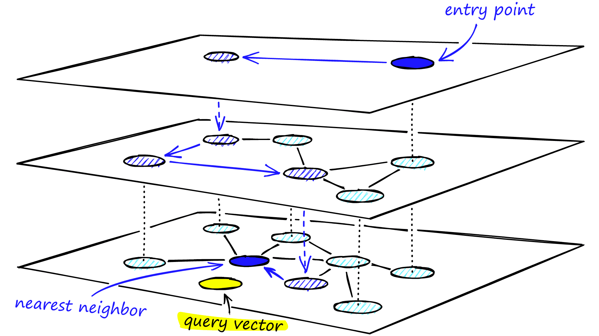
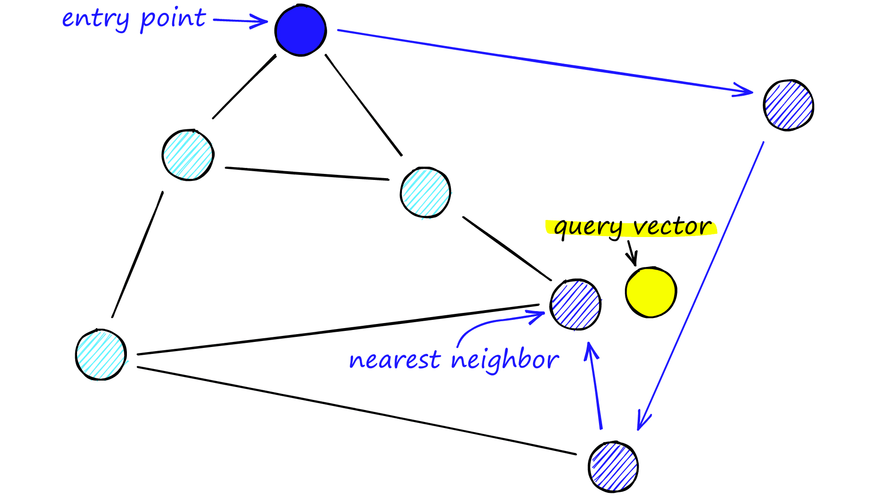
HNSW (in brief)
Hierarchical Navigable Small World – graph-based method that is commonly used for medium-sized vector databases
NSW: starting at some entry node, greedly step through the neighbors that are closest to query
HNSW: coarse-to-fine search through the nodes using a hierarchical graph

Slide 18
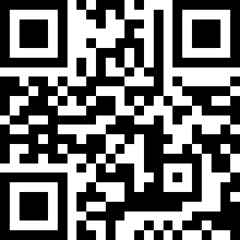
Q1
https://tinyurl.com/AML441-L4

Slide 19
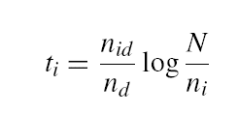
Inverse document file for retrieval of count-based docs
Applies to text (word counts), images (clustered keypoint counts), and other tokenized representations
Like a book index: keep a list of all the words (tokens) and all the pages (documents) that contain them.
Rank database documents based on summed tf-idf measure for each word/token in the query document
tf-idf: Term Frequency – Inverse Document Frequency
# documents
# times word appears in document
# documents that contain the word
# words in document

Slide 20
Clustering
Assign a label to each data point based on the similarities between points
Why cluster
  Represent data point with a single integer instead of a floating point vector
    Saves space
    Simple to count and estimate probability
  Discover trends in the data
  Make predictions based on groupings

Slide 21
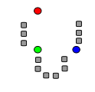
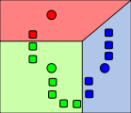
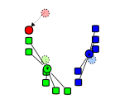
K-means algorithm
1. Randomly select K centers
2. Assign each point to nearest center (L2 dist)
3. Compute new center (mean) for each cluster
Illustration: http://en.wikipedia.org/wiki/K-means_clustering

Slide 22
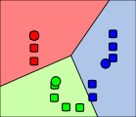
K-means algorithm
1. Randomly select K centers
2. Assign each point to nearest center (L2 dist)
Back to 2
3. Compute new center (mean) for each cluster
Illustration: http://en.wikipedia.org/wiki/K-means_clustering

Slide 23
Pseudo-code
kmeans(X, K, maxiter)
# Create cluster centers
center = X[:K].copy()
Until maxiter iterations or convergence:
  For each nth sample in X:
  # get index of nearest center
  idx[n] = get_nearest(X[n], centers)
  For each kth center:
  # get mean of data points assigned to cluster k
  center[k] = X[idx==k].mean(axis=0)
  Convergence is if no idx changed in this iteration
return center, idx

Slide 24
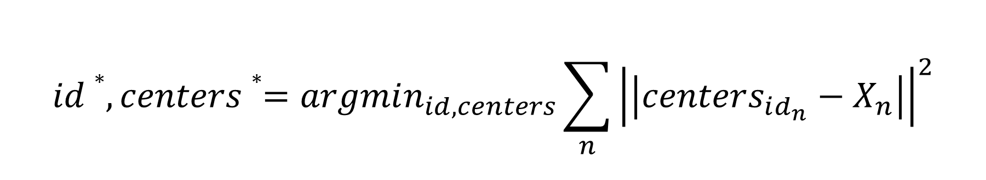
What is the cost minimized by K means?
$$id∗, centers∗=argmin_{id, centers}\sum_{n}{{\left|\left|centers_{id_{n}}−X_{n}\right|\right|}^{2}}$$
Choose ids that minimizes square cost given centers
Choose centers that minimize square cost given ids

Slide 25
K-means Demo
https://www.naftaliharris.com/blog/visualizing-k-means-clustering/

Slide 26
What are some disadvantages of K-means in terms of clustering quality?
All feature dimensions have equal weight
Tends to break data into clusters of similar numbers of points (can be good or bad)
Does not take into account any local structure
Typically, no easy way to choose K
Can be slow if the number of data points and clusters is large

Slide 27
Implementation issues
How to choose K?
  Typically chosen by hand
  Often based on the number of clusters you want considering time/space requirements
How do you initialize
  Randomly choose points
  Iterative furthest point

Slide 28
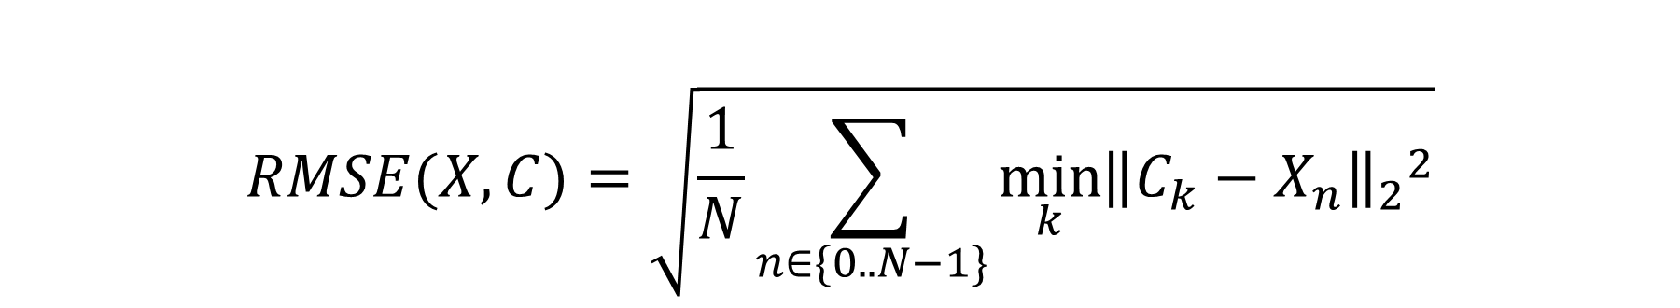
Evaluating clustering with RMSE
RMSE = root mean squared error
Measures a kind of compression loss, i.e. how well is each data point represented by the closest cluster center
$$RMSE(X, C)=\sqrt{\frac{1}{N}\sum_{n∈\{0..N−1\}}{{\min_{k}{{\left\|C_{k}−X_{n}\right\|}_{2}}}^{2}}}$$

Slide 29
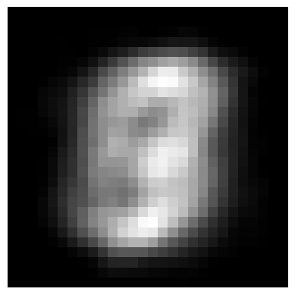
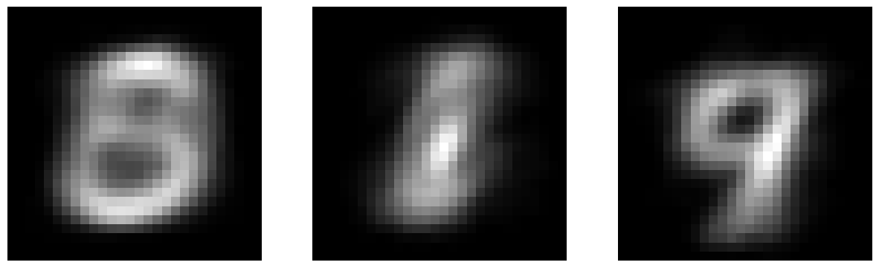
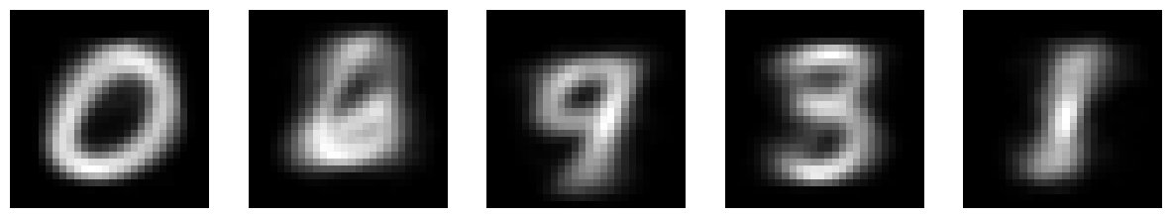
Example: K-means on MNIST
K=3, RMSE = 49.3
K=1, RMSE = 55.0
K=5, RMSE = 45.6
K=10, RMSE = 41.9
K=20, RMSE = 37.82
K=40, RMSE = 34.44

Slide 30
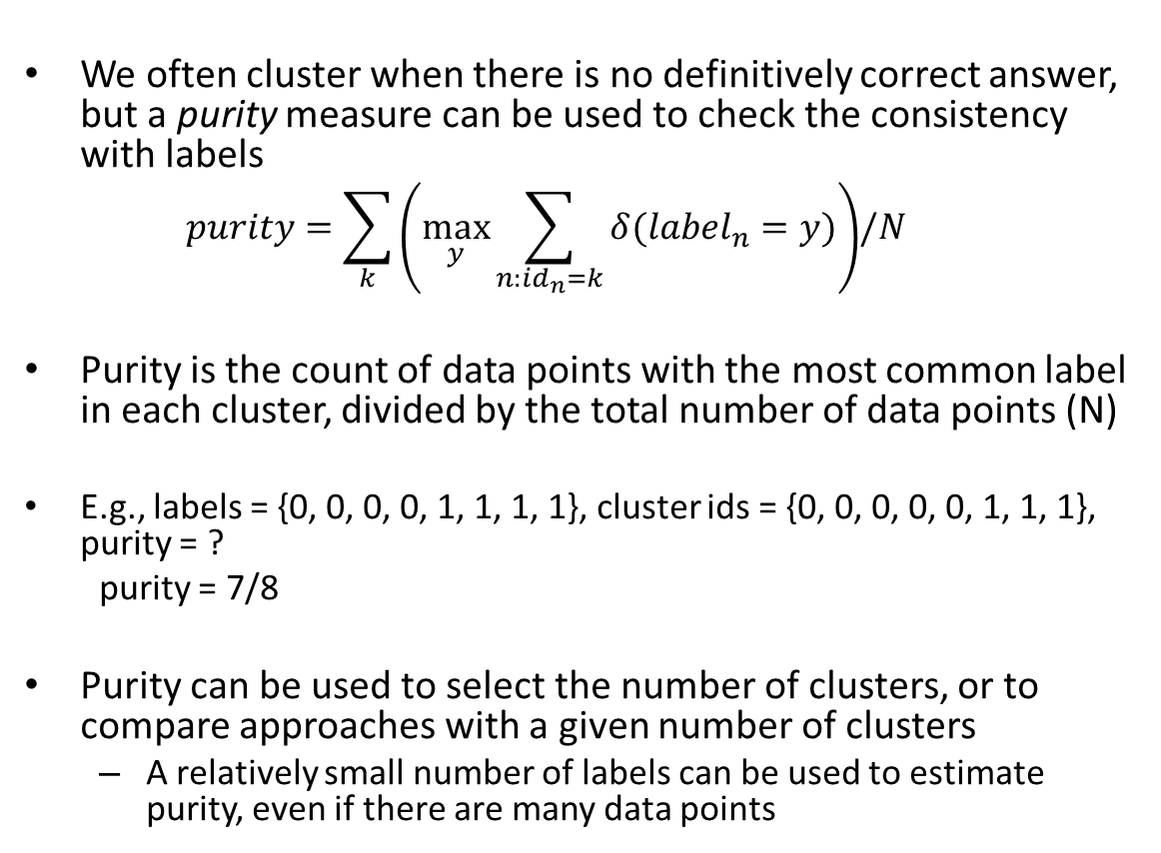
Evaluating clusters with purity
We often cluster when there is no definitively correct answer, but a purity measure can be used to check the consistency with labels
  $$purity=\sum_{k}{\left(\max_{y}{\sum_{n:id_{n}=k}{δ(label_{n}=y)}}\right)}{/N}$$
Purity is the count of data points with the most common label in each cluster, divided by the total number of data points (N)
E.g., labels = {0, 0, 0, 0, 1, 1, 1, 1}, cluster ids = {0, 0, 0, 0, 0, 1, 1, 1}, purity = ?
  purity = 7/8
Purity can be used to select the number of clusters, or to compare approaches with a given number of clusters
  A relatively small number of labels can be used to estimate purity, even if there are many data points

Slide 31
Q2
https://tinyurl.com/AML441-L4

Slide 32
Hierarchical K-means
Iteratively cluster points into K groups, then cluster each group into K groups

Slide 33
Notes:
We then run k-means on the descriptor space. In this setting, k defines what we call the branch-factor of the tree, which indicates how fast the tree branches.
In this illustration, k is three. We then run k-means again, recursively on each of the resulting quantization cells.
This defines the vocabulary tree, which is essentially a hierarchical set of cluster centers and their corresponding Voronoi regions.
We typically use a branch-factor of 10 and six levels, resulting in a million leaf nodes. We lovingly call this the Mega-Voc.

Slide 43
Notes:
We now have the vocabulary tree, and the online phase can begin.
In order to add an image to the database, we perform feature extraction. Each descriptor vector is now dropped down from the root of the tree and quantized very efficiently into a path down the tree, encoded by a single integer.
Each node in the vocabulary tree has an associated inverted file index.
Indicies back to the new image are then added to the relevant inverted files.
This is a very efficient operation that is carried out whenever we want to add an image.

Slide 44
Advantages of Hierarchical K-Means
Fast cluster training
  With a branching factor of 10, can cluster into 1M clusters by clustering into 10 clusters ~111,111 times, each time using e.g. 10K data points
  Vs. e.g. clustering 1B data points into 1M clusters
  Kmeans is O(K*N*D) per iteration so this is a 900,000x speedup!
Fast lookup
  Find cluster number in O(log(K)*D) vs. O(K*D)
  16,667x speedup in the example above

Slide 45
Are there any disadvantages of hierarchical Kmeans?
Yes, the assignment might not be quite as good, but often usually isn’t a huge deal since K means is used to approximate data points with centroid anyway
Notes:
Yes, the assignment might not be quite as good, but this usually isn’t a huge deal since K means is used to approximate data points with centroid anyway

Slide 46
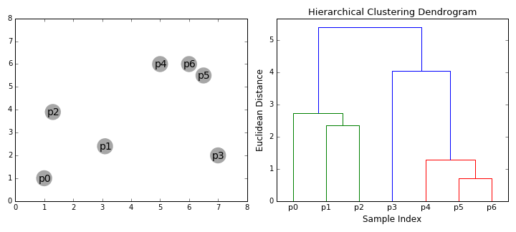
Agglomerative clustering
Iteratively merge the two most similar points or clusters
  Can use various distance measures
  Can use different “linkages”, e.g. distance of nearest points in two clusters or the cluster averages
  Ideally the minimum distance between clusters should increase after each merge (e.g. if using the distance between cluster centers)
  Number of clusters can be set based on when the cost to merge increases suddenly
https://dashee87.github.io/data%20science/general/Clustering-with-Scikit-with-GIFs/

Slide 47
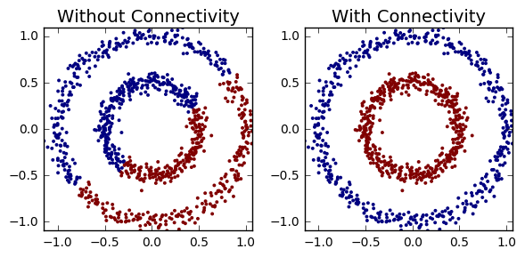
Agglomerative clustering
With good choices of linkage, agglomerative clustering can reflect the data connectivity structure (“manifold”)
Clustering based on distance of 5 nearest neighbors between clusters
https://dashee87.github.io/data%20science/general/Clustering-with-Scikit-with-GIFs/

Slide 48
Applications of clustering
K-means
  Quantization (codebooks for image generation)
  Search
  Data visualization (show the average image of clusters of images)
Hierarchical K-means
  Fast search (document / image search)
Agglomerative clustering
  Finding structures in the data (image segmentation, grouping camera locations together)

Slide 49
Q3-Q4
https://tinyurl.com/AML441-L4

Slide 50
HW 1
You should now be able to complete this HW

Slide 51
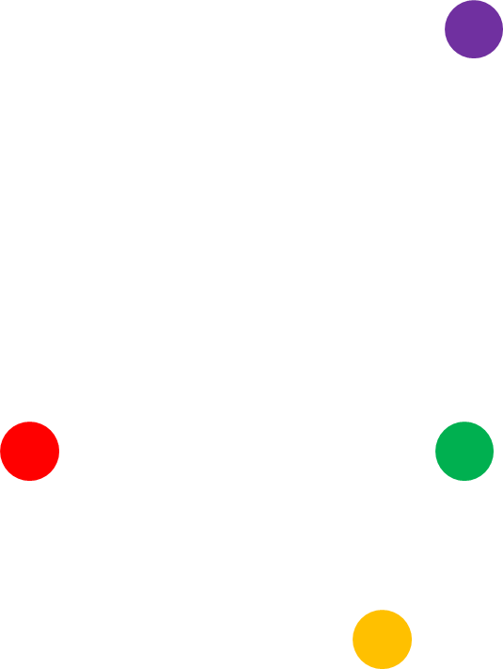
Things to remember
Use highly optimized libraries like FAISS for search/retrieval
Approximate search methods like LSH can be used to find similar points quickly
Clustering groups similar data points
K-means is the must-know method, but there are many others

