Slide 1

KNN Regression and Generalization
Applied Machine Learning
Derek Hoiem
Dall-E

Slide 2
Previous Lecture Recap
Data is a set of numbers that contains information. Images, audio, signals, tabular data and everything else must be represented as a vector of numbers to be used in ML.
Information is the power to predict something – a lot of the challenge in ML is in transforming the data to make the desired information more obvious
In machine learning, we have
  Sample: a data point, such as a feature vector and label corresponding to the input and desired output of the model
  Dataset: a collection of samples
  Training set: a dataset used to train the model
  Validation set: a dataset used to select which model to use or compare variants and manually set parameters
  Test set: a dataset used to evaluate the final model
In a classification problem, the goal is to map from features to a categorical label (or “class”)
Nearest neighbor (or K-NN) algorithm can perform classification by retrieving the K nearest neighbors to the query features and assigning their most common label
We can measure error and confusion matrices to show the fraction of mistakes and what kinds of mistakes are made

Slide 3
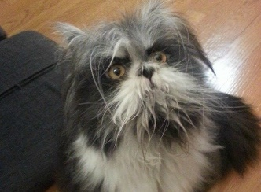
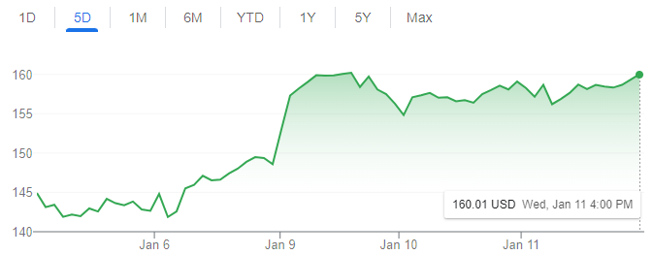
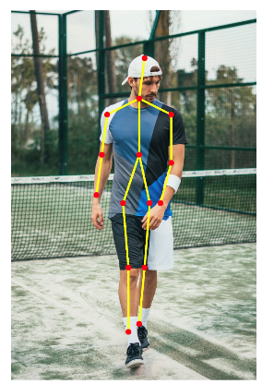
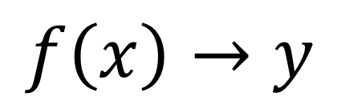
Machine learning model maps from features to prediction
$$f\left(x\right)→y$$
Features
Prediction
Examples
Classification: predict label
  Is this a dog or a cat?
  Is this email spam or not?
Regression: predict value
  What will the stock price be tomorrow?
  What will be the high temperature tomorrow?
Structured prediction: predict a set of related values
  What is the pose of this person?

Slide 4
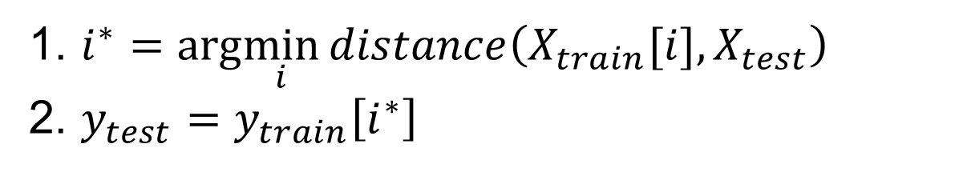
Nearest neighbor algorithm (K-NN)
For given test features, assign the label / target value of the most similar training features
1. $i^{∗}=arg\min_{i}{distance\left(X_{train}[i],X_{test}\right)}$
2. $y_{test}=y_{train}\left[i^{∗}\right]$
For K-NN, there is no learned model, just the training data and the retrieval function.

Slide 5
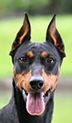
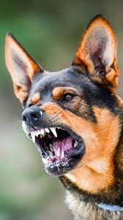
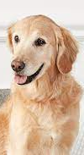

Key principle of machine learning
Given feature/target pairs $\left(X_{1},y_{1}\right),…,\left(X_{n},y_{n}\right):$
if $X_{i}$ is similar to $X_{j}$, then $y_{i}$ is probably similar to $y_{j}$
Fundamentally, learning depends on:
Representation of samples
Similarity function
Aggressive
Friendly
Aggressive?
Probably Aggressive

Slide 6
Today’s lecture
Similarity measures
Regression
Generalization

Slide 7
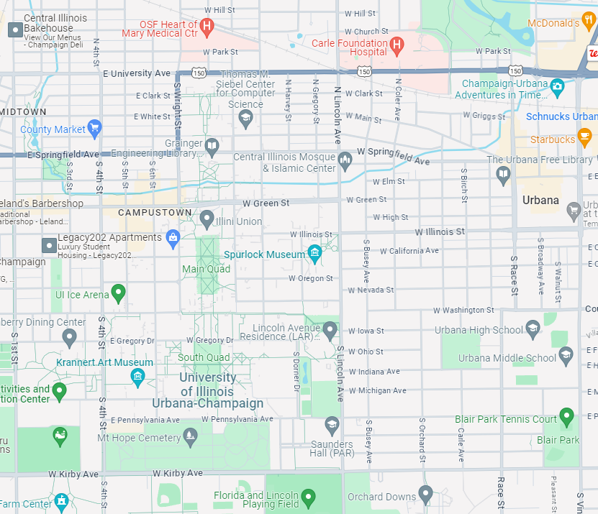

Common Distance/Similarity Measures
L2: Euclidean
$$d_{2}\left(x,y\right)={\left\|x−y\right\|}_{2}=\sqrt{\sum_{i}{{\left(x_{i}−y_{i}\right)}^{2}}}$$

Slide 8
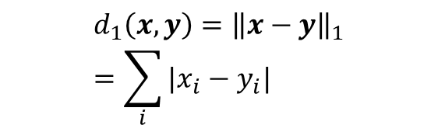
Common Distance/Similarity Measures
L1: City-Block
$$d_{1}\left(x,y\right)={\left\|x−y\right\|}_{1}=\sum_{i}{|x_{i}−y_{i}|}$$

Slide 9
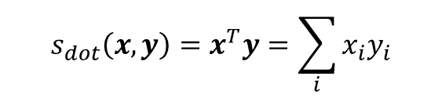

Common Distance/Similarity Measures
Dot product, Cosine
Dot product (or inner product)
$$s_{dot}\left(x,y\right)=x^{T}y=\sum_{i}{x_{i}y_{i}}$$
Cosine similarity
$$s_{cos}\left(x,y\right)=\frac{x^{T}y}{{\left\|x\right\|}_{2}{\left\|y\right\|}_{2}}$$
Cosine similarity
Dot product: how far does one vector go in the direction of the other vector
Cosine similarity: how similar are the two directions

Slide 10
Which is closest to the red circle under L1, L2, and cosine distance?
Notes:
Answer: orange/yellow is closest under L2, green is closest under L1, and purple is closest under cosine

Slide 11
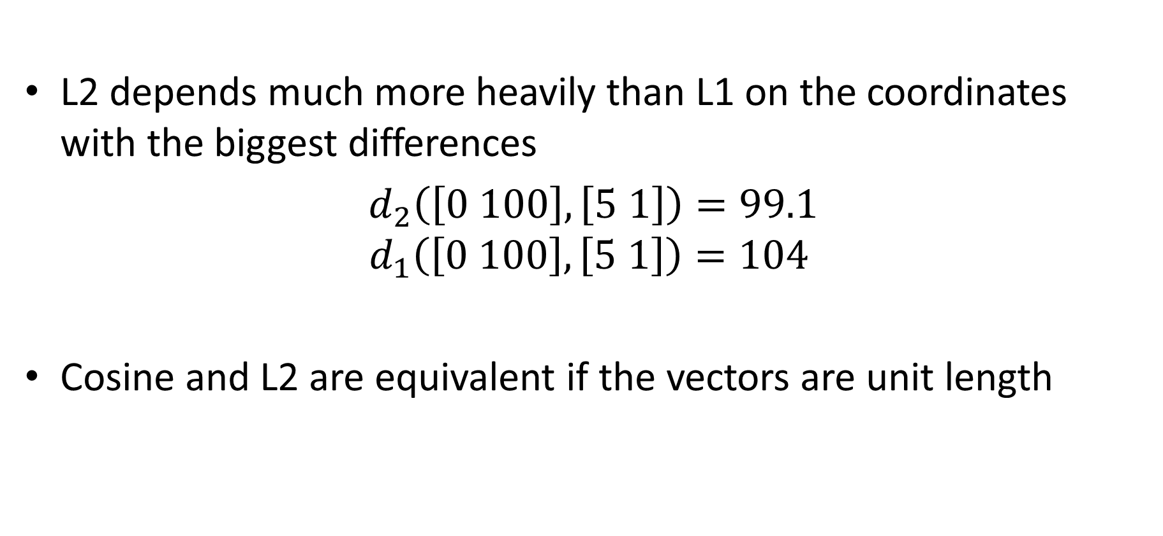
Comparing distance/similarity functions
L2 depends much more heavily than L1 on the coordinates with the biggest differences
$d_{2}\left(\left[0 100\right], \left[5 1\right]\right)=99.1$
$$d_{1}\left(\left[0 100\right], \left[5 1\right]\right)=104$$
Cosine and L2 are equivalent if the vectors are unit length
$${\left\|x−y\right\|}_{2}^{2}=x^{T}x−2x^{T}y+y^{T}y=2(1−s_{cos}\left(x,y\right))$$
1
1

Slide 12
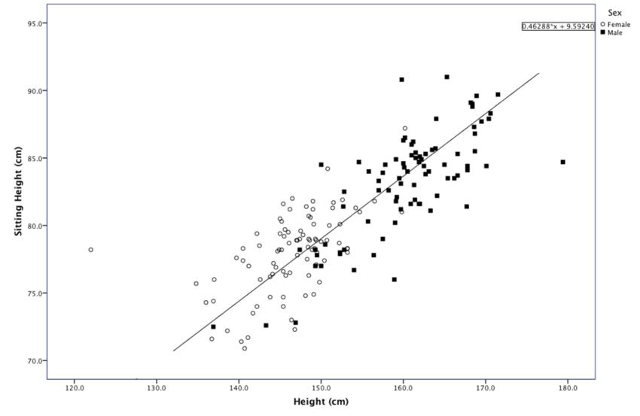
Classification: Predict sex from standing/sitting heights
o
+
x
https://www.researchgate.net/figure/Scatter-plot-of-Sitting-Height-over-Height-for-males-and-females_fig3_301724988

Slide 13
Classification: Predict sex from standing/sitting heights
o
+
x
https://www.researchgate.net/figure/Scatter-plot-of-Sitting-Height-over-Height-for-males-and-females_fig3_301724988

Slide 14
Classification: Predict sex from standing/sitting heights
o
+
x
https://www.researchgate.net/figure/Scatter-plot-of-Sitting-Height-over-Height-for-males-and-females_fig3_301724988

Slide 15
KNN Regression
Also retrieve the K-nearest neighbors
But, instead of predicting the most common retrieved label, predict the average of the returned values

Slide 16
Regression: Predict sitting height from standing height with 1NN
x
+
o
https://www.researchgate.net/figure/Scatter-plot-of-Sitting-Height-over-Height-for-males-and-females_fig3_301724988

Slide 17
Regression: Predict sitting height from standing height with 1NN
x
+
o
https://www.researchgate.net/figure/Scatter-plot-of-Sitting-Height-over-Height-for-males-and-females_fig3_301724988

Slide 18
Regression: Predict sitting height from standing height with 3NN
x
+
o
https://www.researchgate.net/figure/Scatter-plot-of-Sitting-Height-over-Height-for-males-and-females_fig3_301724988

Slide 19
Regression: Predict sitting height from standing height with 1NN
x
+
o
https://www.researchgate.net/figure/Scatter-plot-of-Sitting-Height-over-Height-for-males-and-females_fig3_301724988

Slide 20
Regression: Predict sitting height from standing height with 1NN
x
+
o
https://www.researchgate.net/figure/Scatter-plot-of-Sitting-Height-over-Height-for-males-and-females_fig3_301724988

Slide 21
Regression: Predict sitting height from standing height with 3NN
x
+
o
https://www.researchgate.net/figure/Scatter-plot-of-Sitting-Height-over-Height-for-males-and-females_fig3_301724988

Slide 22
Regression: Predict sitting height from standing height with 1NN
x
+
o
https://www.researchgate.net/figure/Scatter-plot-of-Sitting-Height-over-Height-for-males-and-females_fig3_301724988

Slide 23
Regression: Predict sitting height from standing height with 1NN
x
+
o
https://www.researchgate.net/figure/Scatter-plot-of-Sitting-Height-over-Height-for-males-and-females_fig3_301724988

Slide 24
Regression: Predict sitting height from standing height with 3NN
x
+
o
https://www.researchgate.net/figure/Scatter-plot-of-Sitting-Height-over-Height-for-males-and-females_fig3_301724988

Slide 25
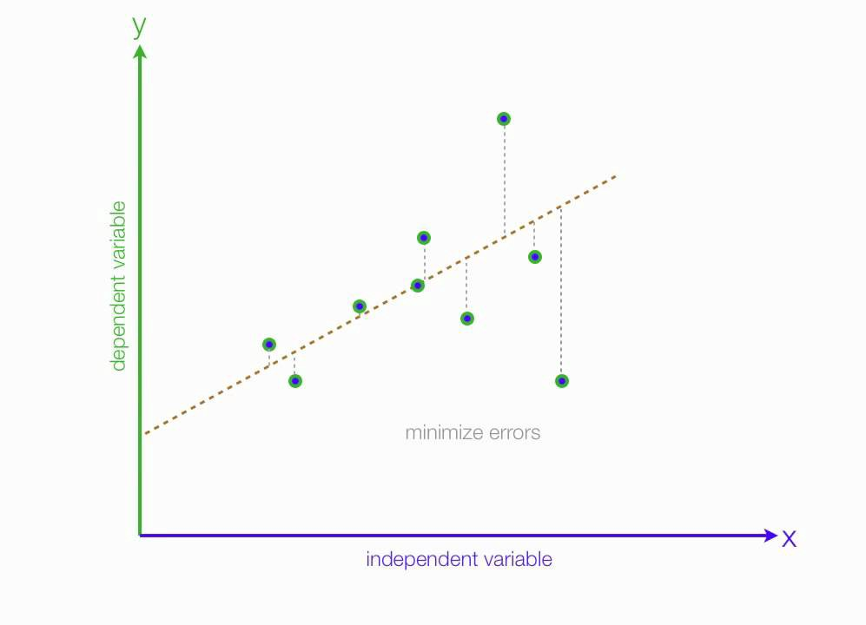
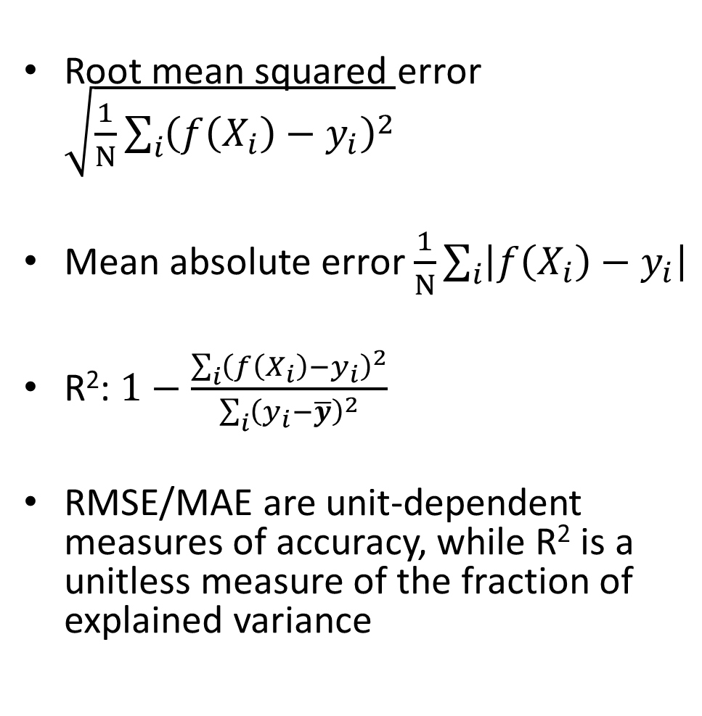
How do we measure and analyze regression error?
Root mean squared error $\sqrt{\frac{1}{N}\sum_{i}{{\left(f\left(X_{i}\right)−y_{i}\right)}^{2}}}$
Mean absolute error $\frac{1}{N}\sum_{i}{\left|f\left(X_{i}\right)−y_{i}\right|}$
R²: $1−\frac{\sum_{i}{{\left(f\left(X_{i}\right)−y_{i}\right)}^{2}}}{\sum_{i}{{\left(y_{i}−\overline{y}\right)}^{2}}}$
RMSE/MAE are unit-dependent measures of accuracy, while R² is a unitless measure of the fraction of explained variance
$$f\left(x\right)$$
(unexplained variance)
(total variance)
Fig: https://medium.com/analytics-vidhya/mae-mse-rmse-coefficient-of-determination-adjusted-r-squared-which-metric-is-better-cd0326a5697e

Slide 26
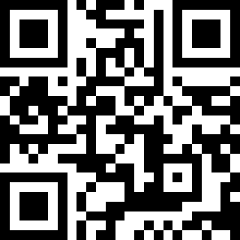
Q1-Q3
https://tinyurl.com/AML441-L3

Slide 27
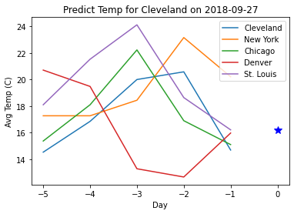
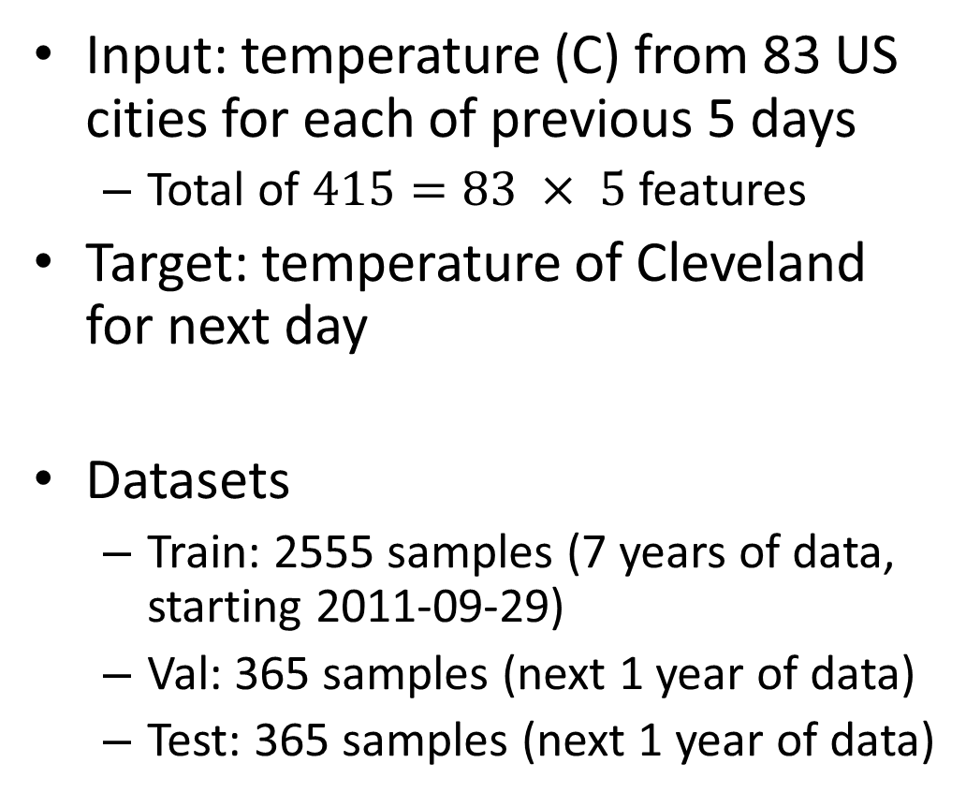
Introducing the Temperature Regression Dataset
Input: temperature (C) from 83 US cities for each of previous 5 days
  Total of $415=83 × 5$ features
Target: temperature of Cleveland for next day
Datasets
  Train: 2555 samples (7 years of data, starting 2011-09-29)
  Val: 365 samples (next 1 year of data)
  Test: 365 samples (next 1 year of data)

Slide 28
KNN for Temperature Regression
def regress_KNN(X_query, X_train, y_train, K):
# (1) Compute distances between X_query and each sample in X_train
# (2) Get the K_smallest_idx: K indices corresponding to smallest distances(e.g. use np.argsort)
# (3) Return the mean of y_train[K_smallest_idx]
def RMSE(y_pred, y_true):
return np.sqrt(np.mean((y_pred-y_true)**2))
Testing procedure:
# Get y_pred[i] = regressKNN(X_test[i], X_train, y_train, K) for each ith sample in X_test
# measure error: err = RMSE(y_pred, y_test)

Slide 29
Some things to consider
The temperatures will vary a lot over the year, which will reduce the number of examples with similar temperatures
  What can we do?

Slide 30
Some things to consider
The temperatures will vary a lot over the year, which will reduce the number of examples with similar temperatures
  What can we do?
  Reframe the problem by making all of the temperatures relative to previous day’s Cleveland temperature
How do we choose K?

Slide 31
Choosing K Using a Validation Set
For each candidate K, e.g. K=1, 3, 5, 9, 11, 25:
  Evaluate error using the validation set
Select the K with the lowest validation error

Slide 32
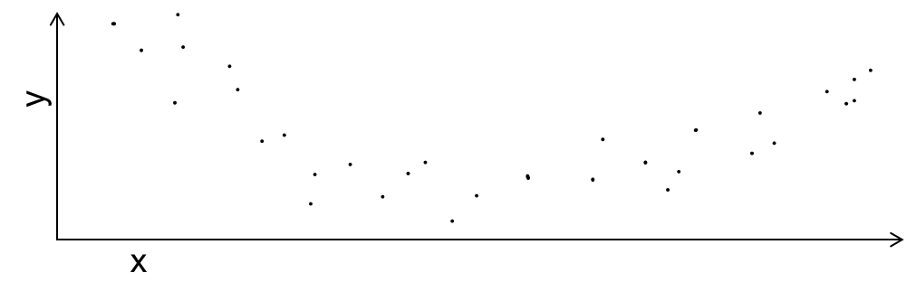

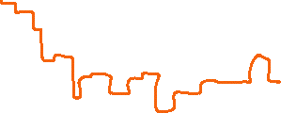


Small K may “overfit” data, while large K may not be able to fit the true trend
K=1
K=5
K=25

Slide 33
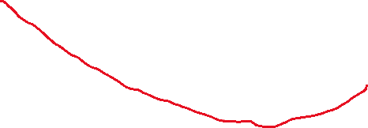
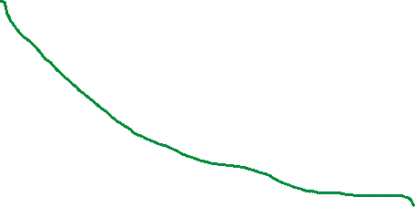
Error and Bias Variance Trade-off
K=1
Under-fitting
Overfitting
K=5
Test error
Error
Train error
Generalization Error
K=25
Complexity/Precision of Model
K=25
K=5
K=1

Slide 34
Error and Bias Variance Trade-off
When model parameters are fit to a training set and evaluated on a test set
Training error: The error on the training set
Test error: The error on the test set
Generalization error: test error – training error
Test error has three important sources in common ML settings:
Intrinsic: sometimes it is not possible to achieve zero error given available features (e.g. handwriting, weather prediction)
  Bayes optimal error: The error if the true function P(y|x) is known
Model Bias: the model is limited so that it can’t fit perfectly to the true data distribution (e.g. there will be error, even if you have infinite training data)
Model Variance: given finite training data, different parameters and predictions would result from different samplings of data
A more complex or specific model is expected to have
Lower bias: better fit to training set
Higher variance: more uncertainty in best parameters, so higher generalization error
Could have higher or lower test error

Slide 35
Q4-Q6
https://tinyurl.com/AML441-L3

Slide 36
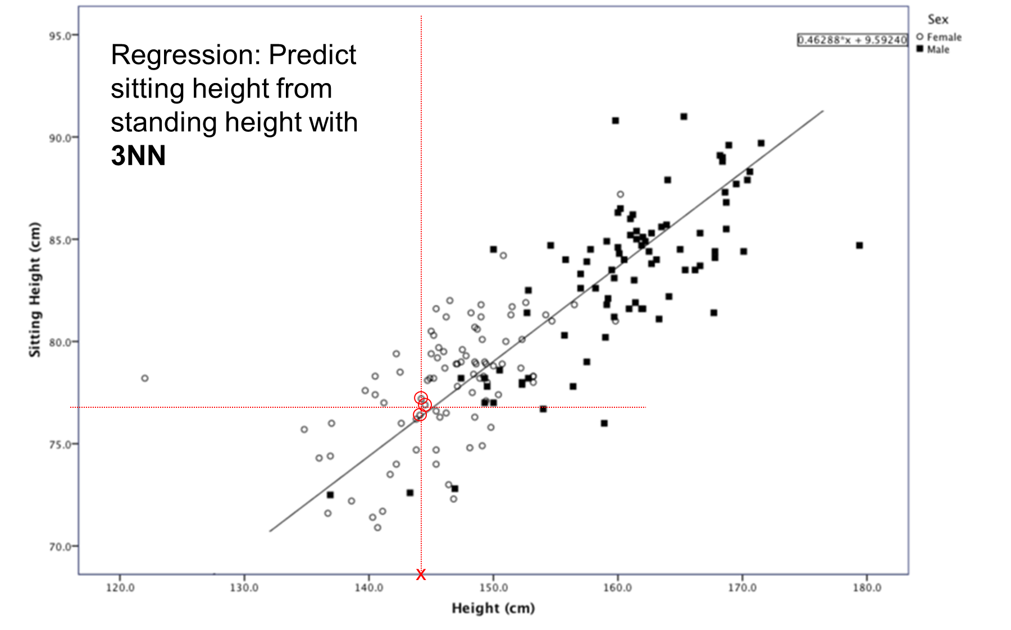
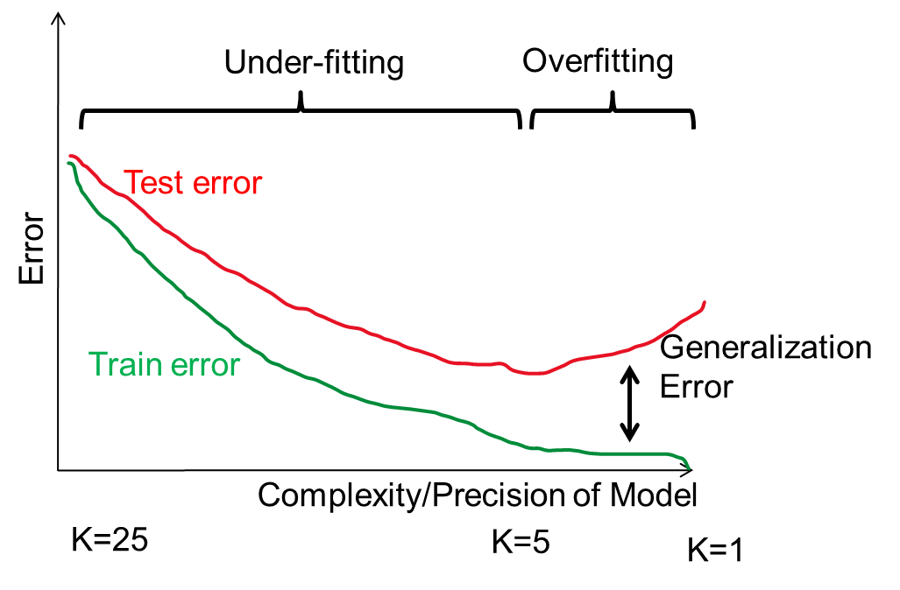
Things to remember
Similarity/distance measures: L1, L2, cosine
KNN can be used for either classification (return most common label) or regression (return average target value)
Test error is composed of
  Irreducible error (perfect prediction not possible given features)
  Bias (model cannot perfectly fit the true function)
  Variance (parameters cannot be perfectly learned from training data)

Slide 37
Thursday
Retrieval and clustering

