Slide 1
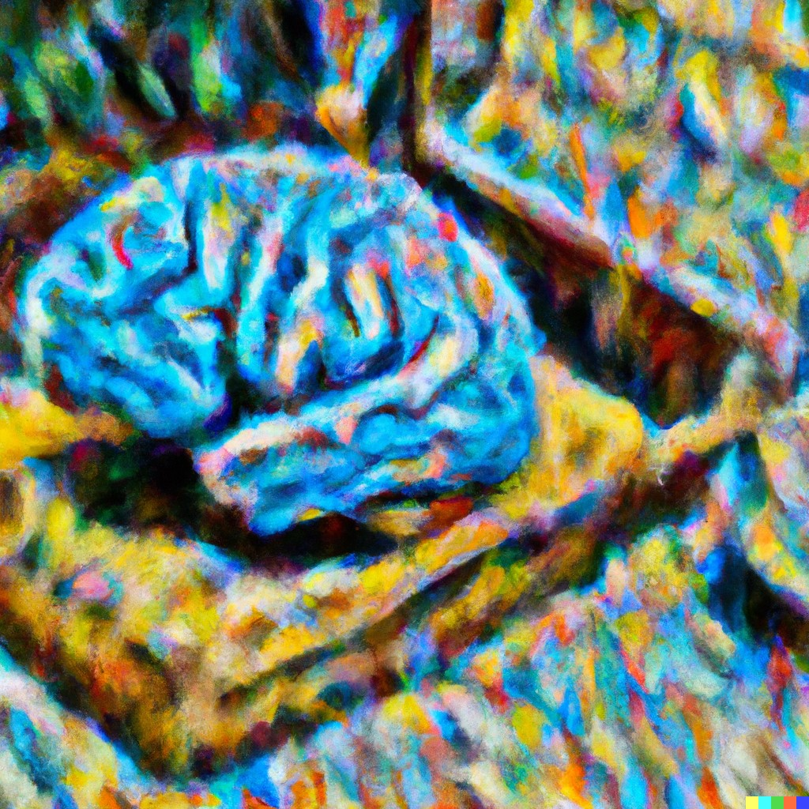
CS441
Applied Machine Learning
Instructor: Derek Hoiem
Art by Dall-E: “Computer brain gathering knowledge, impressionist”

Slide 2
Today’s Class
A little about me
Intro to Applied Machine Learning
Course outline and logistics

Slide 3
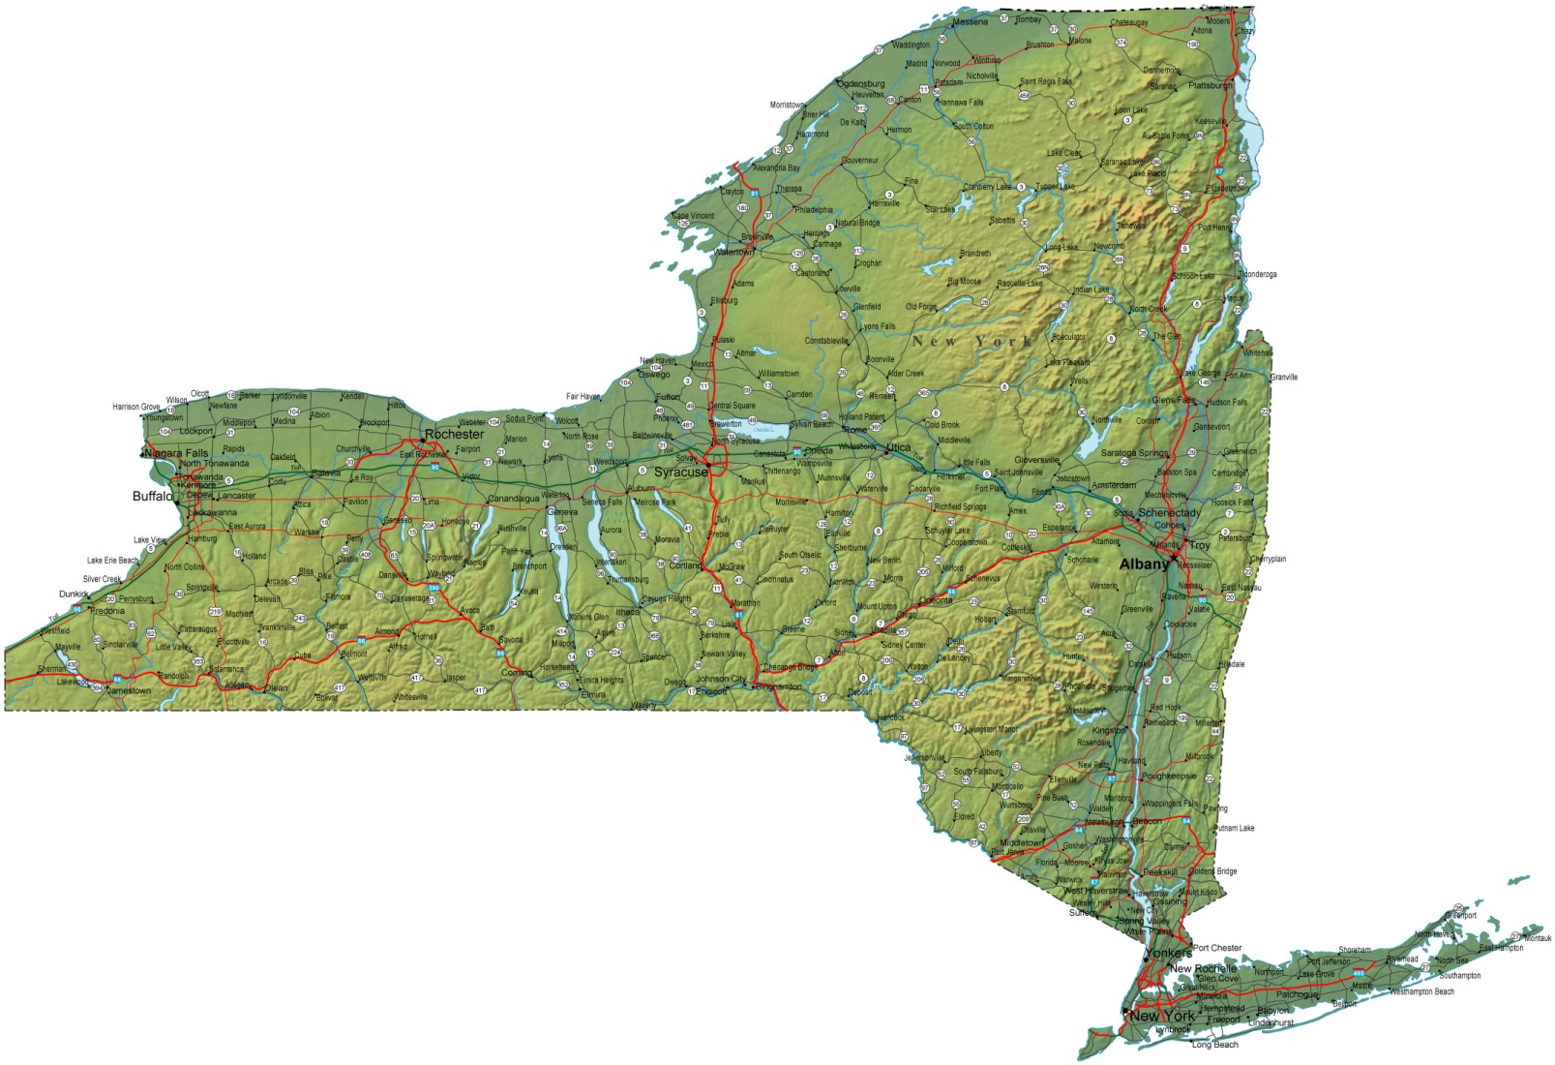
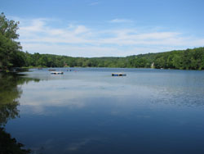
About me
Raised in “upstate” NY

Slide 4
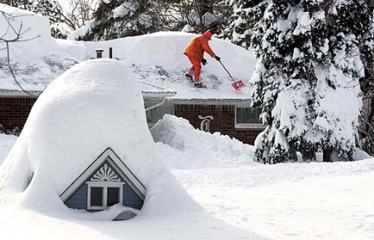
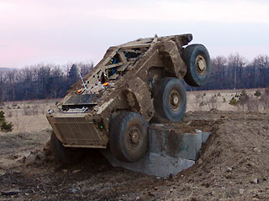
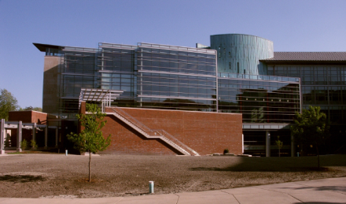
A little about me
Undergrad at SUNY Buffalo (EE, CE)
PhD in Robotics at Carnegie Mellon
Professor in Computer Science at University of Illinois

Slide 5
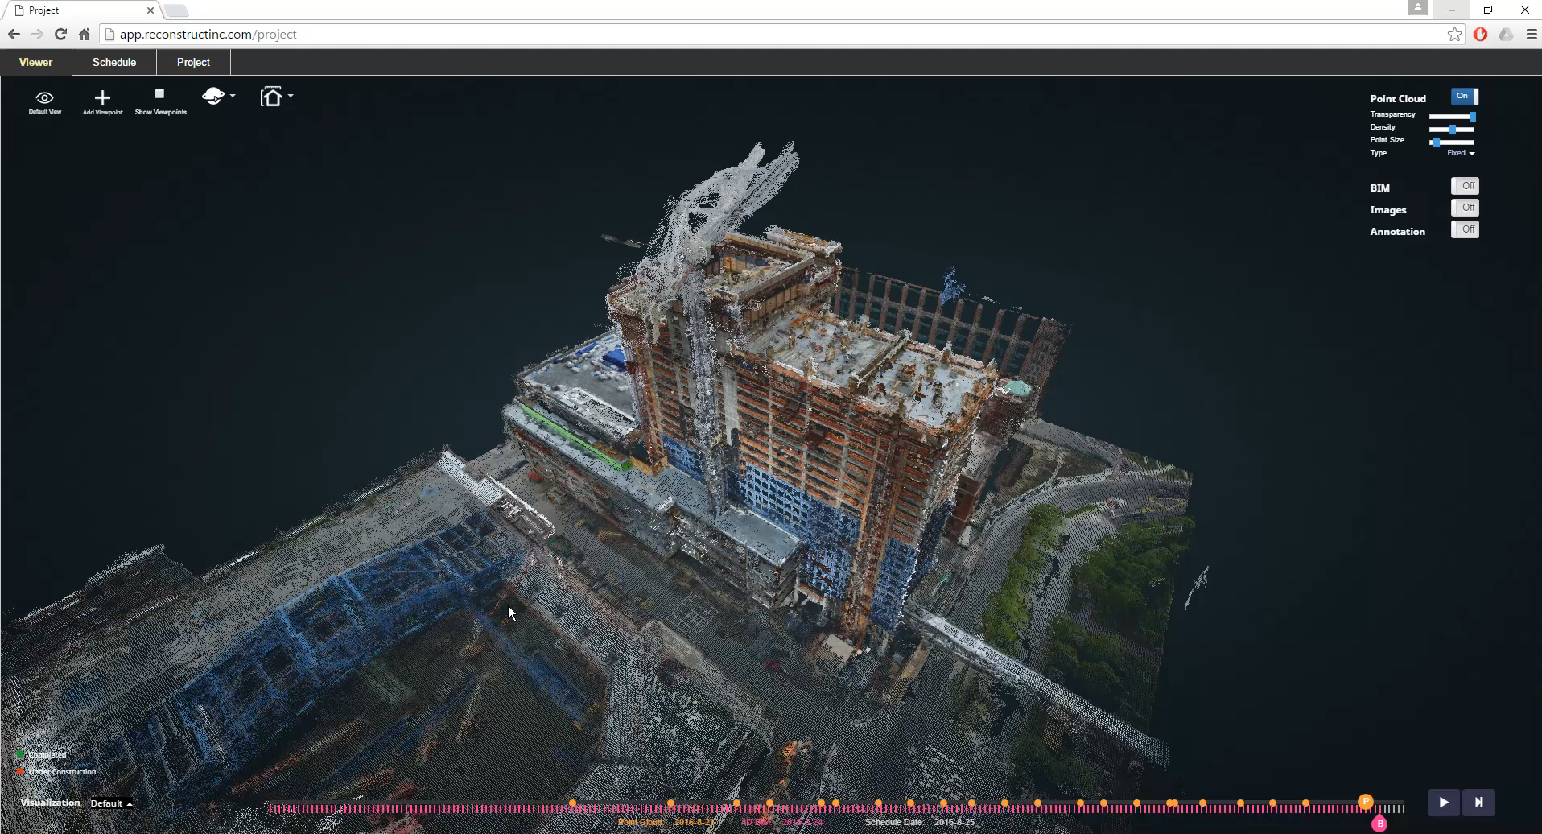
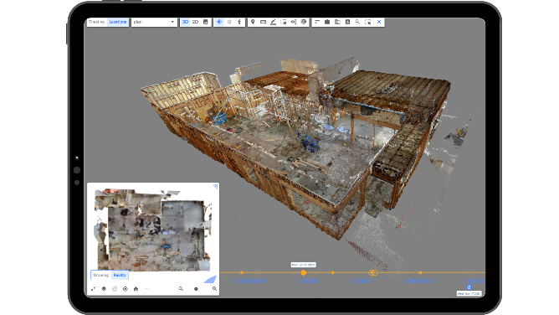
Reconstruct: vision for construction
Co-founder and Chief Science Officer of Reconstruct
https://vimeo.com/242479887
https://www.reconstructinc.com/

Slide 6

I ML

Slide 7
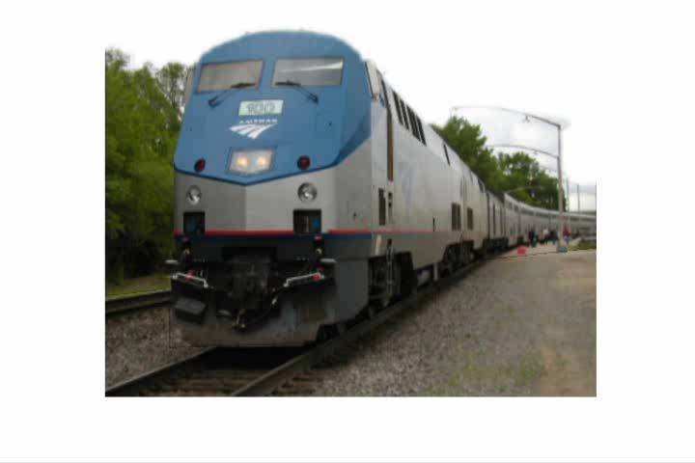
My early research: Learning to interpret geometry
Hoiem et al. 2005

Slide 8
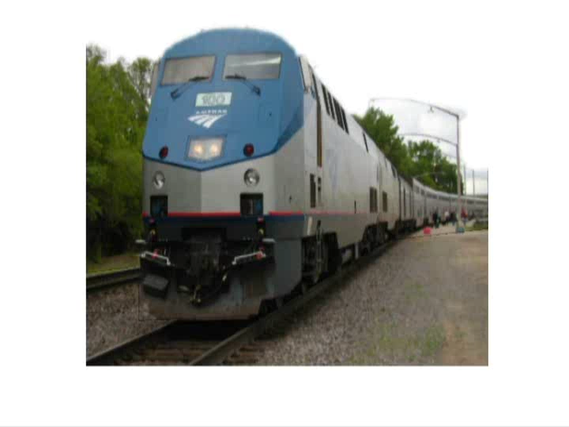
My early research: Learning to interpret geometry
Hoiem et al. 2005

Slide 9
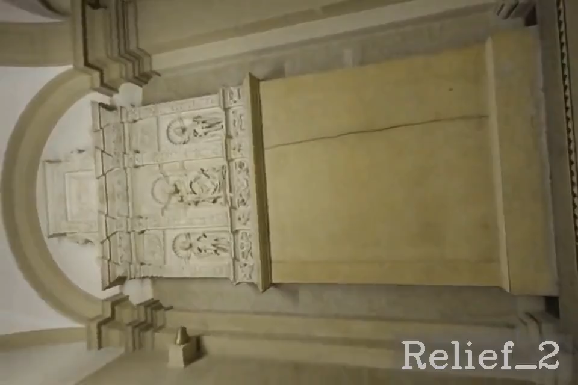
MonoPatchNeRF: use deep networks to model 3D scenes
Wu Lee Zou Wang Hoiem. 2025

Slide 10
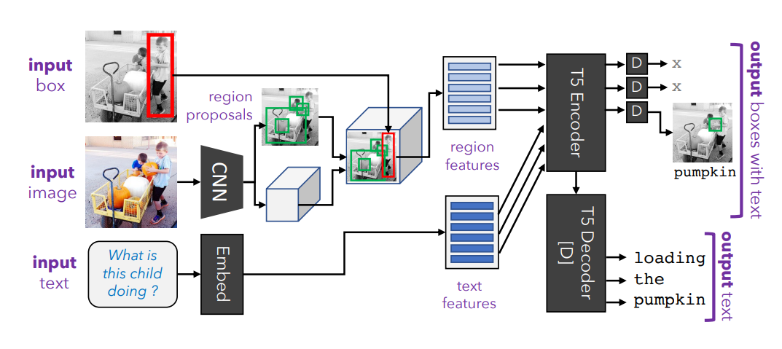
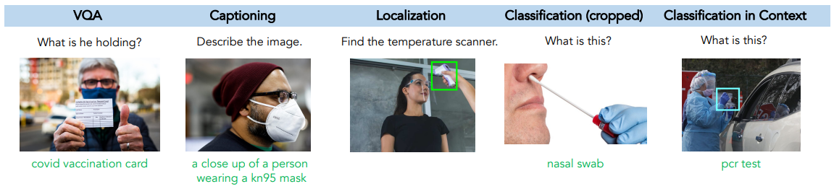
General Purpose Learners
Kamath et al. 2022

Slide 11
Other examples of my research that use machine learning
Vision
  Object detection
  Image classification
  Photo album organization
  Image retrieval
  Describing objects
  3D scene modeling
  3D object modeling
  Robot navigation
  Shadow detection and removal
  Generating animations
Vision and Language
  Visual question answering
  Phrase grounding
  Video analysis
  Large multimodal models
Audio
  Sound detection
  Music identification

Slide 12
Machine learning and the quest for intelligent machines

Slide 13
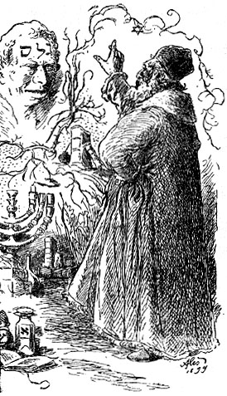
Rabbi Loew’s Golem
By Mikoláš Aleš https://commons.wikimedia.org/w/index.php?curid=2210897
Notes:
People have always been fascinated by life and how to re-create it. Golems date back to early Judaism, based on idea that life can be created from dead matter.

Slide 14
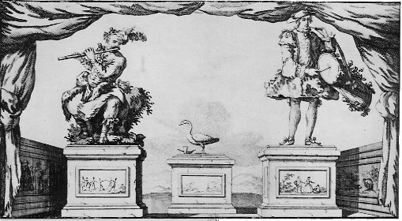
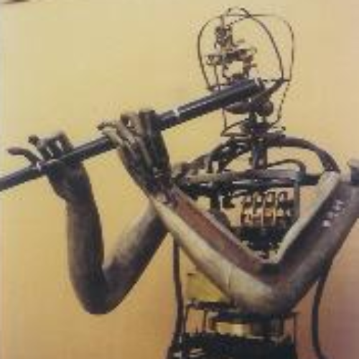
Vaucanson’s Automata (1738)
Flute player
Defecating Duck
Tambourine Player
http://www.francoisjunod.com/automates/eightennth/vaucanson_uk.htm
https://time.graphics/event/1736967
Notes:
In the late 18th century, people were particularly interested in the mechanics of the body.

Slide 15
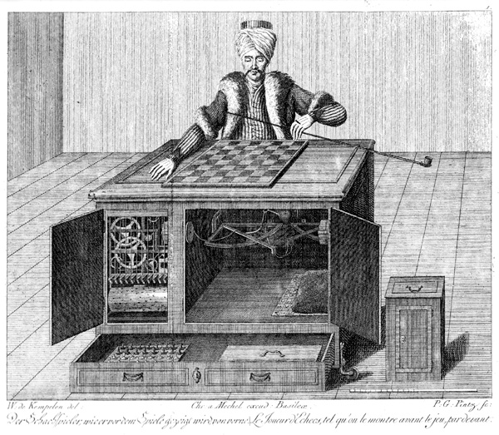
Mechanical Turk (1770)
Secretly operated by a chess master, the mechanical turk was exhibited as an automatic chess playing machine.
Opponents included Benjamin Franklin and Napoleon Bonaparte.
Engraving of Mechanical Turk (src)
Notes:
There was also interest in mechanizing intelligence

Slide 16
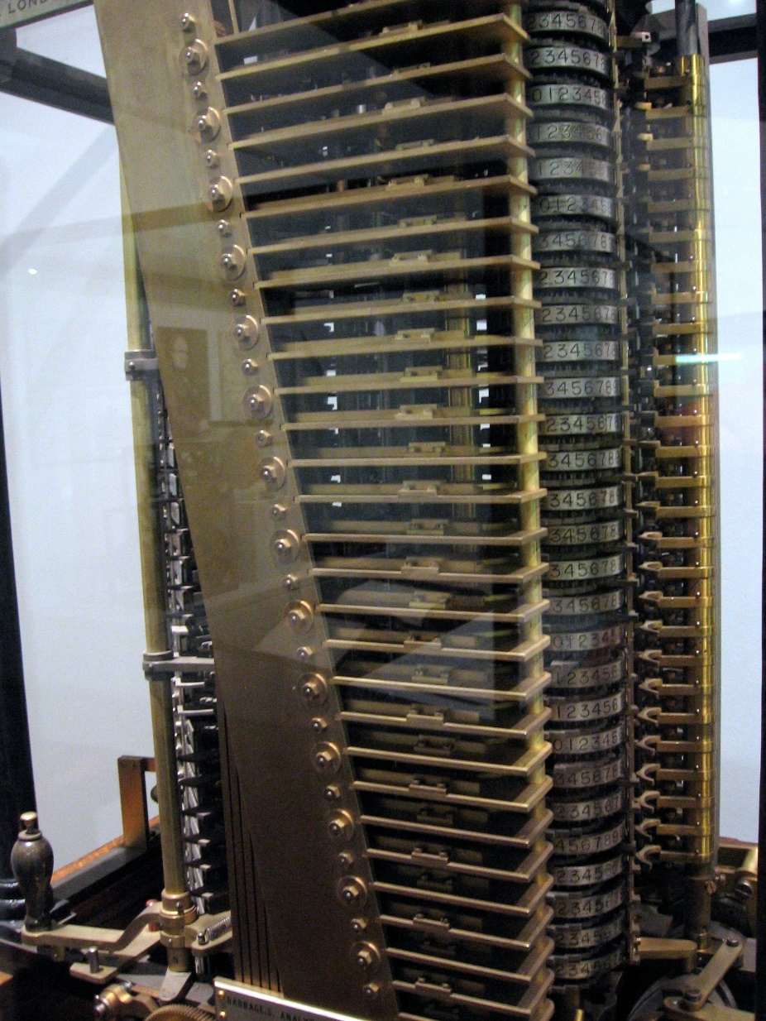
Babbage’s analytical engine (1837)
Not ever completely built
Ada Lovelace described a way to calculate Bernoulli numbers using the machine in 1843 (first computer program)
Analytical Engine Mill, built 1910 (src)

Slide 17
Two truths and a lie
AGI was predicted to be just around the corner in 1957
The first self-driving car was built in 2005
Today, AI Chatbots have 1B weekly users

Slide 18
Some AI milestones
Early days (1950-1980)
Alan Turing proposes the Imitation Game (1949)
The Logic Theorist theorem prover (1955) – Newell and Simon
The Perceptron - Rosenblatt (1957) (expected to lead to AGI)
Eliza Chat Bot (1966) – Weizenbaum
A few wins (1980-2010)
USPS uses OCR for mail processing (1982)
First commercially successful AI – Expert Systems (1980s)
Navlab5 drives 2,848 miles across the country averaging 64 mph, 98% autonomously (1995)
“Deep Blue” defeats Kasparov in Chess (1997)
Roomba (2002)
Face detection in digital cameras (2005)
Google Translate (2006)
Rise of deep learning and generative models (2012-now)
Convolutional network kicks butt in the ImageNet Challenge (2012)
AlphaGo defeats Lee Sedol in Go (2016)
ChatGPT released to public (2022)
AI ChatBots have 1 billion weekly active users (2025)
Notes:
1. The Dartmouth Conference (1956)
Often considered the "birthplace" of AI as a formal discipline, this conference was organized by John McCarthy, Marvin Minsky, Nathaniel Rochester, and Claude Shannon. The term "artificial intelligence" was coined here, and the event marked the beginning of serious research into AI.
2. The Logic Theorist (1955-1956)
Developed by Allen Newell and Herbert A. Simon, the Logic Theorist is considered one of the first AI programs. It was able to prove mathematical theorems by mimicking the reasoning process used by humans.
3. ELIZA (1966)
Created by Joseph Weizenbaum at MIT, ELIZA was an early natural language processing program that could mimic conversation. Its most famous mode, the "DOCTOR" script, simulated a Rogerian psychotherapist and engaged users in simple conversations.
4. The Perceptron (1958)
Invented by Frank Rosenblatt, the Perceptron was one of the earliest models of a neural network. Although initially limited, it laid the groundwork for later advances in machine learning.
5. The AI Winter (1970s-1980s)
This period saw reduced funding and interest in AI due to unmet expectations and the limitations of existing AI technologies. Research slowed significantly, but the period also led to valuable reassessments of the goals and methods in AI.
6. Expert Systems (1980s)
Expert systems, like MYCIN and DENDRAL, became one of the first commercially successful applications of AI. These systems used rule-based reasoning to solve complex problems in specific domains, such as medical diagnosis.
7. Deep Blue Defeats Garry Kasparov (1997)
IBM's Deep Blue, a chess-playing computer, defeated the world champion Garry Kasparov. This event was a significant milestone, demonstrating the power of AI in complex decision-making tasks.
8. The Advent of Machine Learning and Big Data (2000s)
The 2000s saw a shift towards machine learning, especially with the increasing availability of large datasets and the rise of big data. Algorithms like support vector machines and random forests became popular during this time.
9. Deep Learning Revolution (2010s)
The development of deep learning, particularly neural networks with many layers (deep neural networks), marked a major breakthrough. Notable achievements include AlexNet winning the ImageNet competition in 2012, which demonstrated the power of convolutional neural networks (CNNs) for image recognition.
10. AlphaGo Defeats Lee Sedol (2016)
Developed by DeepMind, AlphaGo defeated Lee Sedol, one of the world’s top Go players. This victory was particularly significant because Go is an extremely complex game with more possible moves than there are atoms in the universe, making it a challenging problem for AI.
11. GPT-3 (2020)
OpenAI’s GPT-3, a language model with 175 billion parameters, demonstrated unprecedented capabilities in natural language processing, including generating human-like text, answering questions, and performing tasks such as translation and summarization.
12. AI in Everyday Life (2020s)
AI has become integrated into everyday life through applications such as voice assistants (e.g., Siri, Alexa), recommendation systems (e.g., Netflix, YouTube), and autonomous vehicles. The ongoing development of AI ethics and regulation is also becoming increasingly important as AI systems become more pervasive.

Slide 19
Two truths and a lie
AGI was predicted to be just around the corner in 1957
The first self-driving car was built in 2005
Today, AI Chatbots have 1B weekly users

Slide 20
We are what we learn – intelligence, the ability to learn, is a defining characteristic of our humanity
How our learning works is one of the great mysteries, and solving it will help us understand ourselves

Slide 21
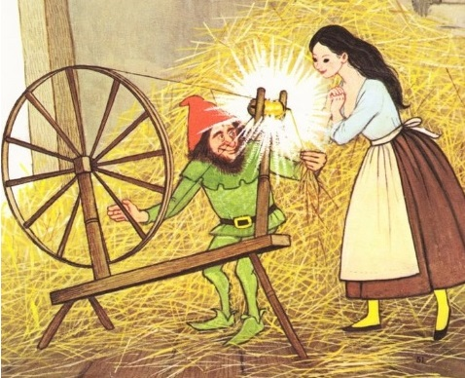
What is machine learning?
Create predictive models or useful insights from raw data
  Alexa speech recognition
  Amazon product recommendations
  Tesla autopilot
  GPT-3 text generation
  Image generation
  Data visualization
How? Select a model and solve for the parameters that optimize some objective in training data
Data
Algorithm
ML spins raw data into gold!

Slide 22
Machine Learning
ML spins raw data into gold!
Data
Algorithm
Data
Collect, Annotate, Curate, Format
Model
Train / Evaluate
Design
Model design
Loss, Training Algorithm
Evaluation design

Slide 23
Process of ML
Model design
  How do we encode information?
  How do we predict (decode)?
Optimize encoder/decoder models using data
Target Labels
Loss / Feedback
Loss / Feedback
Input Data
Encoder
Decoder
Prediction
Text
Images
Audio
Discrete/continuous values
Structured/unstructured
Few/many examples
Few/many features
Clean/noisy labels
Manual feature design
Deep networks
Trees
Clustering
Feature selection
Kernels
Density estimation
Linear regressor
SVM
Logistic regressor
Nearest Neighbor
Probabilistic model
Clusters
Low dimensional embedding
Category
Pixel labels
Generated text, image, audio
Positions
Yes/No

Slide 24
Traditional ML: Focus on the Model/Algorithm Design
Data
Collect, Annotate, Curate, Format
Model
Evaluate
Design
Model design
Loss, Training Algorithm
Evaluation design

Slide 25
Deep ML: Focus on the Data (image/text/audio)
Data
Collect, Annotate, Curate, Format
Model
Evaluate
Design
Model design
Loss, Training Algorithm
Evaluation design

Slide 26
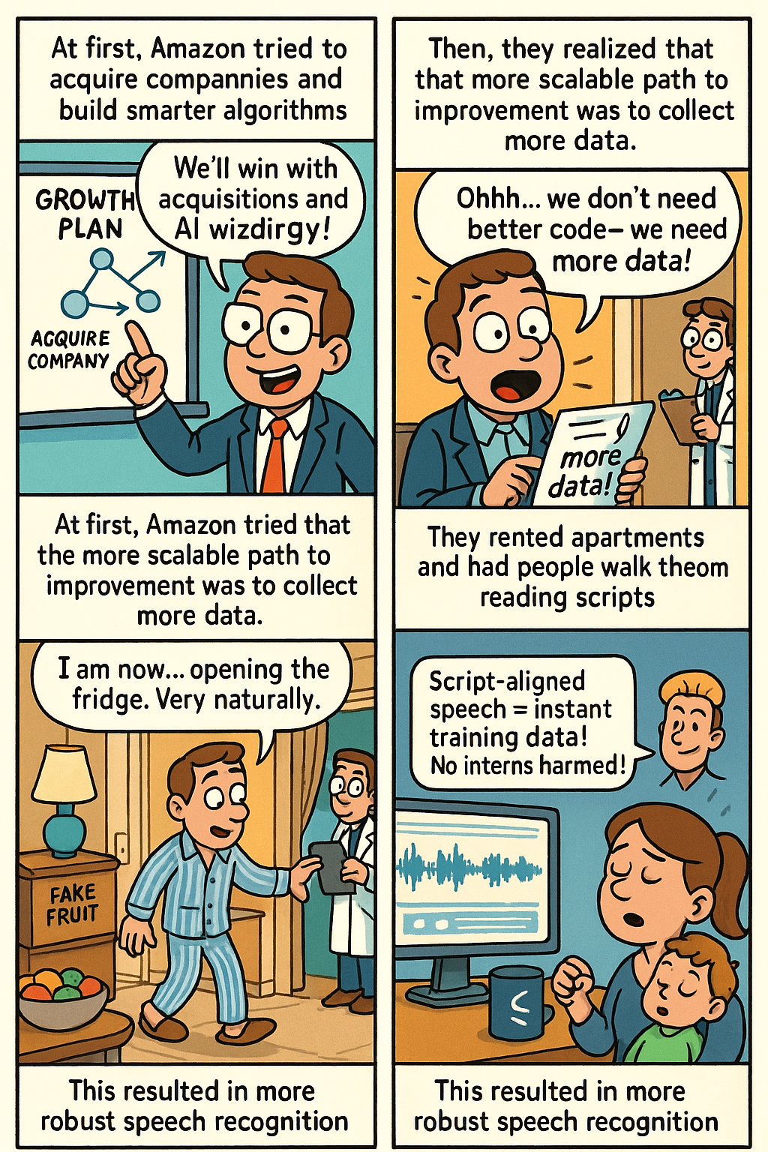
Example: Alexa Speech Recognition
(Comic created by ChatGPT :/ )

Slide 27
Why learn ML?

Slide 28
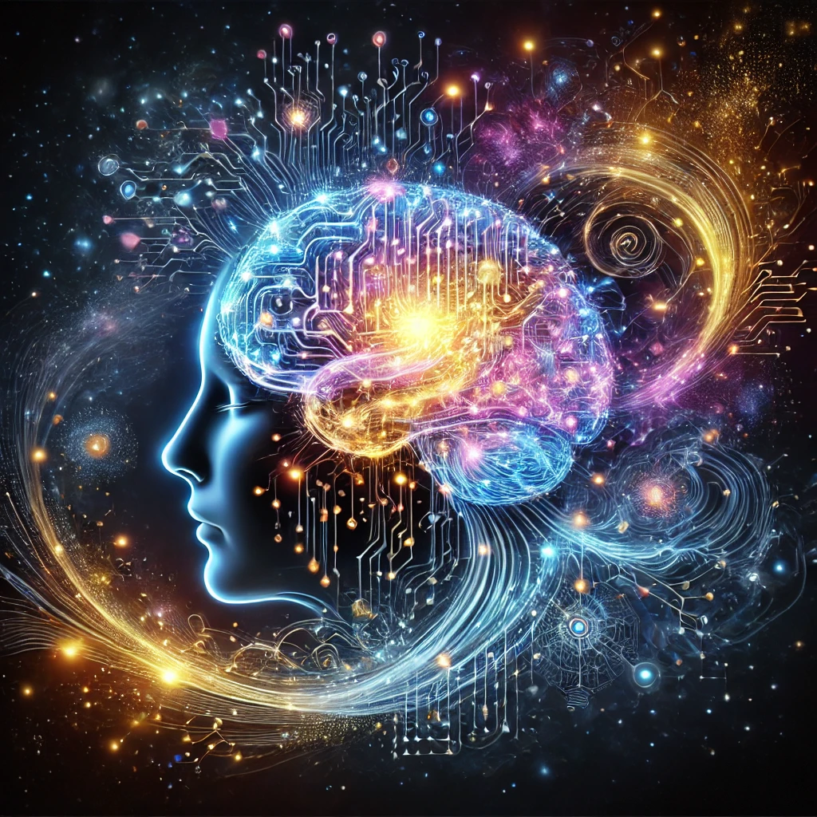
Appreciate your own intelligence
Our identities are largely characterized by what we learn.
Making machines that learn can help understand our own learning.
Notes:
https://en.wikipedia.org/wiki/Know_thyself

Slide 29
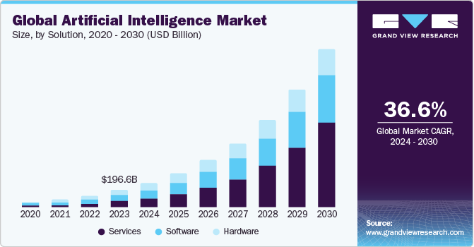
Learn to use ML to solve problems
Key concepts and methodologies for learning from data
Algorithms and their strengths and limitations
Domain-specific representations
Ability to select the right tools for the job

Slide 30
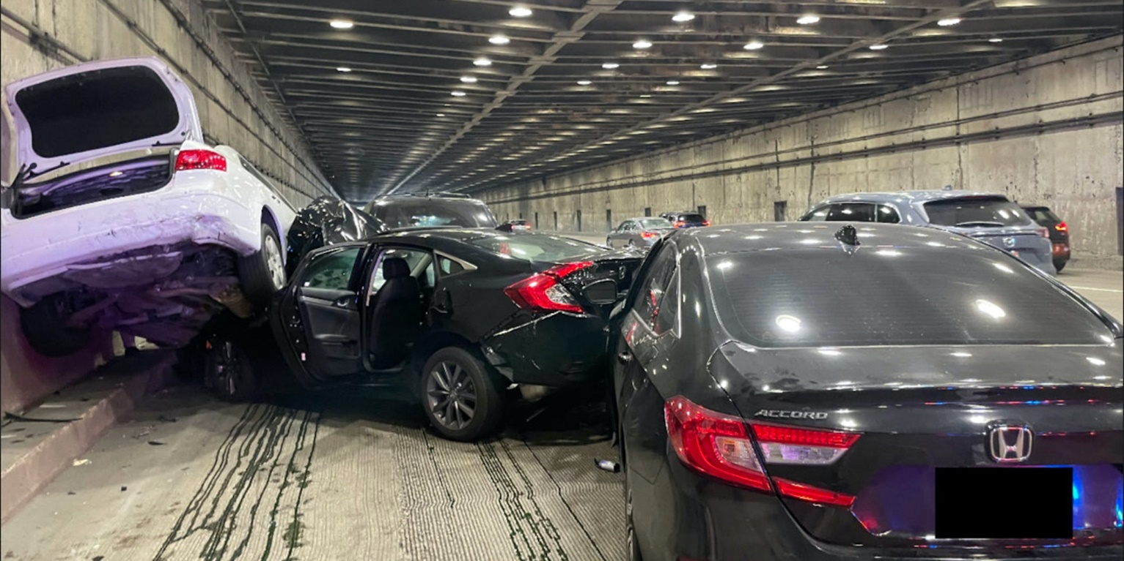
Develop responsibly by understanding societal and individual impact
Recommending systems
Surveillance
Robots
Smart assistants
Text generation
Autonomous cars
Social media bots
Tesla accident

Slide 31
The whole machine learning problem
Data preparation
  Collect and curate data
  Annotate the data (for supervised problems)
  Split your data into train, validation, and test sets
Algorithm and model development
  Design methods to extract features from the data
  Design a machine learning model and identify key parameters and loss
  Train, select parameters, and evaluate your designs using the validation set
Final evaluation using the test set
Integrate into your application
Example: voice recognition in Alexa
Our focus, but it’s important to understand all of it

Slide 32
Course outline
Prof: Derek Hoiem dhoiem@illinois.edu
TAs
Sewoong (Sam) Lee (samuel27)
Zhen Zhu (zhenzhu4)
Courtney McBeth (cmcbeth2)
Isaac Ngui (ingui2)
Michal Shlapentokh-Rothman (michal5)
Sethu TV (st34)
Website: https://courses.engr.illinois.edu/cs441/fa2025/
Bookmark this page!!

Slide 33
Machine learning is also useful
Unimate (1961) – first industrial robot
Expert Systems (80’s) - first commercially successful AI for things like medical diagnosis
USPS fully automated optical reader (1982)
Tesla autonomous driving, Alexa, Siri, Copilot, …

Slide 34
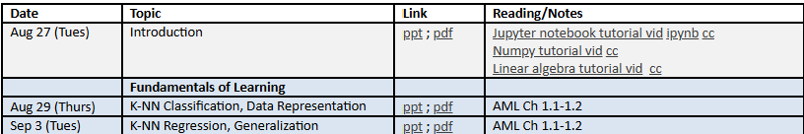
How the class works
Application
HWs
  Conduct experiments in Jupyter notebooks
  Report results
  Answer questions to test your understanding
Final project
  Define your own problem
  Collect data
  Train and evaluate model(s)
Lectures & Reading
Attend lecture
Reading materials and notes are optional
Recordings available (if they work), slides available
Getting help
Ask quick questions on CampusWire
  We aim to answer within 24 hours
For more in-depth help/understanding, come to office hours
Schedules for office hours and CW answering will be posted
Exams
Three 50-minute cumulative exams to test conceptual knowledge
Exams held in CBTF (closed book/notes)

Slide 35
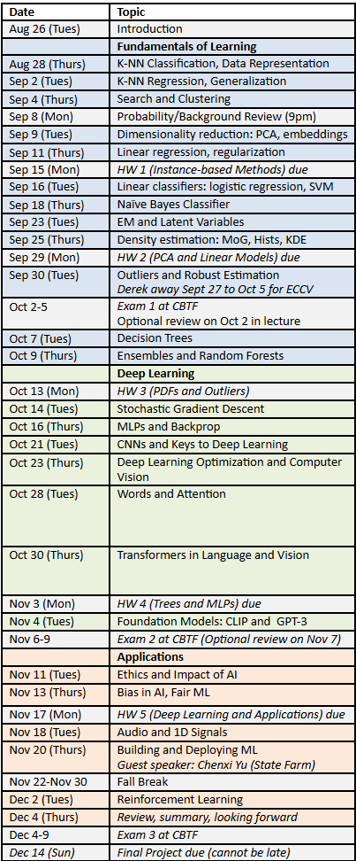
Topics
Fundamentals of learning
  How to build classifiers and regressors based on provided features
  Working with data, instance-based methods, linear models, probabilistic methods, trees
Deep representation learning
  How to learn effective representations
  Optimization, MLPs, CNNs, transformers, vision, language, foundational models
Applications
  Ethics and impact, bias/fairness, building applications, RL, audio and time series

Slide 36
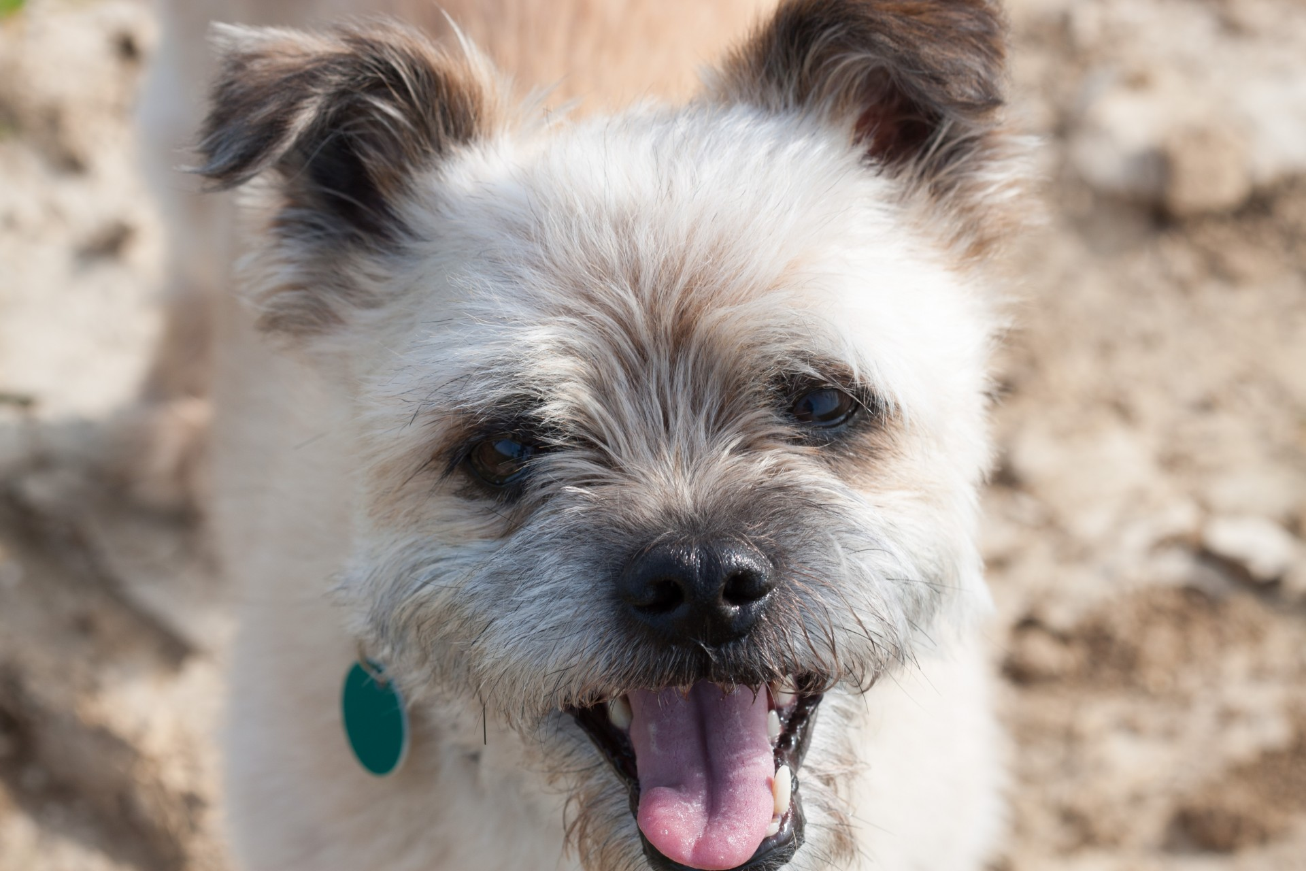

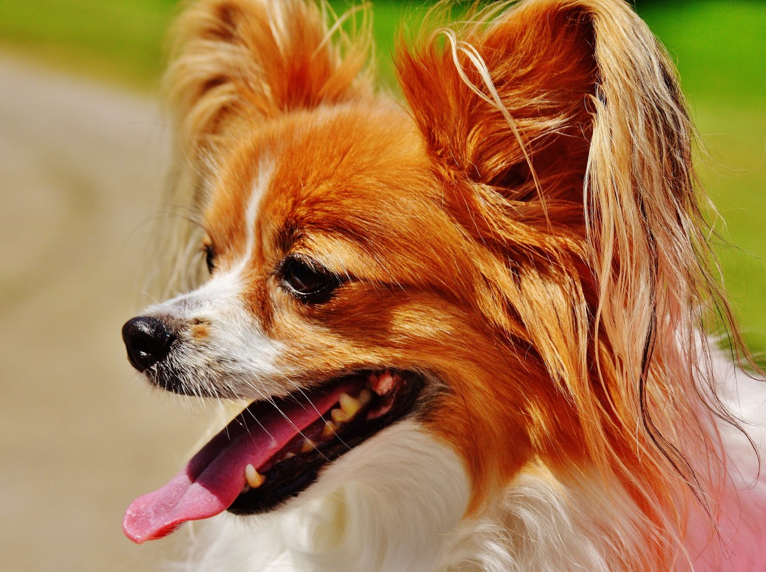
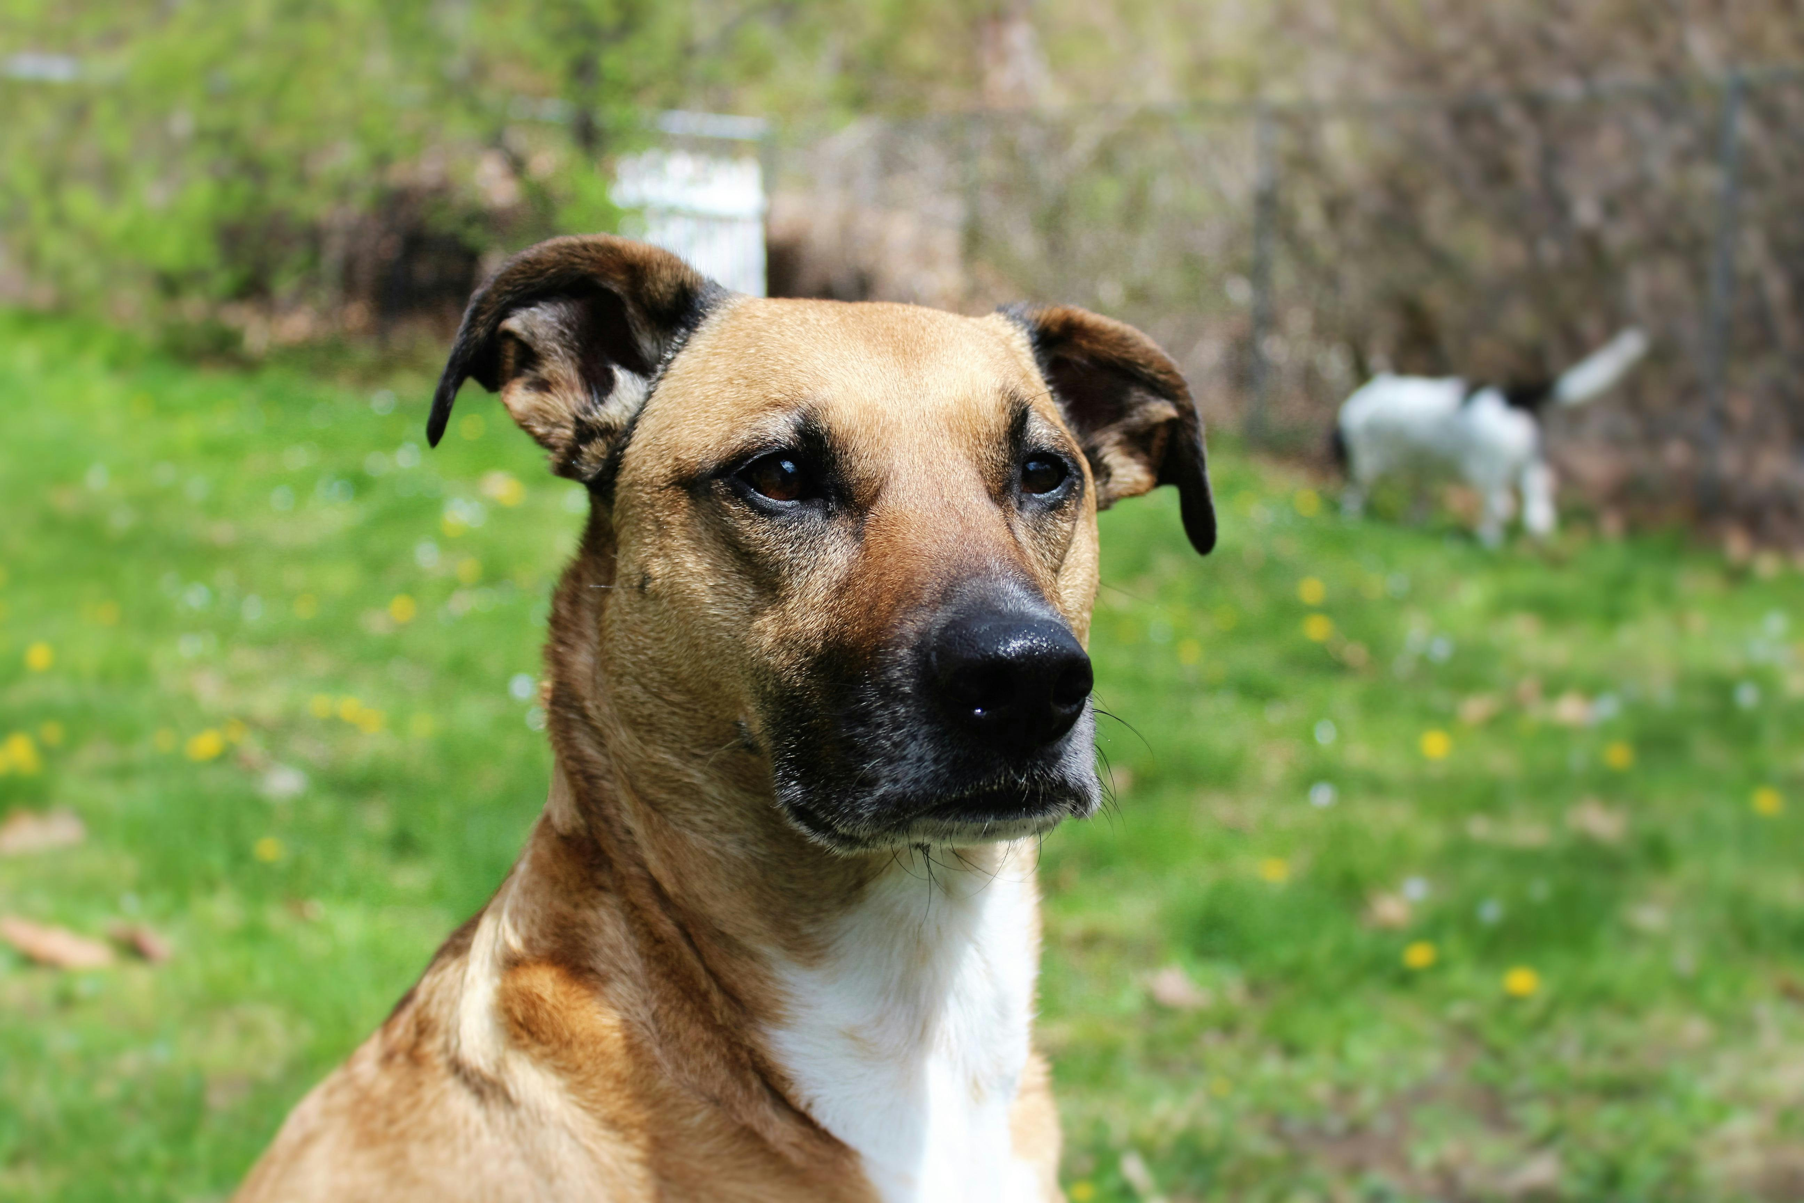
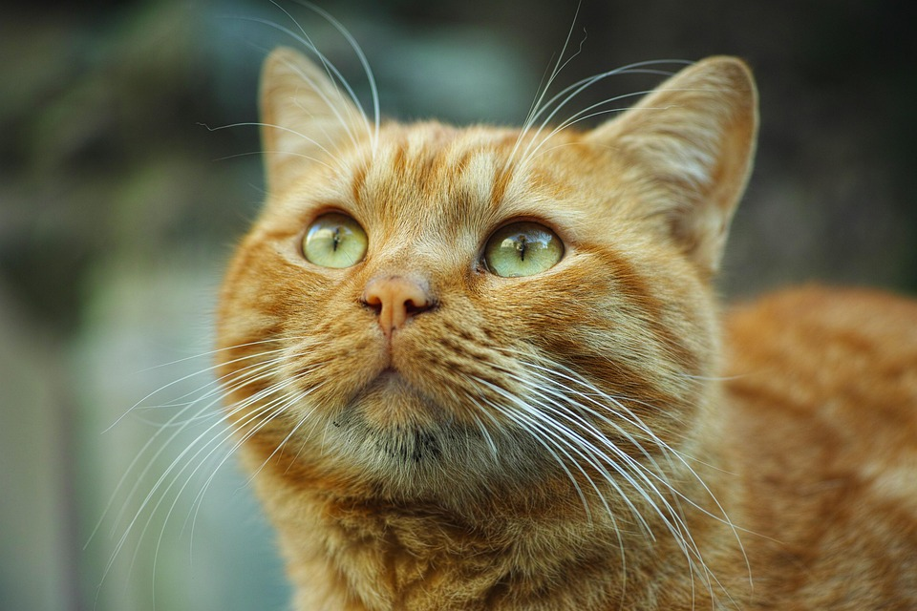
Weeks 1-3
Instance-based Methods
How do we represent data --- color, temperature, pixel intensity, name, etc. --- with numbers?
Given a new sample, how do we find similar examples in our dataset and use it for prediction?
How do we represent similar information with fewer numbers and visualize it?
dog
cat
??
dog
cat

Slide 37
Weeks 3-4
How do we learn a linear model from data, using a weighted combination of features to produce a score or a predicted value?
More dog-like
dog
cat
??
dog
cat

Slide 38
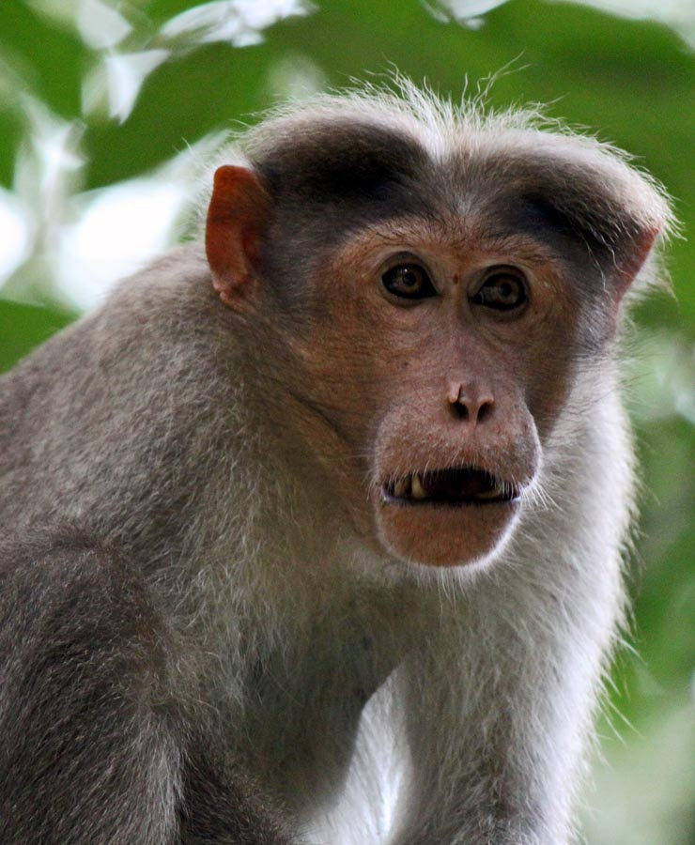
Weeks 4-6
How do we estimate the likelihood of a data sample and use it for prediction, grouping, or to find outliers?
??
dog
cat
dog
cat

Slide 39
Week 7
How do we learn rules from data and use them to vote for predictions?
dog
cat
??
dog
cat

Slide 40
Weeks 8-9
How do we learn new representations of our data using neural networks?
dog
cat
??
dog
cat

Slide 41
Weeks 8-9
How do we learn new representations of our data using neural networks?
dog
??
cat
dog
cat

Slide 42
Weeks 9-10
How do we learn to represent images and text?
A small white puppy with a blue tag. The puppy has its mouth open.

Slide 43
Weeks 11-12
Hire (guard dog)
Don’t hire
How do we understand the social and personal impact of AI and develop responsibly?

Slide 44

Weeks 13-15
How does ML get deployed in practice? (case study with State Farm)
Other application domains (audio) and methods (RL)

Slide 45
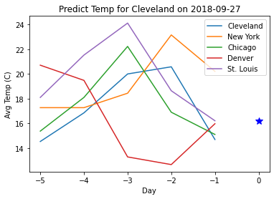
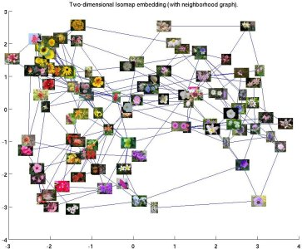
Data you’ll use
Handwritten digits
City Temperatures (predict next day)
Text messages (spam vs not)
Salaries
Penguin measurements (predict species)
Images of pets and flowers (breed/species classification)
Your own data (final project)

Slide 46
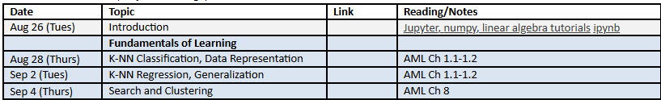
How will you learn?
Lectures and Reading
Lecture attendance is expected
Reading materials and notes are optional
Lectures will be recorded, and slides and recordings will be available
If a technical problem prevents recording, only slides will be available

Slide 47
How will you learn?
Assignments
Conduct experiments in Jupyter notebook, report results, answer questions to test your understanding
HW 1: Instance-based methods (Sep 15)
  Retrieval, clustering, KNN classification and regression
HW 2: Linear Models (Sep 29)
  PCA and embeddings, linear regression, logistics regression, SVM
HW 3: Probabilistic Methods (Oct 13)
  Naïve Bayes, EM, robust estimation
HW 4: Trees and MLPs (Nov 3)
  Decision trees, random forests, boosting, multi-layer perceptrons
HW 5: Deep learning and applications (Nov 17)
  Linear probe, fine-tuning, investigating a real-world application area
Final Project (Dec 14): Apply ML, collect data, develop/compare approaches on a problem of your choice

Slide 48
How will you learn?
Exams
Three 50-minute exams to test conceptual knowledge
Exams will be held in CBTF (closed book/notes)
Cumulative

Slide 49
How will you learn?
Getting Help Outside of Class
For questions that have short answers, see if it’s been answered on CampusWire; if not, post
  We try to answer within 24 hours (our schedule to check will be posted)
For more in-depth help, or to better understand the material, come to office hours
  Schedule will be posted on CampusWire

Slide 50
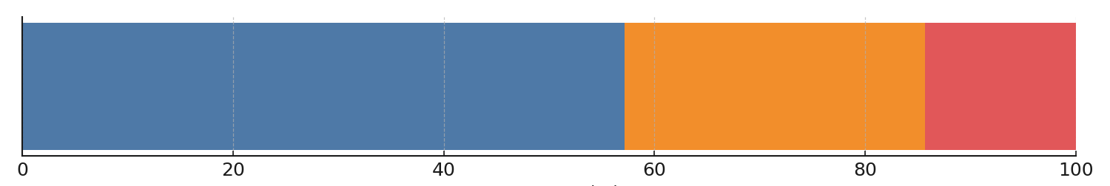
Grading
Exams: 200 pts
Three exams, lowest exam score is dropped
Final Project: 100 pts
Experience Points: 400+ points
5 homeworks: 100+ points each
Participation: 2 points per opportunity (up to ~30 opportunities)
3 credit: XP target is 400 points
4 credit: XP target is 525 points
Late policy (for regular assignments only)
Up to ten free days total – use them wisely!
5 XP penalty per day after that
Project must be submitted within two weeks of due date to receive any points
Final grade calculation
Course_Grade = (XP + highest_exam + 2nd_highest_exam + final_project) / (max(XP, XP_target) + 300)
If you exceed target
Final Proj
XP
Exams

Slide 51

Earn 2 XP now – tell me a little about you
https://tinyurl.com/AML-L1

Slide 52
Covid, masks, sickness
If you’re well, please come to lectures and office hours. Masks are optional.
If you’re sick, please stay home. No need to show proof of illness or get permission to miss.

Slide 53
Using ChatGPT / AI models
OK for assignments and study prep
  Built into colabs
  Can use CoPilot, Cursor, or others
  Use for debugging, ask it to make up questions for you, or ask it to explain why you got something wrong
Not available in exams

Slide 54
Academic Integrity
These are OK
Discuss homeworks with classmates (don’t show each other code)
Use Stack Overflow to learn how to use a Python module
Use GPT/Co-Pilot/Gemini etc to learn how to use a Python module, or streamline coding
Get ideas from online (make sure to attribute the source)
Not OK
Copying or looking at homework-specific code (i.e. so that you claim credit for part of an assignment based on code that you didn’t write)
Using external resources (code, ideas, data) without acknowledging them
Remember
Ask if you’re not sure if it’s ok
You are safe as long as you acknowledge all of your sources of inspiration, code, etc. in your write-up
If you use an AI tool, acknowledge it

Slide 55
How is this course different from…
CS 446 ML
  This course provides a foundation for ML practice, while 446 provides a foundation for ML research
  This course has less theory, derivations, and optimization, and more on application, representations, and examples
Online version of CS 441 AML
  CS 441 online is being updated
  This course focuses more on concepts and modern usage of ML, homeworks require more independence
CS 444 Deep Learning for CV, other domain-oriented courses
  This course is much broader

Slide 56
What is expected of you?
You have sufficient background in math and CS, and/or will work hard to catch up in the first couple weeks
You will attend all lectures (preferred), or watch the recordings
If you get stuck, you’ll try your best to figure it out, but then seek help if you can’t
You are willing to spend ~9-12 hours per week on lectures, reading, review and assignments

Slide 57
Feedback is welcome
I will occasionally solicit feedback through surveys – please respond
You can always talk to me after class or send me a message on CampusWire
My goal is to be a force multiplier on how much you can learn with a given amount of effort

Slide 58
Action Items
Bookmark the website https://courses.grainger.illinois.edu/CS441/fa2025/
Sign up for campuswire (if not already signed up)
Read the syllabus and schedule
Unless you consider yourself highly proficient in Python/numpy and linear algebra, watch/do the tutorials linked in the web page
If you are planning to drop the class, please do it right away so that others can register
See you Thursday, on “KNN Classification”

