Slide 1
CS 425 / ECE 428
Distributed Systems
Fall 2015
Indranil Gupta (Indy)
Peer-to-peer Systems
All slides © IG

Slide 2
Napster Structure
Filename Info about
Store a directory, i.e.,
filenames with peer pointers
PennyLane.mp3 Beatles, @
128.84.92.23:1006
…..
napster.com Servers
S
S
Client machines
(“Peers”)
S
P
P
P
P
P
P
Store their own
files

Slide 3
Napster Search
2. All servers search their lists (ternary tree algorithm)
Store peer pointers
for all files
napster.com Servers
S
S
Client machines
(“Peers”)
1. Query
S
P
3. Response
P
4. ping candidates
P
P
P
P
Store their own
files
5. download from best host

Slide 4
Gnutella
Store their own
files
Servents (“Peers”)
P
P
P
Also store
“peer pointers”
P
P
P
P
Connected in an overlay graph
(== each link is an implicit Internet path)

Slide 5


Gnutella Search
Query’s flooded out, ttl-restricted, forwarded only once
P
P
P
P
TTL=2
P
P
P
Who has PennyLane.mp3?

Slide 6
Gnutella Search
Successful results QueryHit’s routed on reverse path
P
P
P
P
P
P
P
Who has PennyLane.mp3?

Slide 7


Chord
Developers: I. Stoica, D. Karger, F. Kaashoek, H. Balakrishnan, R. Morris, Berkeley and MIT
Intelligent choice of neighbors to reduce latency and message cost of routing (lookups/inserts)
Uses Consistent Hashing on node’s (peer’s) address
  SHA-1(ip_address,port) →160 bit string
  Truncated to m bits
  Called peer id (number between 0 and )
  Not unique but id conflicts very unlikely
  Can then map peers to one of logical points on a circle

Slide 8
Ring of peers
Say m=7
0
6 nodes
N112
N16
N96
N32
N80
N45

Slide 9
Peer pointers (1): successors
Say m=7
0
N112
N16
N96
N32
N80
N45
(similarly predecessors)

Slide 10
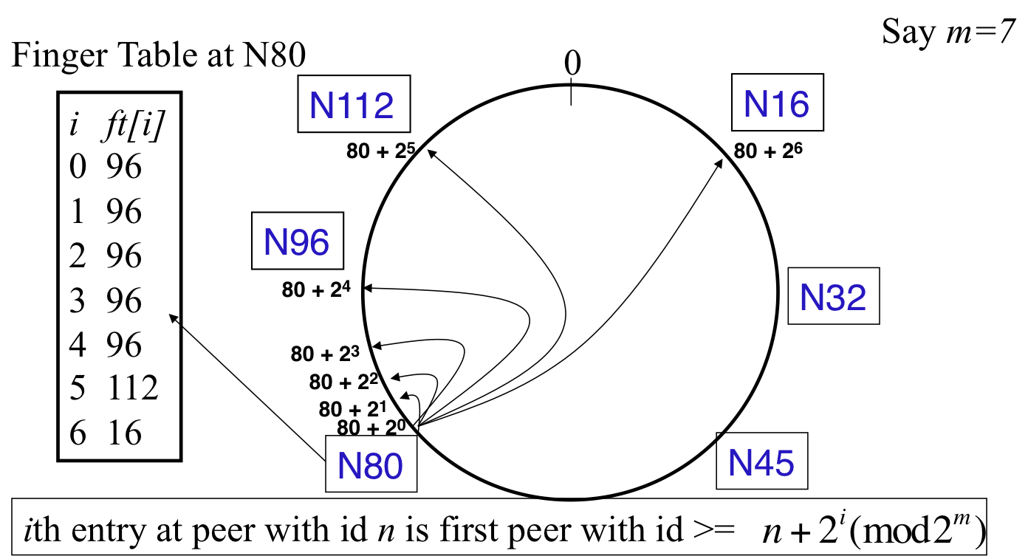
Peer pointers (2): finger tables

Slide 11

What about the files?
Filenames also mapped using same consistent hash function
  SHA-1(filename) →160 bit string (key)
  File is stored at first peer with id greater than or equal to its key (mod )
File cnn.com/index.html that maps to key K42 is stored at first peer with id greater than 42
  Note that we are considering a different file-sharing application here : cooperative web caching
  The same discussion applies to any other file sharing application, including that of mp3 files.
Consistent Hashing => with K keys and N peers, each peer stores O(K/N) keys. (i.e., < c.K/N, for some constant c)

Slide 12
Mapping Files
Say m=7
0
N112
N16
N96
N32
N80
N45
File with key K42
stored here

Slide 13
Search
Say m=7
0
N112
N16
N96
Who has cnn.com/index.html?
(hashes to K42)
N32
N80
N45
File cnn.com/index.html with
key K42 stored here

Slide 14
Search
At node n, send query for key k to largest successor/finger entry <= k
if none exist, send query to successor(n)
At or to the anti-clockwise of k
(it wraps around the ring)
0
N112
N16
Say m=7
N96
Who has cnn.com/index.html?
(hashes to K42)
N32
N80
N45
File cnn.com/index.html with
key K42 stored here

Slide 15
Search
At node n, send query for key k to largest successor/finger entry <= k
if none exist, send query to successor(n)
0
N112
N16
Say m=7
All “arrows” are RPCs
(remote procedure calls)
N96
Who has cnn.com/index.html?
(hashes to K42)
N32
N80
N45
File cnn.com/index.html with
key K42 stored here

Slide 16

Analysis
Here
Search takes O(log(N)) time
  Proof
  (intuition): at each step, distance between query and peer-with-file reduces by a factor of at least 2
  (intuition): after log(N) forwardings, distance to key is at most
  Number of node identifiers in a range of
  is O(log(N)) with high probability (why? SHA-1! and “Balls and Bins”)
  So using successors in that range will be ok, using another O(log(N)) hops
Next hop
Key

Slide 17
Analysis (contd.)
O(log(N)) search time holds for file insertions too (in general for routing to any key)
  “Routing” can thus be used as a building block for
    All operations: insert, lookup, delete
O(log(N)) time true only if finger and successor entries correct
When might these entries be wrong?
  When you have failures

Slide 18
Rest of the slides are for optional reading

Slide 19
Search under peer failures
Lookup fails
(N16 does not know N45)
Say m=7
0
N112
N16
N96
X
X
Who has cnn.com/index.html?
(hashes to K42)
N32
X
N80
N45
File cnn.com/index.html with
key K42 stored here

Slide 20
Search under peer failures
Say m=7
One solution: maintain r multiple successor entries
In case of failure, use successor entries
0
N112
N16
N96
X
Who has cnn.com/index.html?
(hashes to K42)
N32
N80
N45
File cnn.com/index.html with
key K42 stored here

Slide 21
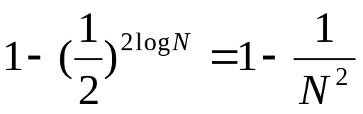
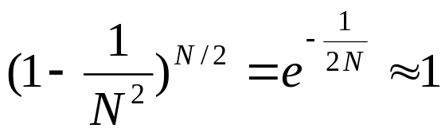
Search under peer failures
Choosing r=2log(N) suffices to maintain lookup correctness w.h.p.(i.e., ring connected)
  Say 50% of nodes fail
  Pr(at given node, at least one successor alive)=
  Pr(above is true at all alive nodes)=

Slide 22
Search under peer failures (2)
Say m=7
Lookup fails
(N45 is dead)
0
N112
N16
N96
Who has cnn.com/index.html?
(hashes to K42)
N32
X
X
N80
N45
File cnn.com/index.html with
key K42 stored here

Slide 23
Search under peer failures (2)
Say m=7
One solution: replicate file/key at r successors and predecessors
0
N112
N16
N96
Who has cnn.com/index.html?
(hashes to K42)
N32
K42 replicated
X
N80
N45
File cnn.com/index.html with
key K42 stored here
K42 replicated

Slide 24
Need to deal with dynamic changes
Peers fail
New peers join
Peers leave
  P2P systems have a high rate of churn (node join, leave and failure)
    25% per hour in Overnet (eDonkey)
    100% per hour in Gnutella
    Lower in managed clusters
    Common feature in all distributed systems, including wide-area (e.g., PlanetLab), clusters (e.g., Emulab), clouds (e.g., AWS), etc.
So, all the time, need to:
→ Need to update successors and fingers, and copy keys

Slide 25
New peers joining
Introducer directs N40 to N45 (and N32)
N32 updates successor to N40
N40 initializes successor to N45, and inits fingers from it
N40 periodically talks to neighbors to update finger table
Say m=7
0
N112
N16
Stabilization
Protocol
(followed by
all nodes)
N96
N32
N40
N80
N45

Slide 26
New peers joining (2)
N40 may need to copy some files/keys from N45
(files with fileid between 32 and 40)
Say m=7
0
N112
N16
N96
N32
N40
N80
N45
K34,K38

Slide 27
New peers joining (3)
A new peer affects O(log(N)) other finger entries in the system, on average [Why?]
Number of messages per peer join= O(log(N)*log(N))
Similar set of operations for dealing with peers leaving
  For dealing with failures, also need failure detectors (you’ve seen them!)

Slide 28

Stabilization Protocol
Concurrent peer joins, leaves, failures might cause loopiness of pointers, and failure of lookups
  Chord peers periodically run a stabilization algorithm that checks and updates pointers and keys
  Ensures non-loopiness of fingers, eventual success of lookups and O(log(N)) lookups w.h.p.
  Each stabilization round at a peer involves a constant number of messages
  Strong stability takes stabilization rounds
  For more see [TechReport on Chord webpage]

