Slide 1
CS 425 / ECE 428
Distributed Systems
Fall 2026
Aishwarya Ganesan
w/ Ram Kesavan
Ack: Indranil Gupta (Indy)
Lecture 5-6: Failure Detection and Membership
All slides © IG

Slide 2
Announcements
MP1: Due Sunday 9/13, demos Monday 9/14
  VMs distributed last week: see Piazza
  GitHub course repo: see Piazza
    IT does not handle requests on weekends
  MP1 Demo, Signup, and Submission instructions release on Piazza
    (Due by Fri Sep 11) [MP Demo Signup Sheet]
    (Due by Sun Sep) [a. MP1 Submission Form & b. push MP code to GitHub]
    (Due by Sun Sep 13) [MP1 Report Submission on Gradescope]
    (On Mon Sep 14) Demos
HW1: due 9/20
Check Piazza often! It’s where all the announcements are at!

Slide 3
Failures are the Norm
… not the exception, in datacenters.
Say, the rate of failure of one machine (OS/disk/motherboard/network, etc.) is once every 10 years (120 months) on average.
When you have 120 servers in the DC, the mean time to failure (MTTF) of the next machine is 1 month.
When you have 12,000 servers in the DC, the MTTF is about once every 7.2 hours!
Soft crashes and failures are even more frequent!

Slide 4
Target Settings
Process ‘group’-based systems
  Clouds/Datacenters
  Replicated servers
  Distributed databases
Fail-stop (crash) process failures
  (not fail-recover failures)

Slide 5

Group Membership Service
Application Queries
e.g., gossip, database, DHT’s, etc.
Application Process pi
joins, leaves, failures
of members
Membership
Protocol
Membership List
Group
Membership List
Unreliable
Communication
Notes:
- say “non-byzantine”
ANIMATE!

Slide 6
Two sub-protocols
Application Process pi
Group
Membership List
pj
Disseminate node joins, node leaves, failures
Dissemination
Complete list all the time (Strongly consistent)
  Virtual synchrony
Almost-Complete list (Weakly consistent)
  Gossip-style, SWIM, …
Or Partial-random list (other systems)
  SCAMP, T-MAN, Cyclon,…
Failure Detector
Unreliable
Communication
Focus of this series of lecture
Notes:
- say “non-byzantine”

Slide 7
Large Group: Scalability A Goal
this is us (pi)
Process Group
“Members”
1000’s of processes
Unreliable Communication
Network
Notes:
- say “non-byzantine”

Slide 8
Group Membership Protocol
II
Failure Detector
Some process
finds out quickly
pi
I pj crashed
pj
III
Dissemination
Unreliable Communication
Network
Fail-stop Failures only
Notes:
- animate f-d and then dissemination?
- say “non-byzantine”

Slide 9
Next
How do you design a group membership protocol?

Slide 10
I. pj crashes
Nothing we can do about it!
A frequent occurrence
Common case rather than exception
Frequency goes up linearly with size of datacenter

Slide 11
II. Distributed Failure Detectors: Desirable Properties
Completeness = each failure is detected
Accuracy = there is no mistaken detection
Speed
  Time to first detection of a failure
Scale
  Equal Load on each member
  Network Message Load

Slide 12
Distributed Failure Detectors: Properties
Impossible together in
lossy networks [Chandra
and Toueg]
Completeness
Accuracy
What is a 100% complete
failure detector? Hint: trivial
If possible, then can
solve consensus! (but
consensus is known to be
unsolvable in
asynchronous systems)
What is a 100% accurate
failure detector?
Which is more important?
Completeness or Accuracy?

Slide 13
What Real Failure Detectors Prefer
Completeness
Accuracy
Speed
  Time to first detection of a failure
Scale
  Equal Load on each member
  Network Message Load
Guaranteed
Partial/Probabilistic
guarantee

Slide 14
What Real Failure Detectors Prefer
Completeness
Accuracy
Speed
  Time to first detection of a failure
Scale
  Equal Load on each member
  Network Message Load
Guaranteed
Partial/Probabilistic
guarantee
Time until some non-faulty
process detects the failure

Slide 15
What Real Failure Detectors Prefer
Completeness
Accuracy
Speed
  Time to first detection of a failure
Scale
  Equal Load on each member
  Network Message Load
Guaranteed
Partial/Probabilistic
guarantee
Time until some non-faulty
process detects the failure
No bottlenecks/single
failure point
Notes:
How did the little process know it had failed the exam? Because the teacher gave it a time out.

Slide 16
Failure Detector Properties
In spite of
arbitrary simultaneous
process failures
Completeness
Accuracy
Speed
  Time to first detection of a failure
Scale
  Equal Load on each member
  Network Message Load

Slide 17
Centralized Heartbeating
pi
…
pi, Heartbeat Seq. l++
pj
    Heartbeats sent periodically
If heartbeat not received from pi within timeout,
mark pi as failed

Slide 18


Slide 19
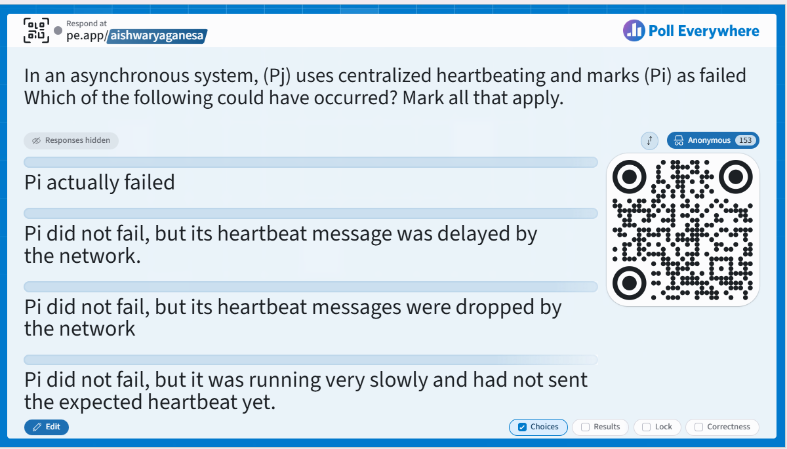

Slide 20
Which failure-detector property is violated in cases B–D?

Slide 21
Centralized Heartbeating
☹ Hotspot
pi
Cannot tolerate Pj failing
Pj cannot distinguish whether Pi failed or Pi’s messages are dropped/delayed.
For completeness, Pj marks Pi as having failed
…
pi, Heartbeat Seq. l++
pj
    Heartbeats sent periodically
If heartbeat not received from pi within timeout,
mark pi as failed
Notes:
Yeah, any heartbeatprotocol will never be accurate in an asynchronous network,no matter whether you have central or any ofthe variants we study, because these heartbeatmessages can get dropped. PI's heartbeats toPJ can all be dropped by the network, eventhough PI is alive. And from the viewpointof PJ, it cannot distinguish whether PI hasactually failed or whether PI's heartbeatsare getting dropped. And between those twochoices, in order to guarantee completeness, PJ mustmark PI as having failed. And therefore,you will have false positives in anyheart beating protocol. This is a very common trick question in ourexams, by the way.

Slide 22
Ring Heartbeating
pi
pi, Heartbeat Seq. l++
pj
…
…
Notes:
Why are neighbors on a ring deep in love? … Because one’s heart beats for the other.
How does a newly-married couple detect failures? Ring heartbeating.

Slide 23
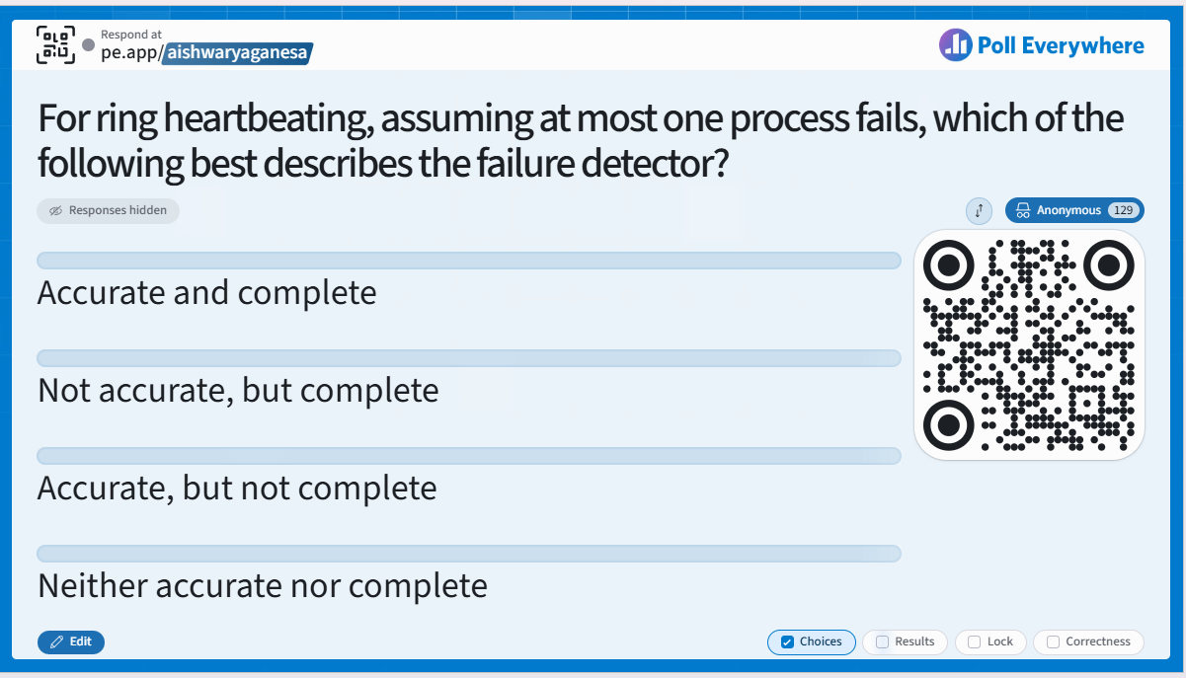

Slide 24
Ring Heartbeating
☹ Unpredictable on
simultaneous multiple failures
pi
pi, Heartbeat Seq. l++
pj
…
…
Notes:
Why are neighbors on a ring deep in love? … Because one’s heart beats for the other.
How does a newly-married couple detect failures? Ring heartbeating.
For ring heartbeating, assuming at most one process fails, which of the following best describes the failure detector?
Accurate and complete
B. Not accurate, but complete
C. Accurate, but not complete
D. Neither accurate nor complete
For ring heartbeating, which of the following best describes the failure detector?
A. Accurate and complete
B. Not accurate, but complete
C. Accurate, but not complete
D. Neither accurate nor complete

Slide 25
All-to-All Heartbeating
Equal load per member
☹ Single hb loss → false detection
pi
pi, Heartbeat Seq. l++
…
pj
Accurate?
Complete?
Notes:
N^2 messages in the network
1 drop will result in failed detection
Vs.
N

Slide 26
Next
How do we increase the robustness of all-to-all heartbeating?

Slide 27
Gossip-style Heartbeating
☺ Good accuracy properties; why?
pi
Array of
Heartbeat Seq. l
for member subset
Gossip about your heartbeat
and other processes’ heartbeats

Slide 28
Gossip-Style Failure Detection
1 | 10120
2 | 10103
3 | 10098
4 | 10111
1 | 10120
2 | 10103
3 | 10098
4 | 10111
1 | 10118 | 64
2 | 10110 | 64
3 | 10090 | 58
4 | 10111 | 65
1 | 10118 | 64
2 | 10110 | 64
3 | 10090 | 58
4 | 10111 | 65
1 | 10120 | 66
2 | 10103 | 62
3 | 10098 | 63
4 | 10111 | 65
2
1
Address
Time (local)
1 | 10120 | 70
2 | 10110 | 64
3 | 10098 | 70
4 | 10111 | 65
Heartbeat Counter
Protocol:
Nodes periodically gossip their membership list: pick random nodes, send it list
On receipt, it is merged with local membership list
When an entry times out locally, member is marked as failed
4
3
Current time : 70 at node 2
(asynchronous clocks)
Suppose current time is 80 at node 2 and timeout is 12 units, which nodes will 2 mark as fail?
Notes:
Latest heartbeat counter node 1 has heard from node 3.
Node 3 is the only one that can increment the heartbeat counter. Other nodes just gossip it.
Local time when entry was last updated

Slide 29
Gossip-Style Failure Detection
If the heartbeat has not increased for more than T_{fail} seconds,
the member is considered failed
And after a further T_{cleanup} seconds, it will delete the member from the list
Why an additional timeout? Why not delete right away?

Slide 30
Gossip-Style Failure Detection
What if an entry pointing to a failed node is deleted right after T_{fail} (=24) seconds?
Fix: remember for another T_{fail}
1 | 10120 | 66
2 | 10110 | 64
3 | 10098 | 75
4 | 10111 | 65
1 | 10120 | 66
2 | 10110 | 64
3 | 10098 | 50
4 | 10111 | 65
1 | 10120 | 66
2 | 10110 | 64
4 | 10111 | 65
1 | 10120 | 66
2 | 10103 | 62
3 | 10098 | 55
4 | 10111 | 65
2
1
Current time : 75 at node 2
4
3

Slide 31
How to set T_{fail} and T_{cleanup}?

Slide 32
Analysis/Discussion
Well-known result: a gossip takes O(log(N)) time to propagate.
So: Given sufficient bandwidth, a single heartbeat takes O(log(N)) time to propagate.
So: N heartbeats take:
  O(log(N)) time to propagate, if bandwidth allowed per node is allowed to be O(N)
  O(N.log(N)) time to propagate, if bandwidth allowed per node is only O(1)
  What about O(k) bandwidth?

Slide 33
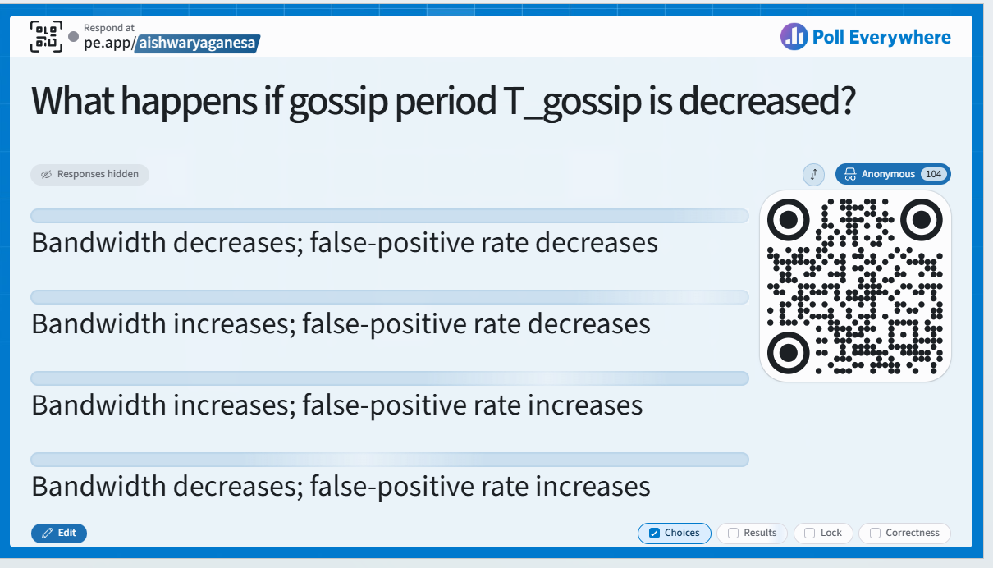

Slide 34
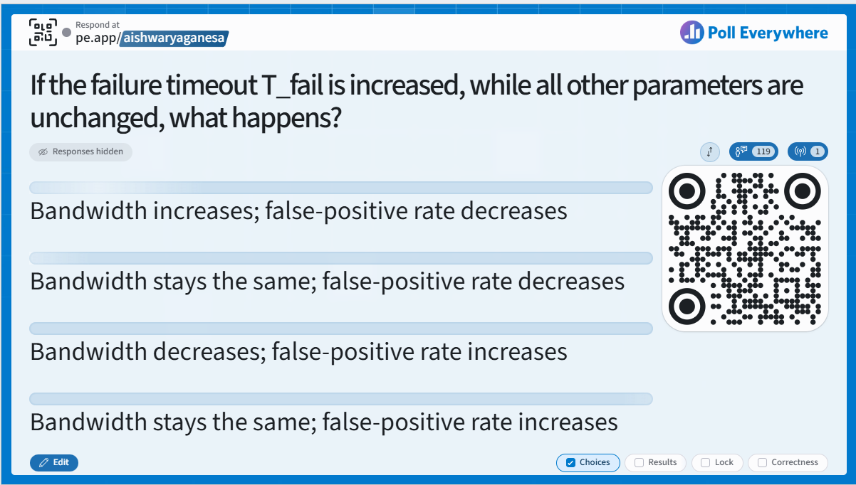

Slide 35
Analysis/Discussion
Well-known result: a gossip takes O(log(N)) time to propagate.
So: Given sufficient bandwidth, a single heartbeat takes O(log(N)) time to propagate.
So: N heartbeats take:
  O(log(N)) time to propagate, if bandwidth allowed per node is allowed to be O(N)
  O(N.log(N)) time to propagate, if bandwidth allowed per node is only O(1)
  What about O(k) bandwidth?
What happens if gossip period T_{gossip} is decreased?
What happens to P_{mistake} (false positive rate) as T_{fail} and T_{cleanup} is increased?
Tradeoff: False positive rate vs. detection time vs. bandwidth

Slide 36
CS 425 / ECE 428
Distributed Systems
Fall 2026
Aishwarya Ganesan
w/ Ram Kesavan
Ack: Indranil Gupta (Indy)
Lecture 5-6: Failure Detection and Membership
All slides © IG

Slide 37
Failure Detector Properties …
Completeness
Accuracy
Speed
  Time to first detection of a failure
Scale
  Equal Load on each member
  Network Message Load

Slide 38
So far (heartbeating protocols)…
Accurate? Complete?
Centralized
Ring
All-to-all
Gossip

Slide 39
Next
So, is this the best we can do? What is the best we can do?

Slide 40
…Are application-defined Requirements
Guarantee always
Completeness
Accuracy
Speed
  Time to first detection of a failure
Scale
  Equal Load on each member
  Network Message Load
Probability PM(T)
T time units
Notes:
Target detection time what is the probability of detecting a non-faulty node as faulty.

Slide 41
…Are application-defined Requirements
Guarantee always
Completeness
Accuracy
Speed
  Time to first detection of a failure
Scale
  Equal Load on each member
  Network Message Load
Probability PM(T)
T time units
N*L: Compare this across protocols

Slide 42
All-to-All Heartbeating
pi
Every T units
pi, Heartbeat Seq. l++
L=N/T
…

Slide 43
Gossip-style Heartbeating
T=logN * tg
pi
Array of
Heartbeat Seq. l
for member subset
L=N/tg=N*logN/T
Every tg units
=gossip period,
send O(N) gossip
message

Slide 44
What’s the Best/Optimal we can do?
Worst case load L* per member in the group (messages per second)
  as a function of T, PM(T), N
  Independent Message Loss probability p_{ml}
Notes:
Pml^r < PM(T) => r > log(PM(T))/log(pml) (since PM(T) and pml are each < 1.

Slide 45
Heartbeating
Optimal L is independent of N (!)
All-to-all and gossip-based: sub-optimal
    L=O(N/T)
    try to achieve simultaneous detection at all processes
    fail to distinguish Failure Detection and Dissemination components
Can we reach this bound?
Key:
  Separate the two components
  Use a non heartbeat-based Failure Detection Component

Slide 46
Next
Is there a better failure detector?

Slide 47
SWIM Failure Detector Protocol
pi
pj
random pj
ping
K random
processes
X
ack
random K
ping-req
X
Protocol period
= T’ time units
ping
ack
ack

Slide 48
Detection Time
Prob. of being pinged in T’=
E[T ] =
Completeness: Any alive member detects failure
  Eventually
  By using a trick: within worst case O(N) protocol periods
Notes:
This detection time is based on only direct pings. Indirect pings will reduce detection time even further!
Reiterate that it converges. Also it is *independent* of N.
Pr[pinging]; => expected detection time, whp detection time, wc detection time. (ind of n)
PM(T) can be calc’ed as a function of T, pml, pf (ind of n)
Trends on wc L/L* and E[L]/L*

Slide 49
Accuracy, Load
PM(T) is exponential in -K. Also depends on pml (and pf )
  See paper
for up to 15 % loss rates
Notes:
Pr[pinging]; => expected detection time, whp detection time, wc detection time. (ind of n)
PM(T) can be calc’ed as a function of T, pml, pf (ind of n)
Trends on wc L/L* and E[L]/L*

Slide 50
SWIM Failure Detector
Parameter | SWIM
First Detection Time | Expected periods Constant (independent of group size)
Process Load | Constant per period < 8 L* for 15% loss
False Positive Rate | Tunable (via K) Falls exponentially as load is scaled
Completeness | Deterministic time-bounded Within O(log(N)) periods w.h.p.

Slide 51
Time-bounded Completeness
Key: select each membership element once as a ping target in a traversal
  Round-robin pinging
  Random permutation of list after each traversal
Each failure is detected in worst case 2N-1 (local) protocol periods
Preserves FD properties

Slide 52
SWIM versus Heartbeating
Heartbeating
O(N)
First Detection
Time
SWIM
Heartbeating
Constant
Process Load
For Fixed :
False Positive Rate
Message Loss Rate
Constant
O(N)

Slide 53
Next
How do failure detectors fit into the big picture of a group membership protocol?
What are the missing blocks?

Slide 54
Group Membership Protocol
II
Failure Detector
Some process
finds out quickly
pi
I pj crashed
pj
III
Dissemination
Unreliable Communication
Network
Fail-stop Failures only
HOW ?
HOW ?
HOW ?
HOW ?

Slide 55
Dissemination Options
Multicast (Hardware / IP)
  unreliable
  multiple simultaneous multicasts
Point-to-point (TCP / UDP)
  expensive
Zero extra messages: Piggyback on Failure Detector messages
  Infection-style Dissemination

Slide 56
Infection-style Dissemination
pi
pj
random pj
ping
K random
processes
X
ack
random K
ping-req
X
Protocol period
= T time units
ping
ack
Piggybacked
membership
information
ack

Slide 57
Infection-style Dissemination
Epidemic/Gossip style dissemination
  After protocol periods, processes would not have heard about an update
Maintain a buffer of recently joined/evicted processes
  Piggyback from this buffer
  Prefer recent updates
Buffer elements are garbage collected after a while
  After protocol periods, i.e., once they’ve propagated through the system; this defines weak consistency

Slide 58
Suspicion Mechanism
False detections, due to
  Perturbed processes
  Packet losses, e.g., from congestion
Indirect pinging may not solve the problem
Key: suspect a process before declaring it as failed in the group

Slide 59
Suspicion Mechanism
pi
Dissmn
Dissmn (Suspect pj)
FD
FD:: pi ping failed
Dissmn::(Suspect pj)
Suspected
Time out
FD::pi ping success
Dissmn::(Alive pj)
Alive
Failed
Dissmn (Alive pj)
Dissmn (Failed pj)
Notes:
For pi:
If it thinks pj is in suspected state (pi’s ping of pj failed in the past or it received a Suspect(pj) message), continues selecting ping targets as normal BUT if pi happens to pick pj as target and gets a response, then pi starts sending Alive (pj, message with a new incarnation number for pj).
Incarnation number can only come from pj (when pj gets a ping from pi with a Suspect(pj) piggybacked, pj responds with a new incarnation number for itself).
For pi:
If it thinks pj is in suspected state and this suspicion times out before pi receives any Alive(pj, higher incarnation number) message then pi starts disseminating Failed (pj) messages.
Failed (pj) messages override all earlier Alive and Suspected messages regardless of their incarnation numbers. (So once any alive node times out on a suspicion for pj, then pj will eventually be forced to leave.)

Slide 60
Suspicion Mechanism
Distinguish multiple suspicions of a process
  Per-process incarnation number
  Inc # for pi can be incremented only by pi
    e.g., when it receives a (Suspect, pi) message
  Somewhat similar to DSDV (routing protocol in ad-hoc nets)
Higher inc# notifications over-ride lower inc#’s
Within an inc#: (Suspect inc #) > (Alive, inc #)
(Failed, inc #) overrides everything else

Slide 61
SWIM In Industry
First used in Oasis/CoralCDN
Implemented open-source by Hashicorp Inc.
  Called “Serf”
  Later “Consul”
Today: Uber implemented it, uses it for failure detection in their infrastructure
  See “ringpop” system

Slide 62
Wrap Up
Failures the norm, not the exception in datacenters
Every distributed system uses a failure detector
Many distributed systems use a membership service
Ring failure detection underlies
  IBM SP2 and many other similar clusters/machines
Gossip-style failure detection underlies
  Amazon EC2/S3 (rumored!)

Slide 63
Announcements
HW1: due 9/20
Please view Grid Computing Lecture Video from website!
  (We won’t lecture in class)

