Slide 1
CS 425 / ECE 428
Distributed Systems
Fall 202
Aishwarya Ganesan & Ram Kesavan
Lecture 13: Snapshots
Ack: Indranil Gupta
All slides © IG

Slide 2
Announcements
HW2 solutions will be released today
MP2 grades have been released
In-class midterm Thursday 10/8
  Bring pencil+eraser for MCQ bubble sheet
  Course webpage specifies the two rooms
  Make sure you’re in correct classroom for the midterm
  Piazza post with more details
  Practice mid-term released

Slide 3
A Local Snapshot
EoY/EoQ factory inventory audit
Once work stops on the last Friday of the Y/Q
  Assembly lines frozen
  Employees walk around to count all components and completed products sitting on shelves/containers/etc.
  Stitch together all counts
Result: Accurate frozen picture of the inventory

Slide 4
Distributed Snapshot
Inventory audit across many factories across the globe
But, global supply chain never stops moving & factories are in different time zones
Each location <X>:
  Does its inventory at local midnight
  Labels all outgoing boxes with “captured in Q3 audit at location <X>”
  If it receives a box with no label, counts it locally
Global logically consistent inventory picture
  Without needing to temporarily shut down factories

Slide 5
In a Distributed System
In the cloud: application/service is running on multiple servers
Servers handle concurrent events and interact with each other
The ability to obtain a “global picture” of the system is important
Some uses of having a global picture of the system
  Checkpointing: can restart distributed application on failure
  Garbage collection of objects: objects at servers that don’t have any other objects (at any servers) with pointers to them
  Deadlock detection: Useful in database transaction systems
  Termination of computation: Useful in batch computing systems like Folding@Home, SETI@Home

Slide 6
What’s a Global Snapshot?
Global Snapshot = Global State =
  Individual state of each process in the distributed system
  +
  Individual state of each communication channel in the distributed system
Capture the instantaneous state of each process
And the instantaneous state of each communication channel, i.e., messages in transit on the channels

Slide 7
Obvious First Solution
Synchronize clocks of all processes
Ask all processes to record their states at known time t
Problems?
  Time synchronization is not perfect
  Also, does not record the state of messages in the channels
Synchronization not required – causality is enough!

Slide 8
Example
Pi
Cij
Cji
Pj

Slide 9
[$1000,
100 iPhones]
Pi
Cij
[empty]
[empty]
Cji
Pj
[$600,
50 Androids]
[Global Snapshot 0]

Slide 10
[$701,
100 iPhones]
Pi
Cij
[empty]
[$299, Order Android ]
Cji
Pj
[$600,
50 Androids]
[Global Snapshot 1]

Slide 11
[$701,
100 iPhones]
Pi
Cij
[$499, Order iPhone]
[$299, Order Android ]
Cji
Pj
[$101,
50 Androids]
[Global Snapshot 2]

Slide 12
[$1200, 1 iPhone order from Pj,
100 iPhones]
Pi
Cij
[empty]
[$299, Order Android ]
Cji
Pj
[$101,
50 Androids]
[Global Snapshot 3]

Slide 13
[$1200,
99 iPhones]
Pi
Cij
[empty]
[
($299, Order Android ),
(1 iPhone)
]
Cji
Pj
[$101,
50 Androids]
[Global Snapshot 4]

Slide 14
[$1200,
99 iPhones]
Pi
Cij
[empty]
[
(1 iPhone)
]
Cji
Pj
[$400, 1 Android order from Pi,
50 Androids]
[Global Snapshot 5]

Slide 15
[$1200,
99 iPhones]
Pi
Cij
[empty]
[empty]
… and so on …
Cji
Pj
[$400, 1 Android order from Pi,
50 Androids, 1 iPhone]
[Global Snapshot 6]

Slide 16
Moving from State to State
Whenever an event happens anywhere in the system, the global state changes
  Process receives message
  Process sends message
  Process takes a step
State to state movement obeys causality
  Next: Causal algorithm for Global Snapshot calculation

Slide 17
System Model
Problem: Record a global snapshot (state for each process, and state for each channel)
System Model:
  N processes in the system
  There are two uni-directional communication channels between each process pair : Pj → Pi and Pi → Pj
  Communication channels are FIFO-ordered
    First in First out in each direction
      Does not apply across channels
  No failure
  All messages arrive intact, and are not duplicated and dropped
    Other papers later relaxed some of these assumptions

Slide 18
Requirements
Snapshot should not interfere with normal application actions.
Snapshot should not require application to pause the sending or receiving messages
Each process is able to record its own state
  Process state: Application-defined state or, in the worst case:
  its heap, registers, program counter, code, etc. (essentially the coredump)
Any process may initiate the snapshot
  We’ll assume just one snapshot run for now
Global state can be collected asynchronously in a distributed fashion
Notes:
System call that essentially takes a “snapshot” of a process’s state? Answer: fork( )

Slide 19
Chandy-Lamport Global Snapshot Algorithm
Initiator Pi records its own state
Initiator Pi creates special messages called “Markers”
  Not an application message, does not interfere with application messages
for j=1 to N except i
Pi sends out a Marker message on outgoing channel C_{ij}
for j=1 to N except i
Starts recording all incoming messages on each of the incoming channels at Pi: C_{ji}
Notes:
Let us assume only 1 snapshot initiation at any time. Can differentiate between different initiations using Pid+snapshot-version#.

Slide 20
Chandy-Lamport Global Snapshot Algorithm (2)
Whenever a process Pi receives a Marker message on an incoming channel C_{ki}
if (this is the first Marker Pi is seeing)
  Pi records its own state first
  Sets the state of channel C_{ki} as “empty”
  for j=1 to N except i
    Pi sends out a Marker message on outgoing channel C_{ij}
  Starts recording the incoming messages on each of the incoming channels at Pi: C_{ji} (for j=1 to N except i and k)
else // already seen a Marker message
  Stops recording and records the state of channel C_{ki} = all messages that arrived on it since recording was turned on.
Notes:
First Marker message (for this snapshot)

Slide 21
Chandy-Lamport Global Snapshot Algorithm (3)
The algorithm terminates when
Each process has received (or sent!) a first Marker
  To record its own state
Each process has received a Marker on the remaining (N-2) incoming channels
  To record the state of all those channels
Then, all of this distributed state can be collected to obtain the complete global snapshot

Slide 22
Example
Example
A B C D E
P1
Time
E F G
P2
H I J
P3
Instruction or Step
Message

Slide 23
P1 is Initiator:
Record local state S1,
Send out markers
Turn on recording on incoming channels C₂₁, C₃₁
A B C D E
P1
Time
E F G
P2
H I J
P3

Slide 24
S1, Record C₂₁, C₃₁
A B C D E
P1
Time
E F G
P2
H I J
P3
First Marker!
Record own state as S3
Mark C₁₃ state as empty
Turn on recording on other incoming C₂₃
Send out Markers

Slide 25
S1, Record C₂₁, C₃₁
A B C D E
P1
Time
E F G
P2
H I J
P3
S3
C₁₃ = < >
Record C₂₃

Slide 26
Duplicate Marker!
State of channel C₃₁ = < >
S1, Record C₂₁, C₃₁
A B C D E
P1
Time
E F G
P2
H I J
P3
S3
C₁₃ = < >
Record C₂₃

Slide 27
S1, Record C₂₁, C₃₁
C₃₁ = < >
A B C D E
P1
Time
E F G
P2
H I J
P3
First Marker!
Record own state as S2
Mark C₃₂ state as empty
Turn on recording on C₁₂
Send out Markers
S3
C₁₃ = < >
Record C₂₃

Slide 28
S1, Record C₂₁, C₃₁
C₃₁ = < >
A B C D E
P1
Time
E F G
P2
H I J
P3
S2
C₃₂ = < >
Record C₁₂
S3
C₁₃ = < >
Record C₂₃

Slide 29
S1, Record C₂₁, C₃₁
C₃₁ = < >
A B C D E
P1
Time
E F G
P2
H I J
P3
S2
C₃₂ = < >
Record C₁₂
Duplicate!
C₁₂ = < >
S3
C₁₃ = < >
Record C₂₃

Slide 30
Duplicate!
C₂₁ = <message G→D >
S1, Record C₂₁, C₃₁
C₃₁ = < >
A B C D E
P1
Time
E F G
P2
H I J
P3
S2
C₃₂ = < >
Record C₁₂
C₁₂ = < >
S3
C₁₃ = < >
Record C₂₃

Slide 31
C₂₁ = <message G→D >
S1, Record C₂₁, C₃₁
C₃₁ = < >
A B C D E
P1
Time
E F G
P2
H I J
P3
S2
C₃₂ = < >
Record C₁₂
C₁₂ = < >
S3
C₁₃ = < >
Record C₂₃
Duplicate!
C₂₃ = < >

Slide 32
Algorithm has Terminated
C₂₁ = <message G→D >
S1
C₃₁ = < >
A B C D E
P1
Time
E F G
P2
H I J
P3
S2
C₃₂ = < >
C₁₂ = < >
S3
C₁₃ = < >
C₂₃ = < >

Slide 33
Collect the Global Snapshot Pieces
C₂₁ = <message G→D >
S1
C₃₁ = < >
A B C D E
P1
Time
E F G
P2
H I J
P3
S2 C₃₂ = < >
C₁₂ = < >
S3 C₁₃ = < >
C₂₃ = < >

Slide 34
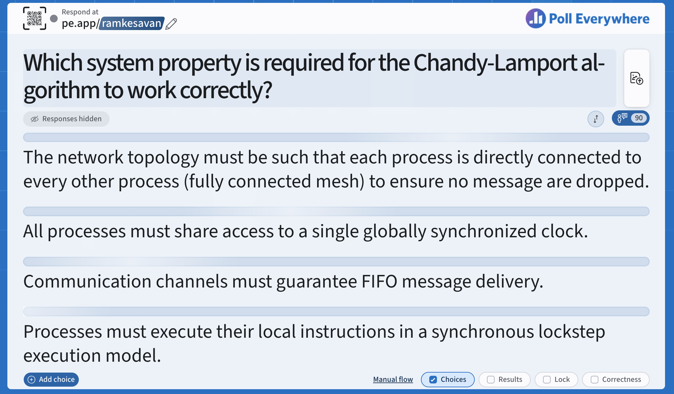

Slide 35
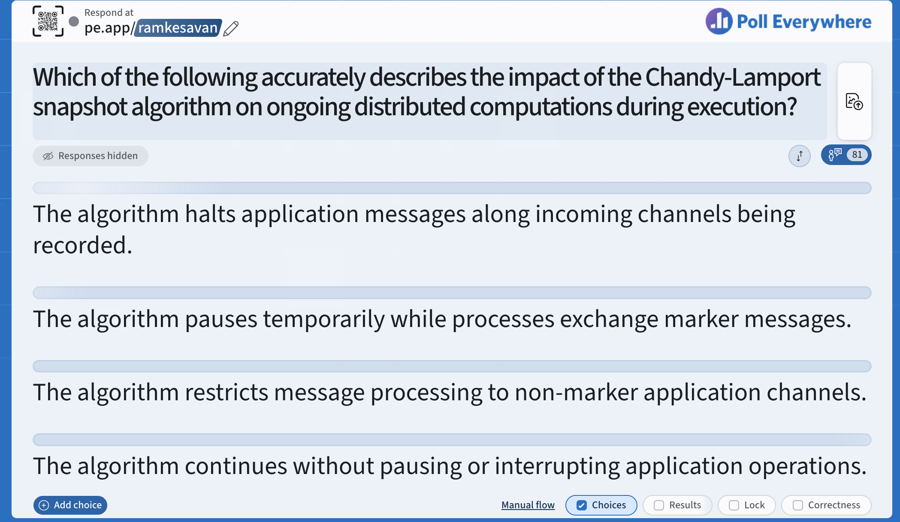

Slide 36
Next
Global Snapshot calculated by Chandy-Lamport algorithm is causally correct
  How do we know that?

Slide 37
Cuts
Cut = time frontier at each process and at each channel
Events at the process/channel that happen before the cut are “in the cut”
  And happening after the cut are “out of the cut”

Slide 38
Consistent Cuts
Consistent Cut: a cut that obeys causality
A cut C is a consistent cut if and only if:
  for (each pair of events e, f in the system)
  if (f is in cut C) && (e→f) // e happens-before f
    then e is also in cut C

Slide 39
Example
A B C D E
P1
Time
E F G
P2
H I J
P3
Consistent Cut
Inconsistent Cut
G → D, but only D is in cut

Slide 40
Our Global Snapshot Example …
C₂₁ = <message G→D >
S1
C₃₁ = < >
A B C D E
P1
Time
E F G
P2
H I J
P3
S2
C₃₂ = < >
C₁₂ = < >
S3
C₁₃ = < >
C₂₃ = < >

Slide 41
… is causally correct
C₂₁ = <message G→D >
S1
C₃₁ = < >
A B C D E
P1
Time
E F G
P2
H I J
P3
S2
C₃₂ = < >
C₁₂ = < >
S3
C₁₃ = < >
Consistent Cut captured by our Global Snapshot Example
C₂₃ = < >

Slide 42
In fact…
Any run of the Chandy-Lamport Global Snapshot algorithm creates a consistent cut
AND
Every message straddling the consistent cut is captured in the channel states of the snapshot

Slide 43
Chandy-Lamport Global Snapshot algorithm creates a consistent cut
Let’s quickly look at the proof
Let e_{i} and e_{j} be events occurring at Pi and Pj, respectively such that
  e_{i} → e_{j} (e_{i} happens before e_{j})
The snapshot algorithm ensures that
if e_{j} is in the cut then e_{i} is also in the cut.
That is: if e_{j} → <Pj records its state>, then
  it must be true that e_{i} → <Pi records its state>.

Slide 44
Chandy-Lamport Global Snapshot algorithm creates a consistent cut: Proof
if e_{j} → <Pj records its state>, then it must be true that e_{i} → <Pi records its state>.
  By contradiction, suppose e_{j} → <Pj records its state> and <Pi records its state> → e_{i}
  Consider the path of app messages (through other processes) that go from e_{i} → e_{j}
  Due to FIFO ordering, markers on each link in above path will precede regular app messages
  Thus, since <Pi records its state> → e_{i} , it must be true that Pj received a marker before e_{j}
  Thus, e_{j} is not in the cut => contradiction

Slide 45
“Correctness” in Distributed Systems
Can be seen in two ways
Liveness and Safety
Often confused – it’s important to distinguish from each other

Slide 46
Liveness
Liveness = guarantee that something good will happen, eventually
  Eventually == does not imply a time bound, but if you let the system run long enough, then …

Slide 47
Liveness: Examples
Liveness = guarantee that something good will happen, eventually
  Eventually == does not imply a time bound, but if you let the system run long enough, then …
Examples in Real World
  Guarantee: at least one of the athletes in the 100m final will win gold
  Aspirational: a criminal will eventually be jailed
Examples in a Distributed System
  Distributed computation: will eventually terminate
  “Completeness” in failure detection: each failure is eventually detected by some non-faulty process
  In Consensus: All processes eventually decide on a value

Slide 48
Safety
Safety = guarantee that something bad will never happen

Slide 49
Safety: Examples
Safety = guarantee that something bad will never happen
Examples in Real World
  Aspirational: an innocent person will never be jailed
Examples in a Distributed System
  No deadlock in a distributed transaction system
  No object is orphaned in a distributed object system
  “Accuracy” in failure detection
  In Consensus: no 2 processes decide on different values

Slide 50
Can We Guarantee Both?
Can be difficult to satisfy both liveness and safety in an asynchronous distributed system!
  Failure Detection: Completeness (Liveness) and Accuracy (Safety) cannot both be guaranteed in an asynchronous distributed system
  Consensus: Decisions (Liveness) and correct decisions (Safety) cannot both be guaranteed by any consensus protocol in an asynchronous distributed system
  Very difficult for legal systems (anywhere in the world) to guarantee that all criminals are jailed (Liveness) and that no innocents are jailed (Safety)

Slide 51
In the language of Global States
Recall that a distributed system moves from one global state to another global state, via causal steps
Liveness w.r.t. a property Pr in a given state S means
  S satisfies Pr, or there is some causal path of global states from S to S’ where S’ satisfies Pr
Safety w.r.t. a property Pr in a given state S means
  S satisfies Pr, and all global states S’ reachable from S also satisfy Pr

Slide 52
Using Global Snapshot Algorithm
Chandy-Lamport algorithm can be used to detect global properties that are stable
  Stable = once true, stays true forever afterwards
Stable Liveness examples
  Computation has terminated
Stable Non-Safety examples
  There is a deadlock
  An object is orphaned (no pointers point to it)
All stable global properties can be detected using the Chandy-Lamport algorithm
  Due to its causal correctness

Slide 53
Summary
The ability to calculate global snapshots in a distributed system is very important
But don’t want to interrupt running distributed application
Chandy-Lamport algorithm calculates global snapshot
Obeys causality (creates a consistent cut)
Can be used to detect stable global properties
Safety vs. Liveness

