Slide 1
CS 425 / ECE 428
Distributed Systems
Fall 2025
Indranil Gupta (Indy)
w/ Aishwarya Ganesan, Ram Kesavan
Lecture 5: Gossiping
All slides © IG

Slide 2


Slide 3

Today’s Agenda
Epidemics, or how to use them to your advantage (to do good things)

Slide 4
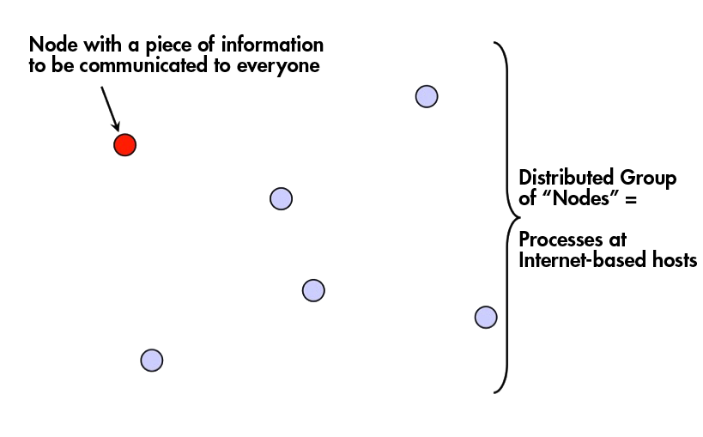
Multicast
4

Slide 5
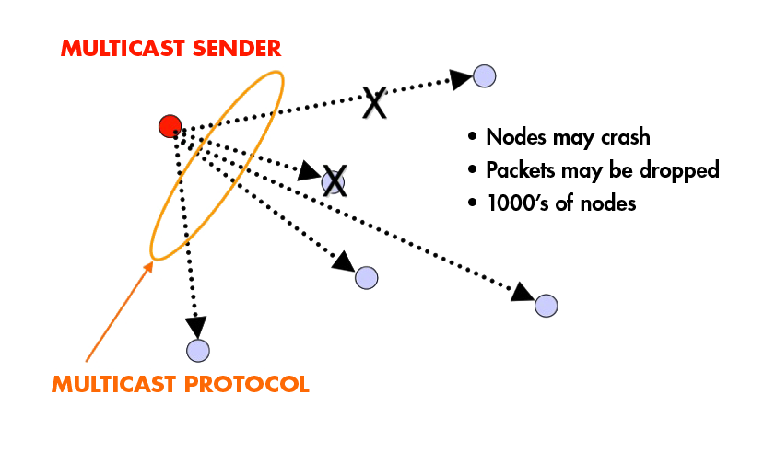
Fault-tolerance and Scalability
Needs:
Reliability (Atomicity)
  100% receipt
Speed
5

Slide 6
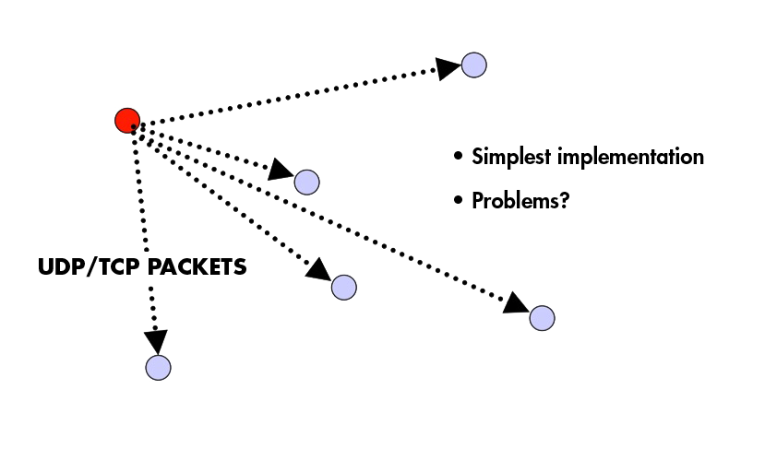
Centralized
6

Slide 7
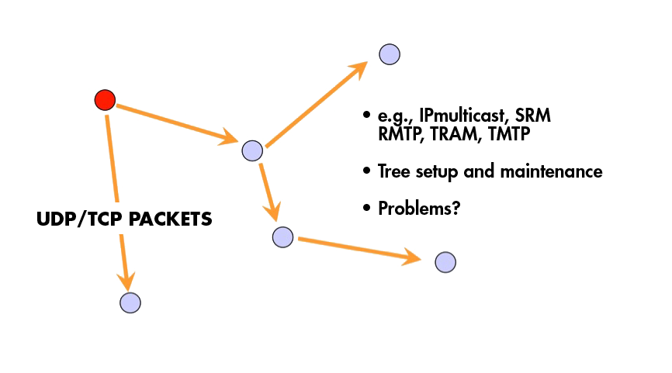
Tree-Based
7

Slide 8
Tree-based Multicast Protocols
Build a spanning tree among the processes of the multicast group
Use spanning tree to disseminate multicasts
Use either acknowledgments (ACKs) or negative acknowledgements (NAKs) to repair multicasts not received
SRM (Scalable Reliable Multicast)
  Uses NAKs
  But adds random delays, and uses exponential backoff to avoid NAK storms
  (Do you know why SRM is called a “talented” protocol?)
RMTP (Reliable Multicast Transport Protocol)
  Uses ACKs
  But ACKs only sent to designated receivers, which then re-transmit missing multicasts
These protocols still cause an O(N) ACK/NAK overhead [Birman99]
8
Notes:
Did you know the SRM protocol was a talented kid? Reportedly it had a NAK for all new things it heard.

Slide 9
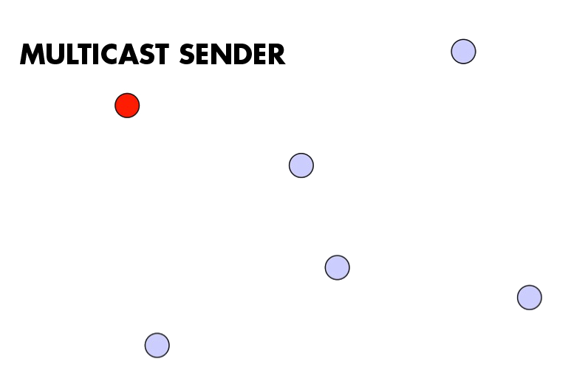
A Third Approach
9

Slide 10
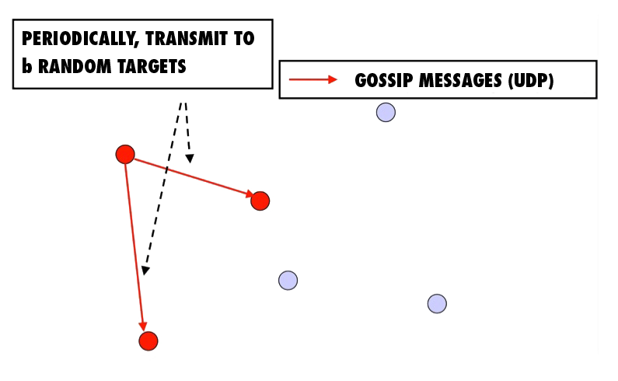
A Third Approach
10

Slide 11
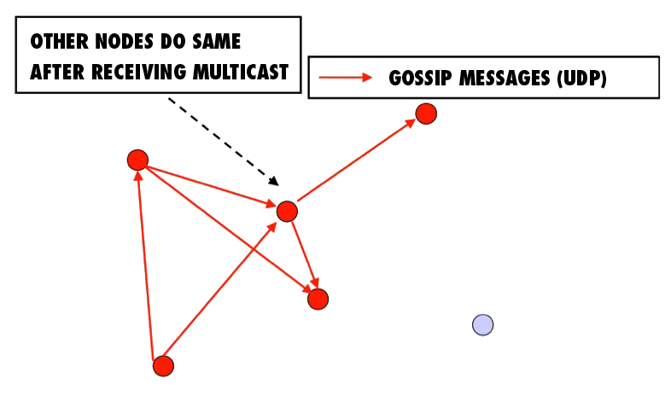
A Third Approach
11

Slide 12
A Third Approach
12

Slide 13
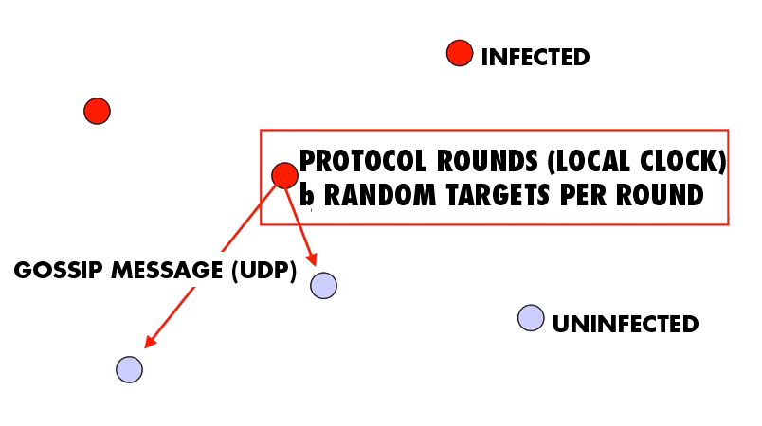
“Epidemic” Multicast (or “Gossip”)
13

Slide 14
Push vs. Pull
So that was “Push” gossip
  Once you have a multicast message, you start gossiping about it
  Multiple messages? Gossip a random subset of them, or recently-received ones, or higher priority ones
There’s also “Pull” gossip
  Periodically poll a few randomly selected processes for new multicast messages that you haven’t received
  Get those messages
Hybrid variant: Push-Pull
  As the name suggests
14

Slide 15
Announcements
MP1: Due coming Sunday 9/14, demos Monday 9/15
  VMs distributed: see Piazza
  Demo signup sheet: now on Piazza (sign up by Friday!)
  Demo details: will be posted tomorrow on Piazza
    Make sure you print individual and total linecounts
HW1 due soon, Thu 9/18!
Check Piazza often! It’s where all the announcements are at!

Slide 16
Properties
Claim that the simple Push protocol
Is lightweight in large groups
Spreads a multicast quickly
Is highly fault-tolerant
16

Slide 17
Analysis
From old mathematical branch of Epidemiology [Bailey 75]
Population of (n+1) individuals mixing homogeneously
Contact rate between any individual pair is
At any time, each individual is either uninfected (numbering x) or infected (numbering y)
Then,
  and at all times
Infected–uninfected contact turns latter infected, and it stays infected
17

Slide 18
Analysis (contd.)
Continuous time process
Then
(why?)
with solution:
(can you derive it?)
18

Slide 19
Epidemic Multicast
19

Slide 20
Epidemic Multicast Analysis
(why?)
Substituting, at time t=clog(n), the number of infected is
(correct? can you derive it?)
20

Slide 21
Analysis (contd.)
Set c,b to be small numbers independent of n
Within clog(n) rounds, [low latency]
  all but number of nodes receive the multicast
  [reliability]
  each node has transmitted no more than cblog(n)gossip messages [lightweight]
21

Slide 22
Why is log(N) low?
log(N) is not constant in theory
But pragmatically, it is a very slowly growing number
Base 2
  log(1000) ~ 10
  log(1M) ~ 20
  log (1B) ~ 30
  log(all IPv4 addresses) = 32
  log(all IPv6 addresses) = 128
22

Slide 23
Fault-tolerance
Packet loss
  50% packet loss: analyze with b replaced with b/2
  To achieve same reliability as 0% packet loss, takes twice as many rounds
Node failure
  50% of nodes fail: analyze with n replaced with n/2 and b replaced with b/2
  Same as above
23

Slide 24
Fault-tolerance
With failures, is it possible that the epidemic might die out quickly?
Possible, but improbable:
  Once a few nodes are infected, with high probability, the epidemic will not die out
  So the analysis we saw in the previous slides is actually behavior with high probability
  [Galey and Dani 98]
Think: why do rumors spread so fast? why do infectious diseases cascade quickly into epidemics? why does a virus or worm spread rapidly?
24

Slide 25
Pull Gossip: Analysis
In all forms of gossip, it takes O(log(N)) rounds before about N/2 processes get the gossip
  Why? Because that’s the fastest you can spread a message – a spanning tree with fanout (degree) of constant degree has O(log(N)) total nodes (height of tree)
Thereafter, pull gossip is faster than push gossip
After the ith, round let be the fraction of non-infected processes. Let each round have k pulls. Then
This is super-exponential
Second half of pull gossip finishes in time O(log(log(N))
25
Notes:
Push: p_{i+1}=q * p_i, where q is a constant fraction q = (1-b/n)^(n*(1-p_i)) ~ e^(-b)

Slide 26
Topology-Aware Gossip
Network topology is hierarchical
Random gossip target selection => core routers face O(N) load (Why?)
Fix: In subnet i, which contains n_{i} nodes, pick gossip target in your subnet with probability (1-1/n_{i})
Router load=O(1)
Dissemination time=O(log(N))
N/2 nodes in a subnet
Router
N/2 nodes in a subnet
26

Slide 27
Answer – Push Analysis (contd.)
Using:
Substituting, at time t=clog(n)
27

Slide 28
SO,...
Is this all theory and a bunch of equations?
Or are there implementations yet?
28

Slide 29
Some implementations
Clearinghouse and Bayou projects: email and database transactions [PODC ‘87]
refDBMS system [Usenix ‘94]
Bimodal Multicast [ACM TOCS ‘99]
Sensor networks [Li Li et al, Infocom ‘02, and PBBF, ICDCS ‘05]
AWS EC2 and S3 Cloud (rumored). [‘00s]
Cassandra key-value store (and others) use gossip for maintaining membership lists
Usenet NNTP (Network News Transport Protocol) [‘79]
29

Slide 30
NNTP Inter-server Protocol
Each client uploads and downloads news posts from a news server
2.
CHECK <Message IDs>
Upstream
Server
Downstream
Server
238 {Give me!}
TAKETHIS <Message>
239 OK
Server retains news posts for a while,
transmits them lazily, deletes them after a while.
30

Slide 31
Summary
Multicast is an important problem
Tree-based multicast protocols
When concerned about scale and fault-tolerance, gossip is an attractive solution
Also known as epidemics
Fast, reliable, fault-tolerant, scalable, topology-aware
31

Slide 32
Announcements
MP1: Due coming Sunday 9/14, demos Monday 9/15
  VMs distributed: see Piazza
  Demo signup sheet: now on Piazza (sign up by Friday!)
  Demo details: will be posted tomorrow on Piazza
    Make sure you print individual and total linecounts
HW1 due soon, Thu 9/18!
Check Piazza often! It’s where all the announcements are at!

