Slide 1
CS 425 / ECE 428
Distributed Systems
Fall 2025
Aishwarya Ganesan
W/ Indranil Gupta (Indy)
Lecture 26: Graph Processing, Machine Learning
All slides © IG

Slide 2
Graph Processing: What We’ll Cover
Distributed Graph Processing
Google’s Pregel system
Inspiration for many newer graph processing systems: Piccolo, Giraph, GraphLab, PowerGraph, LFGraph, X-Stream, etc.
2
Notes:
Pregel is not open sourced, but papers have been published on it, and it has inspired many graph processing systems → 2010
QUESTION: Why Pregel?
As an homage to famous polymath Leonard Euler. River Pregolya & Bridges of Konigsberg—led to the invention graph theory. He popularized the use of Pi, f(x). It is estimated that a quarter of the combined output in the 18th century in math, physics, mechanics, astronomy, and navigation came from Euler! At one point in his life, after he was completely blind, he averaged 1 paper a week for an entire year!

Slide 3
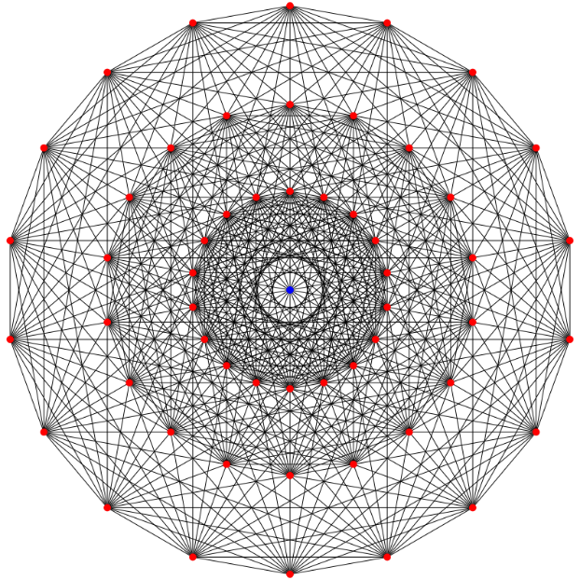
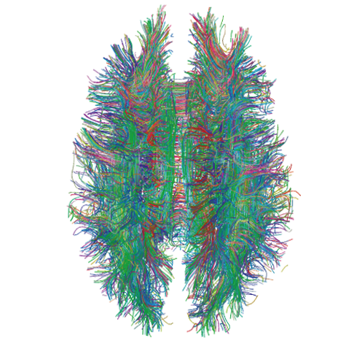
Lots of Graphs
Large graphs are all around us
Internet Graph: vertices are routers/switches and edges are links
World Wide Web: vertices are webpages, and edges are URL links on a webpage pointing to another webpage
Called “Directed” graph as edges are uni-directional
Social graphs: Facebook, Twitter, LinkedIn
Biological graphs: Brain neurons, DNA interaction graphs, ecosystem graphs, etc.
Source: Wikimedia Commons, Wikipedia
3
Notes:
Some graphs are directed (www)

Slide 4
Graph Processing Operations
Need to derive properties from these graphs
Need to summarize these graphs into statistics
E.g., find shortest paths between pairs of vertices
Internet (for routing)
LinkedIn (degrees of separation)
E.g., do matching
Dating graphs in match.com (for better dates)
PageRank
Web Graphs
Google search, Bing search, Yahoo search: all rely on this
And many (many) other examples!
4
Notes:
Degrees of separation in Linkedin → shortest path algorithm.
Lots of graph algorithms---shortest paths, min spanning tree, max flow, min-cut.
QUESTION: how many colors needed to color a world map? 5-coloring was proved in 1800s, and 4-coloring was proved only in 1976 and one of the first major theorems proved with the assistance of a computer.

Slide 5
Why Hard?
Because these graphs are large!
Human social network has 100s Millions of vertices and Billions of edges
WWW has Millions of vertices and edges
Hard to store the entire graph on one server and process it
On one beefy server: may be slow, or may be very expensive (performance to cost ratio very low)
Use distributed cluster/cloud!
5

Slide 6
Typical Graph Processing Application
Works in iterations
Each vertex assigned a value
In each iteration, each vertex:
Gather: Gathers values from its immediate neighbors (vertices who join it directly with an edge). E.g., @A: B→A, C→A, D→A,…
Apply: Does some computation using its own value and its neighbors’ values.
Scatter: Updates its new value and sends it out to its neighboring vertices. E.g., A→B, C, D, E
Graph processing terminates after: i) fixed iterations, or ii) vertices stop changing values
C
B
A
D
E
6
Notes:
QUESTION: Can MapReduce be used for such applications?

Slide 7
Hadoop/MapReduce to the Rescue?
Multi-stage Hadoop
Each stage == 1 graph iteration
Assign vertex ids as keys in the reduce phase
Well-known
At the end of every stage, transfer all vertices over network (to neighbor vertices)
All vertex values written to HDFS (file system)
Very slow!
7
Notes:
One can ask the same Q as with Stream-processing
So, a graph processing algorithm that needs 100 iterations needs 100 MR stages!
In fact, Page-Rank used to run on a multi-stage MR before Pregel came along.

Slide 8
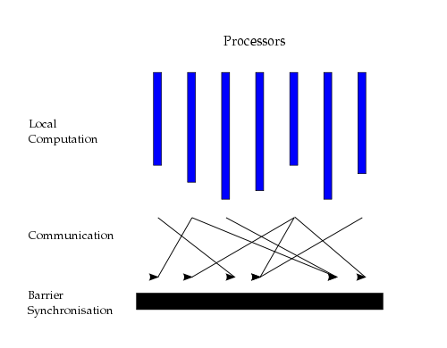
Bulk Synchronous Parallel Model
“Think like a vertex”
Originally by Valiant (1990)
8
Source: http://en.wikipedia.org/wiki/Bulk_synchronous_parallel
Notes:
Initially developed in 80s by Leslie Valiant. Then, a team across many univs developed the various libs, languages, and tools in the 90s and published BSPlib.
Used by many engines today
Contrast with map-reduce & graph processing: iterations of local compute, communicate (Get or Put operations), and a barrier.

Slide 9
Basic Distributed Graph Processing
“Think like a vertex”
Assign each vertex to one server
Each server thus gets a subset of vertices
In each iteration, each server performs Gather-Apply-Scatter for all its assigned vertices
Gather: get all neighboring vertices’ values
Apply: compute own new value from own old value and gathered neighbors’ values
Scatter: send own new value to neighboring vertices
C
B
A
D
E
9
Notes:
Input & output formats are abstracted away; user-specified Reader/Writer subclasses of the abstract base class
Apply is local to node, so no races WRT what a neighbor gets to read.
Apply step can also mutate the graph: add/subtract vertex/edge as a neighbor; but its effect is seen in the next iteration only, much like a scatter message. Race conditions are handled either based on a priority (deletions before additions) or via user-specified handlers

Slide 10
Assigning Vertices
How to decide which server a given vertex is assigned to?
Different options
Hash-based: Hash(vertex id) modulo number of servers
Remember consistent hashing from P2P systems?!
Locality-based: Assign vertices with more neighbors to the same server as its neighbors
Reduces server to server communication volume after each iteration
Need to be careful: some “intelligent” locality-based schemes may take up a lot of upfront time and may not give sufficient benefits!
10
Notes:
Use clustering for locality-based, but that itself is a graph-algorithm ☺

Slide 11
Pregel System By Google
Pregel uses the leader/worker model
Leader (one server)
Maintains list of worker servers
Monitors workers; restarts them on failure
Provides Web-UI monitoring tool of job progress
Worker (rest of the servers)
Processes its vertices
Communicates with the other workers
Persistent data is stored as files on a distributed storage system (such as GFS or BigTable)
Temporary data is stored on local disk
11

Slide 12
Pregel Execution
Many copies of the program begin executing on a cluster
The leader (“Master” originally) assigns a partition of input (vertices) to each worker
Each worker loads the vertices and marks them as active
The leader instructs each worker to perform an iteration
Each worker loops through its active vertices & computes for each vertex
Messages can be sent whenever, but need to be delivered before the end of the iteration (i.e., the barrier)
Worker informs leader after completing an iteration; sends #active vertices for next iteration, and any aggregator values
When all workers reach iteration barrier, leader starts next iteration
Computation halts when, in some iteration: no vertices are active and when no messages are in transit
Leader instructs each worker to save its portion of the graph
12

Slide 13
Fault-Tolerance in Pregel
Checkpointing
Periodically, at start of an iteration, leader instructs the workers to save state of their partitions to persistent storage
e.g., Vertex values, edge values, incoming messages
Failure detection
Using periodic “ping” messages from leader → worker
Recovery
The leader reassigns graph partitions to the currently available workers
The workers all reload their partition state from most recent available checkpoint
13
Notes:
A barrier (between iterations) is a convenient place to checkpoint all state. Maybe start check pointing only after some min number of iterations.
Optimizations: all partitions/workers start from the checkpointed state OR only failed partitions/workers start from the checkpointed state (saves compute resources)

Slide 14
How Fast Is It?
Shortest paths from one vertex to all vertices
SSSP: “Single Source Shortest Path”
On 1 Billion vertex graph (tree)
50 workers: 180 seconds
800 workers: 20 seconds
50 B vertices on 800 workers: 700 seconds (~12 minutes)
Pretty Fast!
14
Notes:
State of the art multi-core PCs from 2010
Human graph → 7B

Slide 15
Summary: Graph Processing
Lots of (large) graphs around us
Need to process these
MapReduce not a good match
Distributed Graph Processing systems: Pregel by Google
Many follow-up systems
Piccolo, Giraph: Pregel-like
GraphLab, PowerGraph, LFGraph, X-Stream: more advanced
15
Notes:
Some follow-up systems support dynamic repartitioning of the vertex set across workers, based on observed communication patterns & load in the system.

Slide 16
CS 425 / ECE 428
Distributed Systems
Fall 2024
Aishwarya Ganesan
w/ Indranil Gupta (Indy)
Lecture 26 (contd.): Machine Learning (in syllabus)

Slide 17
Basic ML: SGD
“Machine learning is nothing but damn statistics.” – A lot of people
Machine learning trains “models” (computer representations)
Training vs. Inference (latter called Prediction, or Model Serving)
Learning: Supervised vs. Unsupervised vs Reinforcement
SGD = Stochastic Gradient Descent
Minimize an objective function that is smooth and differentiable
Popular variants: AdaGrad (adaptive gradient), Adam (adaptive moment), RMSProp
A common strawman application for many distributed ML papers!
17
Notes:
Supervised: train on labeled data
Unsupervised: (kNN style) search for hidden patterns in unlabeled data; recommendation engines, for eg.
DeepBlue vs DeepChess/Stockfish vs Alpha-Zero (1/2 of training)
Reinforcement learning: AlphaGoZero/Alpha-Zero vs the earlier models. Similar to how our brains work. Indeterminate time for completion, depends on environmental factors and the reinforcement/reward function. Demis Hassabis (DeepMind) used this technique to solve all but 3 of Atari games available. Raw pixels as the representation of the environment, and score as the reinforcement. AlphaGo uses board states’ ranks as the reinforcement function.
Supervised learning: Essentially, we’re solving/finding the mathematical curve in a N (for a large N) dimensional space that fits all the training data; so that only the points labeled as “belongs/true” will lie on the curve. Once the curve has been computed, given a new point, we can tell if it sits on the curve or not.
The simplest equation is y = Ax + B, where x is the input (say a pic) and y is the yes/no answer of whether the pic is/has a cat.
NN are used to find y = A*[x1, x2, …xn] + B where A and B are matrices that need to be computed across all those dimensions.
SGD is the method used to minimize the error between the computed value of y and the desired result (based on the labeled data).

Slide 18
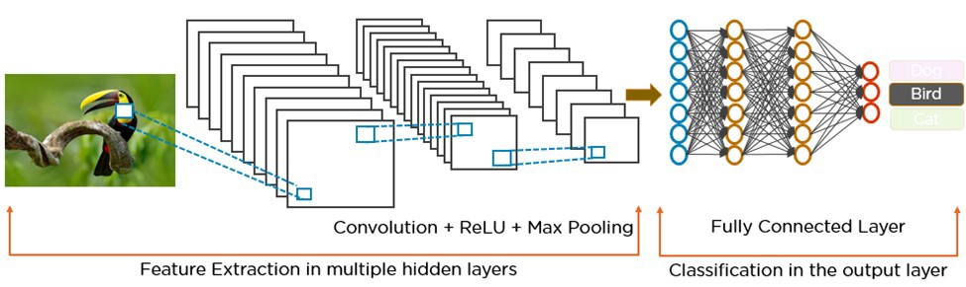
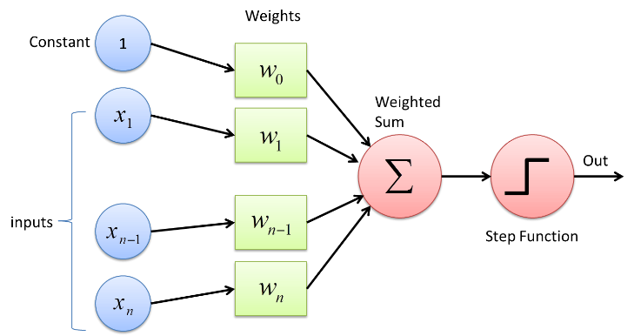
Basic Neural Networks
ANN = Artificial Neural Network
Another kind of “model”
A common form of representation learning
Used widely in vision, NLP, …
Graphs of operators
Operators can be computationally heavy
Graph can be in “stages” or “layers”
Common: All to all communication between operators in consecutive stages
Most edges have a set of associated weights (parameters). (Exceptions: activation funcs (ReLU), dropout). The collection of these weights IS the model.
A Perceptron layer
18
Notes:
NN: generates a set of equations with several variables, and training is used to find the coefficients to these equations.
Several layers of nodes called artificial neurons (loosely based on the brain) connected by edges to (synapses). Signals are tensors sent thru’ edges. Output of a node is a computed by some non-linear function over the totality of its inputs (from the previous layer); and each edge essentially gets a weight (to tune the strength of its signal), and that is tuned during the training.
Multi-layer perceptron, aka MLPs

Slide 19
Basic Neural Networks (2)
Training data passed “forward”, followed by calculating error against known result (supervised learning)
followed by “backward” pass that adjusts/updates the weights at operators (so that for an incorrect training pass, if the same input were to be passed through, the result would be correct)
Data between operators: tensors (multi-dimensional vectors)
Default: train on one item (forward + backward), followed by next item
Extension: train on a mini-batch of items
After model is trained, Prediction/Inference needs only forward pass
Emerging area: Online training : do both training and inference together (aka Continual training)
Hyperparameter: configuration parameter for your model (not to be confused with a model “weight” == parameter), e.g., batch size
19
Notes:
Error is computed by subtracting result from expected-result. Used in compute a loss value, which is then used by backpropagation to tweak (using algos like gradient descent) each weight in model (in A, not B). The next image is sent in, and so on. Repeat across images for N times.

Slide 20
ANN Types: FFNN, CNNs, RNNs
FFNN: feed forward neural net (no loops)
DNN: Deep NN
More than one stage
“Hidden” layers between input and output
CNN: Convolutional NN
DNN + additional layers for convolutions
Transform data, e.g., sequence of filters that result in an activation/detection, e.g., image.
E.g., Facebook photo captioning
RNN: Recurrent NN
DNN + loops within layer (e.g., time aspect (e.g., GIF), sequential aspects)
E.g., auto-correction on your phone
Other types: GNN (graph neural net), Transformer, …
A few neural nets used in evaluation of distributed machine learning
Inception(v3), (G)NMT, Resnet,…
20

Slide 21
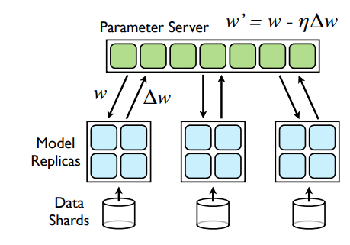
Distributed Machine Learning
Training data – collection of input and output labels x_{i}, y_{i} of size N
Learn model weights w
Model size and N can be huge
Centralized Machine Learning
Slow and often infeasible
Distributed Machine Learning
Parallelize via Multiple workers
“Parameter Server” to aggregate data from workers
from current iteration and start next iteration at workers.
Dean, Jeffrey, et al. "Large scale distributed deep networks." Advances in Neural Information Processing Systems (NeurIPS) 25 (2012).
21
Notes:
In each iteration: each worker trains the model on a subset of its data shard, sends the adjustments to the weights to the p-server. The p-server waits for all workers to send their adjustments, then computes the new weights, sends it to all workers. Next iteration starts.

Slide 22
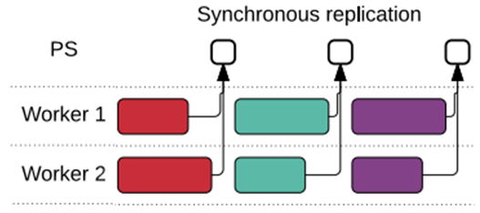
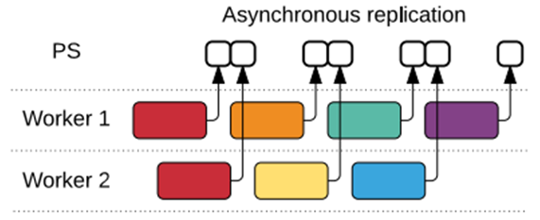
Kinds of Parallelism
Layer 1
Layer 2
Layer3
Layer 4
Data parallelism: multiple workers run same model, different data is sent to each device, data “batched” into mini-batches
Workers synchronize after each mini-batch
Parameter Server approach
All-Reduce approach: each worker multicasts weights to others
Variant: Asynchronous training
Model parallelism: same model (DNN graph) is split across multiple devices, one input passed through collection of devices at a time.
L1
L1
L2
L3
L2
L3
L4
L4
worker 1
worker 2
L1
L2
L3
L4
Abadi, Martín, et al. "TensorFlow: a system for Large-Scale machine learning." 12th USENIX Symposium on Operating Systems Design and Implementation (OSDI 16). 2016.
22

Slide 23
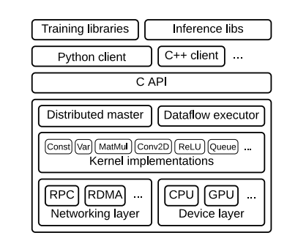
TensorFlow
Built by Google
Framework for large-scale training and inference
Hides details of distribution
Uses dataflow graphs to represent computation, shared state, and operations that mutate state
Dataflow captures structure of computation in ML
Extensible, runtime contains over 200 standard operations
Support for CPUs, GPUs, and TPUs (Tensor Processing Units)
Different communication protocols
Abadi, Martín, et al. "TensorFlow: a system for Large-Scale machine learning." 12th USENIX Symposium on Operating Systems Design and Implementation (OSDI 16). 2016.
23
Notes:
Open-sourced 2015; v2 in 2019. Supports multiple languages: Java, C++, python, JavaScript
Dataflow graph: each vertex represents a local calculation (aka operation), each edge represents the output or input (tensor)

Slide 24
Image classifier using TensorFlow API
# 1. Construct a graph representing the model.
x = tf.placeholder(tf.float32, [BATCH_SIZE, 784]) # Placeholder for input.
y = tf.placeholder(tf.float32, [BATCH_SIZE, 10]) # Placeholder for labels.
W_1 = tf.Variable(tf.random_uniform([784, 100])) # 784x100 weight matrix.
b_1 = tf.Variable(tf.zeros([100])) # 100-element bias vector.
layer_1 = tf.nn.relu(tf.matmul(x, W_1) + b_2) # Output of hidden layer.
W_2 = tf.Variable(tf.random_uniform([100, 10])) # 100x10 weight matrix.
b_2 = tf.Variable(tf.zeros([10])) # 10-element bias vector.
layer_2 = tf.matmul(layer_1, W_2) + b_2 # Output of linear layer.
# 2. Add nodes that represent the optimization algorithm.
loss = tf.nn.softmax_cross_entropy_with_logits(layer_2, y)
train_op = tf.train.AdagradOptimizer(0.01).minimize(loss)
# 3. Execute the graph on batches of input data.
with tf.Session() as sess: # Connect to the TF runtime.
sess.run(tf.initialize_all_variables()) # Randomly initialize weights.
for step in range(NUM_STEPS): # Train iteratively for NUM_STEPS.
x_data, y_data = ... # Load one batch of input data.
sess.run(train_op, {x: x_data, y: y_data}) # Perform one training step.
Abadi, Martín, et al. "TensorFlow: a system for Large-Scale machine learning." 12th USENIX symposium on operating systems design and implementation (OSDI 16). 2016.
24
Notes:
Based on the old API from the original paper.
x = Each input (image) is a 784-float tensor (28x28 image)
y = Each output/label is a 10-float tensor, that tells you the number in that image: 0 thru’ 9.
1st layer: 784 nodes, y = W1x+B1, where B is the bias vector. Produces 100 outputs
2nd layer: 100 nodes, y = W2x+B2, produces 10 outputs (y)
Loss function: compares expected y to generated y and computes a loss, uses Adaptive Gradient.
All images are run thru’ the model in one iteration to tune W1 & W2; and NUM_STEPS-1 iterations are repeated.
After which, any input x should give us an x with high probability.

Slide 25
PyTorch
Another popular ML framework originally developed by Meta
Tesla Autopilot, Uber's Pyro, Hugging Face's Transformers
Dynamic computation graphs
Automatic computation of gradients
Implements many algorithms and components
Domain-specific – TorchText, TorchVision, and TorchAudio – include datasets
Tensors – n-dimensional arrays
Module – define what makes up the model and a forward member function.
E.g., Linear Module
weight and bias as parameters
forward function generates output as input * weight + bias
25
Notes:
Torch was released 2001 under GPL license; subsumed by PyTorch in 2018.
Domain-specific: libraries included for each domain within the PyTorch eco-system. For eg, TorchAudio includes I/O functions for reading/saving audio files, necessary transforms for audio data, pre-trained models for speech recognition.

Slide 26
Example with DistributedDataParallel
dist.init_process_group("gloo", rank=rank, world_size=world_size) # create default process group
model = nn.Linear(10, 10).to(rank) # create local model
ddp_model = DDP(model, device_ids=[rank]) # construct DDP model
# define loss function and optimizer
loss_fn = nn.MSELoss()
optimizer = optim.SGD(ddp_model.parameters(), lr=0.001)
# forward pass
outputs = ddp_model(torch.randn(20, 10).to(rank))
labels = torch.randn(20, 10).to(rank)
# backward pass
loss_fn(outputs, labels).backward()
# update parameters
optimizer.step()
26
Notes:
This example showcases how to build data parallelism: DDP.

Slide 27
Jax
ML framework from Google
Provides a familiar NumPy-style API
Multiple backends, including CPU, GPU, & TPU
grad: automatic differentiation
jit: compilation
vmap: auto-vectorization
pmap: automatic parallelization
27
Notes:
Is a Python library designed to follow the structure and workflow of NumPy.
JAX has a steeper learning curve (compared to PyTorch and TensorFlow); for the experienced ML developer with more math background. Is replacing TensorFlow within Google.
Higher performance due to XLA (accelerated linear algebra), grad, vmap, and pmap (SPMD—single program multiple data); pmap is improved by shard_map() API

Slide 28
Other ML
Distributed ML
assumes homogenous data across workers
Federated Machine Learning
allows heterogeneous data across workers
workers may be datacenters or mobile devices
failures, possibly privacy issues.
E.g., Google’s Federated learning to predict keystrokes from mobile devices
28
Notes:
Federated: Heterogenous workers: for eg. some are machines in a data center and some are mobile devices.
The process involves training a model locally on each device, then sending only the model updates (not the raw data) to a central server for aggregation into a new, improved global model. This method preserves data privacy and security, enabling collaborative learning from diverse datasets across multiple locations, such as those on mobile phones or within different organizations.

Slide 29
Summary of this Lecture, and one more video to watch!
Emerging topics in Distributed Computing
Nov6th: Stream Processing (in syllabus)
Graph Processing (in syllabus)
Machine Learning (in syllabus)
Additional Video on Course website (In Syllabus, NOT optional): Spark

Slide 30
Announcements
HW4 due this Thursday 12/4 at 2 pm US Central
MP4 due this Sunday (12/7), demos next Monday (12/8)
30

