Slide 1
CS 425 / ECE 428
Distributed Systems
Fall 2025
Indranil Gupta (Indy)
W/ Aishwarya Ganesan
Lecture 22: Structure of Networks
All slides © IG

Slide 2
What’s a Network/Graph?
Has vertices (i.e., nodes)
E.g., in the Facebook graph, each user = a vertex (or a node)
Has edges that connect pairs of vertices
E.g., in the Facebook graph, a friend relationship = an edge
2
Notes:
QUESTION: How many have done a course on graph theory? My fav course from undergrad…vertices, edges, paths, trees + cycles, min-cut, max-flows, etc.
Graphs are used to represent relationships between objects. Bidirectional vs unidirectional edges.
Eg. Highways/rail-tracks/flights and cities
QUESTION: Any examples that you can think of?

Slide 3
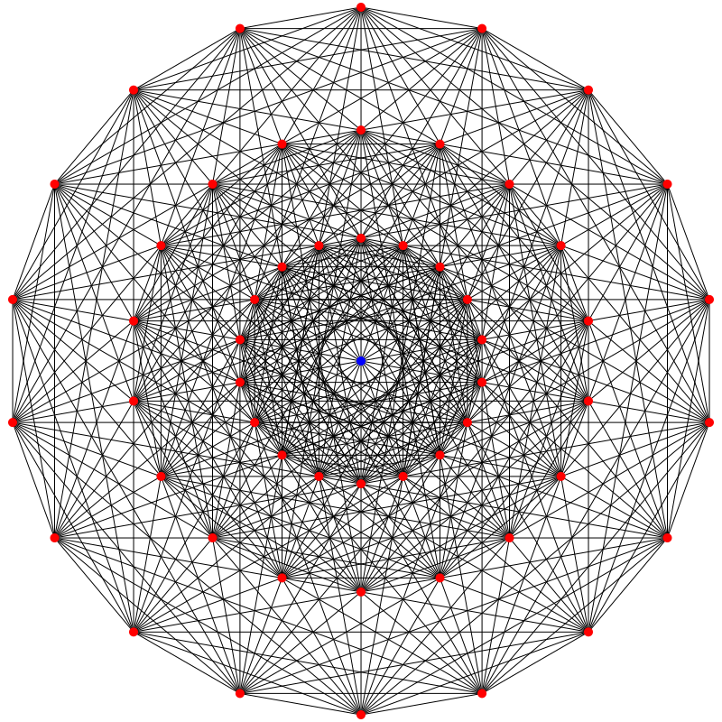
Lots of Graphs/networks
Large graphs/network are all around us
Internet : vertices are routers/switches and edges are links
World Wide Web: vertices are webpages, and edges are URL links on a webpage pointing to another webpage
Called “Directed” graph as edges are uni-directional
Social networks: Facebook, Twitter, LinkedIn
Biological networks: DNA interaction graphs, ecosystem graphs, etc.
Source: Wikimedia Commons
3
Notes:
Ecosystem: (1) geographies that have the same species of fish, birds, plants. (2) species that eat each other or depend on each other.
Created by humans vs those in nature.

Slide 4
Complexity of Networks
Structural: human population has ~8 B nodes, there are millions of computers on the Internet…
Evolution: people make new friends all the time, ISP’s change hands all the time…
Diversity: some people are more popular, some friendships are more important…
Node Complexity: Endpoints have different CPUs, Windows is a complicated OS, Mobile devices …
Emergent phenomena: simple end behavior ➔ leads to ➔ complex system-wide behavior.
If we understand the basics of climate, why is weather still so unpredictable?
4
Notes:
Node can have attributes
Emergent phenomena: self-organization—the individual parts don’t show the emergent properties!
Eg. flocking of birds, formation of ice, hurricane formation, consciousness from neurons,
In all areas: Biology, Physics, Chemistry, technology, religion, etc.

Slide 5
Network Structure
“Six degrees of Kevin Bacon”
Milgram’s experiment in 1970
Recent work on shows similarities between the structures of: Internet, WWW, human social networks, p2p overlays, Electric power grid, protein networks
These networks have “evolved naturally”
Many of these are “small world networks”
5
Notes:
https://oracleofbacon.org/ & an actual TEDx talk by Kevin on this topic about https://www.sixdegrees.org/ (a charity organization).
Stanley Milgram: However, 64 of the letters eventually did reach the target contact. Among these chains, the average path length fell around five and a half or six. https://en.wikipedia.org/wiki/Small-world_experiment#:~:text=In%20an%20experiment%20in%20which,came%20from%20two%20other%20men.
And in 2011, a study by Facebook found that its users were separated by an average of 4.57 degrees. https://www.thecut.com/2018/03/the-history-of-the-six-degrees-of-separation-study.html
5-6 path-lengths is an emergent property!
Small-world networks: sweet spot between highly connected graphs and very sparsely connected and long-path-length grapsh. For eg, most ppl know a small number of ppl, but there’s a few #ppl that have enormous #friends, so high clustering and small path-length.

Slide 6
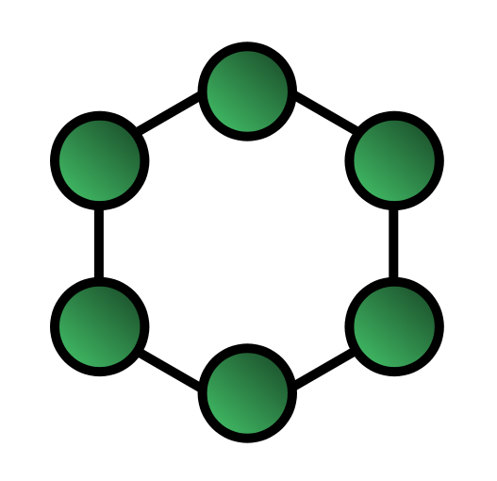
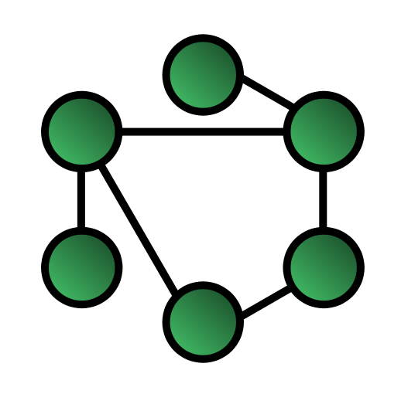
Two Important Network Properties
Clustering Coefficient: CC
Pr(A-B edge, given an A-C edge and a C-B edge)
Path Length of shortest path
Extended Ring graph: high CC, long paths
Random graph: low CC, short paths
Small World Networks: high CC, short paths
6
Notes:
Explain Path-length computation.
QUESTION: How to convert an extended ring graph to have shorter paths at the cost of lower CC? By taking random edges out of a cluster and connect them to a random vertex. Slowly reduce CC while reducing path-length too. However, both trends don’t change at the same rate (next slide)!

Slide 7
Deriving Small-world Graphs
Convert more and more edges to point to random nodes
Clustering Coefficient
Path Length
Extended
Ring graph
Small World
Networks
Random
Graph
7
Notes:
Adding 1 short path benefits everyone and drops the average path length very quickly.
SW Networks hit the sweet spot.

Slide 8
Small-world Networks All Around
Most “natural evolved” networks are small world
Network of actors → six degrees of Kevin Bacon
Network of humans → Milgram’s experiment
Co-authorship network → “Erdos Number”
World Wide Web, the Internet, …
Many of these networks also “grow incrementally”
“Preferential” model of growth
When adding a vertex to graph, connect it to existing vertex v with probability proportional to num_neighbors(v)
8
Notes:
Erdos: 1500 papers with 500+ unique co-authors!
Much like bacon# calculator, there are portals that can compute your erdos#.

Slide 9
Degrees
Degree of a vertex = number of its immediate neighbor vertices
Degree distribution – what is the probability of a given node having k edges (neighbors, friends, …)
Regular graph: all nodes same degree
Gaussian
Random graph: Exponential
Power law:
9

Slide 10
Power Law Graphs
Number of nodes with degree k is ~
1 100 10000 1M
log (number of nodes)
Power law
Heavy tailed
Exponential
1 10 100 1000
log (node degree=k)
10
Notes:
Straight line for power-law graphs.
In general, power-law graphs may share some properties with heavy-tailed graphs.

Slide 11
Small-world and Power-Law
A lot of small world networks are power law graphs
Internet backbone, telephone call graph, protein networks
WWW is a small-world graph and also a power-law graph with α=2.1-2.4
Gnutella p2p system network has heavy-tailed degree distribution
Power law networks also called scale-free
Gnutella has 3.4 edges per vertex, independent of scale (i.e., number of vertices)
11

Slide 12
Small-world ≠ Power-Law
Not all small world networks are power law
E.g., co-author networks
Not all power-law networks are small world
E.g., Disconnected power-law networks
12

Slide 13
Resilience of Small-world+Power-Law
Most nodes have small degree, but a few nodes have high degree
Attacks on small world networks
Killing a large number of randomly chosen nodes does not disconnect graph
Killing a few high-degree nodes will disconnect graph
“A few (of the many thousand) nutrients are very important to your body”
“The Electric Grid is very vulnerable to attacks”
13
Notes:
Why is this relevant to distributed systems?

Slide 14
Routing in Small-world/Power-law Networks
Build shortest-path routes between every pair of vertices
=> Most of these routes will pass via the few high-degree vertices in the graphs
=> High-degree vertices are heavily overloaded
High-degree vertices more likely to suffer congestions or crash
Same phenomenon in Electric power grid
Solution may be to introduce some randomness in path selection; don’t always use shortest path
14
Notes:
ISP to ISP contracts often influence routing more than shortest-path, which introduces some randomness.
This also means that when you build a distributed system, highly ”connected” services or nodes or objects (in whatever dependency graph you build) become points of failure; adding some randomness (even if it appears counterintuitive WRT performance/cost) to the graph is a good idea.
Alleviate congestion by introducing additional paths in the graph, overlay additional resilience based on what the underlying infrastructure does not provide,

Slide 15
Summary
Networks (graphs) are all around us
Man-made networks like Internet, WWW, p2p
Natural networks like protein networks, human social network
Yet, many of these have common characteristics
Small-world
Power-law
Useful to know this: when designing distributed systems that run on such networks
Can better predict how these networks might behave
15

Slide 16
Announcements
HW4 released, due 12/4 (Thursday)
Deadline will creep up on you! Start a problem as soon as the topic is discussed
HW4 and MP4 due soon after Thanksgiving/Fall Break, so please start soon!
MP3 due Sunday 11/9, demos on 11/10
Final Exam: See Piazza
16

