Slide 1
CS 425 / ECE 428
Distributed Systems
Fall 2024
Aishwarya Ganesan
w/ Indranil Gupta (Indy)
Lecture 24 B: Consistency Models
All slides © IG/AG

Slide 2
Announcements
HW4 and MP4 due after TG/Fall break
MP3 grades released

Slide 3


Consistency Models
Contract between distributed system and application
Dictates what results can the system return for operations
  Concurrent reads and writes by clients on replicas
  Depending on how operations are performed, guarantees offered by the distributed system differ
  Consistency model dictates what is permissible
System developers – design/optimize system to meet contract
Application developers – need to understand what contract is for application correctness
clients
system
3

Slide 4

Consistency Spectrum
Faster reads and writes
More consistency
Strong
(e.g., Linearizability,
Sequential)
Eventual
4

Slide 5
Spectrum Ends: Eventual Consistency
Cassandra offers Eventual Consistency
  originally from Amazon’s Dynamo and LinkedIn’s Voldemort
If writes to a key stop, all replicas of key will converge
Reads might see any previous write
  weak guarantee
More performant – allows concurrent writes
More availability – disconnected operation
Need to resolve conflicts between multiple object versions
  Cassandra – latest timestamp wins
req
resp
C1
W(x=1)
W(x=2)
C2
R(x)=0
C3
R(x)=0
C4
5

Slide 6

Spectrum Ends: Strong Consistency
Can R(x) at C4 return 1 because W(x=2) at C2 and R(x) at C4 are concurrent?
Linearizability [Herlihy and Wing]
Strong consistency (the C in CAP)
Intuitively, each operation by a client is visible instantaneously to other clients
  instantaneously in real time
All operations are totally ordered in a way that respects real-time order of operations
  if A completes before B begins, A ordered before B
  what if A and B are concurrent?
    order in a way such that total order is a valid sequential one
Appears to be a single machine (one-copy semantics)
Trades off performance and availability
C1
W(x=1)
W(x=2)
C2
R(x)
1
2
C3
R(x)
2
1
?
C4
6

Slide 7
Spectrum Ends: Strong Consistency
Models II
Suppose you have another R(x) at C3 after first R(x)=2. What should second R(x) return?
Can both reads, R(y) and R(x), return 0?
Sequential Consistency (Lamport):
  "... the result of any execution is the same as if the operations of all the processors were executed in some sequential order, and the operations of each individual processor appear in this sequence in the order specified by its program."
All operations are totally ordered
  total order respects local order of operations at clients
Sequential vs linearizability?
  sequential is weaker than linearizability (can have stale reads)
  but strong compared to many models
C1
W(x=1)
W(x=2)
C2
R(x)
2
C3
0/1/2
R(x)
?
C4
W(x=1)
1
0
R(y)
C1
W(y=1)
1
Must be 1 and
never 0
R(x)
?
C2
7

Slide 8
Consistency Spectrum
Faster reads and writes
Eventual
Sequential
Linearizable
More consistency
Linearizability is easy to program against, but can lead to low performance/availability
Eventual consistency is performant and leads to high availability, but hard to program against
There is a variety of options in-between
7

Slide 9
Causal Consistency
No total order of operations
Available under partitions
Avoids many inconsistencies that happen with eventual
Operations must respect partial order based on information flow or causality
  Operations from same client are causally related
  If client C1 does a write and a read at client C2 sees it, then these ops are causally related
  Transitive
W(x=1)
Causality, not messages
C1
R(x)1
W(y=1)
C2
R(x)
may return 0 or 1
R(y)1
R(x)
must
return 1
C3
Eventual
Causal
Sequential
Linearizable
8

Slide 10
Session-based Consistency Models
[Terry et al. 1994]
Does causal imply MR?
Monotonic reads (MR) – intuitively, reads cannot go back in time
if a client issues read R₁ and then R₂, R₂ must at least observe the state as of R₁
Monotonic writes (MW) – if a client issues write W₁ and then W₂, clients must see W₁ before W₂
Read my writes (RMW) – if a client issues W₁ and then R₁, R₁ must see the effects of W₁
All these models are available in the presence of partitions
MR
Eventual
MW
Causal
Sequential
Linearizable
RMW
9

Slide 11
Newer Consistency Models
CRDTs (Commutative Replicated Data Types): Data structures for which commutated writes give same result [INRIA, France]
  E.g., value == int, and only op allowed is +1
  Guaranteed to eventually converge
  Effectively, servers don’t need to worry about consistency and conflict resolution
Red-blue Consistency: Rewrite client transactions to separate ops into red ops vs. blue ops [MPI-SWS Germany and others]
  Blue ops can be executed (commutated) in any order across DCs
  Red ops need to be executed in the same order at each DC
  Composite model: blue ops are eventually consistent and red ops are strongly consistent
10

Slide 12
Newer Consistency Models (Contd.)
Bounded staleness
  Guarantees that data lags at most by K versions or T time units
  User or app can set K or T on reads
Probabilistically Bounded Staleness (PBS)
  expected bounds on staleness with respect to both versions and time
  SLA-style consistency predictions
11

Slide 13
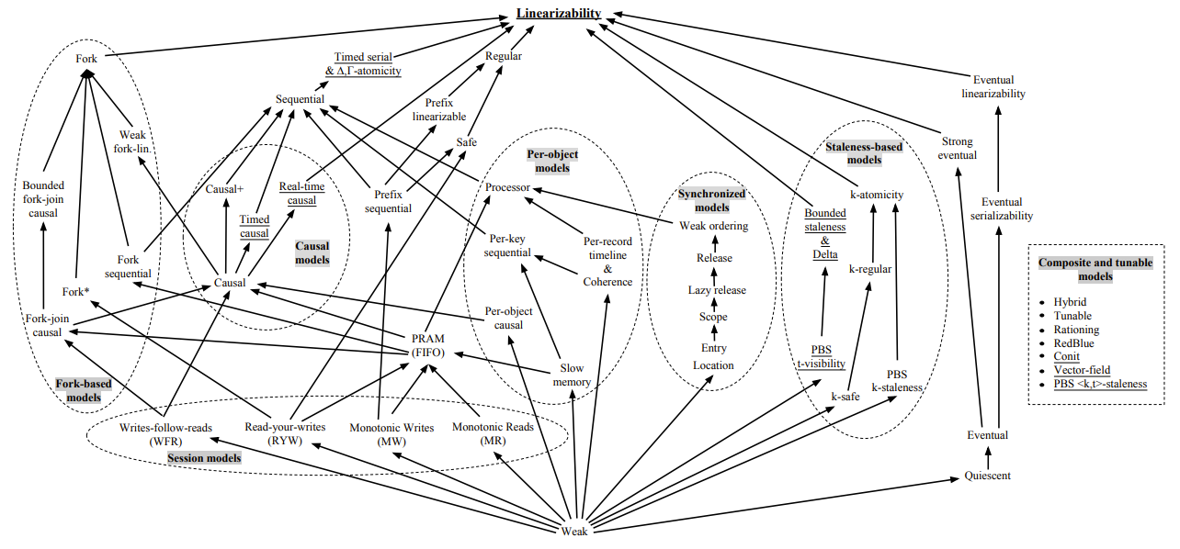
The Consistency Spectrum
[1] Viotti and Vukolic 2016
12

Slide 14
Which Consistency Model should you use?
Use the lowest consistency model that is “correct” for your application
  Gets you fastest availability
13

