Slide 1
CS 425 / ECE 428
Distributed Systems
Fall 2023
Aishwarya Ganesan
W/ Indranil Gupta (Indy)
Lecture 26 A: Stream Processing, Graph Processing
(and Optional Machine Learning)
All slides © IG
Notes:
Twitter launched in 2006
Storm – 2014 publication,
2008 first video

Slide 2
Stream Processing: What We’ll Cover
Why Stream Processing
Storm
2
Notes:
Papers published in stream processing from the 90s

Slide 3
Stream Processing Challenge
Large amounts of data => Need for real-time views of data
Social network trends, e.g., Twitter real-time search
Website statistics, e.g., Google Analytics
Intrusion detection systems, e.g., in most datacenters
Process large amounts of data
With latencies of few seconds
With high throughput
3
Notes:
3vs → volume, velocity and variety
The data has higher value when it arrives and so you want to process it quickly.

Slide 4
MapReduce?
Batch Processing => Need to wait for entire computation on large dataset to complete
Not intended for long-running stream-processing
4
Notes:
Incremental versions of stream processing
Not intended to be a long running application

Slide 5
Which one of these is NOT a stream processing job?
A) Uber
Calculating surge prices
B) LinkedIn
Aggregating updates into one email
C) Netflix
Understanding user behavior to improve personalization
D) TripAdvisor
Calculating earnings per day & fraud detection
E) None of them are stream processing
F) → ALL of them are stream processing jobs!
[https://www.youtube.com/watch?v=YUBPimFvcN4]
[http://www.vldb.org/pvldb/vol10/p1634-noghabi.pdf]
[https://www.youtube.com/watch?v=p8qSWE_nAAE]
[https://www.youtube.com/watch?v=KQ5OnL2hMBY]
5

Slide 6
Enter Storm
Apache Project
http://storm.apache.org/
Highly active JVM project
Multiple languages supported via API
Python, Ruby, etc.
Used by over 30 companies including
Twitter: For personalization, search
Flipboard: For generating custom feeds
Weather Channel, WebMD, etc.
6

Slide 7
Storm Components
Tuples
Streams
Spouts
Bolts
Topologies
7

Slide 8
Tuple
An ordered list of elements
E.g., <tweeter, tweet>
E.g., <“Miley Cyrus”, “Hey! Here’s my new song!”>
E.g., <“Justin Bieber”, “Hey! Here’s MY new song!”>
E.g., <URL, clicker-IP, date, time>
E.g., <coursera.org, 101.102.103.104, 4/4, 10:35:40>
E.g., <coursera.org, 101.102.103.105, 4/4, 10:35:42>
Tuple
8
Notes:
For a single job, you might have many thousands of tuples coming in per second.

Slide 9
Stream
Sequence of tuples
Potentially unbounded in number of tuples
Social network example:
<“Miley Cyrus”, “Hey! Here’s my new song!”>,
<“Justin Bieber”, “Hey! Here’s MY new song!”>,
<“Rolling Stones”, “Hey! Here’s my old song that’s still a super-hit!”>, …
Website example:
<coursera.org, 101.102.103.104, 4/4, 10:35:40>, <coursera.org, 101.102.103.105, 4/4, 10:35:42>, …
Tuple
Tuple
Tuple
9
Notes:
Unbounded – jobs can run forever until forcibly stopped

Slide 10
Spout
A Storm entity (process) that is a source of streams
Often reads from a crawler or DB
Tuple
Tuple
Tuple
Tuple
Tuple
Tuple
10
Notes:
Where does the stream come from?

Slide 11
Bolt
A Storm entity (process) that
Processes input streams
Outputs more streams for other bolts
11

Slide 12
Topology
A directed graph of spouts and bolts (and output bolts)
Corresponds to a Storm “application”
12

Slide 13
Topology
Can have cycles if the application
requires it
13

Slide 14
Bolts come in many Flavors
Operations that can be performed
Filter: forward only tuples which satisfy a condition
Joins: When receiving two streams A and B, output all pairs (A,B) which satisfy a condition
Apply/transform: Modify each tuple according to a function
And many others
But bolts need to process a lot of data
Need to make them fast
14
Notes:
User specified bolts

Slide 15
Parallelizing Bolts
Have multiple processes (“tasks”) constitute a bolt
Incoming streams split among the tasks
Typically each incoming tuple goes to one task in the bolt
Decided by “Grouping strategy”
Three types of grouping are popular
15
Notes:
Parallelization means that there are multiple instantiations of each bolt, and these are called tasks.

Slide 16
Grouping
Shuffle Grouping
Streams are distributed evenly among the bolt’s tasks
Round-robin fashion
16

Slide 17
Grouping
Fields Grouping
Group a stream by a subset of its fields
E.g., All tweets where twitter username starts with [A-H,a-h,0-3] go to task 1, tweets starting with [I-Q,i-q,4-6]go to task 2, tweets starting with [R-Z,r-z,7-9] go to task 3
[A-H,a-h,0-3]
[I-Q,i-q,4-6]
[R-Z,r-z,7-9]
17

Slide 18
Grouping
All Grouping
All tasks of bolt receive all input tuples
18

Slide 19
Storm Cluster
Job Submission
Master (Coordinator or Leader) node
Runs a daemon called Nimbus
Responsible for
Distributing code around cluster
Assigning tasks to machines
Monitoring for failures of machines
Worker node
Runs on a machine (server)
Runs a daemon called Supervisor
Listens for work assigned to its machine
Runs “Executors”(which contain groups of tasks)
Zookeeper
Coordinates Nimbus and Supervisors communication
All state of Supervisor and Nimbus is kept here
Nimbus
ZK Cluster
Supervisor
W1
W2
W3
W4
Worker Nodes
Supervisor
W1
W2
W3
W4
19

Slide 20
Failures
A tuple is considered failed when its topology (graph) of resulting tuples fails to be fully processed within a specified timeout
Anchoring: Anchor an output to one or more input tuples
Failure of one tuple causes one or more tuples to replayed
20

Slide 21
API For Fault-Tolerance (OutputCollector)
Emit(tuple, output)
Emits an output tuple, perhaps anchored on an input tuple (first argument)
Ack(tuple)
Acknowledge that you (bolt) finished processing a tuple
Fail(tuple)
Immediately fail the spout tuple at the root of tuple topology if there is an exception from the database, etc.
Must remember to ack/fail each tuple
Each tuple consumes memory. Failure to do so results in memory leaks.
21
Notes:
Emit is used by spout

Slide 22
Twitter’s Heron System (Optional Additional Slide)
Fixes the inefficiencies of Storm’s acking mechanism (among other things)
Uses backpressure: a congested downstream tuple will ask upstream tuples to slow or stop sending tuples
1. TCP Backpressure: uses TCP windowing mechanism to propagate backpressure
2. Spout Backpressure: node stops reading from its upstream spouts
3. Stage by Stage Backpressure: think of the topology as stage-based, and propagate back via stages
Use:
Spout+TCP, or
Stage by Stage + TCP
Beats Storm throughput handily (see Heron paper)
22

Slide 23
Summary: Stream Processing
Processing data in real-time a big requirement today
Storm
And other sister systems, e.g., Spark Streaming, Heron, (LinkedIn’s Samza, “Kafka”, etc.)
Parallelism
Application topologies
Fault-tolerance
23

Slide 24
Graph Processing: What We’ll Cover
Distributed Graph Processing
Google’s Pregel system
Inspiration for many newer graph processing systems: Piccolo, Giraph, GraphLab, PowerGraph, LFGraph, X-Stream, etc.
24
Notes:
Pregel is not Open Source but papers have been published on it and has inspired many graph processing systems → 2010

Slide 25
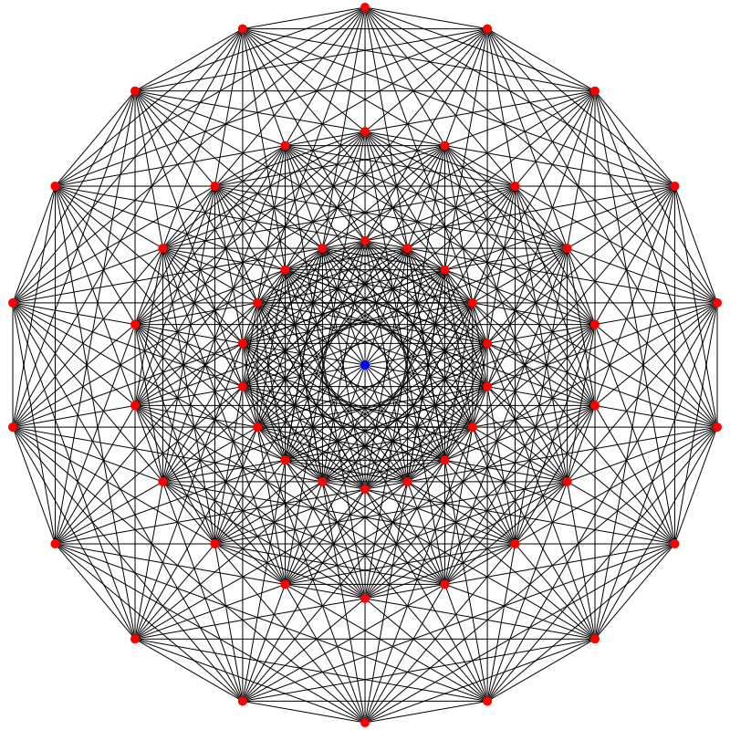
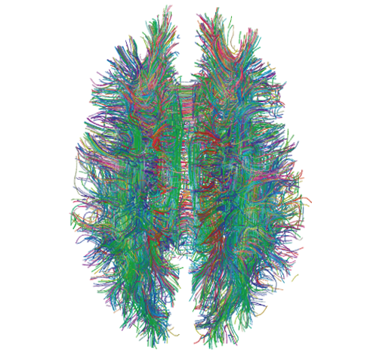
Lots of Graphs
Large graphs are all around us
Internet Graph: vertices are routers/switches and edges are links
World Wide Web: vertices are webpages, and edges are URL links on a webpage pointing to another webpage
Called “Directed” graph as edges are uni-directional
Social graphs: Facebook, Twitter, LinkedIn
Biological graphs: Brain neurons, DNA interaction graphs, ecosystem graphs, etc.
Source: Wikimedia Commons, Wikipedia
25
Notes:
Describe whether graphs are directed or not →

Slide 26
Graph Processing Operations
Need to derive properties from these graphs
Need to summarize these graphs into statistics
E.g., find shortest paths between pairs of vertices
Internet (for routing)
LinkedIn (degrees of separation)
E.g., do matching
Dating graphs in match.com (for better dates)
PageRank
Web Graphs
Google search, Bing search, Yahoo search: all rely on this
And many (many) other examples!
26
Notes:
Degrees of separation in linkedin → shortest path algorithm

Slide 27
Why Hard?
Because these graphs are large!
Human social network has 100s Millions of vertices and Billions of edges
WWW has Millions of vertices and edges
Hard to store the entire graph on one server and process it
On one beefy server: may be slow, or may be very expensive (performance to cost ratio very low)
Use distributed cluster/cloud!
27

Slide 28
Typical Graph Processing Application
Works in iterations
Each vertex assigned a value
In each iteration, each vertex:
Gather: Gathers values from its immediate neighbors (vertices who join it directly with an edge). E.g., @A: B→A, C→A, D→A,…
Apply: Does some computation using its own value and its neighbors’ values.
Scatter: Updates its new value and sends it out to its neighboring vertices. E.g., A→B, C, D, E
Graph processing terminates after: i) fixed iterations, or ii) vertices stop changing values
C
B
A
D
E
28

Slide 29
Hadoop/MapReduce to the Rescue?
Multi-stage Hadoop
Each stage == 1 graph iteration
Assign vertex ids as keys in the reduce phase
Well-known
At the end of every stage, transfer all vertices over network (to neighbor vertices)
All vertex values written to HDFS (file system)
Very slow!
29
Notes:
So if you have 100 iterations, you have 100 MRs

Slide 30
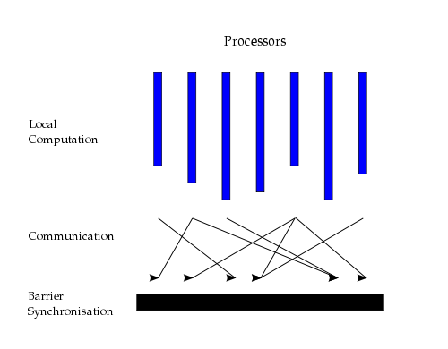
Bulk Synchronous Parallel Model
“Think like a vertex”
Originally by Valiant (1990)
30
Source: http://en.wikipedia.org/wiki/Bulk_synchronous_parallel
Notes:
Used by many engines today

Slide 31
Basic Distributed Graph Processing
“Think like a vertex”
Assign each vertex to one server
Each server thus gets a subset of vertices
In each iteration, each server performs Gather-Apply-Scatter for all its assigned vertices
Gather: get all neighboring vertices’ values
Apply: compute own new value from own old value and gathered neighbors’ values
Scatter: send own new value to neighboring vertices
C
B
A
D
E
31

Slide 32
Assigning Vertices
How to decide which server a given vertex is assigned to?
Different options
Hash-based: Hash(vertex id) modulo number of servers
Remember consistent hashing from P2P systems?!
Locality-based: Assign vertices with more neighbors to the same server as its neighbors
Reduces server to server communication volume after each iteration
Need to be careful: some “intelligent” locality-based schemes may take up a lot of upfront time and may not give sufficient benefits!
32

Slide 33
Pregel System By Google
Pregel uses the leader/worker model
Leader (one server)
Maintains list of worker servers
Monitors workers; restarts them on failure
Provides Web-UI monitoring tool of job progress
Worker (rest of the servers)
Processes its vertices
Communicates with the other workers
Persistent data is stored as files on a distributed storage system (such as GFS or BigTable)
Temporary data is stored on local disk
33

Slide 34
Pregel Execution
Many copies of the program begin executing on a cluster
The leader (“Master” originally) assigns a partition of input (vertices) to each worker
Each worker loads the vertices and marks them as active
The leader instructs each worker to perform an iteration
Each worker loops through its active vertices & computes for each vertex
Messages can be sent whenever, but need to be delivered before the end of the iteration (i.e., the barrier)
When all workers reach iteration barrier, leader starts next iteration
Computation halts when, in some iteration: no vertices are active and when no messages are in transit
Leader instructs each worker to save its portion of the graph
34

Slide 35
Fault-Tolerance in Pregel
Checkpointing
Periodically, leader instructs the workers to save state of their partitions to persistent storage
e.g., Vertex values, edge values, incoming messages
Failure detection
Using periodic “ping” messages from leader → worker
Recovery
The leader reassigns graph partitions to the currently available workers
The workers all reload their partition state from most recent available checkpoint
35

Slide 36
How Fast Is It?
Shortest paths from one vertex to all vertices
SSSP: “Single Source Shortest Path”
On 1 Billion vertex graph (tree)
50 workers: 180 seconds
800 workers: 20 seconds
50 B vertices on 800 workers: 700 seconds (~12 minutes)
Pretty Fast!
36
Notes:
Human graph → 7B

Slide 37
Summary: Graph Processing
Lots of (large) graphs around us
Need to process these
MapReduce not a good match
Distributed Graph Processing systems: Pregel by Google
Many follow-up systems
Piccolo, Giraph: Pregel-like
GraphLab, PowerGraph, LFGraph, X-Stream: more advanced
37

Slide 38
CS 425 / ECE 428
Distributed Systems
Fall 2023
Aishwarya Ganesan
w/ Indranil Gupta (Indy)
Lecture 26 A (contd.): Machine Learning (in syllabus)

Slide 39
Basic ML: SGD
“Machine learning is nothing but damn statistics.” – A lot of people
Machine learning trains “models” (computer representations)
Training vs. Inference (latter called Prediction, or Model Serving)
Supervised vs. Unsupervised learning
SGD = Stochastic Gradient Descent
Minimize an objective function that is smooth and differentiable
Popular variants: AdaGrad (adaptive gradient), Adam (adaptive moment), RMSProp
A common strawman application for many distributed ML papers!
39

Slide 40
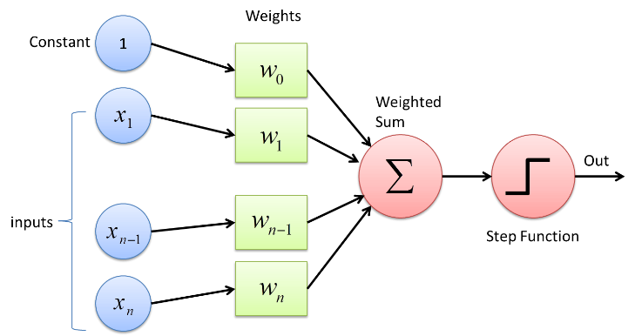
Basic Neural Networks
ANN = Artificial Neural Network
Another kind of “model”
A common form of representation learning
Used widely in vision, NLP, …
Graphs of operators
Operators can be computationally heavy
Graph can be in “stages” or “layers”
Common: All to all communication between operators in consecutive stages
Most edges have a set of associated weights (parameters). (Exceptions: activation funcs (ReLU), dropout). The collection of these weights IS the model.
A Perceptron layer
40

Slide 41
Basic Neural Networks (2)
Data passed into train passes “forwards”, followed by calculating error against known result (supervised learning)
followed by “backward” pass that adjusts/updates the weights at operators (so that for an incorrect training pass, if the same input were to be passed through, the result would be correct)
Data between operators: tensors (multi-dimensional vectors)
Default: train on one item (forward + backward), followed by next item
Extension: train on a mini-batch of items
After model is trained, Prediction/Inference needs only forward pass
Emerging area: Online training : do both training and inference together (aka Continual training)
Hyperparameter: configuration parameter for your model (not to be confused with a model “weight” == parameter), e.g., batch size
41

Slide 42
ANN Types: FFNN, CNNs, RNNs
FFNN: feed forward neural net (no loops)
DNN: Deep NN
More than one stage
“Hidden” layers between input and output
CNN: Convolutional NN
DNN + additional layers for convolutions
Transform data, e.g., sequence of filters that result in an activation/detection, e.g., image.
E.g., Facebook photo captioning
RNN: Recurrent NN
DNN + loops within layer (e.g., time aspect (e.g., GIF), sequential aspects)
E.g., auto-correction on your phone
Other types: GNN (graph neural net), Transformer, …
A few neural nets used in evaluation of distributed machine learning
Inception(v3), (G)NMT, Resnet,…
42

Slide 43
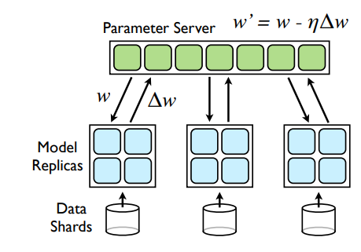
Distributed Machine Learning
Training data – collection of input and output labels x_{i}, y_{i} of size N
Learn model weights w
Model size and N can be huge
Centralized Machine Learning
Slow and often infeasible
Distributed Machine Learning
Parallelize via Multiple workers
“Parameter Server” to aggregate data from workers
from current iteration and start next iteration at workers.
Dean, Jeffrey, et al. "Large scale distributed deep networks." Advances in Neural Information Processing Systems (NeurIPS) 25 (2012).
43

Slide 44
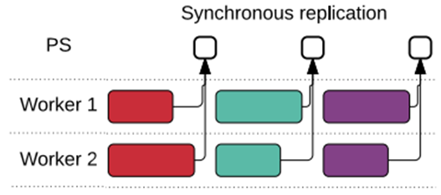
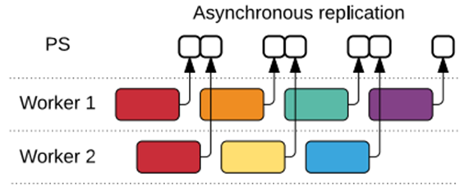
Kinds of Parallelism
Layer 1
Layer 2
Layer3
Layer 4
Data parallelism: multiple workers run same model, different data is sent to each device, data “batched” into mini-batches
Workers synchronize after each mini-batch
Parameter Server approach
All-Reduce approach – workers multicast weights to all other workers
Variant: Asynchronous training
Model parallelism: same model (DNN graph) is split across multiple devices, one input passed through collection of devices at a time.
L1
L1
L2
L3
L2
L3
L4
L4
worker 1
worker 2
L1
L2
L3
L4
Abadi, Martín, et al. "TensorFlow: a system for Large-Scale machine learning." 12th USENIX Symposium on Operating Systems Design and Implementation (OSDI 16). 2016.
44

Slide 45
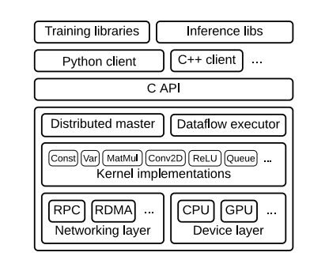
TensorFlow
Built by Google
Framework for large-scale training and inference
Hides details of distribution
Uses dataflow graphs to represent computation, shared state, and operations that mutate state
Dataflow captures structure of computation in ML
Extensible, runtime contains over 200 standard operations
Support for CPUs, GPUs, and TPUs (Tensor Processing Units)
Different communication protocols
Abadi, Martín, et al. "TensorFlow: a system for Large-Scale machine learning." 12th USENIX Symposium on Operating Systems Design and Implementation (OSDI 16). 2016.
45

Slide 46
Image classifier using TensorFlow API
# 1. Construct a graph representing the model.
x = tf.placeholder(tf.float32, [BATCH_SIZE, 784]) # Placeholder for input.
y = tf.placeholder(tf.float32, [BATCH_SIZE, 10]) # Placeholder for labels.
W_1 = tf.Variable(tf.random_uniform([784, 100])) # 784x100 weight matrix.
b_1 = tf.Variable(tf.zeros([100])) # 100-element bias vector.
layer_1 = tf.nn.relu(tf.matmul(x, W_1) + b_2) # Output of hidden layer.
W_2 = tf.Variable(tf.random_uniform([100, 10])) # 100x10 weight matrix.
b_2 = tf.Variable(tf.zeros([10])) # 10-element bias vector.
layer_2 = tf.matmul(layer_1, W_2) + b_2 # Output of linear layer.
# 2. Add nodes that represent the optimization algorithm.
loss = tf.nn.softmax_cross_entropy_with_logits(layer_2, y)
train_op = tf.train.AdagradOptimizer(0.01).minimize(loss)
# 3. Execute the graph on batches of input data.
with tf.Session() as sess: # Connect to the TF runtime.
sess.run(tf.initialize_all_variables()) # Randomly initialize weights.
for step in range(NUM_STEPS): # Train iteratively for NUM_STEPS.
x_data, y_data = ... # Load one batch of input data.
sess.run(train_op, {x: x_data, y: y_data}) # Perform one training step.
Abadi, Martín, et al. "TensorFlow: a system for Large-Scale machine learning." 12th USENIX symposium on operating systems design and implementation (OSDI 16). 2016.
46

Slide 47
PyTorch
Another popular ML framework originally developed by Meta
Tesla Autopilot, Uber's Pyro, Hugging Face's Transformers
Dynamic computation graphs
Automatic computation of gradients
Implements many algorithms and components
Domain-specific – TorchText, TorchVision, and TorchAudio – include datasets
Tensors – n-dimensional arrays
Module – define what makes up the model and a forward member function.
E.g., Linear Module
weight and bias as parameters
forward function generates output as input * weight + bias
47

Slide 48
Example with DistributedDataParallel
dist.init_process_group("gloo", rank=rank, world_size=world_size) # create default process group
model = nn.Linear(10, 10).to(rank) # create local model
ddp_model = DDP(model, device_ids=[rank]) # construct DDP model
# define loss function and optimizer
loss_fn = nn.MSELoss()
optimizer = optim.SGD(ddp_model.parameters(), lr=0.001)
# forward pass
outputs = ddp_model(torch.randn(20, 10).to(rank))
labels = torch.randn(20, 10).to(rank)
# backward pass
loss_fn(outputs, labels).backward()
# update parameters
optimizer.step()
48

Slide 49
Jax
ML framework from Google
Provides a familiar NumPy-style API
Multiple backends, including CPU, GPU, & TPU
grad: automatic differentiation
jit: compilation
vmap: auto-vectorization
pmap: automatic parallelization
49

Slide 50
Other ML
Distributed ML
assumes homogenous data across workers
Federated Machine Learning
allows heterogeneous data across workers
workers may be datacenters or mobile devices
failures, possibly privacy issues.
E.g., Google’s Federated learning to predict keystrokes from mobile devices
50

Slide 51
Summary of this Lecture, and one more video to watch!
Emerging topics in Distributed Computing
Stream Processing (in syllabus)
Graph Processing (in syllabus)
Machine Learning (in syllabus)
Additional Video on Course website (In Syllabus, NOT optional): Spark

