Slide 1
Compression of Large Language Models
ECE563: Course Presentation
Mosbah Aouad , Anirudh Choudhary and Jeter Hwang
Oct. 8, 2024
University of Illinois at Urbana-Champaign

Slide 2
Outline
Background
Popular Compression Approaches
Problem Formulation
Pruning: SparseGPT / Wanda
Quantization: GPTQ
Experiments and Results
Conclusion

Slide 3
Introduction

Slide 4
Background
Large Language Models (LLMS) generalize better on unseen data.
LLMs outperform small models in emerging tasks (ex: multi-step reasoning, instruction following...)
High memory and computational budgets block their deployment on edge devices
GPT-175B needs 325 GB of GPU memory just to load [1].
Interest has increased in compressing these models.
Compression claims to maintain performance with 50-60% sparsity and 2-3 bits quantization.

Slide 5
Review of Compression Methods [2],[3]
Quantization: transforms FP32 weights/activations into lower-bit floats or integers.
Pruning: removes redundant parameters that don't affect performance.
Knowledge Distillation: trains a smaller model using knowledge from a larger one.
Compact Architecture Design: creates architectures that save parameters (e.g., new convolution filters, self-attention forms).
Dynamic Networks: uses a super-net where only a substructure is activated per inference (e.g., Mixture of Experts).
Low-Rank Factorization: applies matrix decomposition to estimate key parameters.

Slide 6
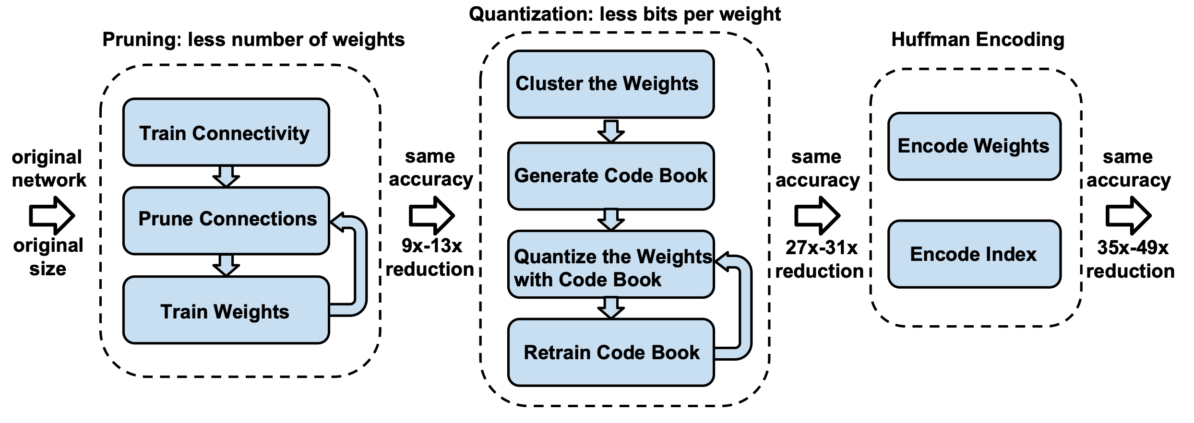
Pruning and Quantization: Deep Compression [4]
Pruning
Drop weights with magnitude below a threshold​
Quantization​
Group non-zero weights using clustering (K-means)​
Quantize centroid weights into 5 bits
Huffman Encoding​
Encode quantized ​ weights​
Challenges
Requires retraining
Difficult to scale

Slide 7
Problem Formulation

Slide 8
Problem Formulation
Objective:
Investigate capabilities and limitations of state-of-the-art LLM compression algorithms
Evaluate compressed LLMs for NLP tasks with varying difficulty.
Challenges:
Limited understanding of the compression effect across tasks.
Appropriate evaluation metrics for compression (Are perplexity-based evaluations enough?)
Do ad-hoc compression methods perform similarly? (Quantization vs Pruning)

Slide 9
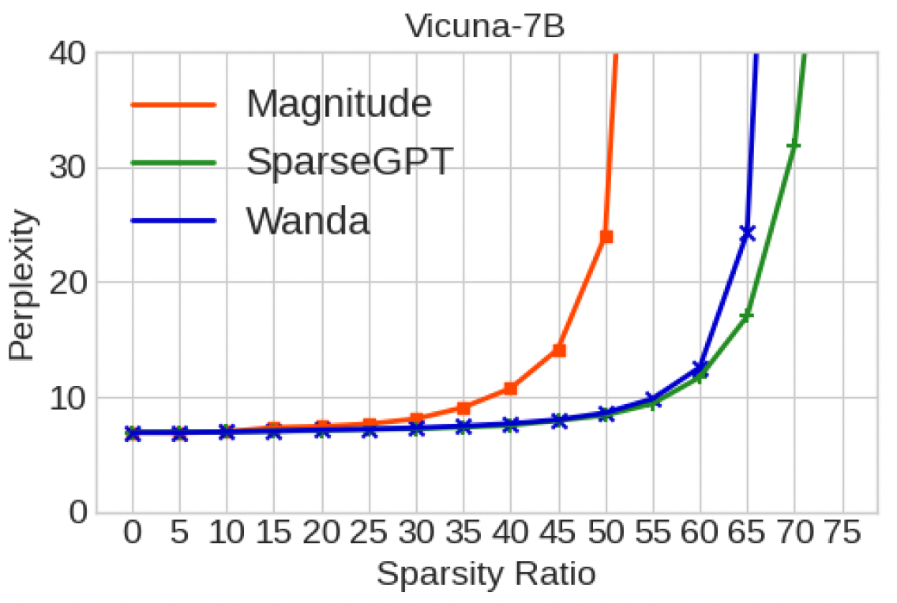
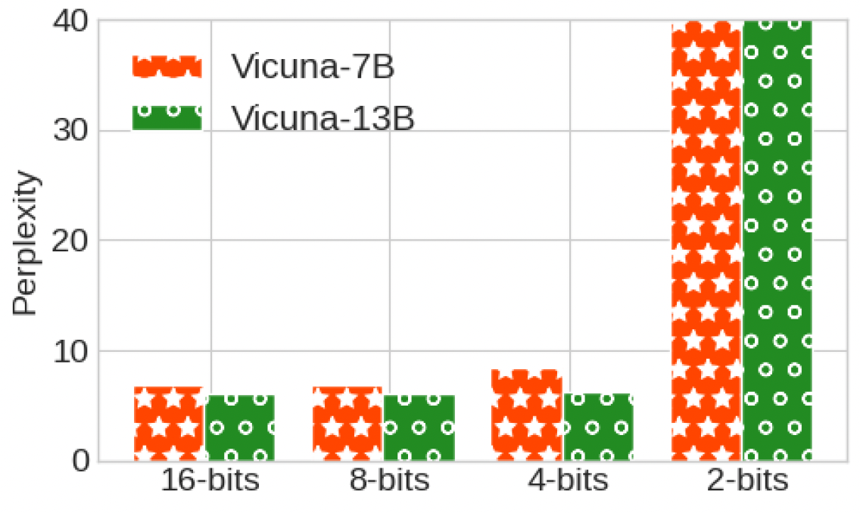
Is Perplexity-evaluation enough?
Perplexity quantifies how uncertain is the model in predicting the sequence of words.
For a model with probability distribution $P(w_{1},w_{2},…,w_{2})$ over a sequence of words $w_{1},w_{2},…,w_{2}$, perplexity is defined as:
Perplexity increases with more aggressive compressions
$$Perplexity=2^{(\frac{−1}{N}\sum_{i=1}^{N}{\log_{2}P(w_{i}|w_{1}\text{​,}w_{2}\text{​​,…,}w_{i−1}))}}$$
LLMs hallucinates while the increase in perplexity is insignificant

Slide 10
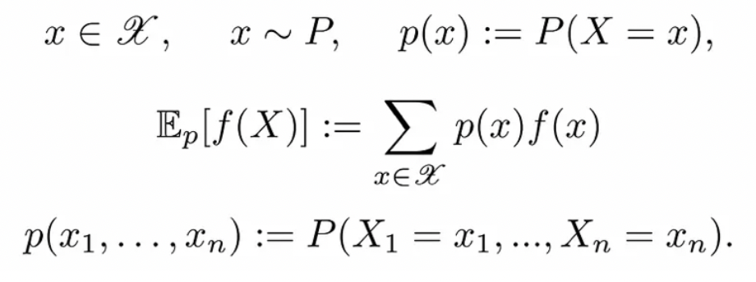
Information Theory and Perplexity
If we consider $x_{1}, x_{2},…,$ $x_{n}$ as words, let’s define the following setup:
Entropy is defined as follows:
Perplexity can be defined as follows:

Slide 11
Information Theory and Perplexity
A stochastic process (SP) is an indexed set of random variables (RVs).
The simplest SP is a set of i.i.d. RVs. In this case, we can define the empirical entropy as:
From the weak law of large numbers:
However, in Language Models, words are not i.i.d.

Slide 12
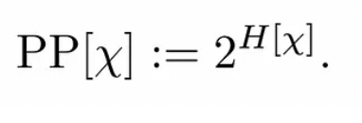
Information Theory and Perplexity
In NLP, we have SPs with non i.i.d sequences of r.v.
Assume the SP is stationary:
for all sequences of words and for all time shifts t.
Define the entropy rate as:
Average Entropy per Token Average Entropy of the last token
or
Define perplexity as follows:
This is the uncertainty per token of the stationary process.

Slide 13
Information Theory and Perplexity
If we assume the SP is also ergodic, we use Birkoff’s Ergodic Theorem:
The following generalization also holds:
→ To compute the entropy rate of an ergodic process, we only need to draw one single very long sequence and compute its negative log probability.

Slide 14
Perplexity and Compression
Perplexity measures confidence not efficiency.
Compressed model might maintain similar perplexity but suffer in other aspects like robustness, long-term coherence, or reasoning ability.
Better Metrics to evaluate compressed models:
Task-Specific Performance Metrics: Accuracy, F1, Exact match, BLEU, ROUGE
Human Evaluation
Knowledge Retention metrics between the compressed and uncompressed models:
Accuracy Agreement, Top-k Accuracy Agreement
Logits Agreement (KL Divergence)
Hidden Layer Representation Agreement
Logit Matching Loss

Slide 15
Quantization
GPTQ: Accurate Post-Training Quantization for Generative Pre-trained Transformers
Elias Frantar, Saleh Ashkboos, Torsten Hoefler, Dan Alistarh (ICLR 2023)

Slide 16
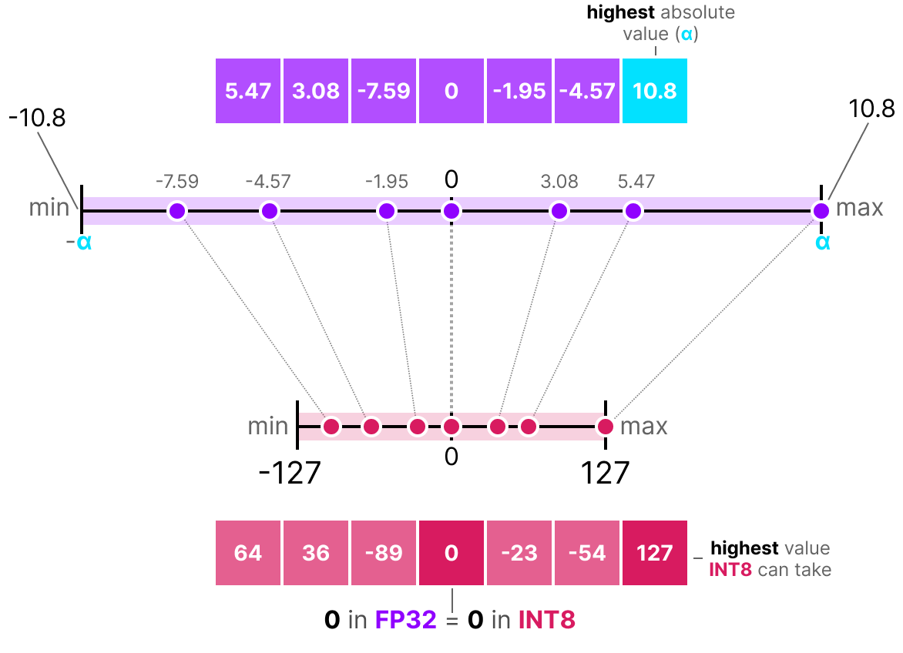
Background
Model retraining
Approximate differentiation; Extremely expensive for LLMs
Post-training
Weight rounding + scaling
Optimize residual error
Minimize Reconstruction Error
dequantized weights
layer weights
Image credits: https://newsletter.maartengrootendorst.com/p/a-visual-guide-to-quantization

Slide 17
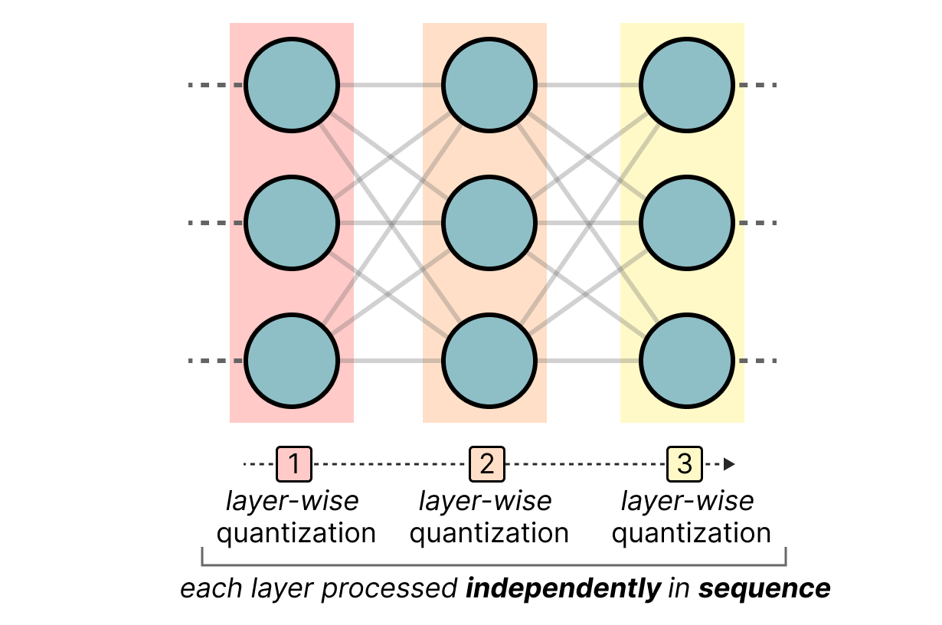
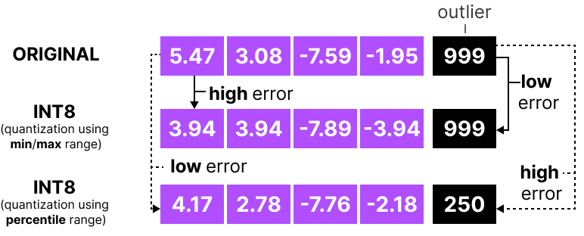
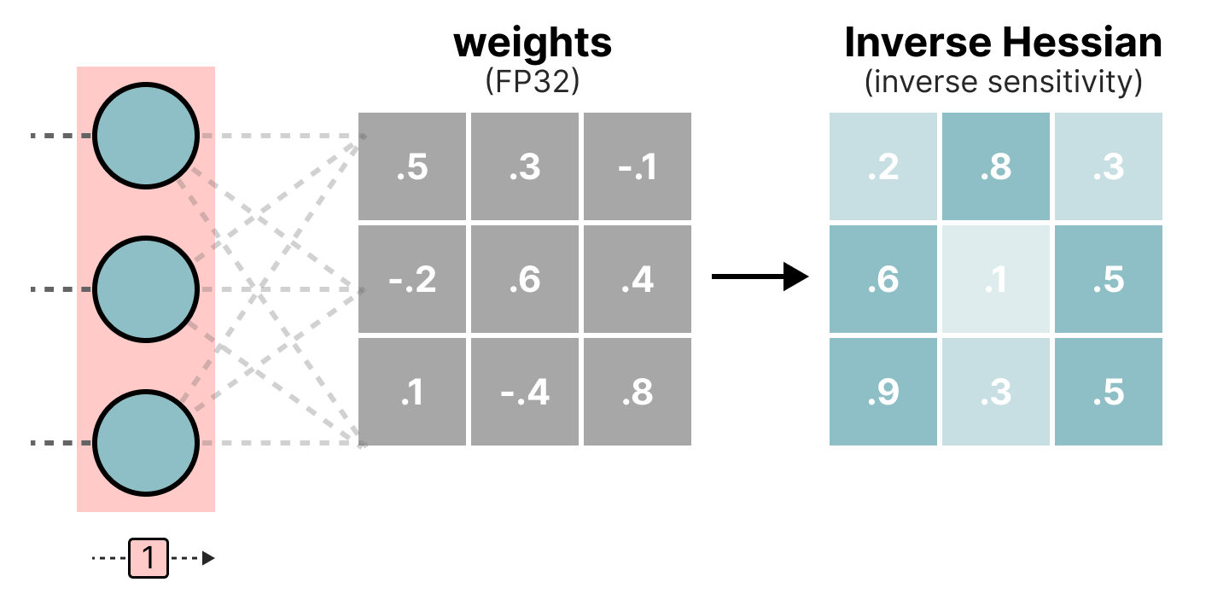
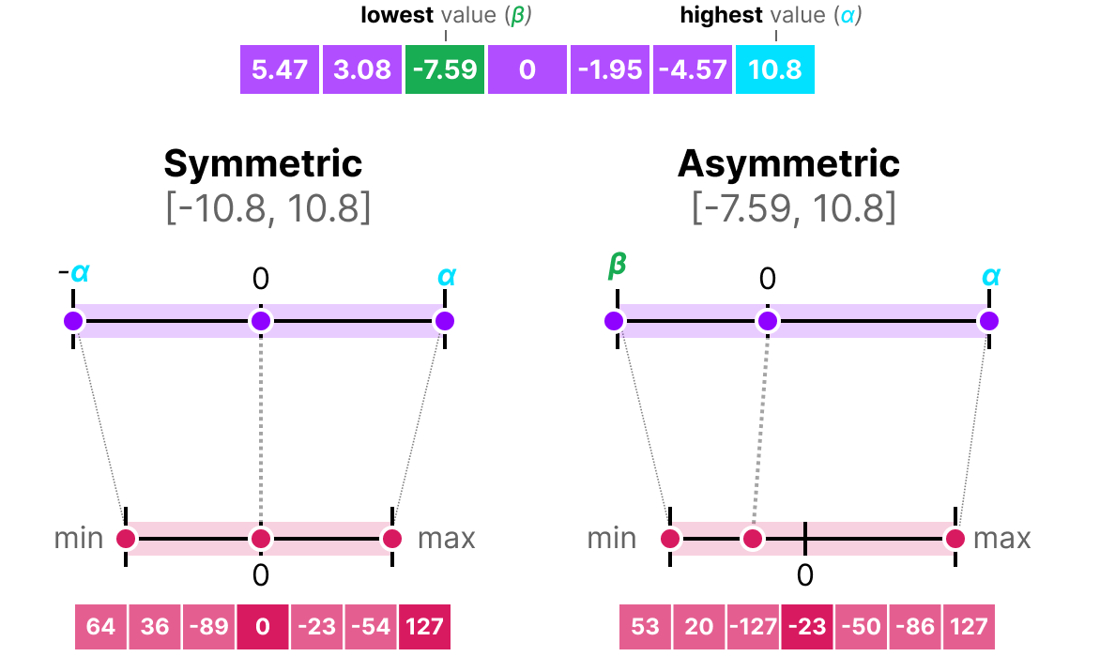
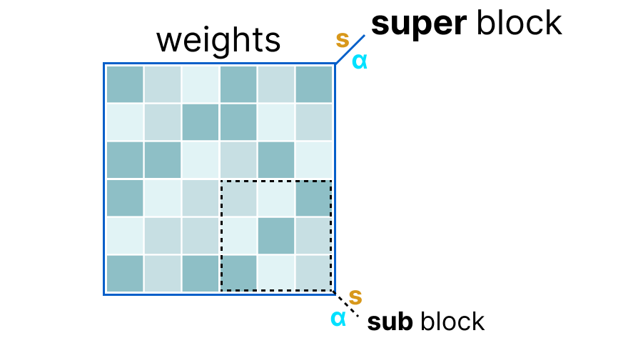
Background – Key Considerations
Hessian
Weights and/or activations
(Individual weights; weight column; sub-block)​
Weight importance
(Loss sensitivity; Saliency)
Type of quantization
(symmetric, asymmetric
min/max, percentile. MSE)
Image credits: https://newsletter.maartengrootendorst.com/p/a-visual-guide-to-quantization

Slide 18
GPTQ - Motivation
Challenges in LLM quantization
Rounding-based approach (ZeroQuant, LLM.int8(), nuQmm)
Faster but limited accuracy (higher compression loss)
Adaptive approaches (AdaRound, OBQ)
Time-intensive and difficult to scale (3-bit, 4-bit)
OBQ: Optimal Brain Quantization ^{[9]}
Sequential layer quantization
Greedy: Quantize weight incurring least error first -> adjust non-quantized weights
Prone to outliers (quantized last)
Hessian update has cubic complexity - can only scale to 1.3 B parameters

Slide 19
Optimal Brain Quantizer - Background
Uses second-order derivatives from Hessian matrix for weight update
Derived from Optimal Brain Surgeon^{[5]} pruning framework
For each row in the weight matrix of a neural network layer
Change in training loss
(reconstruction loss)
Local optimum (zero)
q^{th} canonical-basis vector (one-hot)
Lagrangian
Optimal change in loss
Determine q
(index of row element
to prune)
Adjust remaining
weights in the row

Slide 20
Optimal Brain Quantizer - Background
For each row in the weight matrix
Compute Hessian:
F: remaining full-precision weights
Replace pruning with quantization
Weight being quantized
Adjust non-quantized weights
Update Hessian efficiently
by dropping q^{th} row and column:
W
H
Cubic input dependency:

Slide 21
GPTQ ^{[10]} - Methodology
Key Contribution: Faster accurate quantization for 3-bit and 4-bit compression
Insight
Order of quantization doesn’t matter much for large models
Outlier weights quantized towards the end in OBQ – higher error
Quantize all weights in same order for all rows of W
0.5 | 0.3 | 0.1
-0.2 | 0.6 | 0.4
1 | -0.4 | 0.8
Weight matrix

Slide 22
GPTQ ^{[10]} - Methodology
Fast and accurate quantization for 3-bit and 4-bit compression
Insights
Updating Hessian element-wise is inefficient (GPU memory bandwith)
Rounding for a column only affected by updates on that column
Lazy-batch update: process multiple columns (higher GPU utilization)
Update B columns in W and BxB sub-matrix in H

Slide 23
GPTQ ^{[10]} - Methodology
Fast and accurate quantization for 3-bit and 4-bit compression
Insight
Inverse of Hessian can be indefinite (higher probability for larger models)
Recursive Hessian update accumulates numerical errors
Cholesky Decomposition + diagonal perturbations(numerical stability)

Slide 24
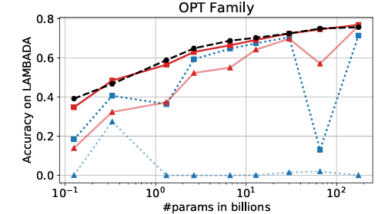
GPTQ - Results
Maintains accuracy compared to FP16 - minimal improvement over RTN for 4-bit
Significant inference speedup and reduction in #GPUs
Faster compression (175B model in 4 hours)

Slide 25
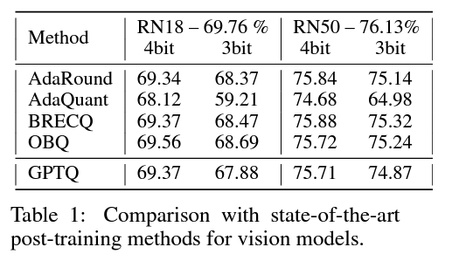
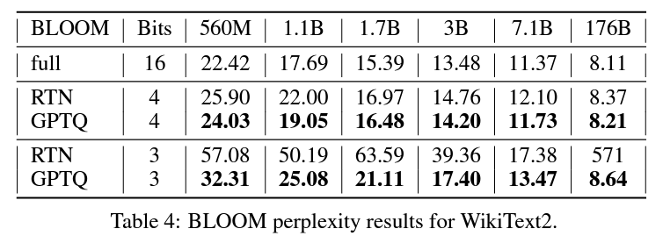
GTPQ - Results
Language generation
Improves perplexity on language generation task (not an ideal metric)
No comparison with OBQ
Lower accuracy for smaller networks (ordering doesn't matter?)

Slide 26
GPTQ - Drawbacks
Gives equal importance to all weights
Activation-aware approach
Collect activation statistics; determine salient weights
Quantize remaining weights to 3-bit/4-bit precision
Doesn't quantize activation (input-dependent)
Inference requires int (weight) and floating-point (activation) multiplication

Slide 27
Pruning

Slide 28
Pruning
Has a long history (dated back to LeCunn et al., NeuRIPS’89 [5])
Often related to sparsity
Categorized by the stage to remove weights
Pre-training (Lottery Ticket Hypothesis [6])
During training (train & prune iteratively)
Post-training (most popular!)
Categorized by the way to remove weights
Unstructured pruning
Semi-structured pruning
Structured pruning
Hardware friendliness
Accuracy drop
Low
High

Slide 29
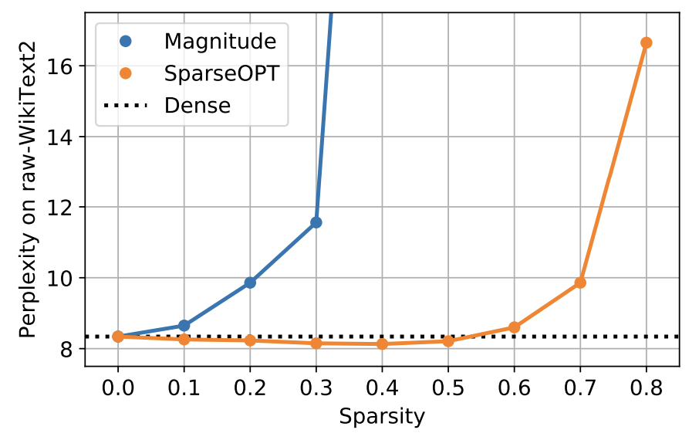
SparseGPT [7] – Motivation
Magnitude-based pruning method fails for high sparsity
Layer-wise pruning
Objective :
Existing solvers are too slow to extend to billion-parameter models

Slide 30
SparseGPT – Methodology
Iterative error compensation (based on Hessian $H^{−1}={\left(XX^{T}+λI\right)}^{−1}$)
Partial update (freezing pruned weights)
Adaptive mask selection
Complexity: $O\left(d_{col}^{3}+d_{row}d_{col}^{2}\right)<O(d_{row}d_{col}^{3})$

Slide 31
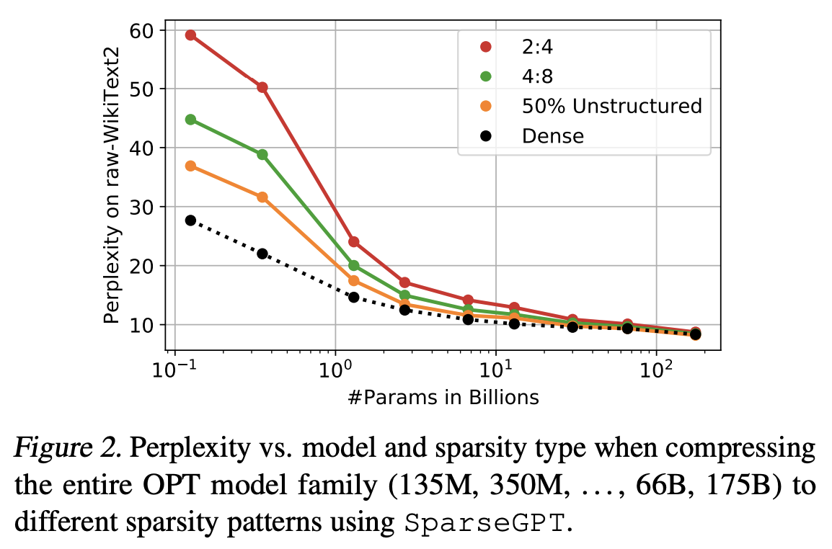
SparseGPT – Results
Outperforms magnitude-based pruning methods by a large margin
Magnitude-based pruning performance degrades a lot even in 50% sparsity
Not observed in vision transformers
Perplexity is a more sensitive metric
Achieve more than 100x pruning speedup against Adaprune [Hubara et al., 2021]

Slide 32
WANDA [8] – Motivation
Accurate pruning methods
Retrain the pruned model
Mask selection process (e.g. SparseGPT: 4.5hrs on a single A100 GPU with 80GB memory)
Naive magnitude-based approach fails for LLM pruning
Weights with small norm doesn’t necessarily generate output with small norm
Magnitude of input activation need to be considered !
How to decide activation magnitude?
Calibration data
Need cheaper pruning methods (magnitude-based pruning method [3])

Slide 33
WANDA – Methodology
Prune weights based on output magnitude
Compare among each output
Can be extended to semi-structured pruning (N:M sparsity)

Slide 34
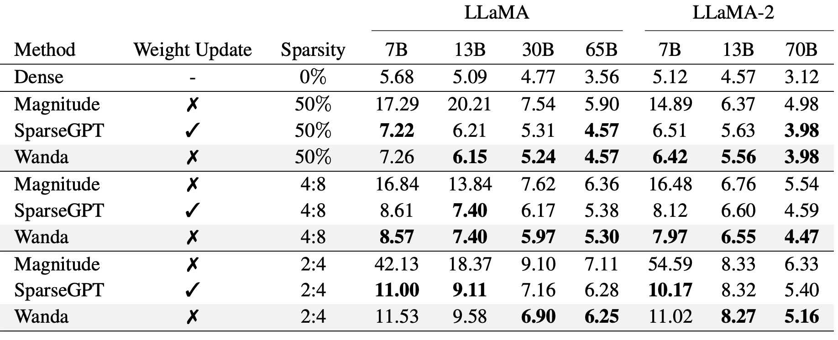
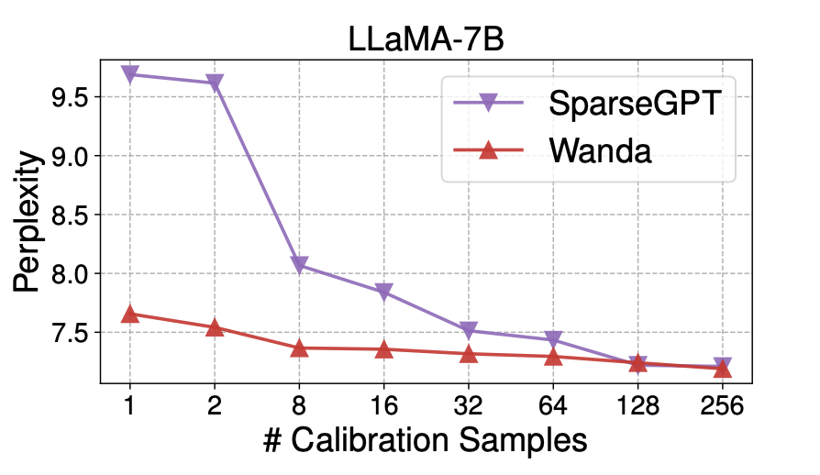
WANDA – Results
Outperform magnitude-based method by a large margin
Generate comparable results to SparseGPT
Robust to calibration samples

Slide 35
SparseGPT vs. WANDA
[Sun et al., ICLR’24]

Slide 36
Compressing LLMs: The truth is rarely pure and never simple Experiments & Results

Slide 37
Experimental Setup
Experiments:
Question Answering (QA)
Factoid-based, Multiple-Choice Reasoning
In-context Tasks
Retrieval Augmented QA; Text Summarization
Evaluation Metrics:
Percentage Drop in performance on each task.
Matching Compressed LLM: Performance Drop <= 5%

Slide 38
Factoid-based Question Answering
Task Definition: Search for entities or entity attributes from a knowledge graph
Prompt Setup:

Slide 39
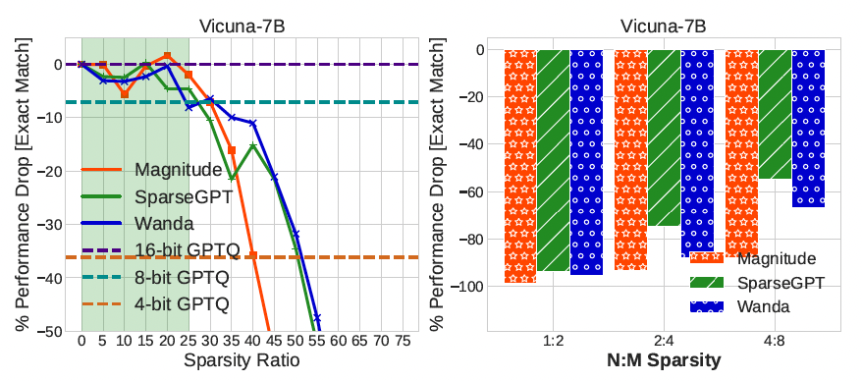
Factoid-based Question Answering
Results:
All pruning methods fail to find a matching sparse LLM after 25% sparsity ratio.
Pruning methods are ineffective for structured sparsity.
Non-aggressive quantization (8-bit) results in approximately 10% performance drop..

Slide 40
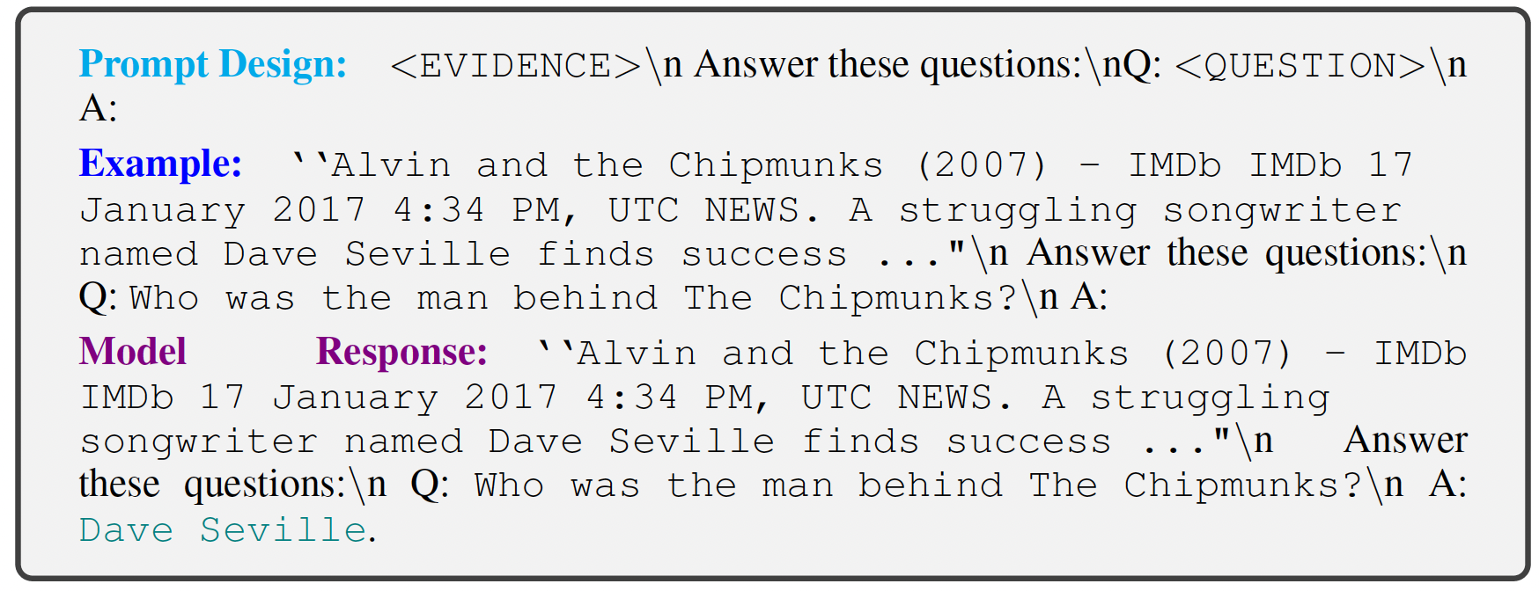
In-context Retrieval Augmented Question Answering (1/2)
Task Definition: LLM answer generation by conditioning on relevant documents
retrieved from an external knowledge source using retrieval algorithms.
Prompt Setup:
Closed Book
Open Book

Slide 41
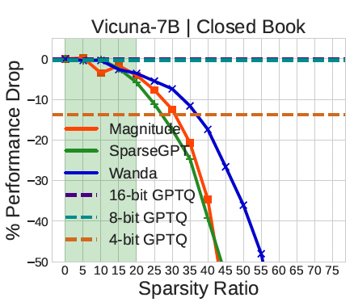
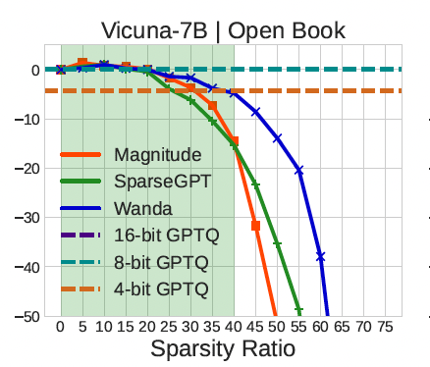
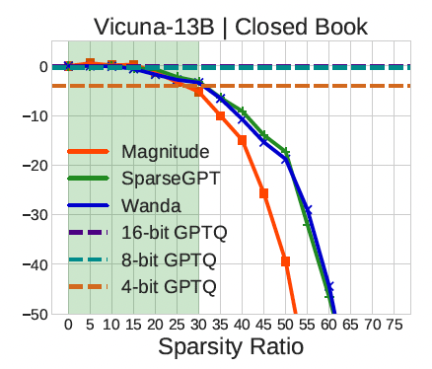
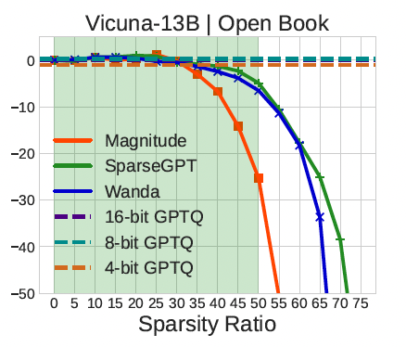
In-context Retrieval Augmented Question Answering (2/2)
Results:
Open-book QA
Compressed models perform better
Quantization: minimal performance drop on open-book QA.
Magnitude sparsity performs better for larger models.

Slide 42
In-Context Text Summarization (1/2)
Task Definition: Summarizing long-context documents in abstractive and extractive settings.
Prompt Setup: (Use Gpt-4 as judge, and compare answers to GPT-3.5)

Slide 43
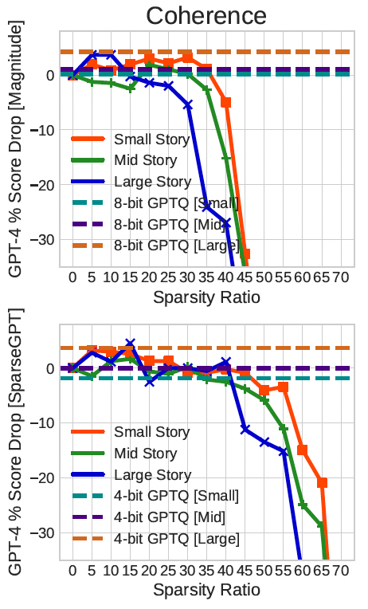
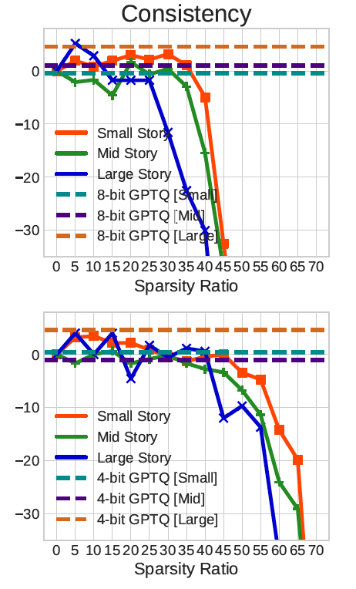
In-Context Text Summarization (2/2)
Results:
Pruning models are matching with up to 45% sparsity ratio.
Quantization have minimal drop in performance for Small stories.
Quantization improved performance on large stories.
Increased sparsity affect the performance on large stories the most.

Slide 44
Multiple-Choice Reasoning based Question Answering (1/2)
Task Definition: Present QA options to the LLMs jointly, and have it output the symbol.
Prompt Setup:

Slide 45
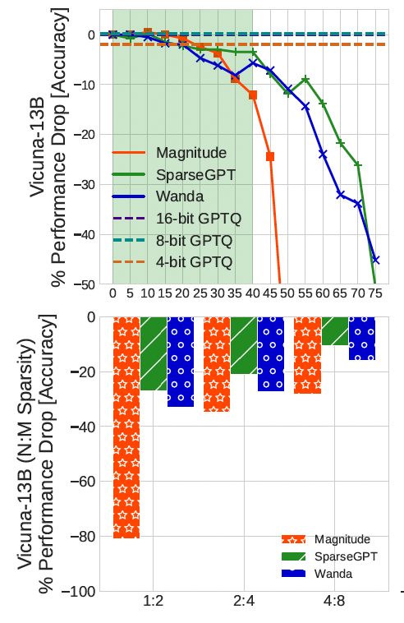
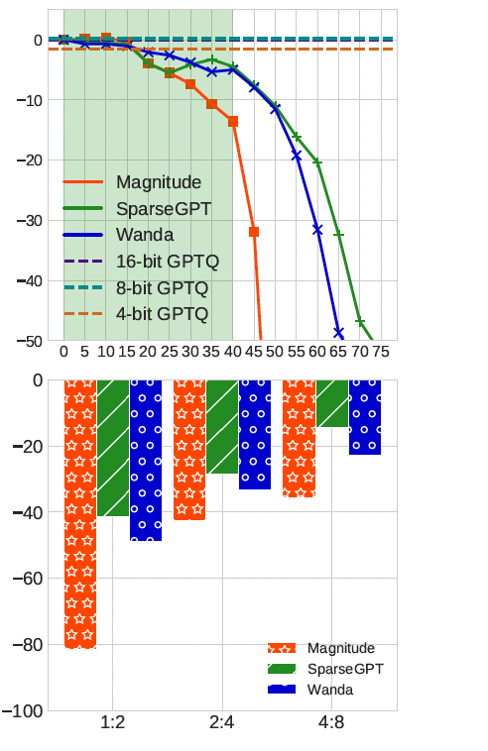
Multiple-Choice Reasoning based Question Answering (2/2)
Results:
STEM
Others (Business, Health, Misc.)
Compressed models perform better on this task than factoid-based QA.
No matching compressed LLM exists for structured sparsity.
Quantization results in smaller performance drops compared to pruning.
Pruning impacts performance differently across disciplines.

Slide 46
Conclusion

Slide 47
Conclusion
Comprehensive evaluation of SOTA compression methods on LLM performance.
Results show quantization methods outperform sparsity on most tasks.
Limitations:
Lacks theoretical or mathematical insights into:
Why perplexity evaluations are not accurate.
Why quantization outperforms sparsity in some settings.
How to determine the desired sparsity percentage or bit precision.

Slide 48
References
Jaiswal, Ajay, Zhe Gan, Xianzhi Du, Bowen Zhang, Zhangyang Wang, and Yinfei Yang. "Compressing llms: The truth is rarely pure and never simple." arXiv preprint arXiv:2310.01382 (2023).
Wang, Wenxiao, Wei Chen, Yicong Luo, Yongliu Long, Zhengkai Lin, Liye Zhang, Binbin Lin, Deng Cai, and Xiaofei He. "Model compression and efficient inference for large language models: A survey." arXiv preprint arXiv:2402.09748(2024).
Cheng, Yu, Duo Wang, Pan Zhou, and Tao Zhang. "A survey of model compression and acceleration for deep neural networks." arXiv preprint arXiv:1710.09282 (2017).
Han, Song, Huizi Mao, and William J. Dally. "Deep compression: Compressing deep neural networks with pruning, trained quantization and huffman coding." arXiv preprint arXiv:1510.00149 (2015).
LeCun, Yann, John Denker, and Sara Solla. "Optimal brain damage." Advances in neural information processing systems2 (1989).
Frankle, Jonathan, and Michael Carbin. "The lottery ticket hypothesis: Finding sparse, trainable neural networks." arXiv preprint arXiv:1803.03635 (2018).
Frantar, Elias, and Dan Alistarh. "Sparsegpt: Massive language models can be accurately pruned in one-shot." In International Conference on Machine Learning, pp. 10323-10337. PMLR, 2023.
Sun, Mingjie, Zhuang Liu, Anna Bair, and J. Zico Kolter. "A simple and effective pruning approach for large language models." arXiv preprint arXiv:2306.11695 (2023).
Frantar, Elias, and Dan Alistarh. "Optimal brain compression: A framework for accurate post-training quantization and pruning." Advances in Neural Information Processing Systems 35 (2022): 4475-4488.
Frantar, Elias, Saleh Ashkboos, Torsten Hoefler, and Dan Alistarh. "Gptq: Accurate post-training quantization for generative pre-trained transformers." arXiv preprint arXiv:2210.17323 (2022).

Slide 49
Back-up

Slide 50
Performance Summary

