Slide 1
ECE 534 Lecture 2
Monday, January 26th, 2026
Adapted from Leveque, EPFL

Slide 2
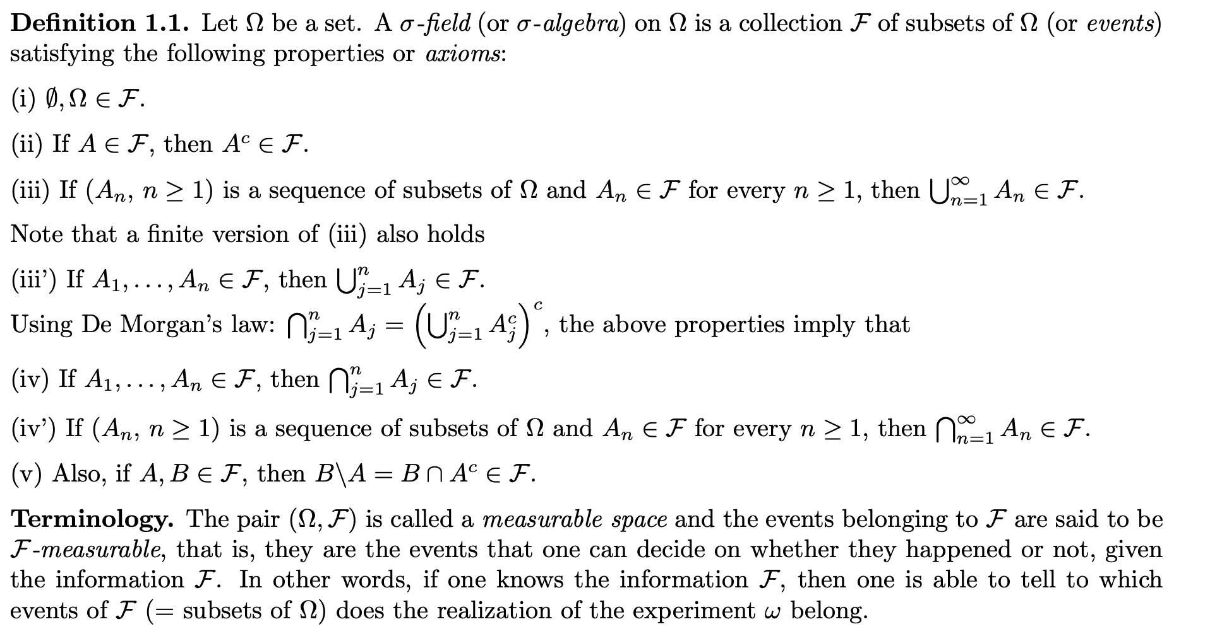
Sigma Algebras/Fields
Recalling the definition/axioms

Slide 3
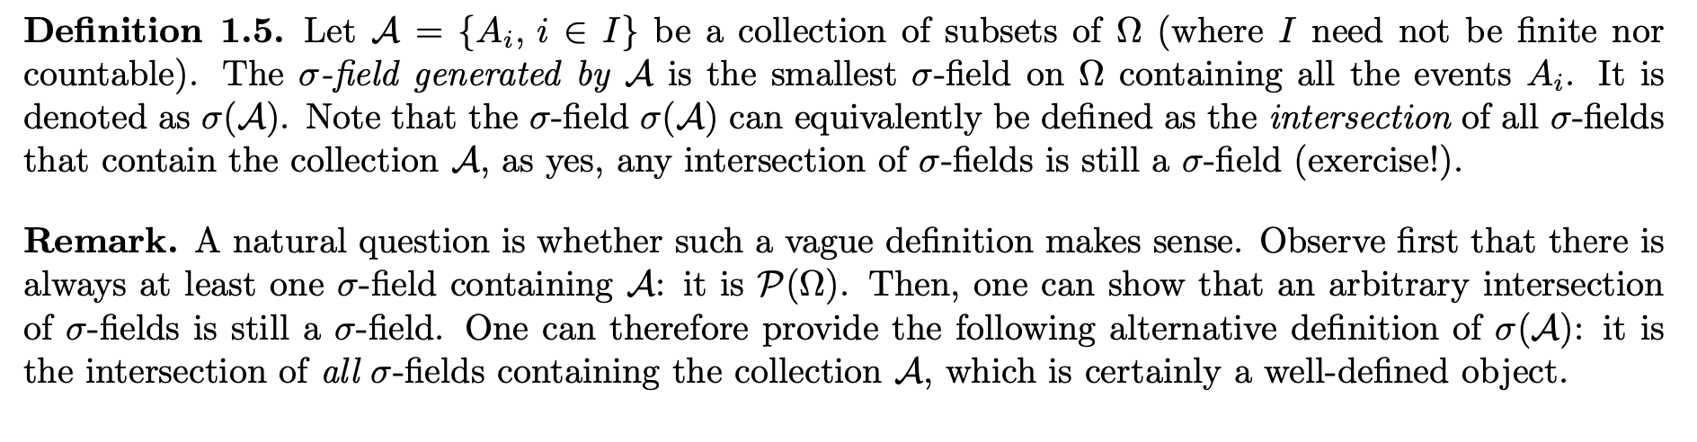
Sigma Algebras/Fields
Recalling the definition/axioms

Slide 4
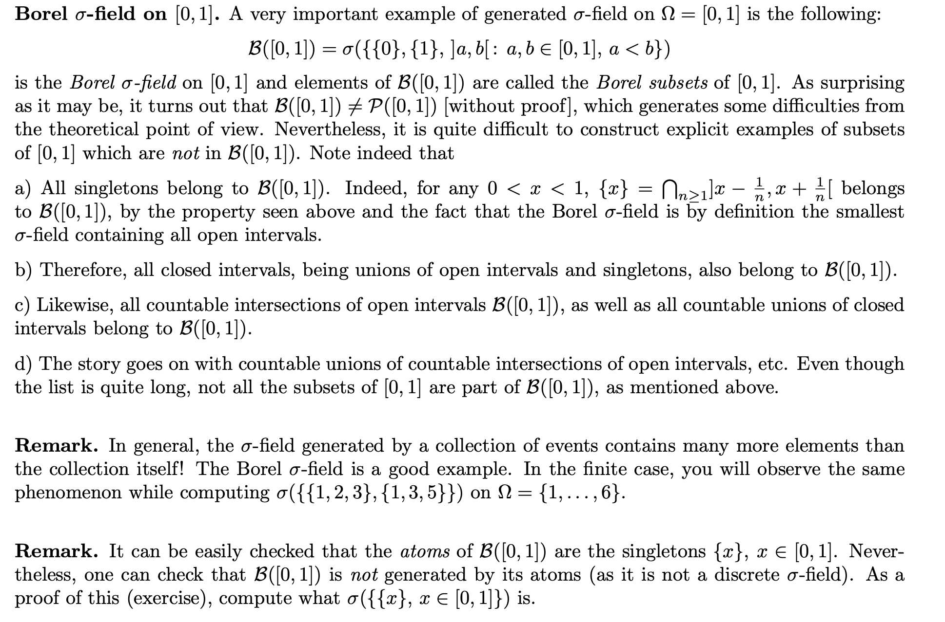
Sigma Algebras/Fields
Recalling the definition/axioms

Slide 5
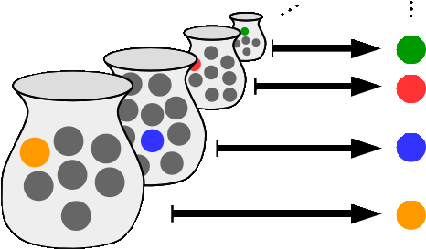
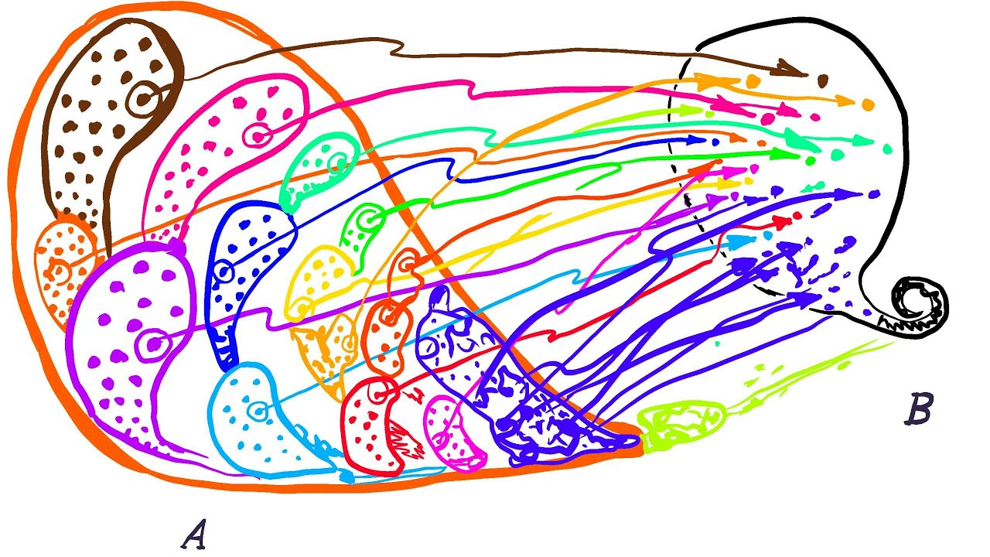
Sigma Algebras/Fields
Recalling the definition/axioms
Axiom of Choice
(Zermelo)
https://www.youtube.com/watch?v=WaxiL4IRIYw

Slide 6
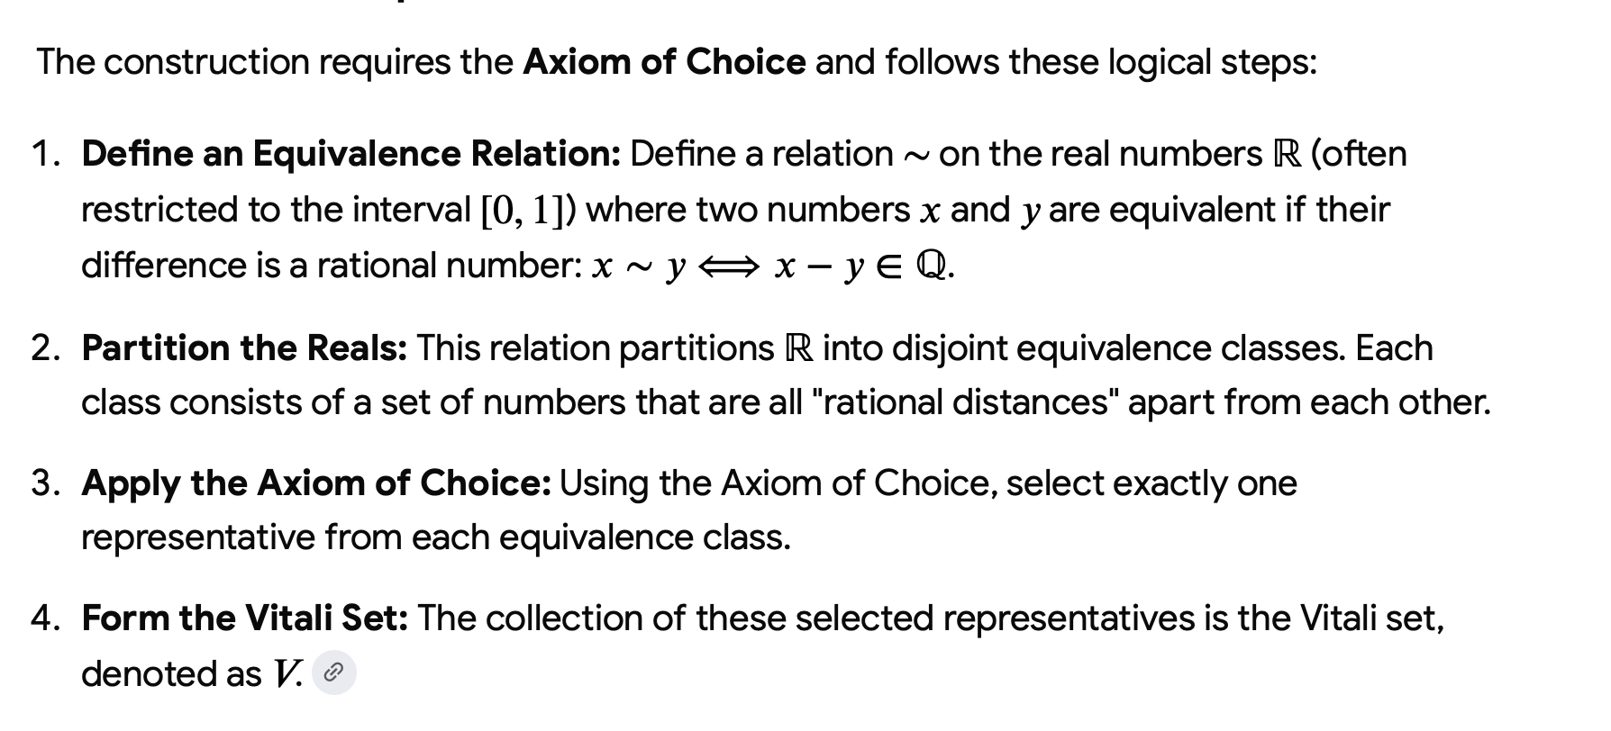
Sigma Algebras/Fields
Recalling the definition/axioms
Axiom of Choice
(Zermelo)
Vitaly sets
https://www.scientificamerican.com/article/mathematicians-explain-why-some-lengths-cant-be-measured/

Slide 7
Sigma Algebras/Fields
Recalling the definition/axioms
Axiom of Choice
(Zermelo)
Vitaly sets

Slide 8
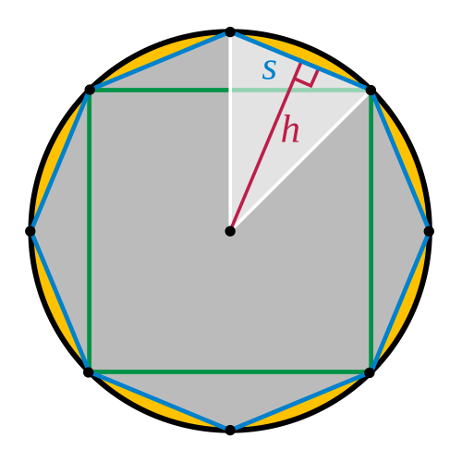
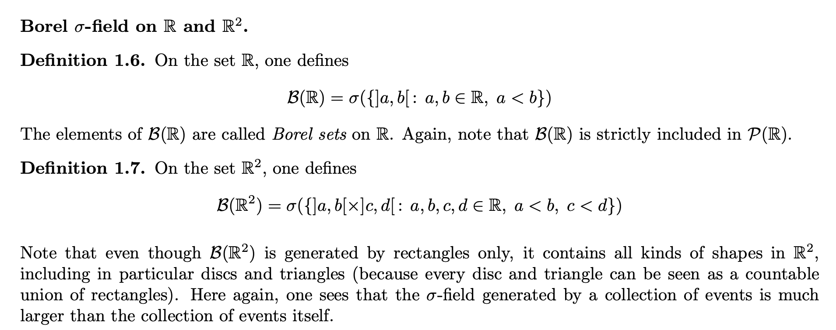
Sigma Algebras/Fields
Archimedes: area of circle via area of
triangles, “limits”

Slide 9
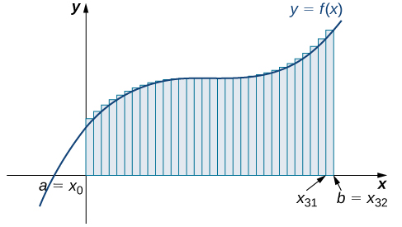
Sigma Algebras/Fields
Area under the curve and Rieman/Lebesgue
Integrals

Slide 10
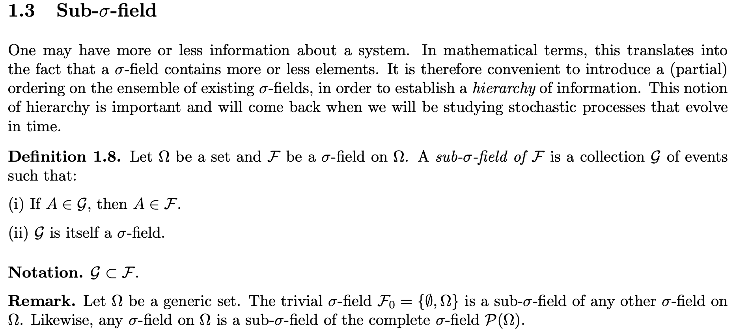
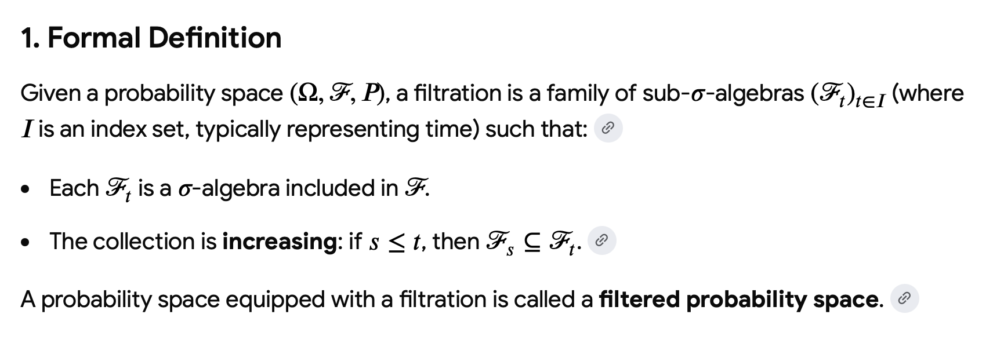
Sigma Algebras/Fields
Recalling the definition/axioms

Slide 11
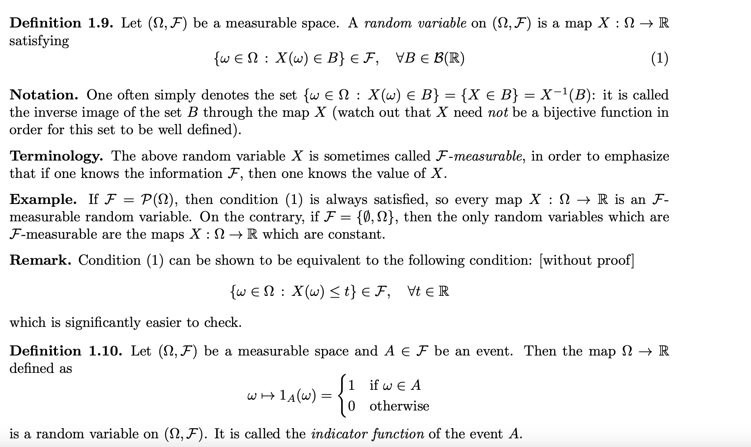
Random Variables

Slide 12
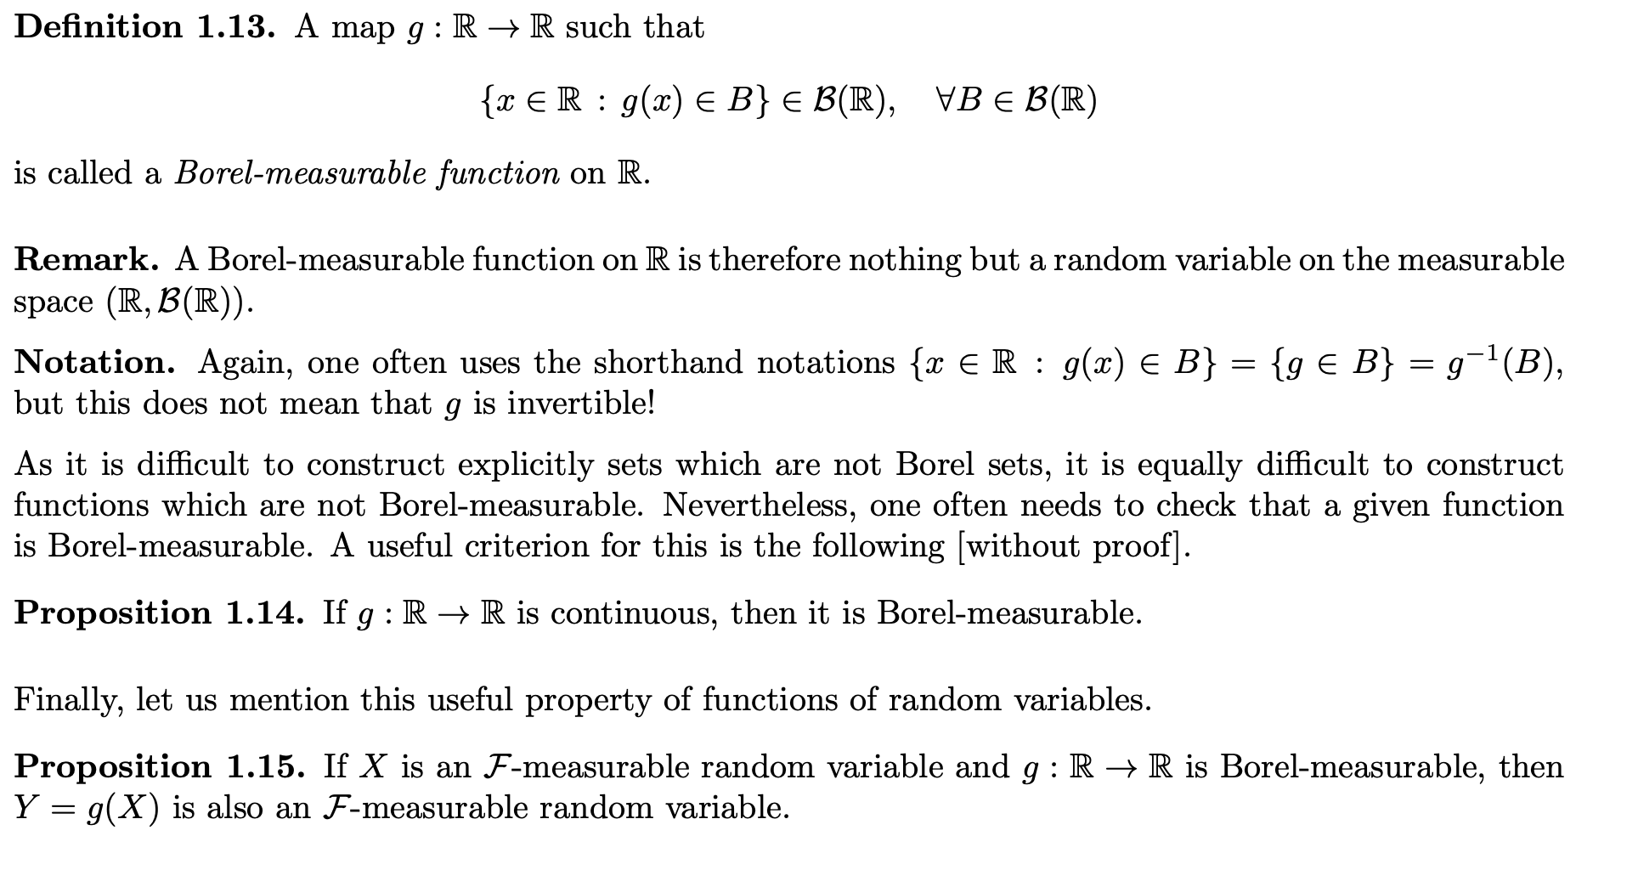
The Notion of Borel Measurability

Slide 13
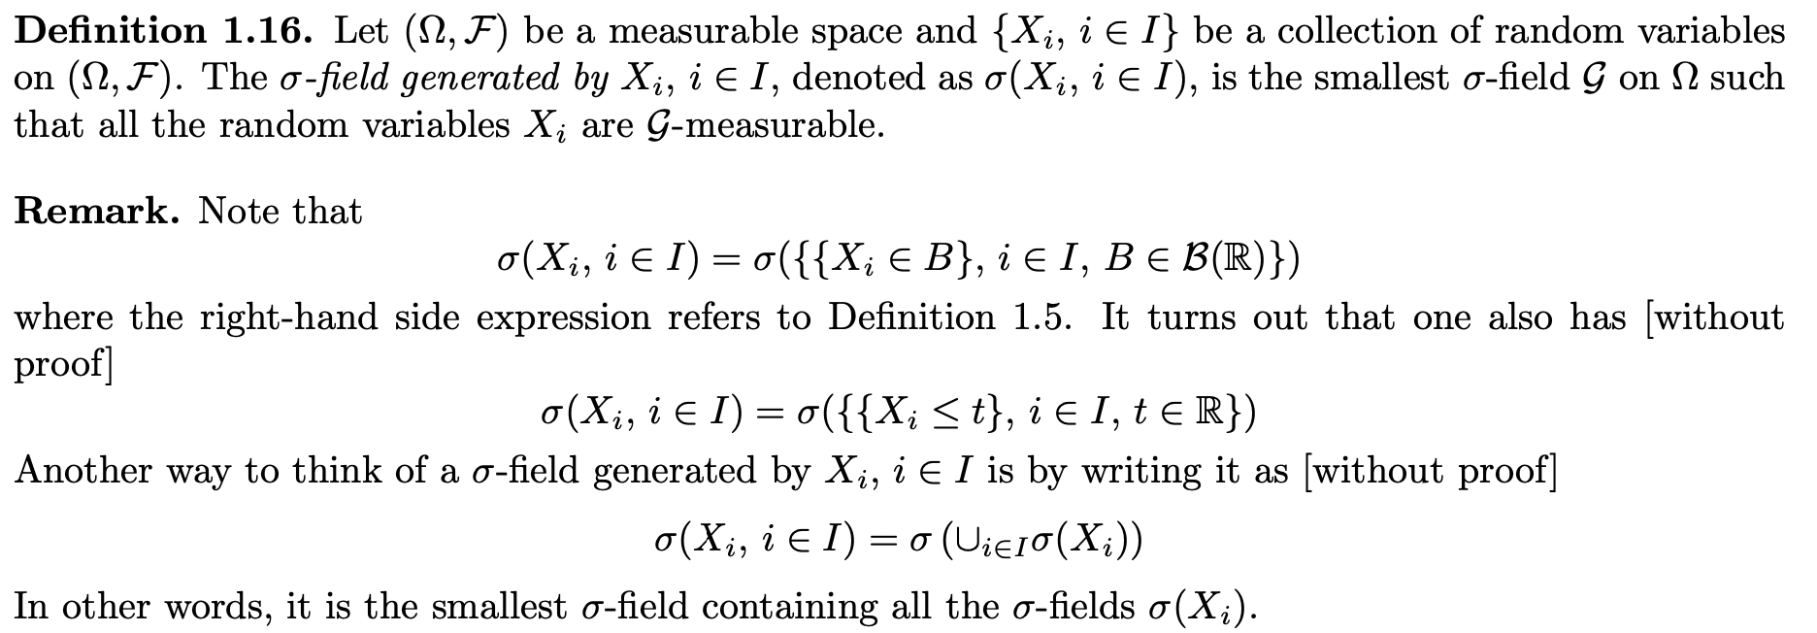
Borel Measurability and Algebra Generated by RVs

Slide 14
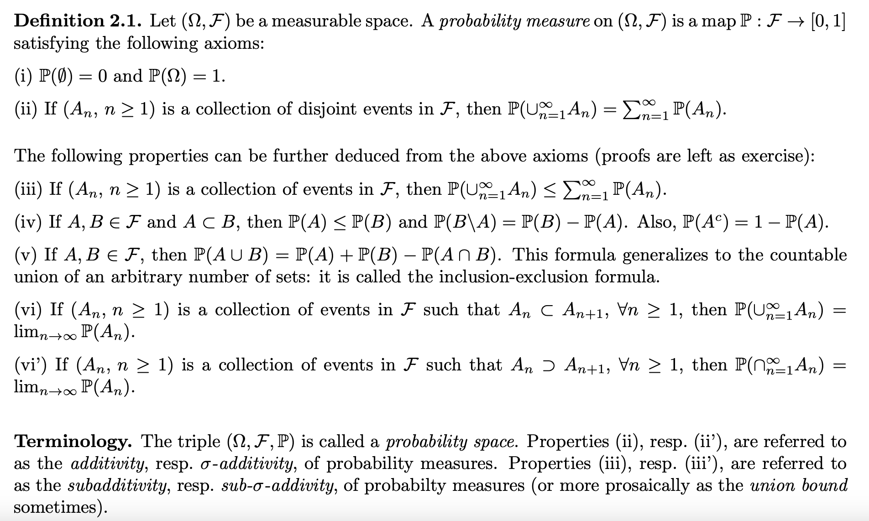
Probability Measures

Slide 15
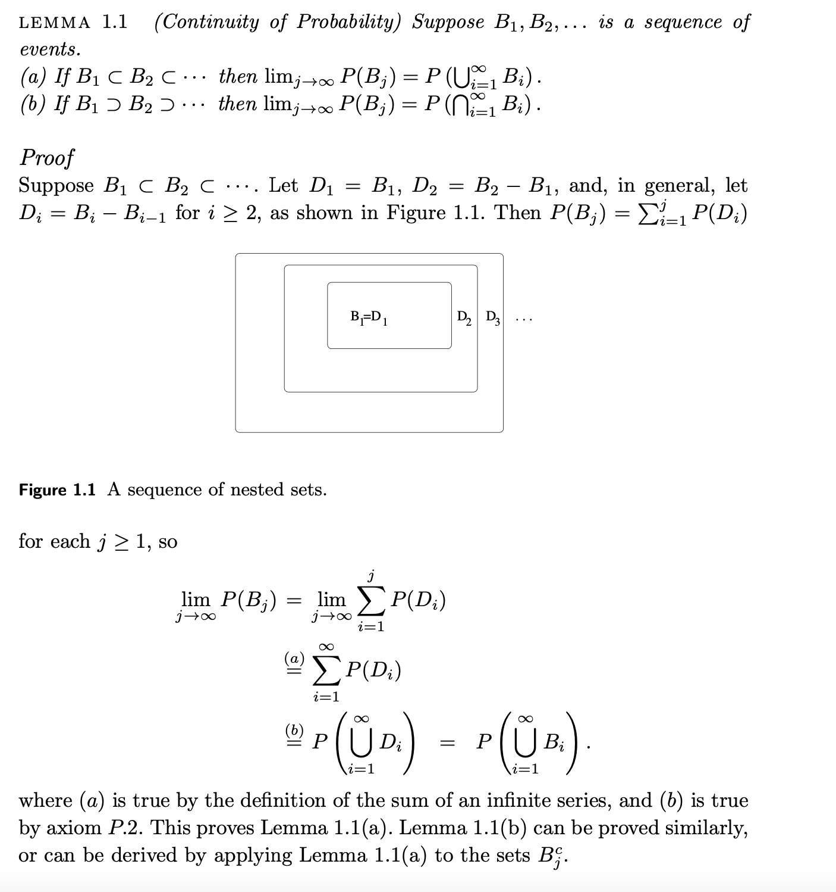
Probability Measures: Proofs and Examples
This proof is from Prof. Hajek’s text. You will have a few related questions on your HW.

Slide 16
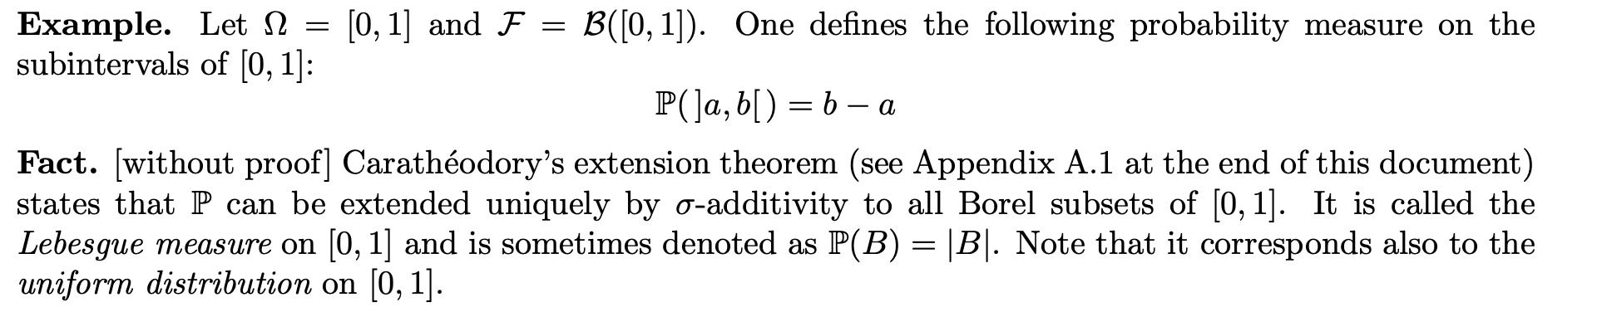
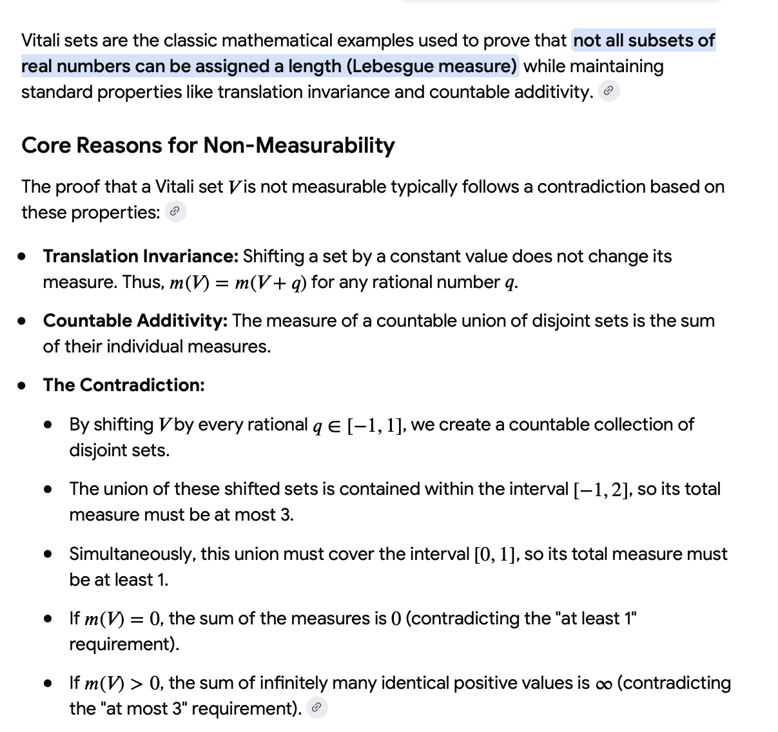
Measures for Borel Sets?

Slide 17
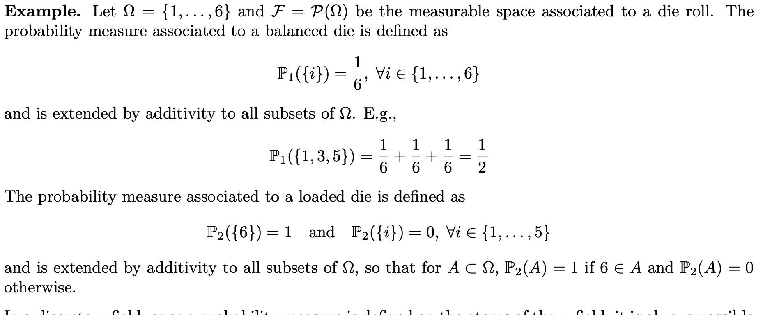
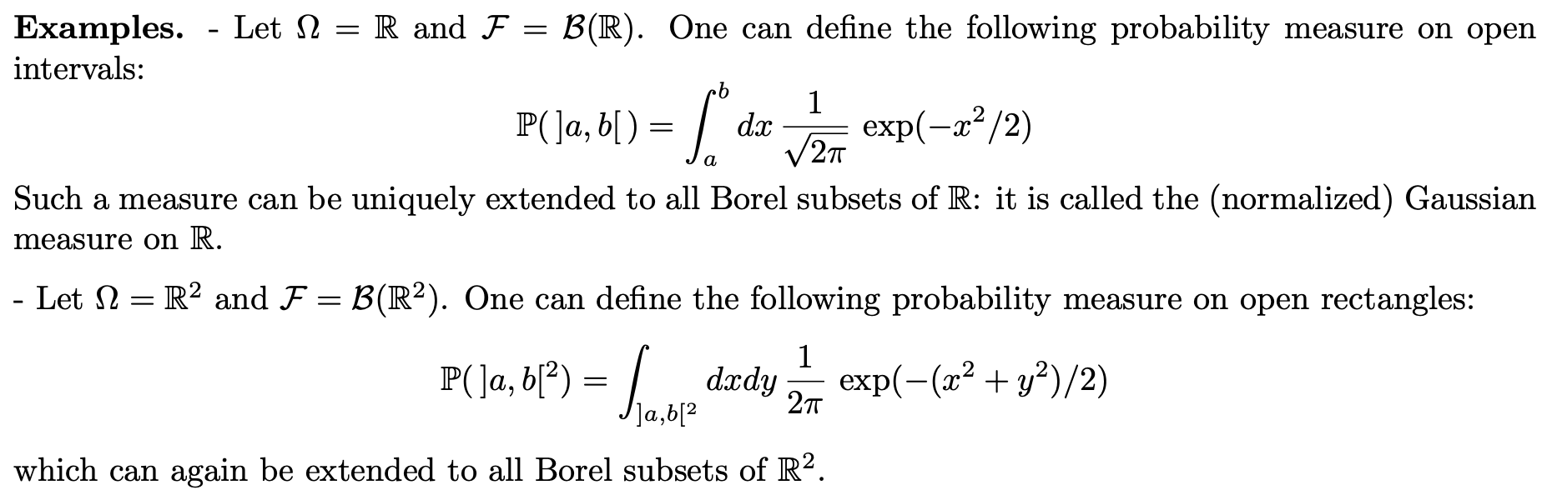
More Examples

Slide 18
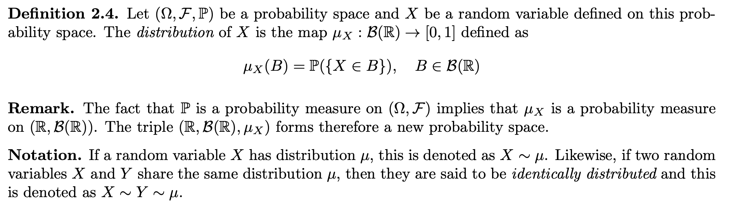
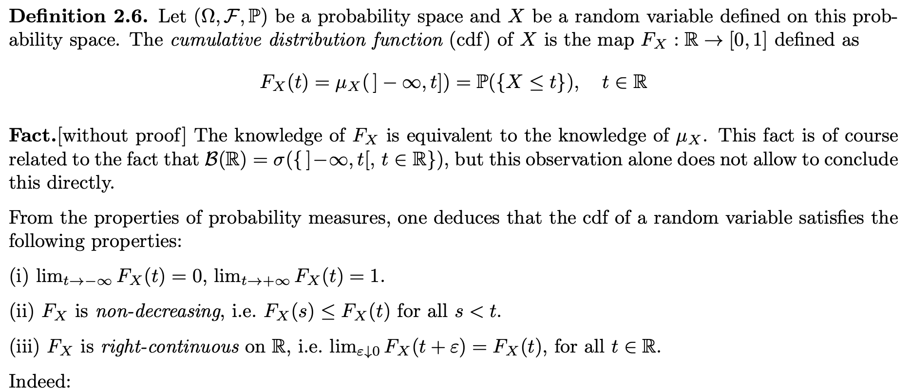
Distributions of RVs

Slide 19
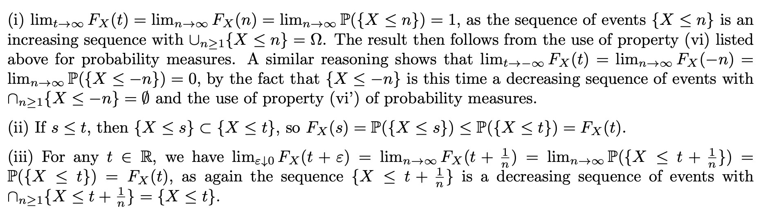
Distributions of RVs

