Slide 1
Equivalence checking
COPYRIGHT OF PROF. SHOBHA VASUDEVAN, ECE, UIUC.
PLEASE DO NOT DISTRIBUTE/REUSE ANY OF THESE SLIDES WITHOUT MY EXPLICIT PERMISSION.
Prof Shobha Vasudevan
ECE 519
LECTURE 2
ACKNOWLEDGEMENT FOR EQ CHECKING SLIDES: PROF. JACOB A. ABRAHAM

Slide 2
Equivalence checking
Checking whether two models of a design are functionally equivalent to each other
Involves a golden and a revised target model
Objective is to find bugs in target model wrt to golden model
Crucial step in transformation based design flow
RTL to gate-level
  Automatic (logic synthesis tools)
  Manual
  Hybrid
Specification (C model) to RTL
  Manual
  Automatic (high level synthesis tools)

Slide 3
Differences between models
Logic synthesis tools to translate control portions
Manual translation for datapath
Sources of errors
  Implementation of synthesis tools, misinterpretations of RTL by designers etc
  Optimizations to improve design parameters like timing, area or power
Gate level designs can undergo a lot of optimizations
  Gate to gate equivalence checking
  Unoptimized is golden model and refined design is target model
Formal equivalence verification is the industry wide practice for
  RTL to gate equivalence
  Gate to gate equivalence checking

Slide 4
Combinational equivalence checking
Applied transformations affect circuit’s combinational logic
  Two level/multi level minimization of logic
  Timing optimization
  Technology mapping
Mainstream in today’s design flows
Current CEC tools can handle very complex designs

Slide 5
Combinational equivalence checking
In this course
  BDD- based algorithms
  SAT based algorithms
ATPG based algorithms

Slide 6
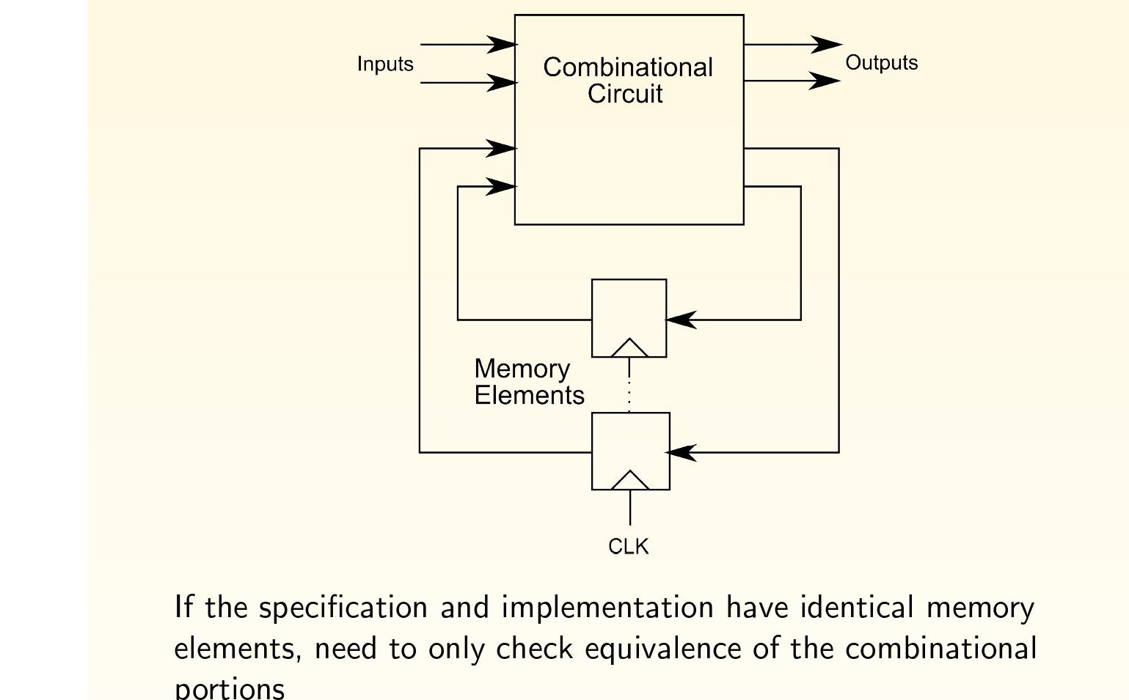
Huffman model of sequential circuits

Slide 7
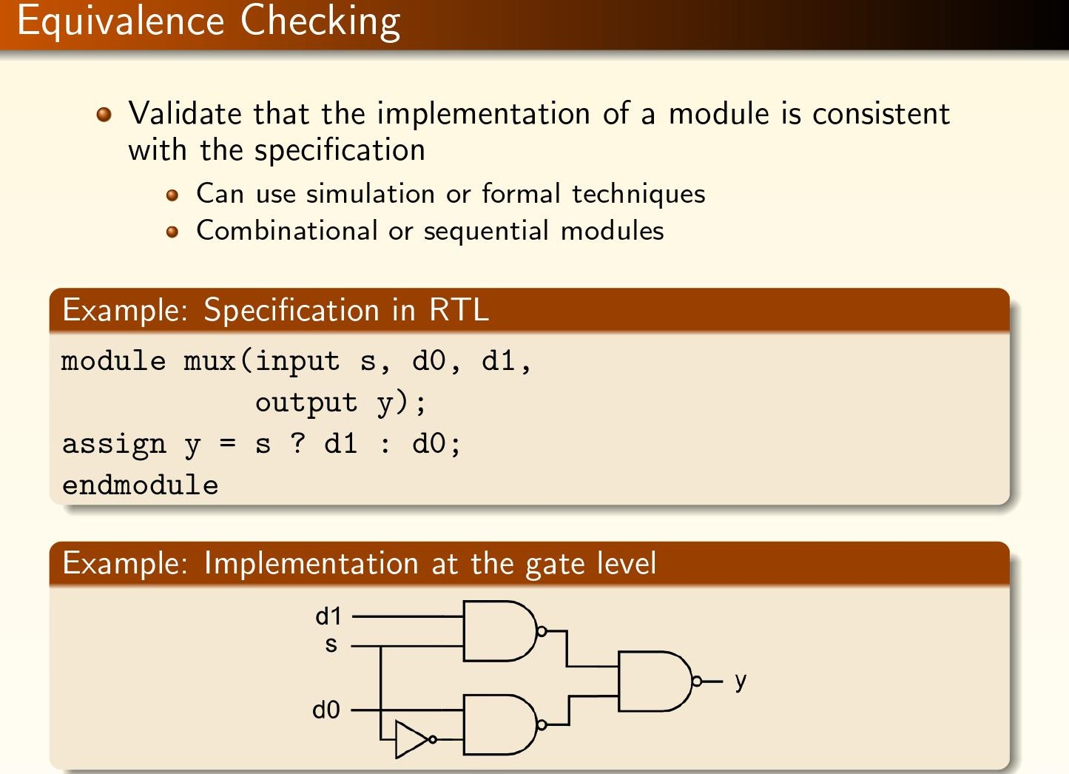

Slide 8
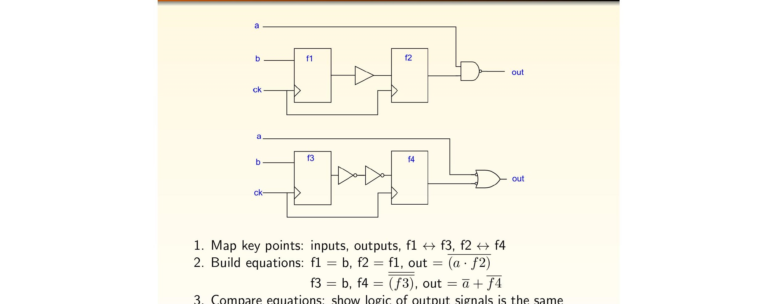
Are the two circuits equivalent?

Slide 9
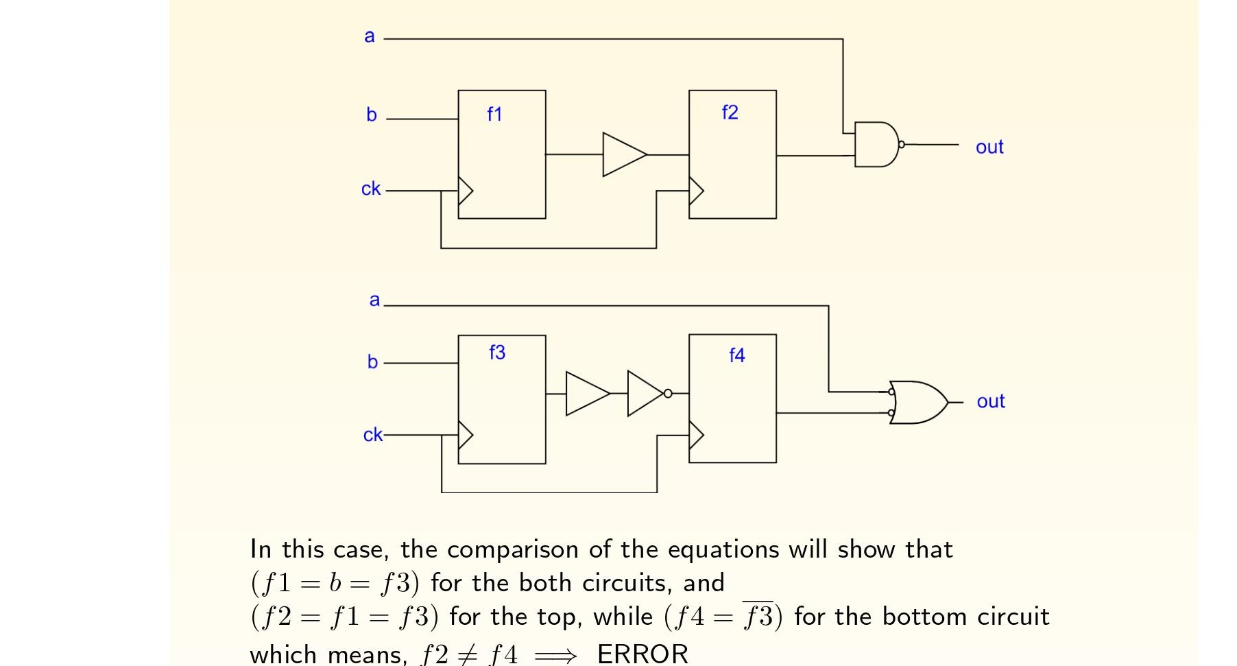
Erroneous comparisons

Slide 10
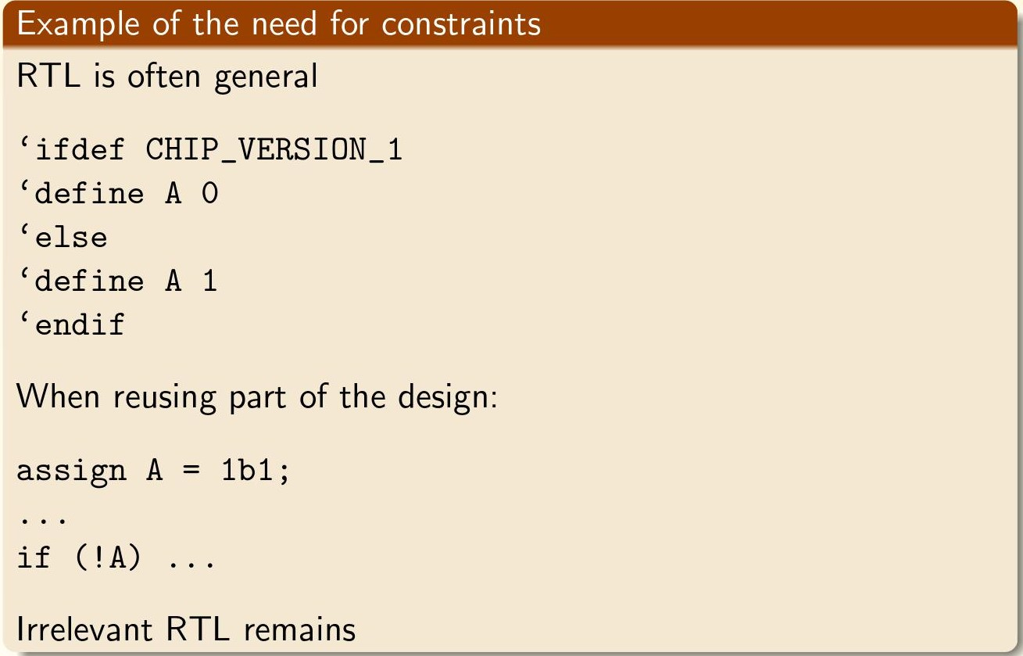
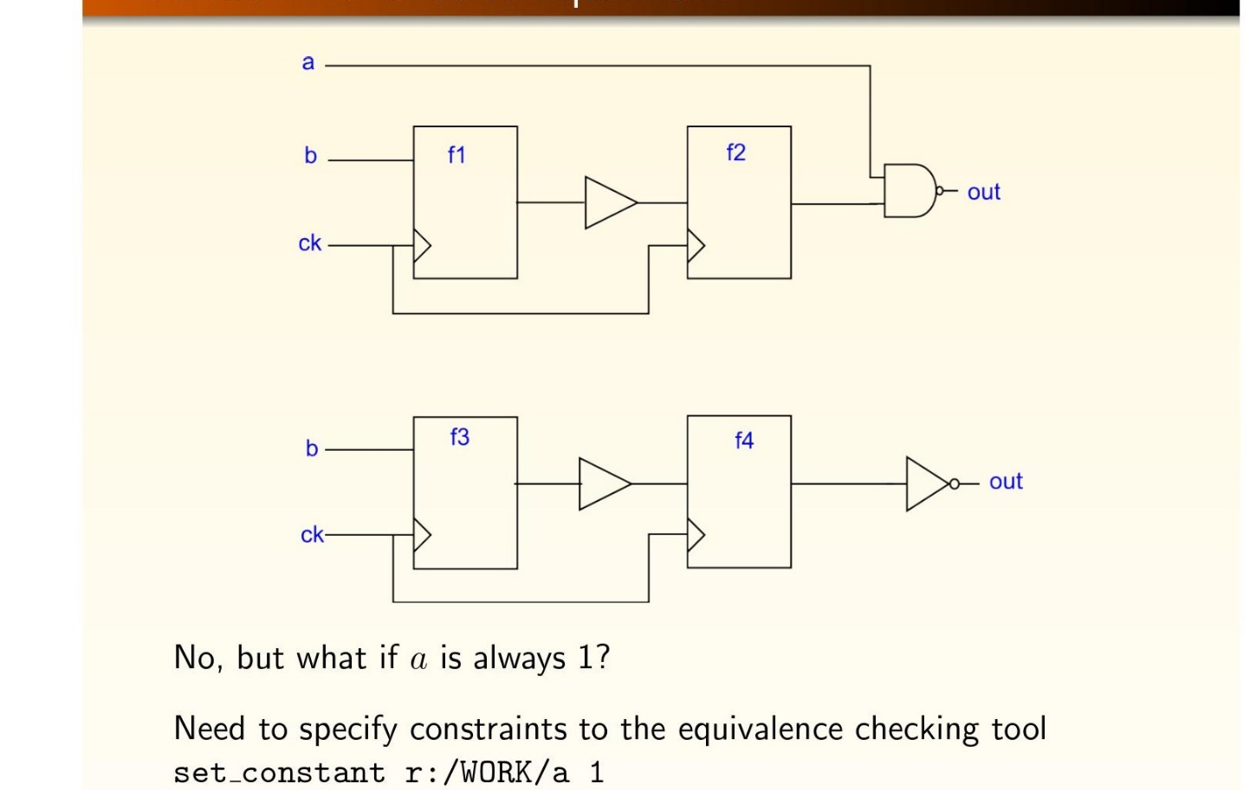
Equivalent under constraints

Slide 11
Why constraints matter
Good synthesis tools take advantage of specified constraints
  Assume constants to reduce size/scope
  Don’t synthesize masked out RTL
  Allow out of band constraint specifications in control files
Equivalence checking tools must recognize constraints
Otherwise will get spurious matches
Practical challenges in constraints
  Could be in wrapper RTL
  Inside analog blackbox
  Could be due to software/external specifications

Slide 12
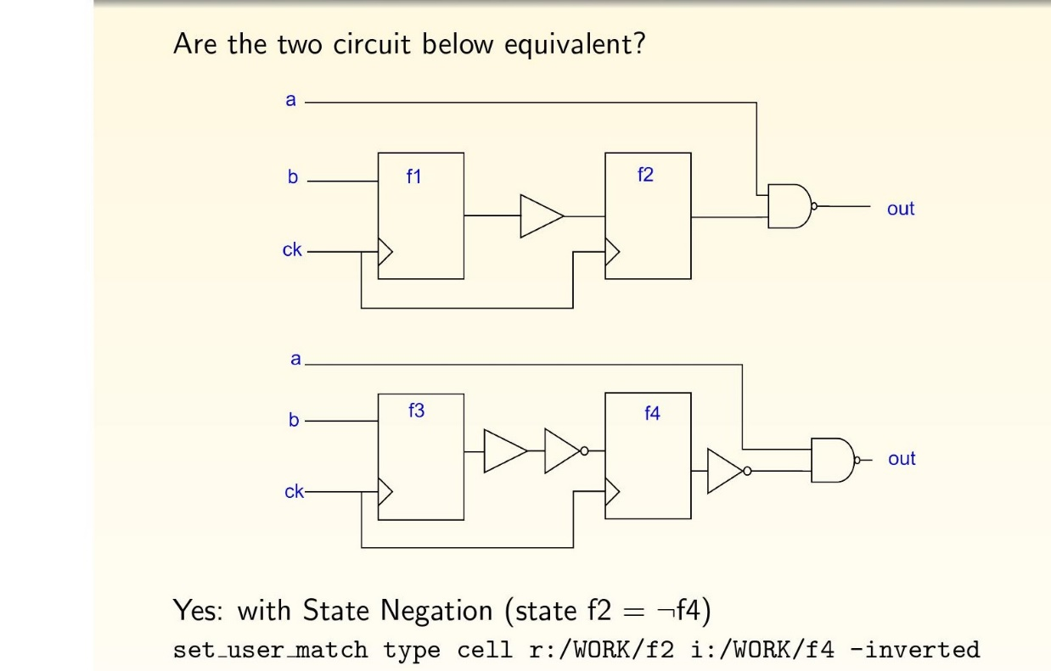
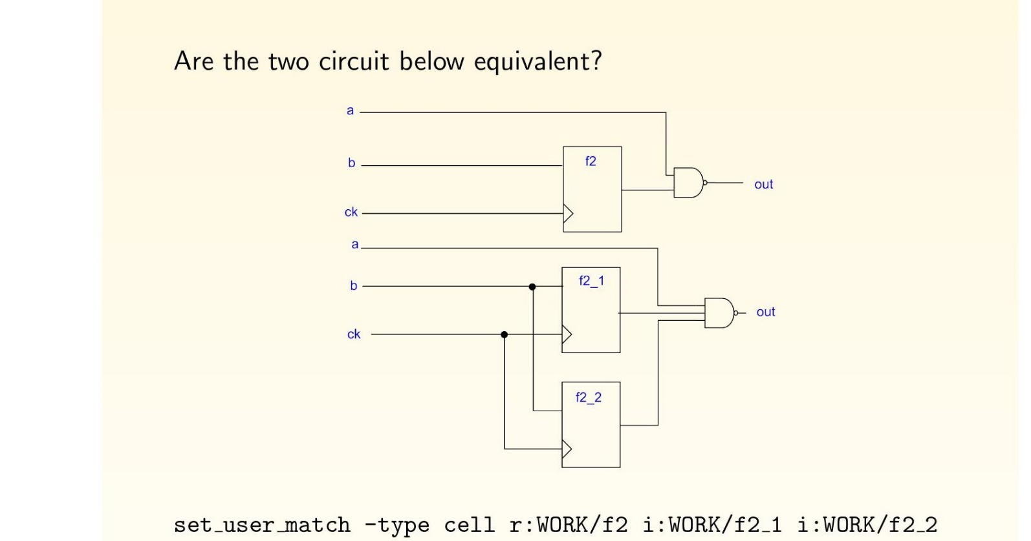
State negation and replication

Slide 13
Don’t care cases

Slide 14
Cut-points in equivalence checking
Verification by decomposing design into smaller parts
Used when combinational cone is tool large
Divide logic at points other than states
Map cutpoints similar to mapping flops
Verify circuit between cutpoints

Slide 15
Adding cutpoints needs scrutiny of internal signals

Slide 16
Hierarchical equivalence checking

Slide 17
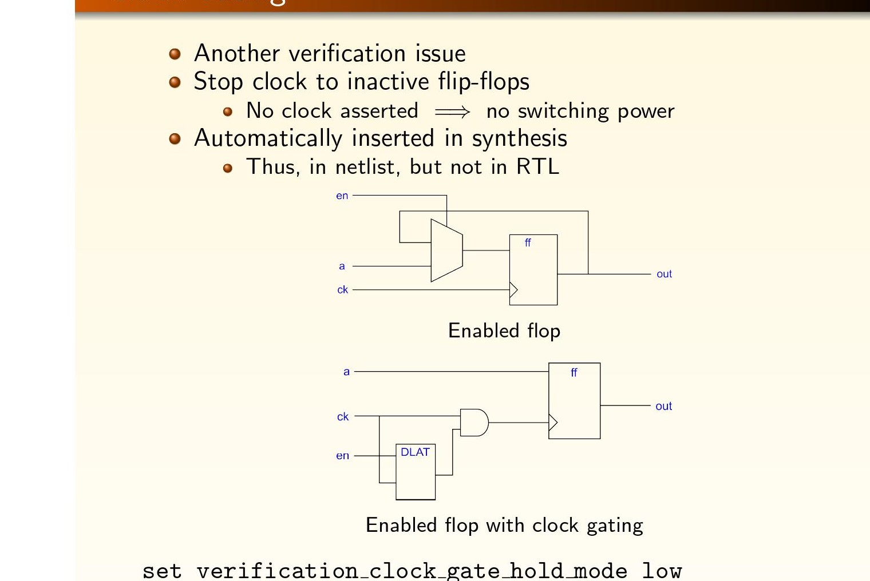
Clock gating

Slide 18
Case splitting
What if some inputs activate/deactivate a lot of logic?
Can distinguish some input values of the same variables
  These can be individual cases or instances of the problem
  Instead of treating all values as equal
Constrain an appropriate variable to 1 or 0 and compare twice
In general, constrain n variables and compare 2^{n} times
Convert problem in space to problem in “time”
  Memory per iteration is more of an issue than number of iterations

Slide 19
Example of case splitting

Slide 20
Retiming

Slide 21
Sequential equivalence checking
Transformations that do not preserve correspondence between memory elements in both models
  Retiming
  State minimization
  State encoding
  Sequential redundancy removal
  Redundancy addition and removal
Checking equivalence requires exploration of the designs’ state space
State space explosion!!
Lot of research, but application still not widespread…
Designers avoid sequential optimizations despite their value

Slide 22
Sequential equivalence checking
Theoretically exponential complexity
Practically heuristics are very useful
Symbolic traversal, induction and structural approaches are useful
In this course
  Basic FSM to FSM equivalence checking
  Reachability analysis
  Symbolic simulation
  Different notions of what sequential equivalence means

Slide 23
Retiming: Why we need sequential equivalence

