Slide 1
ECE 445 Project Pitch:
Isolated Voltage Sensor
Electrical & Computer Engineering
1/24/2023

Slide 2
Motivation
In power electronics research, we often need to equip microcontrollers with the ability to accurately sense a high voltage signal.
ELECTRICAL & COMPUTER ENGINEERING
GRAINGER ENGINEERING

Slide 3
PCB Example
Power Board
Input
Controller Board
Controller
Power Circuit
Digital Control
Cable
Analog/Digital Signals
I/O
Output
CHART / GRAPH
Single-ended voltage (>200 V)
Analog differential signal
Sensing
(Differential Amplifier)
Sensing
(Isolation Amplifier)
This circuit must monitor its output in real time and convey that information to its I/O ports. This poses several challenges to ensuring accuracy and signal integrity. Also, the controller is burdened with the task of
ELECTRICAL & COMPUTER ENGINEERING
GRAINGER ENGINEERING

Slide 4
PCB Example
Power Board
Input
Controller Board
Controller
Power Circuit
Digital Control
Cable
Digital Signals
I/O
Output
CHART / GRAPH
Single-ended voltage (>200 V)
Digital signal
Isolated Voltage Sensor
An isolated voltage sensor would measure the voltage signal at the source and output a digital signal. The designer no longer needs to deal with this problem.
ELECTRICAL & COMPUTER ENGINEERING
GRAINGER ENGINEERING

Slide 5
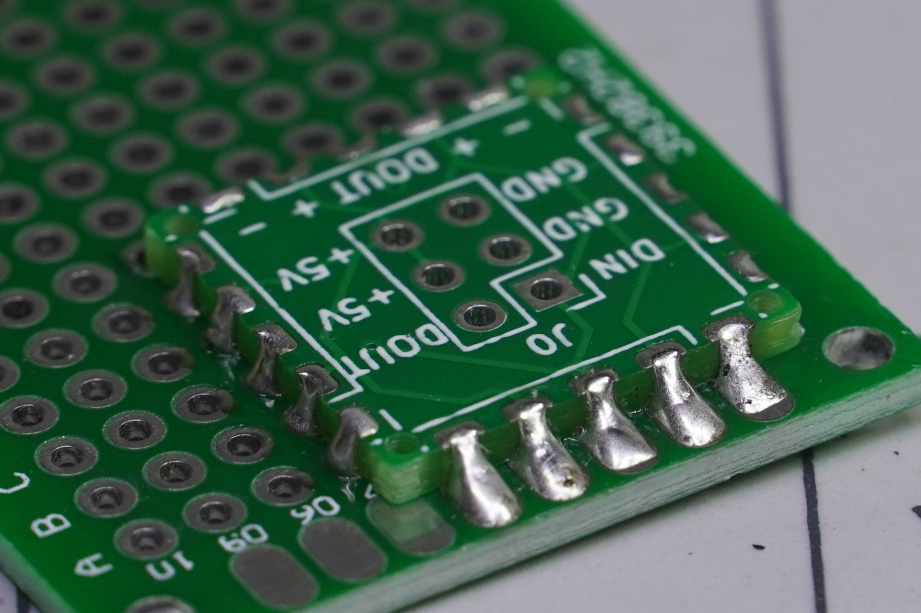
Solution
The board will mount to a PCB in some fashion.
ELECTRICAL & COMPUTER ENGINEERING
GRAINGER ENGINEERING

Slide 6
Project Description
Specifications
+/- 1000 V input
>10 MΩ Input Impedance
100 kHz Bandwidth
0.5% of reading accuracy
Digital Output
Built-in calibration constant storage
Other Metrics of Interest
Noise
Common Mode Leakage
Power consumption
Accuracy over temperature
Cost
Data/Power
Voltage Signal
?
Isolated Power Converter
Analog
Frontend
Optocouplers
A/D
ELECTRICAL & COMPUTER ENGINEERING
GRAINGER ENGINEERING

Slide 7
Example Circuit
Skills Involved
Design of analog front-ends
Error budget
Frequency-domain modeling of analog circuits
Automation of testing
Skills that may be involved
Power converter design
Signal processing
Noise budget
ELECTRICAL & COMPUTER ENGINEERING
GRAINGER ENGINEERING

Slide 8
Contact
Jason Paximadas (jop2@illinois.edu)
Sources
https://embeddedcomputing.com/technology/analog-and-power/pcbs-components/how-to-design-castellated-pcbs-for-board-to-board-attachment
ELECTRICAL & COMPUTER ENGINEERING
GRAINGER ENGINEERING

