Slide 1
Establishing an Intelligent Square Stepping Exercise System for Cognitive-Motor Rehabilitation in Older Adults with Multiple Sclerosis
Dr. Manuel Hernandez
Dr. Emerson Sebastiao
Dr. Rob Motl

Slide 2
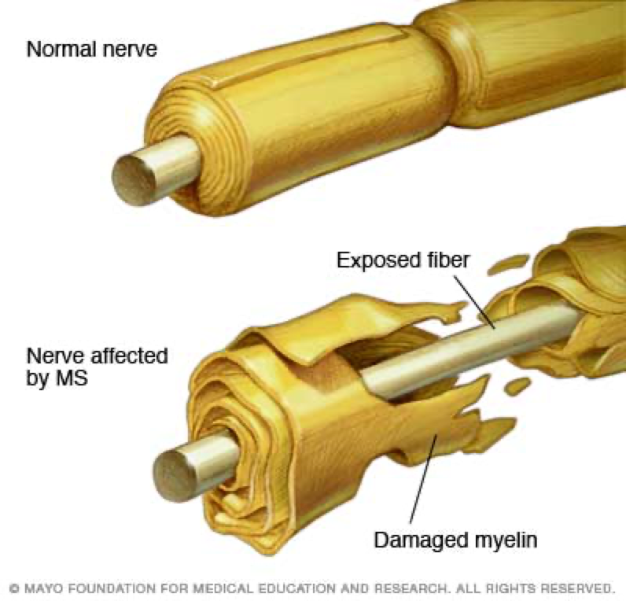
Multiple Sclerosis (MS)
Autoimmune disease affecting nerve-insulating myelin
2+ Million people affected worldwide
Typically diagnosed between 20-50 years of age
Peak prevalence of MS shifting to older age groups¹
1. Marrie, et al., 2011.

Slide 3

MS-related declines
Attention and executive function are crucial for cognitive control of mobility in persons with MS²
Declines in balance, mobility, strength, sensory, cognitive, and mental health function expected from MS³
2. Motl, et al., 2014. 3. Compston and Coles, 2008.

Slide 4

Barriers to engagement with physical activity
Despite benefits, exercise participation remains in low in persons with MS⁴
Lack of physical activity could be due to personal, environmental, and societal barriers⁵
4. Kinnet-Hopkins et al., 2017. 5. Learmonth and Motl, 2016

Slide 5

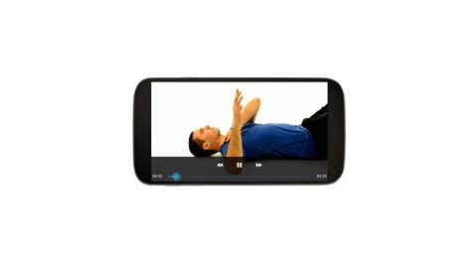

The good news…

Slide 6
Intelligent Home Exercise System for Motor-Cognitive Rehabilitation

Slide 7

Next steps
Goal 1: Refine design and build the smart exercise mat.
Goal 2: Refine software to sync with smart exercise mat.
Goal 3: Increase robustness of system for at-home deployment and collaborate with industry partner.

Slide 8
Establishing an Intelligent Square Stepping Exercise System for Cognitive-Motor Rehabilitation in Older Adults with Multiple Sclerosis

