Slide 1
ECE 445 TA Pitch: SCUBA Nitrox Labeler
Stasiu Chyczewski

Slide 2
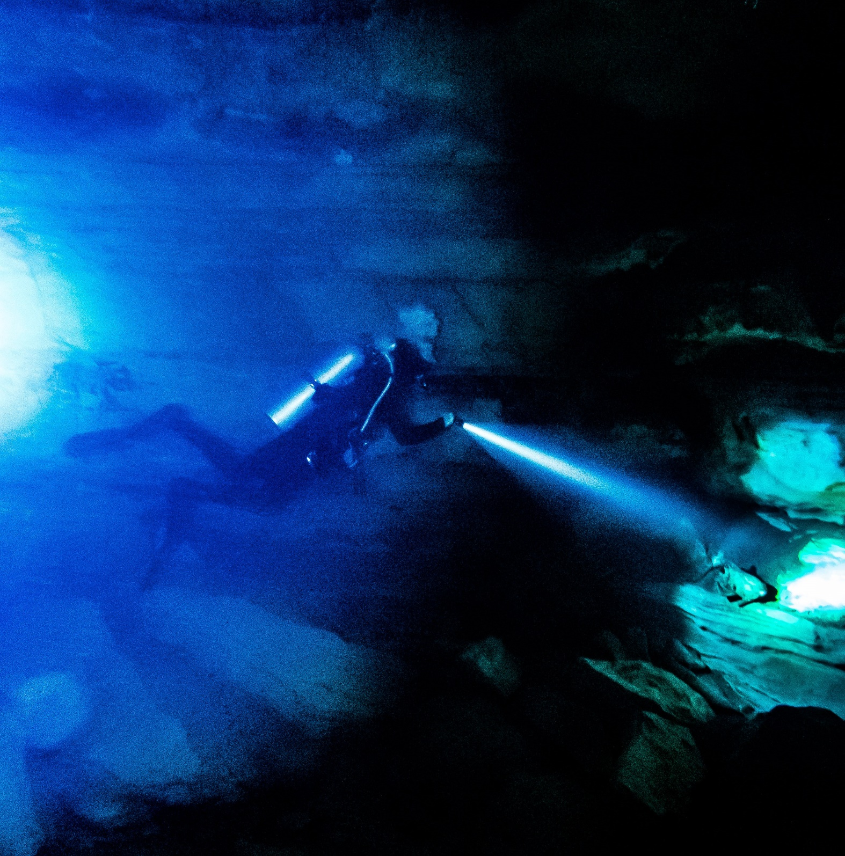
Background: Nitrox Diving
Scuba divers accumulate N₂ in their tissues as they dive due to the increased partial pressure at depth.
Divers using air often need to spend large amounts of time on the surface to off-gas and extend no-deco times on subsequent dives.
Nitrox (breathing gas with a higher percentage O₂ than air) can mitigate this problem.

Slide 3
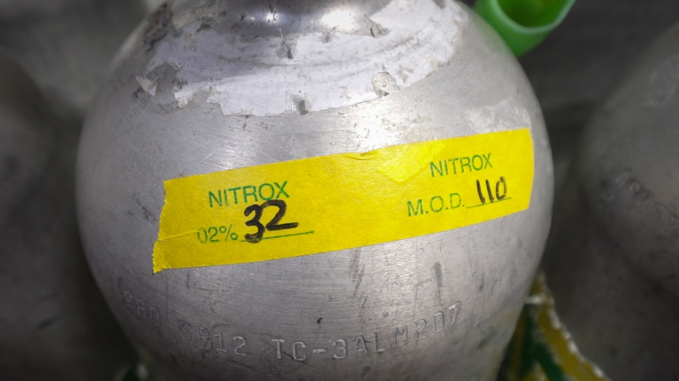
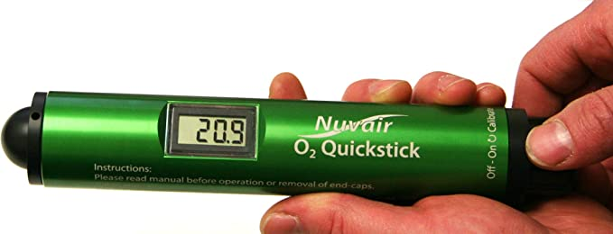
Background: Nitrox Diving
Nitrox diving has additional hazards associated with it, most notably the onset of oxygen toxicity at shallower depths.
To mitigate this hazard, divers are taught to analyze and hand-label their tanks before their dive with information such as the percentage O₂ and MOD (maximum operating depth).
Notes:
Most nitrox mixes are either 32% or 36% O₂
1.6 PO2 air MOD is about 218 ft
36 EANx is 114 ft

Slide 4
Proposal: Compact Nitrox Analyzer/Labeler
Key Requirements | Would be nice
Accurately analyze O₂ content of dive cylinders Allow users to set max PO₂ and calculate resultant depth limits Print easy to read label with critical information (O₂ percentage, MOD, date, etc.) Handheld device | Water resistant, buoyant housing Electronically log analyses and transmit for easy integration with digital dive logs Long lasting, rechargeable batteries

