Slide 1
Bioprinting Conversion Platform
Nathan Chung, Pei-Hsuan Hsieh, Yamuna Phal, Dr. Rohit Bhargava
Chemical Imaging and Structures Lab

Slide 2
105,000 individuals
40,000+ transplants
are waiting for a transplant.
are completed per year.
Health Resources & Services Administration

Slide 3
1 person gets added to the transplant waiting list every 9 minutes
17 die each day waiting for an organ transplant
Health Resources & Services Administration

Slide 4
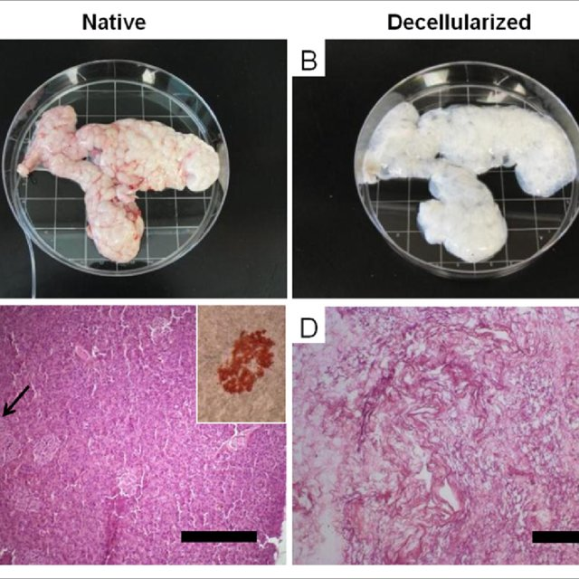
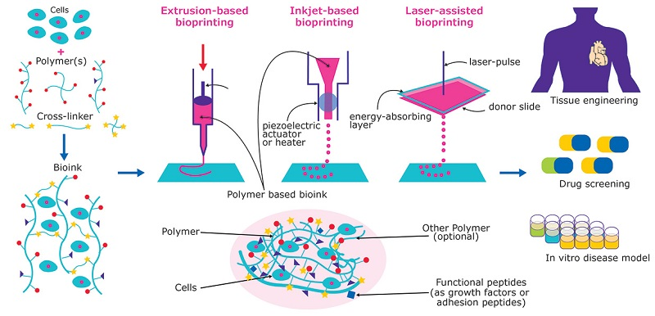
Tissue Engineering
https://www.biochempeg.com/article/189.html
Katari, Ravi et al. (2014). Journal of diabetes science and technology.
Notes:
One way scientists are trying to approach the organ shortage is tissue engineering. Explain tissue engineering

Slide 5
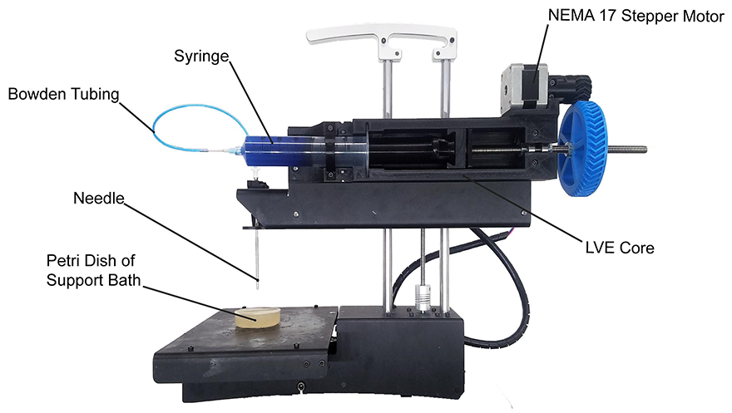
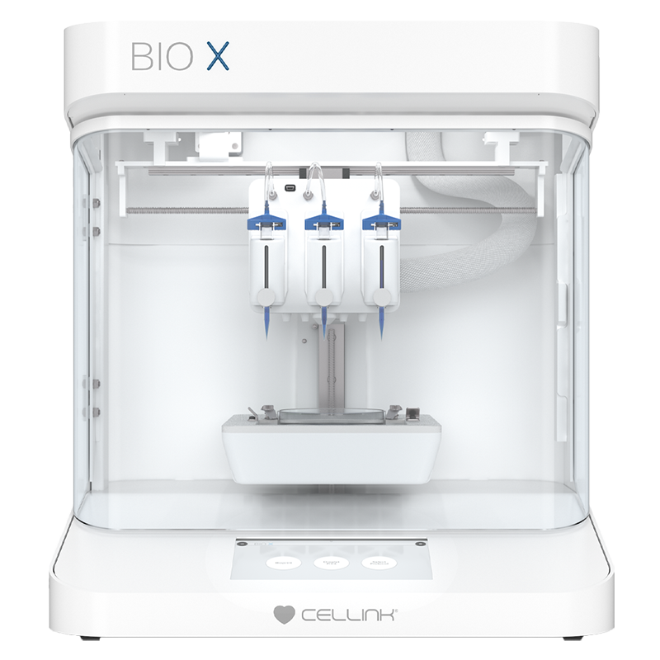
‘DIY’ Bioprinters (3D Printer)
Commercial Bioprinter
Open Source
Pressure Control – No
Starting Price - <$1k
Closed Source
Pressure Control - Yes
Starting Price - $30k

Slide 6
Our Solution / Goal
Increase accessibility of bioprinting to more researchers
Improve the DIY space
Pressure control is critical to printing live cells
New Bioprinting Control Board to allow for easy 3D printer conversion
Enable Multi-material printing to allow for better cell models / microenviroment reproduction

Slide 7
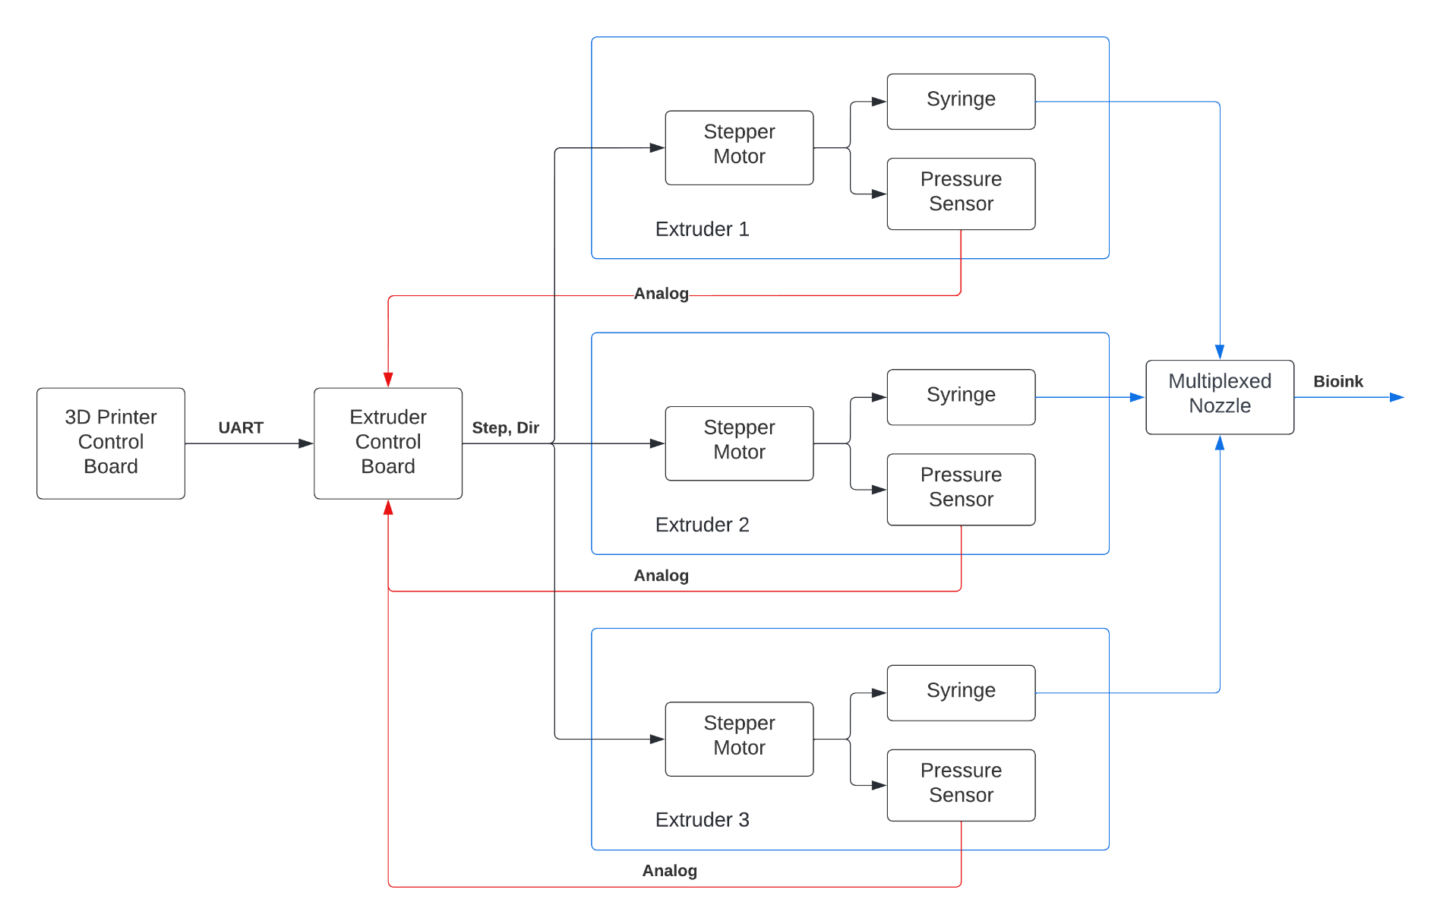
Block Diagram
Features
External Control Board
Closed Loop Pressure Control

Slide 8
CAD Drawings
Extruder Design
Syringe Cap Design

Slide 9
Closed-Loop Pressure Control Board
Required Features
Extruder Pressure Sensing & Control
Stepper Motor Drivers for X, Y, Z axis control (3D Printing)
Temperature and Fan Sensing / Control
Availability to control microcontroller through Raspberry Pi
Firmware for Control Board
Potential Features
Air Quality Sensing – For Live Cell Printing

Slide 10
Other Applications of Bioprinting
Drug Testing
Testing Drugs on 3D
More realistic to invivo (real life)
Creating In-Vitro Models (Our Lab’s Intention)
Cancer Models
Cellular Models

