Slide 1
Katherine Bunsold Department of Communication
ECE 445:
Communication
Notes:
Skills for Presenting Engineering and Applied Knowledge

Slide 2
Agenda
Working with your group
Public Speaking
Tools for success:
Organization
Delivery
Practice
Takeaways and Questions

Slide 3
How to Work Better as
a Group
Start with a Face-to-Face Meeting (where possible)
Get to know each other outside of the project
Establish a culture of “trust” and “honesty”
Set clear guidelines and goals

Slide 4
Making Meetings Efficient
Set a regular time to meet and stick with it
Regularly evaluate your progress
Use a common location for information (box, google doc., etc)
Define action items

Slide 5
Don't let difficulties communicating put you behind
Have a problem? Talk it over as a team and reach out to your TA and professor.

Slide 6
People do not like public speaking
Notes:
How many here would say you are comfortable speaking in public?
More people are afraid of public speaking than they are of spiders.
75% of people have some sort of speech anxiety – not gender biased
Physical response: shaking voice, blushing, rapid heart beat, weak knees, nauseous, sweaty or cold hands, drawing a blank or rambling

Slide 7
Why does public speaking matter?
Oral communication skills matter for:
Interaction and Collaboration
Explanation and Presentations
Self-awareness and Learning
Notes:
…
Talk about some tools for success, starting with Organization

Slide 8
Organization
Organization is key!
Audiences for oral presentations can’t go back and reread what they heard
Oral presentations can be hard to follow
Tools for organization:
Preview statement
Transitions
Repetition
Conclusion statement

Slide 9
Organization (cont’d)
Preview
“Today we will tell you about [A], then [B], then [C].”
Transitions
“First we’d like to explain the objectives for our project”
“Now that I have discussed the design process, [group member’s name] is going to talk about areas for future research”
Repetition
“Again, our object was [X], so we focused on this element a lot.”
“In order to achieve [previously stated objective], we also focused on this”
“So as you can see, our results showed [restate results]”
Conclusion
“In conclusion, today we have presented our senior design project, explaining [A], then [B], then [C]”

Slide 10
Preparing your Organization
Narrow down your presentation into clear sections
Create an outline rather than writing all of your information and memorizing it
What are the key points/ideas you’ll cover in your section?
Elements to include:
Statement of project objectives
Explanation of design process
Explanation of findings

Slide 11
Visual Aids
Visual aids can help you stay organized and help your audience
Design elements:
Simple and clear; very little text
Use standard fonts and colors; make sure it is readable
Use images when possible; just make sure they are clean and professional
Notes:
…
You’ve thought about organizing and are now working on how to visually present it.

Slide 12
Example Organization
Introduction
Objective
This is where you will state your main point! What is a simple explanation of your design?
Explanation of Design
Presentation and Interpretation of Results
Conclusion / Opportunities for future direction

Slide 13
Visual Aids
Visual aids can help you stay organized and help your audience
Design elements:
Simple and clear; very little text
Use standard fonts and colors; make sure it is readable
Use images when possible; just make sure they are clean and professional
Notes:
…
You’ve thought about organizing and are now working on how to visually present it.

Slide 14
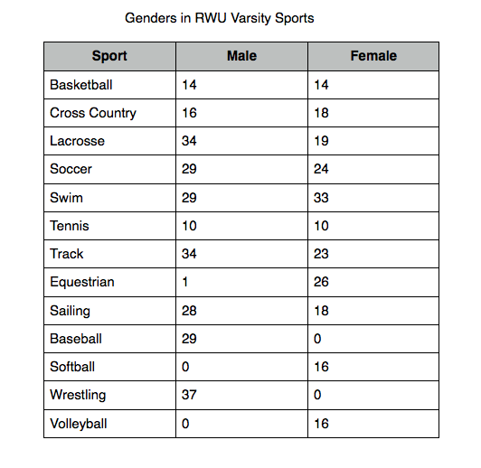
Use visuals to identify the most important information

Slide 15
Use visuals to identify the most important information

Slide 16
Visual Aids cont’d
Be aware of how you will present slides
Do you have a wireless clicker?
Do you need to stand near a computer?
Practice using the slides!
Use verbal transitions between slides
Notes:
Outlines to practice from can be very helpful in writing notes to yourself – you’ll likely know the content of each slide (since it’s based on your own work) but outlines can help you remember transitions, when to pause or breathe, make eye contact, etc.

Slide 17
Delivery skills
Developing public speaking skills takes time
Organization and preparation can help with nerves
Practice is key!
Notes:
So you’ve figured out your organization and have created your presentation…now you need to actually “present” it!
Nerves – remember, a lot of people are nervous, even if they don’t show it. Don’t mistake a confident presenter with someone who is completely comfortable! Fake it ‘till you make it.

Slide 18
Two Vital Delivery Skills
Posture:
Stand up straight, with shoulders rolled back and chest high
Make sure to face the audience (not the screen!), and look at them!
Breathing
Take a deep breath before you begin, and at transitions
This will help with nerves, verbal fillers (“um”) and let your audience catch up
This also helps control pacing if you tend to speak too quickly (like me! ☺)
Notes:
Again, public speaking takes time and this is one day. But, two key physical things you can do to help calm nerves and make you seem confident are posture and breathing.

Slide 19
Communicating Technical Information . . .
Think of Persuasion
Start with Organization
Be Concise
Not just informing audience of your decisions, but persuading them that you made the right decisions
Use visual aids [Block diagrams, photos of product, etc]
"So what?"
Your audience can always ask questions

Slide 20
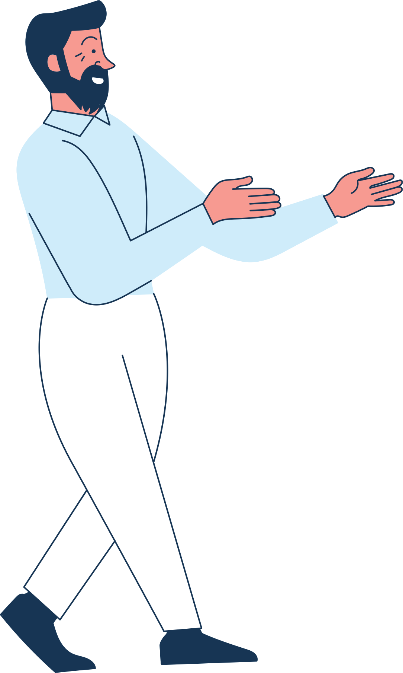
. . . As a Team
Planned & Cohesive Final Product
Importance of transitions
Where does everyone stand?
What do you do when you aren't speaking?

Slide 21
Work to make your group members a source of support, not stress!
Notes:
Basically, your group can be a source of support or stress this semester. Putting in a little extra effort up front can help make your group a source of support; people to pick up slack when you have 4 midterms in 3 days, people who are excited when you make cool progress, people who can help your ideas become better. I’m not saying you need to be best friends with your group members, but having a basic level of courtesy and empathy can go a long way in developing a professional, equitable team.

Slide 22
Recap
Working with your group
Public Speaking
Tools for success:
Organization
Delivery
Practice
Takeaways and Questions
Notes:
So today we’ve talked about public speaking as a skill, some tools for success you can start using right away, and had a little bit of practice. Are there any questions for me?

