Slide 1
Using Computer Vision to Relieve the Crop Phenotyping Bottleneck
Researchers: Andrew Leakey, Narendra Ahuja, John M. Hart
Research Supported by the Center for Digital Agriculture and AIFARMS

Slide 2
Develop Corn and Sorghum Plants Suited for Climate Change
Standard and Water Efficient Sorghum
These plants are being developed at the Institute for Genomic Biology and grown south of campus. Phenotype data is being collected by hand for analysis. We are working to automate this data collection using a camera set-up to collect and process images using Computer Vision.

Slide 3
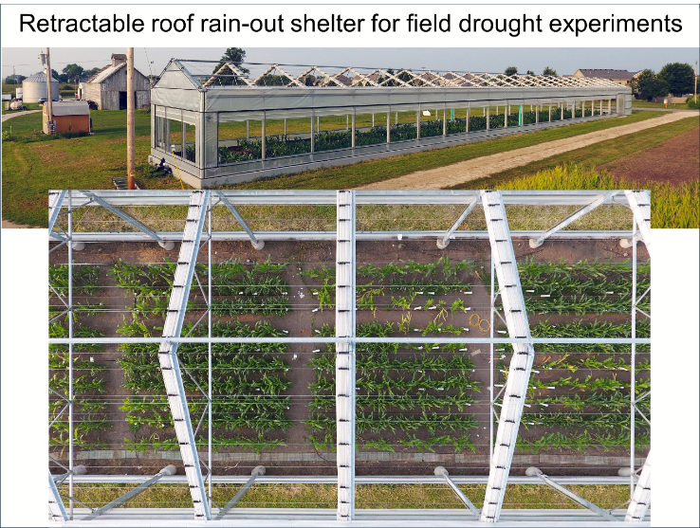
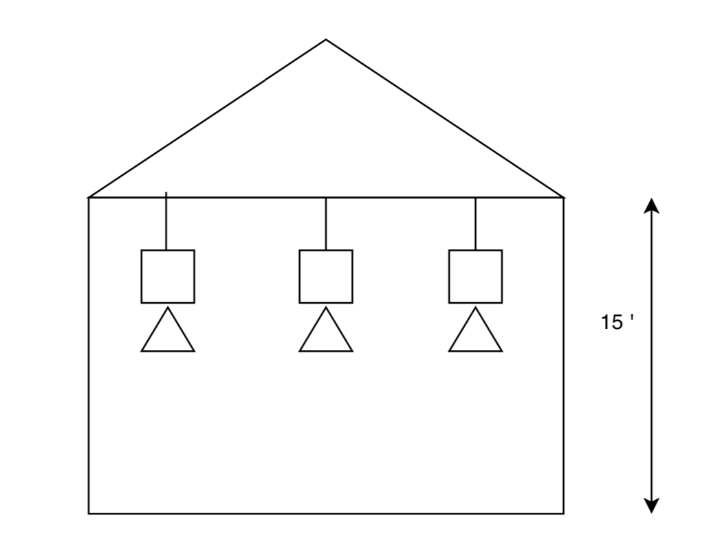
Rain Intercept Facility for Camera Installation
Digital cameras mounted to the retractable roof will enable the extraction of various phenotype data of the different plots
A set of cameras mounted on the overhead roof structure will cover the various plots growing in the field
Time-lapsed images over the growing season will be preprocessed and transmitted to a remote server for growth estimation via computer vision and comparison of the different plots being developed to find the best suited types
Future Camera Installations

Slide 4
Potential Project for ECE445 Group
Design and Develop a Camera System to Collect and Transfer Images from the Field
Program a control board (Raspberry Pi, Jetson AI module, etc.) to operate a set of cameras
Select suitable cameras to provide time-lapse imaging of growing plants
Acquire images multiple times a day simultaneously from all cameras per user requests
Adjust camera parameters for the environmental conditions, sun, wind, etc.
Determine best method for camera connectivity to the control board
Determine best locations for mounting the cameras (FOV) over the different modified plots
Create a user interface for remote control of camera parameters and storage options
Design and build a battery circuit to support the system and recharge using solar panels
Interface control board to local network to offload images to remote Computer Vision Lab
Provide a waterproof enclosure to protect and mount the cameras overhead
Test system at the Rain Intercept Facility (or possibly inside a greenhouse)

Slide 5
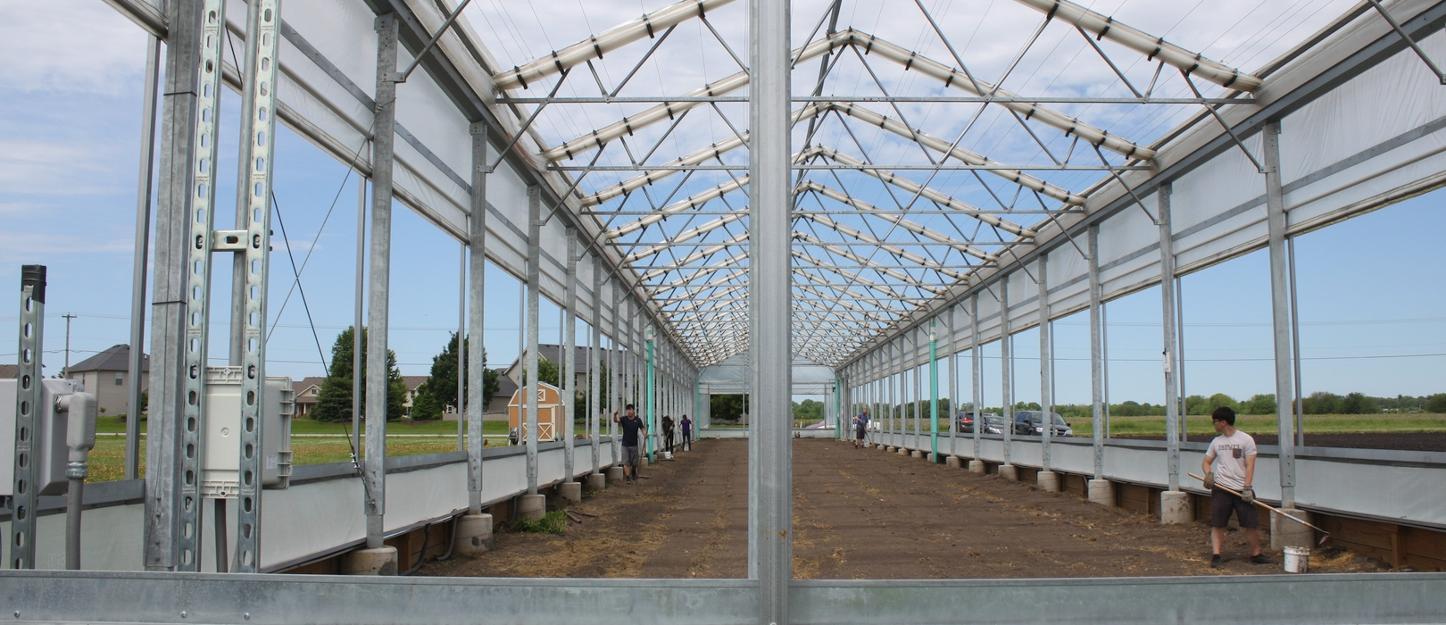
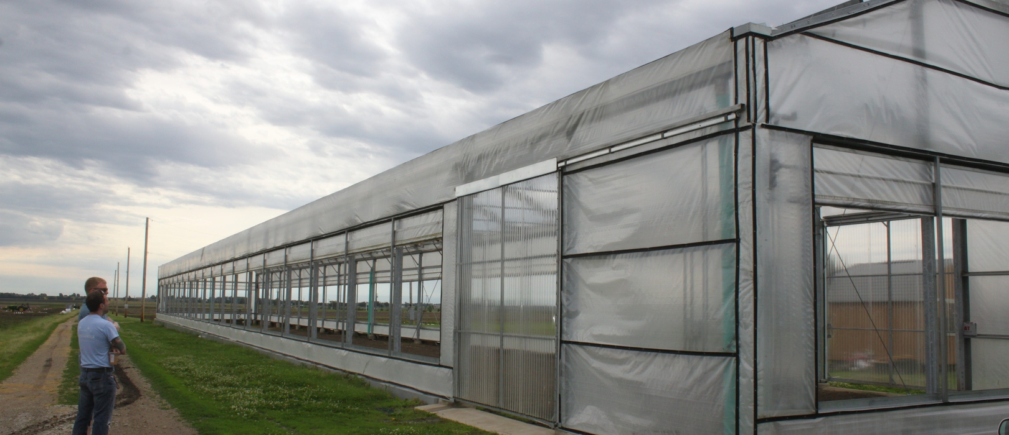
Rain Intercept Facility
Rain Intercept Facility – Retractable roof and sides close as it starts to detect rain.
Allows controlling the amount of water given to each plot during the experimentation.

Slide 6
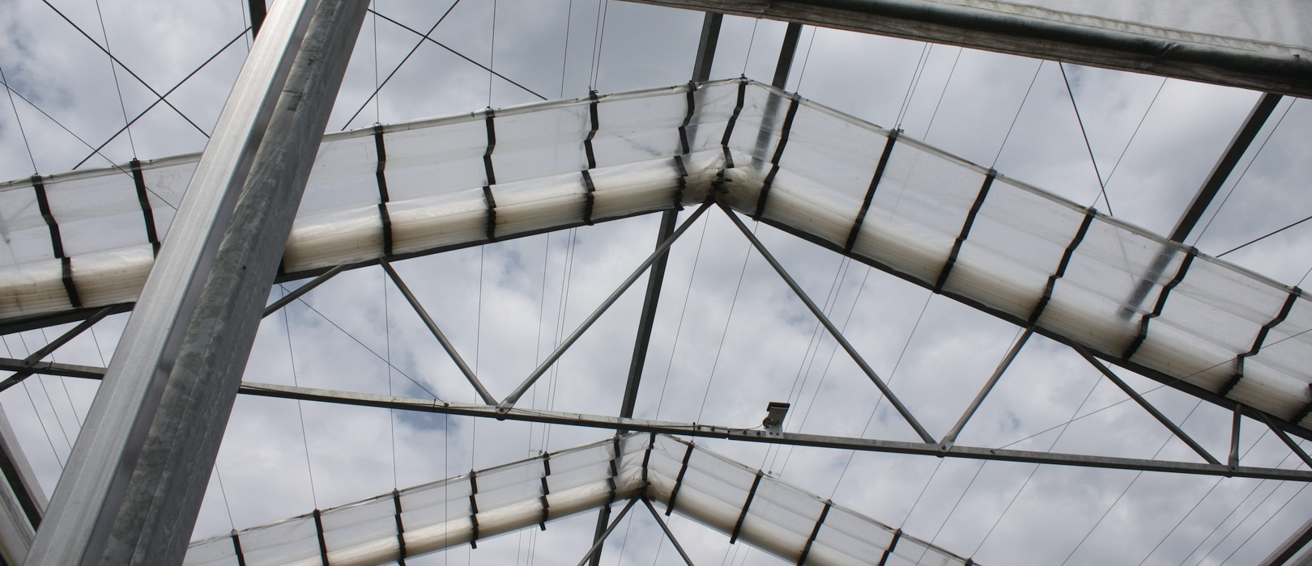
Rain Intercept Facility
Rain Intercept Facility – Beams for mounting cameras

Slide 7
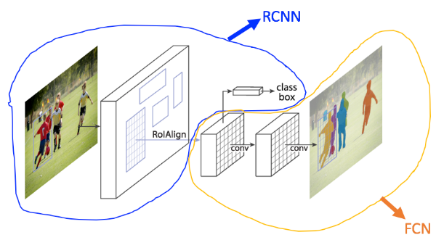
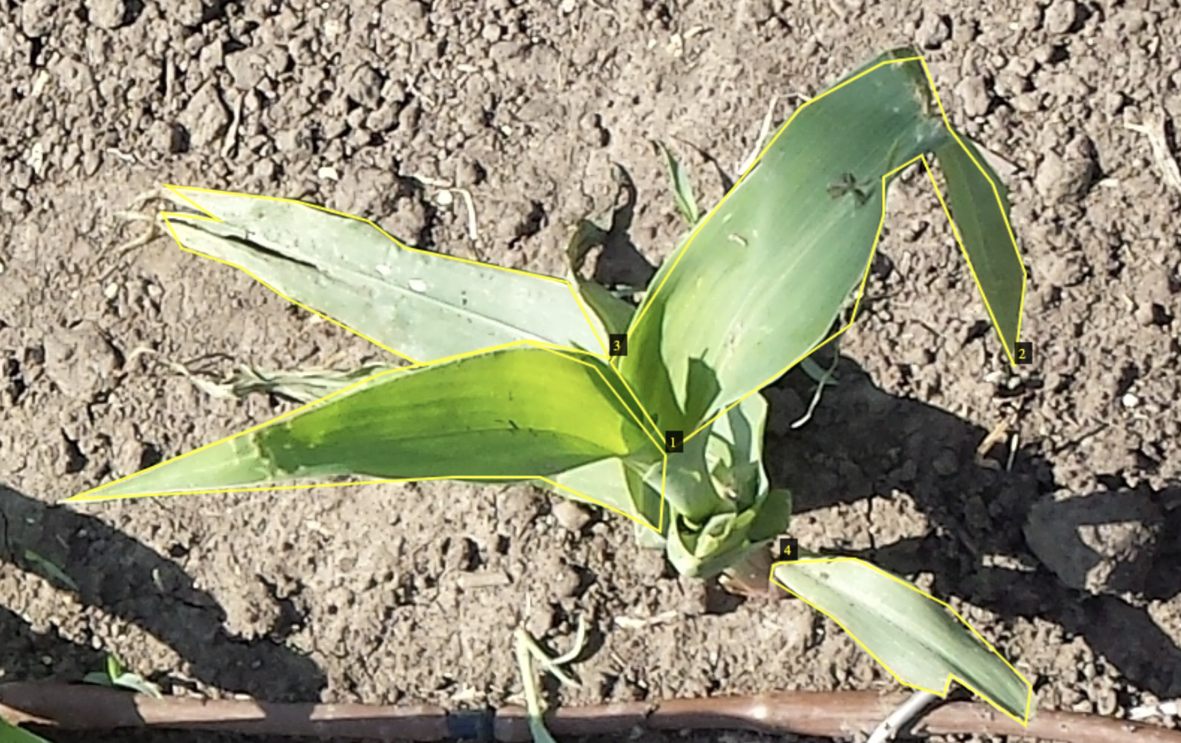
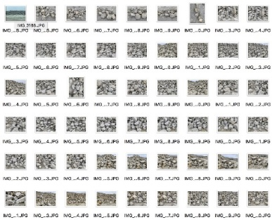
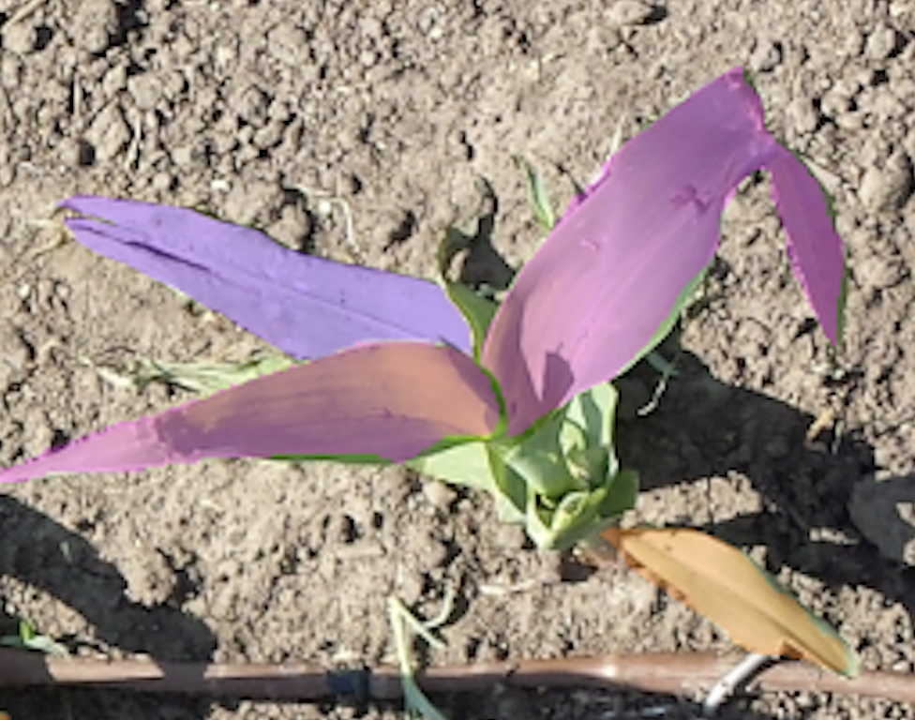
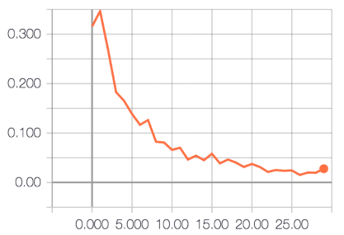
Future Plant/Leaf Segmentation Process
Training of neural network, Mask-R CNN, to identify instances of early plants and leaves
Results enable plant counting in each plot as well a leaf counting on individual plants
Input Image
Model Training
Segmentation Kernel
Labeled Dataset
(Training set)
Output Image
Training Process

Slide 8
Initial Plant Detection Segmentation Results
Mask R-CNN trained using labeled image dataset to detect whole plants in the field images
Used for counting the number of plants found growing in the field in each plot
Input Image
Output Image

Slide 9
Initial Leaf Detection Segmentation Results
Mask R-CNN trained using labeled image dataset to detect individual leaves on plants in the field images
Each leaf assigned individual color to highlight its location in the image
Input Image
Output Image

Slide 10
Potential Project for ECE445 Group
Please feel free to contact me with any questions:
John M. Hart
Principal Research Engineer
Coordinated Science Laboratory and
Center for Digital Agriculture
jmhart3 @ illinois.edu

