Slide 1
ECE 445 Fall 2022: Lecture 1 Overview
Prof. Arne Fliflet (afliflet@illinois.edu)
Prof. Kejie Fang (kfang3@illinois.edu)
Prof. Viktor Gruev (vgruev@Illinois.edu)
Notes:
ECE Main Slide

Slide 2
Today’s Agenda
4:00 Welcome and Overview
4:15 Writing
4:30 Project Pitches
4:50 RFA
5:05 Brainstorming and Ideation
5:40 Deadlines

Slide 3
Introduction
Welcome to ECE 445, Senior Design Laboratory, the department’s capstone course
COVID-19 is still with us, but the course is in-person, lab, and device oriented
We expect you to carry out projects – either your own or based on pitches - that are unique, technically challenging, and useful for solving a real-world problem
You will use the course project design process presented here to design, build, test, and demonstrate a novel device
During these initial lectures we will give you the tools you need for the course and listen to project pitches
Notes:
A capstone course means it is a demonstration of your newly acquired capabilities as electrical and computer engineers
Think about the courses you found particularly interesting
How could the material be used to solve an interesting problem?
We want you to come up with novel solutions to problems
There needs to be a sufficient amount of complexity
Here has to be an EE element to the project
Project needs to be compatible with time and resource constraints
We fully expect that you will undertake challenging projects
One of the best parts of teaching this course comes at the end when we have to decide on which are the best projects

Slide 4
Course Overview
Project Identification and team formation (weeks 1-3)
Students propose project ideas on the course web board and form three-person teams.
Students and staff critique ideas on web board and proposers respond
When an idea seems ready, it becomes the basis of an RFA (Request for Approval)
RFA’s may be further critiqued and then are either approved or rejected
Approved RFAs become projects and are assigned to a TA and an instructor
Project Design (weeks 4-6)
Teams with approved projects meet with TA and begin working on project Proposal and Design Document
The design document is an instruction manual for your project
Project teams present Design Document at Design Review and receive final project go-ahead.
Project fabrication, testing and analysis (weeks 7-12)
Part procurement, circuit simulation, breadboard testing, programming
PCB design and procurement
Final weeks involve system integration and testing of project device
Demo, Final Presentation and Final Report (weeks 13-16)

Slide 5
Project Request for Approval (RFA)
All projects start on the Web Board including pitched projects
Each idea must first be presented on the web board
Professors, TA’s, and other students critique and discuss each idea
The first student to pitch an idea is the owner of that idea
After sufficient discussion, an idea can become an RFA
Projects must meet our criteria for uniqueness, complexity, and scope
Projects must address a new problem or be a new approach
Design complexity involves the project function, circuitry, microprocessor type, and software
Scope must be consistent with course time constraints

Slide 6
Project Design
The sooner your project is approved, the sooner you can begin the design process
The process begins with the Project Proposal
Objective and Background
High-level requirements
Description of design - block diagram, major components
Ethics and safety
The Design Document is an instruction manual for your project
Includes design equations, circuit schematics, physical design, flowcharts, test procedures, and component requirements
Another ECE student not familiar with your project should be able to follow this document and make a working version of your project
The design document specifies the goals you need to achieve in order to have a successful Demo at the end of the course.
Design Document is evaluated in the Design Review

Slide 7
Building and Testing
The middle 6 weeks are devoted to building and testing your project device
Work in accordance with the schedule laid out in your DR along with guidance from TA’s and professors
Identify problems early, make adjustments
Get your PCB order in early
Make early contact with machine shop but keep mechanical design simple
To help you have a successful PCB experience, you will have a PCB training assignment during the first month of the course.

Slide 8
Demonstration and Beyond
Week 13: Demonstrate a fully functioning prototype to your Professor, some TA’s, and other students
This should be the highlight of your course experience
Week 15: Give a formal presentation on your project and submit Final Report
Beyond: Some of you will continue developing and improving your project to create a real-world product
Students own IP of student-originated projects
Sponsors generally own IP of pitched projects
Main course goal is a successful project experience

Slide 9
How to succeed in ECE 445
Get familiar with the course web site and watch the videos
RFA, project proposal, lab notebook, modular design, ethics, ...
Use the PCB assignment to prepare for designing and soldering your project PCB
Use course calendar to anticipate deadlines
Understand the grading process – 21 grades large and small
Design Review, lab book, demo, final presentation & report
Two-part soldering assignment
Team evaluation, individual progress report, peer review
Focus initially on getting a project approved
Participate in web board discussions
Can’t find a project?
Respond to project pitches
Look for teams needing complementary expertise

Slide 10
How to succeed in ECE 445, continued
Work with your teammates to build a strong team
Hold regular meetings
Communicate and be transparent with your teammates and TA
Discuss problems as soon as they arise
Spend time frequently documenting your work in your lab notebook
Get help solving problems - a lot of expertise is available
Keep the project moving during the build and test phases

Slide 11
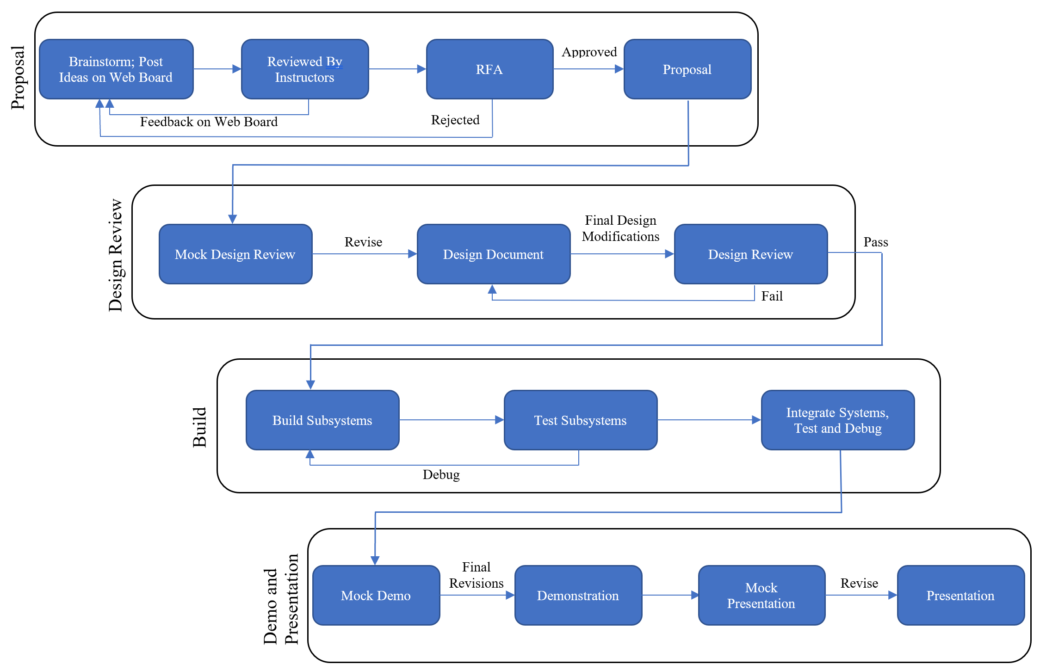

Slide 12
Staff and Support Structure
Three instructors and nine TAs
Each project will have one TA and one instructor
Project teams meet weekly with their TA – the TA is the primary guide and point of contact
Instructors
Professors Arne Fliflet, Kejie Fang, and Viktor Gruev
TAs
Jeff Chang, Stasiu Chyczewski, Zhicong Fan, Mingjia Huo, Qingyu Li, Jason Paximadas, Hojoon Ryu, Akshatkumar Sanghvi, Hanjin Shao
Course Directors
Professors Kumar and Oelze

Slide 13
Closing Remarks
This has been a quick overview – a lot more information is coming
This course is like an express train that is now leaving the station
Expect to work hard
Course grading includes many assignments with deadlines – always pay attention to the course calendar
Each project includes some risk
Expect to encounter obstacles
Don’t be afraid to seek help
Observe COVID-19 protocols

Slide 14
Project Pitches
Photo-irradiation of Glioblastoma (GBM) Emily Smith (emilyjs2@illinois.edu)
STRE&M: Automated Urinanalysis Ryan Monjazeb (rom2@illinoios.edu)
DoubleVision Teaching Fundoscope Ashkhan Hojati (ahotjati2@illinois.edu)

