Slide 1
Stick-On-Car Proximity Sensor
Electrical & Computer Engineering
Shrijan Sathish, Aryan Damani, Raunak Bathwal
04/30/24

Slide 2
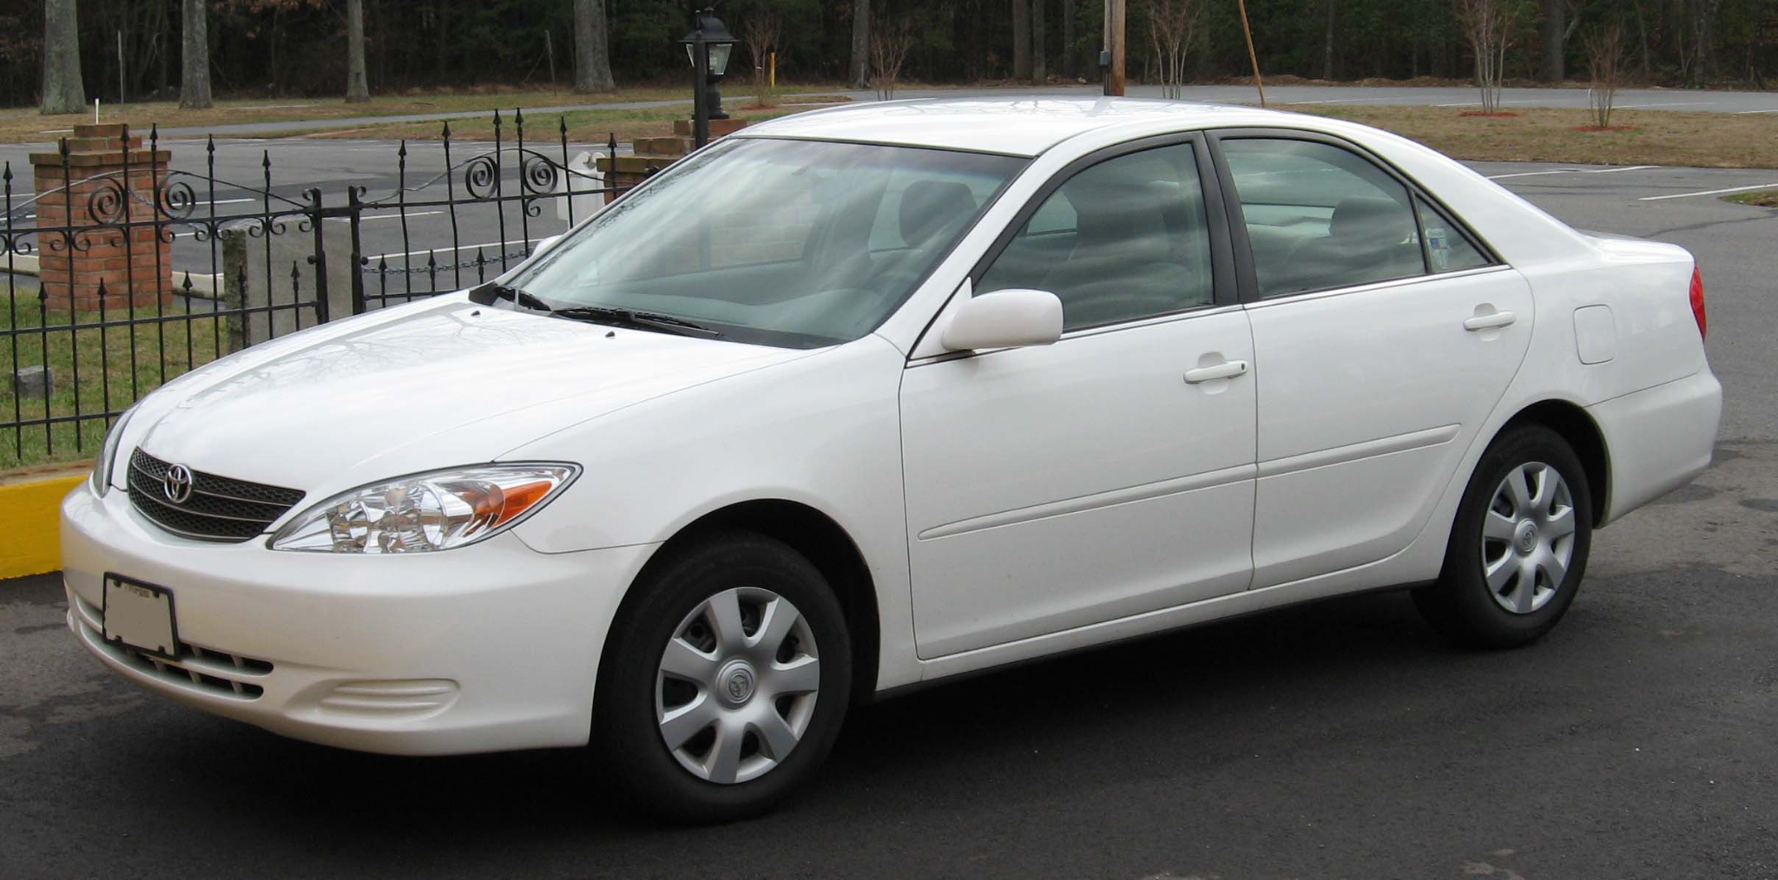
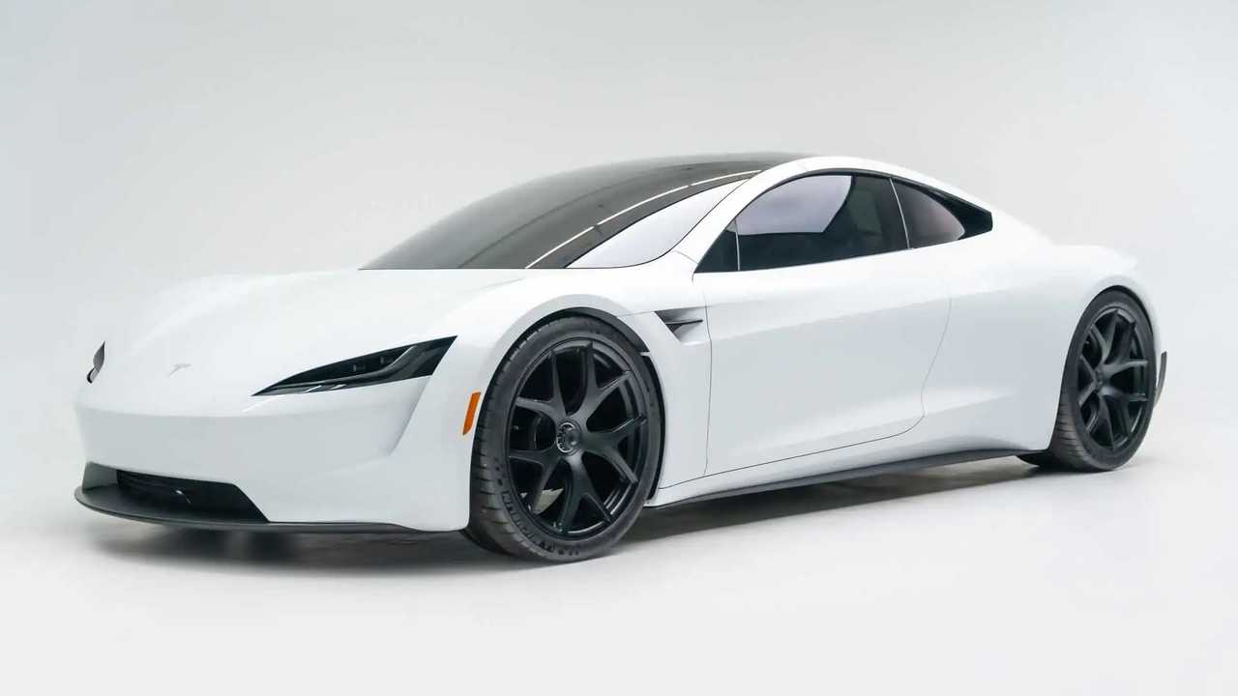
Problem Statement
What’s the Issue?
Built-in obstacle detection in modern day vehicles
Assistance to drivers
But what about older model cars that don’t have this technology?
Issue for tight spaces
Tricks to finesse this, but unreliable
How can we solve this and provide comfort?
IMAGE / GRAPHIC
IMAGE / GRAPHIC
ELECTRICAL & COMPUTER ENGINEERING
GRAINGER ENGINEERING
Notes:
Raunak

Slide 3
Our Solution
4 proximity “sensor modules” on each corner of the car
receiver placed inside the car
communicate through radio frequency
receiver itself will contain 4 lights, each corresponding to a sensor cluster
produces an auditory cue (small “beeps”)
closer to an obstacle, the faster the frequency of the beeps
ELECTRICAL & COMPUTER ENGINEERING
GRAINGER ENGINEERING
Notes:
Damani

Slide 4
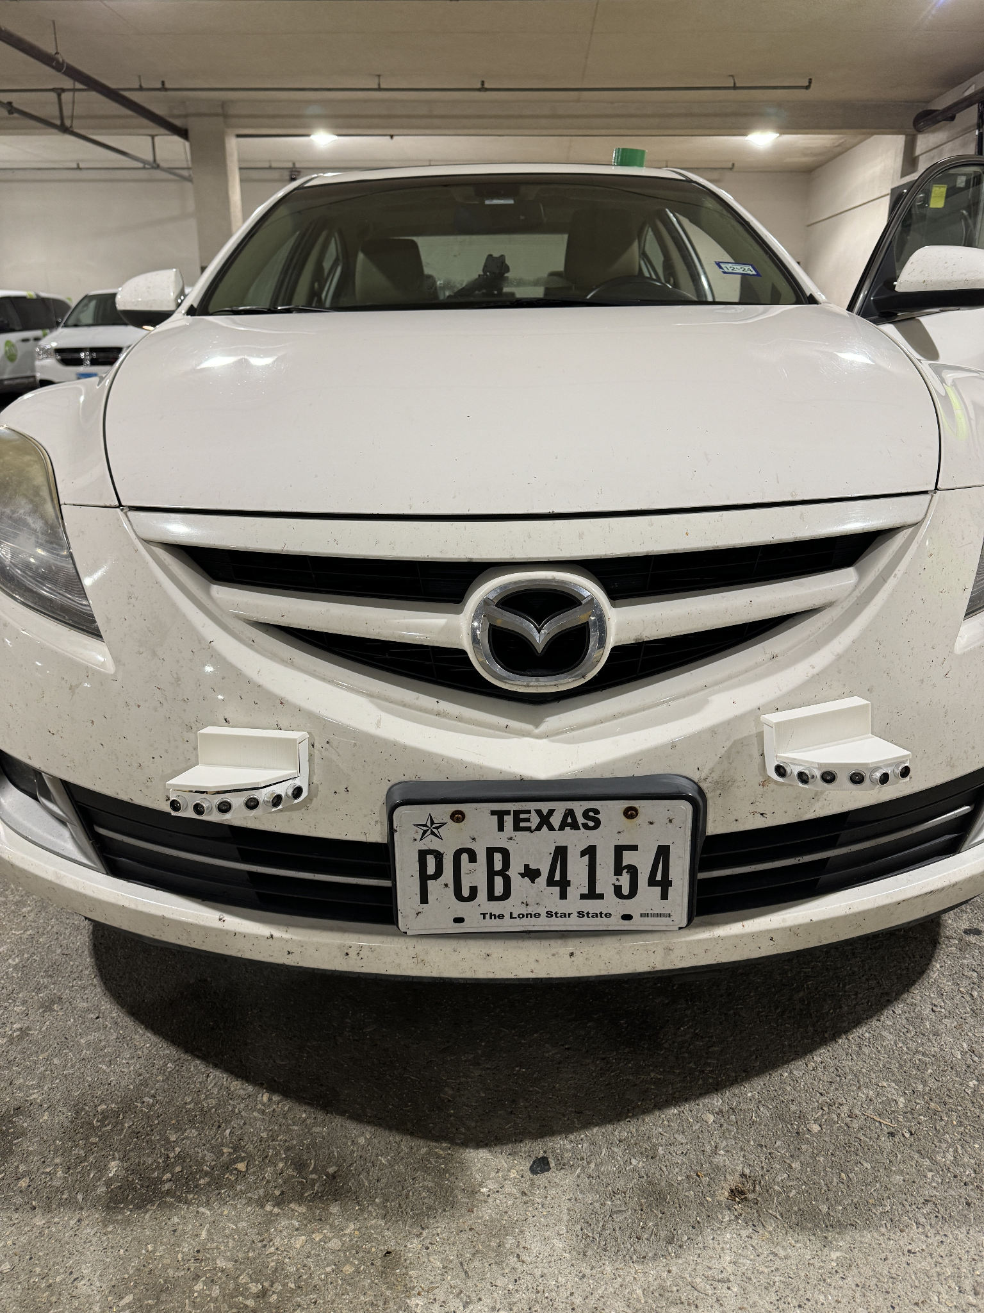
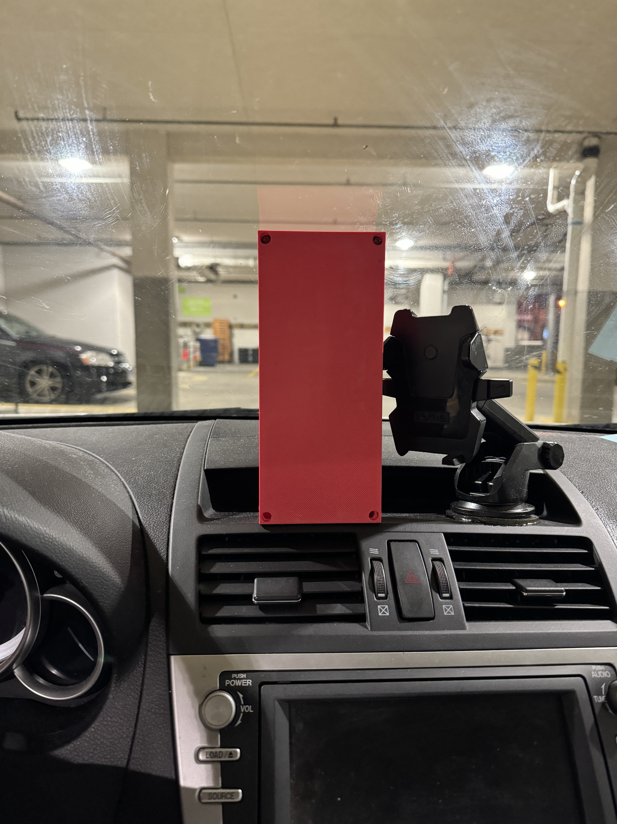
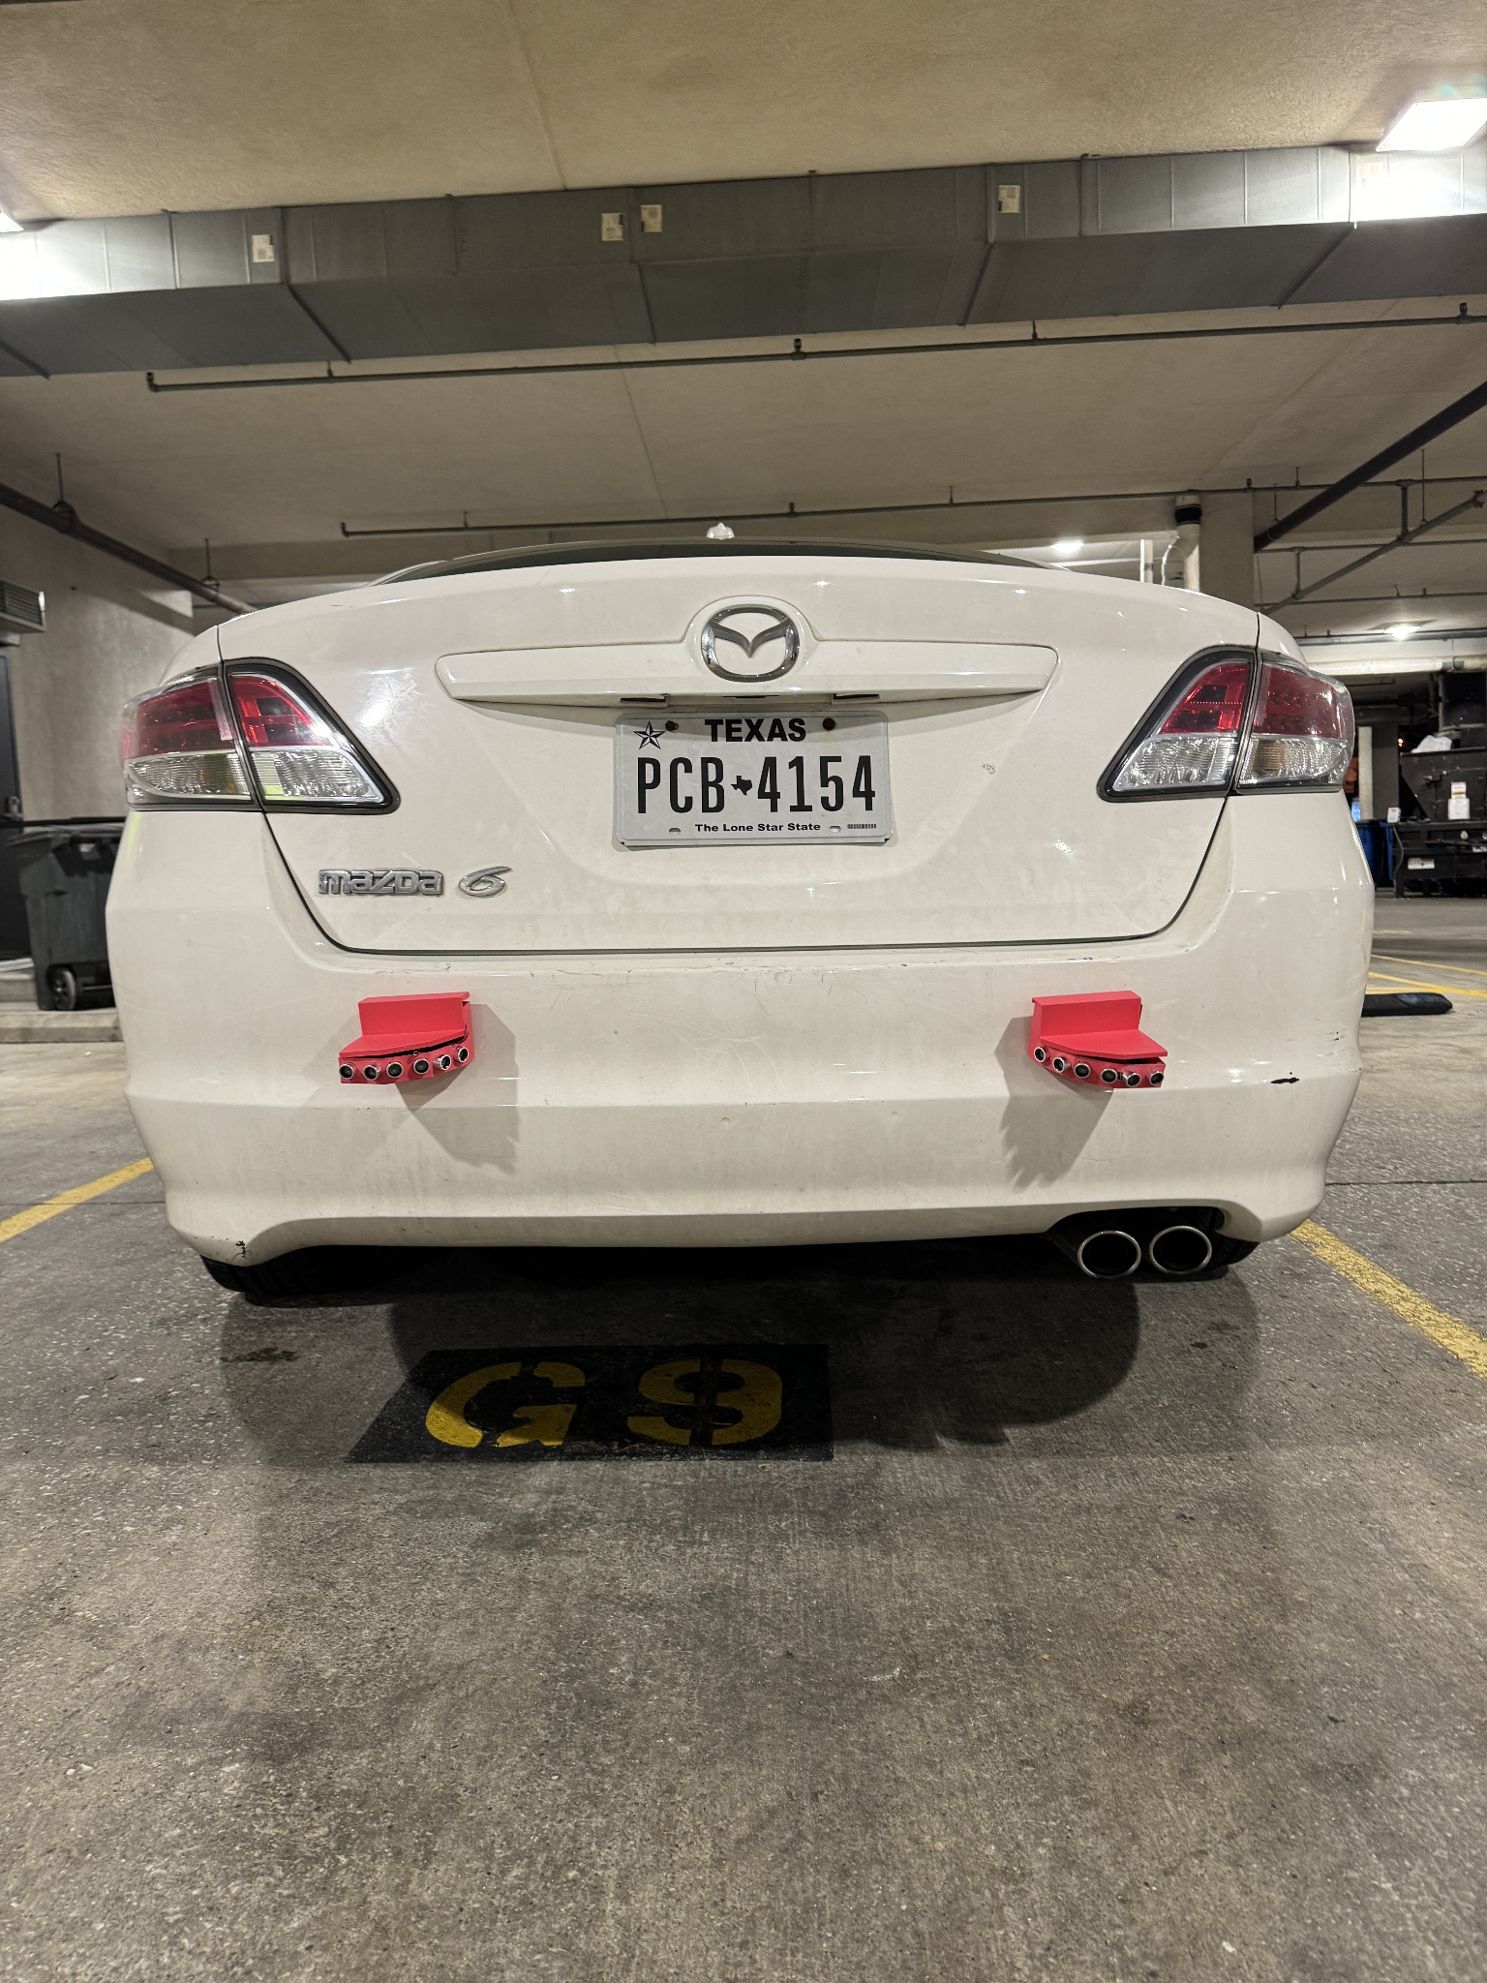
Our Solution
ELECTRICAL & COMPUTER ENGINEERING
GRAINGER ENGINEERING
Notes:
Damani

Slide 5
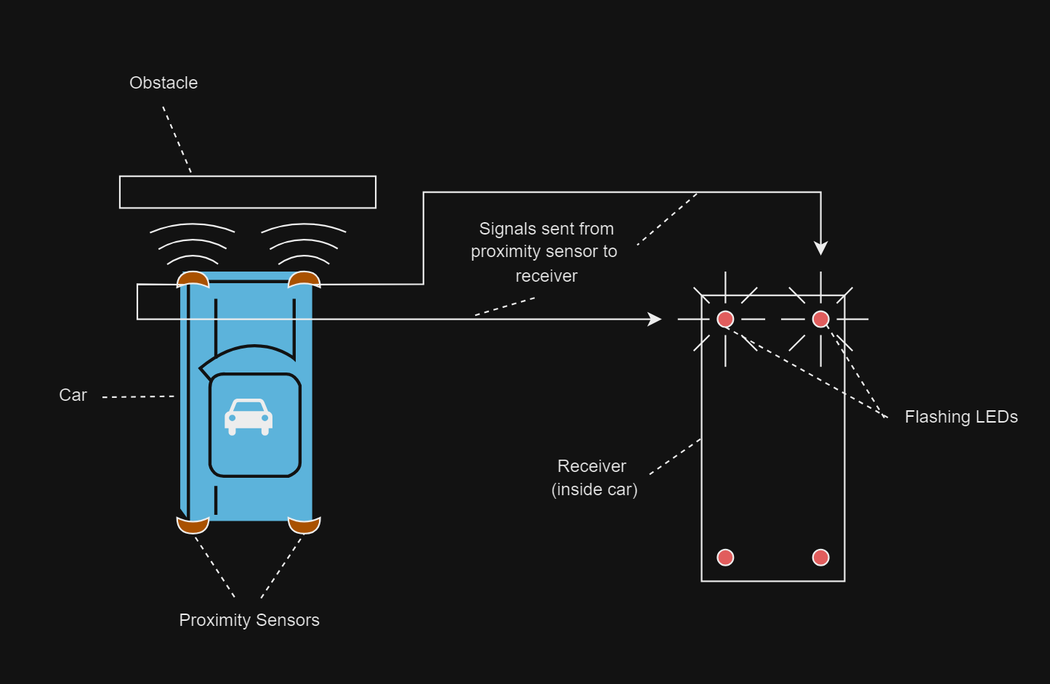
The Idea
CHART / GRAPH
ELECTRICAL & COMPUTER ENGINEERING
GRAINGER ENGINEERING
Notes:
Shrijan

Slide 6
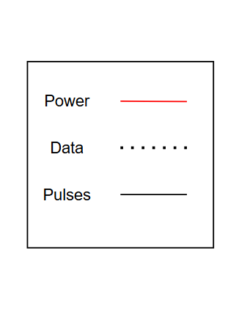
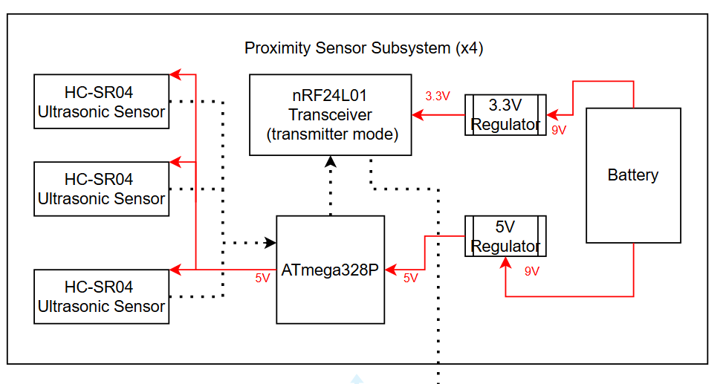
Block Diagram
ELECTRICAL & COMPUTER ENGINEERING
GRAINGER ENGINEERING
Notes:
Raunak

Slide 7
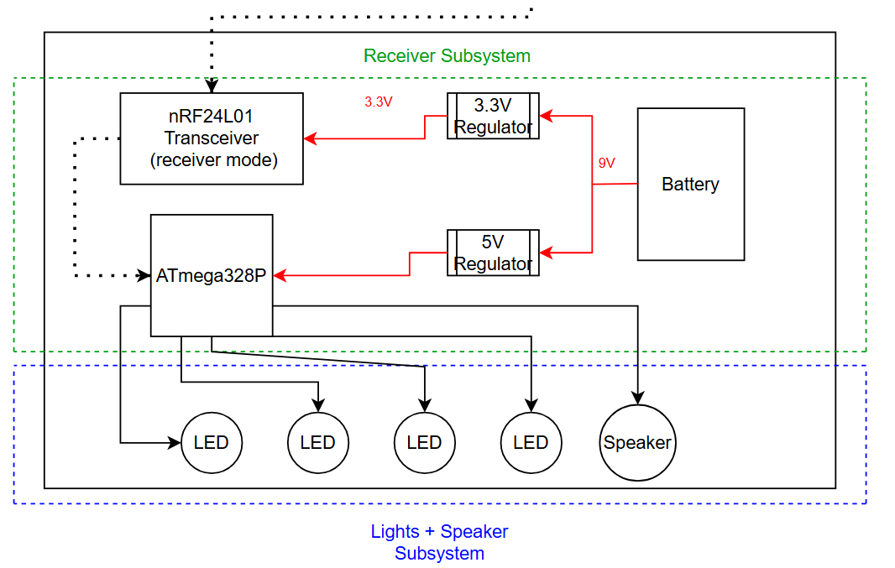
Block Diagram Cont.
ELECTRICAL & COMPUTER ENGINEERING
GRAINGER ENGINEERING
Notes:
Raunak

Slide 8
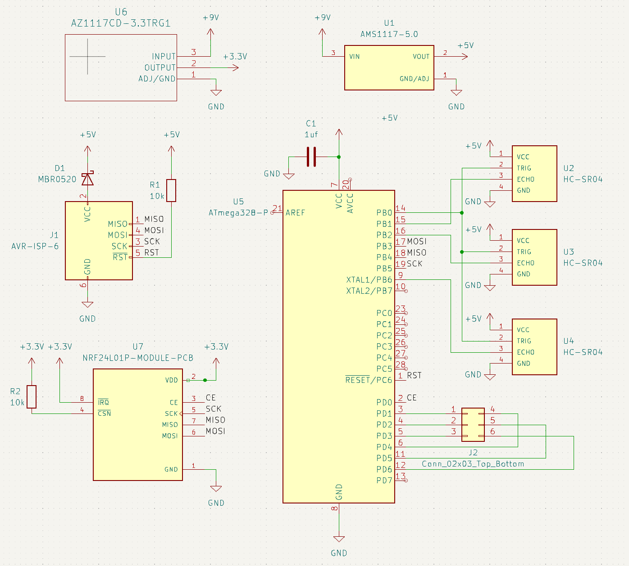
KiCad Schematic
Components
5 Volt Linear Regulator
3.3 Volt Linear Regulator
ATMega328P - AU (with external 16 MHz oscillator)
ISP Header
3x HC-SR04 Ultrasonic Sensor
nRF24L01 Transceiver
9V Battery
IMAGE / GRAPHIC
ELECTRICAL & COMPUTER ENGINEERING
GRAINGER ENGINEERING
Notes:
Shrijan

Slide 9
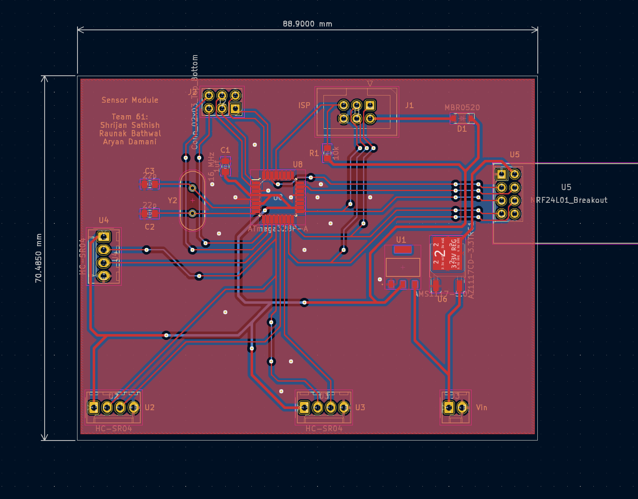
PCB Design
CHART / GRAPH
ELECTRICAL & COMPUTER ENGINEERING
GRAINGER ENGINEERING
Notes:
Shrijan

Slide 10
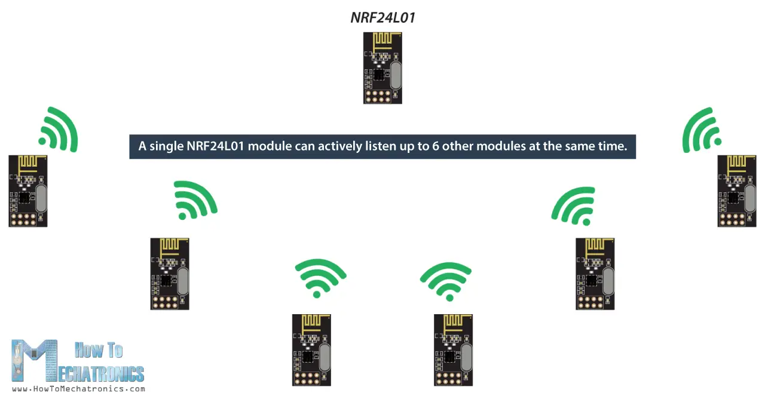
Transmitter/Receiver System
Components
NRF24L01 transceivers
2.4 GHz radio band
SPI Interface
Simultaneous listening
Latency of <10ms
Low cost (~$1 a piece)
IMAGE / GRAPHIC
ELECTRICAL & COMPUTER ENGINEERING
GRAINGER ENGINEERING
Notes:
Damani

Slide 11
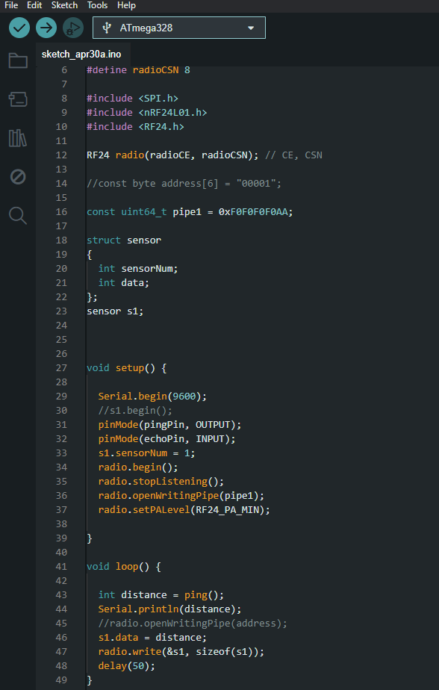
Software
~ 12 times/second
Constantly receiving data
Parsing the module tag and distance data
Enables LED/beep sequence
Distance threshold
Negligible processing time
ELECTRICAL & COMPUTER ENGINEERING
GRAINGER ENGINEERING
Notes:
Damani

Slide 12
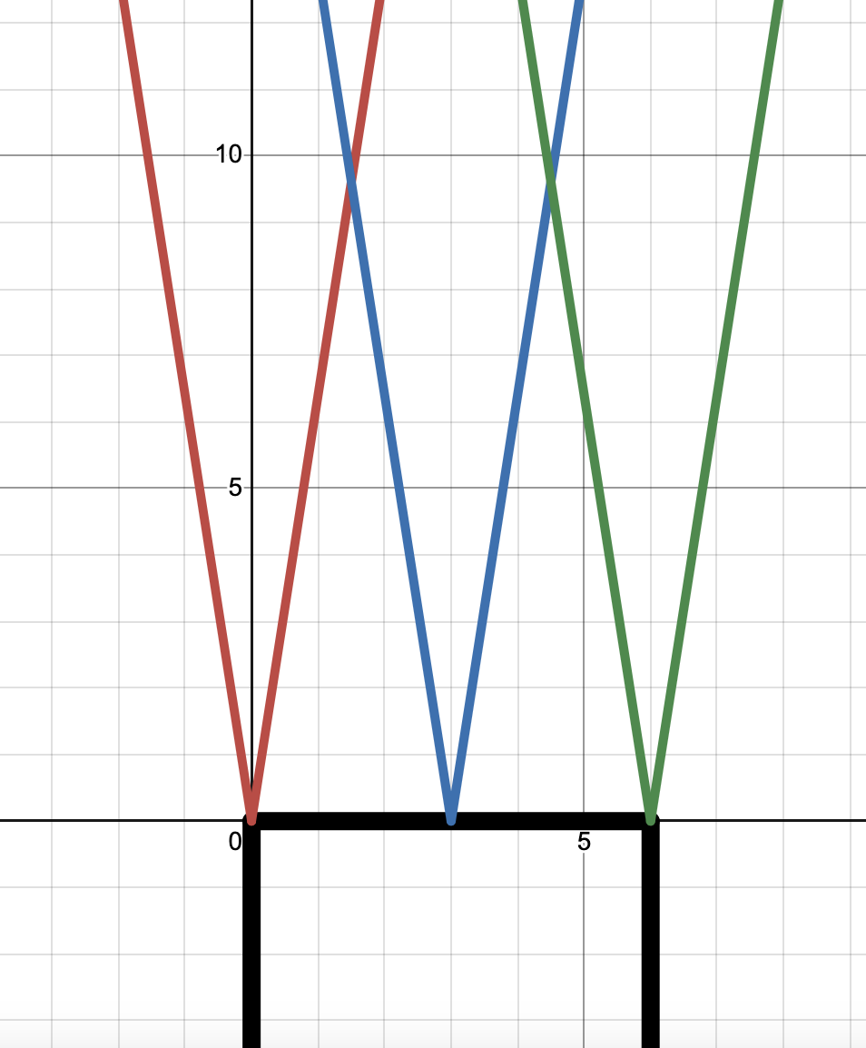
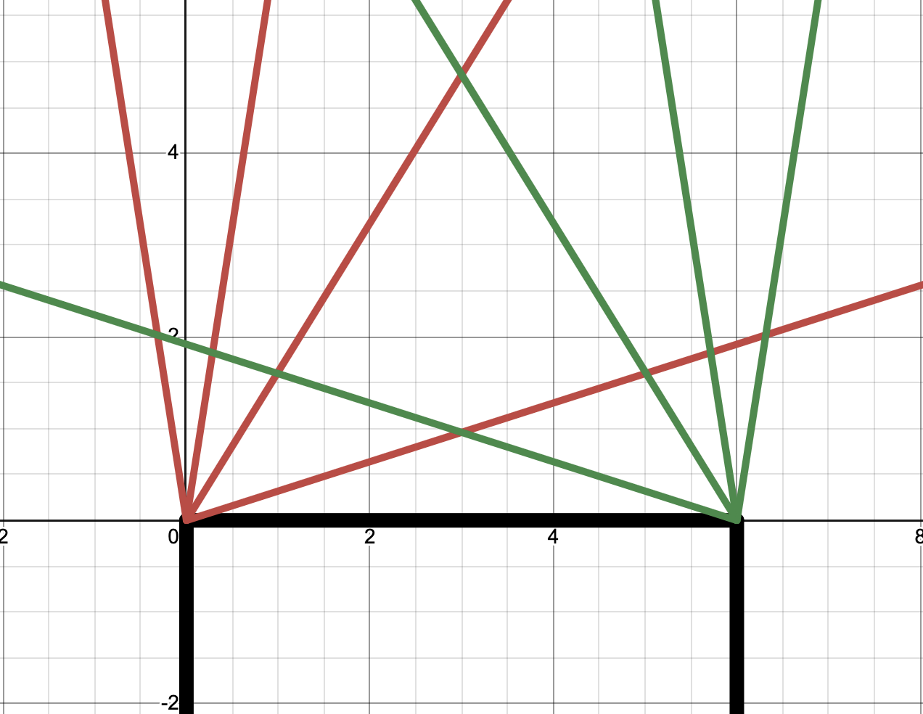
Physical Considerations
Supersonic sensors around 30 degree radius
Detection distance up to 3 feet
Dead space in between
ELECTRICAL & COMPUTER ENGINEERING
GRAINGER ENGINEERING
Notes:
Raunak

Slide 13
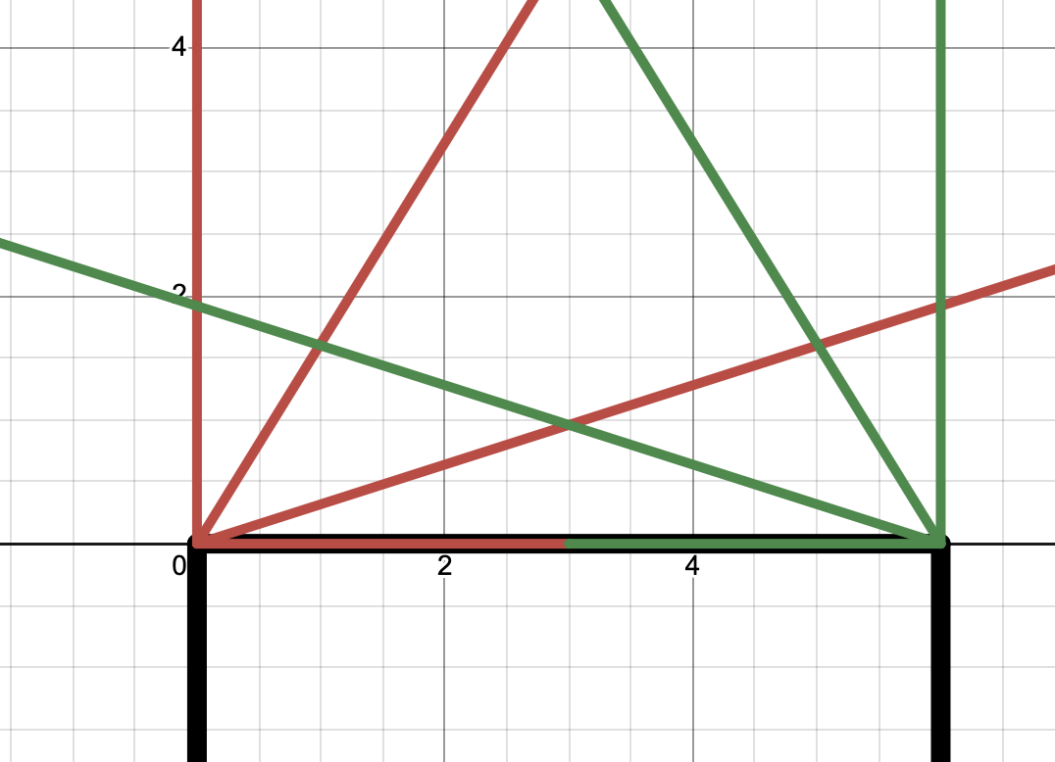
Final Physical Consideration
ELECTRICAL & COMPUTER ENGINEERING
GRAINGER ENGINEERING
Notes:
Raunak

Slide 14
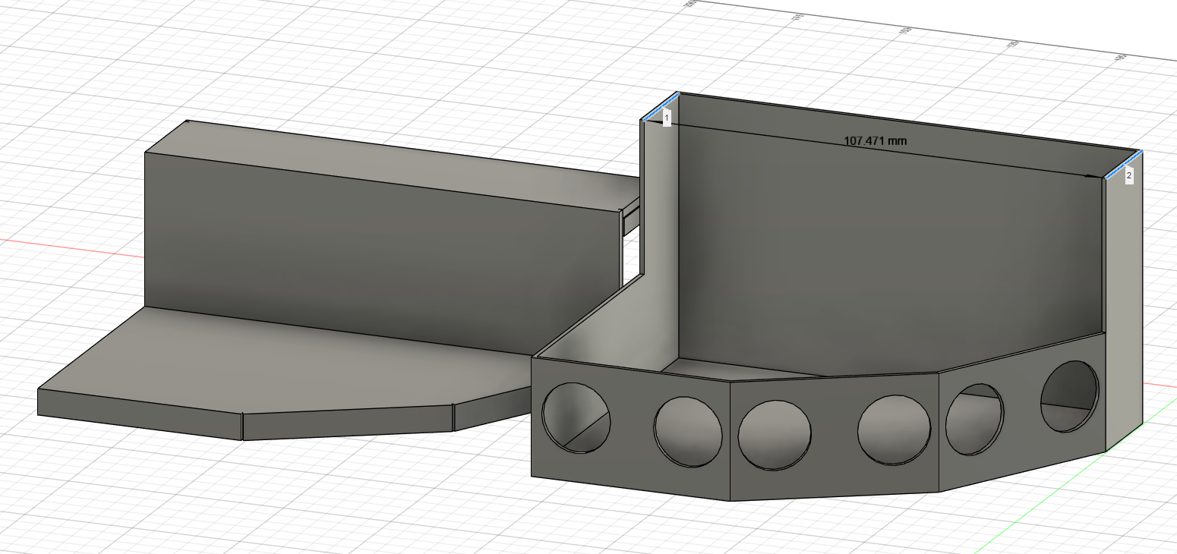
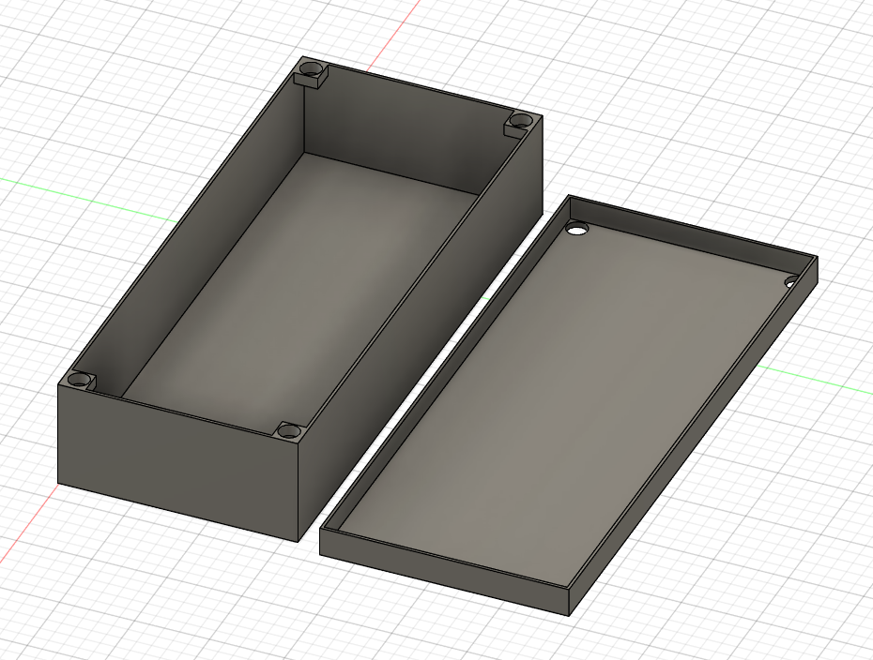
3D Modeling/Design
CADed Models
ELECTRICAL & COMPUTER ENGINEERING
GRAINGER ENGINEERING
Notes:
Raunak

Slide 15
Requirements and Verifications
 | Latency without Obstacles (ms) | Latency with Obstacles (ms)
 | 5 | 8
 | 6 | 9
 | 4 | 8
 | 5 | 7
 | 5 | 6
 | 6 | 8
 | 5 | 8
 | 4 | 9
 | 6 | 9
 | 5 | 8
Average (1000 tries) | 5 | 8
Subsystem 1: Proximity Sensor (x4)
Requirements
It must be able to consistently update the receiver module about distance from obstacles and delay between sensor and receiver is minimal (less than human perceivable)
Verification
We will record the output from the receiver module while we put on object in front of the sensor and detect the delay continuously over 10 minutes, with an alert that triggers if the delay is over 50 ms at any time.
ELECTRICAL & COMPUTER ENGINEERING
GRAINGER ENGINEERING
Notes:
Shrijan

Slide 16
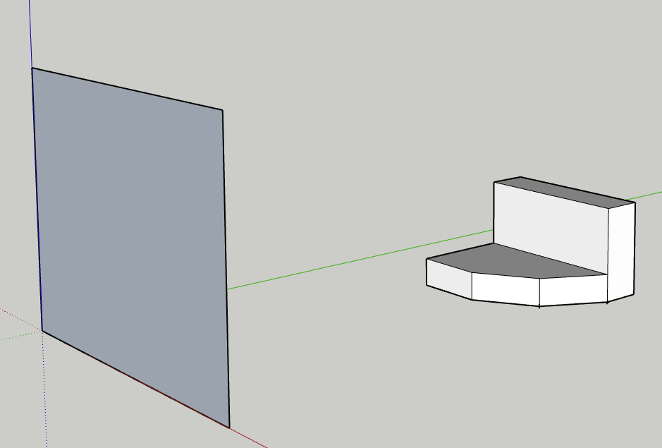
Requirements and Verifications
Subsystem 1: Proximity Sensor (x4)
Requirements | Verification
The proximity sensor must be able to detect objects that come within 0-3 feet of the car continuously. | We will place an object 3 feet away and record the output from the sensor to see if it is detected.
ELECTRICAL & COMPUTER ENGINEERING
GRAINGER ENGINEERING
Notes:
Shrijan

Slide 17
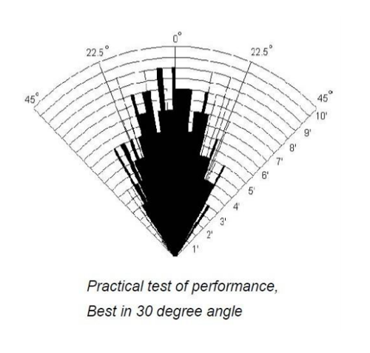
Requirements and Verifications
Subsystem 1: Proximity Sensor (x4)
Verified by holding object 1ft(30cm) in
front of sensor at various angles
Requirements | Verification
Sensor reading is continuous, and is able to detect within ~15 degrees on each side of the sensor, horizontally and vertically | We will place an object 15 degrees from the center of each sensor and record the output from the sensor to see if it is detected.
Angle (deg) | Distance Measured (cm)
-15 | 28
-10 | 29
-5 | 29
0 | 30
5 | 29
10 | 29
15 | 28
Average | 28.85714286
ELECTRICAL & COMPUTER ENGINEERING
GRAINGER ENGINEERING
Notes:
Damani

Slide 18
Requirements and Verifications
Actual Distance (cm) | Measured Distance (cm) | Measured - Actual
5 | 6 | -1
10 | 12 | -2
15 | 17 | -2
20 | 21 | -1
25 | 26 | -1
30 | 32 | -2
35 | 36 | -1
40 | 41 | -1
45 | 47 | -2
50 | 54 | -4
55 | 58 | -3
60 | 65 | -5
 |  | -2.083333333
Subsystem 2: Receiver
Requirements
The receiver inside the car must be able to receive signals from the proximity sensor consistently and update the microcontroller with the new data
Verification
We will test in 2 conditions: open air and through the car. In either condition, the receiver must print the correct data from the sensor subsystem to the console. This will be done by holding an object at a known distance away from the sensor, and making sure this same distance is received at this subsystem.
Average Difference (60 tries): | -4.733333333
ELECTRICAL & COMPUTER ENGINEERING
GRAINGER ENGINEERING
Notes:
Raunak

Slide 19
Requirements and Verifications
Subsystem 2: Receiver
Requirements | Verification
The receiver must be able to discern between the different sensors located around the car | We will hold an object in front of each sensor’s detectable range, one at a time in order to set up this verification. Then, using print to console messages, the receiver must accurately state from which sensor it is receiving data.
ELECTRICAL & COMPUTER ENGINEERING
GRAINGER ENGINEERING
Notes:
Raunak

Slide 20
Requirements and Verifications
Subsystem 3: Lights + Speaker
Requirements | Verification
The LED on each corner (four total) must light up with its corresponding proximity sensor as a visual cue to the user | The four sensors will be placed in the same orientation as they would be on a car. Then, an object will be held in the detectable range of each sensor, one at a time. This should light up the corresponding LED in this subsystem.
ELECTRICAL & COMPUTER ENGINEERING
GRAINGER ENGINEERING
Notes:
Damani

Slide 21
Requirements and Verifications
Subsystem 3: Lights + Speaker
Requirements | Verification
There must be audible and increased frequency beeps as the car gets increasingly closer to an obstacle, giving an audio cue for distance | An object will first be held at a non-detectable distance threshold, and slowly move towards the sensors. At the same time, the speaker must produce beeps at a higher frequency, starting at 1Hz when first detected and increasing to a single tone when right in front of the sensor.
ELECTRICAL & COMPUTER ENGINEERING
GRAINGER ENGINEERING
Notes:
Damani

Slide 22
Successes and Challenges
Successes | Challenges
PCB could be programmed and sensor was able to collect data Multiple transmitters to a single receiver Relatively accurate distance measures Object detection and notification system (lights + speaker) | Transceiver on PCB did not work when testing Had to switch to using arduinos within modules Sensors cannot detect through screens Bulky/many wires
ELECTRICAL & COMPUTER ENGINEERING
GRAINGER ENGINEERING
Notes:
Damani

Slide 23
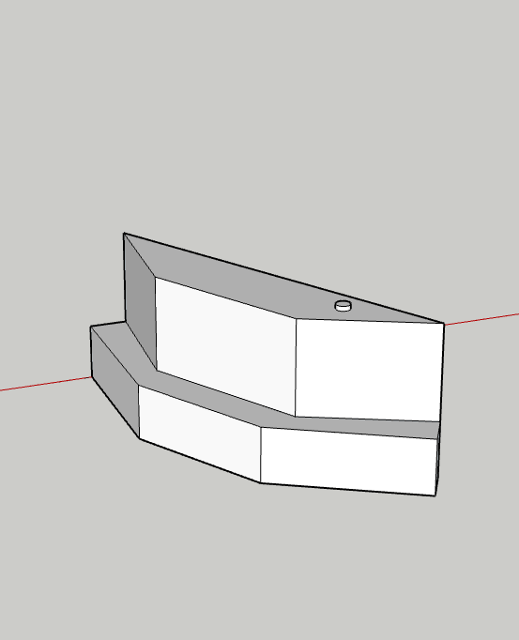
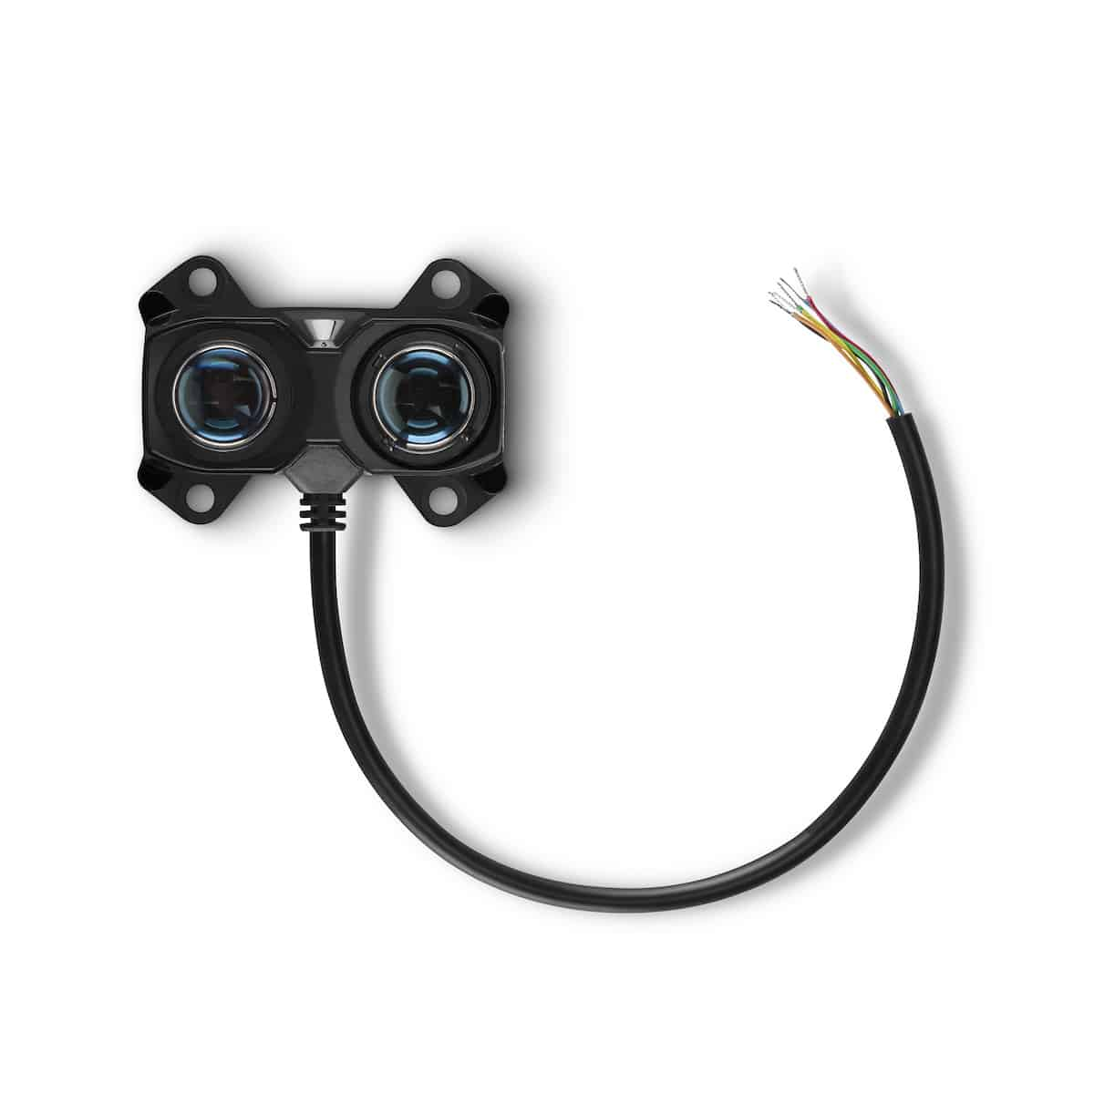
Future Work
Use Lidar
Accuracy
Enclosure
Smaller Form factor
Easier mounting
Wind resistance
Smarter algorithm to throw out outliers
Remove sensor error
Power switches
Convenience
Safety
ELECTRICAL & COMPUTER ENGINEERING
GRAINGER ENGINEERING
Notes:
Shrijan

Slide 24
Thank You!
ELECTRICAL & COMPUTER ENGINEERING
GRAINGER ENGINEERING

