Slide 1

ECE 101, Lecture 2:
History, Map, and Keywords in Computing
Romit Roy Choudhury, Steve Lumetta, Abrita Chakravarty

Slide 2
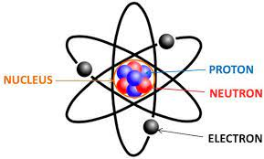
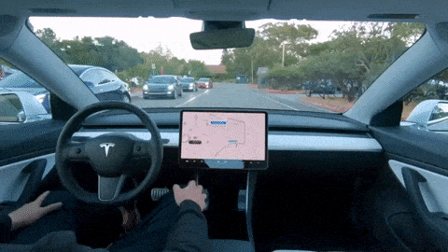
History, Map, and Keywords in Computing
Time
We will travel through time:
Starting from electricity and signals to today’s self driving cars …
Our goal is to get a bird’s eye-view of the whole course

Slide 3
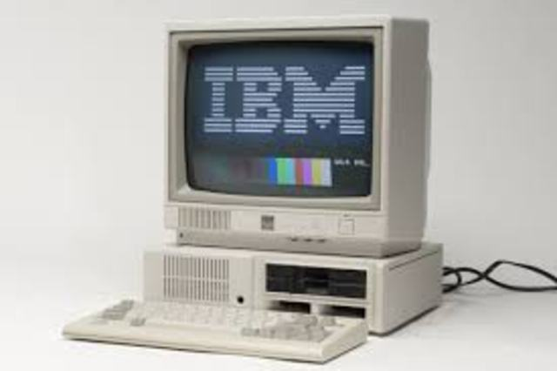
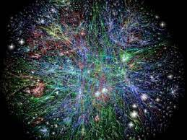
History, Map, and Keywords in Computing
Time
We will travel through time:
Starting from electricity and signals to today’s self driving cars …
Our goal is to get a bird’s eye-view of the whole course
We will meet the computer and the Internet …
And many other important milestones in the path
So, let’s get started.

Slide 4
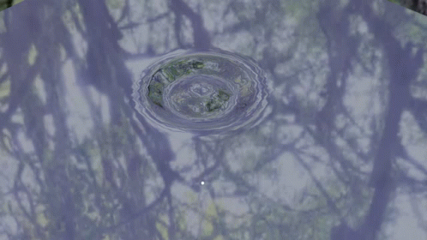
Time
Time
Energy can be thought of traveling as waves - like ripples on water
When you speak, your throat creates such ripples in the air
  Your ear senses the air vibrations (your ear-hairs vibrate)
  They in turn create another form of waves in your nerves
  These are electro-magnetic signals that reaches your brain
  You brain interprets the electricity as sound and speech

Slide 5
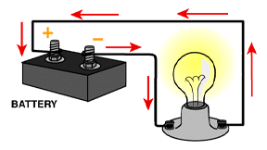
Time
Time
Energy can be thought of traveling as waves - like ripples on water
When you speak, your throat creates such ripples in the air
  Your ear senses the air vibrations (your ear-hairs vibrate)
  They in turn create another form of waves in your nerves
  These are electro-magnetic signals that reaches your brain
  You brain interprets the electricity as sound and speech
You know about electricity flowing through wires …
Turns on light bulbs or charge your phones
Electricity flowing through electronic devices called electrical signals

Slide 6
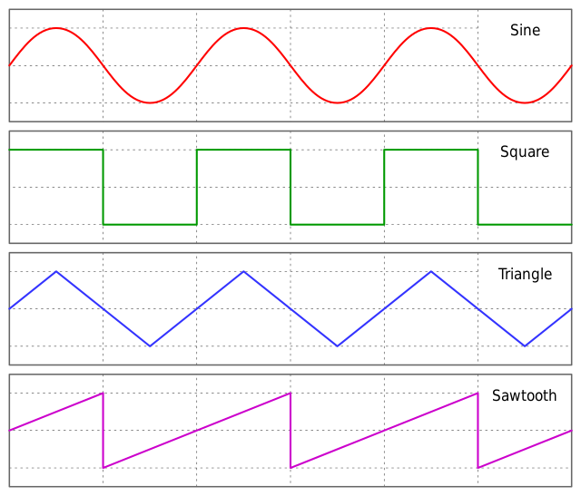
Time
Time
Energy can be thought of traveling as waves - like ripples on water
When you speak, your throat creates such ripples in the air
  Your ear senses the air vibrations (your ear-hairs vibrate)
  They in turn create another form of waves in your nerves
  These are electro-magnetic signals that reaches your brain
  You brain interprets the electricity as sound and speech
You know about electricity flowing through wires …
Turns on light bulbs or charge your phones
Electricity flowing through electronic devices called electrical signals
Henceforth, when we think of signals, let’s picture this:

Slide 7
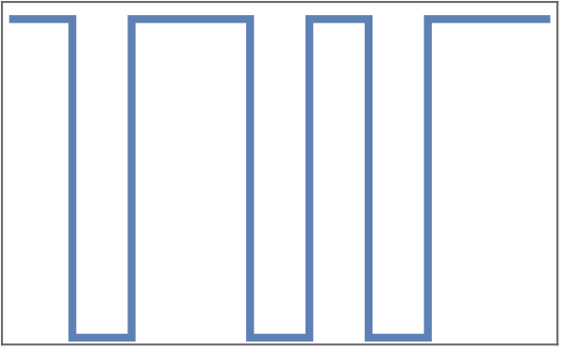
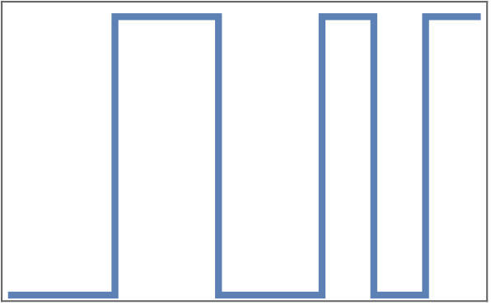
From lecture #1, we wanted to express information as bits
We understand the concept of bits … but how do we physically realize them?
So here is one idea:
Let’s express bits through signals
Specifically:
To represent bit = 1 … let signal be HIGH
To represent bit = 0 … let signal be LOW
- So, now let’s transmit the bit sequence: 1 0 1 1 0 1 0 1 1 1
Now suppose someone sends you this signal.
What bit sequence is she communicating to you?
Communicated bit sequence = 0 0 1 1 0 0 1 0 1

Slide 8
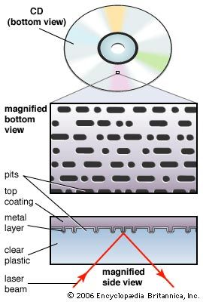
I know how to send bits … but where do I store them?
How about find some natural persisting shape that can be modified
  Pretend some shape is Bit=0 and the modified shape is Bit=1
Store the full bit sequence by modifying the natural shape
That means you have “bit memory”

Slide 9
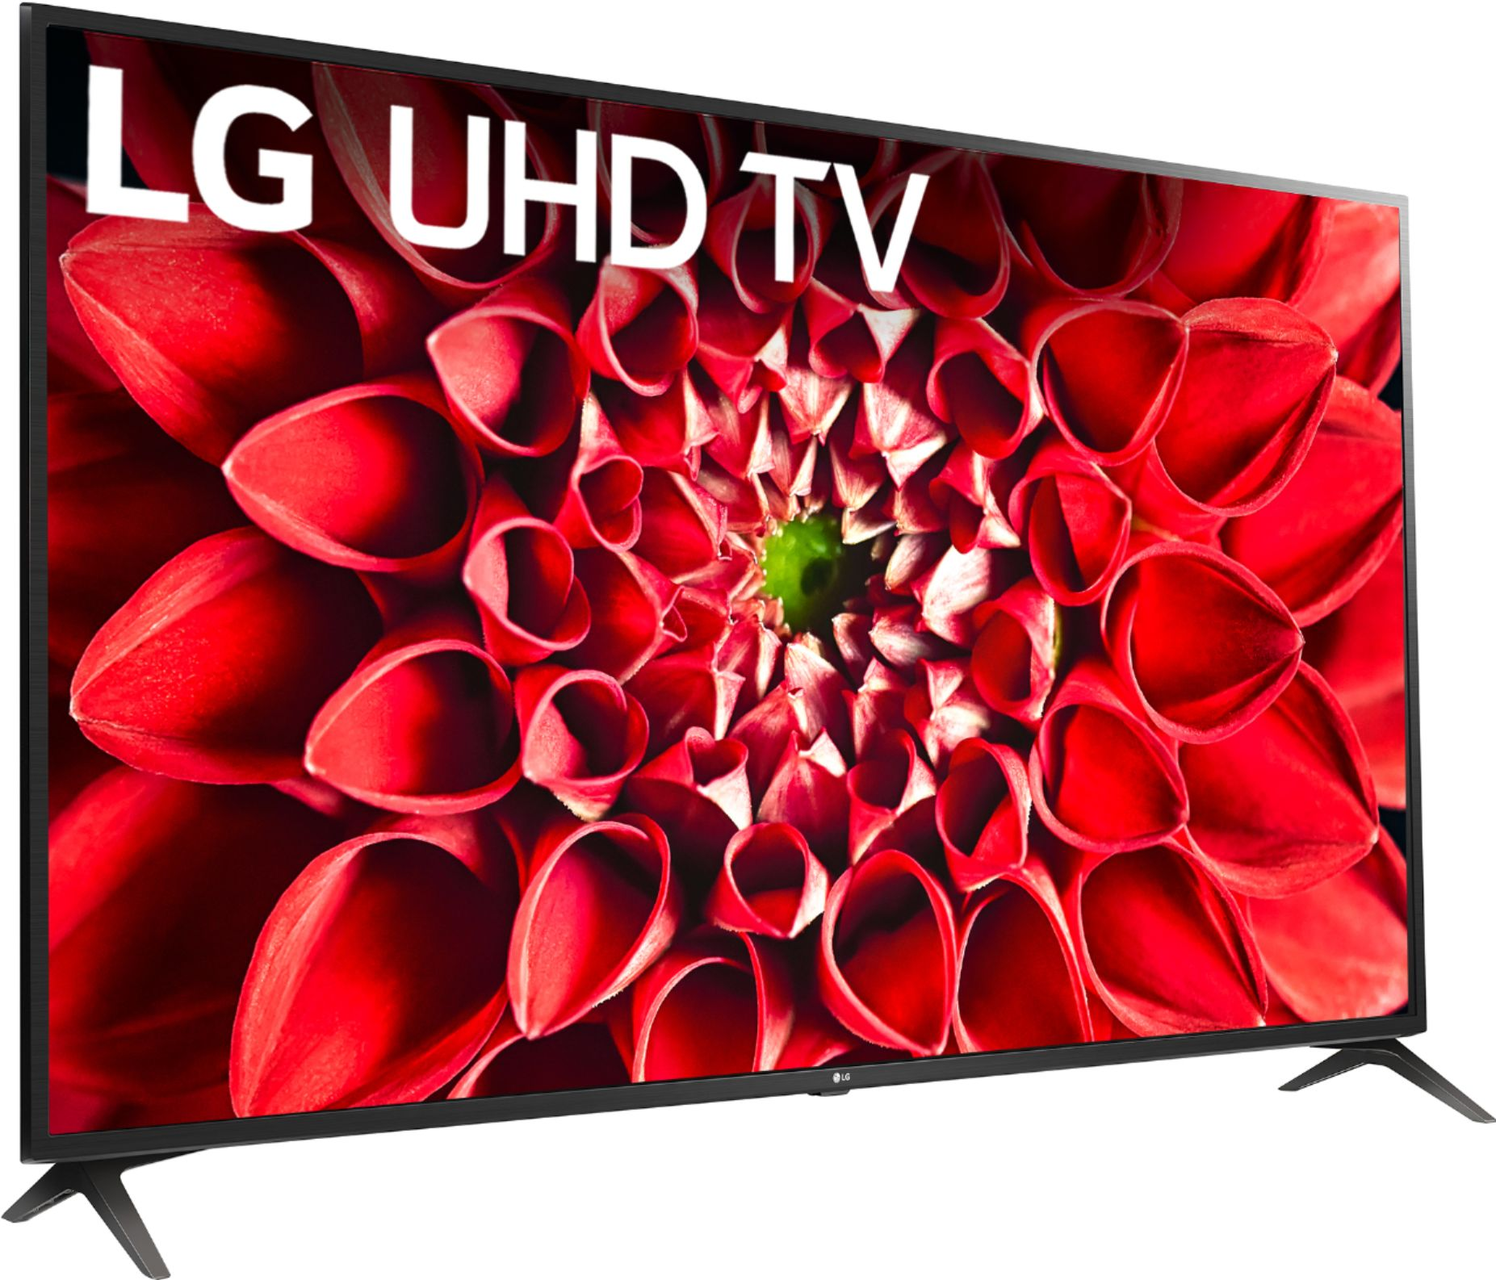
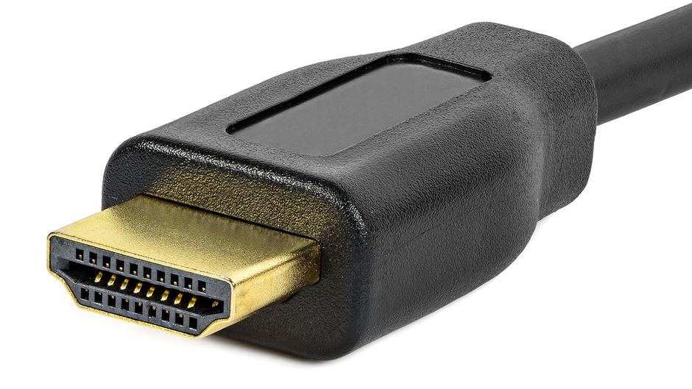

I know how to send bits … but where do I store them?
How about find some natural persisting shape that can be modified
  Pretend some shape is Bit=0 and the modified shape is Bit=1
Store the full bit sequence by modifying the natural shape
That means you have “bit memory”
Communicated bit sequence = 0011010011

Slide 10
Communicated bit sequence = 0011010011
But how does the TV know what to do with the received bits?
That is, where are the instructions (like, when this happens, do this, else that)

Slide 11
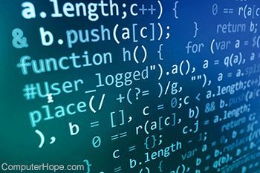
Communicated bit sequence = 0011010011
But how does the TV know what to do with the received bits?
That is, where are the instructions (like, when this happens, do this, else that)
Instructions (aka code)
can also be expressed in bits … and stored in
TVs … and this code can receive bits of data
and display on screen
Digital
Revolution

Slide 12
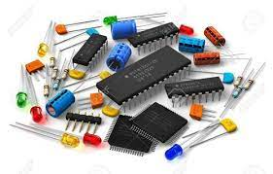
Time
Signals → bits → memory → code
Digital Revolution

Slide 13
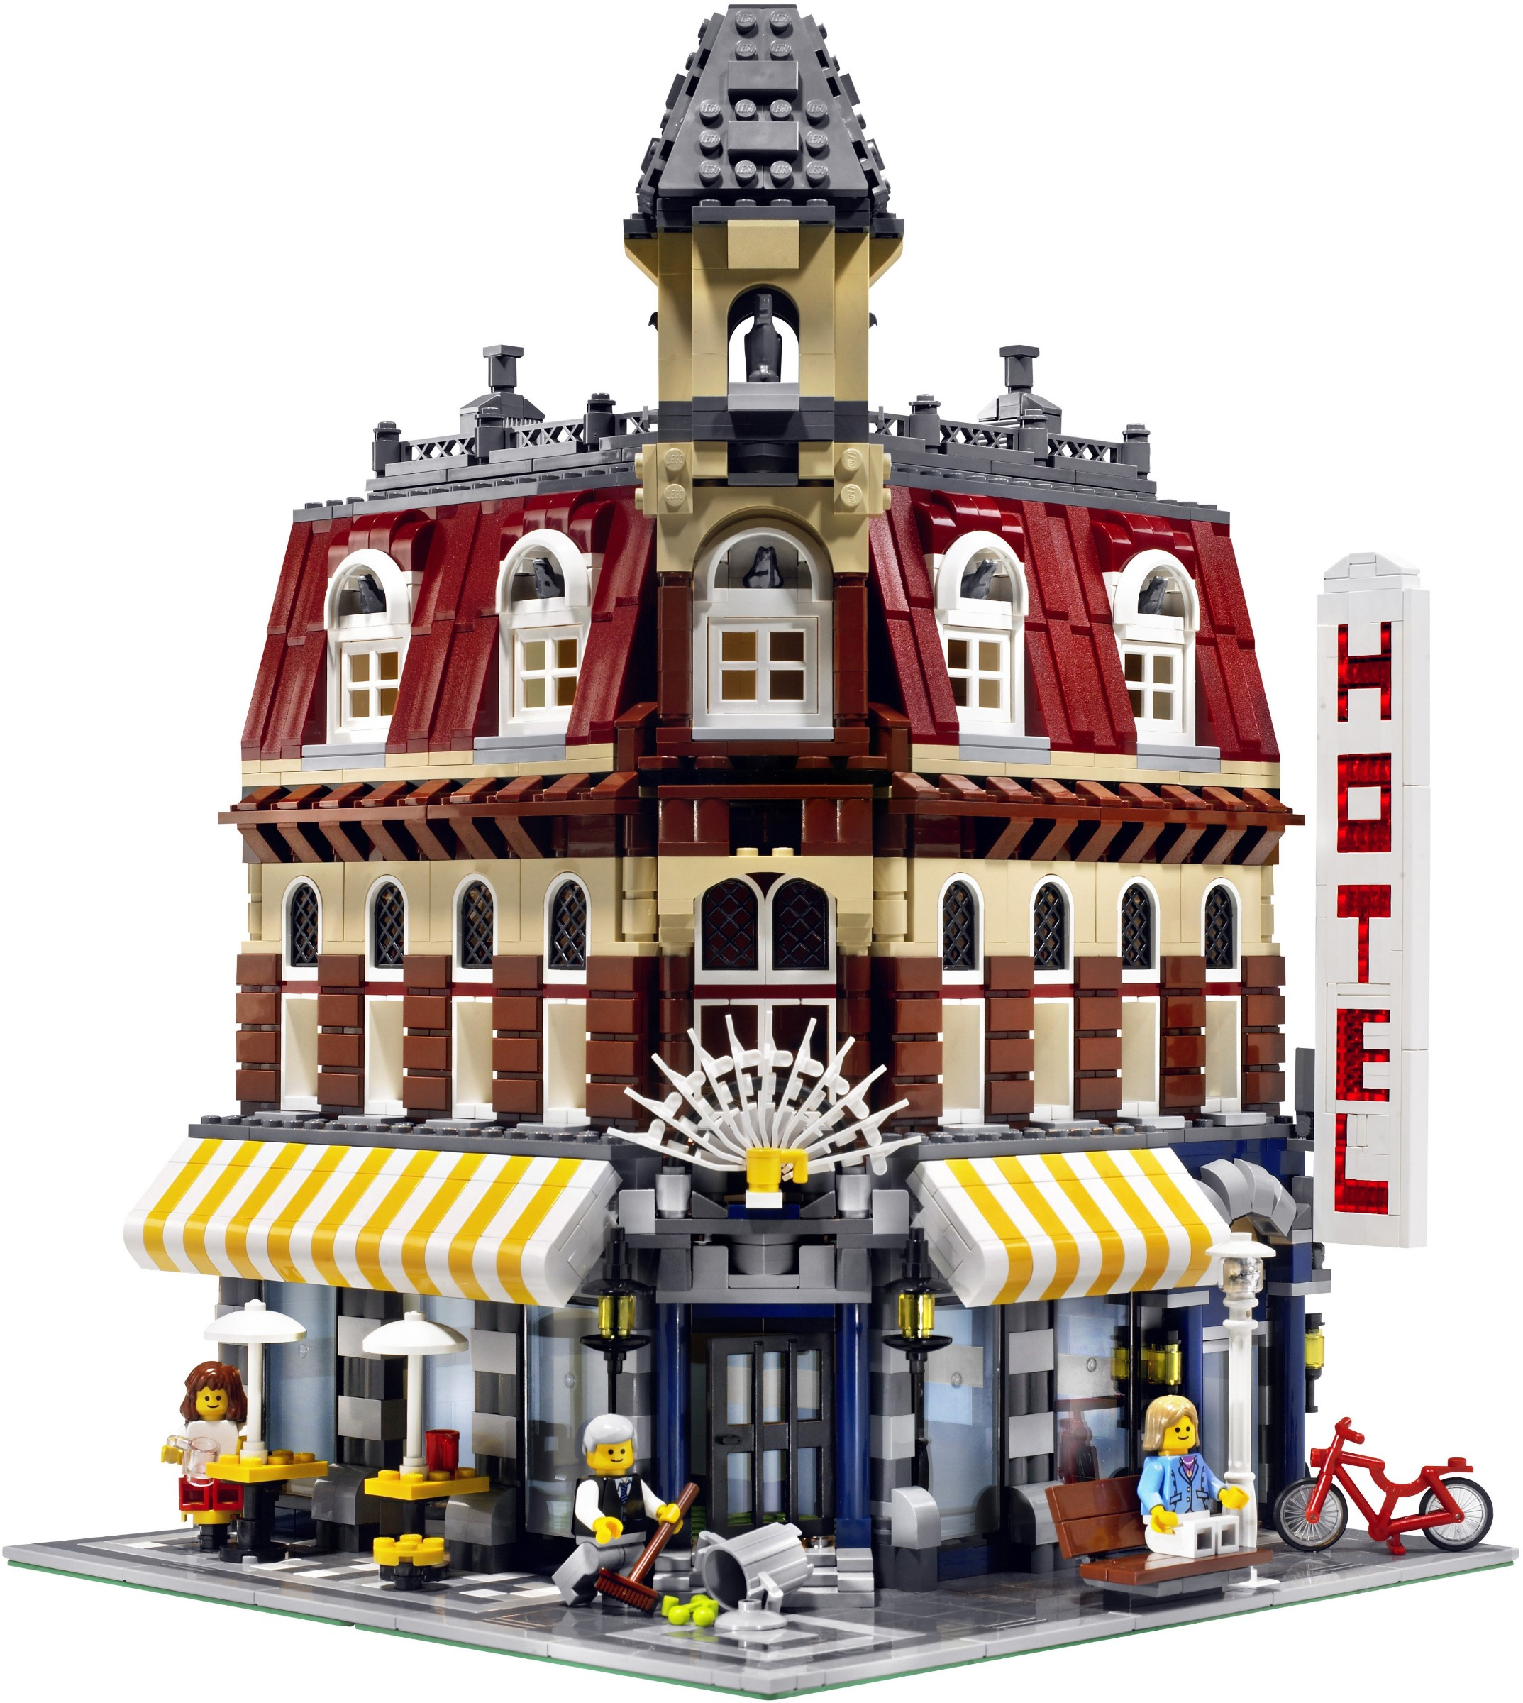
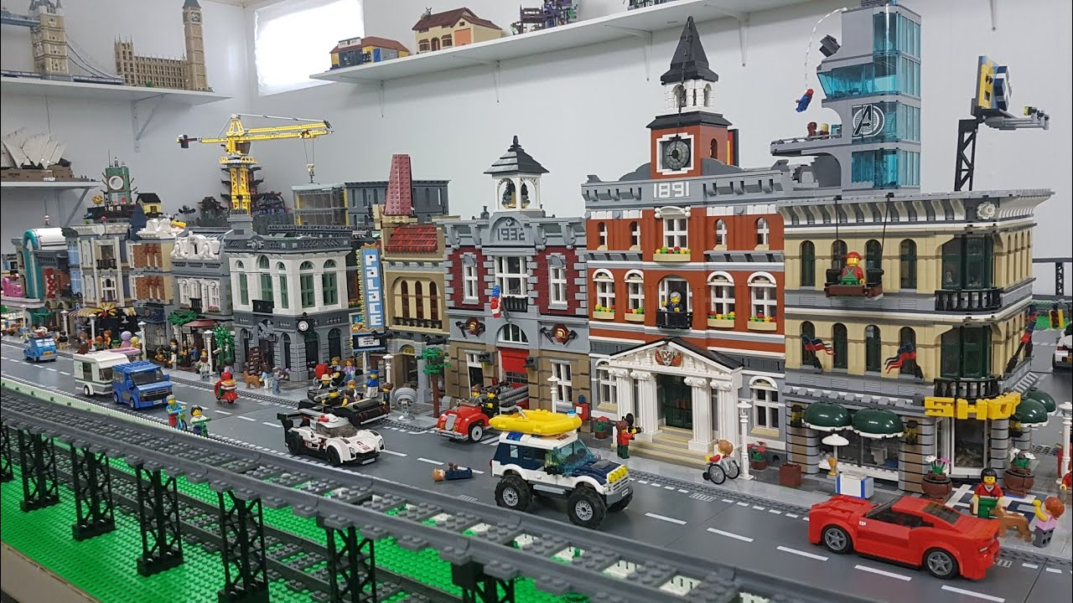
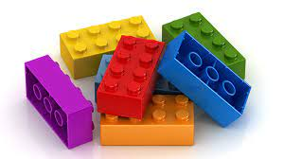
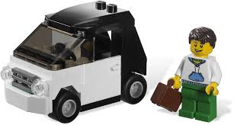
Time
Signals → bits → memory → code
Digital Revolution
Lego building blocks

Slide 14
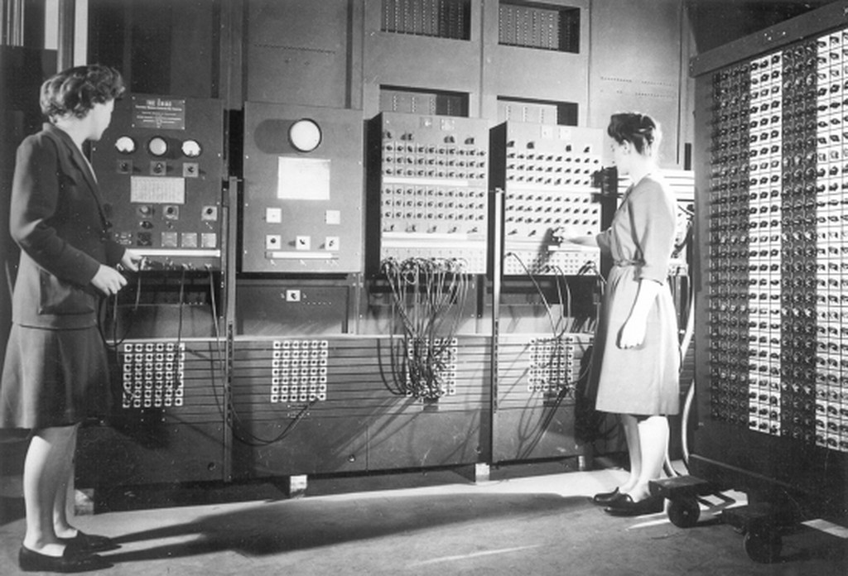
Time
1940s
Electricity
Electronics
The Electronic Numerical Integrator and Computer (ENIAC)

Slide 15
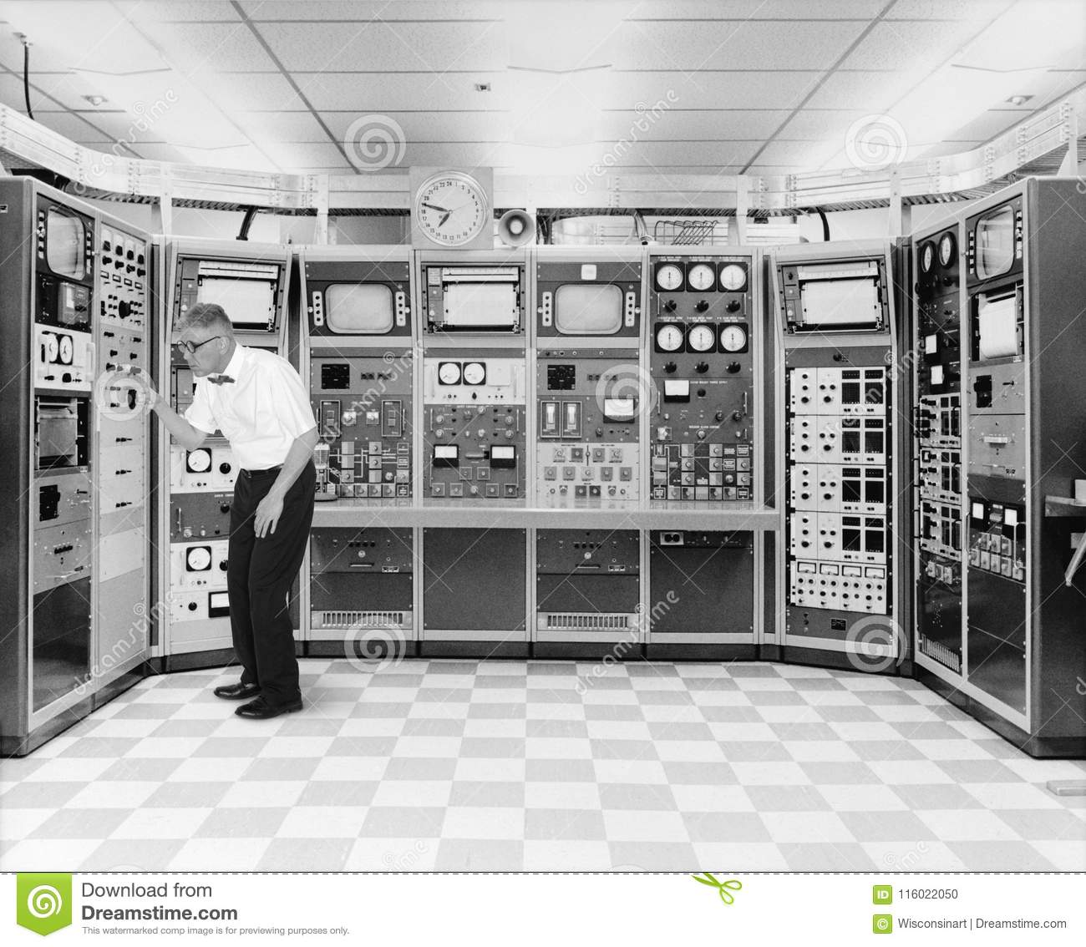
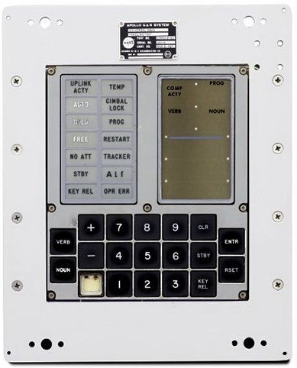
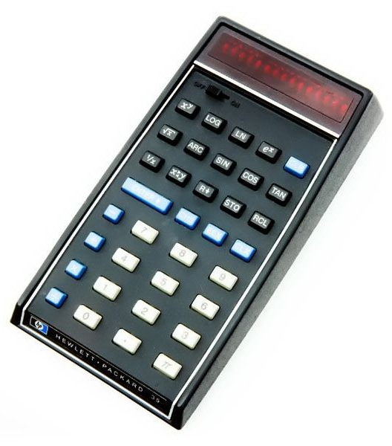
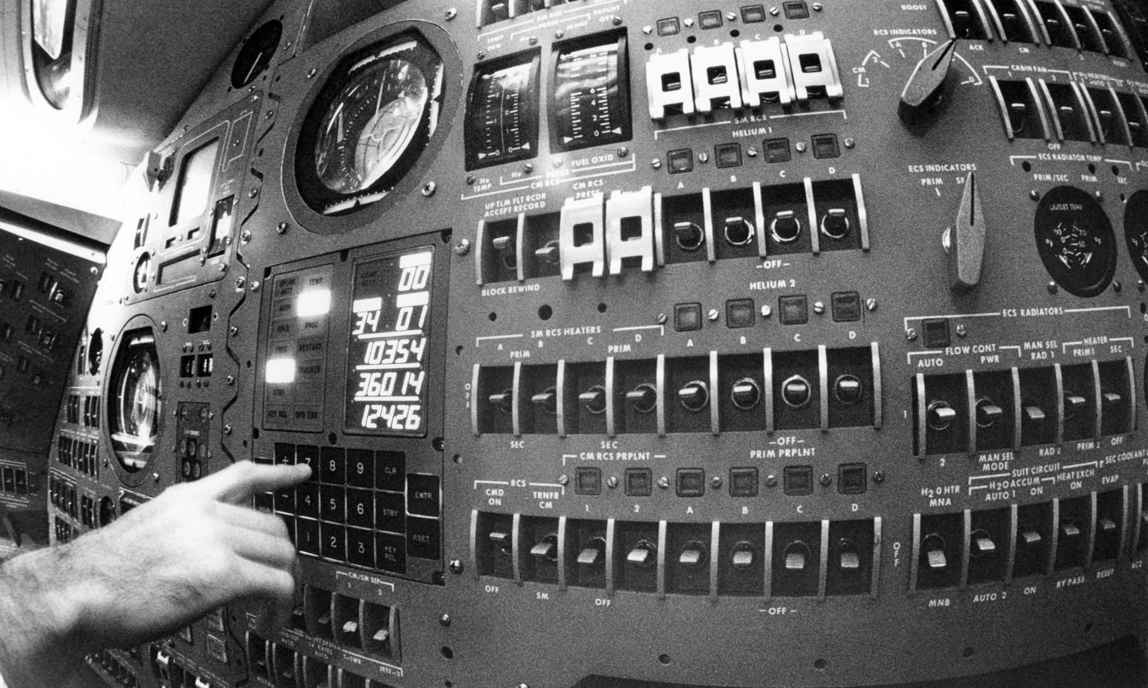
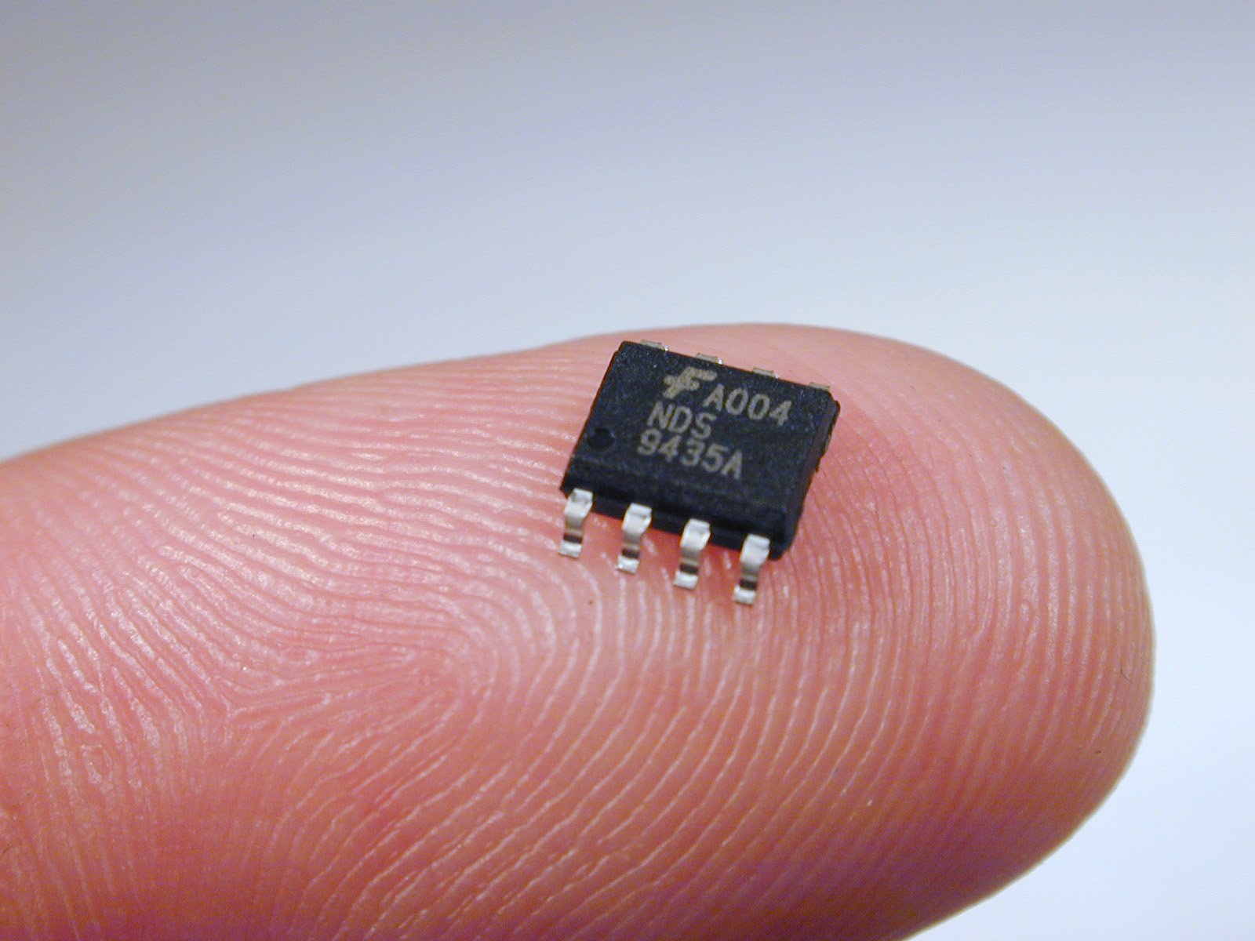
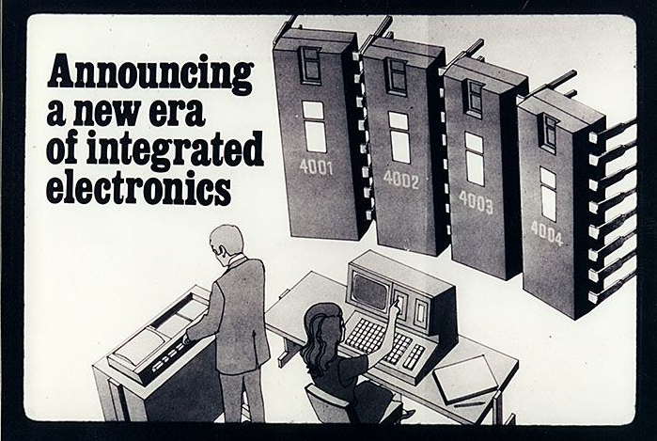
Time
1960s
1970s
Electricity
1940s
Electronics
Main frame computers
(size of a room) with punch cards
Miniaturization into integrated chips:
Very Large Scale Integration (VLSI)
1980s
Apollo guidance computer

Slide 16
Time
Electricity
Electronics
Main frame computers
Apollo guidance computer
Very Large Scale Integration (VLSI)

Slide 17
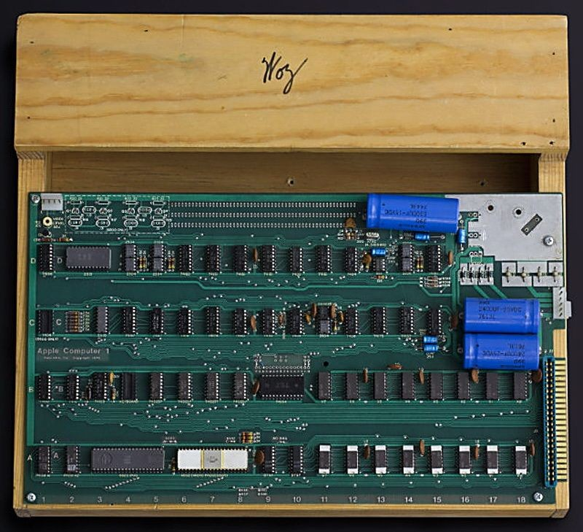
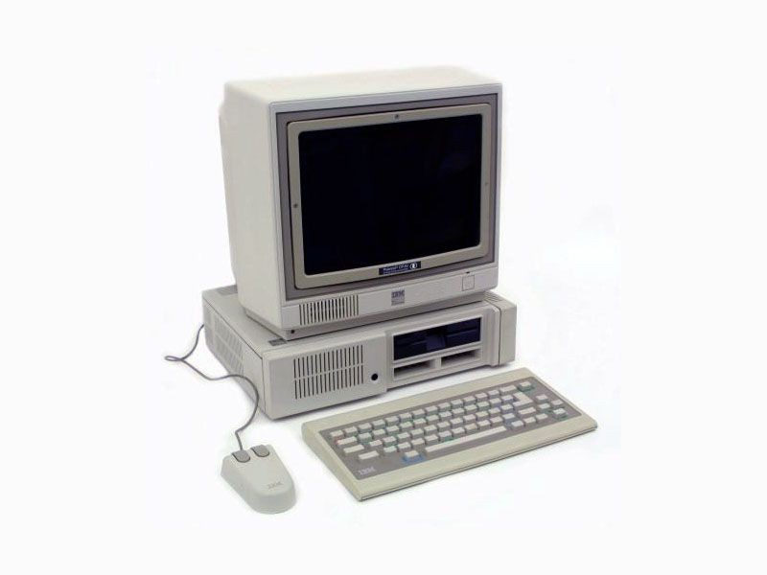
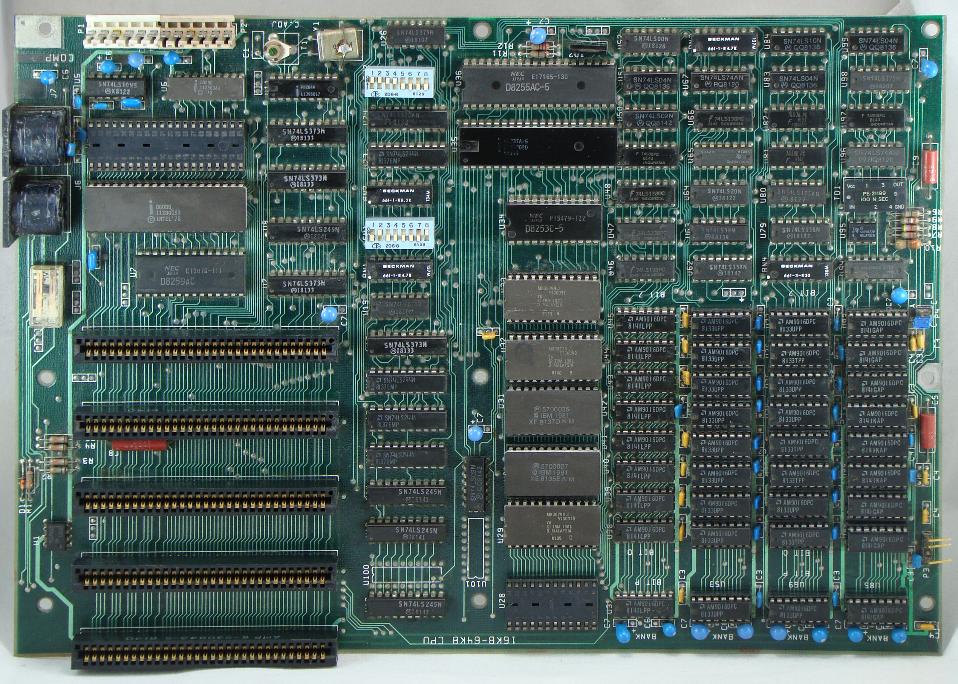
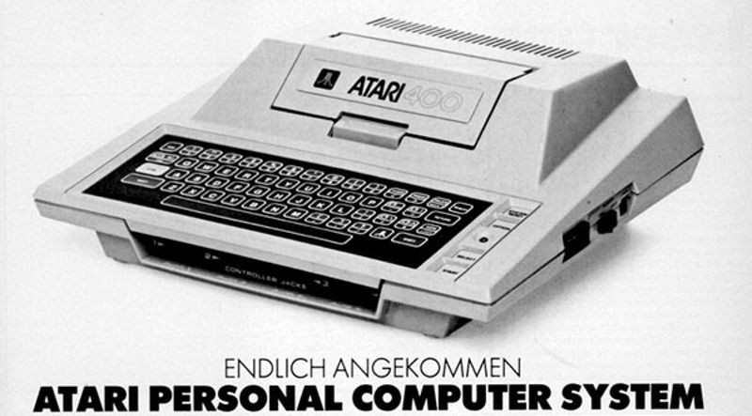
Time
Electricity
Electronics
VLSI
Main frames
Personal
Computers (PCs)

Slide 18
Time
Electricity
Electronics
VLSI
PC
Main frames

Slide 19
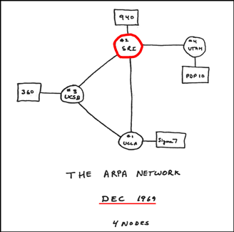
Time
While all this was happening, in parallel, humans
started thinking about connecting computers
Electricity
Electronics
VLSI
PC
Main frames

Slide 20
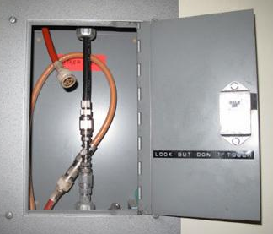
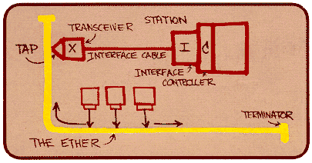
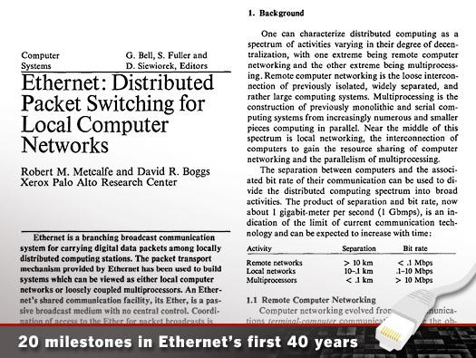
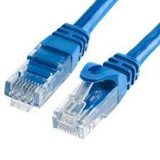
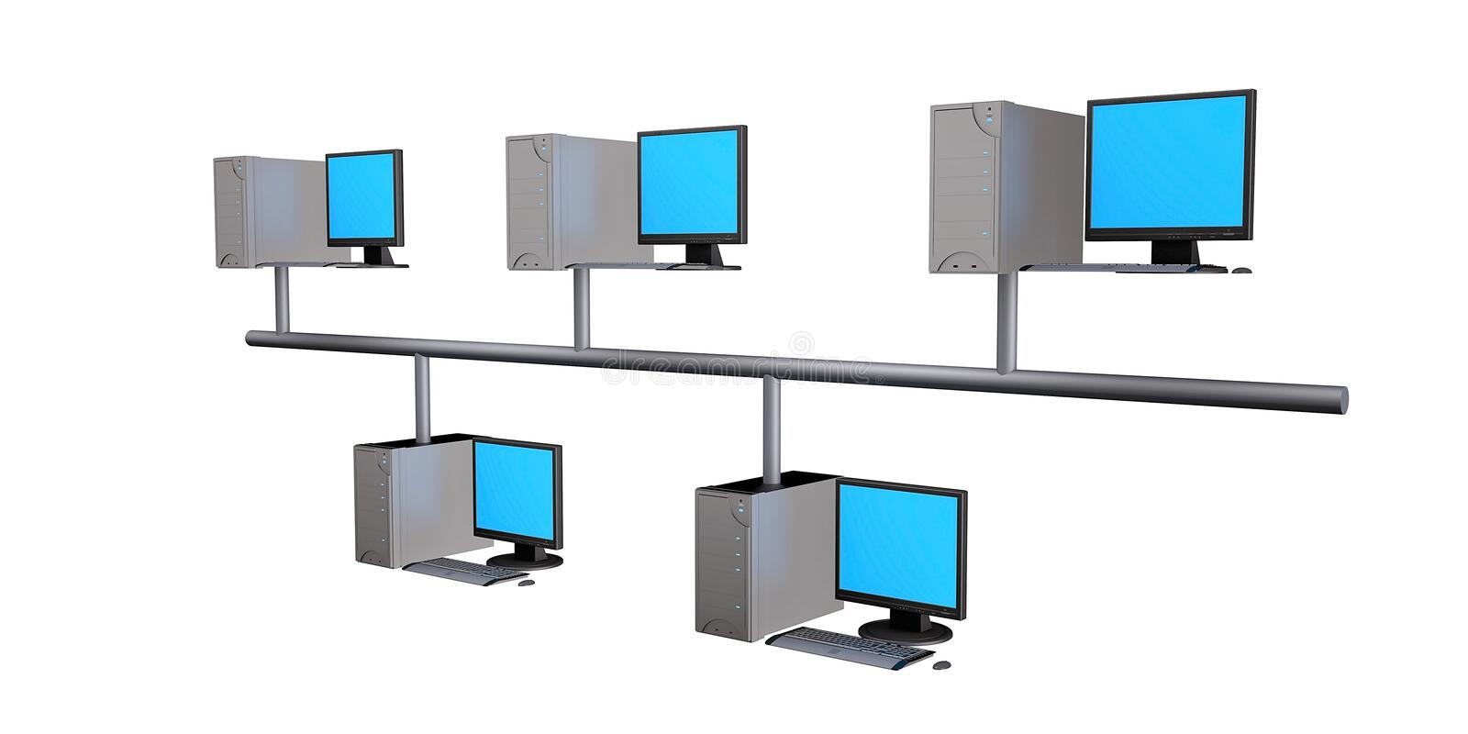
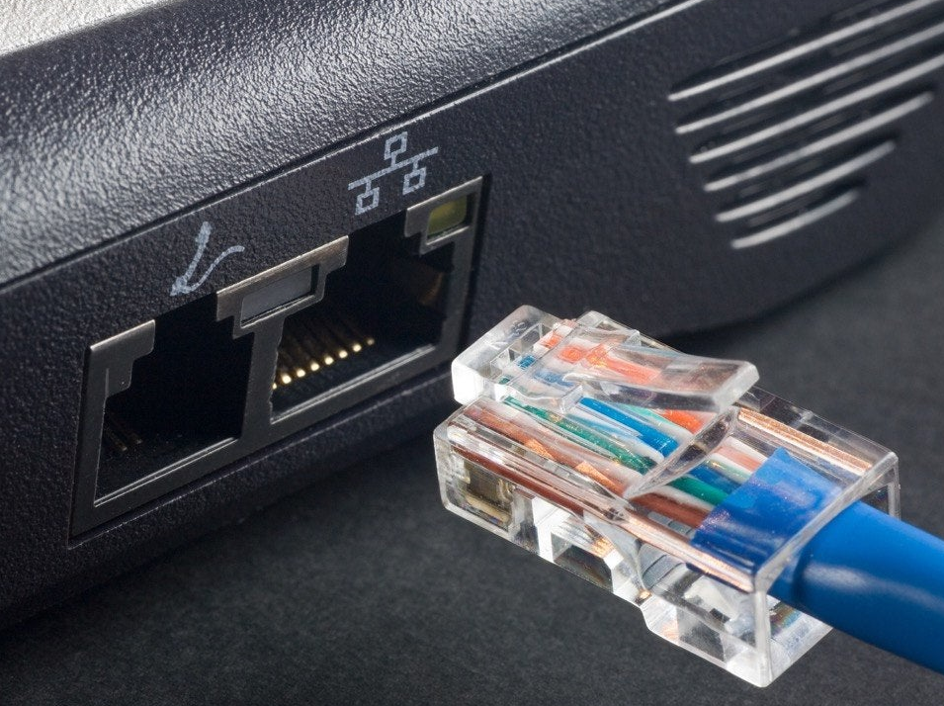
While all this was happening, in parallel, humans
started thinking about connecting computers
Ethernet: Connecting computers via wires
1976
Channel or medium and access control
The idea of protocols/code for communication

Slide 21
But why stop at connecting few computers in a lab?
While all this was happening, in parallel, humans
started thinking about connecting computers
Ethernet: Connecting computers via wires
1976
Channel or medium and access control
The idea of protocols/code for communication

Slide 22
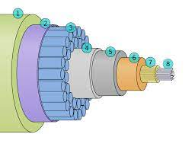
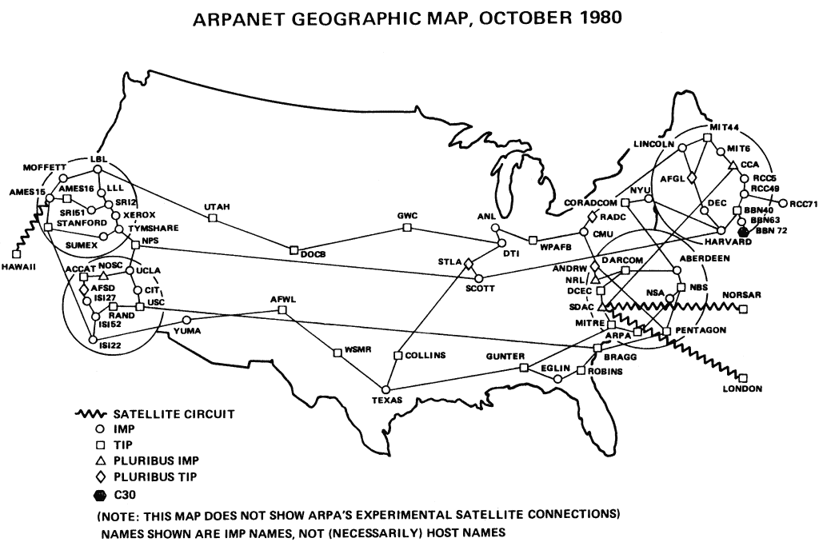
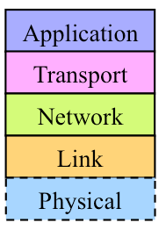
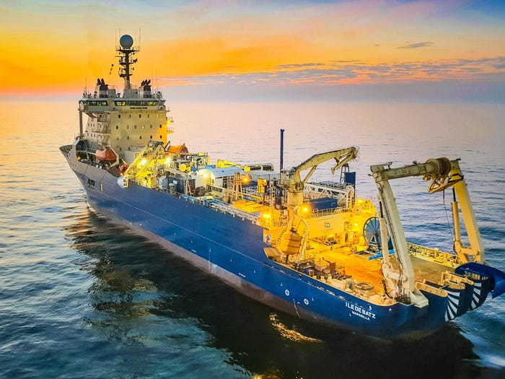
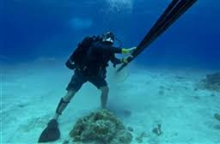
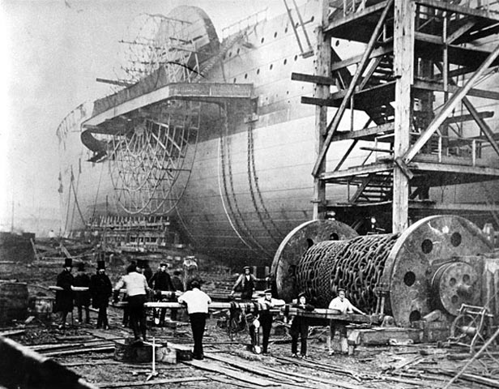
But why stop at connecting few computers in a lab?

Slide 23
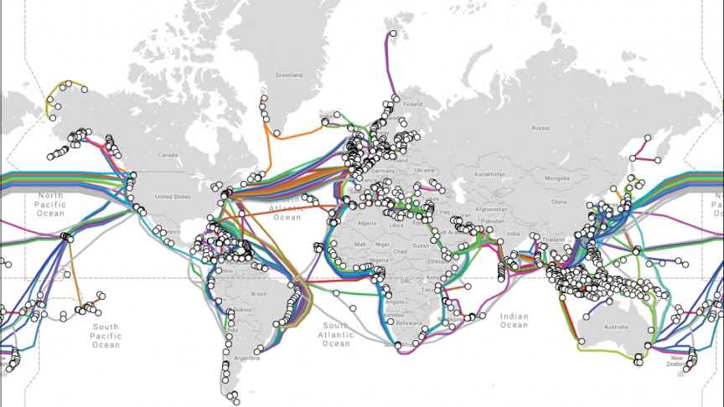
And after an audacious 20 years …

Slide 24
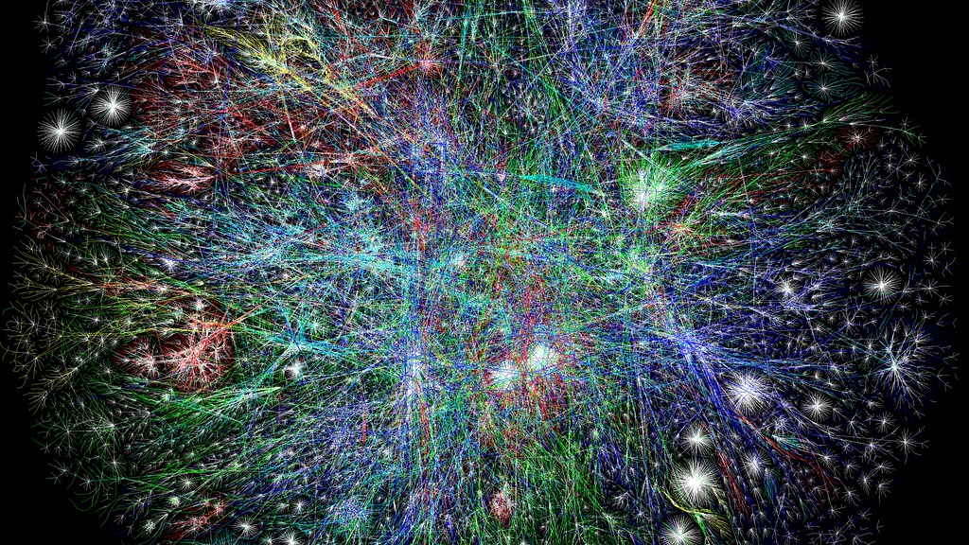
And this dot is your smartphone
And this is the International Space Station

Slide 25
Time
Electricity
Electronics
VLSI
Internet
PC
Main frames
Ethernet

Slide 26
Time
Electricity
Electronics
VLSI
Internet
PC
Main frames
Ethernet
In parallel to inventions in electronics, scientists were also discovering
radio waves and how to communicate them wirelessly

Slide 27
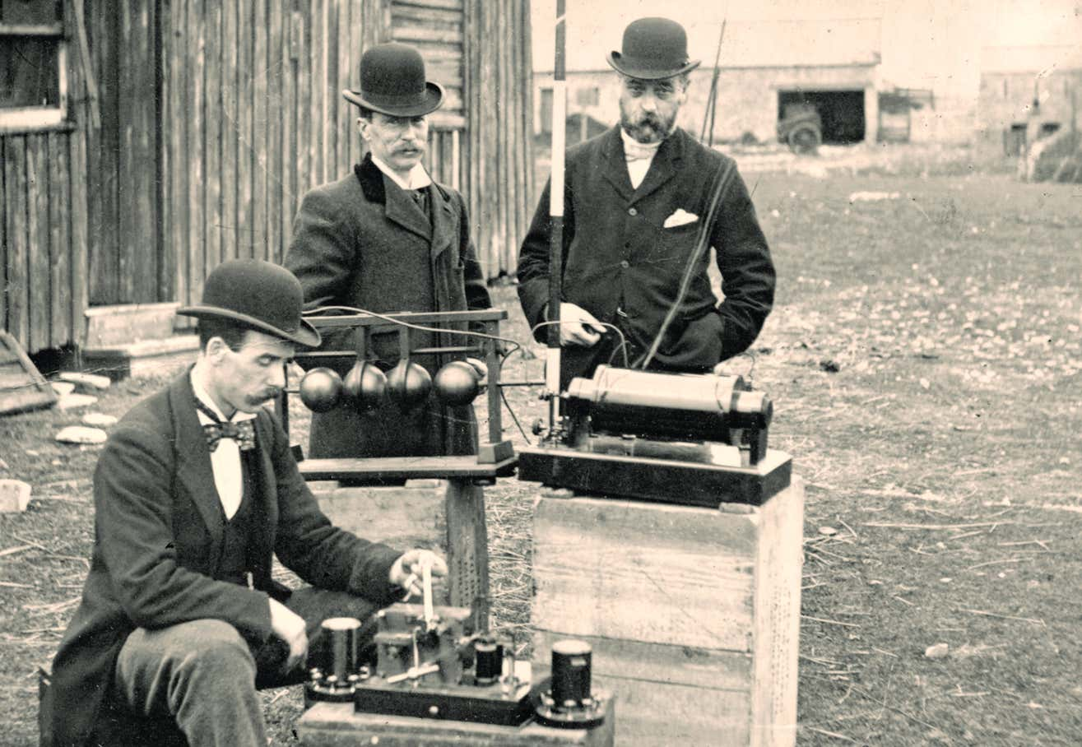

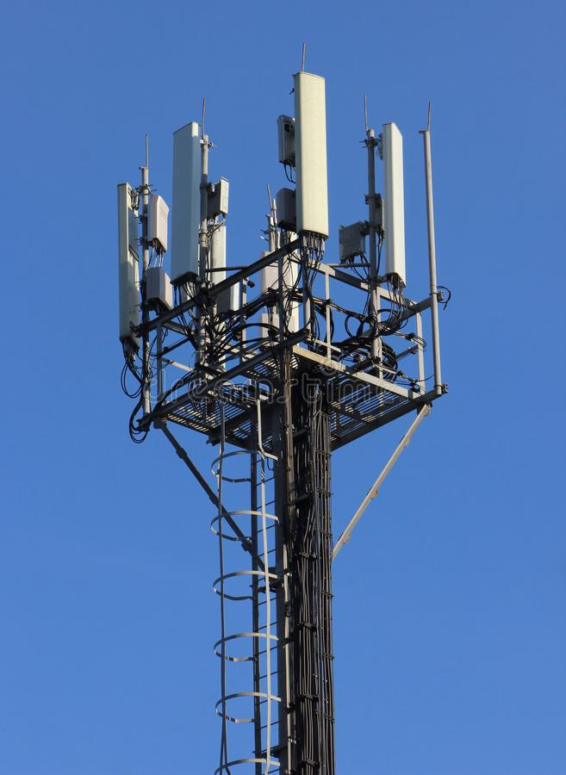
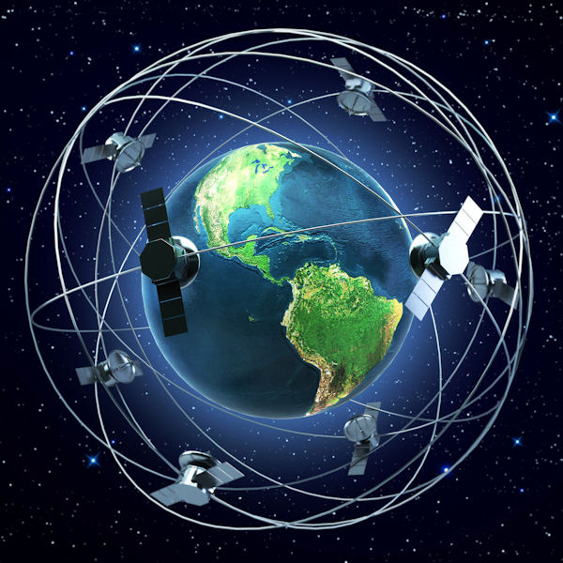
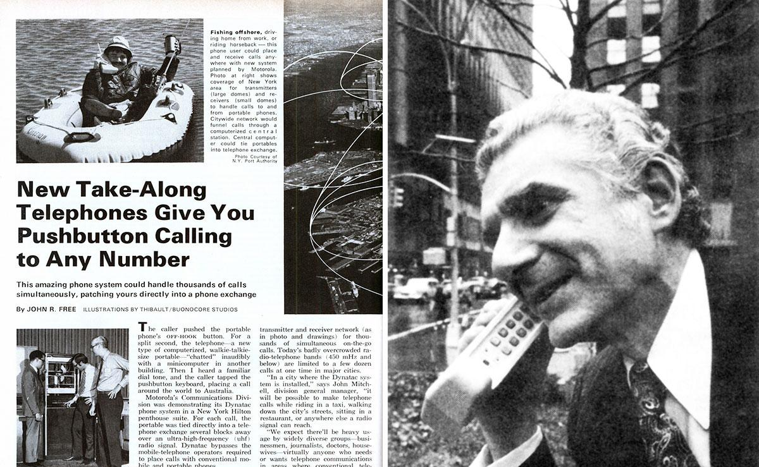
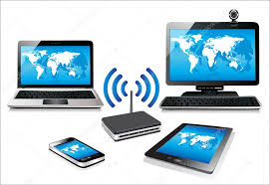
1900s
1907: First trans-Atlantic link
1915: Wireless voice from NY to SF
1920s: Radio, Police, TV broadcast
1940s: Digital electronics revolution
Marconi’s first wireless transmission using
Morse code (using Tesla’s patent)
and Maxwell and Hertz ideas
1943, Walkie Talkie used in World War
1978: First experimental GPS
1973: Cellular network, hand-held phone
Today:
Cellular 5G
Wifi, Bluetooth,
many others

Slide 28
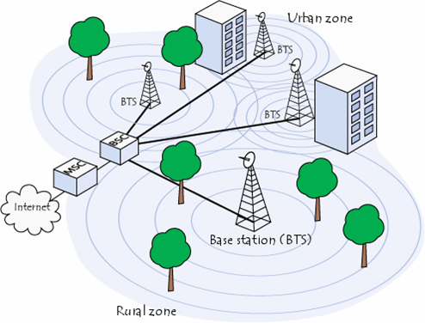

Electronic devices → Wired networks → Internet
Electronic devices → Wireless networks → Internet
Home WiFi

Slide 29

Electronic devices → Wired networks → Internet
Electronic devices → Wireless networks → Internet
Which means everything is connected via the Internet: Internet of Things (IoT)

Slide 30
Time
Electricity
If everything is
connected …
lot of DATA is
funneling in.
- How do we handle?
- Do we store them?
- Do we throw them
away?
Electronics
VLSI
PC
Internet
Main frames
Ethernet
Wireless

Slide 31

IOT has many many
sensors connected …
all streaming data
into the Internet

Slide 32

IOT has many many
sensors connected …
all streaming data
into the Internet
Again, VLSI and
advance battery
technology helping.
Wireless allowing
sensed data to be
sent to Internet

Slide 33

2010

Slide 34

2010
How cheap is your storage today? How much is a GB?

Slide 35


Slide 36

Time
Electricity
Electronics
VLSI
PC
Internet
Main frames
Ethernet
We can acquire so much data now? Anything we can do?
Sensors and Big Data
Wireless

Slide 37

One idea: Can data help computers get smarter?
Consider the task of a computer recognizing a face in a picture
How would you make the computer recognize a face?
Past approaches:
Specify the rules to identify a face
Make the computer look for these rules (or “Features”)
Rules could be:
two symmetric black curves (eyebrows)
two black dots below the curves (iris)
two small dots close to the middle (nostrils)
…
1000. slight darkness below the chin (shadow)
Does this work?

Slide 38


One idea: Can data help computers get smarter?
Consider the task of a computer recognizing a face in a picture
But say you have lots
of facial pictures
Let the computer figure out which patterns are common across thousands or millions of faces (training data)
Remember those patterns (model)
When a new face picture (test data) comes, apply those patterns to check if it is a face. Output yes or no.

Slide 39


Slide 40
Time
Electricity
Electronics
VLSI
Sensors and Big Data
PC
Internet
Main frames
Ethernet
Artificial Intelligence
In parallel to sensing, computing, and communication,
control (i.e., programmed movement or “actuation”)
was also maturing in the field of robotics … can AI help there?
Wireless

Slide 41

Yes, AI particularly effective when humans don’t know why they do what they do (so its hard to teach a computer) …

Slide 42
Yes, AI particularly effective when humans don’t know why they do what they do (so its hard to teach a computer) …

Slide 43


And this is where we are today … convergence of
Sense + Compute (AI) + Communicate + Control
using machines that can do things that we cannot explain.
This is the new age of “autonomous systems”.

Slide 44

Time
Electricity
Electronics
VLSI
Sensors and Big Data
PC
Internet
Main frames
Ethernet
Artificial Intelligence
Wireless
Robotics and Autonomy

Slide 45
Of course, you are NOT supposed to remember all this …
The goal was to show you the landscape for this ECE 101 course …
and why this could be exciting and relevant to students
of all departments in the campus.

Slide 46
Questions? Comments?

