Slide 1
University of Illinois at Urbana-Champaign Dept. of Electrical and Computer Engineering ECE 101: Computing Technologies and the Internet of Things
The Internet (part 1 of 2)

Slide 2
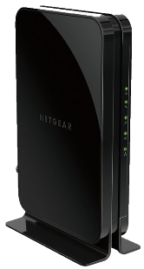
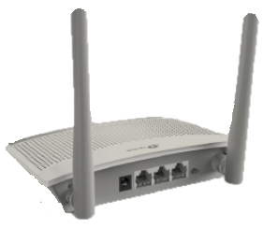
Global Internet: One of Humanity’s Greatest Achievements
We looked at Wifi and cellular.
Now we know how our data get to the Internet.
But what is the Internet?
How does information pass through it?
In a list of human accomplishments in the last century, the Internet is probably near the top.

Slide 3
Tradeoffs: Pros and Cons of a Design
Today, you get to be an engineer!
…
Actually,
today we will focus on
design tradeoffs
as we consider different ways
in which communication networks can be connected.

Slide 4
View Internet Development in Terms of Tradeoffs
Organization of a network—
which machine connects to which other machine—
called the topology of the network.
We’ll compare benefits and disadvantages
of different topologies
to understand how Internet developed
and what problems it solves.

Slide 5
From Computation to Communication
We will talk about the Internet from the ground up.
In our first week,
we talked about bits
and the emergence of computing.
At the same time,
other people were wondering
how results could be communicated.

Slide 6
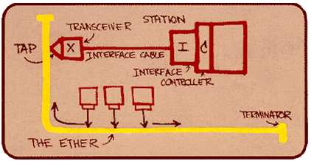
Physical Layer (Wiring) Took Substantial Effort
A lot of research went into developing the physical wires needed to communicate.
early Ethernet cable
shared Ethernet topology

Slide 7
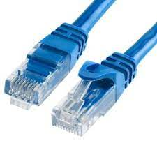
Modern Ethernet Leveraged the Telephone Infrastructure
Today’s Ethernet is much easier to use.
Ethernet cable contains
four twisted pairs of copper wire.
Each pair carries a voltage (bits).
For decades, telephones
used a single pair of the same type
to connect phones throughout the home.

Slide 8
How Do We Connect Many Computers?
Why not just connect everyone?

Slide 9
How Many “Wires” Needed for a Clique?
Connecting everyone to everyone else produces a topology known as a clique.
How many “wires” do we need?
2 “wires”
(one in each direction)
6 “wires”
12 “wires”
How many “wires” for
6 computers?
30

Slide 10
Requirements and Limitations for a Clique Topology
Generalize: how many “wires” for N computers?
To count,
choose one computer (N choices), then
choose a different computer (N – 1 choices).
Total possible choices? N(N – 1) “wires” *
Limitations of a clique?
And too many network interfaces.
*Wires usually only used in one direction, but two can be packaged in one cable, so divide by two for the number of cables.
Too many wires!

Slide 11
Sharing Reduces Wire and Interface Count
Ethernet was originally a shared medium.
Just 1 “wire”—in yellow, labeled “The Ether” in the diagram—for all computers!

Slide 12
The Same Six Computers on a Shared Ethernet
The Ether

Slide 13
Which is Better? A Shared Network or a Clique?
Consider a small group (10-20 computers).
Build a clique or a shared network?
pros of sharing:
cheaper wiring
fewer network interfaces (one per computer instead of 9-19)
pros of a clique:
simpler physical protocols
no need to take turns
simultaneous all-to-all communication
Ethernet solved these issues.

Slide 14
Neither Technique Scales to Large Numbers
What if we have 1,000 computers?
Neither clique topologies nor shared networks scale to large numbers.
Don’t want to pay for a clique (999 wires and 999 network cards per computer!)
But sharing is also not viable:
imagine a room with 1,000 people all speaking
with voices amplified to be audible to all.
What has been done in other contexts?

Slide 15
Airline Routes Must Also be Efficient
I fly from Champaign.
I need to go to many large cities.
And many smaller ones.
I want to fly directly.
Why can’t I?
Hint: everyone wants to fly directly!
Not enough passengers for flights!

Slide 16
Hierarchy Connects All Cities More Efficiently
What do the airlines do instead?
Use a hierarchy.
Designate hub cities.
Route flights hierarchically.
Champaign to Chicago (hub) to Denver (hub) to Dallas (hub) to Columbia

Slide 17
User of Hierarchy Permeates Natural and Human Systems
Hierarchy used ubiquitously in large systems.
Examples in nature include:
trees (trunk, branch, smaller branch, leaf),
roots (main root, smaller, and smaller), and
blood vessels.
Examples in human-made systems include:
airline routes (international, domestic, regional),
corporate structures (CEO, VPs, directors, managers, workers) and
power networks.

Slide 18
One Level of Hierarchy: a Star Topology
Instead of a clique, let’s use a hierarchy.
“hub”
We’ll build a “star”.

Slide 19
Star Topology Between Shared Network and a Clique
In a star, all data pass through the hub.
Benefits (relative to clique or shared):
fewer wires and interfaces than a clique, but
no sharing required.
Disadvantages (to clique):
paths a little slower than a clique (longer, and require processing by hub), and
hub may still be a bottleneck to communication.

Slide 20
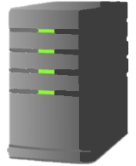
The “Hub” in a Computer Network is a Router
“hub”
But we don’t need a monitor nor a keyboard.
router
A router forwards data packets (routes).

Slide 21
Hierarchies Can be Organized Hierarchically!
But why stop there?
We can use several levels of hierarchy.

Slide 22
More Levels of Hierarchy are Possible
a second level of hierarchy

Slide 23
Tradeoffs: One Level or Two Levels?
Why bother?
Compared with a single level of hierarchy,
the main benefit is that
delay gets better for close nodes.
The disadvantages include:
more routers (more cost),
more interfaces (routers need them, too),
and longer paths have more delay.

Slide 24
Can Keep Adding Layers of Hierarchy
We can do it recursively!
(over and over)

Slide 25
Deep Hierarchies Enable Networks to Span the Globe
If we keep adding levels, the network can get really huge!

Slide 26
What Happens When We Want to Join?
Imagine a hierarchical network here on campus.
We connect the top of our hierarchy to a router in the bigger network in Chicago.
Not just one link!
We connect to two routers instead— maybe a second node in Indianapolis.

Slide 27
Making Connections from UIUC to the World
Chicago
The Valley
UIUC
Build locally, then connect to someone else.
Indianapolis

Slide 28
Design Topologies to Minimize the Impact of Failures
What about failures?
Which link failures in the previous diagram disconnect groups of computers?
Lots!
But not all.
How can we connect our networks so that the network is reliable?
Real topologies are designed to reduce the impact of failures.
Notes:
Nothing too technical, but students will get to play with the idea in the lab.

Slide 29
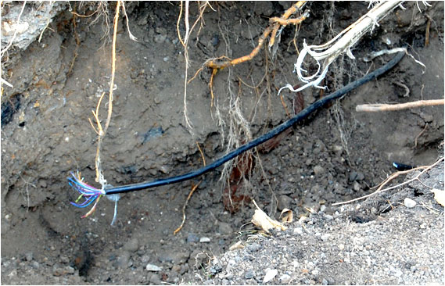
Real Failures Can Still be Catastrophic
In practice, it’s not as reliable as one hopes.
About 15 years ago, a backhoe dug up (and broke) the optical fibers running from our campus to Chicago.
Internet traffic almost instantly shifted to route through Indianapolis.
Although we had paid for that connection, the router in Indianapolis didn’t expect any traffic.
After all, UIUC never sent any traffic that way.
The Internet was down for days at UIUC.

Slide 30
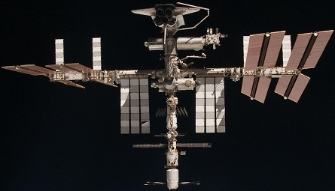
One More Link Can Have a Huge Impact
Chicago
Now astronauts can watch Netflix!
The Valley
UIUC
Netflix
Indianapolis
ISS

Slide 31
Plumbing: the Invisible Infrastructure
Do you care about your plumbing?
You should say, “Absolutely!”
But how often do you think about your plumbing?
Plumbing is an invisible infrastructure: you only think about it when it fails.
So we often talk about infrastructure that works well as “plumbing.”

Slide 32
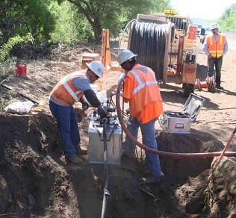
Optical Fiber and Tier 1 ISPs Form the Backbone
What about the “plumbing” in the Internet?
Governments (in the US, for example)
own* the right-of-ways along which
companies lay bundles of optical fiber.
Tier 1 Internet Service Providers (ISPs)
build or lease these fibers
to carry traffic
across the Internet.
These form the backbone of the Internet.
*Purchased in the 19th century to lay railroads across the continent.

Slide 33
Tier 1 ISPs Carry Transit Traffic for Lower Tiers
Tier 1 ISPs cover
different parts of the country
and/or world (sometimes overlapping).
They peer with one another:
connect in several places and
agree to carry data traffic for one another.

Slide 34
Tier 2 and 3 ISPs Connect Directly to Customers
Tier 2 ISPs
connect to Tier 1 ISPs and
provide service in smaller regions,
carrying some transit traffic, but
not as much as Tier 1.
Tier 3 ISPs
connect to Tier 2 ISPs and are fairly local.
They do not carry transit traffic, only passing packets from their customers up to the Tier 2 ISPs (and back).

Slide 35
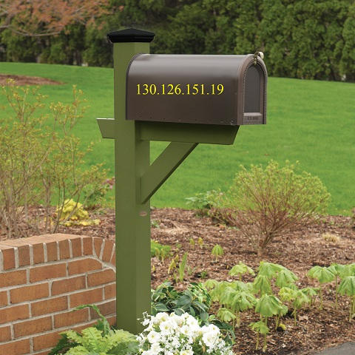
Send Data Packets Across the Internet!
Once it’s all connected,
you can send packets of bits
to any machine on the Internet!
How?
You just need an IP address!
For example, here’s one for
ece.illinois.edu

Slide 36
Every Computer Has a Unique IP Address
An Internet Protocol (IP) address
is 4 Bytes (32 bits)
Humans write 130.126.151.19,
but in the computer, it’s
1000 0010 0111 1110 1001 0111 0001 0011
(without the spaces).
Every computer in the Internet has an IP address.*
*Sort of. Today, a household usually shares one public address.

Slide 37
Sending is Easy: Attach an Address and Send it Off!
To send a birthday photo
to your friend in Tokyo, your computer
finds their computer’s IP address and
puts it into a packet with the photo, then
pushes the packet into the Internet.
Each router along the way
sees the IP address
and knows where to send it
until it arrives at your friend’s computer!
Then their computer unpacks the photo bits.
TO: 210.152.243.234

Slide 38
Routers Forward Data Packets Based on IP Address
When a data packet arrives at a router,
the router must decide
on which outgoing link/network interface
to forward the packet.
The router looks at two things:
destination IP address in packet,
and its forwarding table (also called a routing table).
Which way should it go?

Slide 39
Routers Advertise IP Addresses They Can Reach
I can get packets to UIUC (IP addresses).
A forwarding table maps
IP addresses into
interface numbers
(1, 2, or 3, for example).
Routers periodically
advertise IP address ranges
that they can reach
to their other links.
I can get packets to Japan (IP addresses).
3
1
2

Slide 40
Forwarding Table Built from Advertisements
Each router
builds its forwarding table
based on the advertisements
it hears from its neighbors.
dest | interface
Japan
1
UIUC
3
3
I can get packets to Japan (IP addresses).
1
2
I can get packets to UIUC (IP addresses).

Slide 41
AS: An Independently-Operated Subnetwork
peering between ASs
AS
AS
AS
An organization’s network—including ISPs—is called an Autonomous System (AS).
AS

Slide 42
Forwarding Between ASs Considers Only Reachability
Routing between ASs
uses the Border Gateway Protocol (BGP),
but each AS measures cost differently.
So BGP makes forwarding decisions
based on reachability:
can I get to the destination?
Full paths (hop-to-hop AS routes) are advertised to avoid loops.

Slide 43
Let’s Try Some Forwarding Together
A packet arrives for Northwestern University (in Chicago, IL, USA).
Which interface?
A packet arrives for Tokyo University (in Tokyo, Japan).
Which interface?
A packet arrives for UIUC.
Which interface?
Usually, the more specific answer is chosen.
dest | interface
Japan | 1
UIUC | 3
IL state | 2
2
3
1
1
2
3? Or 2?
3

Slide 44
Routing Within AS Based on Link Costs
Within an AS, each link can be assigned a cost.
Link cost may reflect
length (delay),
link capacity,
congestion (queueing delay),
any combination of those metrics,
or just the AS’s preferences.
link costs
25
13
S
A
B
5
3
3
9
9
1
13
11
C
4
E
F
18
9
3
G
D
7

Slide 45
Routing Within AS Based on Link Costs
To construct a forwarding table,
a router must decide
which path to follow
to reach each other node.
The cost of a path is
the sum of the costs
of the links in the path.
And the desired path is the path with the smallest cost.
25
13
S
A
B
5
3
3
9
9
1
13
11
C
4
E
F
18
9
3
G
D
7

Slide 46
Let’s Find Routes Together!
link cost = 6
M
link cost = 4
1
2
Complete the forwarding table for the node S.
1
1
S
D
2
2
dest | interface
D
M
link cost = 1
2
(by “hops”: all link costs are 1)
2
link cost = 1
M
link cost = 1
link cost = 6
M
link cost = 4
1
2
1
2
1
1
1
1
S
D
S
D
2
2
2
2
dest | interface
D
M | 1
link cost = 1
dest | interface
D
M | 1
link cost = 13
2
1

Slide 47
Let’s Find Routes Together!
Complete the forwarding table for the node S.
A little trickier this time?
1
B
2
3
7
1
1
S
8
D
dest | interface
A | 2
B | 1
D | ?
2
2
4
5
1
A
2

Slide 48
How Many Paths Must We Consider?
4
How many paths are possible?
1
B
2
1
B
2
3
7
3
7
1
1
path cost = 3 + 8 + 5 = 16
path cost = 4 + 8 + 7 = 19
1
1
S
8
D
S
8
D
2
2
2
2
4
5
4
5
1
A
2
1
B
2
1
B
2
1
A
2
3
7
3
7
path cost = 3 + 7 = 10
path cost = 4 + 5 = 9
1
1
1
1
S
8
D
S
8
D
2
2
2
2
4
5
4
5
1
A
2
1
A
2

Slide 49
Let’s Find Routes Together!
Complete the forwarding table for the node S.
A little trickier this time?
1
B
2
7
2
1
1
S
1
D
1
B
2
3
7
dest | interface
A | 2
B
D
2
2
4
5
1
1
1
A
2
S
8
D
2
dest | interface
A | 2
B | 1
D
2
2
2
4
5
1
A
2
2

Slide 50
Let’s Find Routes Together!
Complete the forwarding table for destination D from the node S.
(Prof. Roy Choudhury made it!)
25
1
13
S
2
A
B
dest | interface
D | ?
… | …
5
3
3
3
9
9
1
13
11
C
4
E
F
18
9
3
G
D
7

Slide 51
Build a Spanning Tree for Each Destination
In practice, we build a tree starting from the destination.
What node is closest to D?
F at distance 3
And the closest to that pair?
B at distance 4
And …
25
1
14
4
19
13
S
2
A
B
5
3
3
3
9
9
1
13
11
3
C
4
E
F
7
11
18
9
3
G
D
7
7

Slide 52
Let’s Find Routes Together!
Complete the forwarding table for destination D from the node S.
(Prof. Roy Choudhury made it!)
25
1
13
S
2
A
B
dest | interface
D
… | …
5
3
3
3
2
9
9
1
13
11
C
4
E
F
18
9
3
G
D
7

Slide 53
Logically Separated Data and Control Planes
Routers forward packets.
Packets with data are said
to be passing through the data plane.
In addition to forwarding packets,
routers exchange information
about routes available to them.
These coordination messages
travel through the control plane.
The two planes
use the same physical network
(except within a single router),
but are logically separate.

Slide 54
Internet Plumbing: Routing and Forwarding
Routers have established a control plane between themselves.
And have populated their forwarding tables.
This is the plumbing in the Internet.

Slide 55
Terminology You Should Know from These Slides
design tradeoffs
network topology
Ethernet
clique topology
network interface
shared network
hierarchy
star topology
router
Internet Service Providers (ISPs; Tier 1,2,3)
Internet backbone
peering
Transit traffic
IP address
forwarding
Route advertisements
Routing (building forwarding table)
Autonomous System (AS)
Border Gateway Protocol (BGP)

Slide 56
Concepts You Should Know from These Slides
engineers must consider tradeoffs between alternative designs
number of “wires” needed for a clique
tradeoffs: clique vs. shared vs. hierarchy
hierarchy appears in all large systems, both natural and human-made
how topology affects tolerance to failures
packets only allowed to cross Tier 1 & 2 ISPs (transit traffic)
each computer has a 4B IP address
how a router uses its forwarding table
routers forward packets in data plane and send route advertisements in control plane
how to find shortest paths in small graphs

Slide 57
Routing within an AS: from Advertisement to Table
Within an AS,
routers advertise distances to neighbors.
Once in a while, each router
uses its recorded view of costs in the network
to compute paths to all destinations.
and produce a forwarding table

